Slide 1

Card-Based Cryptography Meets Differential Privacy
Yair Cohen & Amit Gini

Slide 2
Table of Contents
1. Introduction
5. Protocol 3
2. Key Concepts
6. Data Presentation (Graphs)
3. Protocol 1
7. Removing Private Operations
4. Protocol 2
8. Conclusions and Summary

Slide 3
Part A: Introduction
Introduction
With the rapid development of cryptography, various kinds of cryptographic primitives have been proposed and allowed secure data processing on sensitive data. However, most of these primitives are supposed to be implemented by computers and, as such, often lead to complicated algorithm design. As a result, there remains a gap in non-experts’ understanding of the security properties, which may prevent active social implementations.

Slide 4
Part A: Introduction
How we solve this problem?
To address this problem, card-based cryptography studies the problem of implementing cryptographic algorithms in a visual way using physical cards and demonstrates their security properties for those who are unfamiliar with cryptography.
Recently, the concept of differential privacy has been attracting a lot of attention as the gold standard for rigorous privacy guarantees.

Slide 5
Part A: Introduction
The Main Goals:
Giving the definition of differential privacy of card-based protocols.
Introduce three card-based protocols for computing binary sum functions (𝑓(𝑥1,…,𝑥𝑛) = ∑(𝑖=1,𝑛)𝑥𝑖) under differential privacy.
Demonstrate the feasibility of combining card-based cryptography with differential privacy.
Address the technical challenge of implementing non-uniform noise generation with physical cards​.

Slide 6
Part A: Introduction
Differential Privacy
Differential privacy is a mathematical concept introduced in to quantify the privacy loss associated with any publication of statistics of databases.
For example, consider the simplest task of computing the sum of n
parties’ private inputs. If the exact result is published, an adversary colluding with n − 1 parties can deduce the input of the remaining party from the result, which in principle cannot be prevented only by secure computation techniques.
Differentially private mechanisms make results untraceable back to individuals by perturbing them with the addition of noise.

Slide 7
Part A: Introduction
Protocols Overview
focuses on minimizing shuffles (only two required) and uses the hypergeometric distribution for noise generation. It is suitable for small-scale applications where accuracy is critical.
introduces randomized response for each input but requires n shuffles, making it computationally expensive. It improves privacy-utility trade-offs in certain scenarios.
optimizes Protocol 2 by reducing the shuffle count to one but requires careful handling of interdependent card states, making it ideal for scenarios where efficiency is paramount.
Protocol 1
Protocol 2
Protocol 3

Slide 8
Part A: Introduction
Applications of Card-Based Differential Privacy
Aggregate votes securely without exposing individual preferences.
Conduct anonymous surveys while ensuring data confidentiality.
Analyze sensitive healthcare data while maintaining patient privacy.
Secure Voting Systems
Privacy-Preserving
Surveys
Medical Data Analysis
Share aggregated statistics between companies without revealing individual data points.
Use card-based protocols to teach complex cryptographic and privacy concepts in an intuitive way.
Collaborative Analytics
Across Organizations
Educational
Demonstrations

Slide 9
Part C: Protocol 1
Protocol 1
Based on the Hypergeometric Distribution
The hypergeometric distribution is a probability distribution of the number Z of ♡s in k cards chosen uniformly at random from a sequence consisting of m−ℓ ♣s and ℓ ♡s.
Objective:
Compute the binary sum 𝑓(𝑥1,…,𝑥𝑛)=∑(𝑖=1,𝑛)𝑥𝑖 while ensuring (ϵ,δ)-differential privacy.
Key Mechanism:
Adds noise to the final result using a hypergeometric distribution.Noise is generated by selecting k cards from a supplementary shuffled sequence of 2ℓ cards:ℓ ♡ (successes) and ℓ ♣ (failures).

Slide 10
Part C: Protocol 1
Protocol 1
Based on the Hypergeometric Distribution
Differential Privacy Guarantees:
Ensures that the output z remains statistically close for neighboring inputs x and x ′ , differing by at most one input.
Formal guarantee:
Pr[M(x) ∈ S] <= e^ ϵPr[M(x’) ∈ S] + δ
⁡Role of Z and y:
Z: Number of ♡ cards in k-card random draw (hypergeometric random variable).
y: Total ♡ cards after opening 𝑛+𝑘 cards (includes participants' inputs and noise).

Slide 11
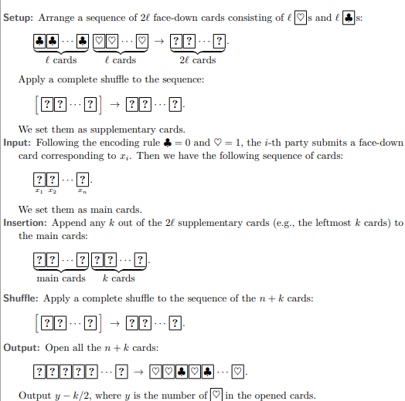
Part C: Protocol 1
Protocol 1
The Algorithm

Slide 12


Part C: Protocol 1
Protocol 1
Noise via Hypergeometric Distribution
Hypergeometric Distribution HG(m,ℓ,k):
Models the probability of selecting z successes (♡) when drawing k cards from a deck of m cards, where ℓ cards are ♡:
⁡
Differential Privacy Requirements (𝜖,δ):
K (number of noise cards) must satisfy:
⁡
Role of Noise:
Noise Z∼HG(2ℓ,ℓ,k) ensures randomness in y, maintaining privacy while reducing bias in the output z.
⁡

Slide 13
Part C: Protocol 1
Protocol 1
Example Implementation
Scenario:
n=3, participants’ inputs: 𝑥1=1, 𝑥2=0, 𝑥3=1.
ℓ=4, k=2: Supplementary deck has 4 ♡ and 4 ♣.
Steps:
Input: Participants submit ♡,♣,♡.
Noise Addition: Draw k=2 cards from the shuffled supplementary deck, e.g., ♡, ♣.
Final Shuffle: Shuffle 𝑛+𝑘=5 cards.
Output Calculation: Reveal cards, e.g., ♡, ♡, ♣, ♡, ♣.
y=3 ♡.
z=y− 2/k​ =3−1=2.

Slide 14
Part C: Protocol 1
Protocol 1
Performance Metrics for Protocol 1
Privacy Guarantees:
The protocol ensures (ϵ,δ)-differential privacy by using noise from the hypergeometric distribution. This makes the result statistically indistinguishable for neighboring inputs, protecting individual contributions.
Card Usage Complexity:
Total cards used: #Card=𝑛+2ℓ.
This includes n input cards (one per participant) and 2ℓ cards for the balanced supplementary deck.
Shuffling Complexity:
Requires 2 complete shuffles: one for randomizing the supplementary deck and another to combine input and noise cards. This ensures privacy by obscuring the relationship between inputs and the output.

Slide 15

Part C: Protocol 1
Protocol 1
Performance Metrics for Protocol 1
Accuracy (MSE):
MSE is given by: MSE=𝑘(2ℓ−𝑘)/4(2ℓ−1).
Larger k (more noise) increases the error, while larger ℓ (more balanced supplementary deck) reduces the error by limiting variance.
For a hypergeometric random variable Z, the variance is given by:
Trade-Offs:
Higher k: Improves privacy but increases error (MSE).
Lower k: Better accuracy but weaker privacy.
The balance depends on the desired trade-off between accuracy and privacy.
Notes:
k: The number of cards drawn—more draws introduce more variability.
ℓ/2ℓ : The proportion of ♡ cards in the deck.
2ℓ−𝑘/2ℓ−1: Corrects for sampling without replacement, reducing variance compared to independent sampling.

