Slide 1
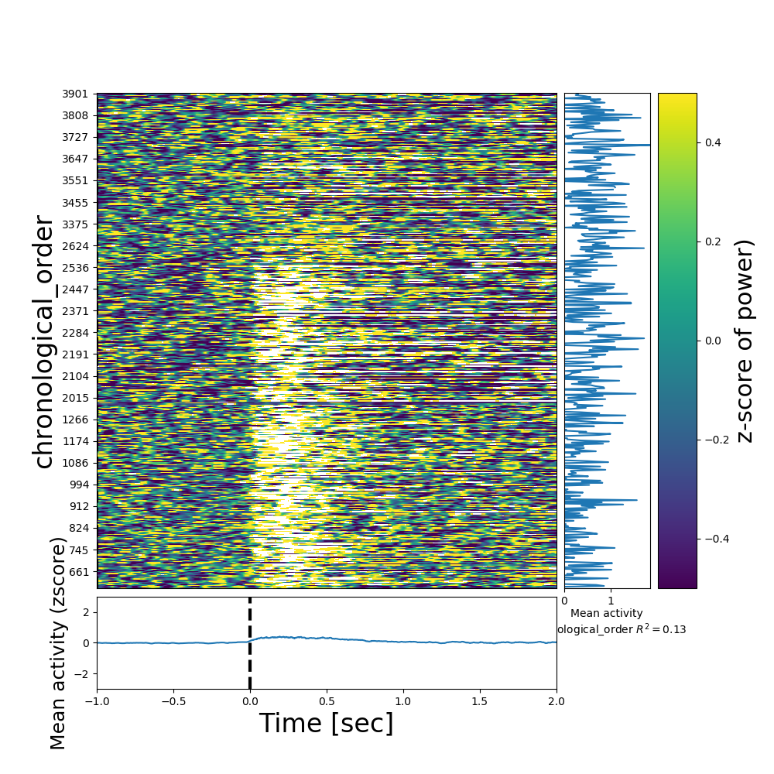
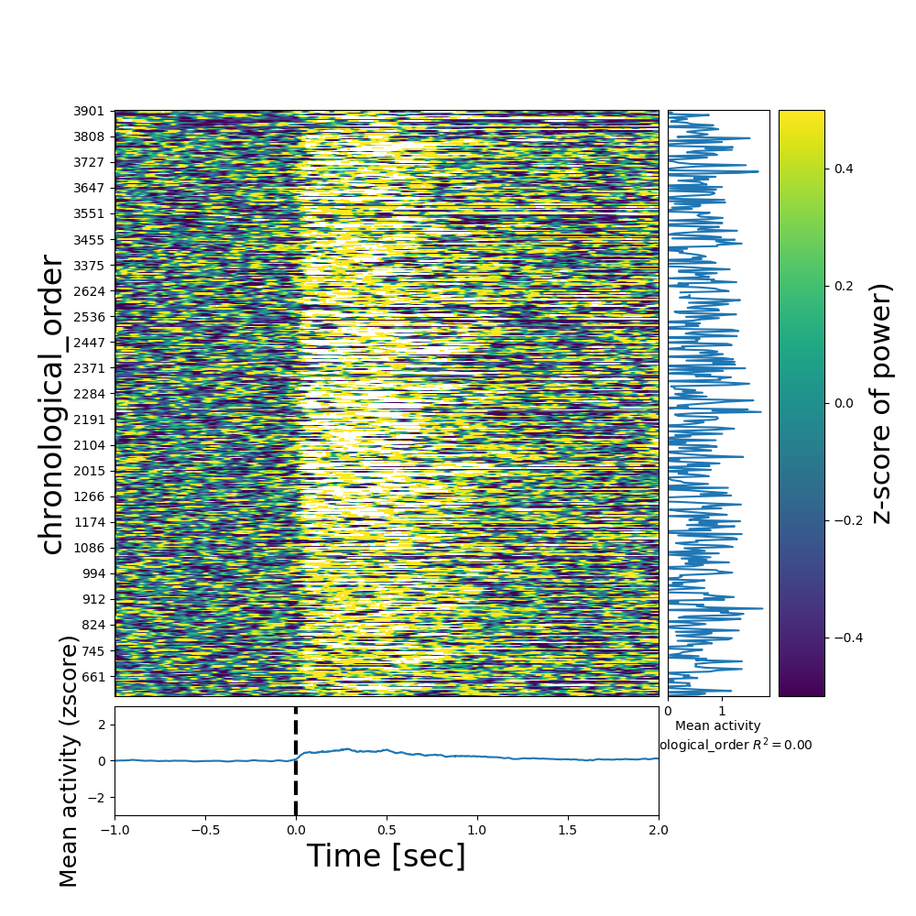
Trial alignment
Microphone recordings: auto-slicing based on the triggers for the two new patients (502 – left, and 504 – right). Values represent z-scored 70-150Hz power of the sound signal. Trials seem well aligned during the auditory blocks. For 502 (left) in the last block, mic recording is just noisy.

Slide 2
Decoding
In what follows, decoding results are based on high-gamma from micro electrodes in patients 479, 482, 502 and 505, taken together, as if from a single brain.

Slide 3
Simple decoding tasks

Slide 4
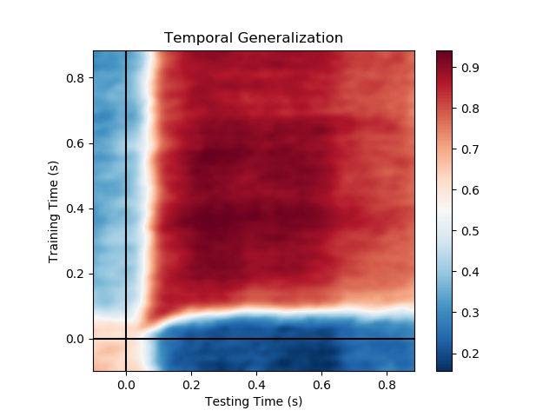
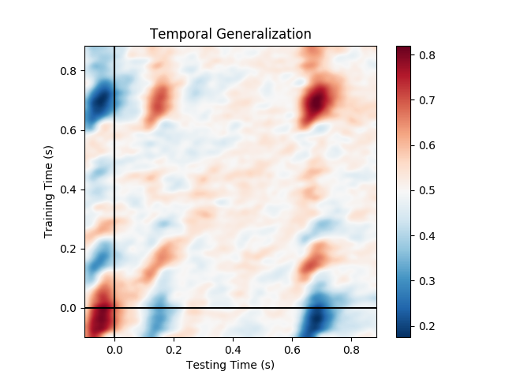
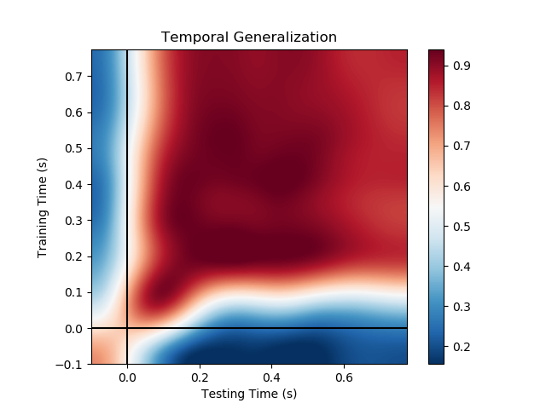
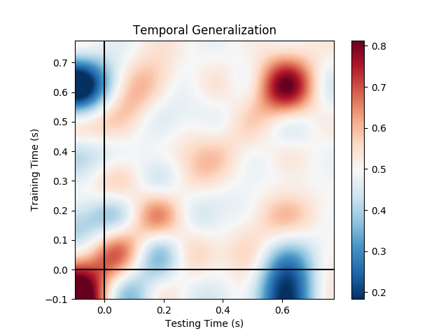
Beginning vs end of sentence
(onset time of first word vs. off-set time of last one)
SOA=500ms
k=8
k=64
Audio
Visual

Slide 5
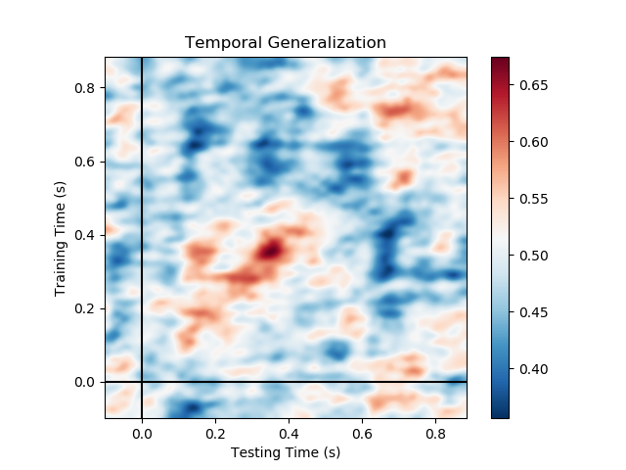
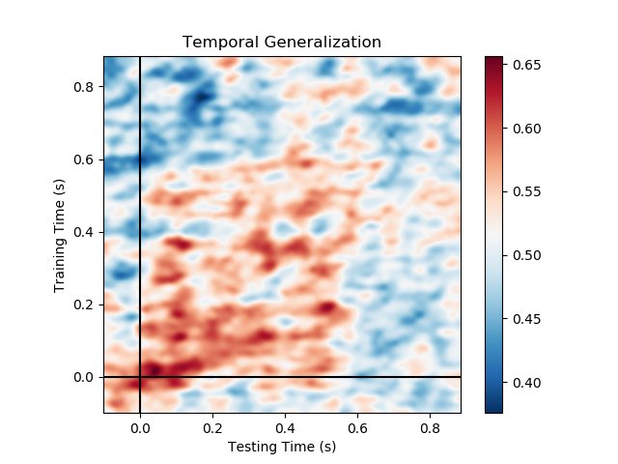
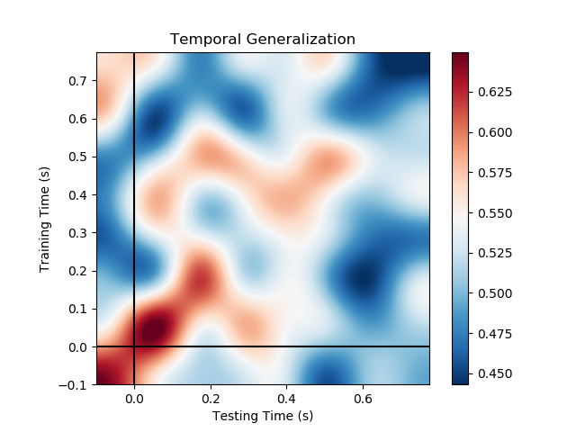
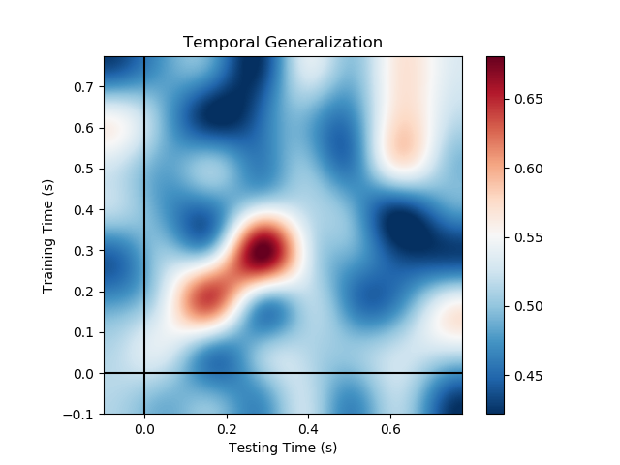
Short vs. long sentences
(aligned to end-of-sentence)
k=8
k=64
Audio
Visual

Slide 6
Grammatical number

Slide 7
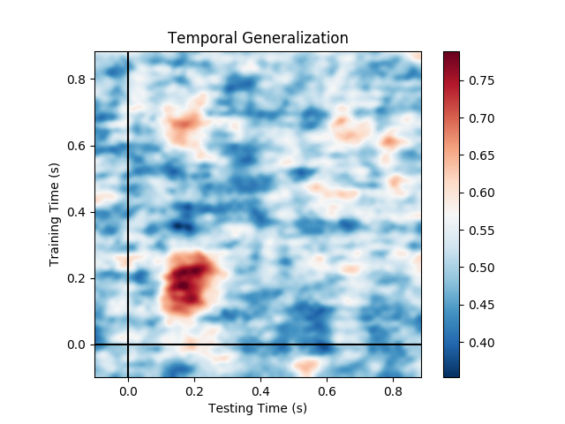
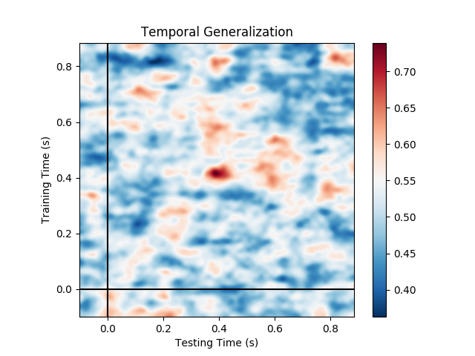
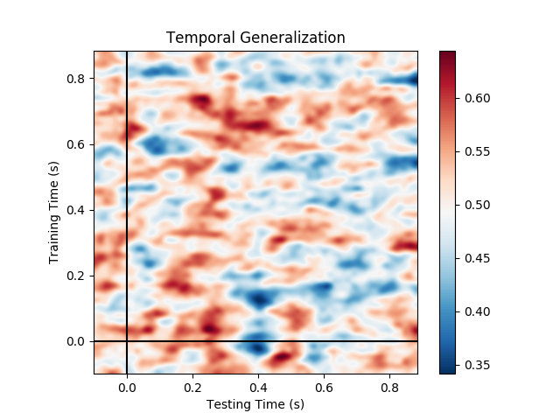
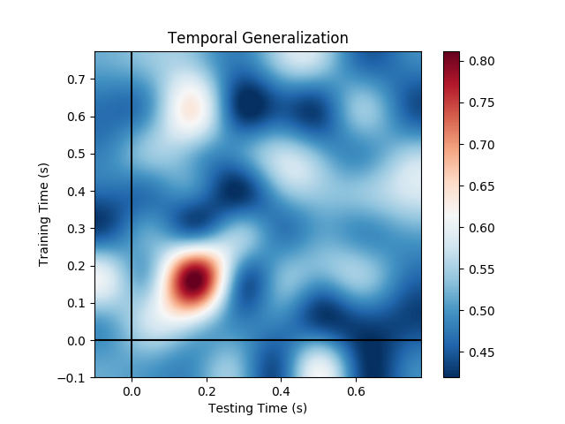
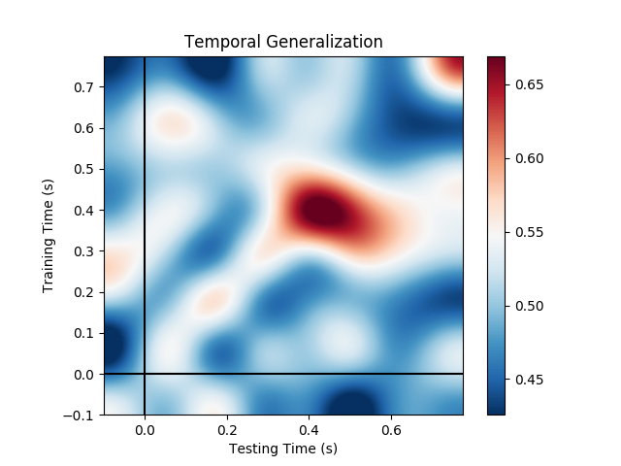
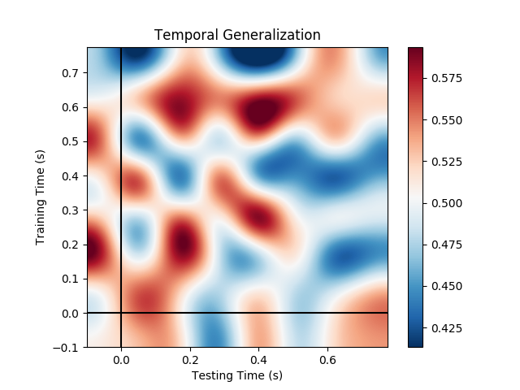
Grammatical number on pronouns
(he/she vs. they)
k=8
k=64
Test time
Audio
Visual
Audio2visual

Slide 8
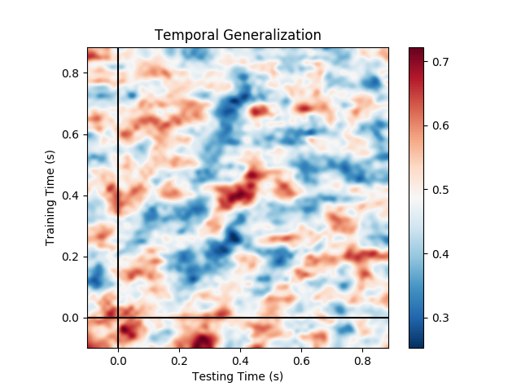
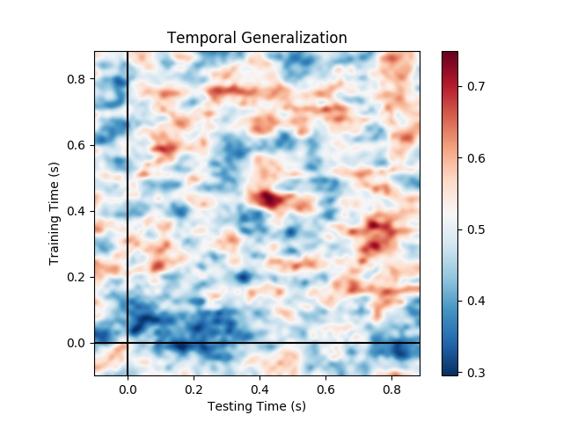
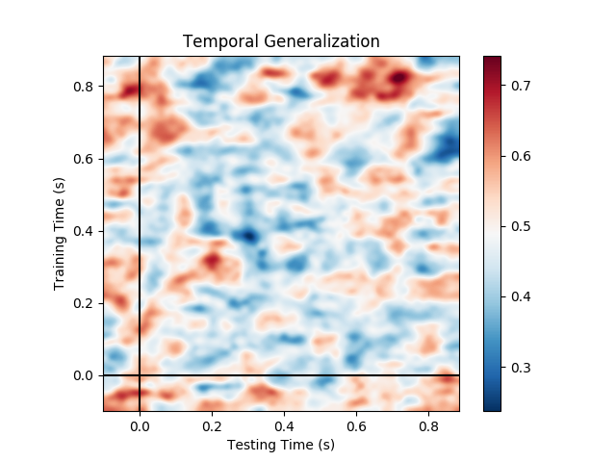
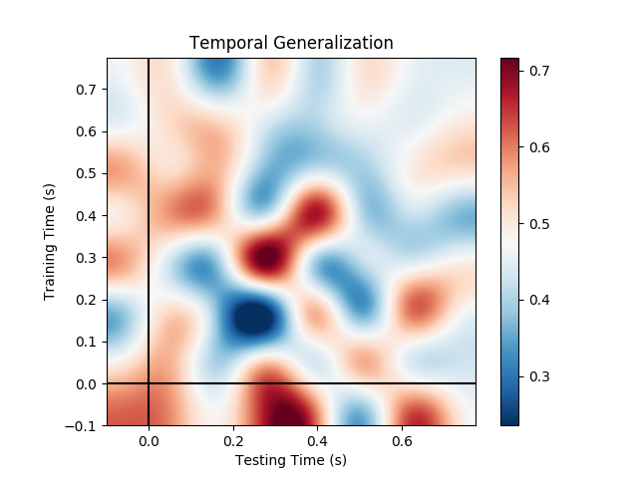
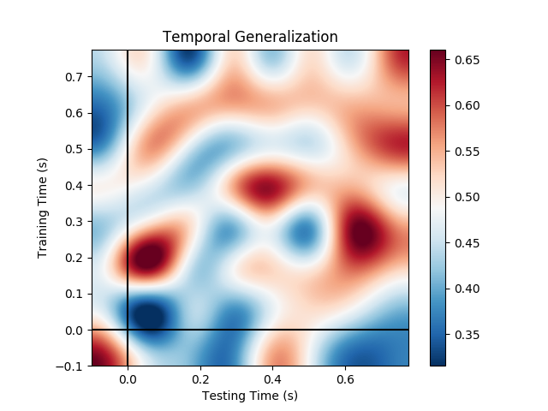
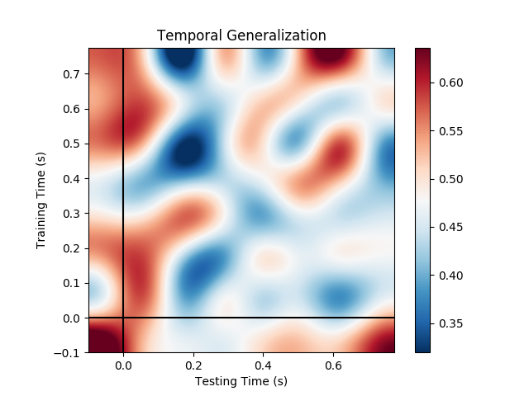
Grammatical number on nouns
(boy/girl/man/woman vs. boys/girl/men/women)
k=8
k=64
Audio
Visual
Audio2visual

Slide 9
Gender

Slide 10
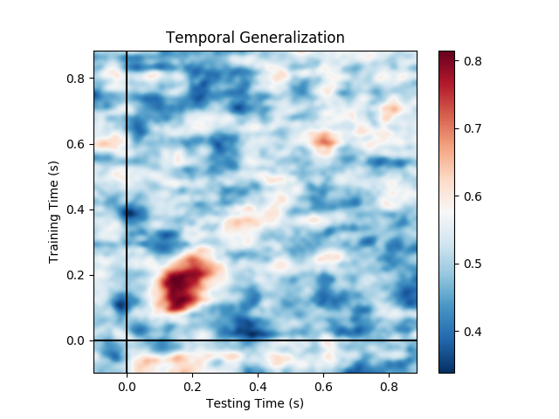
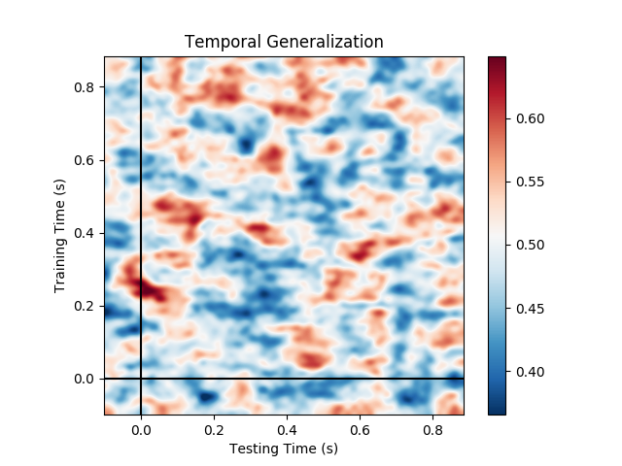
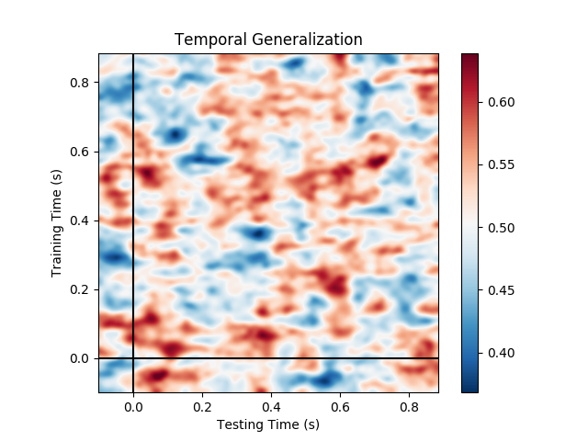
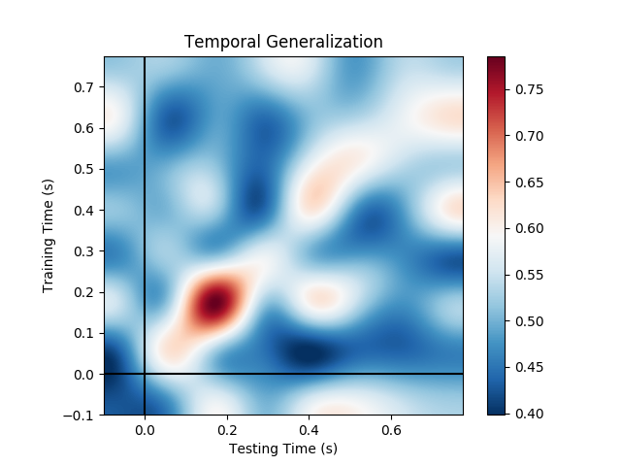
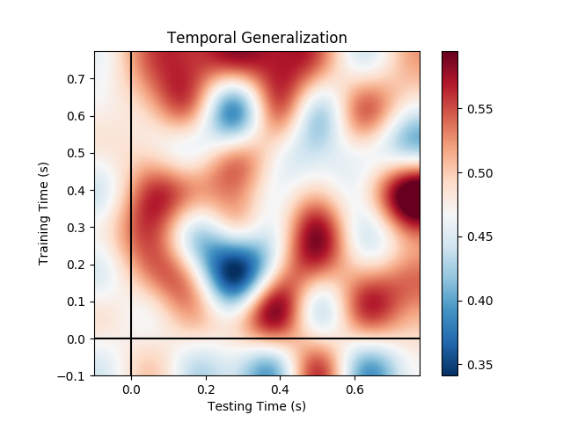
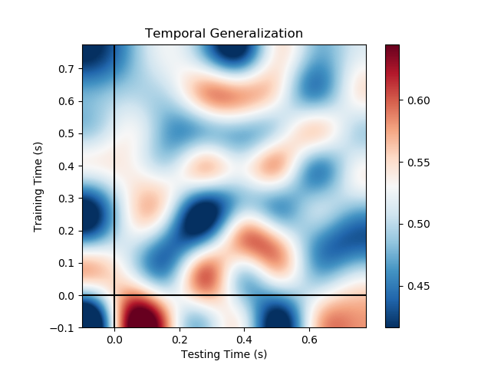
Gender on pronouns
(he vs. she)
k=8
k=64
Audio
Visual
Audio2visual

Slide 11
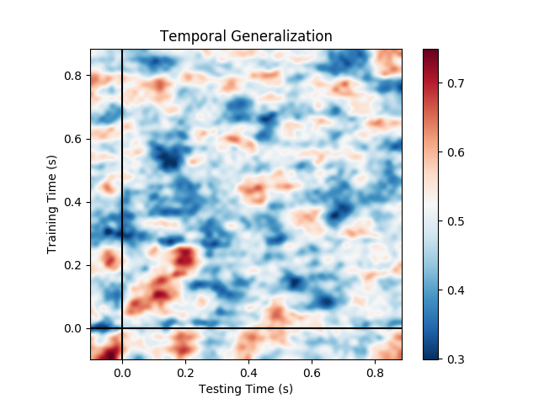
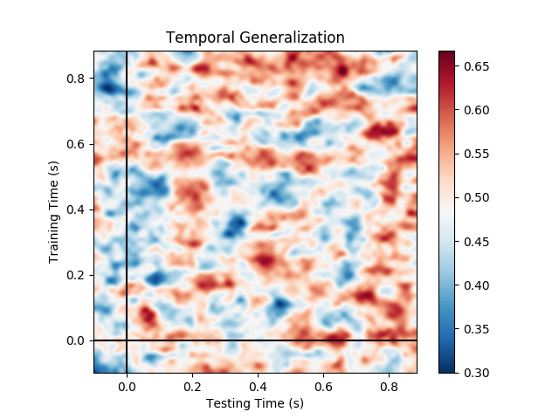
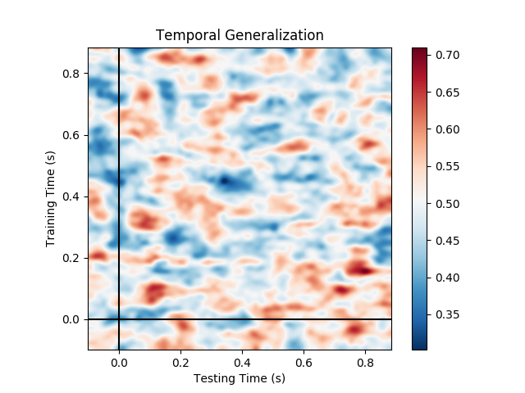
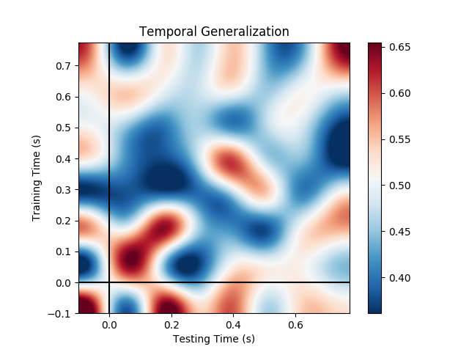
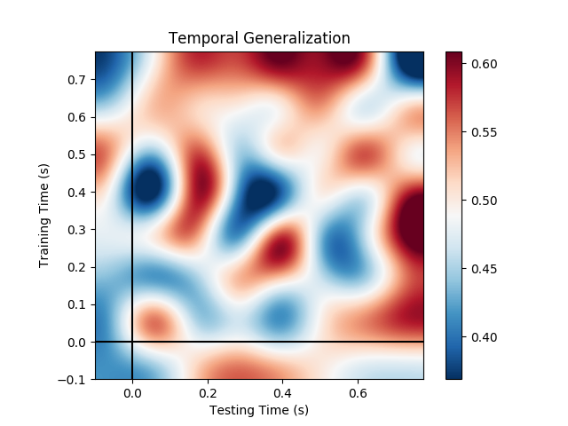
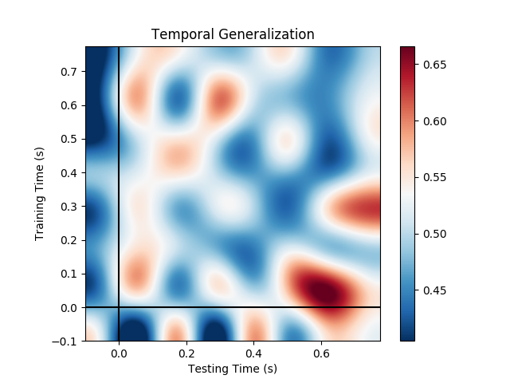
(bio) Gender on nouns
(boy/boys/man/men vs. girl/girls/woman/women)
k=8
k=64
Audio
Visual
Audio2visual

Slide 12
Part-of-Speech
Nouns vs. Verbs

Slide 13
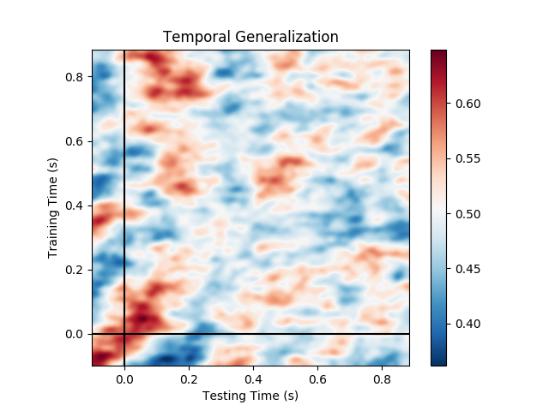
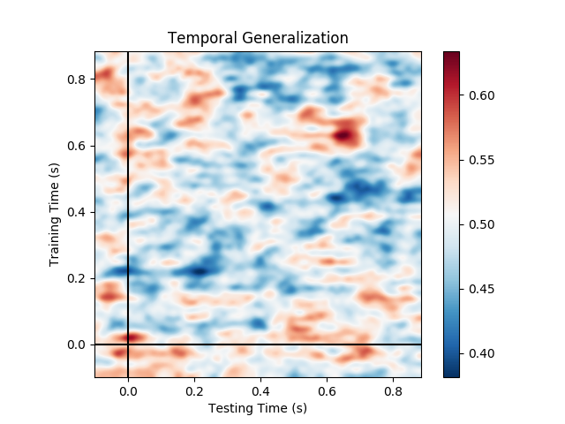
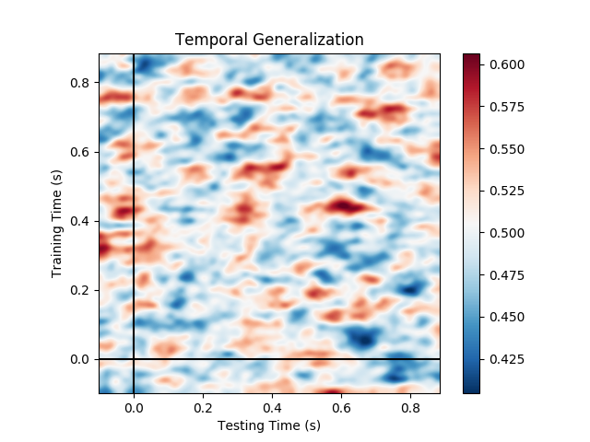
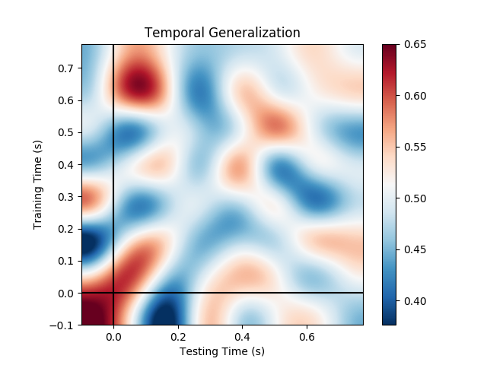
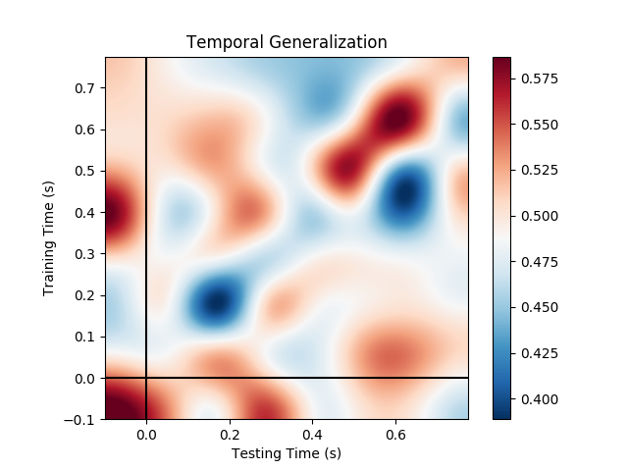
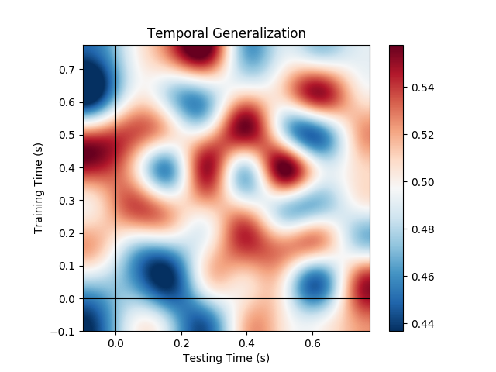
Nouns vs. Verbs
(aligned to word onset)
k=8
k=64
Audio
Visual
Audio2visual

