Slide 1
Decoding analyses
Preliminary decoding analyses, after having:
- re-synchronized the log files
- More data: patients 479, 482, 487 and 493
Contrasts:
First word vs. end-of-sentence (sanity check)
Short vs. longs sentences (sanity check - for now, 2 vs. 5 words)
Part-of-speech (nouns vs. verbs – present tense only)
Grammatical number of nouns (singular vs. plural; with across-modalities testing)
Grammatical number of verbs (singular vs. plural; with across-modalities testing)
Grammatical number – generalization across conditions (nouns→verbs or verbs→nouns)
Grammatical number – generalization across conditions and modalities (nouns-visual→verbs-auditory)
Declarative vs. question sentences

Slide 2
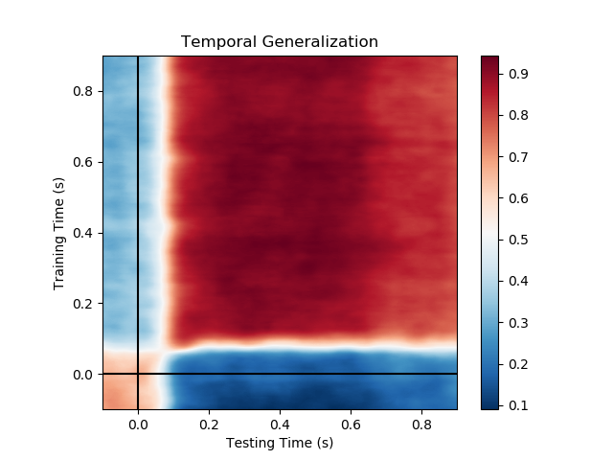
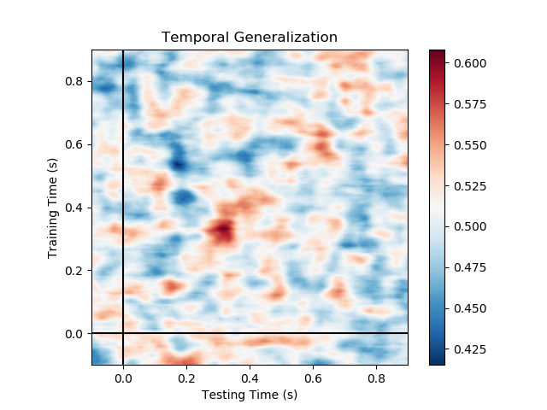
First word vs end of sentence
AUC
Auditory
Visual
Time zero corresponds to word onset

Slide 3
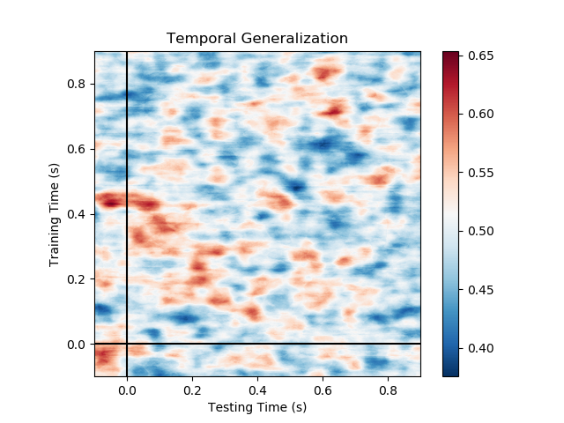
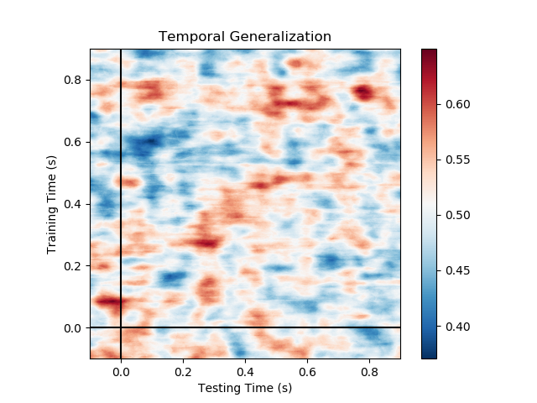
Short vs. long sentence (2 vs 5 words)
AUC
Auditory
Visual
Time zero corresponds to end of sentence

Slide 4
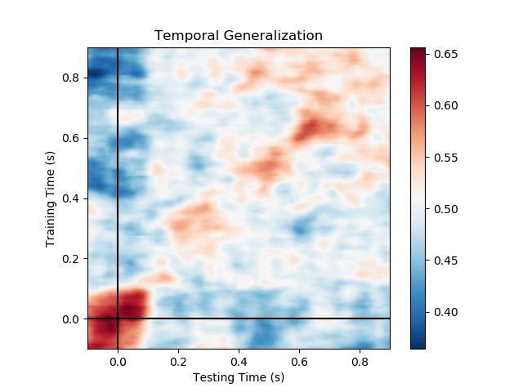
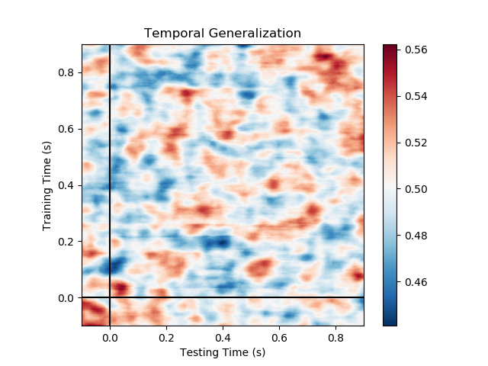
Nouns vs. verbs
Auditory
Visual
Time zero corresponds to word onset

Slide 5
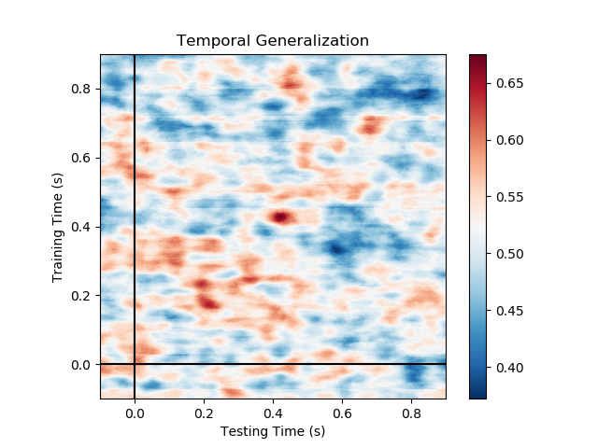
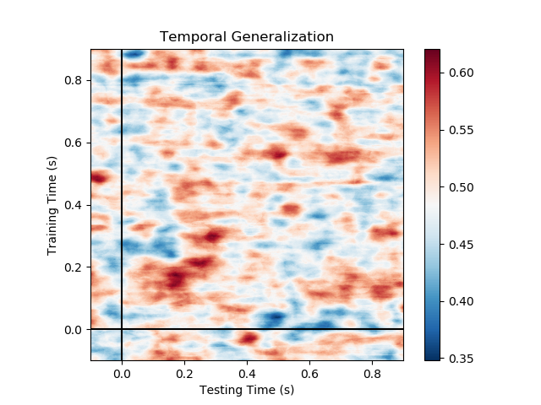
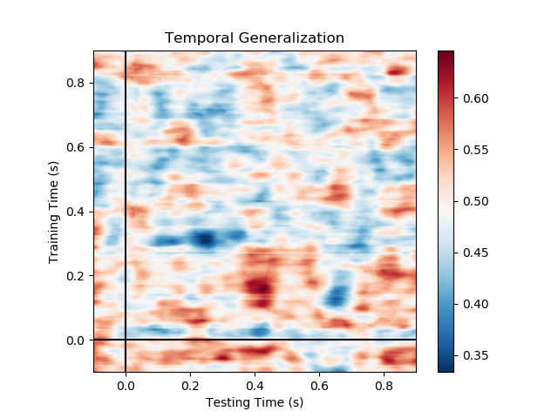
Nouns: singular vs. plural
Across modalities
visual → auditory
Auditory
Visual
Time zero corresponds to noun onset

Slide 6
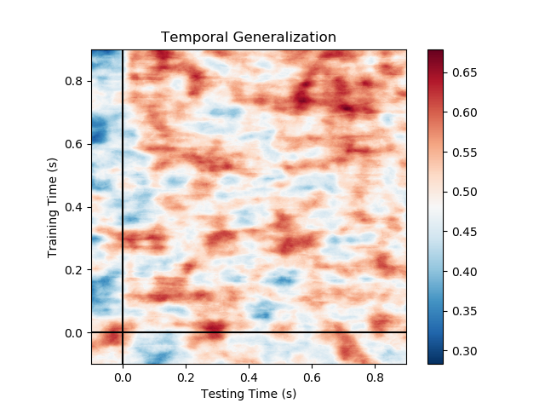
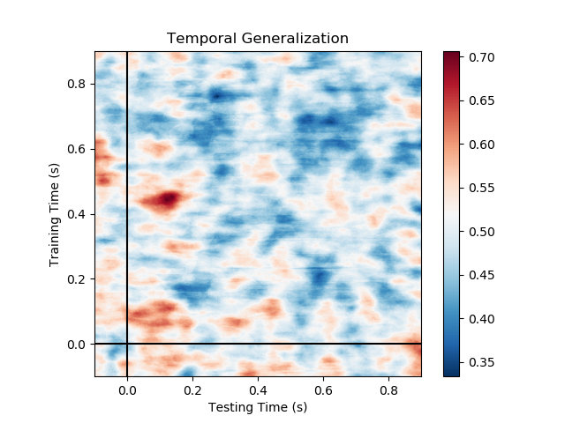
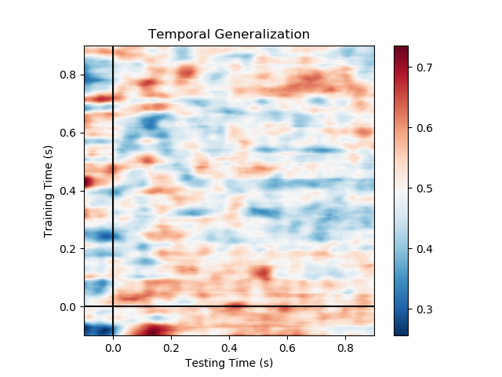
Verbs: singular vs. plural
Across modalities
visual → auditory
Auditory
Visual
Time zero corresponds to verb onset

Slide 7
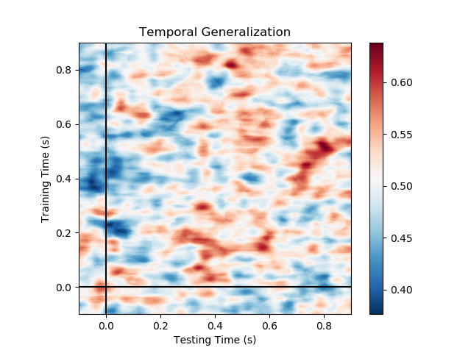
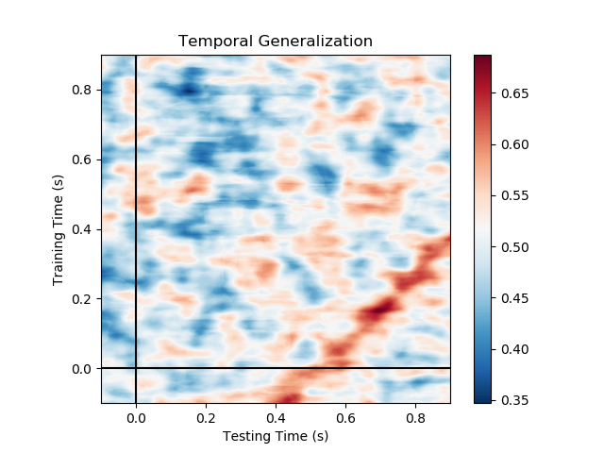
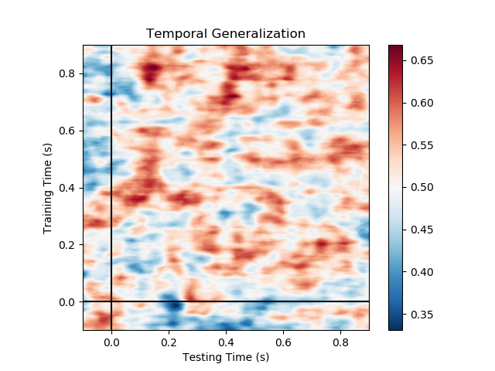
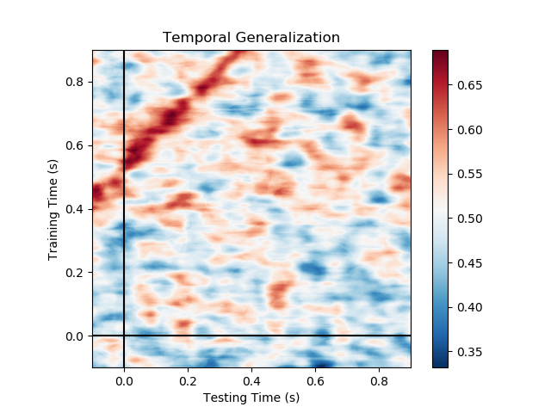
singular vs. plural (across conditions)
Generalization to the succeeding word (SOA of RSVP = 500ms)
verbs -> nouns
nouns -> verbs
Auditory
Visual
Time zero corresponds to word onset

Slide 8
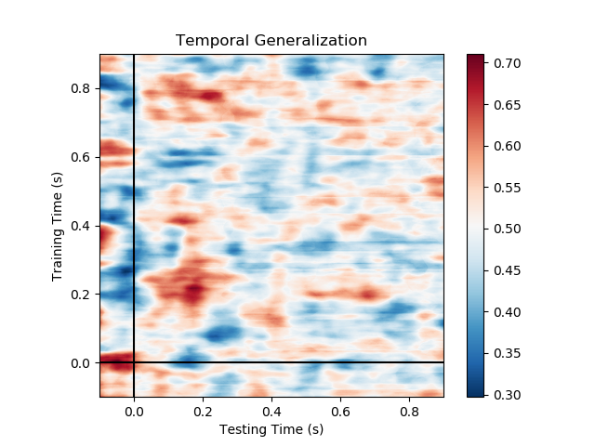
Singular vs. plural
(across conditions and modalities) nouns-visual-->verbs-auditory
Time zero corresponds to word onset

Slide 9
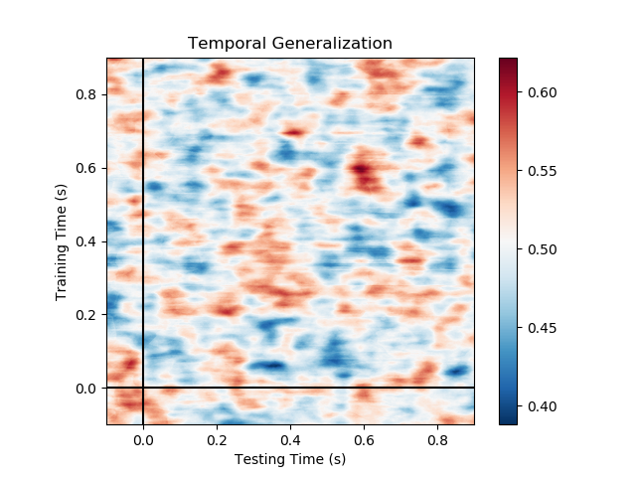
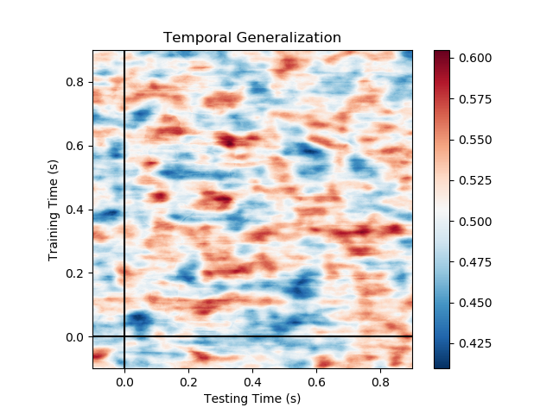
Declarative vs. question
Auditory
Visual
Time zero corresponds to end of sentence

