Slide 1
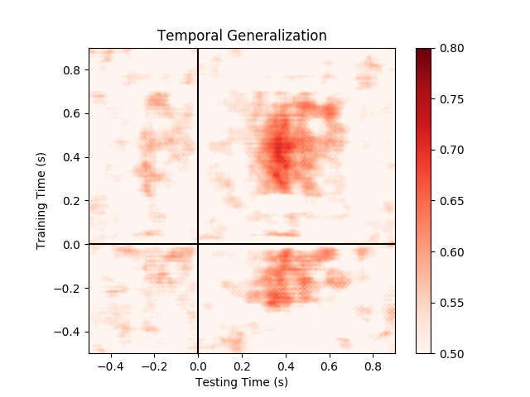
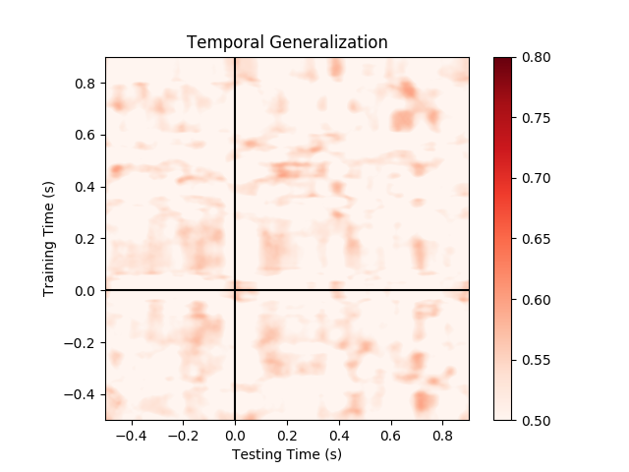
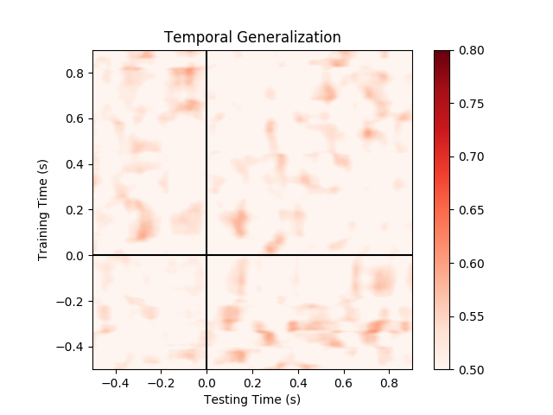
Word length (Visual)
Patient 479 RASTG
A unit in aSTG whose activity is informative about word length during visual presentation.
Good decoding performance from spikes only.
Spikes
High-gamma micro
High-gamma macro

Slide 2
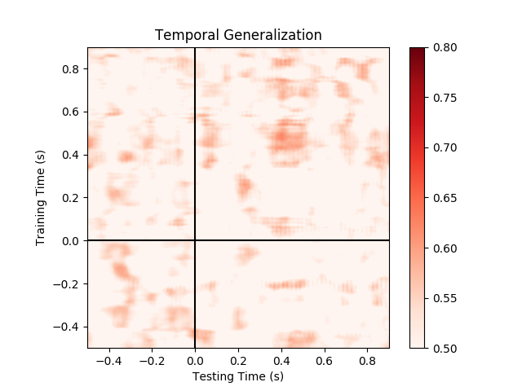
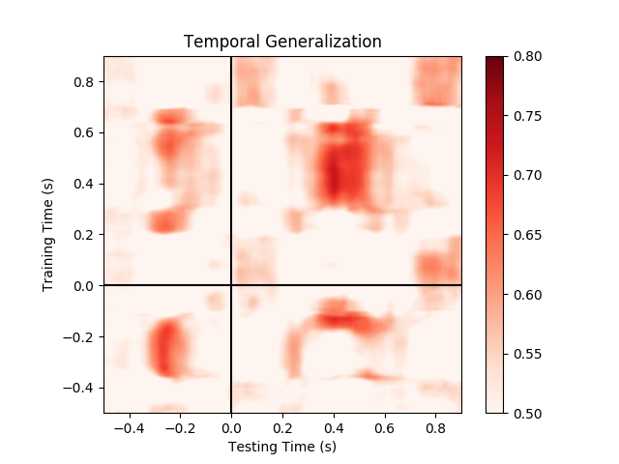
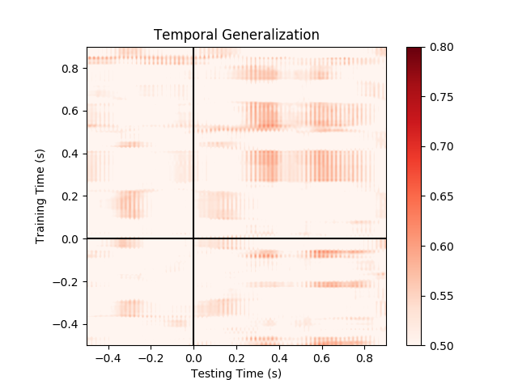
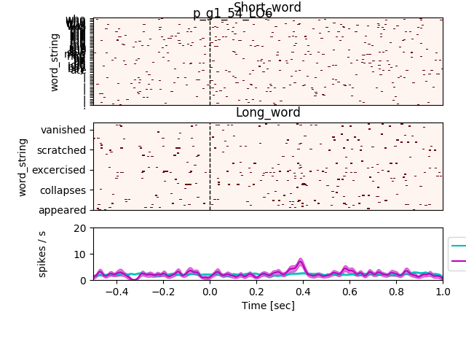
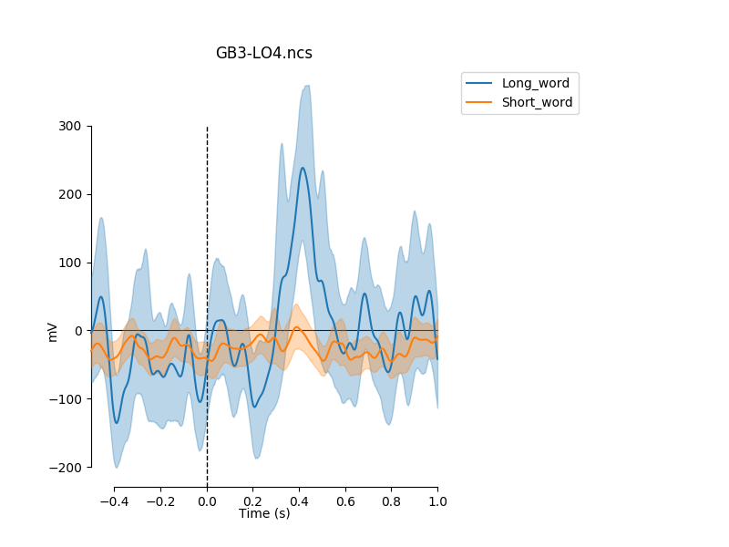
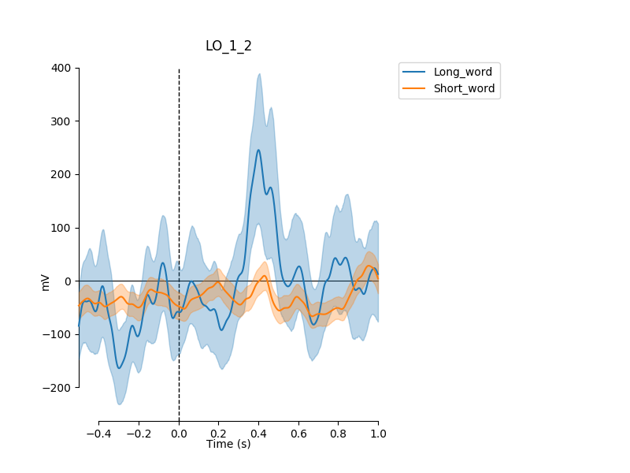
Word length (Visual)
Patient 482 LO
Spikes
High-gamma micro
High-gamma macro

Slide 3
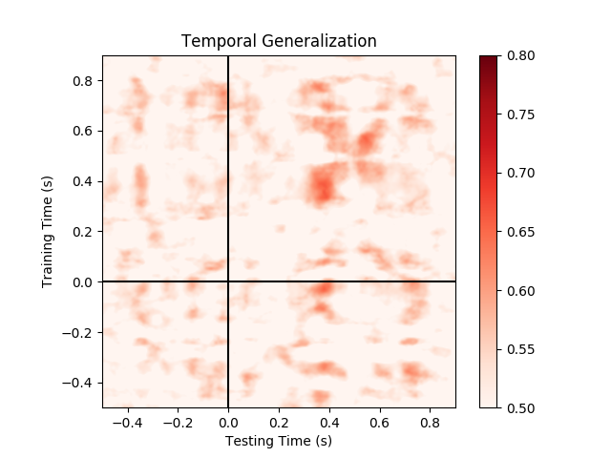
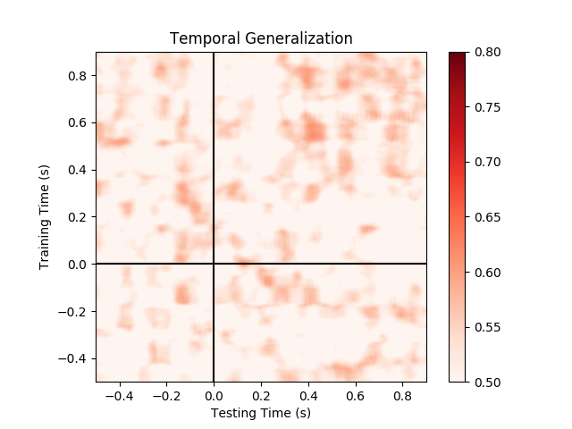
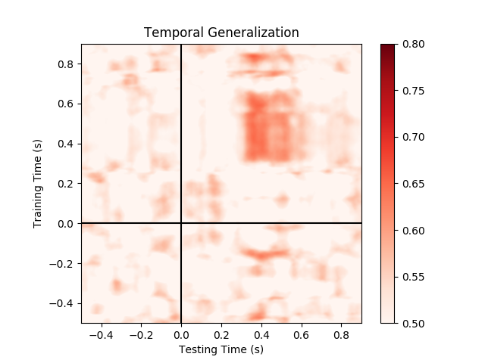
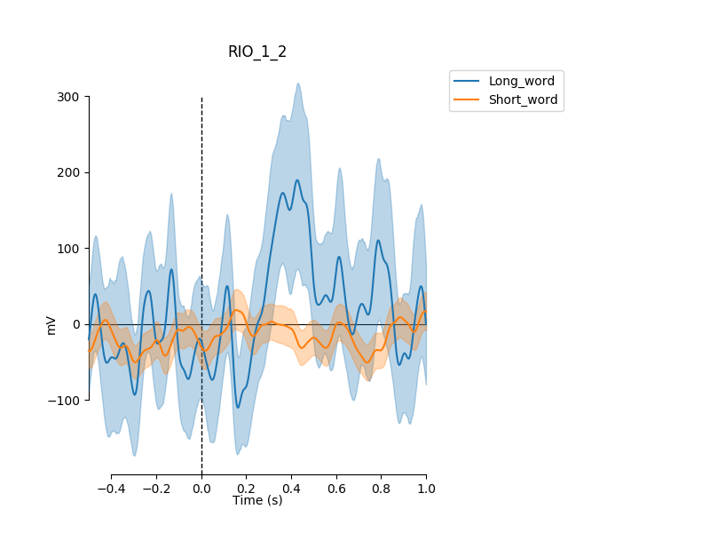
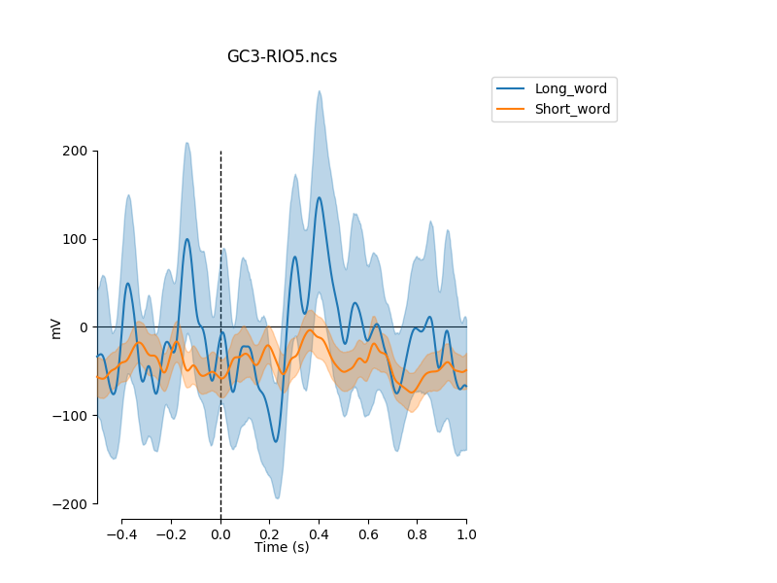
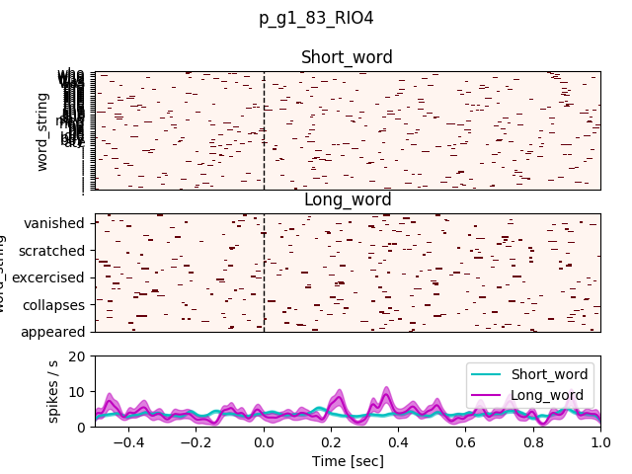
Word length (Visual)
Patient 482 RIO
Spikes
High-gamma micro
High-gamma macro

Slide 4
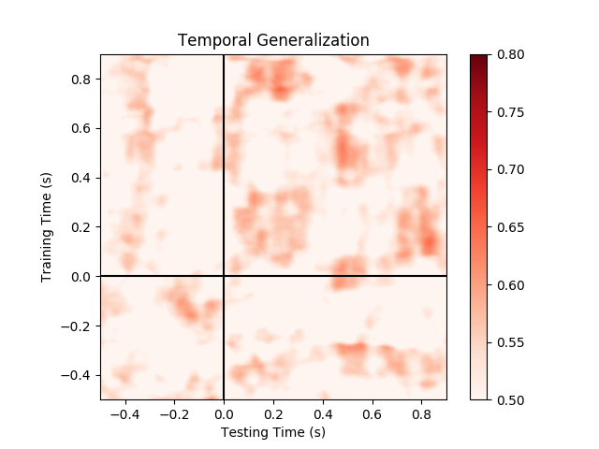
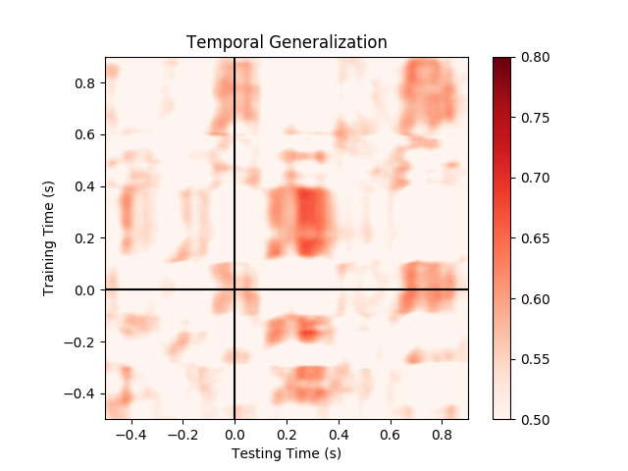
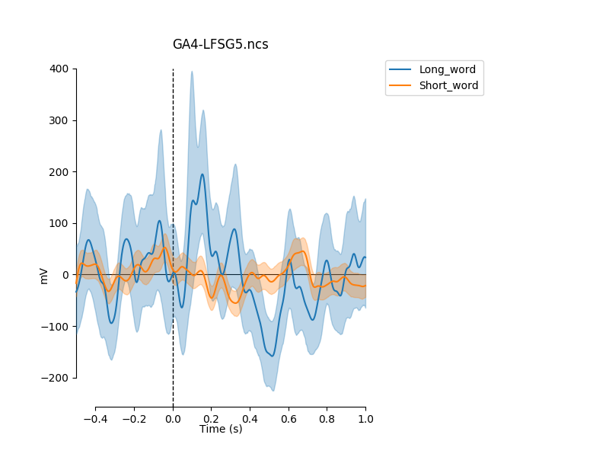
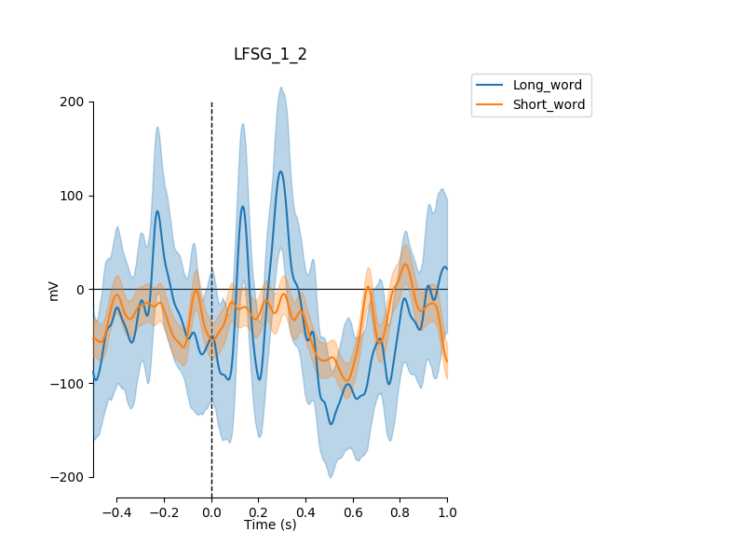
Word length (Visual)
Patient 502 LFSG (fusiform)
Spikes
High-gamma micro
High-gamma macro

Slide 5
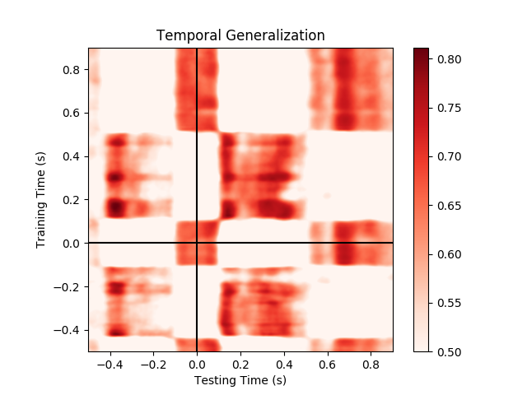
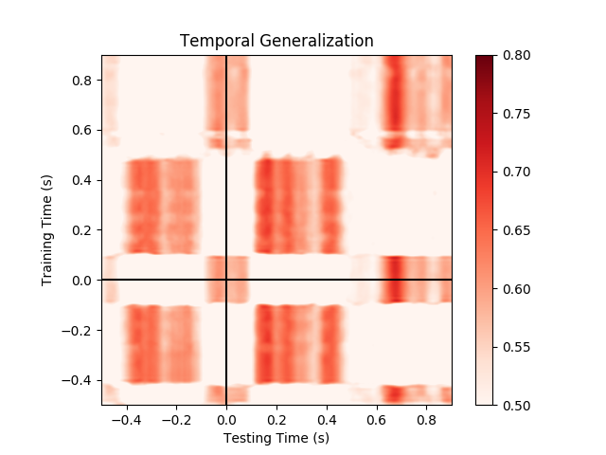
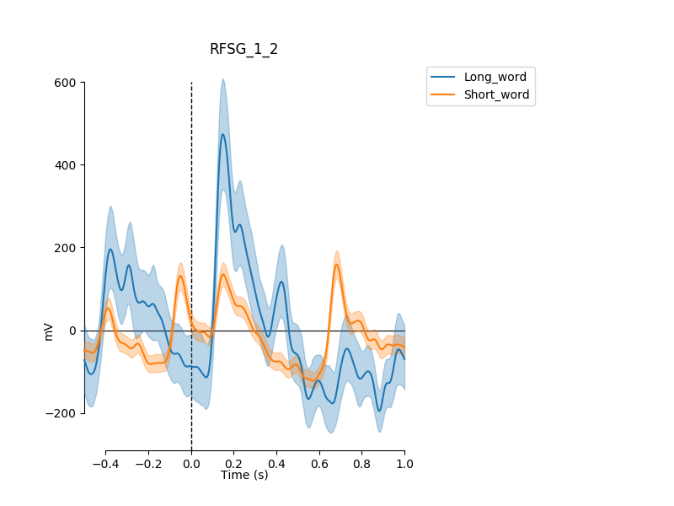
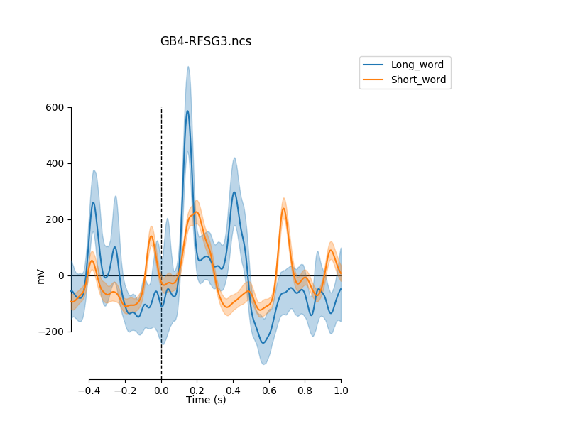
Word length (Visual)
Patient 502 RFSG (fusiform)
Second peak in micro for long words only – check if #morphemes related.
Spikes
High-gamma micro
High-gamma macro

Slide 6
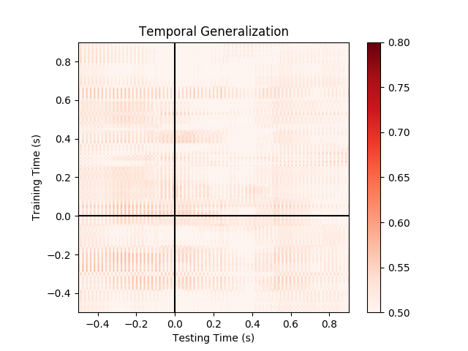
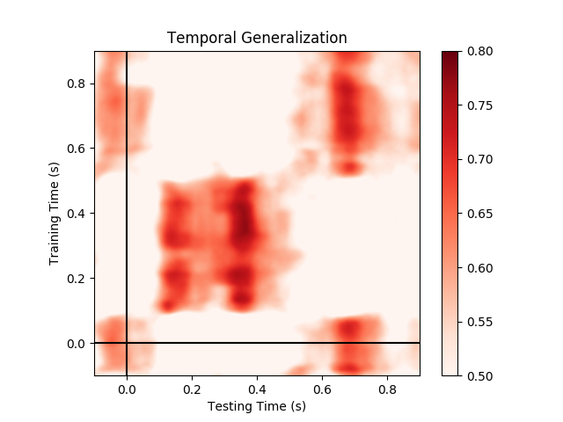
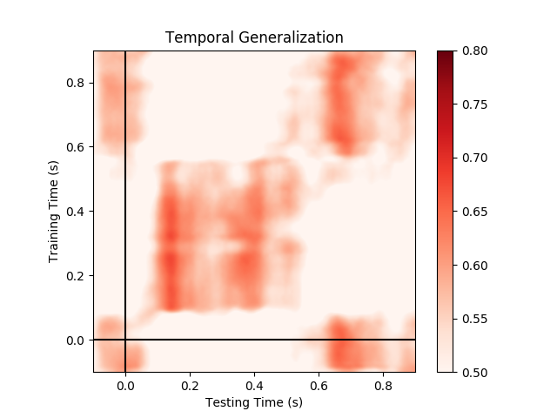
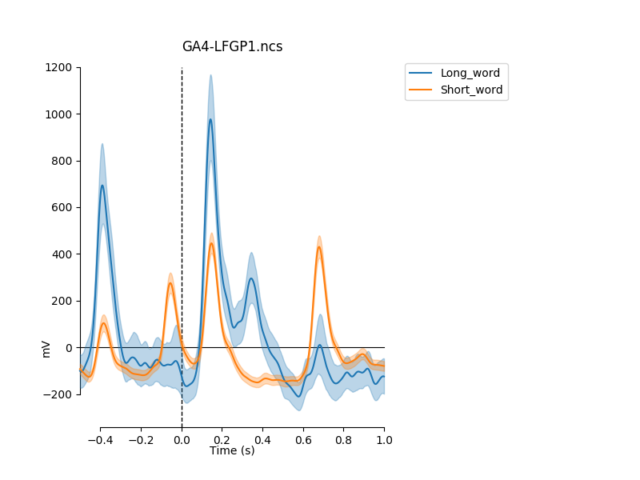
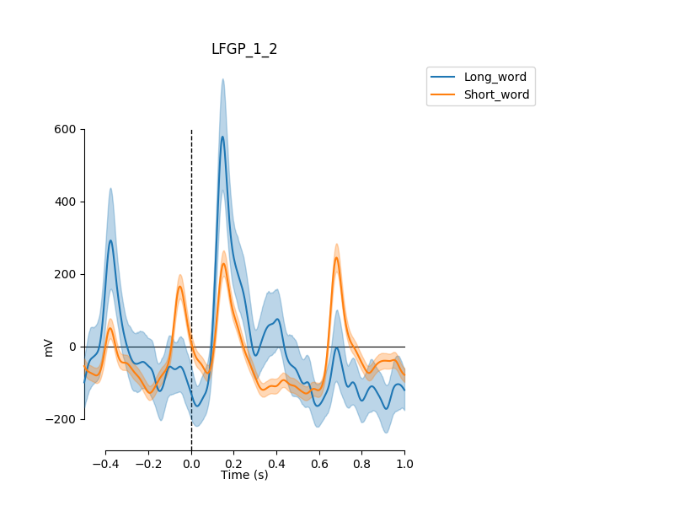
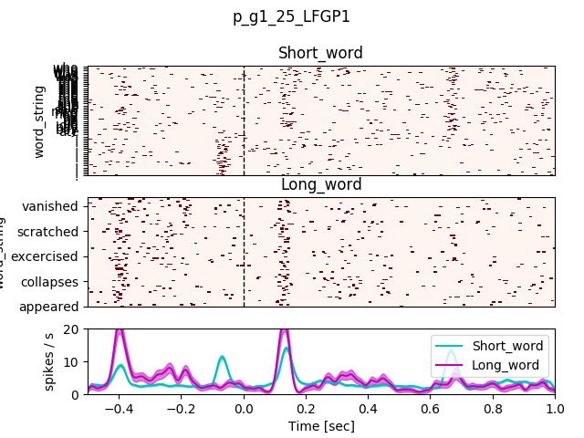
Word length (Visual)
Patient 505 LFSG (fusiform)
Note the varying distance between peaks
Second peak also in this patient, and visible in Macro too.
Spikes
High-gamma micro
High-gamma macro

Slide 7
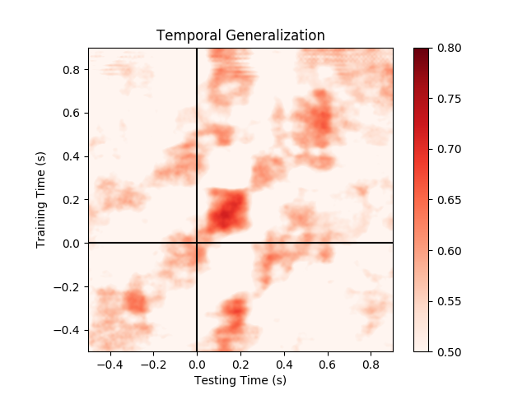
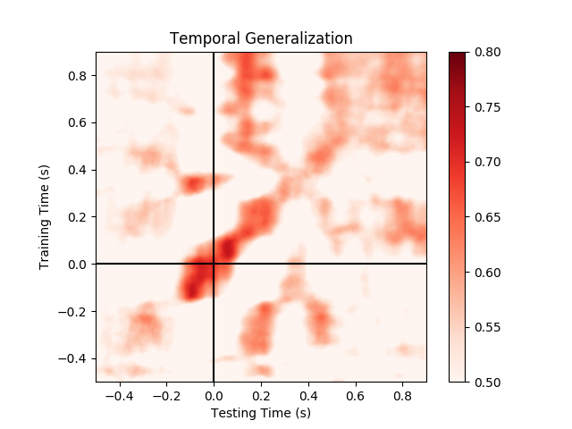
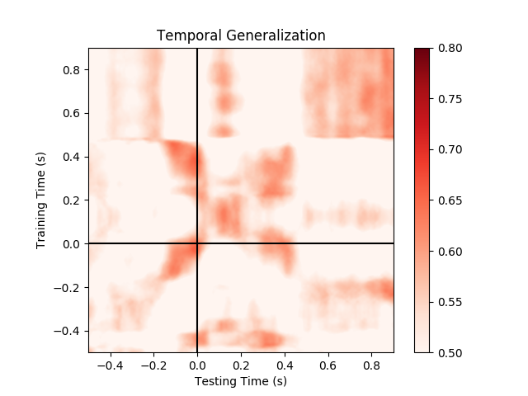
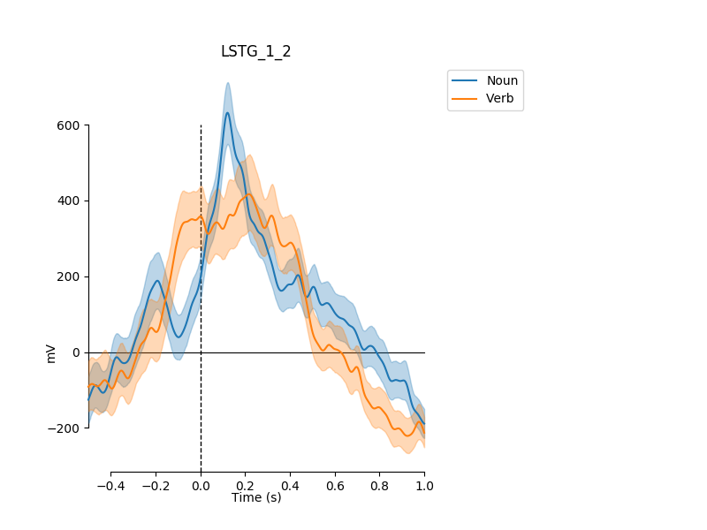
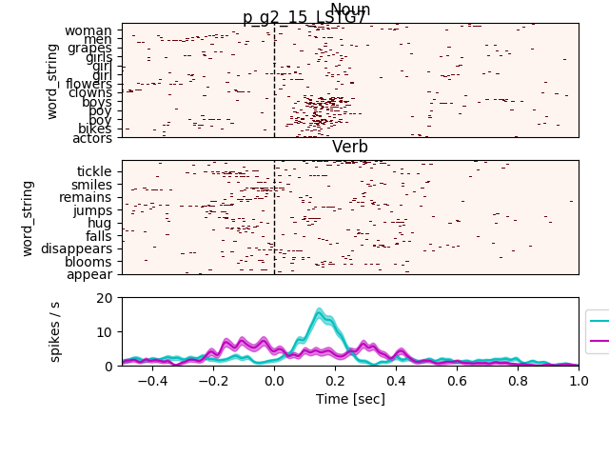
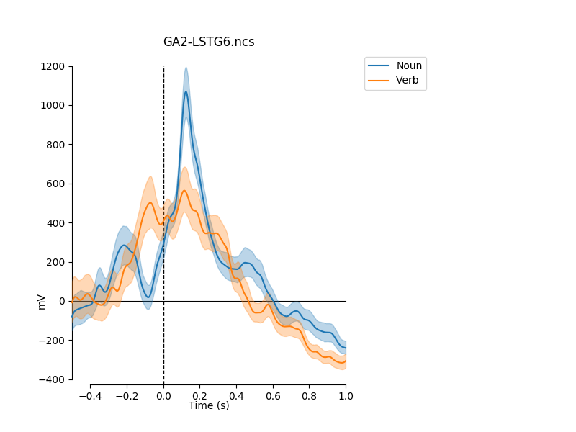
Nouns vs. verbs (Auditory)
Patient 479 LSTG
/b/ unit?
Spikes
High-gamma micro
High-gamma macro

Slide 8
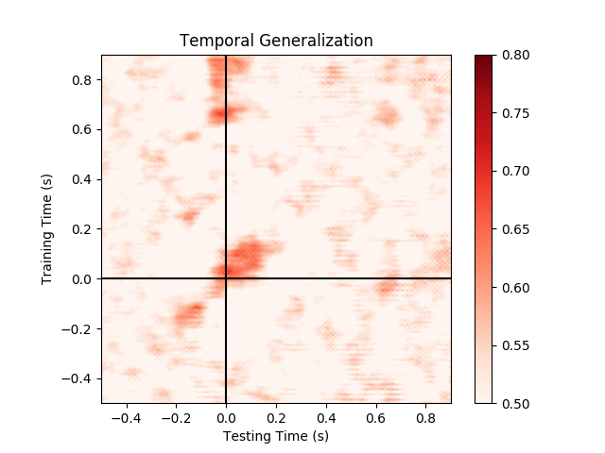
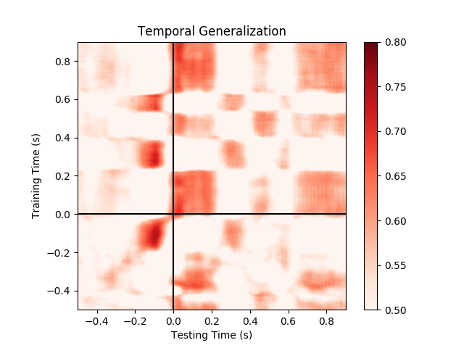
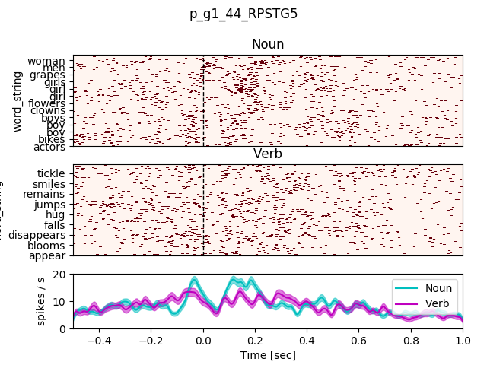
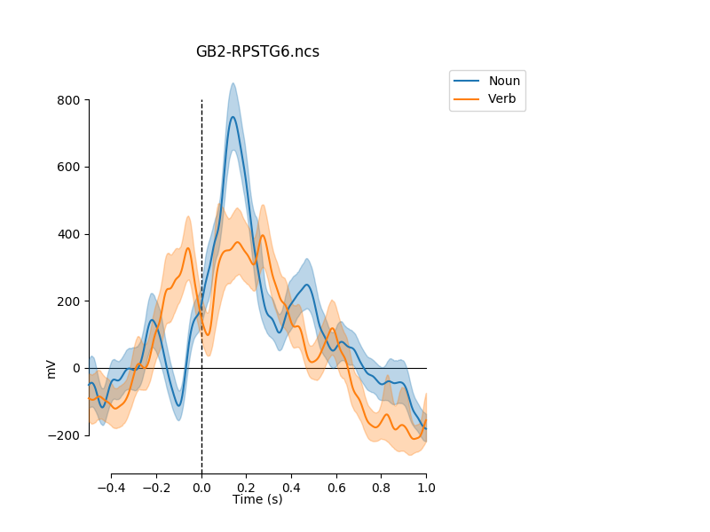
Nouns vs. verbs (Auditory)
Patient 479 RPSTG
Spikes
High-gamma micro
High-gamma macro

Slide 9
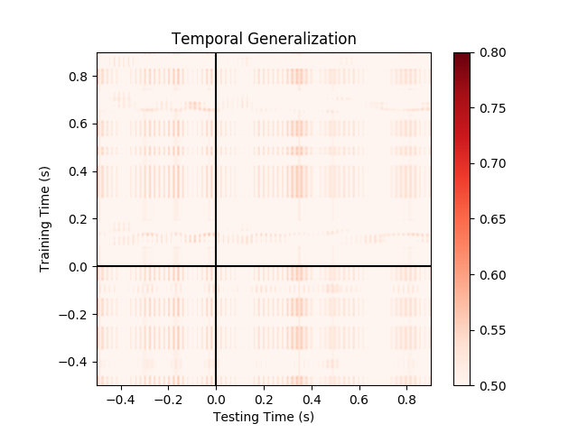
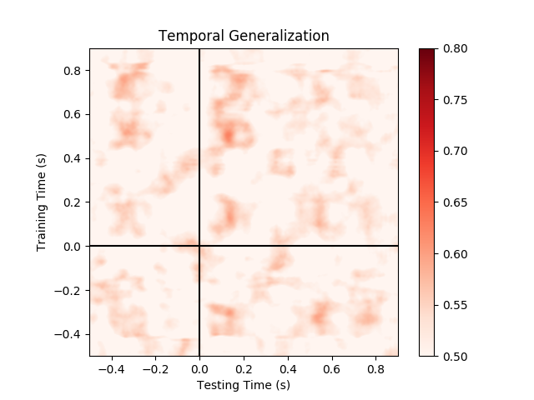
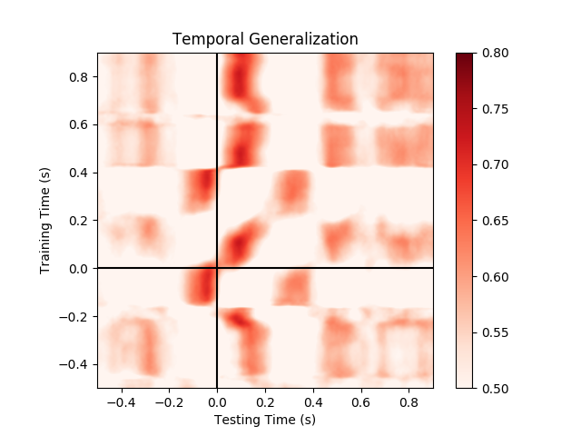
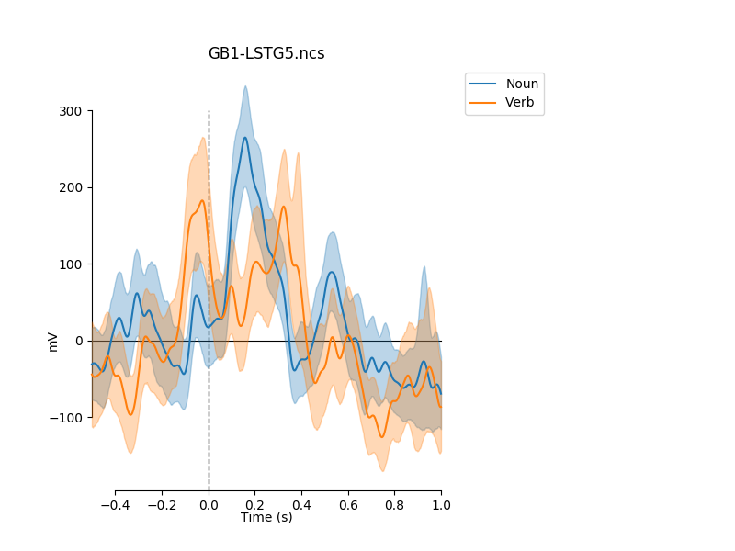
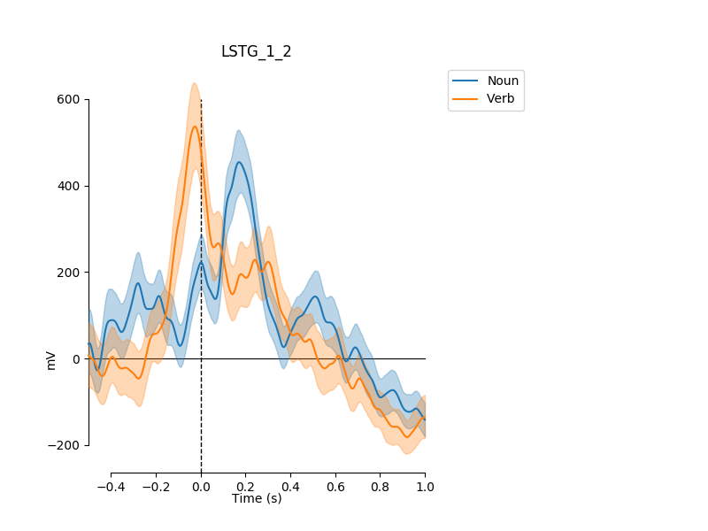
Nouns vs. verbs (Auditory)
Patient 482 LSTG
Spikes
High-gamma micro
High-gamma macro

Slide 10
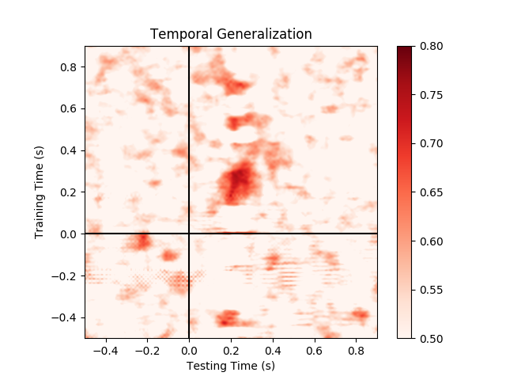
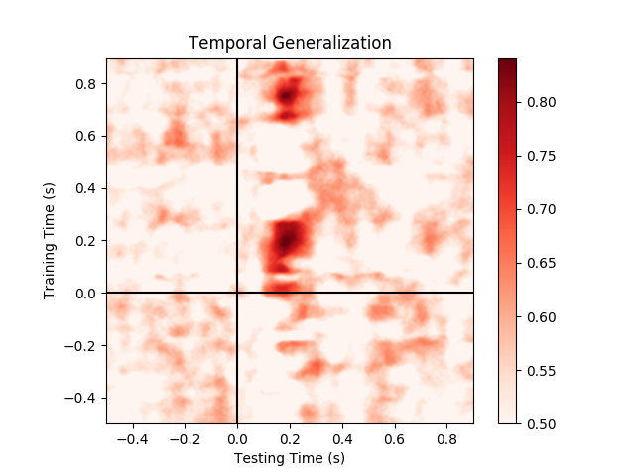
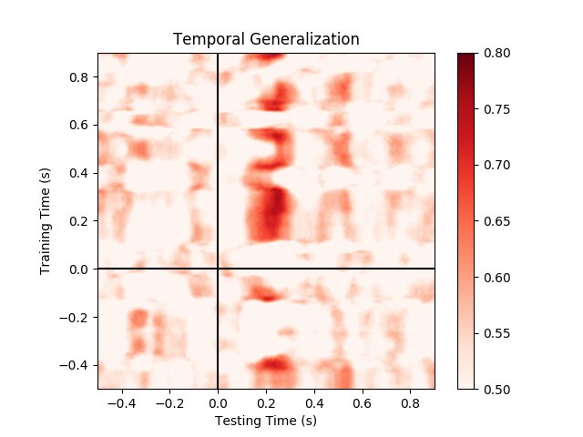
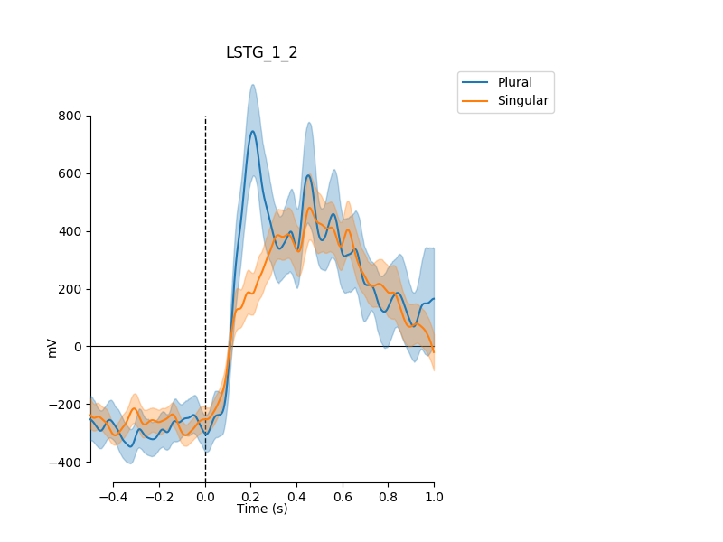
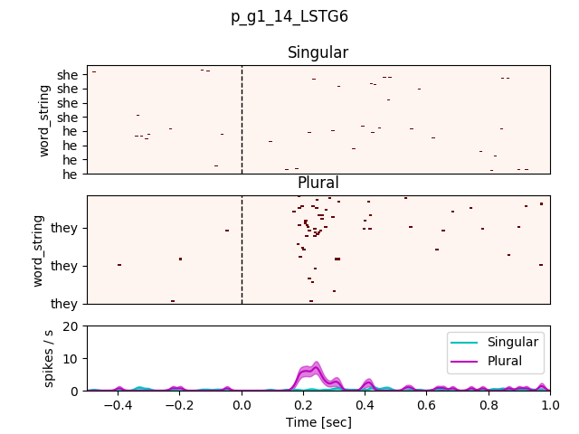
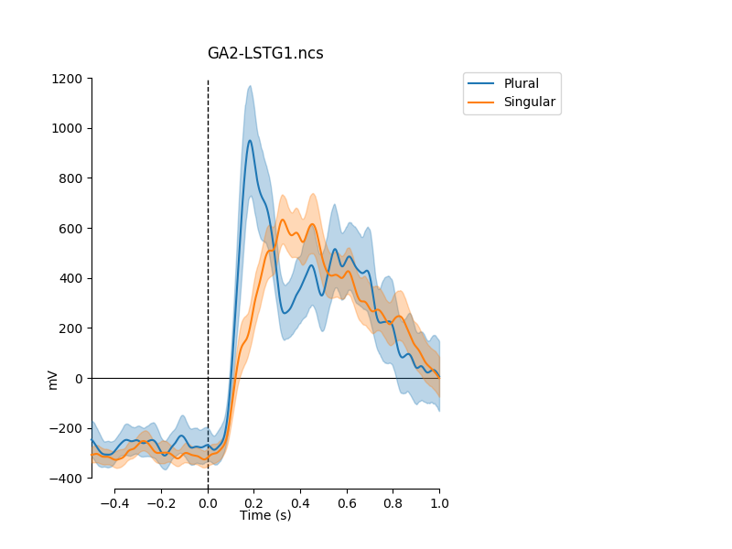
Grammatical number pronouns (Auditory)
Patient 479_11 LSTG
Spikes
High-gamma micro
High-gamma macro

Slide 11




Grammatical number pronouns (Visual)
Patient 502 RSFG (fusiform)
Spikes
High-gamma micro
High-gamma macro

Slide 12






Gender pronouns (Auditory)
Patient 505 LHSG
Increase smoothing before decoding from spikes (?)
Spikes
High-gamma micro
High-gamma macro

Slide 13






Gender pronouns (Auditory)
Patient 479_11 LSTG
Spikes
High-gamma micro
High-gamma macro

Slide 14






Gender nouns (Auditory)
Patient 479 LSTG
Spikes
High-gamma micro
High-gamma macro

Slide 15



Gender pronoun-to-nouns (Auditory)
Patient 479 LSTG
Generalization from pronouns to nouns,
For example, ‘He ..’ vs. ‘She..’ to ‘The bog..’ vs. ‘The girl..’
Compare with the two previous slides
Spikes
High-gamma micro
High-gamma macro

Slide 16





Gender nouns (Auditory)
Patient 482 LEC
Spikes
High-gamma micro
High-gamma macro

Slide 17






Declarative vs. Questions (Auditory)
Patient 479 LSTG
End of sentence
Spikes
High-gamma micro
High-gamma macro

Slide 18






Embedding vs. Long sentences (Auditory)
Patient 479 LSTG
End of sentence
Spikes
High-gamma micro
High-gamma macro

