Slide 1
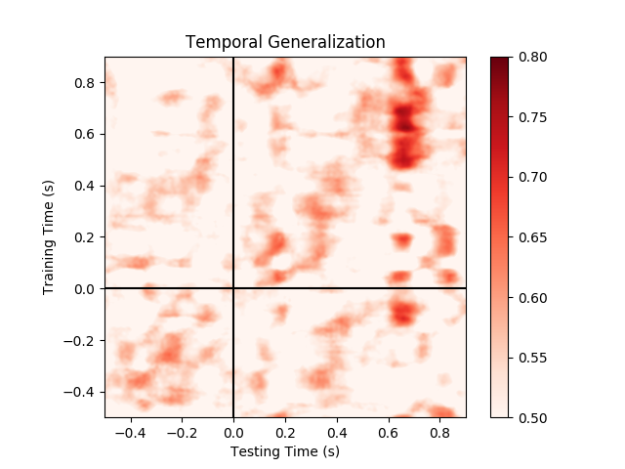
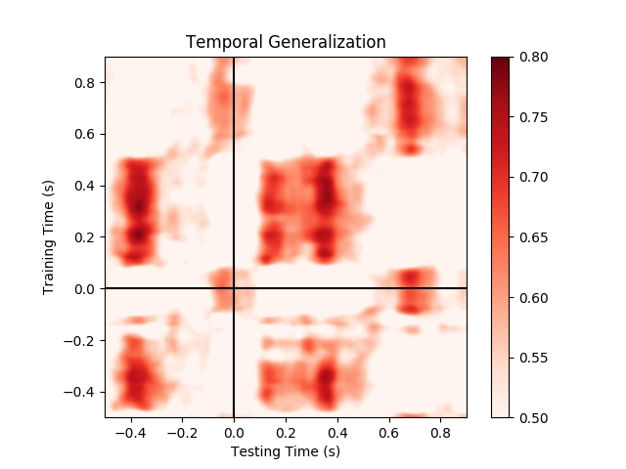
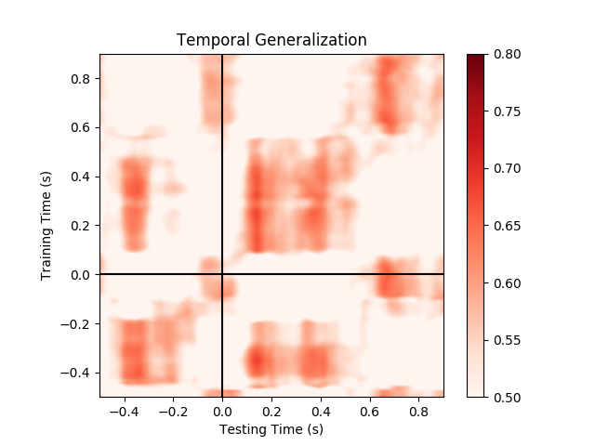
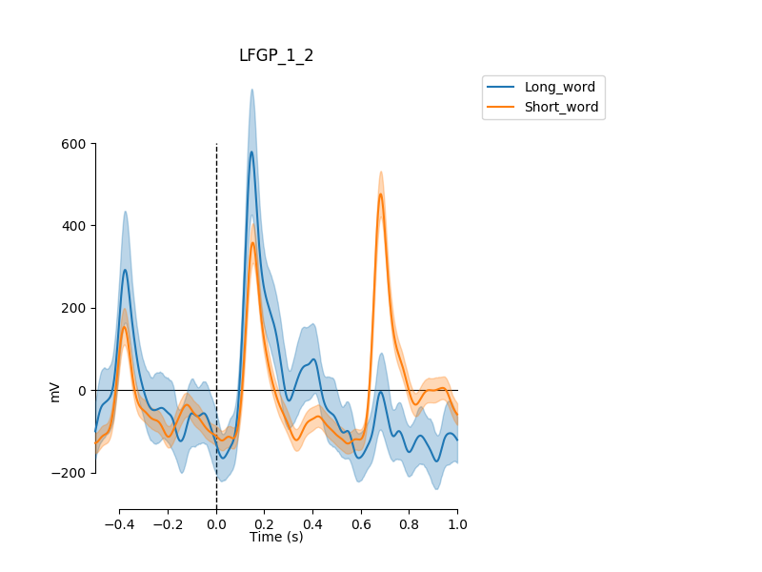
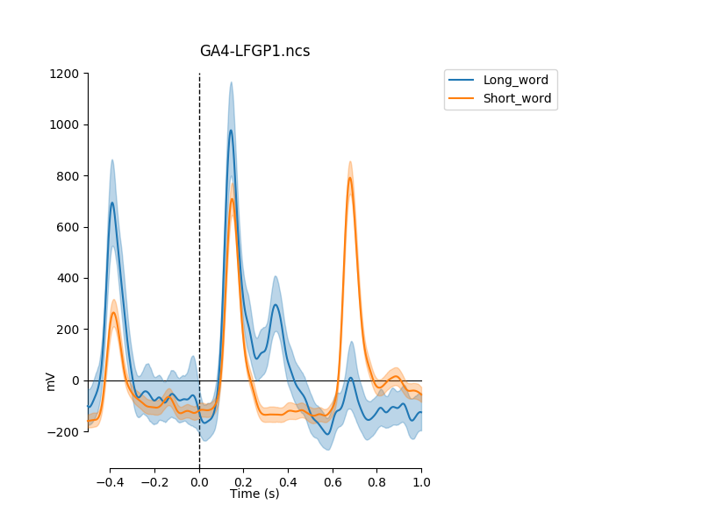
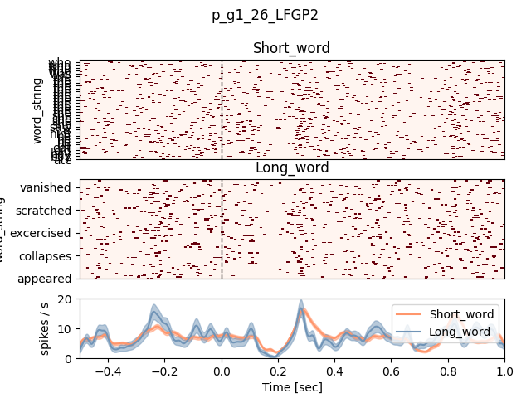
Word length (Visual)
Patient 505 LFGP (left-posterior fusiform)
Second peak in micro for long words only (check if #morphemes related, eye-movement or top-down effects.
Second peak also in macro.
Spikes
High-gamma micro
High-gamma macro

Slide 2
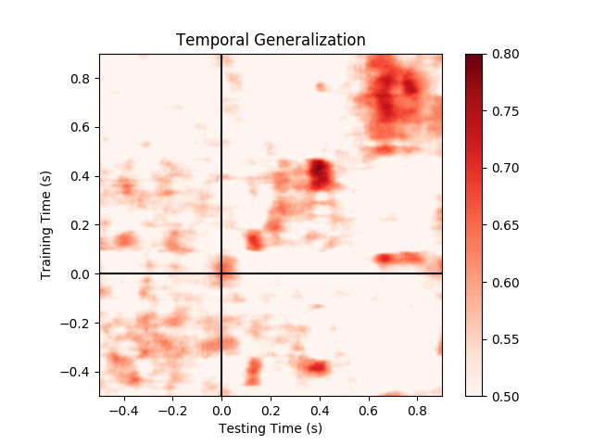
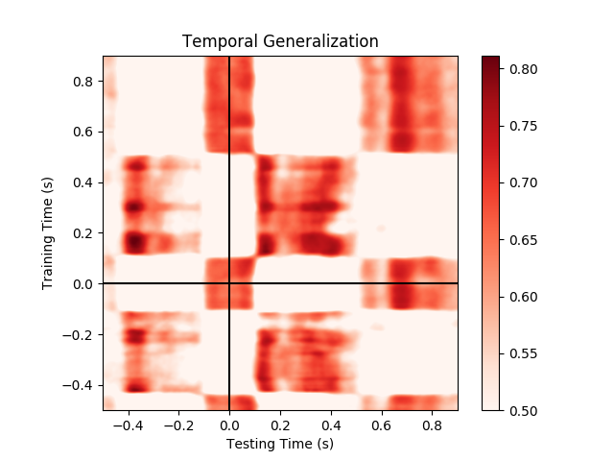
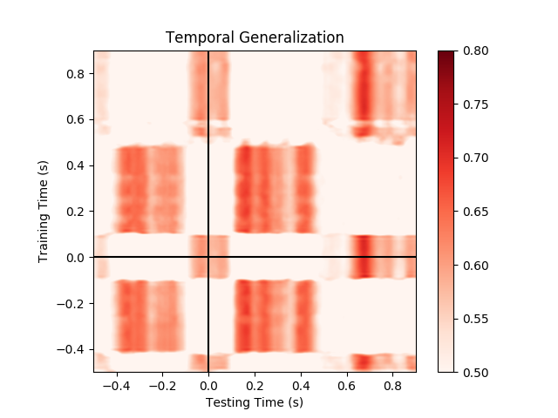
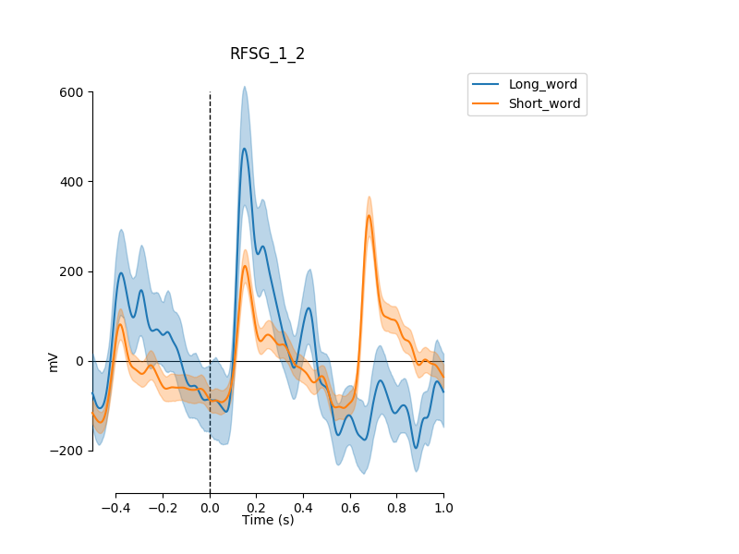
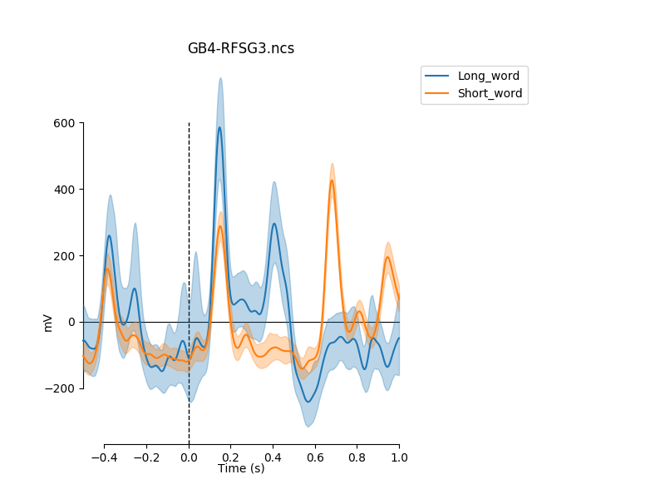
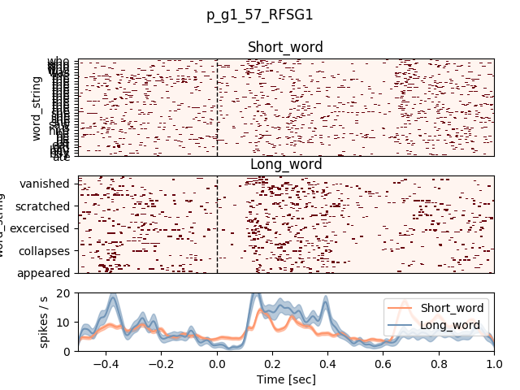
Word length (Visual)
Patient 502 RFSG (fusiform)
Second peak in single-unit as well.
Spikes
High-gamma micro
High-gamma macro

Slide 3
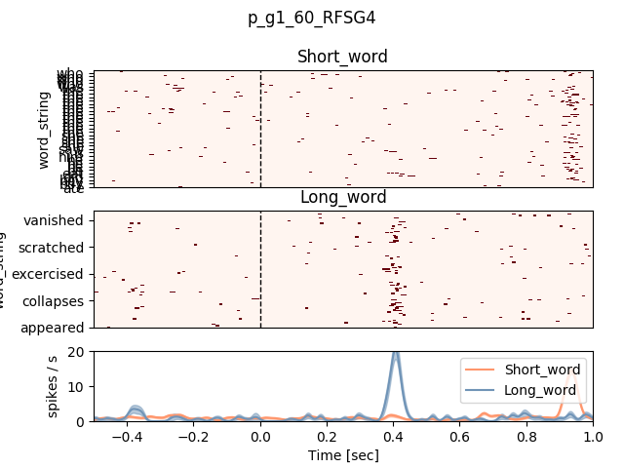
Word length (Visual)
Patient 502 RFSG (fusiform) – another example for a single-unit
Late short response (to morpheme only?)
Spikes
High-gamma micro
High-gamma macro

Slide 4
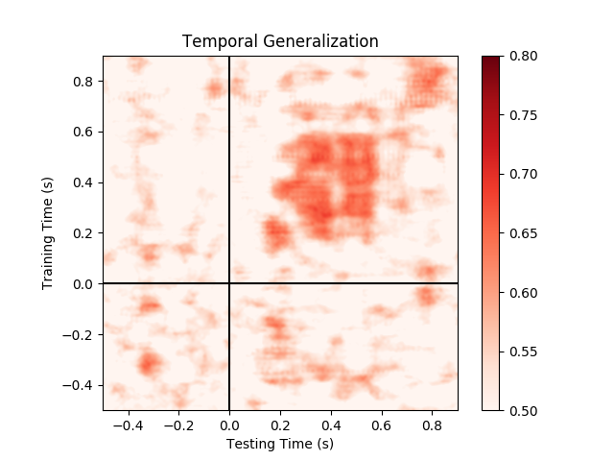
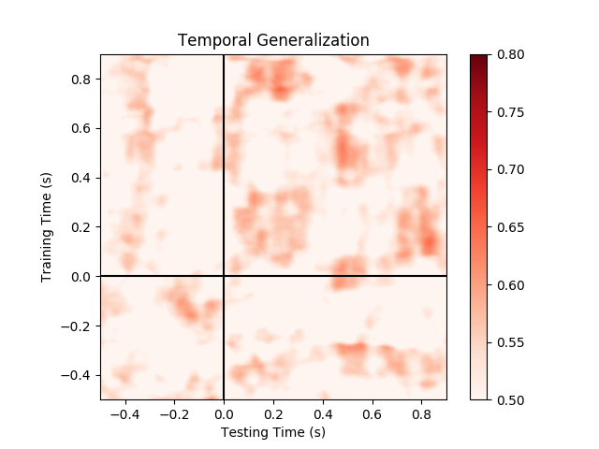
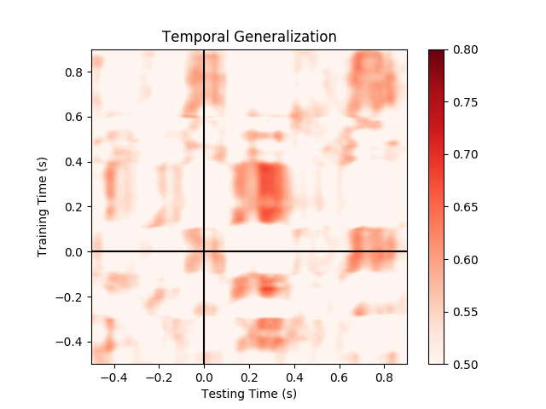
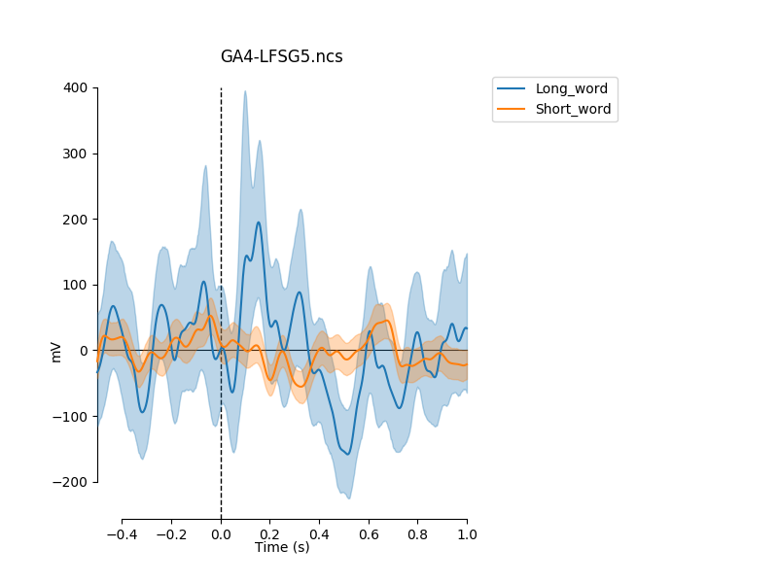
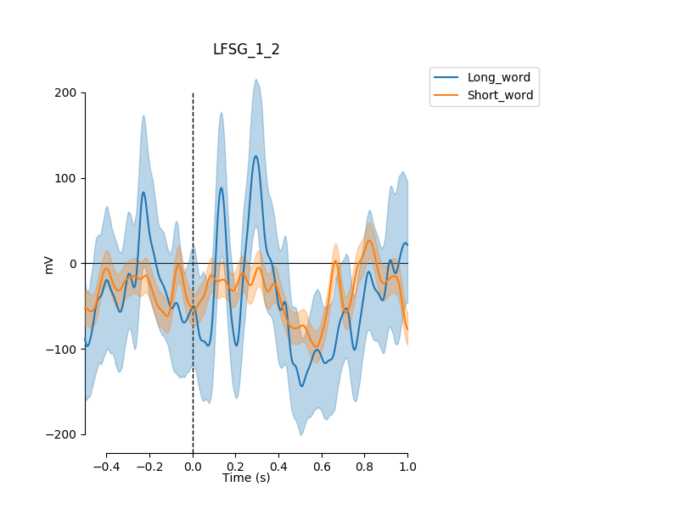
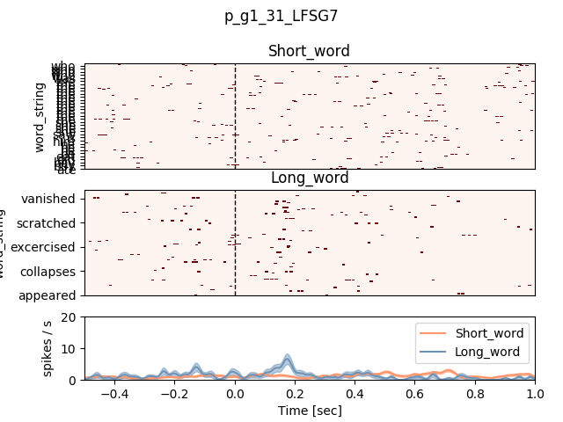
Word length (Visual)
Patient 502 LFSG (fusiform)
Spikes
High-gamma micro
High-gamma macro

Slide 5
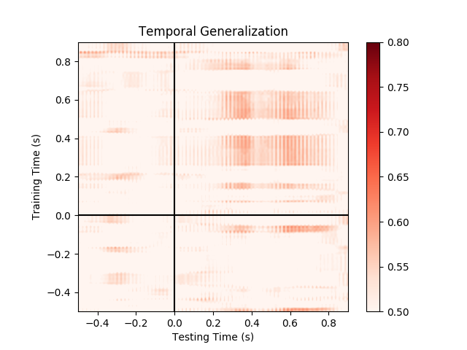
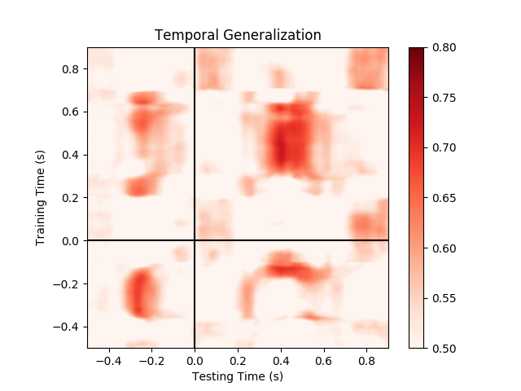
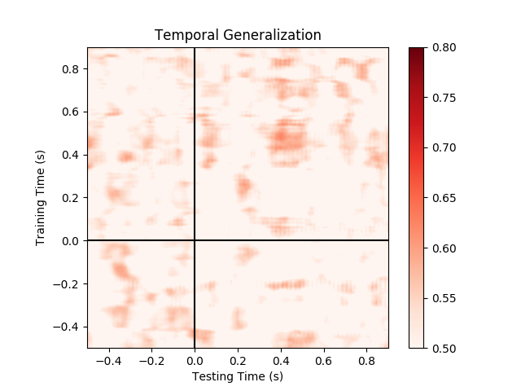
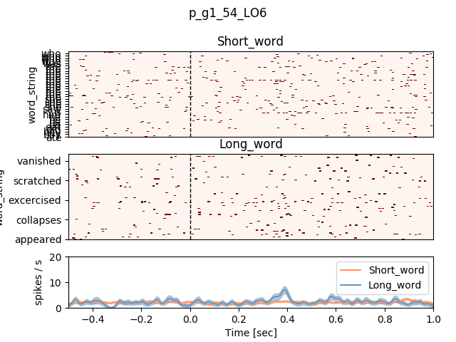
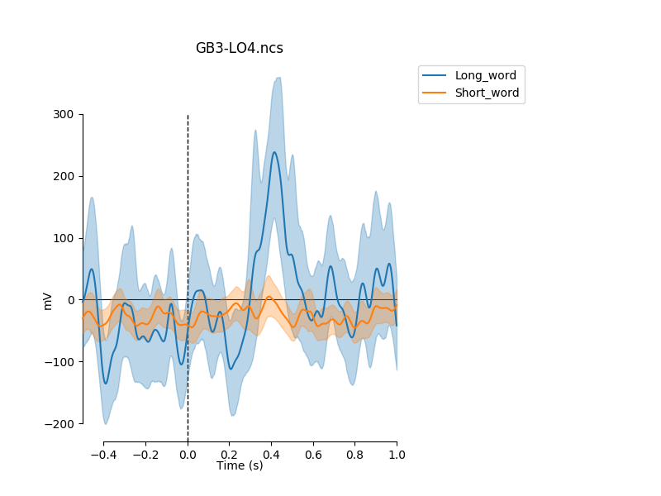
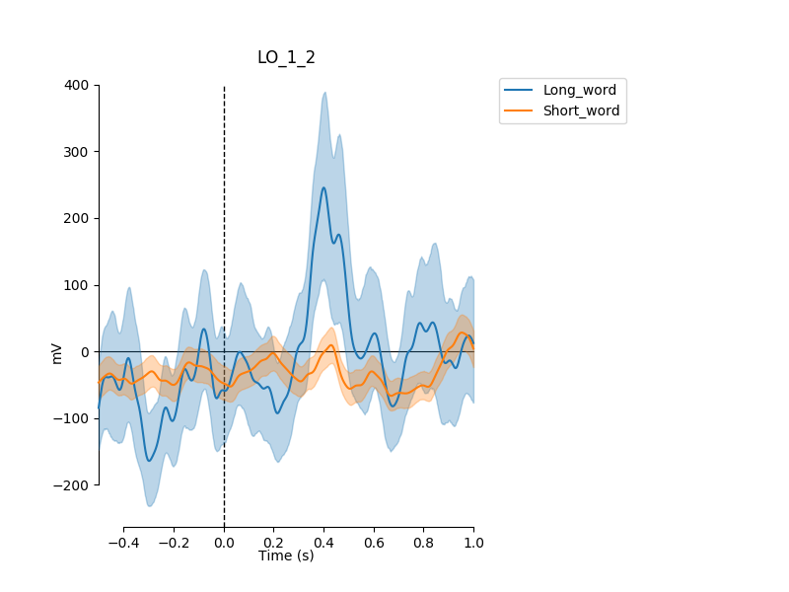
Word length (Visual)
Patient 482 LO
An LO electrode that seems to have a different profile; best decoding from macro elecs
Spikes
High-gamma micro
High-gamma macro

Slide 6
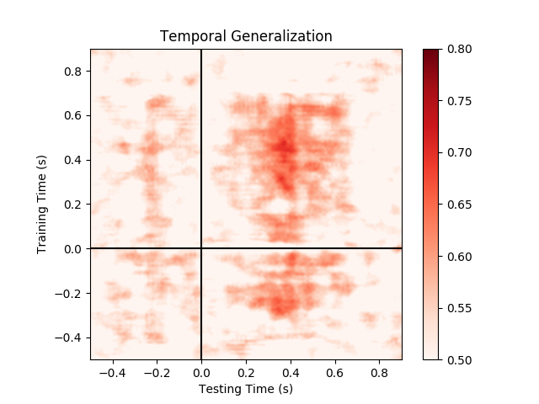
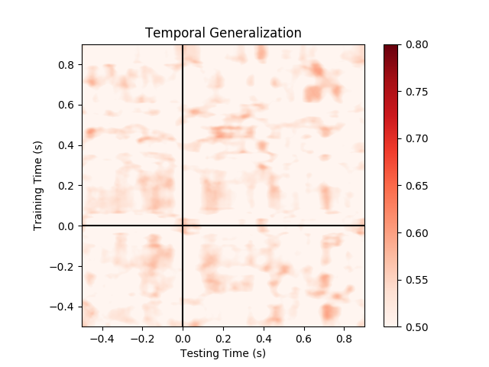
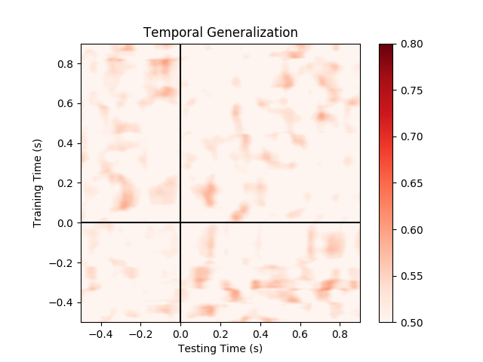
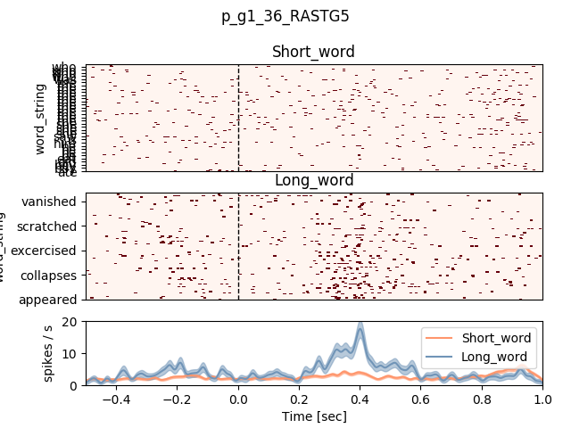
Word length (Visual)
Patient 479 RASTG
Interestingly, a unit in aSTG is informative about word length during visual presentation.
Good decoding performance from spikes only, based on this unit.
Spikes
High-gamma micro
High-gamma macro

Slide 7
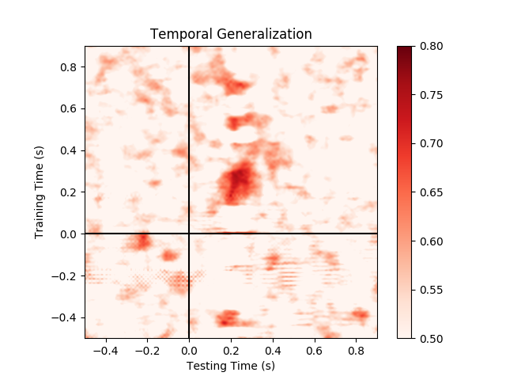
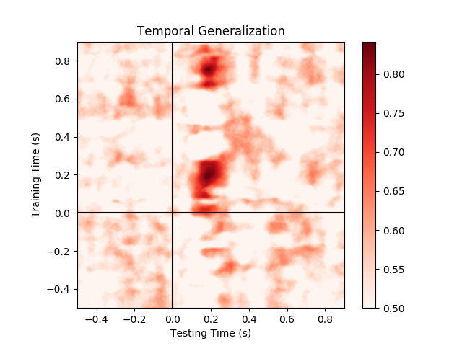
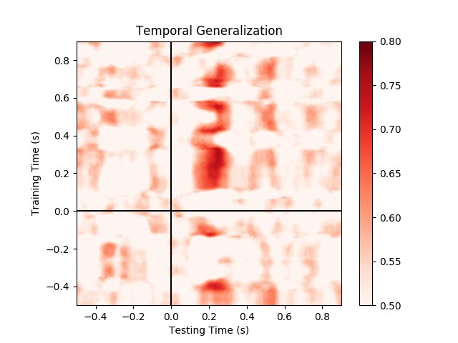
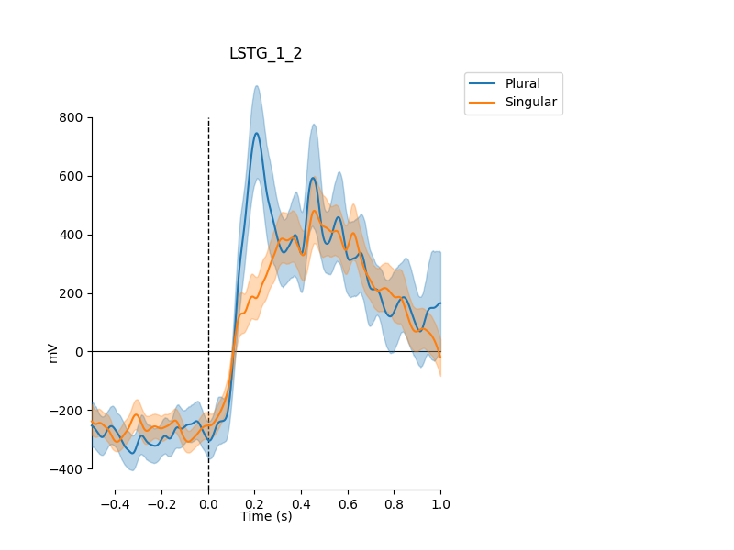
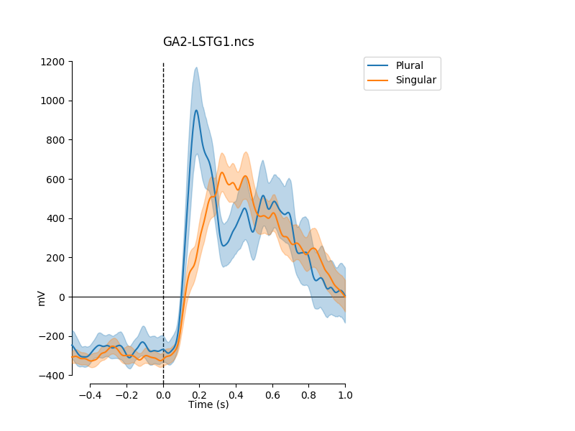
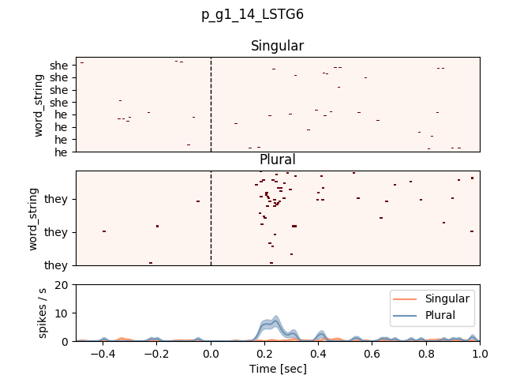
Grammatical number pronouns (Auditory)
Patient 479 LSTG
Spikes
High-gamma micro
High-gamma macro

Slide 8
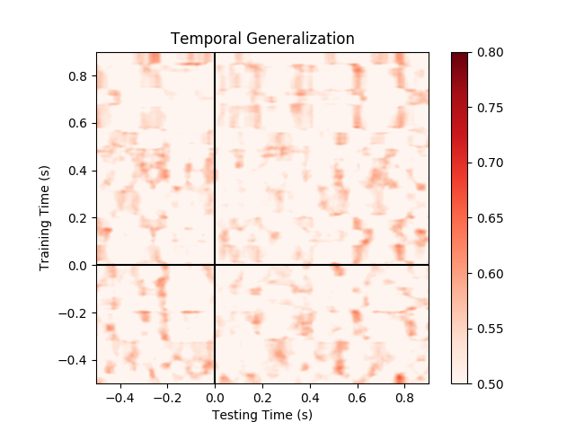
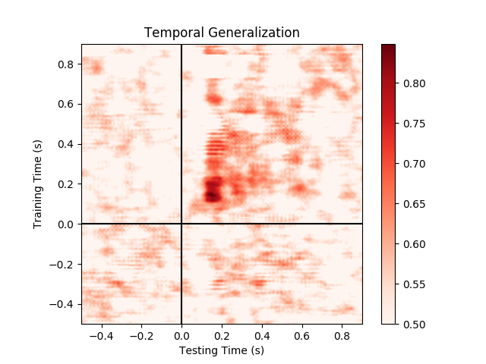
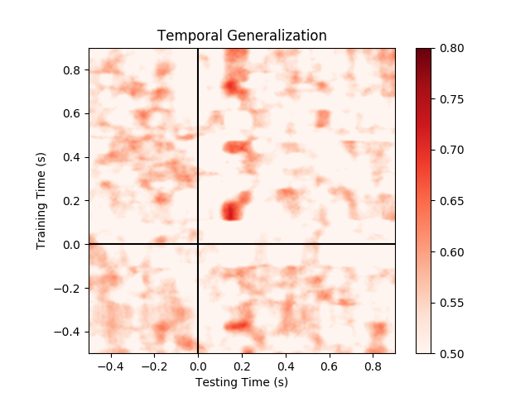
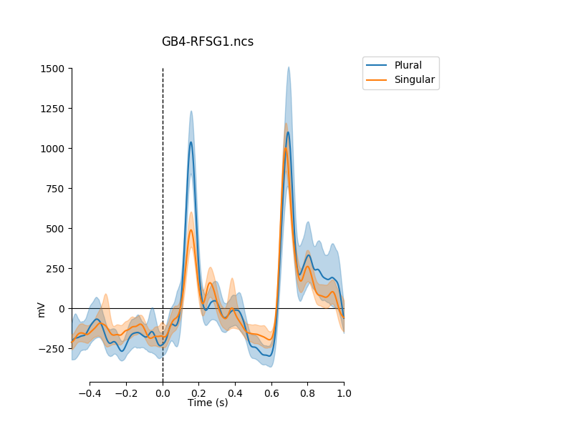
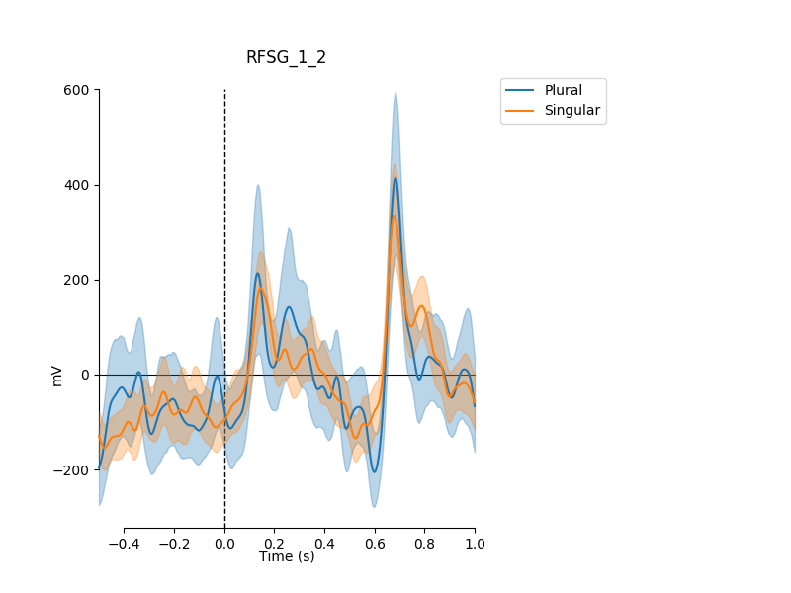
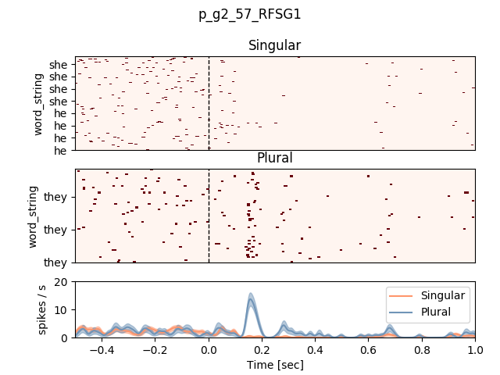
Grammatical number pronouns (Visual)
Patient 502 RSFG (fusiform)
Spikes
High-gamma micro
High-gamma macro

Slide 9
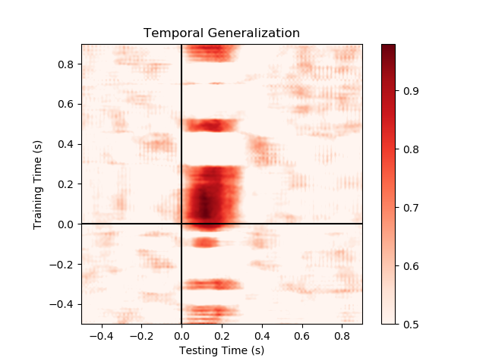
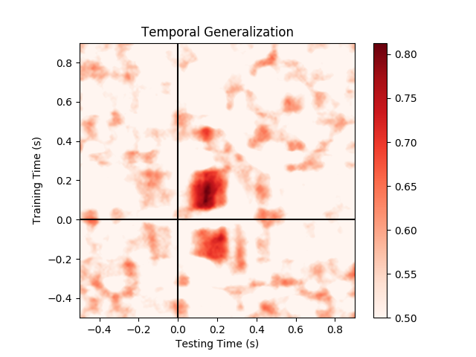
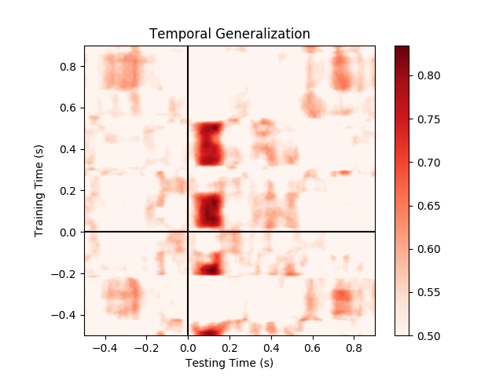
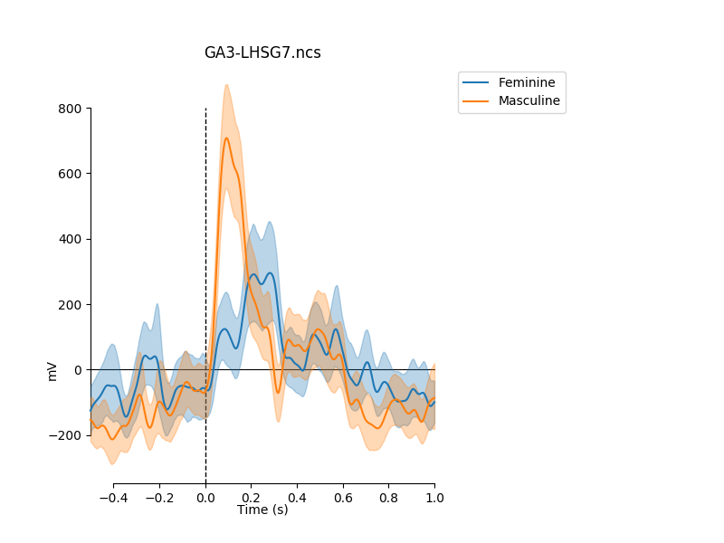
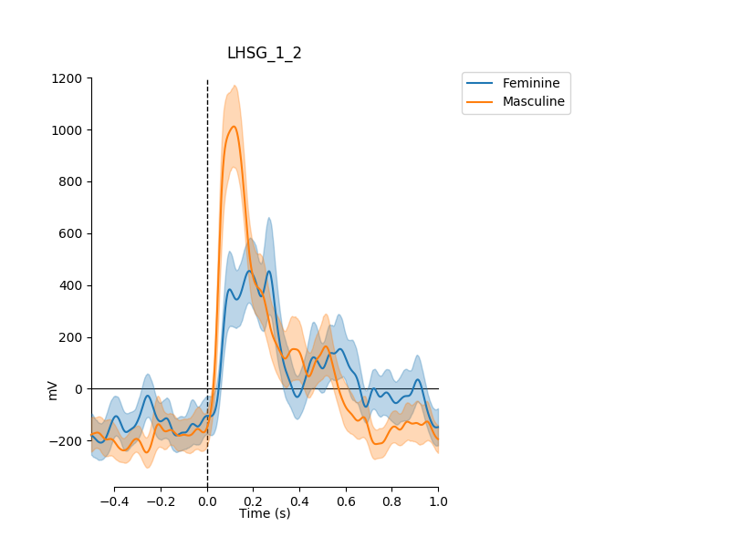
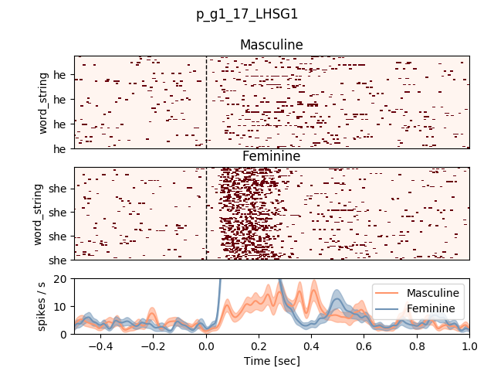
Gender pronouns (Auditory)
Patient 505 LHSG (Heschel)
The ‘sh’ neuron
I’ve sent previously
Spikes
High-gamma micro
High-gamma macro

Slide 10
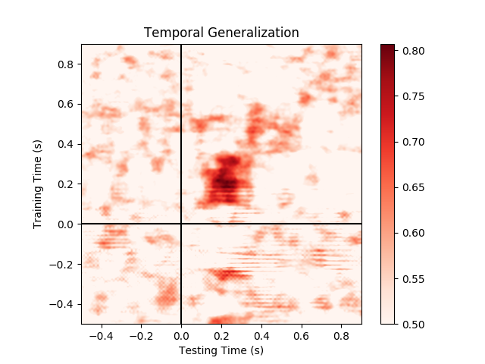
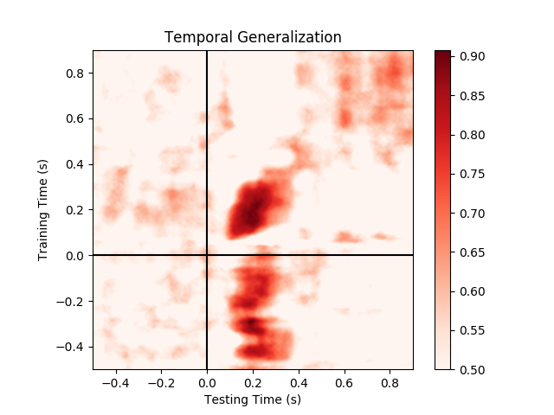
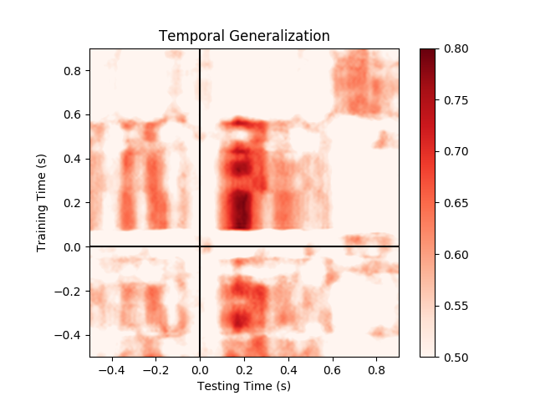



Gender pronouns (Auditory)
Patient 479 LSTG
Spikes
High-gamma micro
High-gamma macro

Slide 11






Gender nouns (Auditory)
Patient 479 LSTG
Spikes
High-gamma micro
High-gamma macro

Slide 12



Gender pronoun-to-nouns (Auditory)
Patient 479 LSTG
Generalization from pronouns to nouns,
For example, ‘He ..’ vs. ‘She..’ to ‘The boy..’ vs. ‘The girl..’
Compare with the two previous slides
Spikes
High-gamma micro
High-gamma macro

Slide 13






Nouns vs. verbs (Auditory)
Patient 479 LSTG
Selective to /b/ (?)
This is the same unit as in the gender contrast
Spikes
High-gamma micro
High-gamma macro

Slide 14






Nouns vs. verbs (Auditory)
Patient 479 RPSTG
Spikes
High-gamma micro
High-gamma macro

Slide 15






Nouns vs. verbs (Auditory)
Patient 482 LSTG
The only unit in this probe
seems to be noisy
Spikes
High-gamma micro
High-gamma macro

Slide 16






Declarative vs. Questions (Auditory)
Patient 479 LSTG
End of sentence
Spikes
High-gamma micro
High-gamma macro

Slide 17






Embedding vs. Long sentences (Auditory)
Patient 479 LSTG
End of sentence
Spikes
High-gamma micro
High-gamma macro

Slide 18

Embedding vs. Long sentences (Auditory)
Patient 479 LSTG – another example of a single unit
End of sentence
Spikes
High-gamma micro
High-gamma macro

Slide 19

Patient 479 LSTG
Channel 11 g3

Slide 20

Patient 502 RFSG
Channel 57 g1

