Slide 1
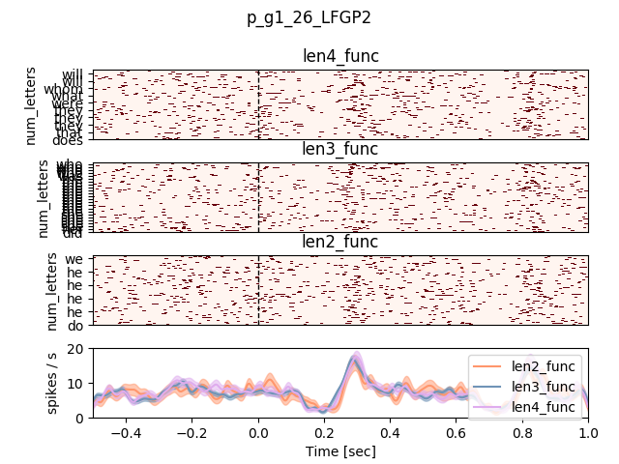
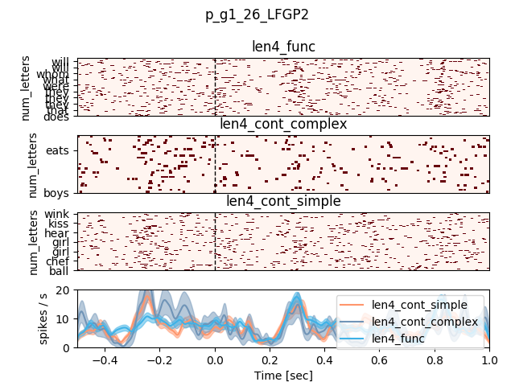
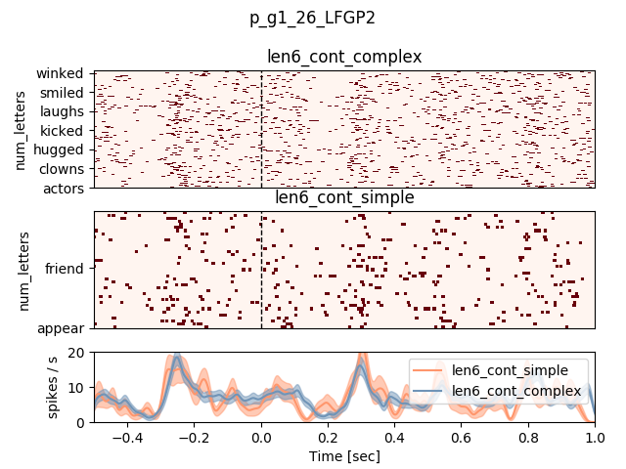
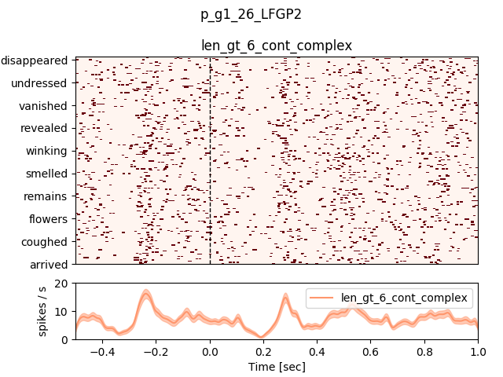
Unit – pt 505, LFGP channel 26, g1
Function words, lengths 2 to 4
Simple/complex/function, length 4
Simple/complex, length 6
Complex, length > 6

Slide 2
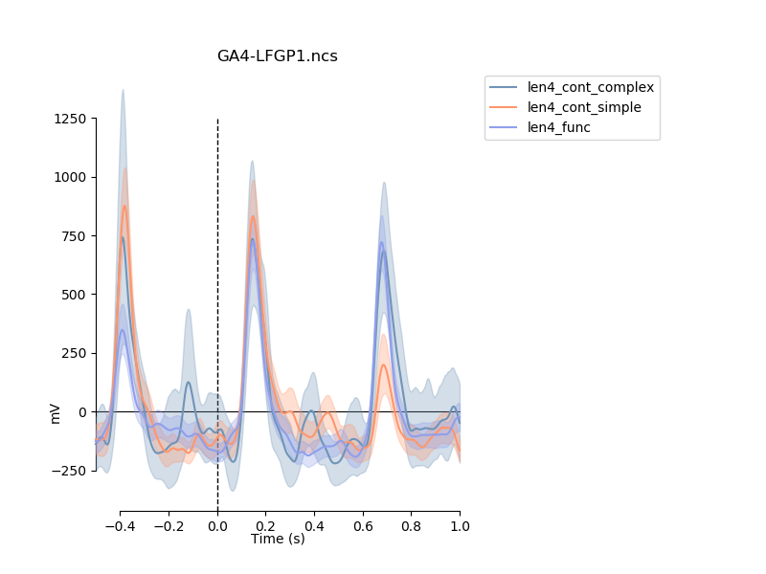
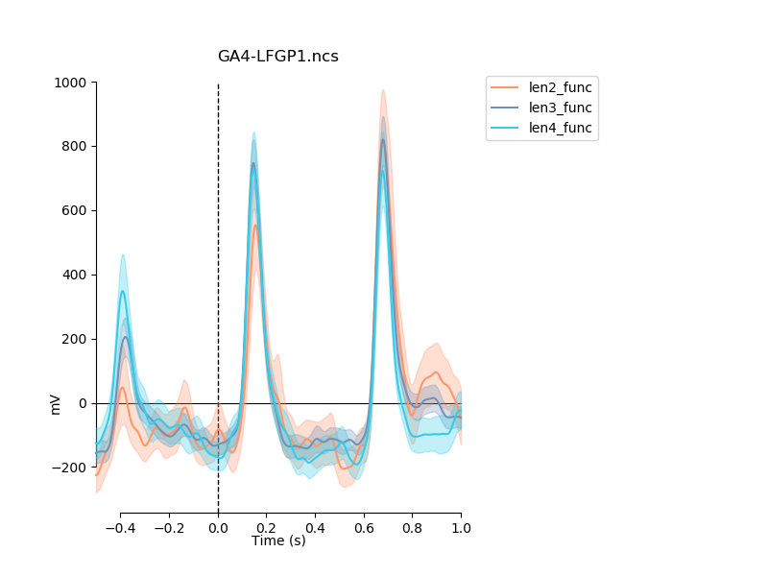
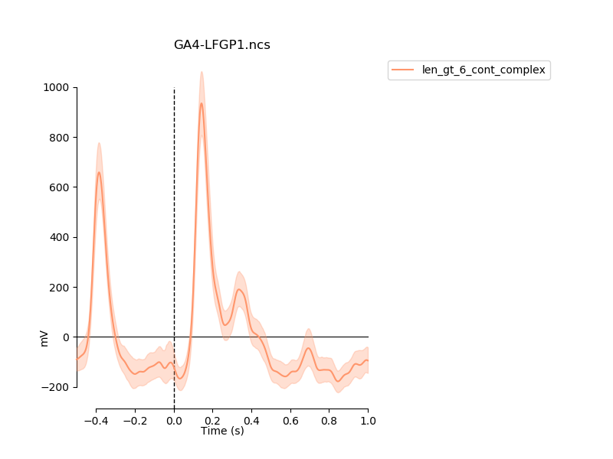
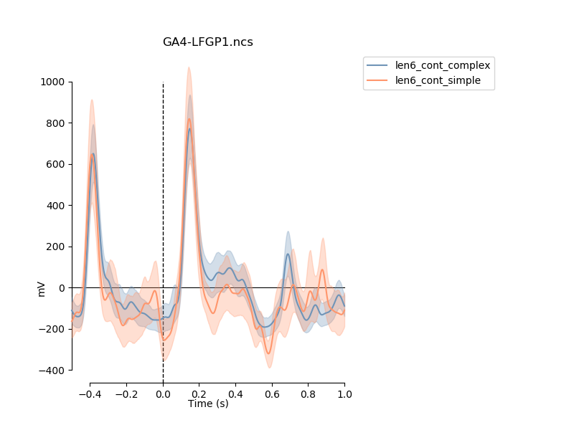
ERSPs micro pt 505, LFGP channel 25
Function words, lengths 2 to 4
Simple/complex/function, length 4
Simple/complex, length 6
Complex, length > 6

Slide 3
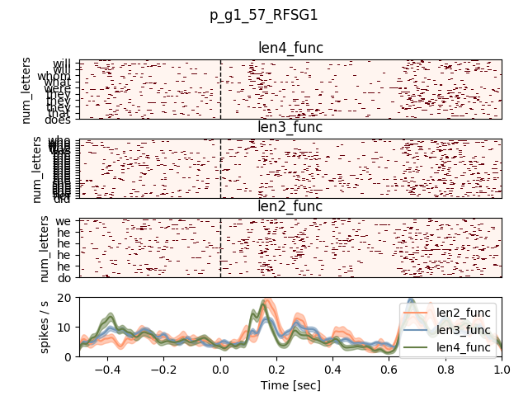
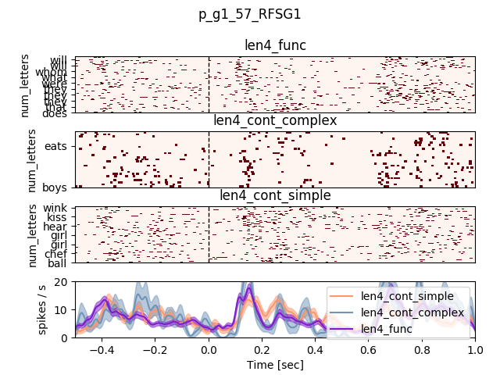
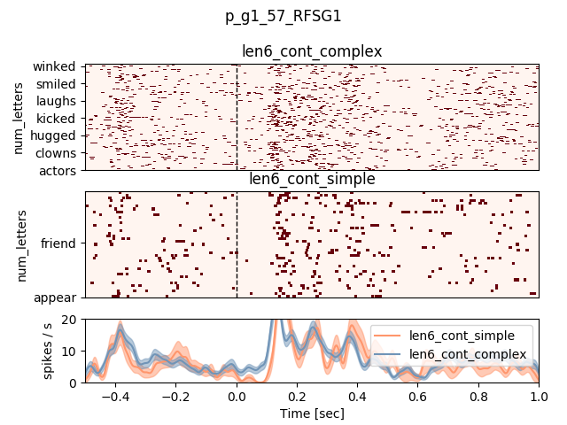
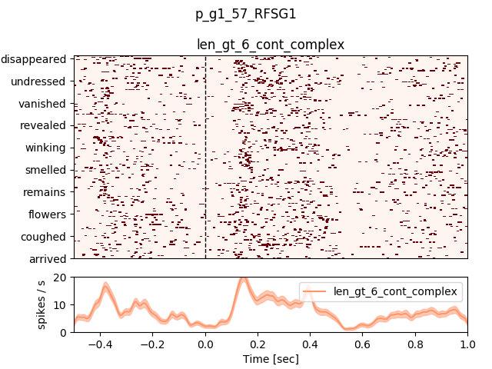
Unit – pt 502, RFSG channel 57, g1
Function words, lengths 2 to 4
Simple/complex/function, length 4
Simple/complex, length 6
Complex, length > 6

Slide 4
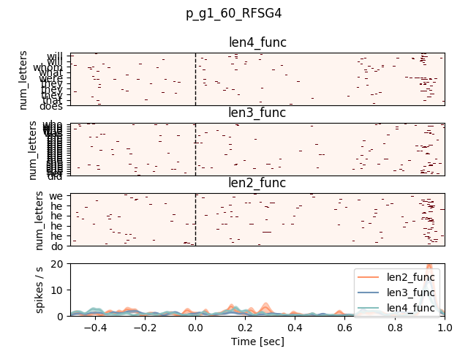
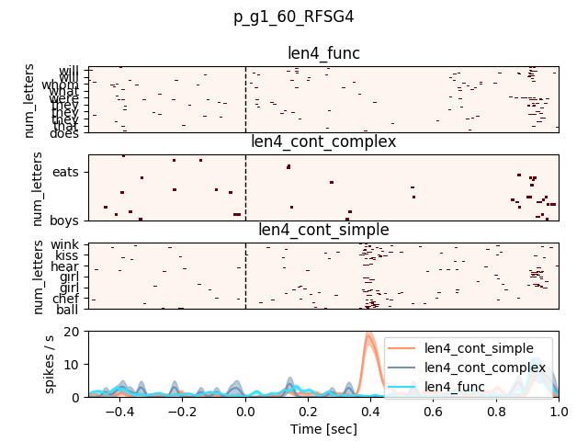
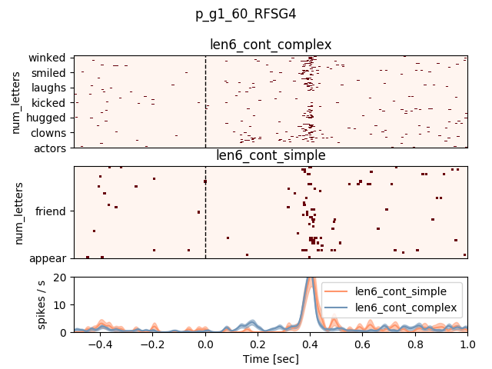
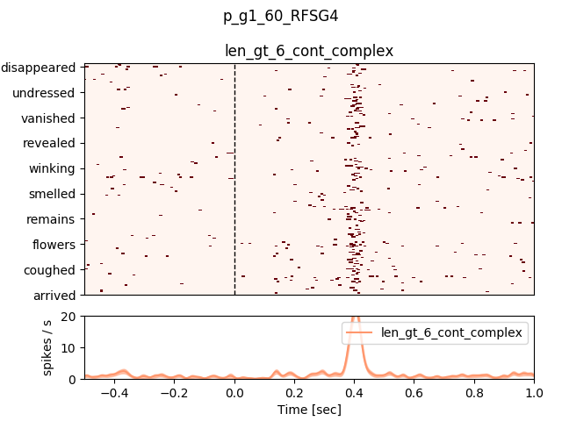
Unit – pt 502, RFSG channel 60, g1
Function words, lengths 2 to 4
Simple/complex/function, length 4
Simple/complex, length 6
Complex, length > 6

Slide 5
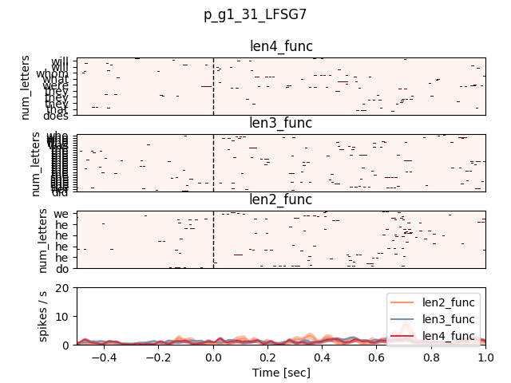
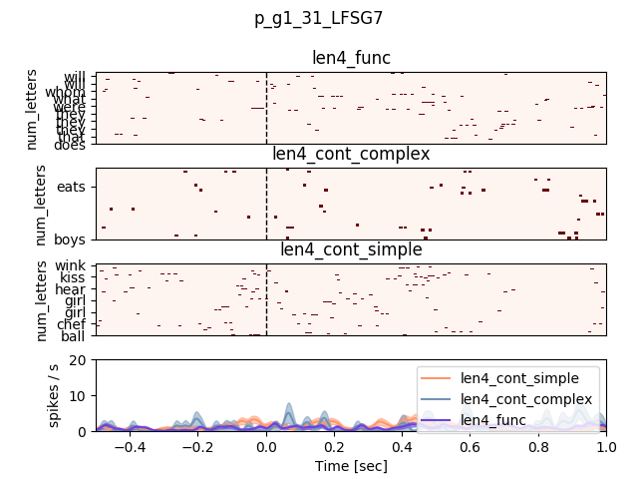
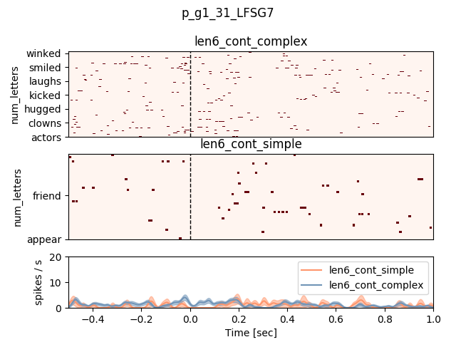
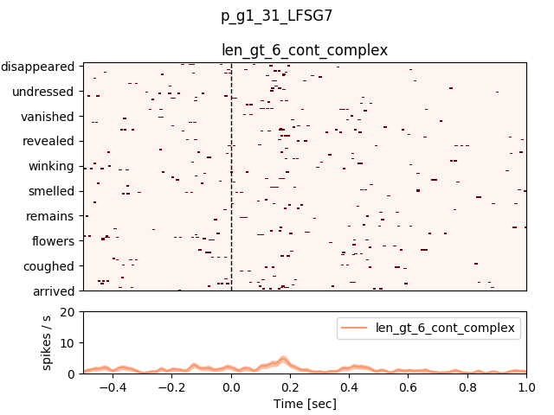
Unit – pt 502, LFSG channel 32, g1
Function words, lengths 2 to 4
Simple/complex/function, length 4
Simple/complex, length 6
Complex, length > 6

Slide 6
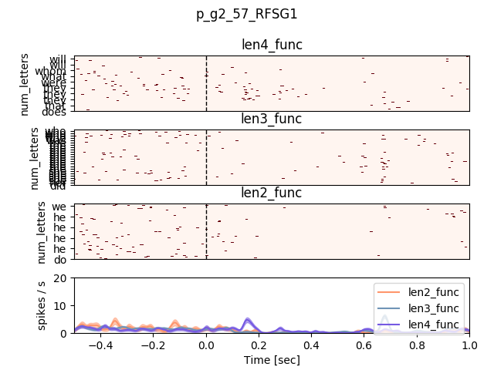
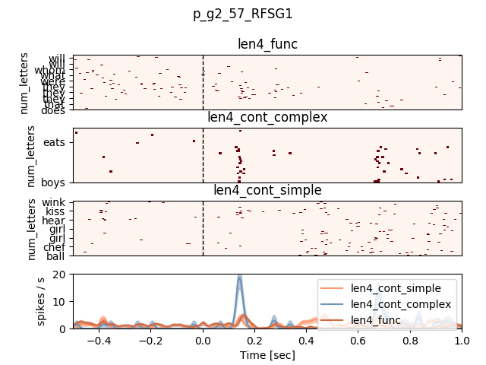
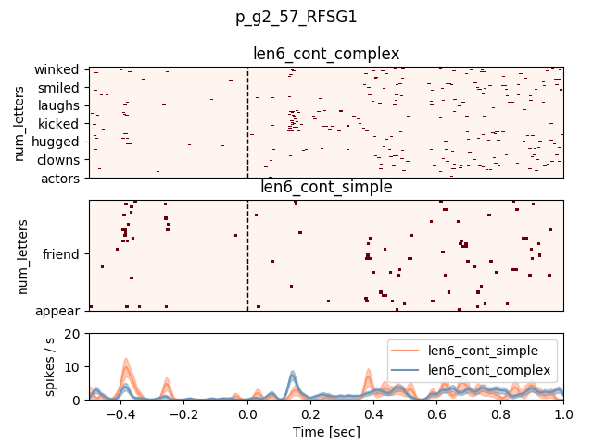
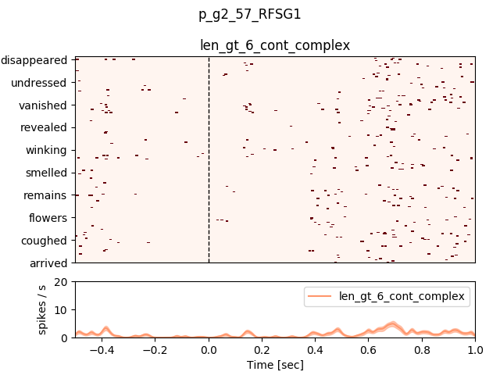
Unit – pt 502, rFSG channel 57, g2
Function words, lengths 2 to 4
Simple/complex/function, length 4
Simple/complex, length 6
Complex, length > 6

Slide 7
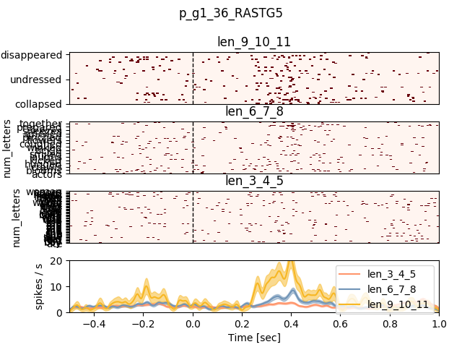
Unit – pt 479, RASTG ch 36, g1

