Slide 1
Examples for effects related to low-level, non syntactic, aspects of the stimuli
Patient 505
Auditory blocks

Slide 2
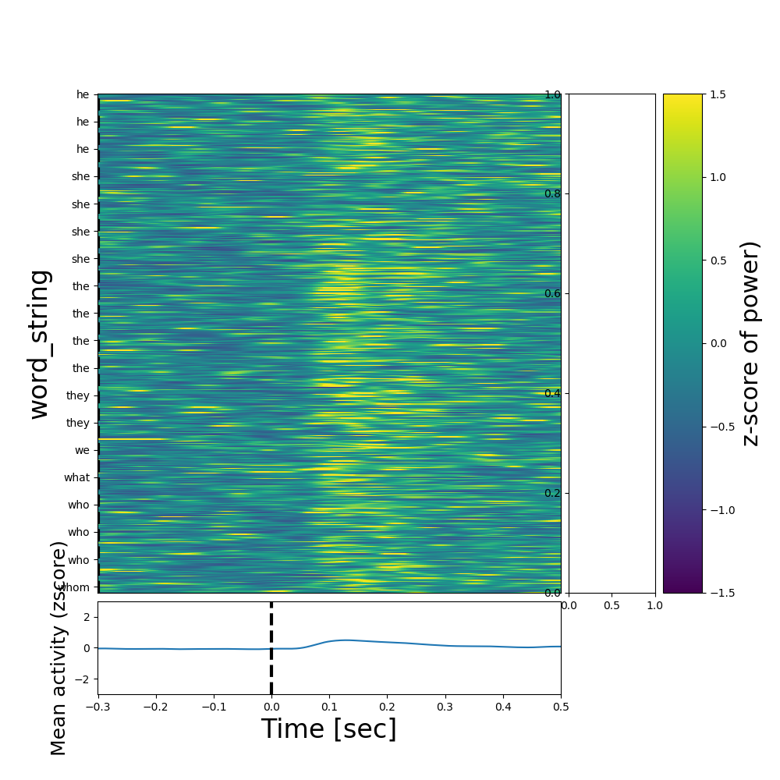
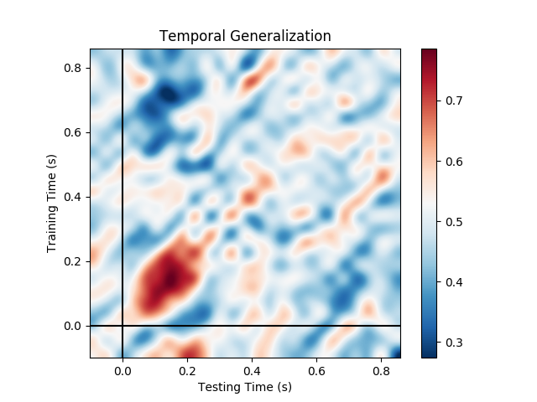
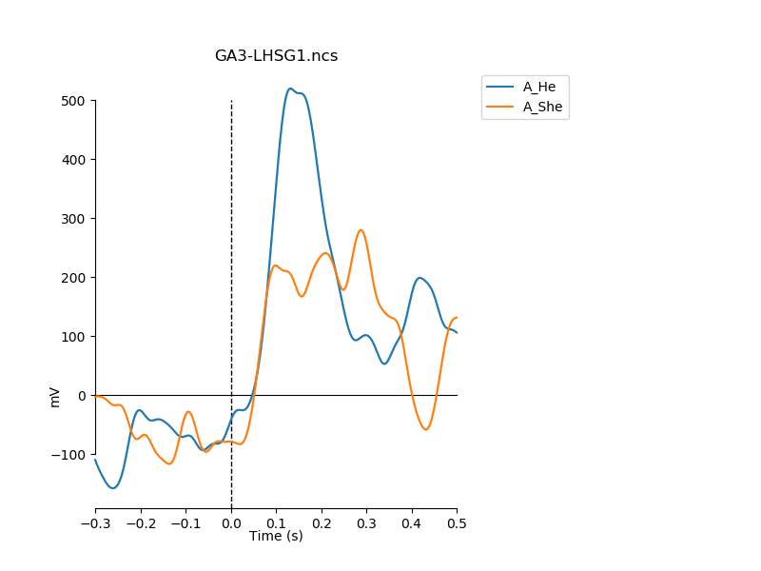
He vs. She (gender pronoun) – left Heschl local high-gamma from micro wires only
All trials sorted according to string of first word
Note the reduced activity after ‘she’
Decoding
(all micros on LHSG probe)
Evoked high-gamma
‘He’ vs. ‘She’
Channel 17

Slide 3
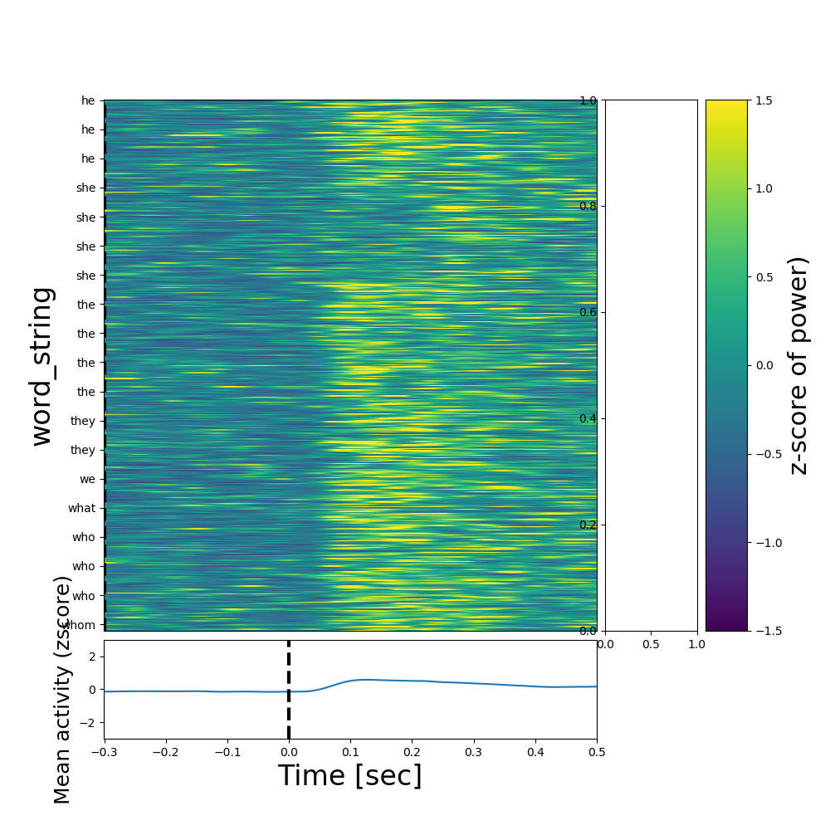
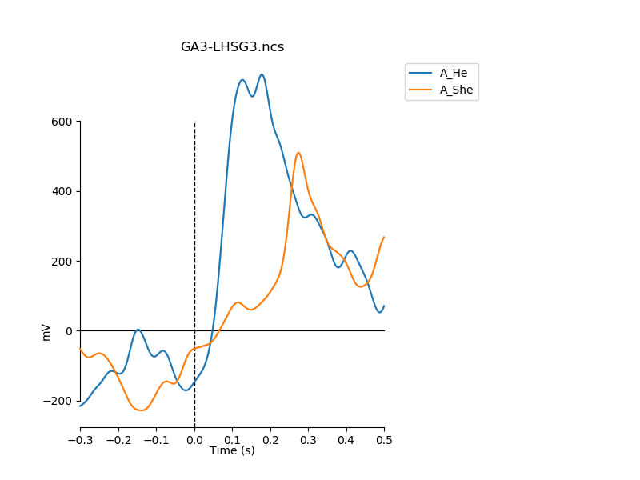
He vs. She (gender pronoun) – left Heschl patient 505 local high-gamma from micro wires only
All trials sorted according to string of first word
Note the reduced activity after ‘she’
Decoding
(all micros on LHSG probe)
Evoked high-gamma
‘He’ vs. ‘She’
Channel 19

Slide 4
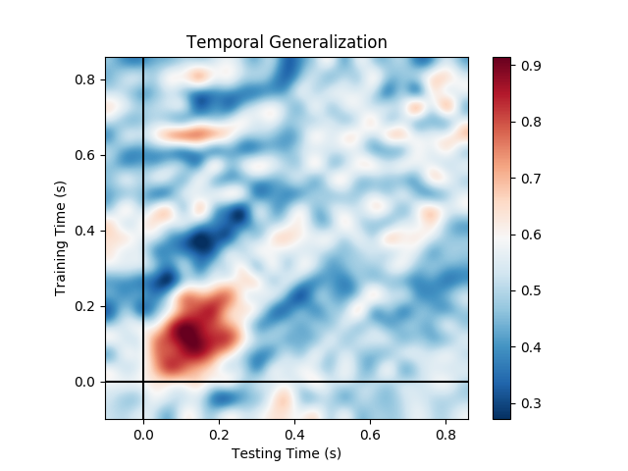
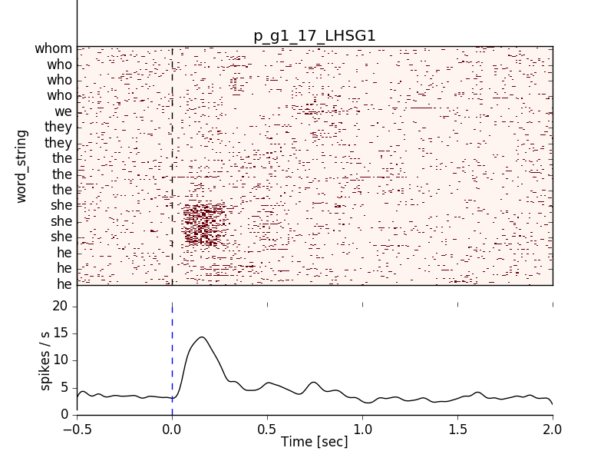
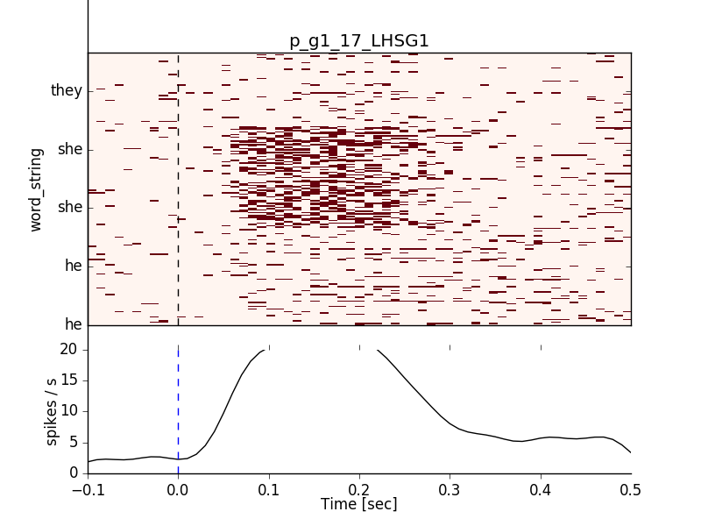
He vs. She (gender of pronoun) – left Heschl patient 505 spikes only
Decoding
(all units on LHSG probe)
All trials sorted according to string of first word
Note the selectivity and increased activity after ‘she’
- The selectivity could be due to the acoustic properties of /S/ in ‘she’. Decoding is thus probably phonologically based.
- reduced high-gamma in this channel (slide 2) may be explained if this is an inhibitory neuron.
Same, for only the pronouns
‘He’ / ‘She’ /’They
Channel 17 – cluster p_g1

Slide 5
Examples for effects related to low-level, non syntactic, aspects of the stimuli
Patient 505
Visual blocks

Slide 6
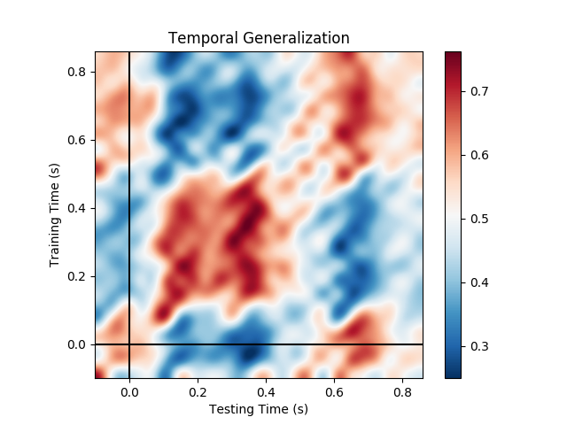
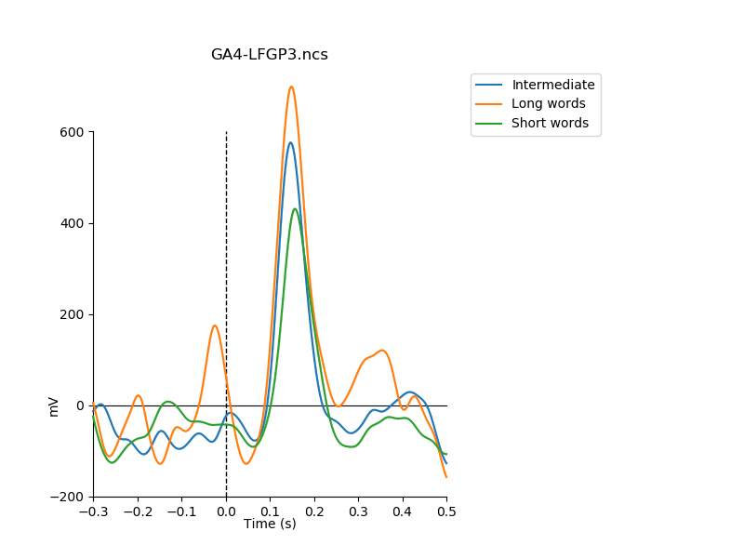
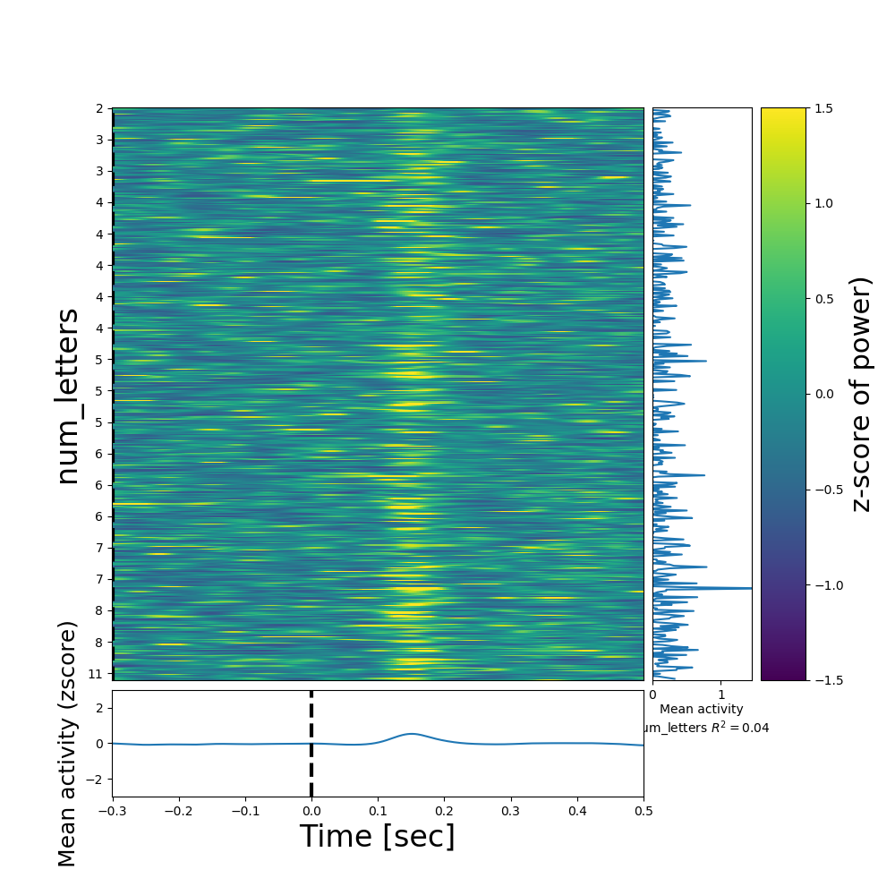
Word length – left posterior fusiform gyrus patient 505 local high-gamma from micro wires only
Decoding from local high-gamma is good. Averaged evoked responses have different profiles (will add STDs and stats later). Note second peak for long words. Regression coefficient is low when taking all values and not only extreme (bottom-right).
Decoding short vs. long
(all micros on LFGP probe)
ESRP, sorted by #letters
Channel 27

Slide 7
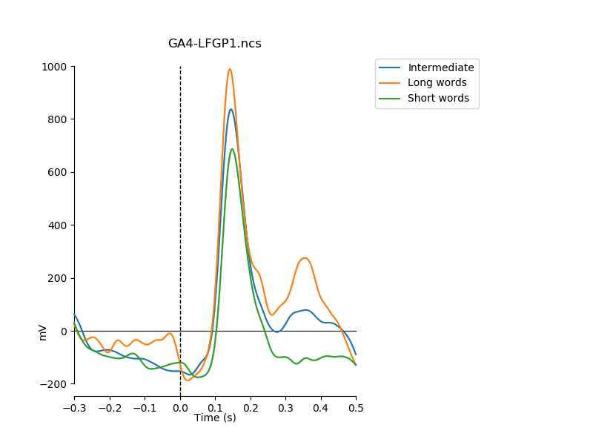
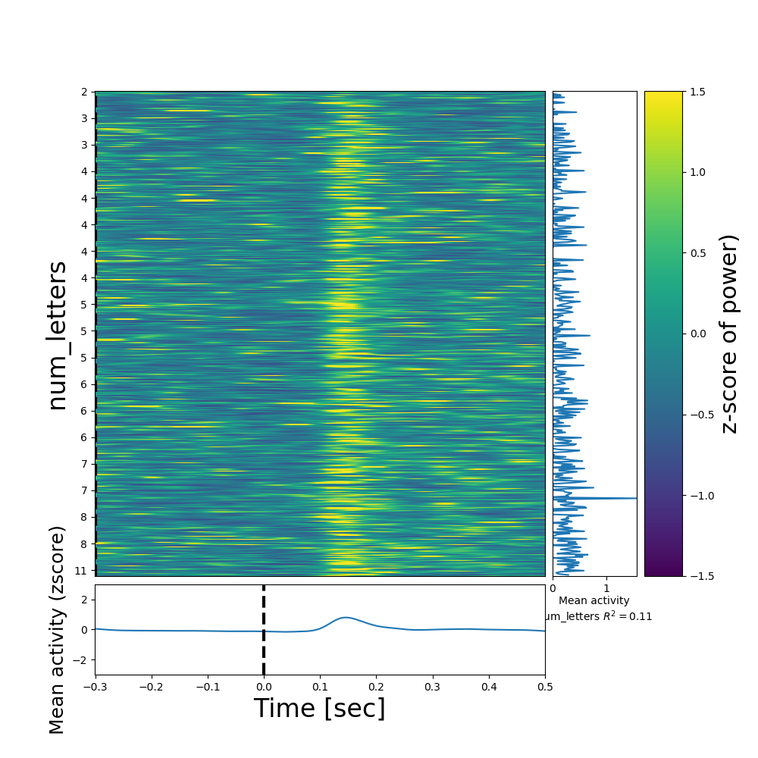
Word length – left posterior fusiform gyrus patient 505 local high-gamma from micro wires only
Decoding from local high-gamma is good. Averaged evoked responses have different profiles (will add STDs and stats later). Note second peak for long words. Regression coefficient is low when taking all values and not only extreme (bottom-right).
Decoding short vs. long
(all micros on LFGP probe)
ESRP, sorted by #letters
Channel 25

Slide 8
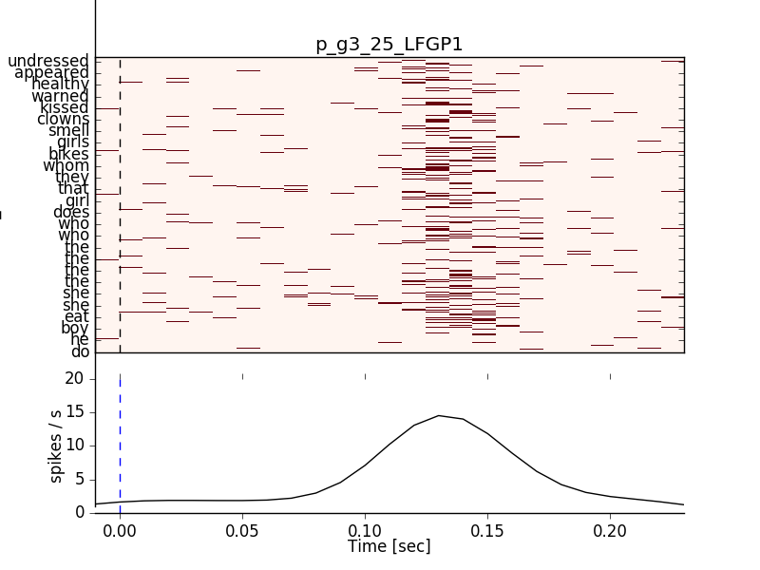
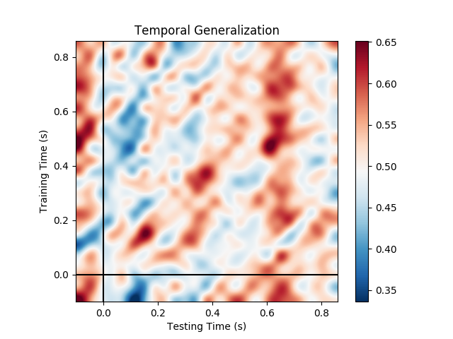
Word length – left posterior fusiform gyrus patient 505 local high-gamma from micro wires only
Decoding from single-unit activity only is low and noisy. There’s also no clear regularity in the corresponding raster.
Decoding short vs. long
(all unit on LFGP probe)
ESRP, sorted by #letters
Channel 25 - p_g3

