Slide 1
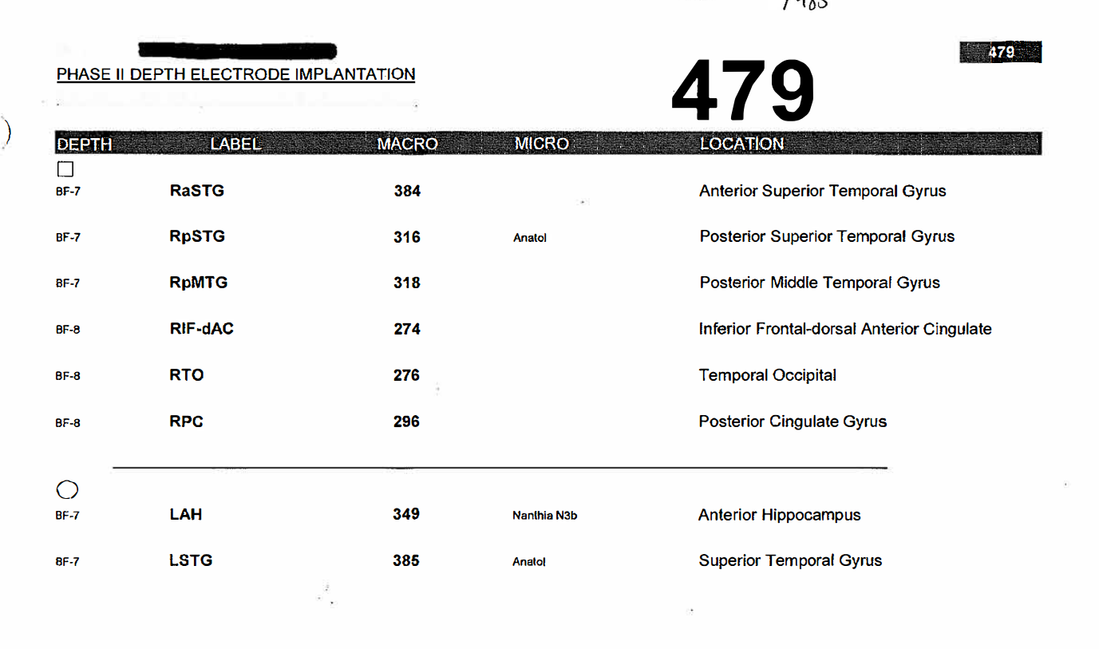
Patient 479
Montage

Slide 2
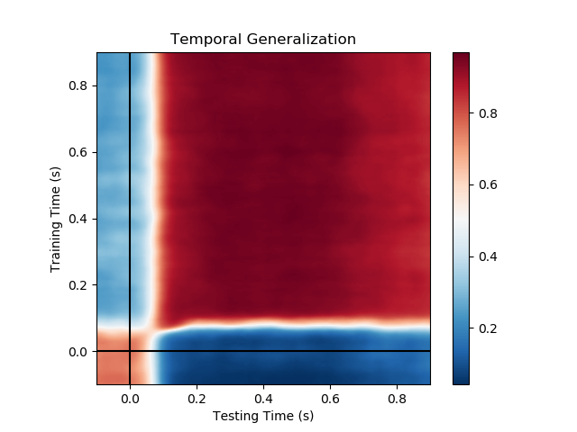
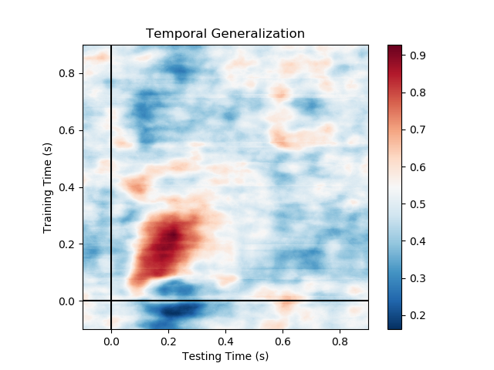
Patient 479
Auditory blocks (basic sanity checks)
First word vs. end of sentence
‘Who’ vs. ‘She’

Slide 3
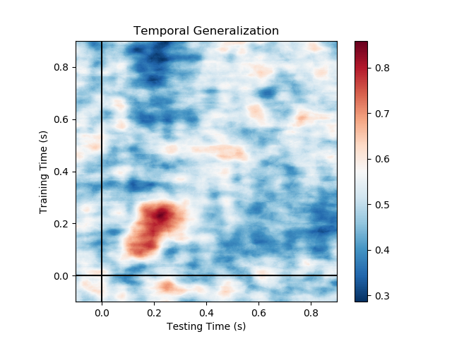
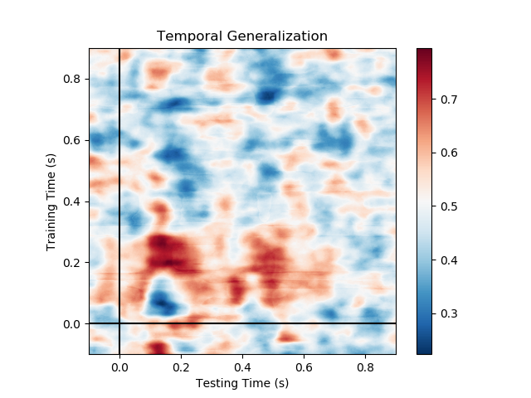
Patient 479
Auditory blocks – gender decoding
Generalization across conditions
Train: ‘he’ vs. ‘she’
Test: ‘boy’ vs. ‘girl’
‘He’ vs. ‘She’

Slide 4
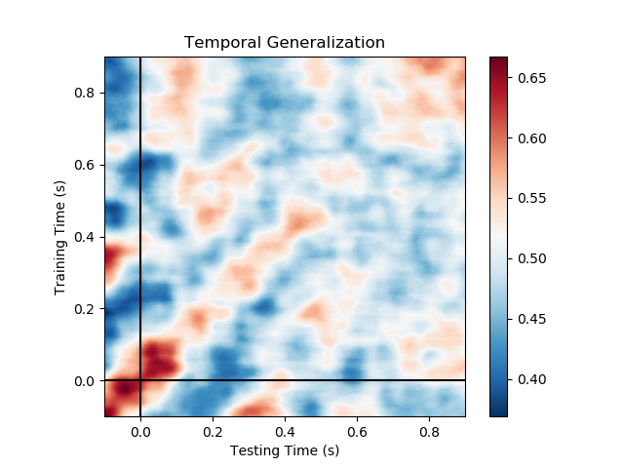
Patient 479
Auditory blocks – part of speech
Nouns vs. Verbs

Slide 5
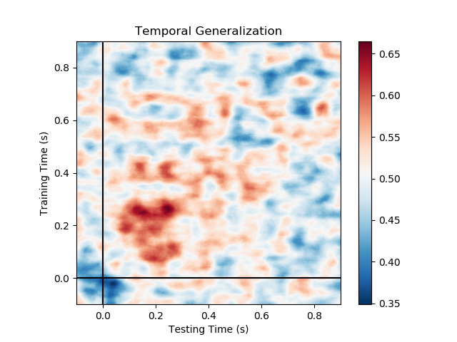
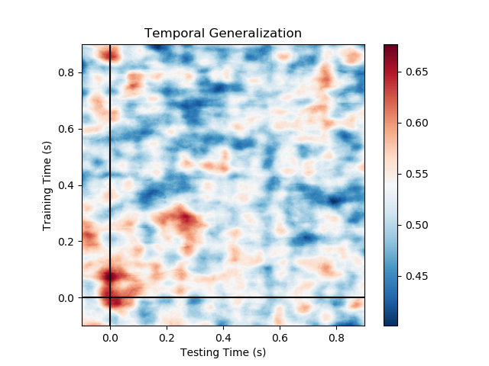
Patient 479
Visual blocks (basic sanity checks)
Short vs. long sentences
(#words=2 vs #words=5)
Aligned to end of sentence
Short vs. long words

Slide 6
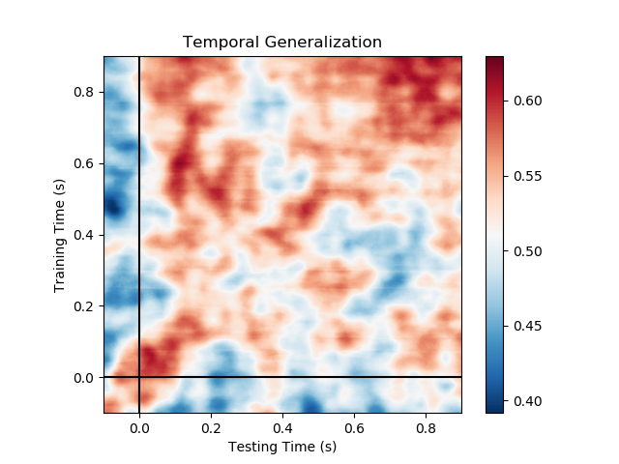
Patient 479
Visual blocks – part of speech
Nouns vs. Verbs

Slide 7
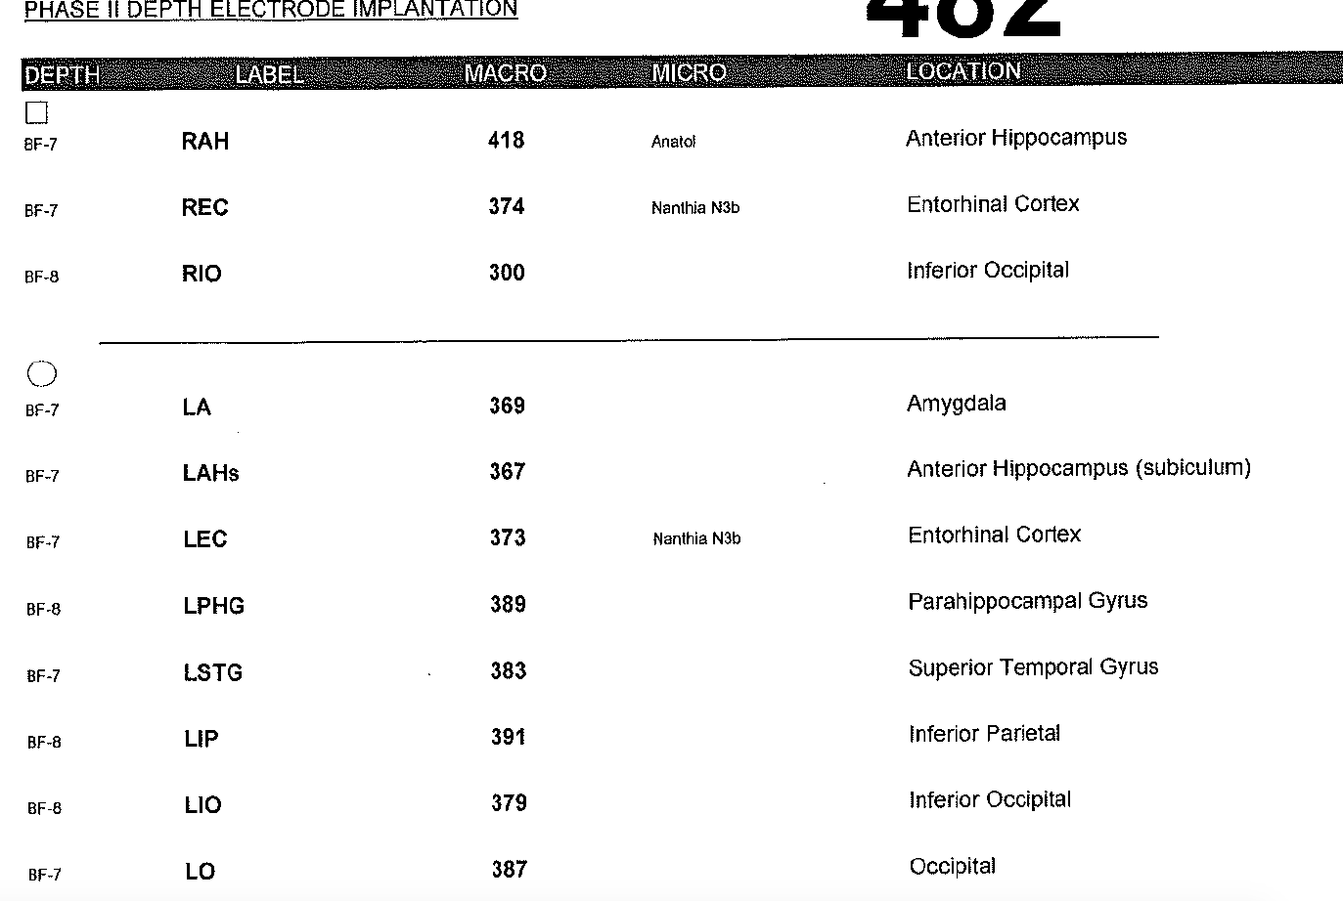
Patient 482
Montage

Slide 8
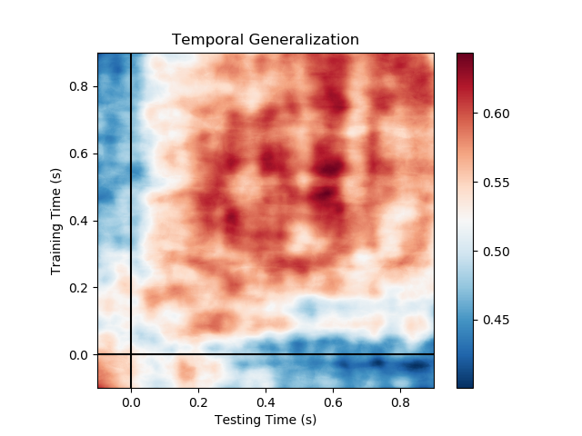
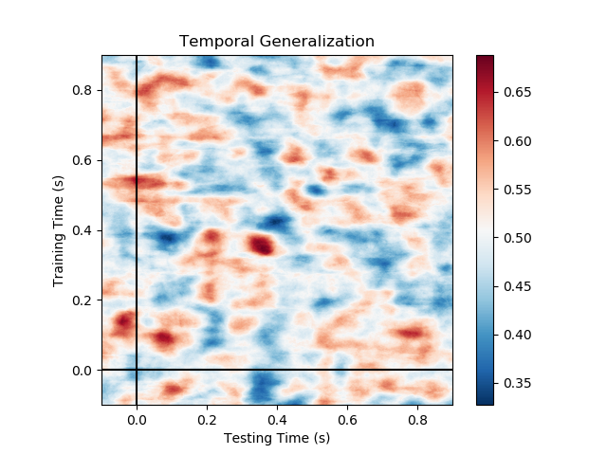
Patient 482
Auditory blocks (basic sanity checks)
First word vs. end of sentence
‘Who’ vs. ‘She’

Slide 9
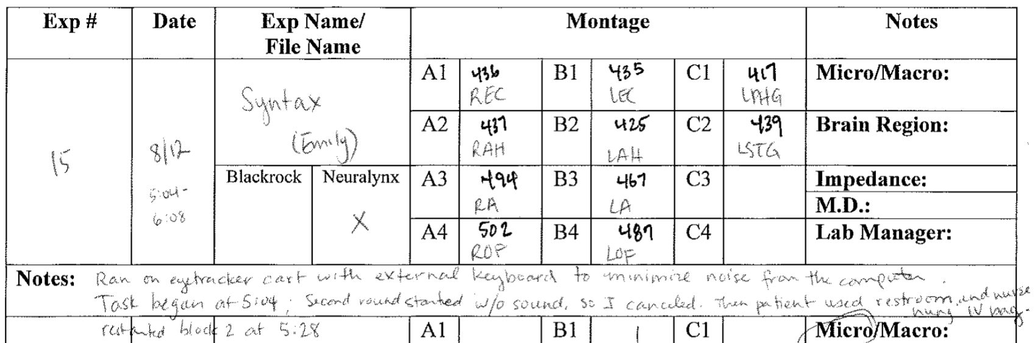
Patient 487
Montage
Ran on eyetracker cart with external keyboard to minimize noise from the computer. Task began at 5:03. Second round started without sound so I canceled. Then patient used restroom and nurse hung IV bag.

Slide 10
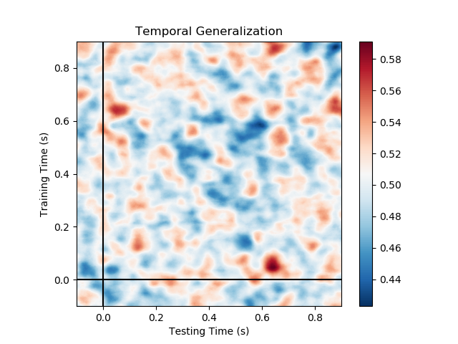
Patient 487
Auditory blocks (basic sanity checks)
First word vs. end of sentence
Fails sanity check

Slide 11
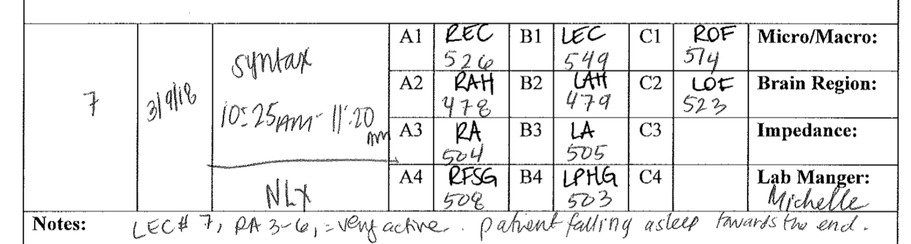
Patient 493
Montage
Patient falling asleep towards the end
No STG electrodes

Slide 12
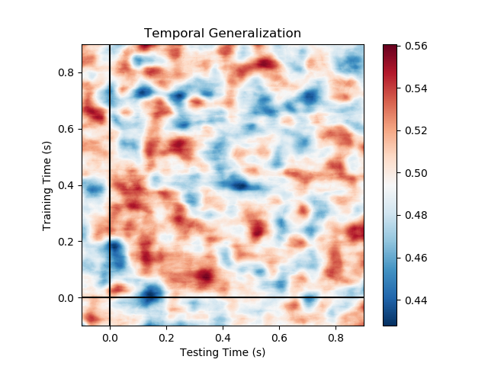
Patient 493
Auditory blocks (basic sanity checks)
First word vs. end of sentence
Fails sanity check

