Slide 1
A brief introduction of DSPE
Basic git operations
Branch management
Setup a dev environment

Slide 2
Basic git operations
git clone
git branch -a
git checkout branchname
git pull
git checkout –b newbranchname --checkout a newbranch to start work
git status
git add –A
git commit –m “commit message”
git push -u origin featureA --push local branch to remote
create a merge request --use gitlab merge featureA to develop
git branch –d featureA --delete local featureA
git push origin -d featureA --delete remote featureA

Slide 3
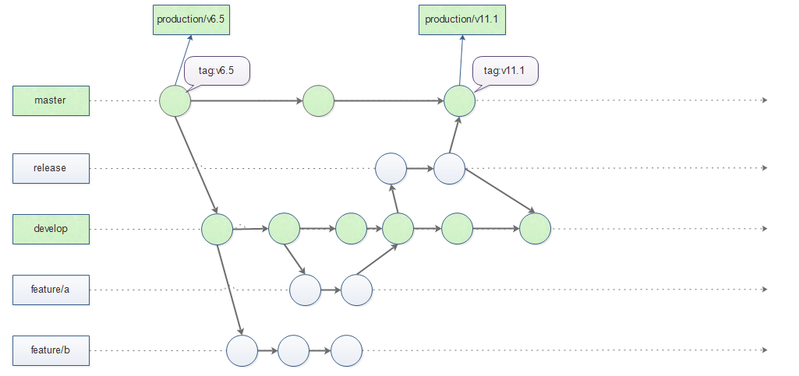
Branch management

Slide 4
How to setup a dev environment quickly
Configure nuget package manager
https://repo.openearth.community/artifactory/api/nuget/optdspedev-nuget
Copy a full dspe package to dev environment
Download code from gitlab
Check the project references path
Create a solution for projects
Change build configuration to [Release], and add existing projects
build

Slide 5
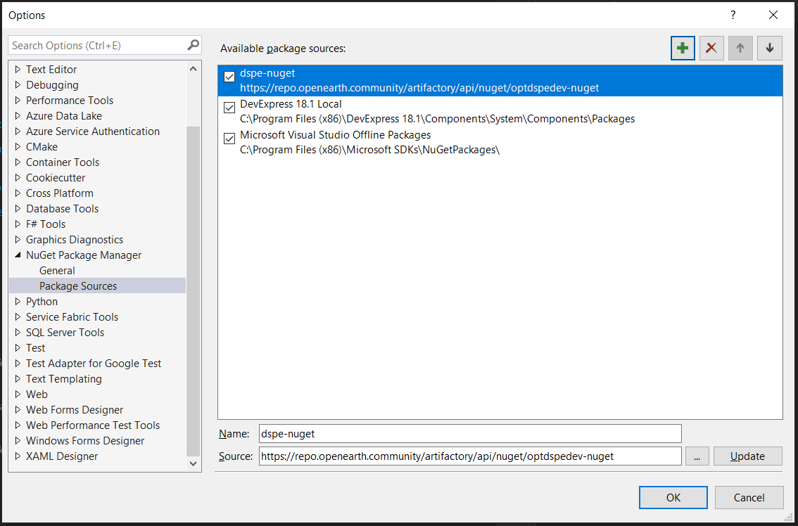
DSPE Nuget config

Slide 6
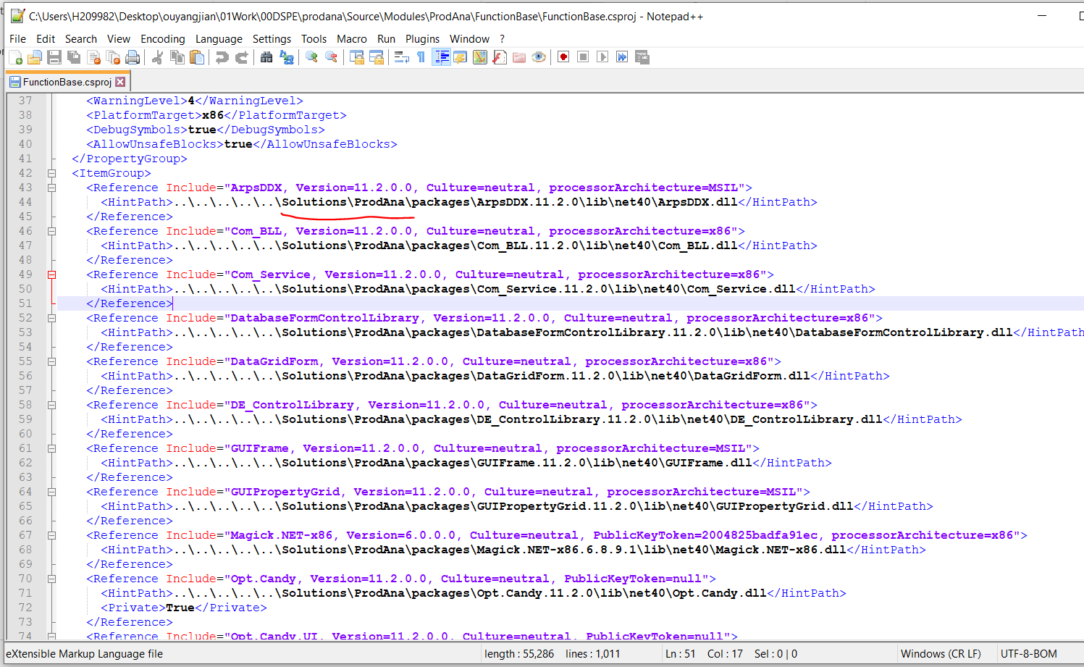
Check project dll references

Slide 7
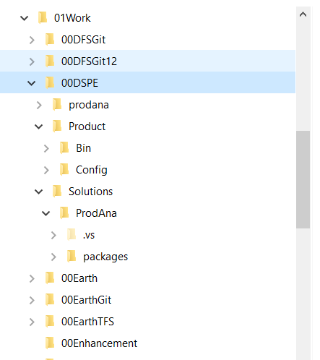
Folder structure
Source code
All Librarys
Config:language,icons,parameters,templates…
VS solution
Nuget packages

Slide 8
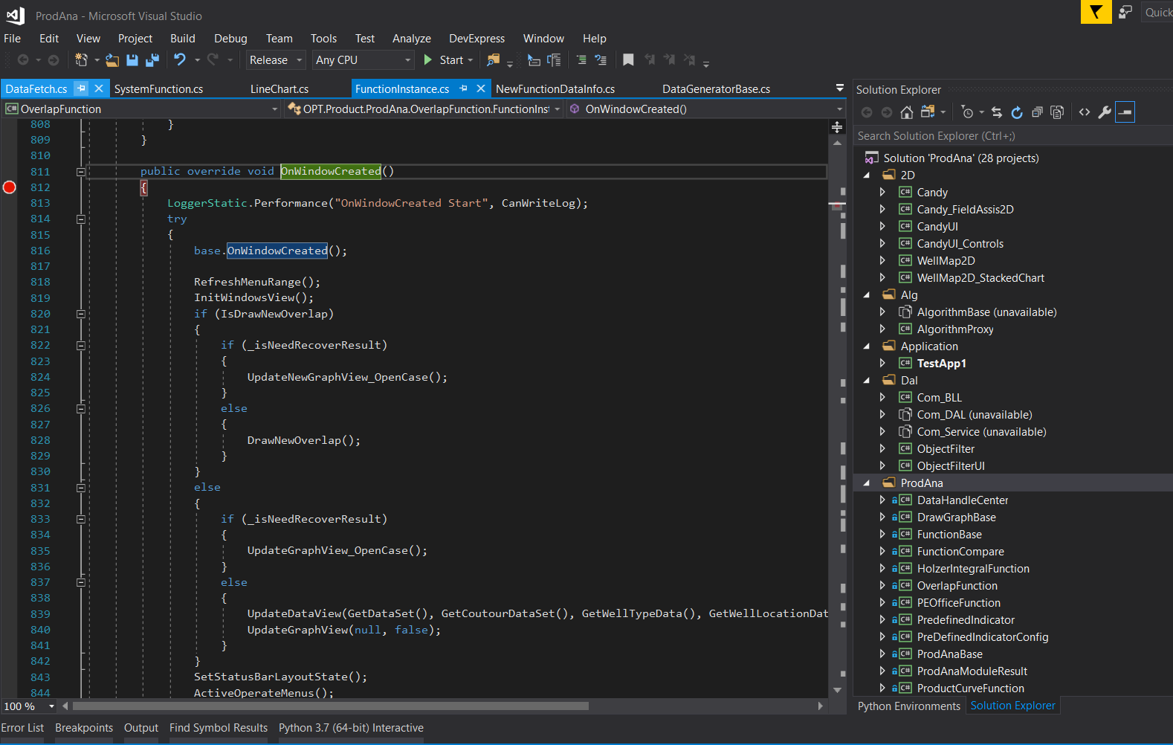
Folder structure
Release

