Slide 1
DSPDM Schema Design

Slide 2
Metadata architecture diagram
UI
Function
ViewModel file
1
# | Features | Remark
1 | Dspdm-MetaData Design Structure | See page 3 for details
2 | Adaptor Mapping file configuration | See page 4 for details
3 | Client organization object model structure saved as a sample file | See page 5 for details
4 | Client organization object model saved as a model configuration file example | See page 6 for details
Metadata
Entity_Metadata/
Mandatory_Metadata
4
3
Model relationship
Model relationship
file
1
Model relationship
Metadata
Entity_Metadata/
Mandatory_Metadata
JDBC API
Adaptor
2
1
Adaptor Mapping file
Metadata
Entity_Metadata/
Mandatory_Metadata
VDB Adaptor
PostgreSQL Adaptor
Oracle Adaptor
Other Adaptor
DSIS Service
VDB
Database service
1
PostgreSQL
Oracle
Other
Metadata
[Entity_Metadata/
Mandatory_Metadata]
Model
Model
Model

Slide 3
Metadata architecture diagram
UI
Function
ViewModel file
1
# | Features | Remark
1 | Dspdm-MetaData Design Structure | See page 3 for details
2 | Adaptor Mapping file configuration | See page 4 for details
3 | Client organization object model structure saved as a sample file | See page 5 for details
4 | Client organization object model saved as a model configuration file example | See page 6 for details
Metadata
Entity_Metadata/
Mandatory_Metadata
4
3
Model relationship
Model relationship
file
1
Model relationship
Metadata
Entity_Metadata/
Mandatory_Metadata
DSDS Odata API
VDB
VDB
Database service
Oracle
Other
1
PostgreSQL
Metadata
[Entity_Metadata/
Mandatory_Metadata]
Model
Model
Model

Slide 4
Metadata hierarchy diagram
1.3
UI
Function
ViewModel file
Metadata
Entity_Metadata/
Mandatory_Metadata
# | Features | Remark
1 | Dspdm-MetaData Design Structure | See page 3 for details
1.1 | Adaptor Mapping file configuration | See page 4 for details
1.2 | Client organization object model structure saved as a sample file | See page 5 for details
1.3 | Client organization object model saved as a model configuration file example | See page 6 for details
Business Objects (Model relationship）
1.2
Model relationship
Model relationship
file
Metadata
Entity_Metadata/
Mandatory_Metadata
JDBC API
1.1
Adaptor
Adaptor Mapping file
Metadata
Entity_Metadata/
Mandatory_Metadata
VDB Adaptor
PostgreSQL Adaptor
Oracle Adaptor
Other Adaptor
DSIS Service
VDB
1
Database service
PostgreSQL
Oracle
Other
Metadata
[Entity_Metadata/
Mandatory_Metadata]
Model
Model
Model

Slide 5
Metadata hierarchy diagram
1.3
UI
Function
ViewModel file
Metadata
Entity_Metadata/
Mandatory_Metadata
# | Features | Remark
1 | Dspdm-MetaData Design Structure | See page 3 for details
1.1 | Adaptor Mapping file configuration | See page 4 for details
1.2 | Client organization object model structure saved as a sample file | See page 5 for details
1.3 | Client organization object model saved as a model configuration file example | See page 6 for details
Business Objects (Model relationship）
1.2
Model relationship
Model relationship
file
Metadata
Entity_Metadata/
Mandatory_Metadata
“PPDM-based” PDMaaS VDB = default
1
Database service
PostgreSQL
Oracle
Other
Metadata
[Entity_Metadata/
Mandatory_Metadata]
Model
Model
Model

Slide 6
Metadata hierarchy diagram
1.3
UI
Function
ViewModel file
Metadata
Entity_Metadata/
Mandatory_Metadata
# | Features | Remark
1 | Dspdm-MetaData Design Structure | See page 3 for details
1.1 | Adaptor Mapping file configuration | See page 4 for details
1.2 | Client organization object model structure saved as a sample file | See page 5 for details
1.3 | Client organization object model saved as a model configuration file example | See page 6 for details
Business Objects (Model relationship）
1.2
Model relationship
Model relationship
file
Metadata
Entity_Metadata/
Mandatory_Metadata
“PPDM-based” PDMaaS VDB = default
1
Database service
PostgreSQL
Oracle
Other
Metadata
[Entity_Metadata/
Mandatory_Metadata]
Model
Model
Model

Slide 7


Dev
1
# | Features
1 | Implementation of Well data through all tiers for Create/Read
2 | Extend UI Components to other reusable data entities from UI Repository
3 | Extend data model to support more entities
4 | Provide UD(Update/Delete) considering exclusive access
5 | Security service (DSIS Security Server) to provide authentication and simple roles/groups
6 | Provide Unit Conversion service (Metric, British conversion) . Use or extend DSIS unit service.
7 | Provide validation service -Validation of data integrity, correctness, etc.
8 | Provide Calculation service -Function calculation, calculated domain object attributes, etc.
9 | Postgresql(Can use Adapter connection or VDB connection
10 | Service storing domain objects (from DFS)
11 | Service providing language and regionalization support
Customer Projects
DSPDM
Data Browser
DropSite for PDM
Other DS Applications (DSPI, DFS, etc)
2
12
External Access Application Interface Development
DSIS WF + Security
3
4
Externally Provided WebAPI Interface
PDMaaS
PDMaaS Restful API
Data object integration validation
Rules: Business Objects or data types to build Presentation DM dynamically, to add attributes and business objects over time when needed
(ie. Base model + extension)
DSIS Services + new Services
7
5
1.1
Validation
Metadata
Entity_Metadata/
Mandatory_Metadata
8
11
Data cache, designed according to actual needs [to be determined]
Calculations
Authorization
6
10
Unit Conversion
Localization
Adapters for different data sources, combined Data Module
“Presentation DM” VDB or Options
DSIS platform VDB object
Data Storage
Metadata
[Entity_Metadata/
Mandatory_Metadata]
1
VDB or Options
9
Source Database(s) – pan-database model
Postgresql Oracle Other Database

Slide 8
PDMaaS
1
# | Features
1 | Implementation of Well data through all tiers for Create/Read
2 | Extend UI Components to other reusable data entities from UI Repository
3 | Extend data model to support more entities
4 | Provide UD(Update/Delete) considering exclusive access
5 | JDBC Plugin for fast query and computation within the MSP; Need to provide generic JDBC plugin
6 | Provide Unit Conversion service (Metric, British conversion) . Use or extend DSIS unit service.
7 | Provide validation service -Validation of data integrity, correctness, etc.
8 | Provide Calculation service -Function calculation, calculated domain object attributes, etc.
9 | Postgresql(Can use Adapter connection or VDB connection
10 | Service storing domain objects (from DFS)
11 | Service providing language and regionalization support
Customer or Service OEC Projects
DSPDM
Data Browser
DropSite for PDM
Other DS App (DSPI, DFS, etc)
2
12
External Access Application Interface Development
DSIS WF + Security
4
Externally Provided WebAPI Interface
PDMaaS
PDMaaS Restful API
Data object integration validation
DSDS Services
Configuration??
7
5
JDBC Plugin
Validation
8
11
Data cache, designed according to actual needs [to be determined]
Data hierarchy
Calculations
Authorization
6
10
Unit Conversion
Localization
Adapters for different data sources, combined Data Module
3
“Presentation DM” VDB
R1
DSIS platform VDB object
Data Storage
Metadata
[Entity_Metadata/
Mandatory_Metadata]
Custom Data Model: Business Objects or data types to build Presentation DM dynamically, to add attributes and business objects over time when needed
(ie. Base model + extension)
M1
9
Source Database(s) – pan-database model
Postgresql Oracle Other Database
Presentation DM derived from “Storage DM”
(Need manual update VDB and PDB for new attributes and Entities)

Slide 9
Dspdm-MetaData Design Structure
1. Dspdm-metadata Design
2. Metadata Data example
3. Model data example
Entity_Metadata
Entity_ID | Entity_Name
1 | Well
2 | Area
well
well_id | area_id | well_name | whipstock_depth | water_depth_datum
1 | 1 | w1 | 10.25 | wdd1
2 | 1 | w2 | 9.85 | wdd2
3 | 2 | w3 | 11.88 | wdd3
4 | 3 | w4 | 22.33 | wdd4
5 | 5 | w5 | 44.66 | wdd5
6 | 5 | w6 | 22.11 | wdd6
7 | 6 | w7 | 33.33 | wdd7
1
Attribute_Metadata
Attribute_ID | Entity_ID | Attribute_Name | Color_Code | Default_Unit
1 | 1 | well_id
2 | 1 | well_name
3 | 1 | whipstock_depth | #FFFFFF | Mpa
4 | 1 | water_depth_datum | #FFF68F | Mpa
5 | 1 | base_depth | #FFC1C1 | Mpa
6 | 1 | well_status
7 | 1 | uwi
8 | 2 | area_id
9 | 2 | area_name
10 | 2 | area_type
11 | 2 | parent_area_id
12 | 2 | parent_area_name
13 | 2 | r_area_type_id
14 | 2 | r_area_level
15 | 2 | area_level_name
area
area_id | area_name | parent_area_id | area_type
1 | a1 |  | at_1
2 | a2 |  | at_2
3 | a3 | 1 | at_3
4 | a4 | 2 | at_4
5 | a5 | 4 | at_5
6 | a6 | 4 | at_6
7 | a7 | 5 | at_7
2
explanation
Object information. For example: well, area
Object structure information. For example: Well_Id, Well_Name…

Slide 10
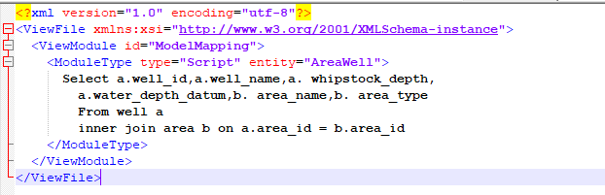
Adaptor Process
1. Adaptor Mapping file configuration
2. Adaptor assembles scripts based on incoming properties
When the client defines the display time model,
it also provides the data source script,
and the model creation is saved to the database.

Slide 11
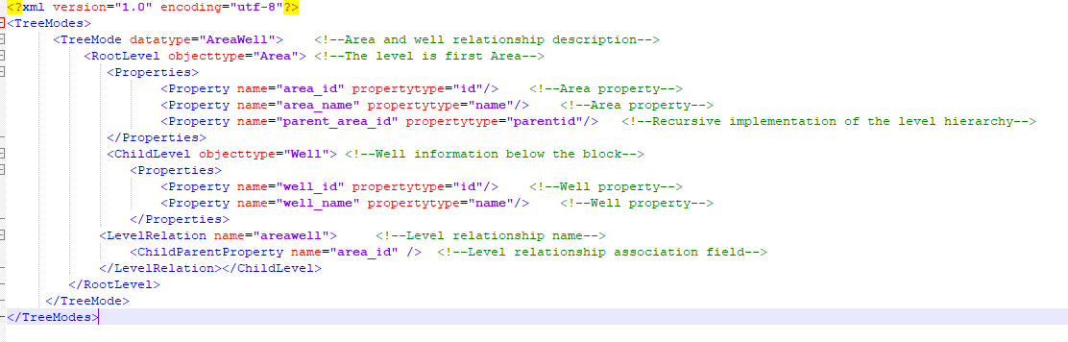
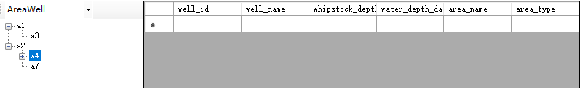
Model relationship
1. Client organization object model structure saved as a sample file
2. Example of presenting data based on client object model structure

Slide 12
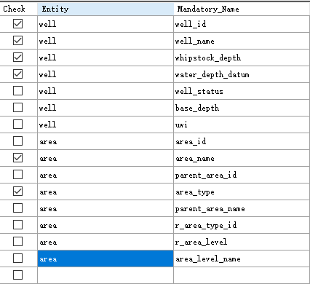
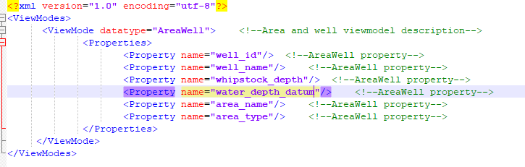


ViewModel display configuration
1. Client organization object model example
2. Client organization object model saved as a model configuration file example
3. Client data display
Choose a1
Choose a3

