Slide 1
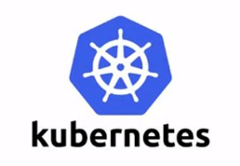
Kubernetes
Peihu Wang
25-Feb-2021

Slide 2
Outline
Introduction (20m)
Practice (40m)

Slide 3
Why we need Kubernetes ?
Operator
Break your sweet dream when server down or service not available in the midnight
Discrepant environment, dependency, port conflict
Migrate new environment
Developer & QA
Need to debug multi environments (dev, qa, integration, pre-production, production)
Difficult to deployment, rollback, canary release

Slide 4
History
2004~2007
Google
Container
2013.03
Docker Project Publish
2014.06
Kubernetes Project
Publish
2015.07
CNCF(Cloud Native Foundation)
Kubernetes

Slide 5
Kubernetes Architecture
Distributed
Local Persistent
Key-Pair DB
Receive scheduler task
Dispatch task to suitable node
kubectl
dashboard
Interact with docker engine to create docker container
Sustain container Lifecyle
Master
etcd
Scheduler
Control # of replica set
api server
Node3
Replication
Controller
kubelet
Kube proxy
pod
container
pod
container
container
container
All actions Entry
Node1
Node2
Apply rules to IPTABLES or IPVS to map service ->pod communication
kubelet
Kube proxy
kubelet
Kube proxy
pod
container
pod
container
pod
container
pod
container
container
container
container
container

Slide 6
Kubernetes Key Components
CoreDNS
Map IP and Domain of SVC
Prometheus
Monitor
……

Slide 7
Pod
Controlled
Non-Controlled
Node
Pod
App=Nginx
Pod
App=msp
Pod
App=postgres
Pod
App=Angular
C1
C2
C3

Slide 8
Controlled Pod
ReplicationController (ReplicaSet & Deployment)
Make sure the number of replication of container is what users’ expectations
If container exit abnormally, new pod will created automatically
If the number of container exceed , the redundant container will be re-claimed
Deployment support rolling-update
Deployment
RS1
RS2
V1
V1
V1
V2
V2
V2

Slide 9
Controlled Pod
HPA (Horizontal Pod Autoscaling)
Support CPU, Memory
Support User defined metric
RS1
HPA
CPU >= 80%
Max 10 and Min 2
V1
V1
V1
V1

Slide 10
Controlled Pod
StatefulSet
Stable Persistent Volume (Postgres, MongoDB)
Enable new Pod access same persistent data
Stable network flag
Enable new Pod keep same PodName and HostName
Deployment by Sequence (0->N-1)
Init containers (All Pod status are running and Ready, Next one start to deploy)
Autoscaling(Auto shrink) by Sequence (N-1->0)
2
App
1
msp
0
Postgres

Slide 11
Controlled Pod
DaemonSet
Make sure one pod replication running on the all or part(taint) of Node
When new Node add into cluster, create a new pod
When the node deleted, these pod will be reclaimed as well
Example
Prometheus Node Exporter
Logstash for log collection

Slide 12
Controlled Pod
Job
Batch task
Only do once
Cron Job
Run once in specific time
Run cycle (daily, weekly)

Slide 13
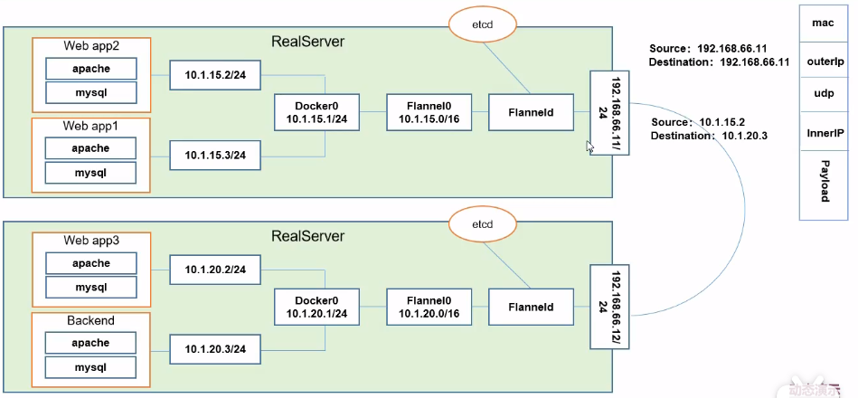
Pod Network

Slide 14
Service
Nginx
Nginx
Deployment
Deployment
APP-Service
App=webapp role=frontend
Label selector
Round-Robin
App1
App1
App1
App1
App=webapp role=frontend
App1
App=webapp role=frontend
App1
App=webapp role=frontend
Postgres
Postgres

Slide 15
Service Category
Cluster IP
Node1
Nginx Deployment
Virtual IP
Nginx Service
App=Nginx
Pod
App=Nginx
Pod
App=Nginx
Pod
App=Nginx
Access
Other
Pod
Cluster IP

Slide 16
Service Category
NodePort
Node1
Nginx Deployment
30001
80
Nginx Service
App=Nginx
Client
Pod
App=Nginx
Pod
App=Nginx
Pod
App=Nginx
Access
Other
Pod
NodePort

Slide 17
Service Category
LoadBalancer
Node1
Cloud Vendors
Nginx Deployment
30001
80
Nginx Service
App=Nginx
Pod
App=Nginx
Pod
App=Nginx
Pod
App=Nginx
Access
Client
Other
Pod
NodePort
Node2
Nginx Deployment
30001
80
Nginx Service
App=Nginx
Pod
App=Nginx
Pod
App=Nginx
Pod
App=Nginx
Access
Other
Pod
NodePort

Slide 18
Service Category
Node1
ExternalName
Nginx Deployment
Postgres service
IP:Port
Pod
App=Nginx
Pod
App=Nginx
Pod
App=Nginx
Cluster A
Node2
Postgres Service
Pod
Postgres
Pod
Postgres
Pod
Postgres
Cluster B

Slide 19

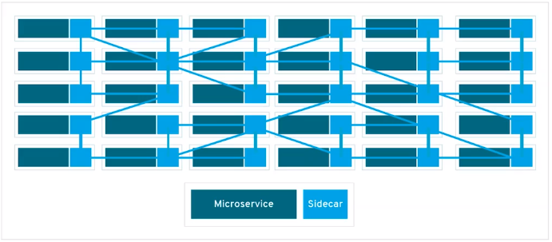
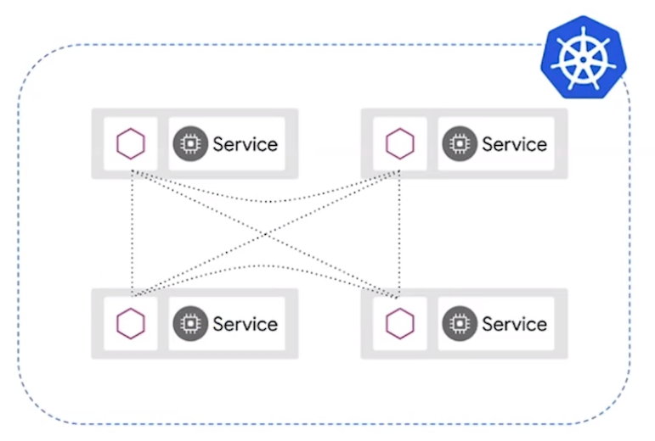
Service Mesh
Istio
Virtual service + destination rule
Traffic control
Fusing
Current-limiting
Route dispatch
Healthy check

Slide 20
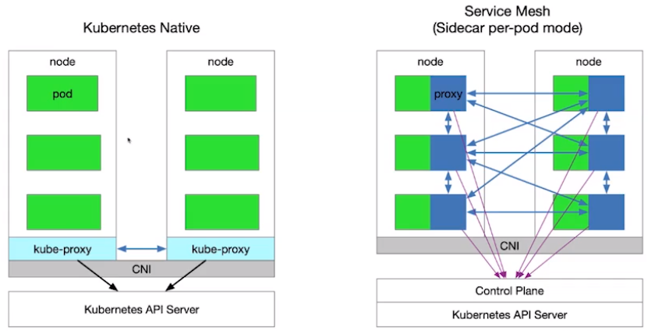
Service Mesh
Kube-proxy is global
Service mesh support to control each service

