Slide 1
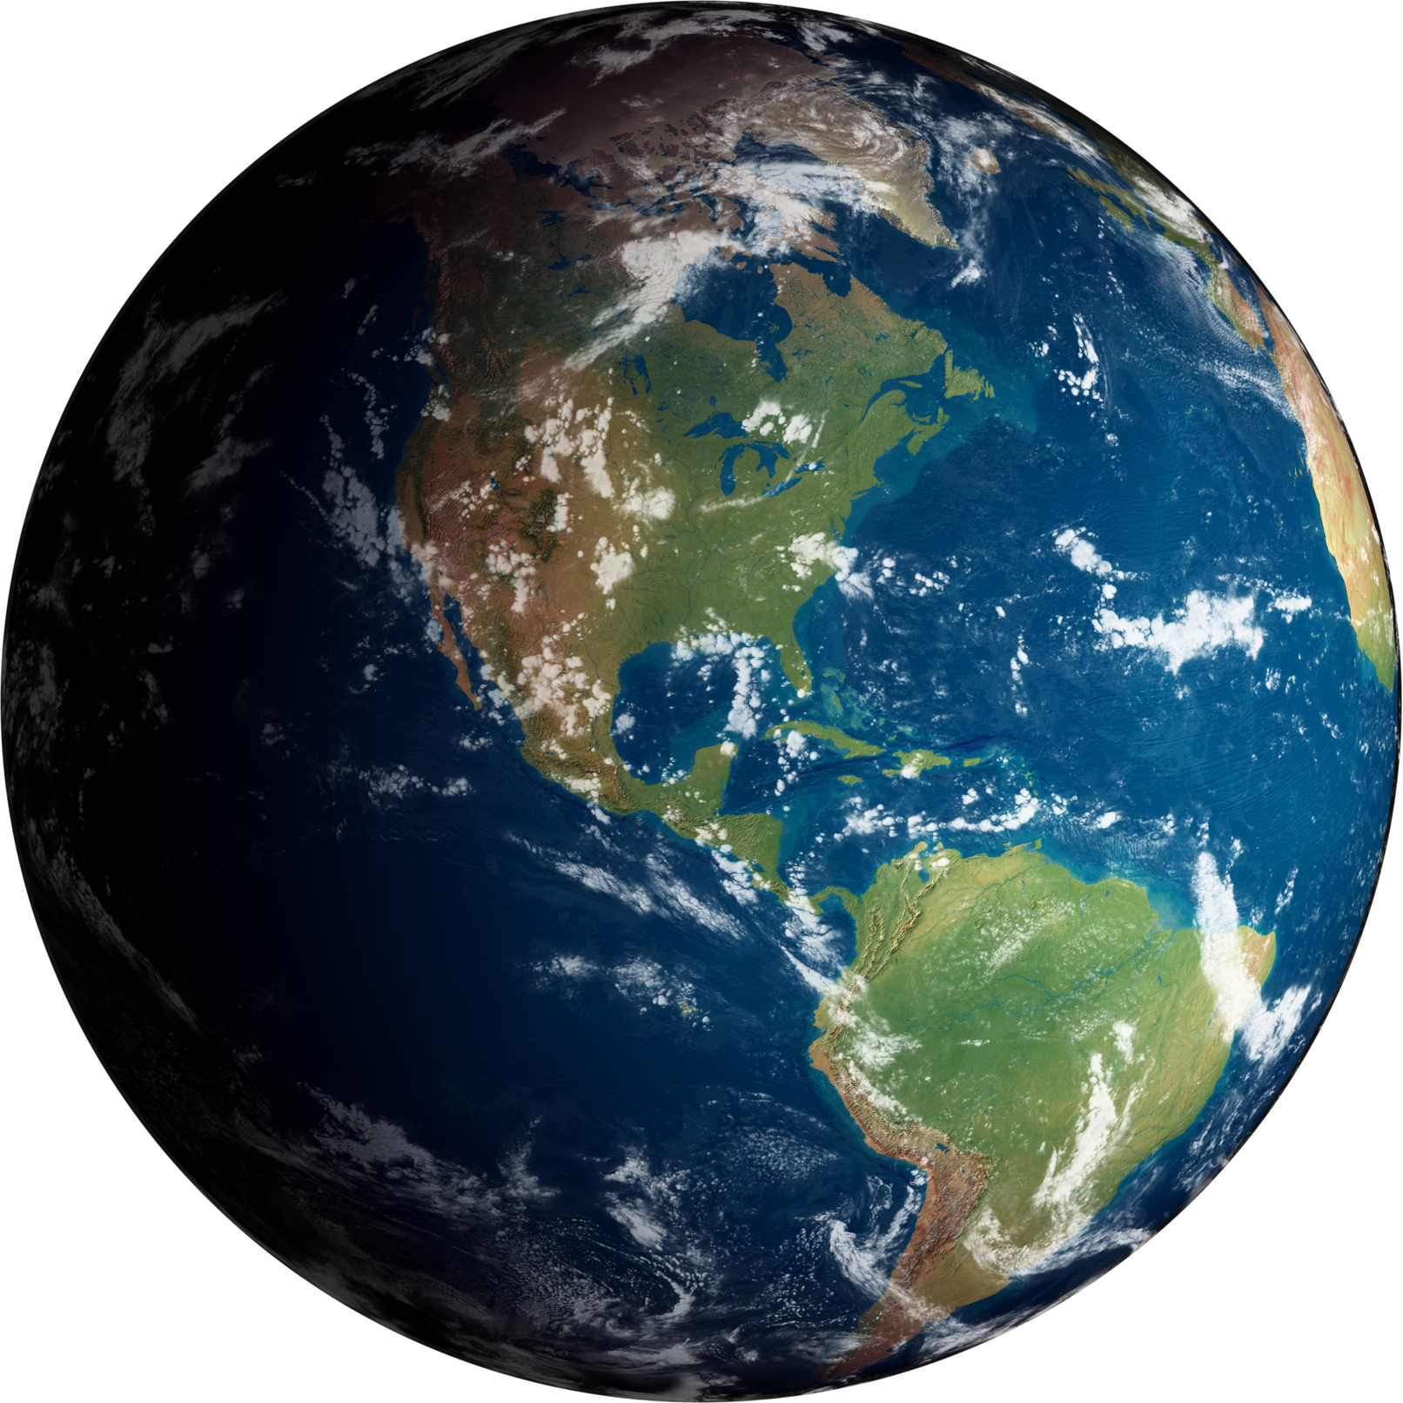



GEOSEG
Satellite Land Cover Segmentation
End-to-end multispectral remote sensing platform — PyTorch ResNet-34 U-Net encoder, a native C++17 acceleration engine, and a full-stack Web GIS dashboard.
16
11
0.9695
INPUT CHANNELS
LAND COVER CLASSES
VALIDATION MIOU
Notes:
1

Slide 2
Group members:
Yajat kataria 25BCE10191
Anushka mathur 25BCE10039
Gaurav Jain 25BCE11422
Tanisha 25BCE10578
Sanidhya Wabhitkar 25BCE10355
Supervisor:
Dr. Rajneesh Patel

Slide 3

Introduction
Why ordinary photos are not enough to understand the Earth
RGB CAMERA VIEW
A standard airplane photo or phone camera only records three colors — Red, Green and Blue. A green plastic roof, a toxic algae pond, a football field and a rainforest canopy can all look almost identical to a machine trained only on RGB.
3 channels — cannot tell a green roof from a forest, or a dry field from bare soil.
✕ Confuses visually-similar materials
GeoSeg looks past visible light. Using ESA Sentinel-2 satellites orbiting 786 km overhead, it reads Near-Infrared and Shortwave-Infrared bands invisible to the human eye — where healthy vegetation, water and built surfaces each leave a distinct signature.
GEOSEG 16-CHANNEL VIEW
13 Sentinel-2 bands + 3 spectral indices — reads chlorophyll reflection, water absorption and thermal bounce.
✓ Separates materials RGB cannot
2
Notes:
2

Slide 4






Project Objectives
What GeoSeg set out to build and prove
Dense pixel-wise classification
Fuse 16 spectral channels
Adapt pretrained vision models
Segment every 10m × 10m ground patch into one of 11 land-cover classes from raw satellite imagery.
Combine 13 raw Sentinel-2 bands with 3 physics-based indices (NDVI, NDWI, NDBI) for richer input.
Expand ImageNet-pretrained 3-channel weights into a 16-channel ResNet-34 U-Net without discarding learned filters.
Engineer for performance
Deliver an end-to-end platform
Validate scientifically
Offload tiling and band math to a native C++17 engine for large-raster, low-latency processing.
Wrap the model in a REST API and a React GIS dashboard so any region on Earth can be selected and segmented.
Reach production-grade accuracy (mIoU) while guarding against spatial data leakage and class imbalance.
3
Notes:
3

Slide 5
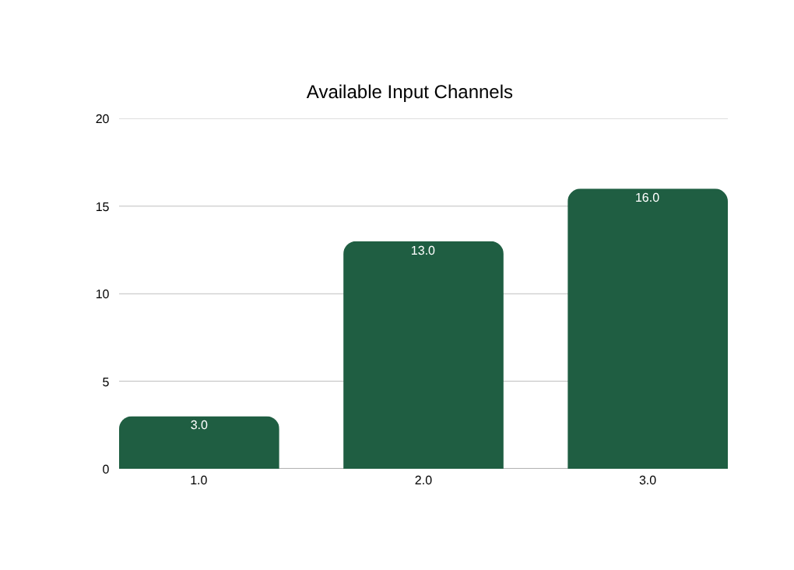


From 3 Channels to 16
Every extra channel gives the model a new physical sense
Physics-based indices
NDVI, NDWI, NDBI are computed from the raw bands, adding vegetation, water and built-up signals directly into the input tensor.
No pretrained knowledge lost
A weight-expansion formula spreads 3-channel ImageNet filters across all 16 channels before training begins.
Result
The network sees chlorophyll reflection, water absorption and thermal bounce — signals invisible to any RGB sensor.
4
Notes:
4

Slide 6
11-Class Land Cover Taxonomy
Every pixel is assigned one physically-grounded class
Forest
Shrubland
Savanna
Grassland
Wetlands
Croplands
Urban / Built-up
Snow / Ice
Barren / Soil
Water
Background
10m × 10m ground resolution per pixel · Colors match the model’s prediction legend
5
Notes:
5

Slide 7

System Architecture
Four cohesive subsystems, engineered as one full-stack platform
1 · Web GIS Dashboard
Interactive map, AOI selector, live training telemetry, GeoTIFF results viewer.
React 18 · TypeScript · Vite · Leaflet
2 · REST API Server
Async subprocess manager, upload verification, health checks, GeoTIFF downloads.
FastAPI · Pydantic v2 · Uvicorn
3 · Deep Learning Core
ResNet-34 U-Net, 16-channel weight expansion, Dice-CE loss, mixed-precision training.
PyTorch 2.x · SMP · TorchGeo · Kornia
4 · High-Speed C++ Engine
Sliding-window tiling, RAII-safe file handles, operator-overloaded band math, feather blending.
C++17 · OpenMP · CMake · pybind11
6
Notes:
6

Slide 8




Deep Learning Pipeline
From raw satellite bands to a segmented map
Load 13 bands
Compute indices
ResNet-34 U-Net
Dice + CE loss
AdamW update
Best checkpoint
SEN12MS multispectral dataset
NDVI · NDWI · NDBI → 16 channels
Predicts 11 land-cover classes
Balances rare vs. dominant classes
Optimizer refines model weights
best_model.pth saved (294 MB)
Where training runs
Training runs locally on GPU/CPU through src/train.py. When "Start Training" is triggered from the UI, the FastAPI backend launches it as a background process and streams live progress back to the dashboard.
7
Notes:
7

Slide 9



The Science: Spectral Indices
Three physics-based formulas turned into extra input channels
NDVI — Vegetation
NDWI — Water
NDBI — Built-up
(B08 − B04) / (B08 + B04 + 1e-6)
(B03 − B08) / (B03 + B08 + 1e-6)
(B11 − B08) / (B11 + B08 + 1e-6)
Measures plant health from Near-Infrared reflectance vs. Red absorption.
Isolates open water bodies, which absorb Near-Infrared almost completely.
Highlights concrete and asphalt using Shortwave-Infrared reflectance.
All three indices are bounded between −1.0 and +1.0, giving the network direct biophysical measurements rather than raw reflectance alone.
8
Notes:
8

Slide 10
Adapting a Pretrained Network
Two formulas that make transfer learning work on 16 channels
3 → 16 Channel Weight Expansion
Compound Dice + Cross-Entropy Loss
W_new = ( 1/3 · Σ W_pretrained ) × ( 3 / 16 )
Loss_Total = Loss_Dice + Loss_CrossEntropy
Every one of the 16 input channels is initialized from the average of the 3 pretrained ImageNet RGB filters, then rescaled by 3/16.
Cross-Entropy provides smooth gradient descent for stable optimization across all 11 classes.
The 3/16 scaling factor preserves activation variance across deep layers — preventing vanishing or exploding gradients so pretrained edge and texture filters remain useful.
Dice Loss optimizes region overlap (IoU) directly, stopping majority classes like forest from drowning out small features like rivers or buildings.
9
Notes:
9

Slide 11
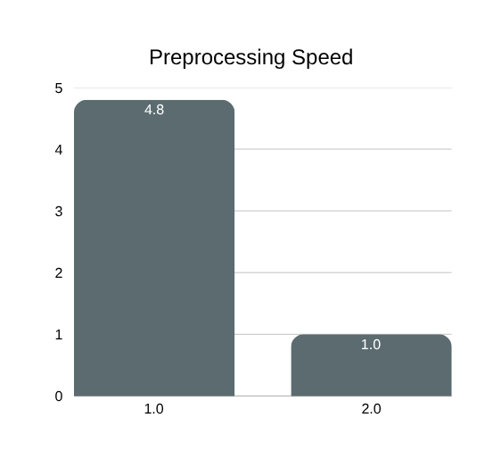
The C++17 Acceleration Engine
Seven OOP design patterns power band math and tiling
Polymorphism Virtual compute() dispatch across NDVI, NDWI, NDBI classes
Abstraction & Inheritance Abstract ImageProcessor interface, concrete BandMathEngine
Templates & Operators Generic Image<T> with overloaded +, −, ×, ÷
Template Method Shared computeNormalizedDifference() base algorithm
Encapsulation Internal bandIndex_ map prevents band-order mismatch bugs
RAII Safe heap buffers, automatic cleanup on destruction
4.8× faster than naive Python for tiling and band-math preprocessing.
Factory Pattern createIndex(name) dynamic spectral-index instantiation
10
Notes:
10

Slide 12

Seamless Large-Image Inference
2D linear feather blending removes tile-border artifacts
Tile the raster
Large GeoTIFFs are cut into 512×512 windows with a 32px overlap margin between neighbors.
Weight by a 2D ramp
Each tile’s prediction confidence fades from 0.0 at its border to 1.0 at its center.
Accumulate & normalize
10,000 × 10,000 px image → 512×512 tiles, 32px overlap
Overlapping tile predictions are summed and normalized, eliminating harsh grid-seam artifacts in the final map.
Why it matters: without feather blending, adjacent tiles disagree at their shared edge, leaving visible grid lines across the final segmented GeoTIFF — a common failure mode in naive sliding-window inference.
11
Notes:
11

Slide 13
4-Phase Progressive Training
Each phase de-risks the next before moving forward
1
2
3
4
EuroSAT Baseline
DeepGlobe U-Net
Full Multispectral
Custom AOI Inference
Validates GPU acceleration and the 13-band dataloader end-to-end.
Proves pixel-wise segmentation with real Dice + Cross-Entropy loss.
Core model — 16-channel input with expanded pretrained weights.
Sliding-window inference on any full-resolution GeoTIFF, any region.
Target: Validation accuracy > 90%
7-class RGB land cover
Achieved: 0.9695 mIoU
Preserves CRS & geotransform
12
Notes:
12

Slide 14



External Data Sources & APIs
How live satellite imagery reaches the platform
Google Earth Engine
ESA Copernicus Hub
Python API (earthengine-api, geemap) fetches live, cloud-free (<10% cloud) Sentinel-2 composites for any drawn region.
Source of the Sentinel-2A/2B 13-band multispectral imagery used across all training phases.
TorchGeo API
ISRO Bhuvan & Esri Imagery
Geospatial PyTorch dataset loaders (torchgeo.datasets) standardize raster ingestion for training.
Live satellite basemap layers rendered on the frontend Leaflet map for area-of-interest selection.
Storage model: a spatial file-system registry (data/, outputs/checkpoints/, outputs/predictions/, outputs/tensorboard/) replaces a SQL database — the natural fit for large geospatial rasters and model weights.
13
Notes:
13

Slide 15
Results & Performance
Phase 3 — full 16-channel multispectral model
0.9695
0.2476
294 MB
4.8×
VALIDATION MIOU
TRAINING LOSS
BEST CHECKPOINT SIZE
C++ PREPROCESSING SPEEDUP
Guardrails that made the number trustworthy
Scene-level splitting
Dice + Cross-Entropy loss
Mixed-precision (AMP)
Prevents spatial leakage — adjacent pixels never split across train/validation, so the model can’t memorize coordinates.
Keeps rare classes (rivers, urban) from being drowned out by dominant classes (forest).
Maintains numerical stability while training faster on 16-channel tensors.
14
Notes:
14

Slide 16

Technical Deep-Dive: Key Questions
Why 16 channels instead of RGB?
What is spatial leakage, and how was it avoided?
RGB cannot separate materials that share a visible color, e.g. artificial turf vs. forest. NIR/SWIR bands reveal chlorophyll reflection and water absorption RGB can’t see.
Randomly shuffling adjacent pixels into train/validation lets a model memorize coordinates instead of features. Scene-level splitting keeps whole scenes on one side of the split.
How does C++ accelerate the pipeline?
Why Dice + Cross-Entropy, not CE alone?
Zero-overhead sliding-window tiling, operator-overloaded band math, and RAII memory safety together give a 4.8× speedup over naive Python preprocessing.
Cross-Entropy alone is biased toward majority classes like forest. Dice Loss directly optimizes IoU, keeping rare classes such as rivers and urban areas accurately mapped.
15
Notes:
15

Slide 17
Conclusion & Future Work
What GeoSeg demonstrates
Where it goes next
A 16-channel multispectral segmentation model reaching 0.9695 validation mIoU
Temporal analysis — track land-cover change across multiple satellite passes
A native C++17 engine delivering a 4.8× preprocessing speedup
Expand the training set beyond SEN12MS for broader geographic generalization
A full-stack platform — model, API, and GIS dashboard — usable on any region on Earth
Deploy the C++ engine as a distributed service for continent-scale inference
Thank You
16
Notes:
16

