Slide 1


KEDCO TECHNICAL
AUTOMATION PLATFORM
Executive Management & Implementation Contract Proposal
A comprehensive, implementation-ready operating platform for dispatch, feeder intelligence, technical workflows, departmental control, secure operational records and executive decision support.
APPLICATION-DERIVED EVIDENCE
Prepared for KEDCO Executive Management · CTO · Senior Technical Leadership
YAJIB SMART SOLUTION UNIVERSAL LIMITED

Slide 2

EXECUTIVE PROPOSITION
ONE OPERATING PICTURE
From fragmented technical activity to one governed operational platform
The system connects frontline operations, technical departments, analytics, approvals, records and executive oversight in a single operating model.
The management case
• Capture operational data once and reuse it across dashboards, reports and workflows.
• Coordinate switching, faults, outages, feeder performance and departmental actions.
• Give management one consistent view of operations, responsibility and performance.
• Retain structured historical records, files, workflow evidence and audit events.
• Scale across regions, stations, departments and future integrations.
Management message: this is not a single dashboard; it is an integrated technical operations platform.

Slide 3
VERIFIED IMPLEMENTATION FOOTPRINT
ACTUAL SYSTEM DATA
A substantial working application already exists
Figures below are taken from the uploaded application archive and persisted system records—not projected adoption statistics.
37
51
55
226
60
HTML application pages
configured users
configured role codes
feeder identities
stations
Operational + admin + utility pages
Current application user registry
Executive, technical & field roles
Across persisted live-operation data
Persisted live-operation data
Persisted operational evidence
Operational governance evidence
Station live-operation records
88,599
259
39
17
33 kV load-flow records
39,926
audit events
daily-log events
file assets
Audit JSONL
Persisted event register
Registered evidence files
11 kV load-flow records
48,570
Historical data snapshots
1,351
Load-flow archive shown here covers eight persisted September 2026 dates in this uploaded package; it is evidence of capability, not a claim of full-period completeness.
Source: KEDCO Technical Automation application archive reviewed 26 Sep 2026

Slide 4
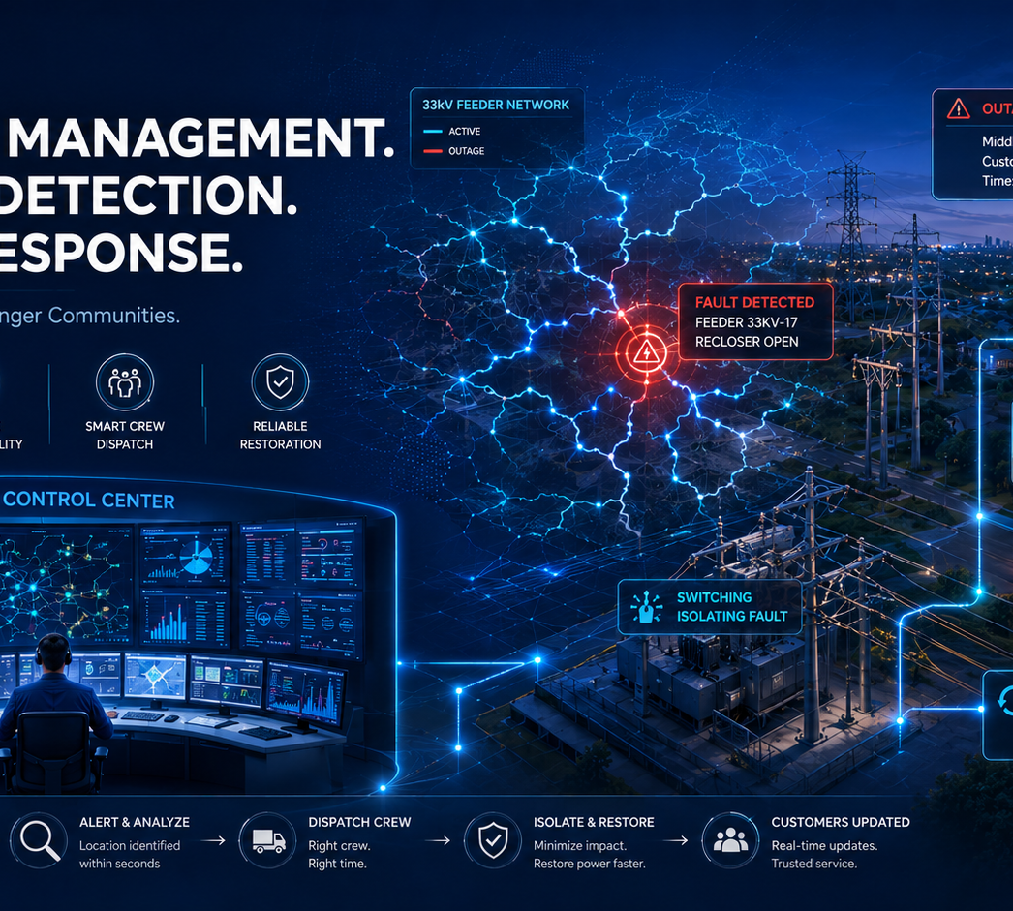
OPERATIONAL CHALLENGE
PROCESS RISKS ADDRESSED
The platform is designed around the problems that slow technical operations
These are operating risks the application explicitly addresses through its workflows and control logic—not unsupported claims about current KEDCO performance.
01
Fragmented records
Hourly readings, outage events, approvals and reports can become separated across people and files.
02
Slow operational handoffs
Fault, switching and maintenance information needs structured routing between responsible authorities.
03
Manual reconciliation
33 kV, 11 kV, TMO, energy, forecast and reporting data require repeat handling when sources are disconnected.
04
Limited traceability
Without a central record, management has less visibility into who submitted, approved, received, closed or restored an action.
05
Data continuity risk
Operational history and evidence need durable secure data repository, backup, snapshots and retrieval paths.

Slide 5
PLATFORM ARCHITECTURE
SECURE · MODULAR
A connected operating stack—from field action to executive intelligence
Backend services route authentication, operational tables, files, synchronization and historical records within a controlled KEDCO environment.
Operational users
Application layer
Automation services
Data services
Management layer
Dispatch & operators
RE / TE & regions
PC&M · O&M · P&I
HSE · Stores · Contractors
37 HTML pages
Role-aware dashboards
Digital eForms
Network maps & analytics
Routing & approvals
Load-flow synchronization
Analyzer & TMO logic
Reporting / export
Application backend
Operational tables
Files & evidence
Snapshots / backups
Executive dashboards
Performance intelligence
Audit & accountability
Historical retrieval
Design principle: preserve operational continuity while keeping the platform compatible with future hosting, telemetry and enterprise integrations.
Source: backend/frontend code, application archive and integration verification reports

Slide 6
ENTERPRISE MODULE LANDSCAPE
CROSS-DIRECTORATE
One platform spanning core technical operations and supporting functions
The archive contains dedicated interfaces for central control, technical departments, regional teams, data functions and executive management.
01
System Operations
02
TMO & Analyzer
03
O&M
04
PC&M
Dispatch · Operator · Head SO
Energy · Forecast · Feeder KPI
RE/TE · Fitters · Jointers
Protection · Control · Metering
05
Planning & Investment
06
HSE
07
MIS & Data
08
Stores
Projects · Network planning · QA
Incidents · actions · assurance
Daily automation · cleaning · quality
Inventory · requests · audit
09
Contractors
10
Executive
11
Transmission
12
Developer/Admin
Delivery · safety · QA/QC
CTO · Technical Administration
132/33 kV operations & guarantees
Users · roles · responsibility master
Source: frontend/pages module inventory

Slide 7
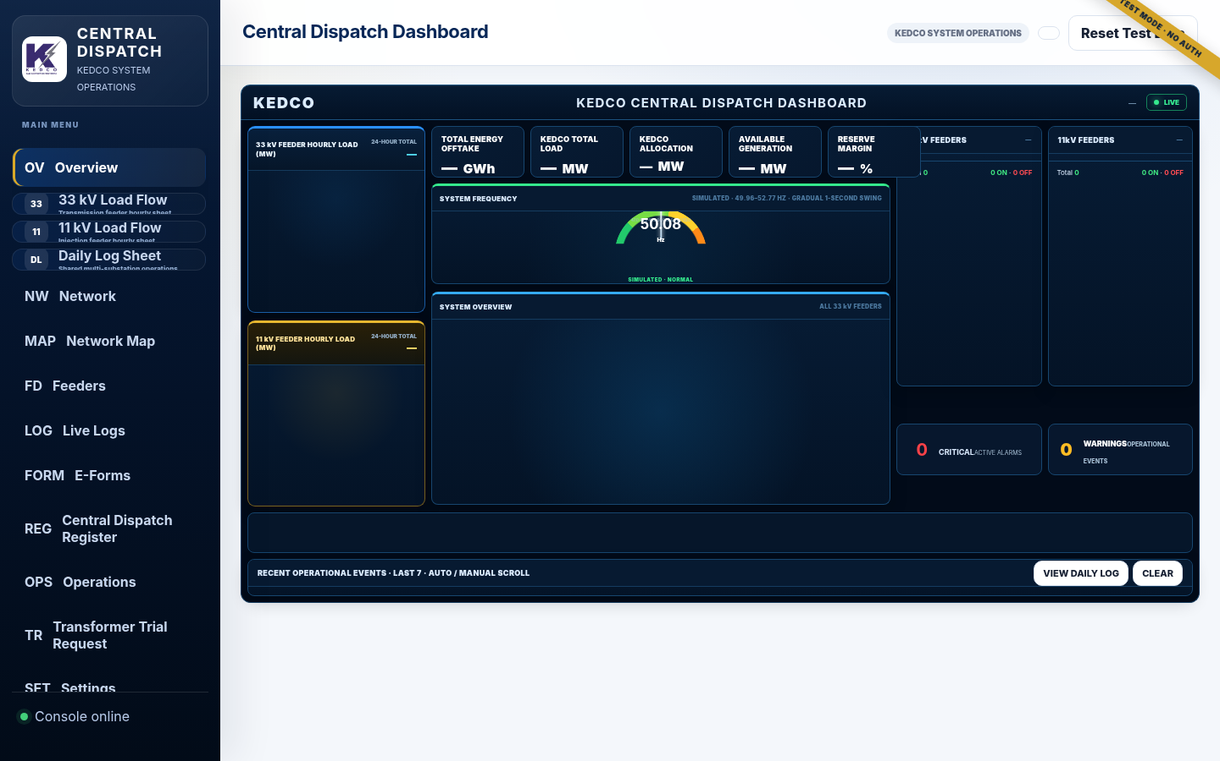
SYSTEM OPERATIONS
CENTRAL DISPATCH
Central Dispatch becomes a live operational control surface
The Dispatch page combines 33/11 kV operating context, network master data, feeder control, outage actions, network mapping and role-aware workflows.
Operational capabilities
• Central Dispatch dashboard with operating status and control-room context
• 33 kV / 11 kV hourly load-flow entry, history and feeder-state tracking
• Network master register and selected electrical path
• Fault, outage, breaker, switching and restoration operations
• Interactive network map and role-aware operational workflows
Source: dispatch.html + application integration verification report

Slide 8
LOAD-FLOW & FEEDER PERFORMANCE
ACTUAL SYSTEM EVIDENCE
33 kV / 11 kV operational data becomes feeder performance intelligence
Both voltage levels are structured by station, region, feeder, date, hour, shift and status, then used for monthly KPI analysis and reporting.
Persisted record volume
Operational & analytical value
33 kV records
• Hourly 33 kV and 11 kV records support live and historical review
• Analyzer classifies active, load-shedding, fault and planned-outage hours
• Monthly KPI, daily average hours, energy and feeder performance are calculated from source data
• Results can be archived, filtered and exported for management reporting
39,926
11 kV records
48,570
Coverage inside this archive sample
8 persisted dates · 81 unique 33 kV feeder names · 145 unique 11 kV feeder names
Verified batch save/read and historical retrieval for both voltage levels.
Source: persisted load-flow records + Analyzer code + integration verification report

Slide 9
DAILY FEEDER OPERATION & OUTAGE MANAGEMENT
CONTROLLED LIFECYCLE
Operations are managed as a lifecycle—not isolated entries
The Daily Log enforces operational categories, planned duration where required, duplicate-open protection and exact feeder restoration.
1
2
3
4
5
6
Detect / instruct
Open event
Route / coordinate
Monitor
Restore / close
Audit / report
Fault, load shedding, breaker, emergency or planned outage
Record feeder, source, reason, time, load lost and planned duration
Share operational record with responsible control or technical authority
Maintain live state and operational history
Close the exact matching record and return to live operating time
Retain event history for management and future analysis
Current archive: 39 persisted Daily Log events
Load shedding · 20
Planned outage · 9
Fault · 9
Breaker fault · 1
Source: daily-log records + integration verification report

Slide 10
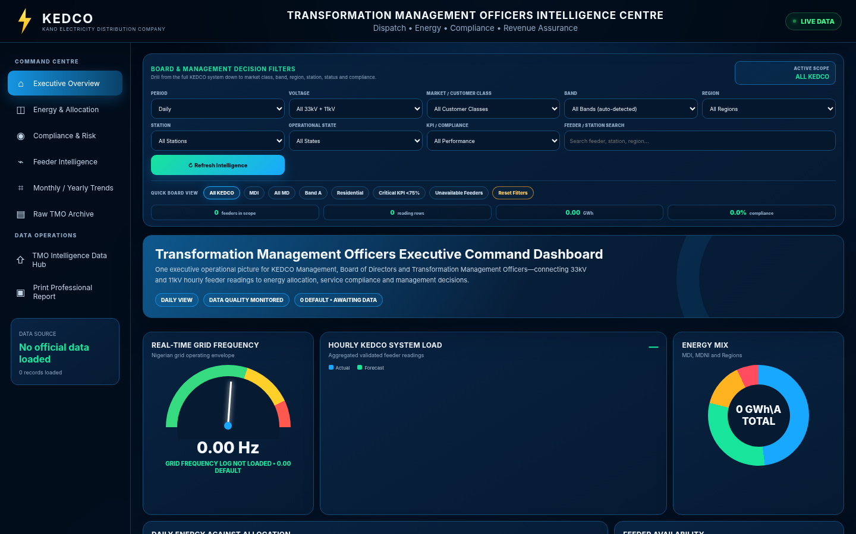
TMO INTELLIGENCE
ENERGY · MARKET · PERFORMANCE
TMO turns technical and commercial inputs into management intelligence
The TMO Intelligence Centre includes load, frequency, energy allocation, forecast, feeder availability, compliance, billing exposure and monthly/yearly views.
System load & frequency
Real-time frequency · hourly KEDCO system load
Energy allocation
Daily energy vs allocation · premium allocation ratio
Forecast performance
Monthly forecast vs actual · available generation allocation
Commercial intelligence
Revenue / billing / tariff inputs · collection and P&L exposure
Compliance & risk
Business-segment compliance · risk distribution · feeder criticality
Monthly / yearly view
12-month trend · YTD scorecard · service compliance
Source: tmo.html headings and data-hub configuration

Slide 11
DIGITAL EFORMS & WORKFLOW ROUTING
6 / 6 END-TO-END PASS
Operational forms become governed digital workflows with evidence and routing
Six System Operations workflows were verified end to end, including required documents and generated route tasks.
O.F.1
Protection Guarantee
O.F.2
Work Permit
O.F.3
Work & Test Permit
2 docs • 5 tasks
2 docs • 5 tasks
2 docs • 5 tasks
PASS
PASS
PASS
O.F.4
Station Guarantee
O.F.17
Order to Operate
O.F.19
Trouble & Repair
1 doc • 6 tasks
1 doc • 4 tasks
No mandatory • 4 tasks
PASS
PASS
PASS
Workflow pattern
Fill eForm → attach required evidence → send to defined authority → receive / review → feedback / approval → retained record & audit trail
Source: integration verification report + approved eForm templates

Slide 12
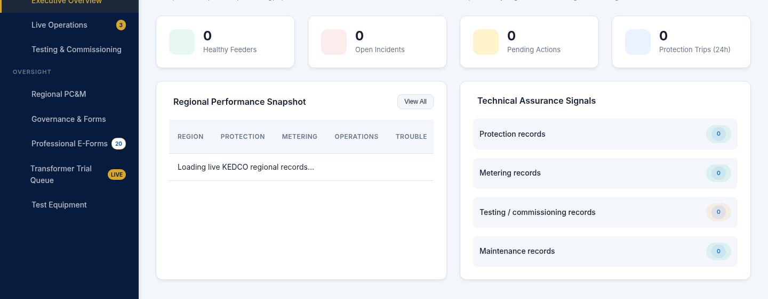
DEPARTMENTAL AUTOMATION
FIELD → MANAGEMENT CONTROL
Technical departments operate from dedicated dashboards, workflows and network-aware workspaces
O&M, PC&M, P&I, HSE, Stores, Contractors and MIS are connected through a common responsibility and reporting model.
Engineering operations
• O&M: faults, restoration, maintenance and RE/TE control
• PC&M: protection, testing and commissioning
• P&I: projects, design review and network planning
Support & network intelligence
• HSE, Stores & Contractors: incidents, materials, work orders and compliance
• MIS: data validation, load/energy reporting and management outputs
• Network maps: feeder responsibility, routes and topology context
Source: O&M, PC&M, P&I, HSE, Stores, Contractors, MIS and network-management pages

Slide 13
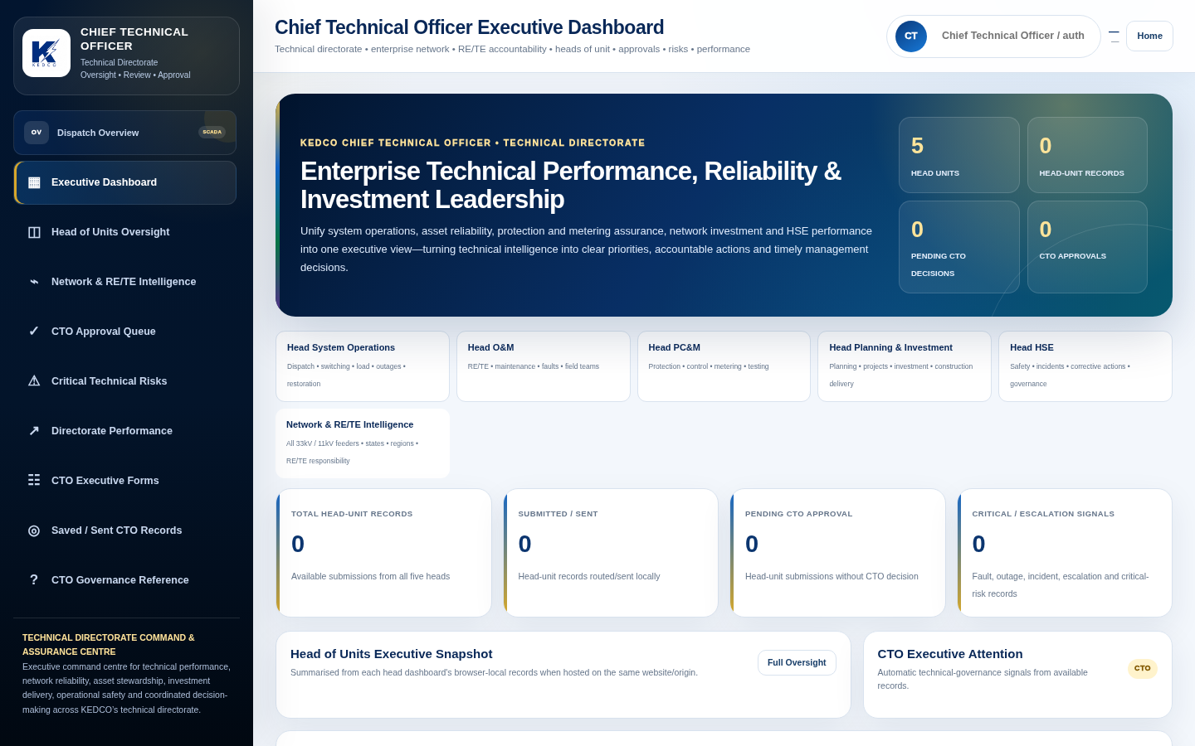
EXECUTIVE MANAGEMENT VISIBILITY
FROM EVENT TO EXECUTIVE VIEW
Leadership dashboards are built into the same operational system
Executive dashboards summarize operating queues, performance, risks and responsibility gaps from the same governed system environment.
Executive oversight surfaces
CTO: head-of-unit snapshot, approvals, technical risks and directorate performance
Head System Operations: control-room activity, trips/outages, switching and system performance
Head O&M: faults/restoration, maintenance programme and regional delivery
Head PC&M: protection feed, trouble reports, transformer try requests and technical assurance
Head P&I: priority projects, network development and delivery controls
Head HSE: regional assurance, incidents and corrective actions
Source: executive and department-head dashboards in archive

Slide 14
IMPLEMENTATION READINESS & GOVERNANCE
VERIFIED PLATFORM
The consolidated platform passed broad technical verification
Verification covers build quality, routing, dependencies, page serving, load-flow, Analyzer/TMO and eForms, with governance controls built into the operating model.
Backend TypeScript typecheck
PASS
Backend production build
PASS
Operational pages with account controls
26 / 26
Role routing targets
52 / 52
Application dependencies
206 checked · 0 broken
Audit events
259
HTML pages served by backend
30 / 30 HTTP 200
Integration checks
12 / 12 PASS
System Operations eForms
6 / 6 PASS
Overall verification result: PASS — build, routing, account controls, operational pages, eForms and integration paths were successfully validated.
Source: internal integration, cleanup and verification reports

Slide 15
MANAGEMENT BENEFITS
PROPOSED OPERATING IMPACT
The value is operational discipline, visibility and speed—not a cosmetic dashboard upgrade
Benefits below describe the operating change enabled by the platform; no unsupported financial percentage or ROI claim is assumed.
Before / operating risk
Platform-enabled operating model
Operational data
Repeated manual entry and disconnected files
Enter once, synchronize and reuse across views
Fault / outage coordination
Phone/chat/file-dependent handoffs
Structured event, responsibility and restoration trail
Approvals & eForms
Paper or loosely tracked document movement
Digital routing, attachments, receipt, feedback and history
Feeder performance
Time-consuming workbook reconciliation
Repeatable KPI analysis and monthly archive
Management visibility
Periodic compilation from multiple sources
Department and executive dashboards from shared records
Historical retrieval
Records distributed across devices and folders
system platform tables, files, snapshots and backups
Accountability
Harder to reconstruct action ownership
User, role, time, feeder, status and outcome traceability
Strategic result: faster coordination, stronger data discipline, clearer responsibility and a more reliable management information chain.

Slide 16
IMPLEMENTATION & SCALE-UP
CONTROLLED ROLLOUT
Deploy in governed phases, then expand on the same platform foundation
Implementation can focus on controlled configuration, operational validation, user readiness and progressive expansion without disrupting technical operations.
01
02
03
04
05
Baseline & preserve
Configure & validate
Pilot operations
Directorate rollout
Scale & integrate
Preserve the current operational dataset, confirm the live implementation baseline and establish a controlled release point.
Confirm users, roles, regions, stations, feeders, routing authorities, forms and operating rules.
Deploy with selected control-room / technical teams; validate real data, workflows and management outputs.
Extend to O&M, PC&M, P&I, HSE, MIS, Stores, Contractors and executive dashboards.
Expand approved hosting, telemetry/SCADA interfaces, mobile field execution, advanced analytics and future enterprise integrations.
Deployment principle: preserve operational records, validate configuration and expand through controlled management checkpoints.
Source: implementation guidance and application architecture review

Slide 17

EXECUTIVE CALL TO ACTION
A strong investment is one that improves the operating system of the business.
KEDCO Technical Automation already demonstrates the core platform, module breadth, workflow logic, secure data persistence, role control and verified integration paths required for a controlled implementation programme.
Recommended management action
Authorize a formal implementation / pilot engagement, preserve the current operational dataset, confirm production scope and execute a governed rollout with management checkpoints.
YAJIB SMART SOLUTION UNIVERSAL LIMITED
KEDCO Technical Automation · Executive Management Proposal

