Slide 1


KEDCO TECHNICAL
AUTOMATION PLATFORM
Executive Management & Implementation Contract Proposal
A comprehensive, implementation-ready operating platform for dispatch, feeder intelligence, technical workflows, departmental control, Local Cloud records and executive decision support.
APPLICATION-DERIVED EVIDENCE
Prepared for KEDCO Executive Management · CTO · Senior Technical Leadership
YAJIB SMART SOLUTION UNIVERSAL LIMITED

Slide 2

EXECUTIVE PROPOSITION
ONE OPERATING PICTURE
From fragmented technical activity to one governed operational platform
The system connects frontline operations, technical departments, analytics, approvals, records and executive oversight in a single operating model.
The management case
Capture operational data once and reuse it across dashboards, reports and technical workflows.
Coordinate switching, faults, outages, feeder performance and departmental actions with traceable records.
Give management a consistent view of system operations, asset activity, responsibilities and performance.
Retain records locally with historical snapshots, files, workflow evidence and audit events.
Scale across regions, stations, departments and future integrations without replacing the operating model.
Management message: this is not a single dashboard; it is an integrated technical operations platform.

Slide 3
VERIFIED IMPLEMENTATION FOOTPRINT
ACTUAL SYSTEM DATA
A substantial working application already exists
Figures below are taken from the uploaded application archive and Local Cloud data—not projected adoption statistics.
37
51
55
226
60
HTML application pages
active Local Cloud users
configured role codes
feeder identities
stations
Operational + admin + utility pages
Current archive user registry
Executive, technical & field roles
Across persisted live-operation data
Persisted live-operation data
Persisted operational evidence
Operational governance evidence
Station live-operation records
88,599
259
39
17
33 kV load-flow records
39,926
audit events
daily-log events
file assets
Audit JSONL
Persisted event register
Registered evidence files
11 kV load-flow records
48,570
Historical data snapshots
1,351
Load-flow archive shown here covers eight persisted September 2026 dates in this uploaded package; it is evidence of capability, not a claim of full-period completeness.
Source: KEDCO Technical Automation application archive reviewed 26 Sep 2026

Slide 4
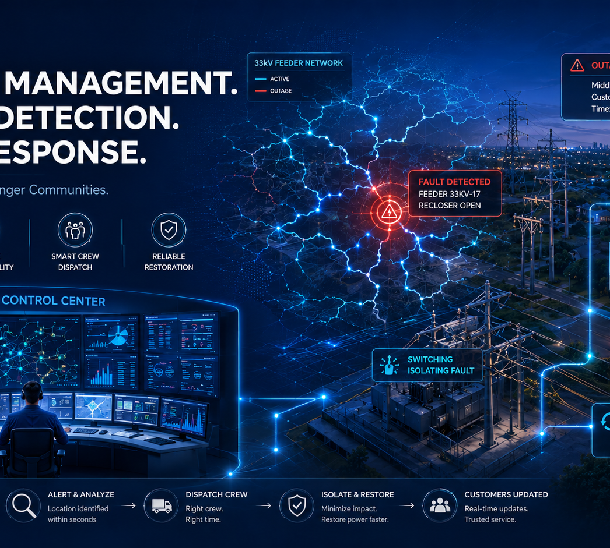
OPERATIONAL CHALLENGE
PROCESS RISKS ADDRESSED
The platform is designed around the problems that slow technical operations
These are operating risks the application explicitly addresses through its workflows and control logic—not unsupported claims about current KEDCO performance.
01
Fragmented records
Hourly readings, outage events, approvals and reports can become separated across people and files.
02
Slow operational handoffs
Fault, switching and maintenance information needs structured routing between responsible authorities.
03
Manual reconciliation
33 kV, 11 kV, TMO, energy, forecast and reporting data require repeat handling when sources are disconnected.
04
Limited traceability
Without a central record, management has less visibility into who submitted, approved, received, closed or restored an action.
05
Data continuity risk
Operational history and evidence need durable local storage, backup, snapshots and retrieval paths.

Slide 5
PLATFORM ARCHITECTURE
LOCAL-FIRST · MODULAR
A connected operating stack—from field action to executive intelligence
The frontend retains a compatibility layer while Local Cloud routes authentication, tables, files, synchronization and historical records to the local Express/JSON backend.
Operational users
Application layer
Automation services
Local Cloud
Management layer
Dispatch & operators
RE / TE & regions
PC&M · O&M · P&I
HSE · Stores · Contractors
37 HTML pages
Role-aware dashboards
Digital eForms
Network maps & analytics
Routing & approvals
Load-flow synchronization
Analyzer & TMO logic
Reporting / export
Express backend
JSON tables
Files & evidence
Snapshots / backups
Executive dashboards
Performance intelligence
Audit & accountability
Historical retrieval
Design principle: preserve operational continuity locally while keeping the frontend interface compatible with future storage/integration choices.
Source: LOCAL_CLOUD_GUIDE.md, backend/frontend code and application archive

Slide 6
ENTERPRISE MODULE LANDSCAPE
CROSS-DIRECTORATE
One platform spanning core technical operations and supporting functions
The archive contains dedicated interfaces for central control, technical departments, regional teams, data functions and executive management.
01
System Operations
02
TMO & Analyzer
03
O&M
04
PC&M
Dispatch · Operator · Head SO
Energy · Forecast · Feeder KPI
RE/TE · Fitters · Jointers
Protection · Control · Metering
05
Planning & Investment
06
HSE
07
MIS & Data
08
Stores
Projects · Network planning · QA
Incidents · actions · assurance
Daily automation · cleaning · quality
Inventory · requests · audit
09
Contractors
10
Executive
11
Transmission
12
Developer/Admin
Delivery · safety · QA/QC
CTO · Technical Administration
132/33 kV operations & guarantees
Users · roles · responsibility master
Source: frontend/pages module inventory

Slide 7
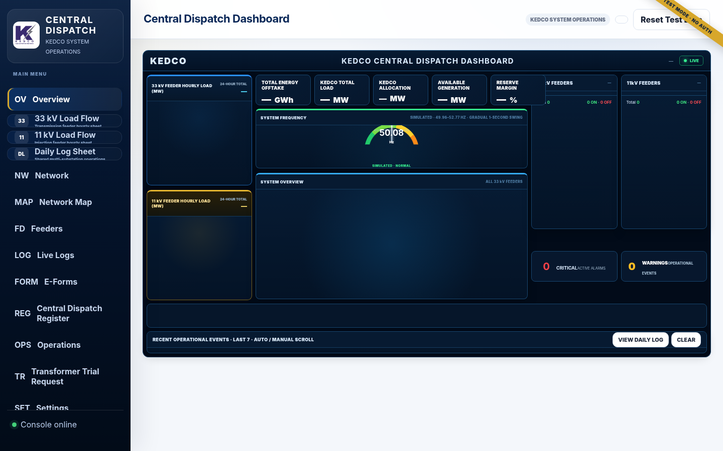
SYSTEM OPERATIONS
CENTRAL DISPATCH
Central Dispatch becomes a live operational control surface
The Dispatch page combines 33/11 kV operating context, network master data, feeder control, outage actions, network mapping and role-aware workflows.
Operational capabilities
Central dispatch dashboard with operating status and control-room context
33 kV / 11 kV load-flow entry, live/history behavior and feeder-state tracking
Network master register and selected electrical path
Outage, fault, breaker, switching and restoration operations
Interactive network map, route editor and Google Maps configuration
Shared Local Cloud Daily Log with operator pages
Source: dispatch.html + Local Cloud verification report

Slide 8
33 KV & 11 KV LOAD-FLOW
ACTUAL ARCHIVE EVIDENCE
Persisted load-flow intelligence at feeder level
The uploaded Local Cloud archive contains both voltage levels with station, region, feeder, date, hour, shift, status, summary and payload fields.
Persisted record volume
Why it matters operationally
33 kV records
Hourly data can be viewed as both live and historical operational evidence.
Dispatch Overview logic treats current-hour 33 kV as the authoritative system-load layer.
11 kV remains downstream feeder status and is not added to 33 kV, preventing double counting.
Records can feed performance analysis, management trends, fault/outage context and reporting.
39,926
11 kV records
48,570
Coverage inside this archive sample
8 persisted dates · 81 unique 33 kV feeder names · 145 unique 11 kV feeder names
Built for operational continuity: batch save/read verified for both voltage levels.
Source: Local Cloud load-flow JSON + LOCAL_CLOUD_TEST_REPORT.md

Slide 9
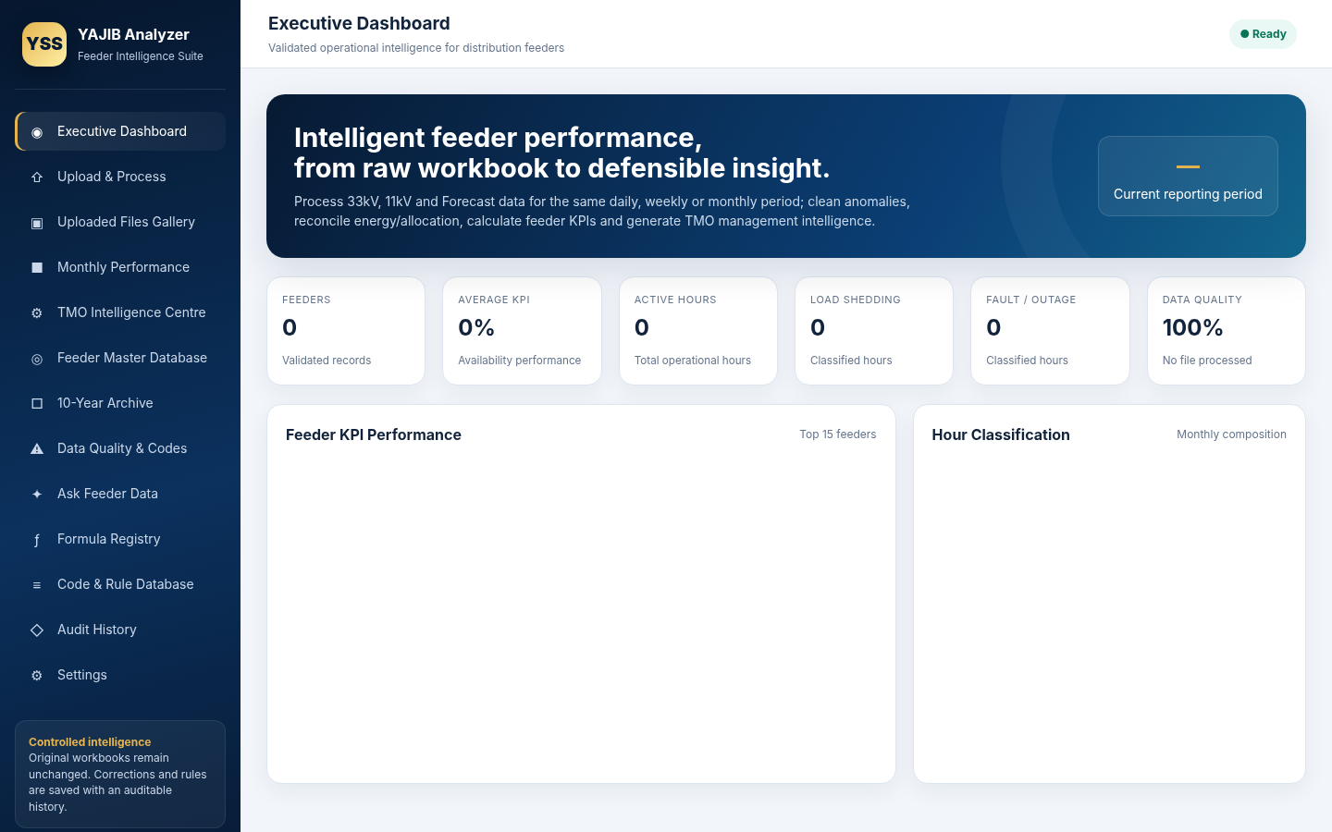
FEEDER PERFORMANCE ANALYZER
RAW DATA → DEFENSIBLE INSIGHT
The analyzer converts raw feeder workbooks into structured monthly intelligence
It brings 33 kV, 11 kV and forecast inputs into one reporting period and supports cleaning, classification, KPI analysis, archive persistence and export.
Analyzer capabilities
33 kV + 11 kV + forecast in the same reporting period
Feeder KPI performance and hour classification
Local Cloud sync, file upload and analyzed-month archive
Monthly feeder performance and daily energy views
33 kV analyzed export includes transformer rating and transformer peak load where source data exists
11 kV analysis schema retained without fabricating missing asset metadata
Source: analyzer.html + LOCAL_CLOUD_TEST_REPORT.md

Slide 10
DAILY FEEDER OPERATION & OUTAGE MANAGEMENT
CONTROLLED LIFECYCLE
Operations are managed as a lifecycle—not isolated entries
The Daily Log enforces operational categories, planned duration where required, duplicate-open protection and exact feeder restoration.
1
2
3
4
5
6
Detect / instruct
Open event
Route / coordinate
Monitor
Restore / close
Audit / report
Fault, load shedding, breaker, emergency or planned outage
Record feeder, source, reason, time, load lost and planned duration
Share operational record with responsible control or technical authority
Maintain live state and operational history
Close the exact matching record and return to live operating time
Retain event history for management and future analysis
Current archive: 39 persisted Daily Log events
Load shedding · 20
Planned outage · 9
Fault · 9
Breaker fault · 1
Source: daily_log_events.json + LOCAL_CLOUD_TEST_REPORT.md

Slide 11
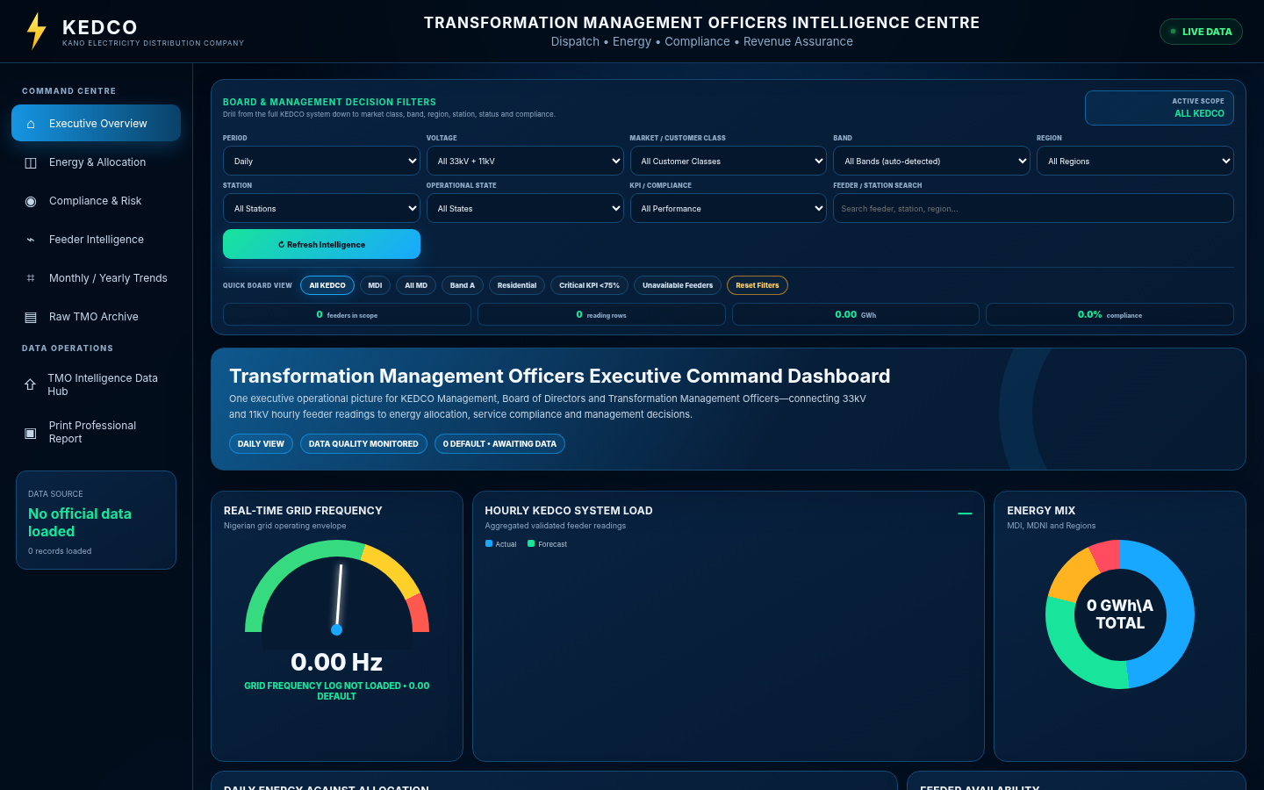
TMO INTELLIGENCE
ENERGY · MARKET · PERFORMANCE
TMO turns technical and commercial inputs into management intelligence
The TMO Intelligence Centre includes load, frequency, energy allocation, forecast, feeder availability, compliance, billing exposure and monthly/yearly views.
System load & frequency
Real-time frequency · hourly KEDCO system load
Energy allocation
Daily energy vs allocation · premium allocation ratio
Forecast performance
Monthly forecast vs actual · available generation allocation
Commercial intelligence
Revenue / billing / tariff inputs · collection and P&L exposure
Compliance & risk
Business-segment compliance · risk distribution · feeder criticality
Monthly / yearly view
12-month trend · YTD scorecard · service compliance
Source: tmo.html headings and data-hub configuration

Slide 12
DIGITAL EFORMS & WORKFLOW ROUTING
6 / 6 END-TO-END PASS
Operational forms become governed digital workflows with evidence and routing
Six System Operations workflows were verified end to end, including required documents and generated route tasks.
O.F.1
Protection Guarantee
O.F.2
Work Permit
O.F.3
Work & Test Permit
2 docs • 5 tasks
2 docs • 5 tasks
2 docs • 5 tasks
PASS
PASS
PASS
O.F.4
Station Guarantee
O.F.17
Order to Operate
O.F.19
Trouble & Repair
1 doc • 6 tasks
1 doc • 4 tasks
No mandatory • 4 tasks
PASS
PASS
PASS
Workflow pattern
Fill eForm → attach required evidence → send to defined authority → receive / review → feedback / approval → retained record & audit trail
Source: LOCAL_CLOUD_TEST_REPORT.md + approved eForm templates

Slide 13
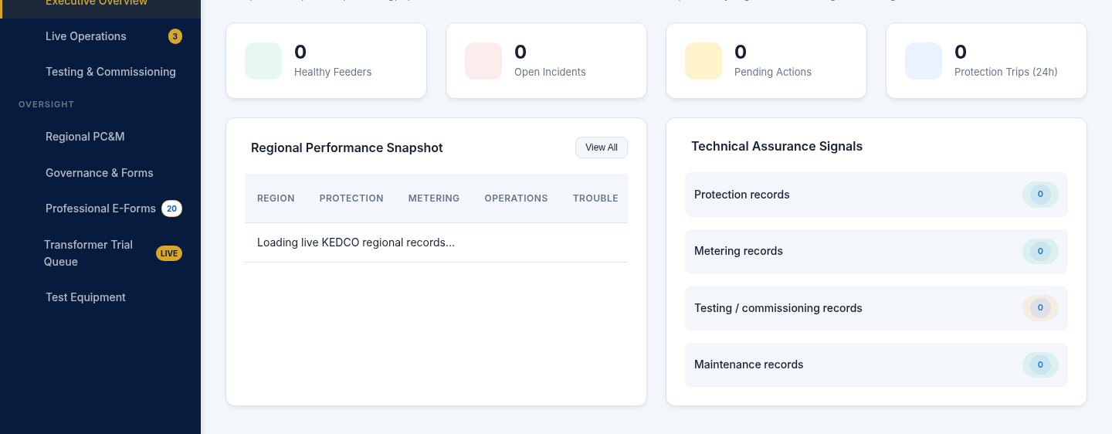
O&M + PC&M
FIELD → TECHNICAL ASSURANCE
Technical departments operate from dedicated dashboards and structured workspaces
The platform separates responsibilities while preserving a common workflow, accountability and management model.
Operations & Maintenance
Head O&M executive dashboard for RE/TE performance, faults, restoration and maintenance
RE/TE responsibility register with state → region → office → voltage → feeder context
Regional electrical fitter and cable jointer digital field workspaces
Interactive network map and route editor embedded in RE/TE operations
Saved/sent records and management register patterns
Protection, Control & Metering
Live protection feed and active trouble reports
Transformer try requests and result workflow
Testing & commissioning hubs for transformers, breakers, meters, cables and lines
Regional and Head PC&M assurance dashboards
Source: headom.html, re_te.html, headpcm.html, regionalpcm.html

Slide 14
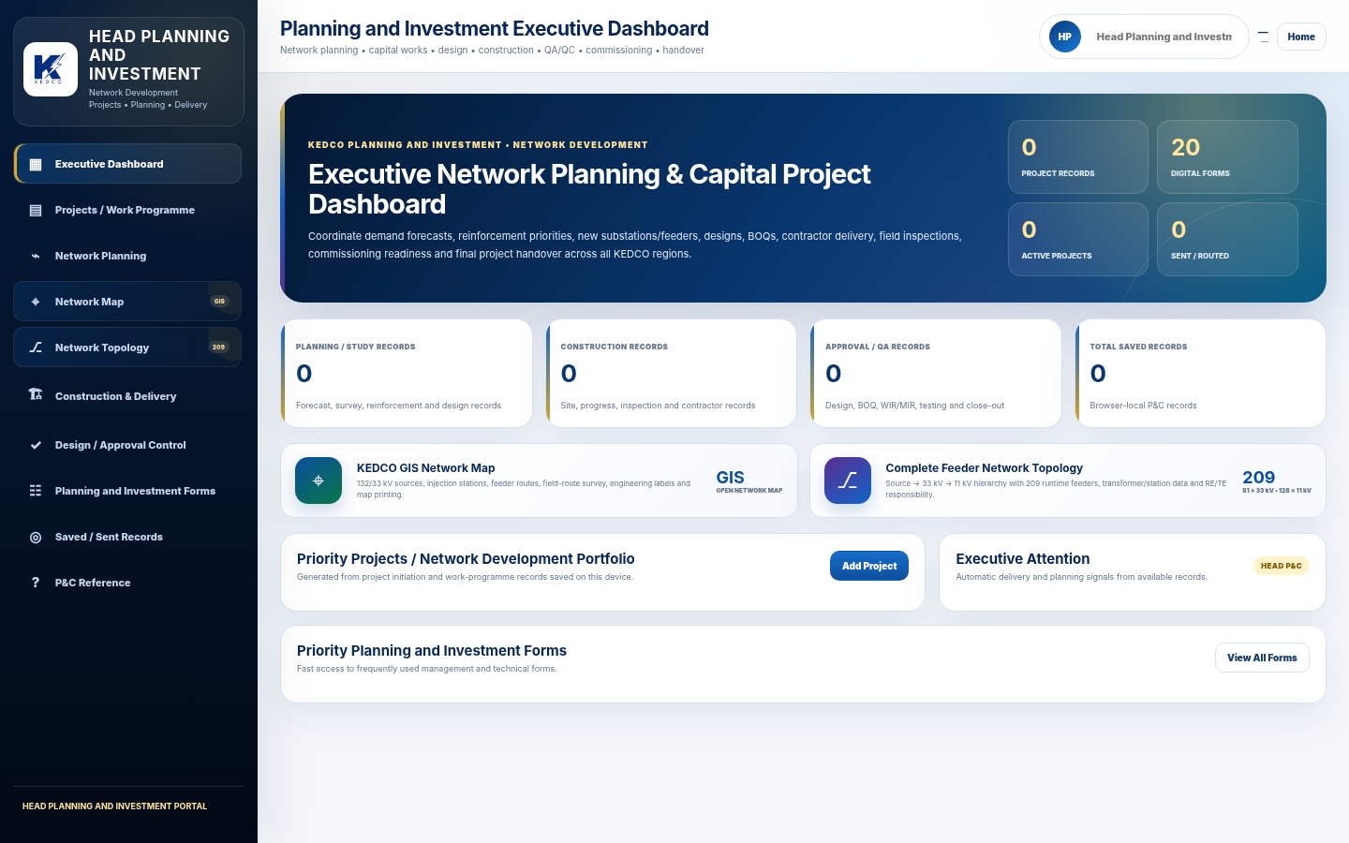
PLANNING, INVESTMENT & NETWORK MANAGEMENT
NETWORK-AWARE PLANNING
Planning decisions are linked to the real network responsibility model
P&I pages combine project/work-program control with network planning, construction delivery, design review and executive/regional forms.
Network-enabled planning
Priority projects and work programme portfolios
Network planning and capacity / development controls
Construction and delivery control
Design approval and quality-control workflows
Interactive topology / route context in technical pages
Region, RE/TE and feeder responsibility mapping for ownership clarity
Source: headpi.html, regionalpi.html, Technical Administration network views

Slide 15
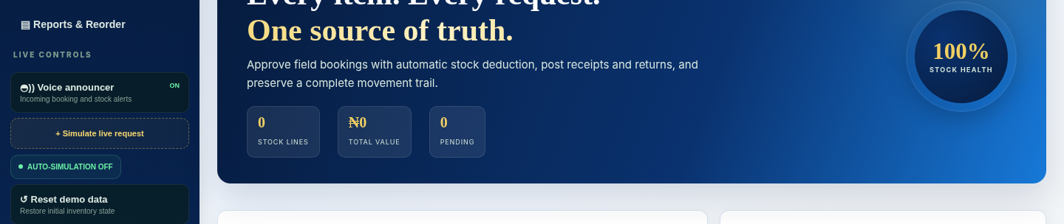
OPERATIONAL SUPPORT MODULES
CONTROL BEYOND THE CONTROL ROOM
HSE, Stores and Contractor control are included in the same governance framework
The platform extends technical automation into the operational dependencies that influence safety, materials availability and project delivery.
HSE
Stores
Contractors
Regional HSE performance
Incidents & near misses
Corrective action management
Management / regional HSE eForms
Incoming booking queue
Stock value by category
Material booking control
Movement audit ledger
Automated reorder schedule
Work-order portfolio
HSE & permit compliance
Progress & QA/QC
Materials / equipment
Digital contractor forms
Same platform principle: structured records, defined ownership, evidence, status and management visibility.
Source: HSE, Stores and Contractor module pages

Slide 16
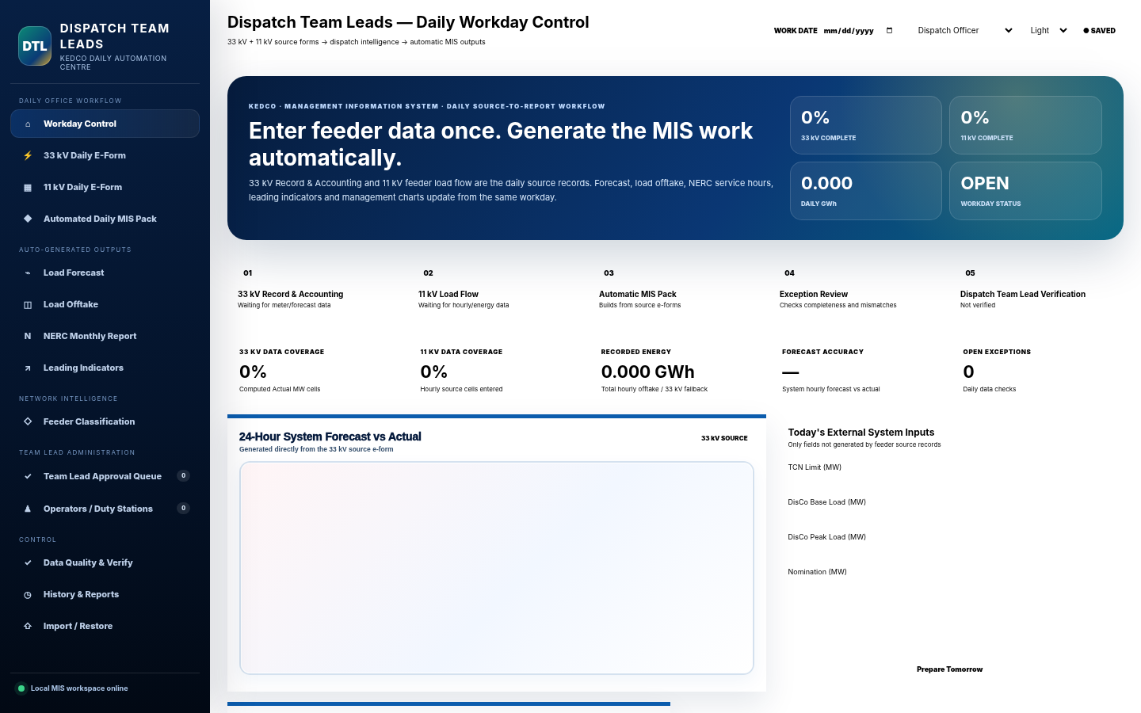
MIS, DATA QUALITY & REPORTING
ENTER ONCE · REUSE MANY TIMES
MIS automation reduces repeated handling between operations and reporting
The MIS module includes daily workday control, exact 33/11 kV eForms, forecast-vs-actual, energy/offtake views and a separate data-cleaning workspace.
1
Import / enter
2
Validate & clean
3
Screen exceptions
4
Generate outputs
5
Management review
Data workspace features
Issue distribution · cleaned preview · exception queue · numeric profile · missing data · category profile
Source: mis.html + teamlead_operatiom_mis.html

Slide 17
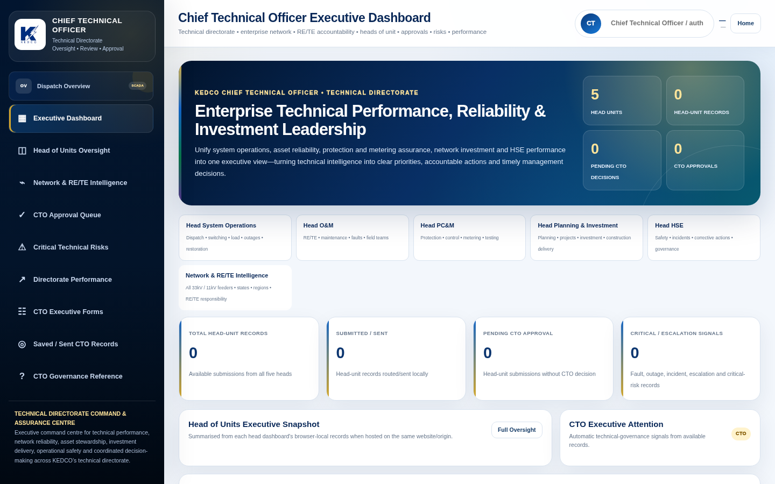
EXECUTIVE MANAGEMENT VISIBILITY
FROM EVENT TO EXECUTIVE VIEW
Leadership dashboards are built into the same operational system
Executive pages are not detached reports: they summarize queues, performance, risks and responsibility gaps from the same application environment.
Executive oversight surfaces
CTO: head-of-unit snapshot, approvals, technical risks and directorate performance
Head System Operations: control-room activity, trips/outages, switching and system performance
Head O&M: faults/restoration, maintenance programme and regional delivery
Head PC&M: protection feed, trouble reports, transformer try requests and technical assurance
Head P&I: priority projects, network development and delivery controls
Head HSE: regional assurance, incidents and corrective actions
Source: executive and department-head dashboards in archive

Slide 18
LOCAL CLOUD & HISTORICAL CONTINUITY
LOCAL STORAGE MODE
Operational data remains under a local, structured storage model
The application routes operational tables, uploads, snapshots and authentication through a local Express backend while browser storage retains preferences, drafts and local session context.
Browser
Session · preferences · drafts · cached page data
Evidence in this archive
Local Express backend
Authentication · API routes · files · tables · sync
1,351
259
snapshots
audit events
table snapshots
audit stream
cloud data/tables
Operational JSON records and event datasets
17
2
Workflow attachments, evidence and source workbooks
file assets
backup sets
cloud data/files
file registry
snapshot bases in package
Backup and restore procedures are included as PowerShell tooling in the project root.
Snapshots & backups
Historical snapshots, versioning and backup archives
Source: LOCAL_CLOUD_GUIDE.md + cloud data directory inventory

Slide 19
ROLE-BASED ACCESS & RESPONSIBILITY CONTROLS
RIGHT USER · RIGHT VIEW
Access is organized around real operational responsibility
The user registry spans executive, control-room, regional, engineering, assurance, data, stores, procurement, finance, legal, contractor and supervisory roles.
51
55
52 / 52
26 / 26
active users
role codes
route targets
operational pages
Current Local Cloud registry
Distinct roles in current registry
Verified role-to-page routing
Shared account controls verified
Executive
MD/CEO · CTO · Technical Administration · heads
Operations
Head SO · Dispatch · Operator · Station Operator · Transmission
Engineering
RE · TE · O&M · PC&M · Planning · HSE
Data & commercial
MIS · Data Analyst · Analyzer · TMO · Stores · Procurement · Finance
External / support
Contractors · Legal · Security · HR/Admin
Supervision
Supervisor · Super Operator · Super RE/TE · Super Transmission
Source: current users.json + 12 Sep verification report

Slide 20
ACCOUNTABILITY, TRACEABILITY & AUDITABILITY
WHO · WHAT · WHEN · WHERE
Every important operational action can leave a structured trail
The data model supports identity, timestamps, network context, status, workflow history, attachments and closing/restoration information.
Identity
User · role · sender · recipient
Outcome
Network context
Approval · feedback · restoration · result
State · region · station · feeder · voltage
AUDITABLE
OPERATIONAL
RECORD
Evidence
Event context
Attachments · file registry · workbook archive
Operation type · reason · load lost · status
Time context
Created · opened · closed · received · reviewed
Source: Local Cloud table schemas and workflow records

Slide 21
IMPLEMENTATION READINESS
VERIFIED 12 SEP 2026
The consolidated Local Cloud edition passed a broad technical verification
The project includes its own integration and verification report covering build, routing, dependencies, page serving, load-flow, Analyzer/TMO and eForms.
Backend TypeScript typecheck
PASS
Backend production build
PASS
Operational pages with account controls
26 / 26
Role routing targets
52 / 52
Local HTML dependencies
206 checked · 0 broken
Inline JavaScript blocks
62 / 62 PASS
HTML pages served by backend
30 / 30 HTTP 200
Integration checks
12 / 12 PASS
System Operations eForms
6 / 6 PASS
Verification report overall result: PASS — consolidated package buildable and tested Local Cloud integration paths passed.
Source: LOCAL_CLOUD_TEST_REPORT.md and CLEANUP_AND_INTEGRATION_REPORT.md

Slide 22
MANAGEMENT BENEFITS
PROPOSED OPERATING IMPACT
The value is operational discipline, visibility and speed—not a cosmetic dashboard upgrade
Benefits below describe the operating change enabled by the platform; no unsupported financial percentage or ROI claim is assumed.
Before / operating risk
Platform-enabled operating model
Operational data
Repeated manual entry and disconnected files
Enter once, synchronize and reuse across views
Fault / outage coordination
Phone/chat/file-dependent handoffs
Structured event, responsibility and restoration trail
Approvals & eForms
Paper or loosely tracked document movement
Digital routing, attachments, receipt, feedback and history
Feeder performance
Time-consuming workbook reconciliation
Repeatable KPI analysis and monthly archive
Management visibility
Periodic compilation from multiple sources
Department and executive dashboards from shared records
Historical retrieval
Records distributed across devices and folders
Local Cloud tables, files, snapshots and backups
Accountability
Harder to reconstruct action ownership
User, role, time, feeder, status and outcome traceability
Strategic result: faster coordination, stronger data discipline, clearer responsibility and a more reliable management information chain.

Slide 23
IMPLEMENTATION APPROACH
CONTROLLED ROLLOUT
Deploy in governed phases without disrupting technical operations
The application is already structured for role-based deployment; implementation can focus on controlled configuration, data preservation, user readiness and operating adoption.
01
02
03
04
05
Baseline & preserve
Configure & validate
Pilot operations
Directorate rollout
Govern & optimize
Back up current cloud data, confirm live workstation version and freeze implementation baseline.
Confirm users, roles, regions, stations, feeders, routing authorities, forms and operating rules.
Deploy with selected control-room / technical teams; validate real data, workflows and management outputs.
Extend to O&M, PC&M, P&I, HSE, MIS, Stores, Contractors and executive dashboards.
Training, SOP alignment, backup schedule, support, change control, analytics refinement and future integrations.
Critical deployment rule from the project documentation: preserve the live workstation cloud data before replacing code or migrating operational records.
Source: deployment note in LOCAL_CLOUD_TEST_REPORT.md

Slide 24
SCALABILITY & FUTURE EXPANSION
BUILD ON THE PLATFORM
The architecture creates a foundation for further technical digitalization
Future opportunities can be added around the same identity, data, workflow and network model instead of creating new isolated applications.
+
Enterprise hosting options
+
SCADA / telemetry integration
+
Mobile field execution
Retain Local Cloud, add controlled central server, hybrid replication or approved cloud hosting.
Bring machine data into the same operational and management views where interfaces are available.
Responsive workflows for fault teams, fitters, jointers, HSE and project supervision.
+
Advanced forecasting
+
Asset intelligence
+
Executive reporting
Expand load / energy forecast models and exception detection using verified historical records.
Connect feeder, transformer, breaker, relay, meter and maintenance histories into lifecycle views.
Automated management packs, performance alerts and board-ready trend reporting.
Expansion principle: integrate where value is clear; preserve the core operational data model and audit trail.

Slide 25

EXECUTIVE CALL TO ACTION
A strong investment is one that improves the operating system of the business.
KEDCO Technical Automation already demonstrates the core platform, module breadth, workflow logic, Local Cloud persistence, role control and verified integration paths required for a controlled implementation programme.
Recommended management action
Authorize a formal implementation / pilot engagement, preserve the current operational dataset, confirm production scope and execute a governed rollout with management checkpoints.
YAJIB SMART SOLUTION UNIVERSAL LIMITED
KEDCO Technical Automation · Executive Management Proposal

