Slide 1
Extending GCC
- Yajnesh T

Slide 2
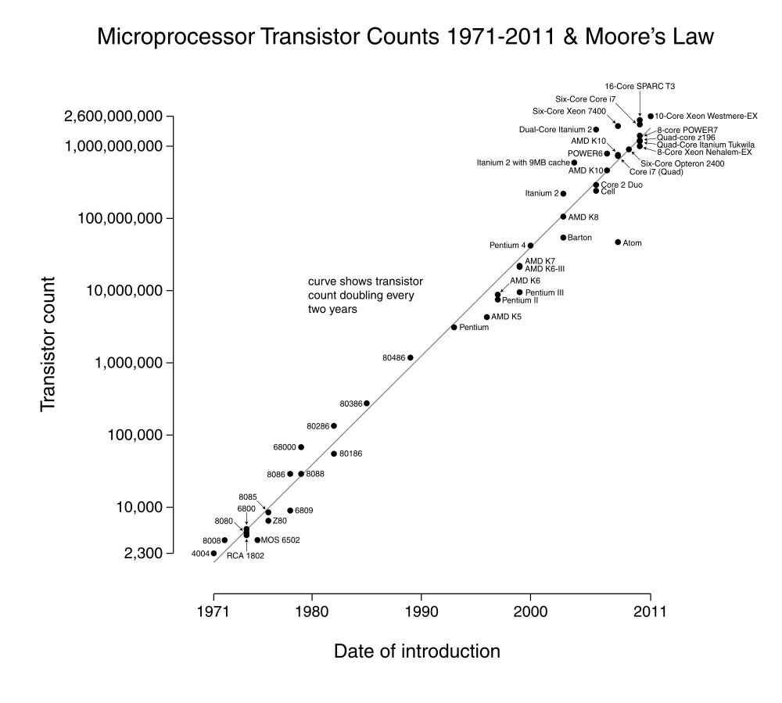
Moore's Law
Performance
Programmers Perspective
Physical Limit

Slide 3
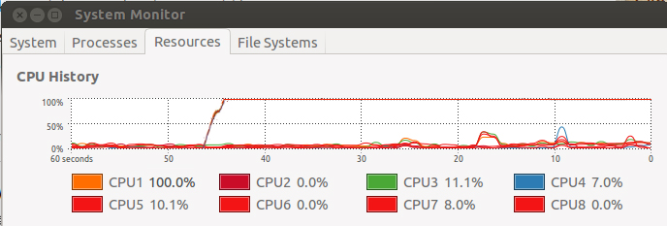
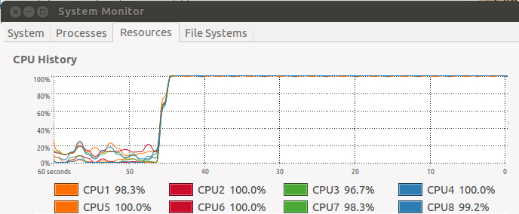
What do we achieve in Parallelization (general)
Notes:
<number><number>

Slide 4
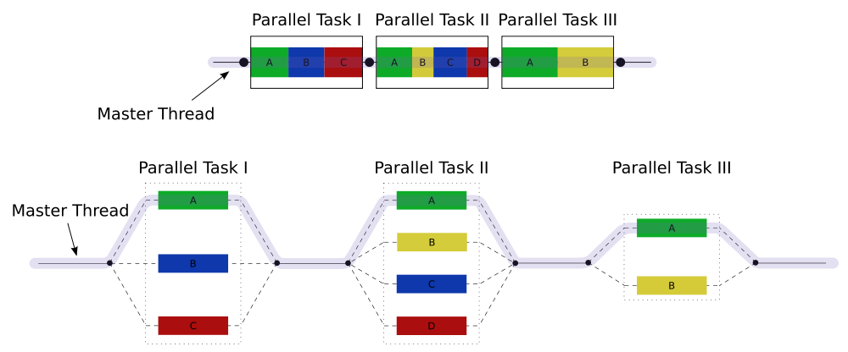
What do we achieve in Parallelization
Notes:
<number><number>

Slide 5
OpenMP
OpenMP is an API that supports multi-platform shared memory multiprocessing programming in C, C++, and Fortran.
Notes:
<number><number>

Slide 6
Problems faced while parallelizing
Tracing the program becomes difficult.
Debugging will be complicated.
Once the code is parallelized , along with the speed, the complexity of the code increases.
This results in increased overall human time & effort spent on a problem.

Slide 7
Auto Parallelization
Let the compiler do the job.
OR
Guided compilation

Slide 8
Modify gcc
Analyze the internals of gcc to add our own pass.
Build local gcc
$gcc input.c -fparallelize

Slide 9
Command line options
$gcc –fparallelize
$gcc –fparallelize –fnested
$gcc -fparallelize -finteractive

Slide 10
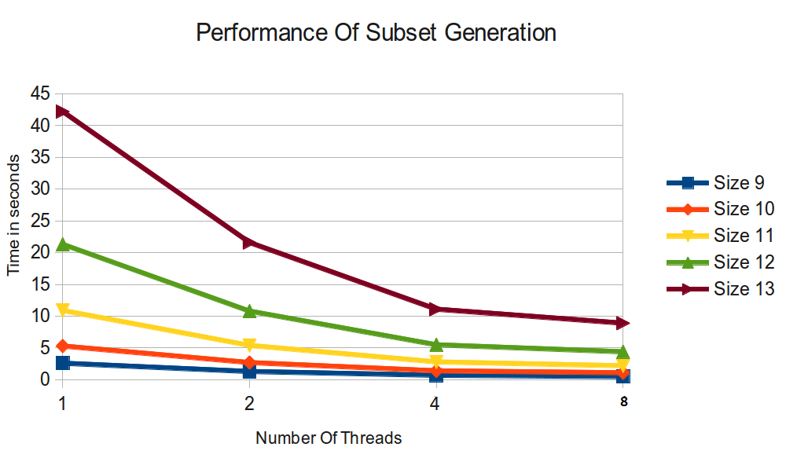
Results:

Slide 11
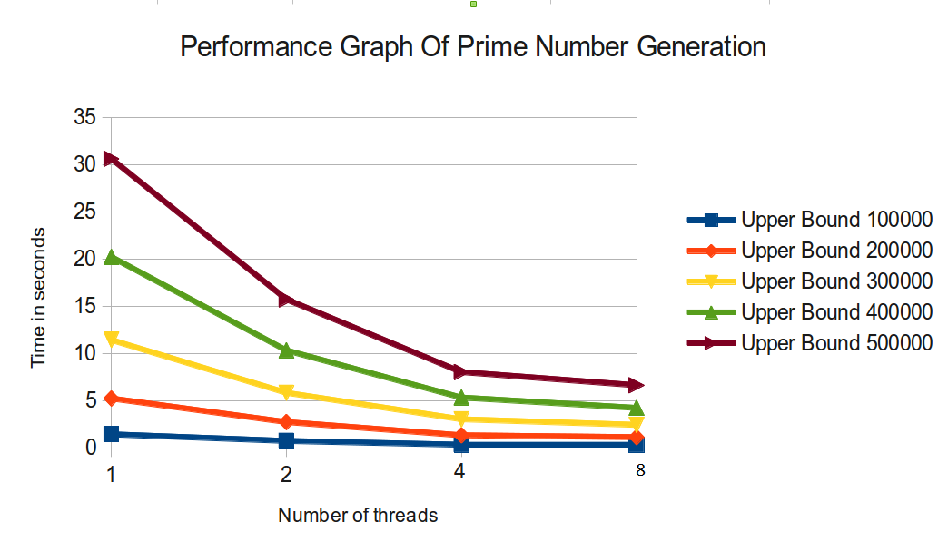
Results:

Slide 12
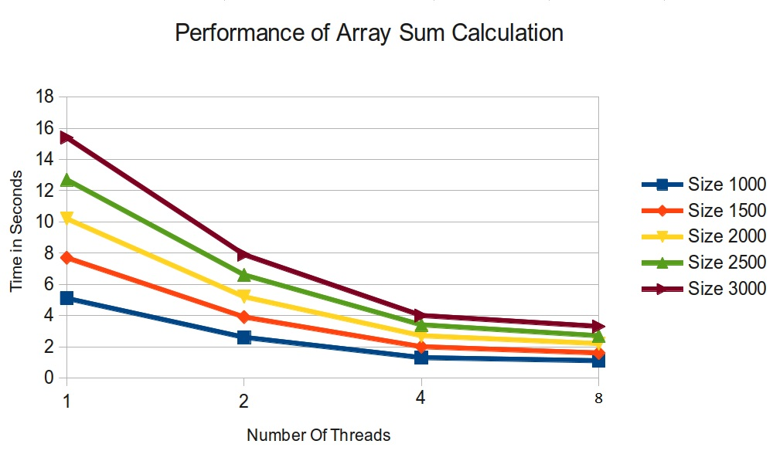
Results:

Slide 13
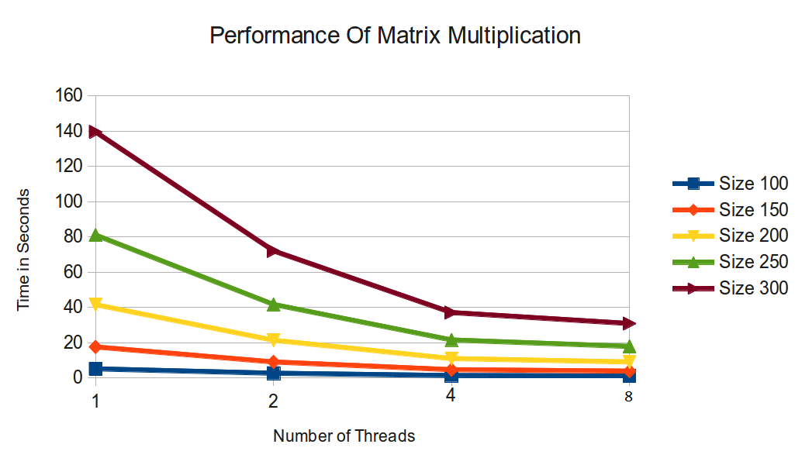
Results:

Slide 14
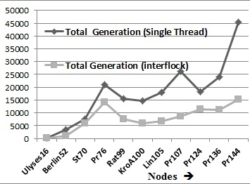
Results:
Interflock-Crossover

