Slide 1
Attrition Analysis

Slide 2
Problem Statement (What unmet need is addressed by technology)
We have used the dataset ibm’s HR analytics employee attrition, which is present in kaggle.
Our model is build to detect attrition of employees after providing the neccessary details.
This is important as companies want to retain their good employees.

Slide 3
Current State of Technology
Currently, attrition analysis is done manually, more naturally but it may lead to understanding errors.
So a set system which uses real world factors to detect attrition is more accurate.

Slide 4
Summery on Data Set Used
The dataset is ibm’s HR analytics employee attrition dataset present in kaggle.
It contains features such as Education, Environment satisfaction, job involvement, job satisfaction, performance rating, relation satisfaction, work life balance.

Slide 5
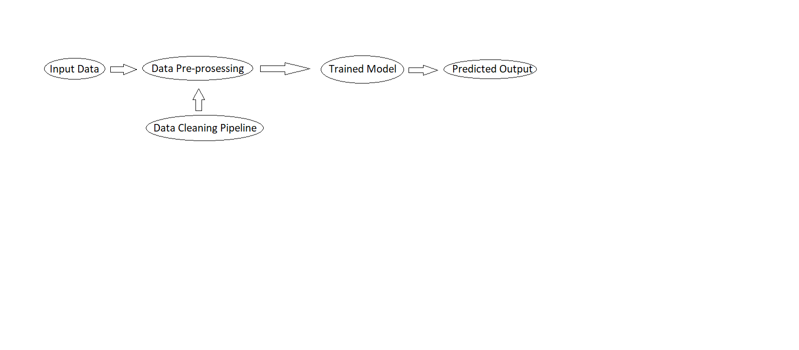
System Architecture/ System Model

Slide 6
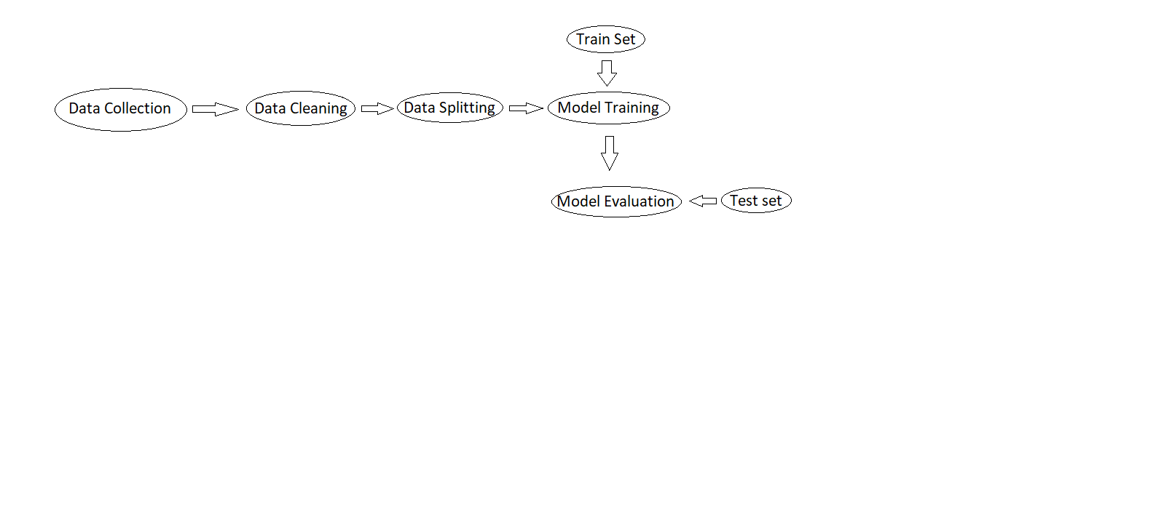
Train Phase

Slide 7
Hardware/Software Used
Python
Google Colab
Kaggle
Random Forest Classifier

Slide 8
Current Status
We used Random forest classifier, trained it using the train set of the dataset after partitioning.
We used the test set to calculate results and got 85% accuracy and 90% precision score.

Slide 9
What is required to further marketability
It can be connected to a web application to make it more user friendly.
It’s services may be deployed to cloud so it may be used by companies who need it directly.

Slide 10
Business opportunities for technology (Market, applications, who will use)
It is in need of every company as attrition is universal and is present in any organization.
Organizations can use it to understand their employees and may help in taking major organizational decisions.

