Slide 1
Chapter 13
Reacting Mixtures
and Combustion

Slide 2
Learning Outcomes
Define complete combustion, theoretical air, enthalpy of formation, and adiabatic flame temperature, and compute values associated with each term.
Develop balanced reaction equations for combustion of hydrocarbon fuels.
Apply mass, energy, and entropy balances to closed systems and control volumes involving chemical reactions.
Conduct exergy analyses, including chemical exergy and the evaluation of exergetic efficiencies.

Slide 3
Introducing Combustion
In combustion reactions, rapid oxidation of combustible elements of the fuel results in energy release as combustion products are formed.
Three major combustible elements in common fuels are
  carbon
  hydrogen
  sulfur

Slide 4
Introducing Combustion
Combustion is complete when
  All carbon present in the fuel is burned to carbon dioxide
  All hydrogen present is burned to water
  All sulfur present is burned to sulfur dioxide
  All other combustible elements are fully oxidized
When these conditions are not fulfilled, combustion is incomplete.

Slide 5
Introducing Combustion
Example: Determine the balanced reaction equation for complete combustion of methane (CH₄) with oxygen (O₂).
For complete combustion, the products contain only carbon dioxide and water:
CH₄ + aO₂ → bCO₂ + cH₂O
where a, b, c denote the moles of O₂, CO₂, and H₂O, respectively, each per mole of CH₄.
Applying conservation of mass to carbon, hydrogen, and oxygen:
C:
1 =
b
H:
4 =
2c
O:
2a =
2b + c
Solving these equations, the balanced reaction equation is
CH₄ + 2O₂ → CO₂ + 2H₂O

Slide 6
Modeling Combustion Air
Oxygen is required in every combustion reaction. In most combustion applications, air provides the needed oxygen.
The following model of dry air is used for simplicity:
  All components of dry air other than oxygen are lumped together with nitrogen. With this idealization, air is considered to be 21% O₂ and 79% N₂ on a molar basis.
  Accordingly, when air supplies the oxygen in a combustion reaction, every mole of O₂ is accompanied by 0.79/0.21 = 3.76 moles of N₂.
  The nitrogen present in the air is assumed inert.
  The molecular weight of dry air is 28.97.
When moist air is used in combustion, the water vapor present in the air should be considered in writing the combustion equation.

Slide 7
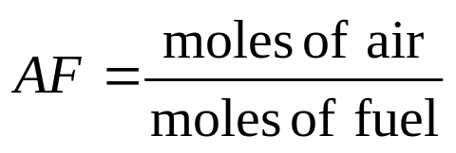
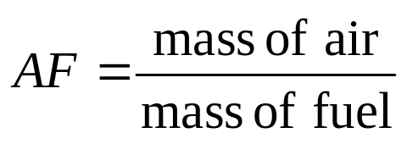
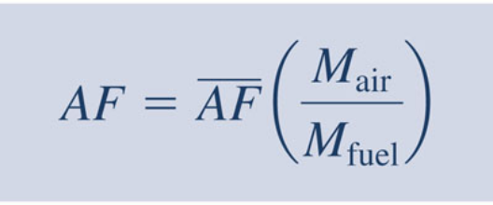
Air-Fuel Ratio
The air-fuel ratio is the ratio of the amount of air in a combustion reaction to the amount of fuel.
The air-fuel ratio can be written on a molar basis:
or on a mass basis:
Conversion between these values is accomplished using the molecular weights of air, M_{air}, and fuel, M_{fuel},
(Eq. 13.2)
The fuel-air ratio is the reciprocal of the air-fuel ratio.

Slide 8
Theoretical Amount of Air
The theoretical amount of air is the minimum amount of air that supplies sufficient oxygen for the complete combustion of all the carbon, hydrogen, and sulfur present in the fuel.
For complete combustion with the theoretical amount of air, the products consist of CO₂, H₂O, and SO₂ plus nitrogen present in the reactants. No free oxygen, O₂, appears in the products.
Normally the amount of air supplied is either greater than or less than the theoretical amount. The amount of air actually supplied is commonly expressed as
  A percent of theoretical air – e.g., 150% of theoretical air equals 1.5 times the theoretical amount.
  A percent excess (or percent deficiency) of air – e.g., 50% excess air equals 150% of theoretical air.

Slide 9
Exploring Combustion Concepts
The balanced chemical equation for complete combustion of methane with the theoretical amount of air is
CH₄ + 2 (O₂ + 3.76 N₂) → CO₂ + 2H₂O + 7.52N₂
(Eq. 13.4)
The coefficient 2 before the term (O₂ + 3.76 N₂) is the number of moles of O₂ in the combustion air per mole of fuel.
The number of moles of N₂ in the combustion air per mole of fuel is 2 × 3.76.
The amount of combustion air per mole of fuel is the sum,
2 + 2 × 3.76 = 2(4.76) = 9.52
This is the air-fuel ratio on a molar basis: AF = 9.52/1.

Slide 10
Exploring Combustion Concepts
The balanced chemical equation for complete combustion of methane with 150% theoretical air is
CH₄ + (1.5) (2) (O₂ + 3.76 N₂) → CO₂ + 2H₂O + O₂ + 11.28 N₂
The amount of air per mole of fuel is 1.5 times the theoretical amount determined by Eq. 13.4.
The excess air supplied appears in the products as O₂ and as a greater amount of N₂ than in Eq. 13.4, based on the theoretical amount of air.
The air-fuel ratio on a molar basis is,
AF = (1.5)(2)(4.76)/1 = 14.28/1

Slide 11
Dry Product Analysis
In practical applications, combustion is generally incomplete.
The products of combustion of actual combustion processes and their relative amounts can be determined only by measurement.
Certain devices for measuring the composition of combustion products report the analysis on a dry product analysis basis where the mole fractions are given for all products except water.

Slide 12
Dry Product Analysis
Example: Ethanol (C₂H₅OH) is burned with air to give products with the dry molar analysis 3.16% CO₂, 16.6% CO, 80.24% N₂. Determine the balanced chemical reaction.
Basing the solution for convenience on 100 moles of dry products, the reaction equation reads:
a C₂H₅OH + b(O₂ + 3.76N₂) → 3.16CO₂ + 16.6CO + 80.24N₂ + cH₂O
where a denotes the moles of fuel required for 100 moles of dry products.
Also note that a term accounting for the water formed in this reaction must be included.

Slide 13

Dry Product Analysis
aC₂H₅OH + b(O₂ + 3.76N₂) → 3.16CO₂ + 16.6CO + 80.24N₂ + cH₂O
Applying conservation of mass
C:
2a =
3.16 + 16.6
→ a = 9.88
H:
6a =
2c
→ c = 29.64
N:
3.76b =
80.24
→ b = 21.34
Checking:
O:
a + 2b =
3.16(2) + 16.6 + c
52.56 = 52.56
The balanced reaction equation is
9.88C₂H₅OH+21.34(O₂+3.76N₂)→3.16CO₂+16.6CO+80.24N₂+29.64H₂O
Expressing this on a per mole of fuel basis
C₂H₅OH + 2.16(O₂ + 3.76N₂) → 0.32CO₂ + 1.68CO + 8.12N₂ + 3H₂O

Slide 14
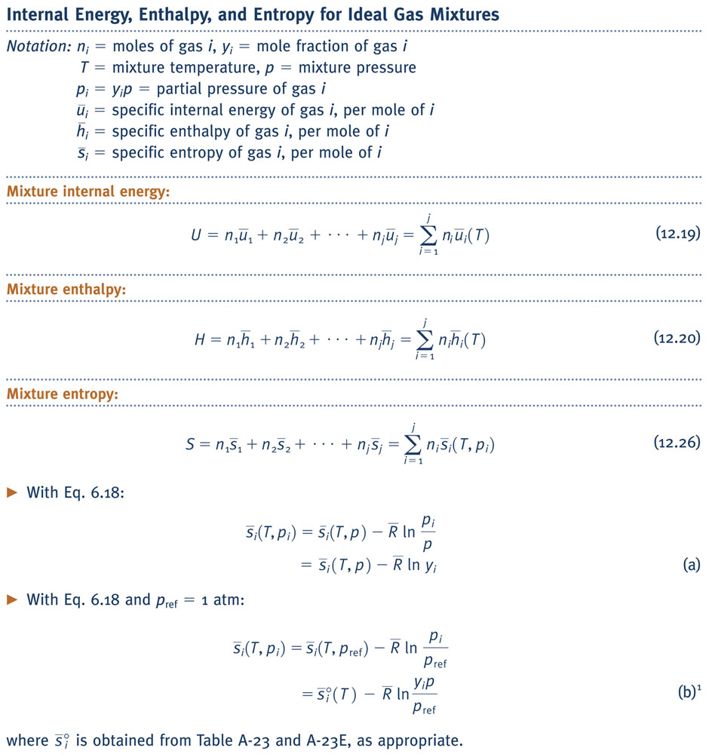
Energy and Entropy Balances for Reacting Systems
The forms of the energy and entropy balances used thus far remain valid for reacting systems. Still, there are some special aspects worth noting.
Combustion air and (frequently) products of combustion are each modeled as ideal gas mixtures. Accordingly, the ideal gas mixture principles summarized in Table 13.1 play a role.
TABLE 13.1

Slide 15
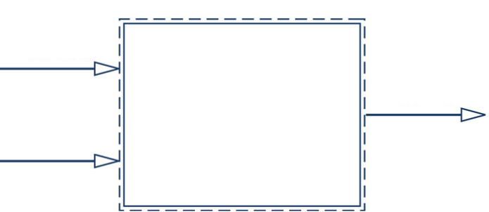
Energy and Entropy Balances for Reacting Systems
For reacting systems, the methods used for evaluating specific enthalpy and specific entropy differ fundamentally from the practices used thus far in nonreacting applications. This brings in two new concepts:
  Enthalpy of formation
  Absolute entropy
A simple example illustrates the need for revising the way enthalpy and entropy are evaluated in reacting systems. The figure shows a control volume in which hydrogen and oxygen enter, each as ideal gases, and react to form liquid water according to
H₂
H₂O
O₂
H₂ + ½O₂ → H₂O

Slide 16
Energy and Entropy Balances for Reacting Systems
H₂
H₂ + ½O₂ → H₂O
H₂O
O₂
To apply an energy balance to the control volume, we might think of using enthalpy data from the steam tables for liquid water and from Table A-23 for the gases.
However, since those tables use arbitrary datums to assign enthalpy values, they must be used only to determine differences in enthalpy between two states, for then and only then do the arbitrary datums cancel – see Sec. 3.6.3.

Slide 17
Energy and Entropy Balances for Reacting Systems
H₂
H₂ + ½O₂ → H₂O
H₂O
O₂
For the case under consideration, H₂ and O₂ enter the control volume but do not exit, and liquid water exits but does not enter. Accordingly, enthalpy differences from inlet to exit do not arise for each of these substances when applying an energy balance to the control volume. For each it is necessary to assign enthalpy values in a way that the common datum cancels. This is achieved using the enthalpy of formation.
Like considerations apply when evaluating entropy values for substances in reacting systems; for them absolute entropy values are required.

Slide 18
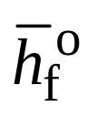
Evaluating Enthalpy for Reactive Systems
An enthalpy datum for the study of reacting systems is established by assigning a value of zero to the enthalpy of C, H₂, N₂, O₂, and other stable elements at the standard reference state defined by T_{ref} = 298.15 K (25ºC) and p_{ref} = 1atm.
The enthalpy of a compound at the standard state equals its enthalpy of formation, denoted .
The enthalpy of formation is the energy released or absorbed when the compound is formed from its elements, the compound and elements all being at T_{ref} and p_{ref}.

Slide 19
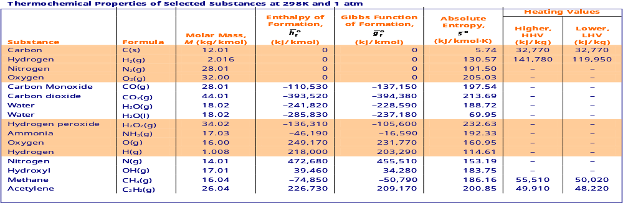
Evaluating Enthalpy for Reactive Systems
Tables A-25 and A-25E give values of the enthalpy of formation in kJ/kmol and Btu/lbmol, respectively.
As indicated by the table heading these data apply only to the standard state, 298 K, 1 atm.
A zero value is assigned to the enthalpy of formation for each of the first four substances.
TABLE A-25

Slide 20

Evaluating Enthalpy for Reactive Systems
Nonzero values apply to all other substances, where a minus sign correspond to an exothermic reaction when the compound is formed from its elements. A positive value of the enthalpy of formation corresponds to an endothermic reaction when the compound is formed from its elements.
TABLE A-25

Slide 21
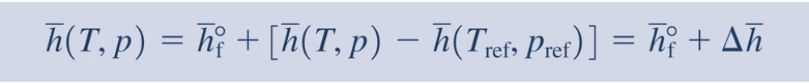
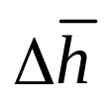
Evaluating Enthalpy for Reactive Systems
The specific enthalpy of a compound at a state where temperature is T and pressure is p is determined from
(Eq. 13.9)
That is, the enthalpy of a compound is composed of
associated with the formation of the compound from its elements. This is obtained from Tables A-25 and A-25E.
associated with the change in state from the standard state to the state where temperature is T and the pressure is p. Since this term is a difference at fixed composition, it can be evaluated from the ideal gas tables, steam tables, or other tables, as appropriate.

Slide 22
Using the Enthalpy of Formation Concept with the Control Volume Energy Rate Balance
The enthalpy of formation concept enables the control volume energy rate balance to be implemented for engineering applications involving combustion, including
  Calculation of heating values (Sec. 13.2.3)
  Calculation of adiabatic flame temperature (Sec. 13.3)
The following example provides a specific illustration showing use of the enthalpy of formation.

Slide 23
Example
Pulverized coal (assume carbon) enters a combustor at 298 K, 1 atm and burns completely with O₂ entering at 400 K, 1 atm. A stream of carbon dioxide exits at 500 K, 1 atm. For a control volume at steady state enclosing the reactor, evaluate the rate of heat transfer, in kJ per kmol of coal entering. Assume the ideal gas model for O₂ and CO₂, and neglect kinetic and potential energy effects.
298 K, 1 atm
C
CO₂
500 K, 1 atm
400 K, 1 atm
O₂
C + O₂ → CO₂

Slide 24
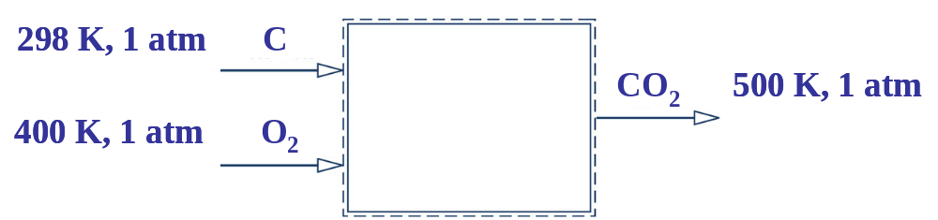
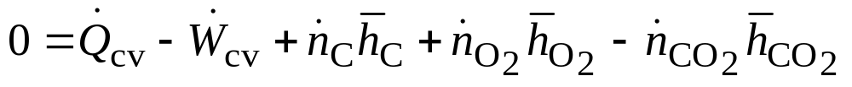
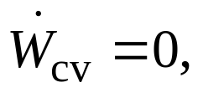
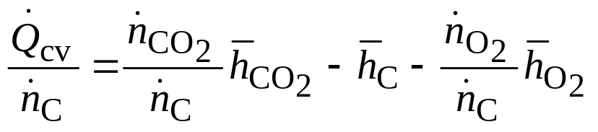
Example
C + O₂ → CO₂
The energy rate balance on a molar basis is:
and kinetic and potential energy effects are neglected.
Solving for the heat transfer per mole of coal, and noting from the reaction equation that the molar flow rates are equal
1
1

Slide 25
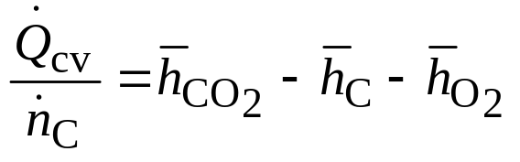
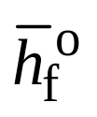
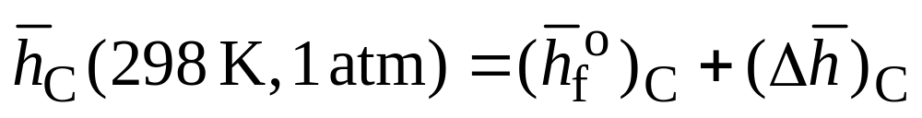
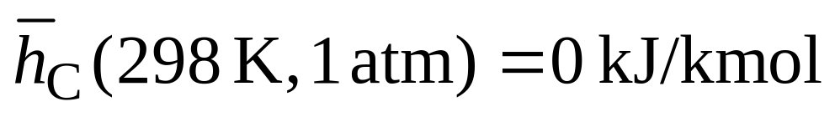
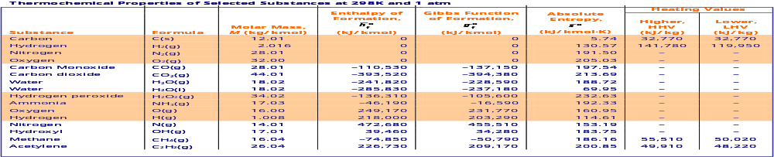
Example
(1)
Carbon enters at the standard state. With from Table A-25, Eq. 13.9 gives
TABLE A-25

Slide 26
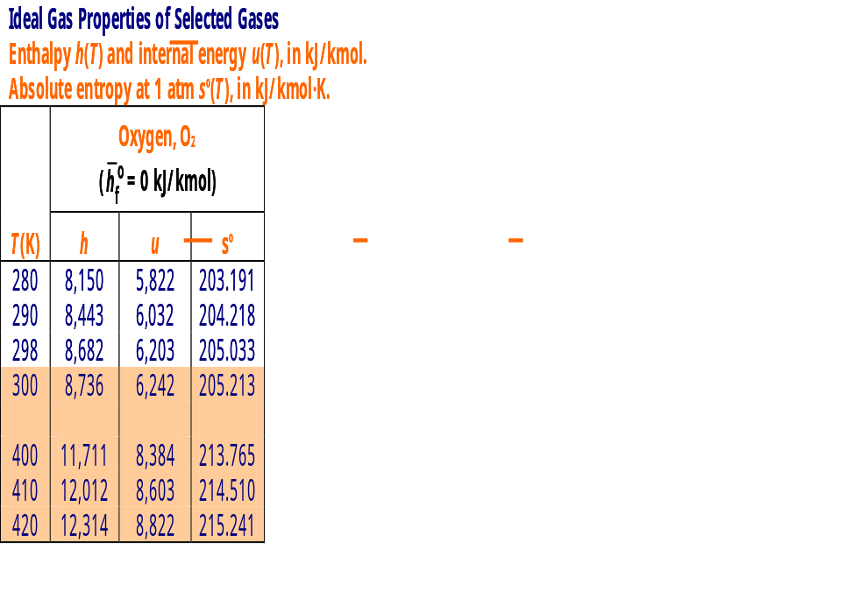
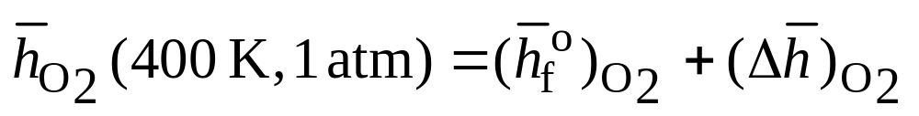
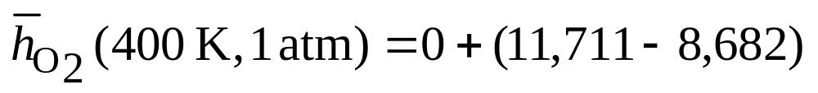
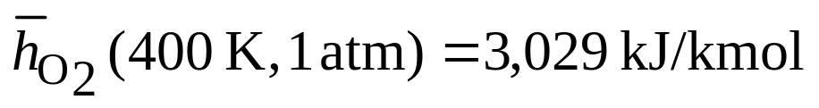
Example
TABLE A-23
(1)
Oxygen enters at 400 K, 1 atm. With data from Table A-23, Eq. 13.9 gives

Slide 27
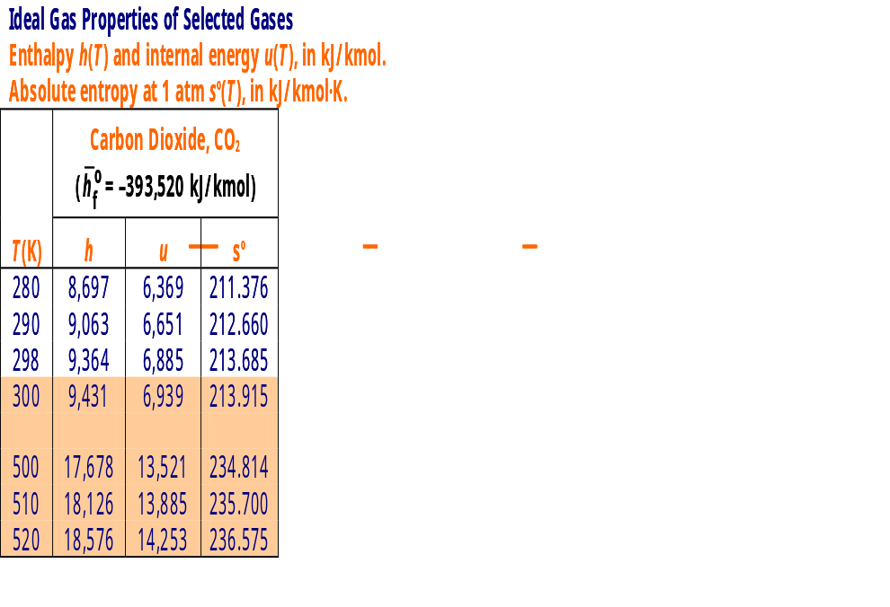
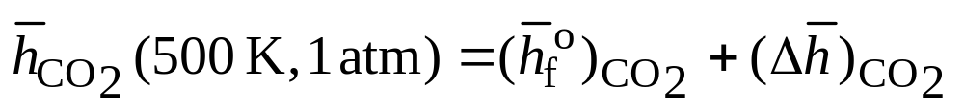
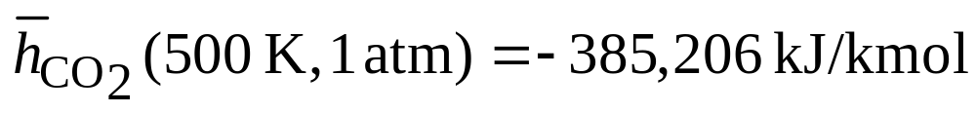
Example
TABLE A-23
(1)
Carbon dioxide exits at 500 K, 1 atm. With data from Table A-23, Eq. 13.9 gives

Slide 28
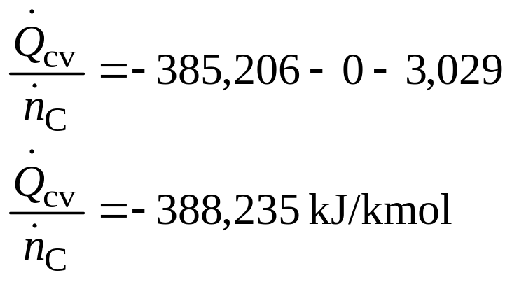
Example
C + O₂ → CO₂
With these values, Eq. (1) gives
The minus sign indicates heat transfer from the control volume.

Slide 29
Heating Values of Hydrocarbon Fuels
The heating values of hydrocarbon fuels have important applications.
The heating value of a fuel is the difference between the enthalpy of the reactants and the enthalpy of the products when the fuel burns completely with air, reactants and products being at the same temperature T and pressure p.

Slide 30
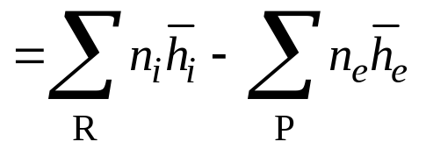
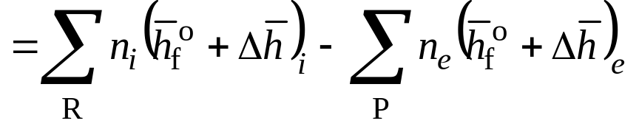
Heating Values of Hydrocarbon Fuels
That is, the heating value per mole of fuel
(1)
where
R denotes the reactants and P denotes the products.
The n’s correspond to the coefficients of the reaction equation, each per mole of fuel.

Slide 31
Heating Values of Hydrocarbon Fuels
Two heating values are recognized by name:
  The higher heating value (HHV) is obtained when all the water formed by combustion is a liquid.
  The lower heating value (LHV) is obtained when all the water formed by combustion is a vapor.
  The higher heating value exceeds the lower heating value by the energy that would be released were all water in the products condensed to liquid.

Slide 32

Heating Values of Hydrocarbon Fuels
Heating value data at 298 K, 1 atm are provided in Tables A-25 and A-25E with units of kJ/kg and Btu/lb, respectively.
TABLE A-25

Slide 33
Heating Values of Hydrocarbon Fuels
Example: Evaluate the lower heating value of liquid octane at 25ºC, 1 atm, in kJ per kg of octane, and compare with the value provided in Table A-25.
The balanced chemical equation for complete combustion of octane is
C₈H₁₈ + 12.5(O₂ + 3.76N₂) → 8CO₂ + 9H₂O(g) + 47N₂
where all water formed is assumed to be a vapor.

Slide 34
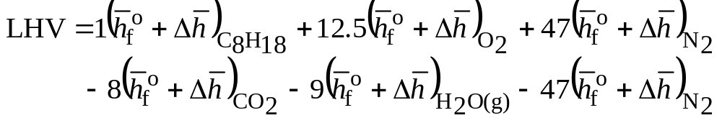
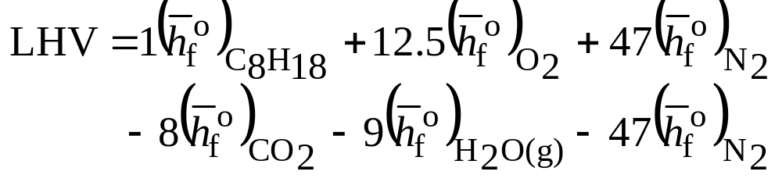
Heating Values of Hydrocarbon Fuels
With coefficients from the chemical equation, Eq. (1) reads
0
0
0
0
0
0
Since the lower heating value at 25ºC and 1 atm is required, this reduces as follows

Slide 35
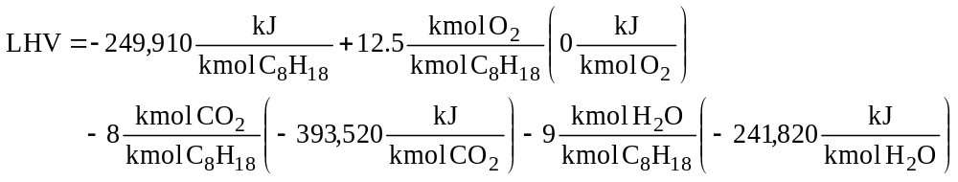
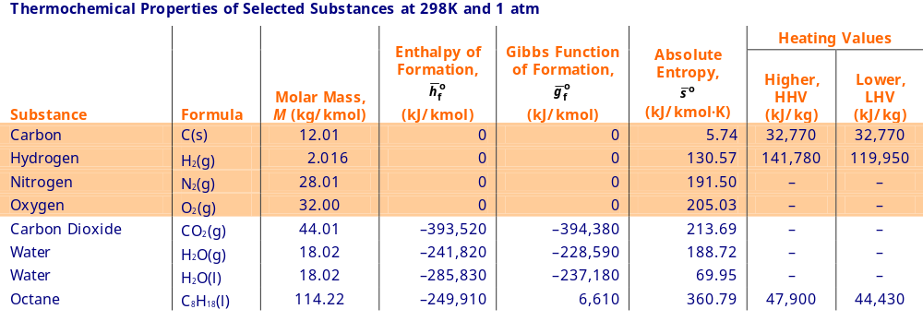
Heating Values of Hydrocarbon Fuels
With enthalpy of formation data obtained from Table A-25, we get the lower heating value on a per mole of octane basis.
LHV = 5,074,630 kJ/kmol C₈H₁₈

Slide 36
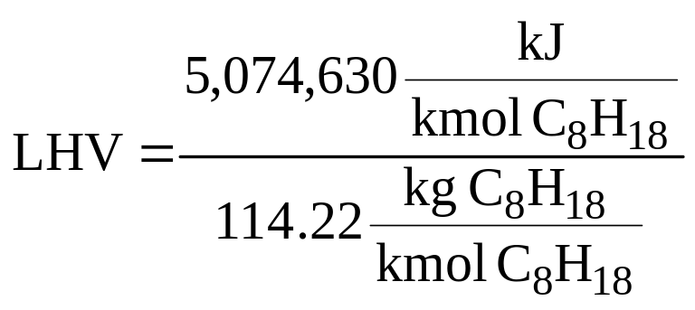
Heating Values of Hydrocarbon Fuels
Dividing by the molecular weight of octane, the lower heating value per kg of octane is
LHV = 44,429 kJ/kg C₈H₁₈
This value agrees with the value (44,430 kJ/kg C₈H₁₈) from Table A-25, as expected.

Slide 37
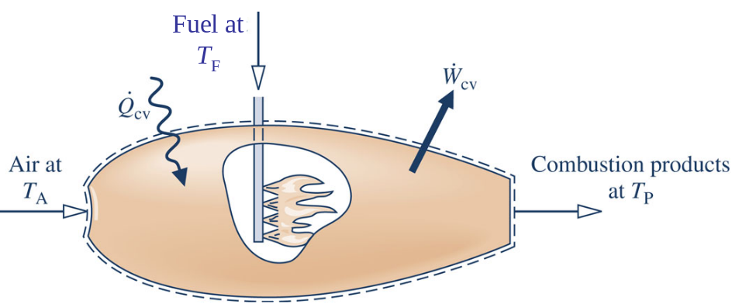

Adiabatic Flame Temperature
To introduce the adiabatic flame temperature concept, consider the reactor at steady state shown in the figure
Heat
Transfer
In the absence of work and appreciable kinetic and potential energy effects, the energy liberated on combustion is transferred from the reactor in two ways only
  Energy accompanying the exiting combustion products
  Heat transfer to the surroundings

Slide 38
Adiabatic Flame Temperature
The smaller the heat transfer to the surroundings, the greater the energy carried out with the combustion products and thus the greater the temperature T_{P} of the combustion products.
The adiabatic flame temperature is the temperature that would be achieved by the products in the limit of adiabatic operation.
The maximum adiabatic flame temperature corresponds to complete combustion with the theoretical amount of air.

Slide 39
Adiabatic Flame Temperature
Example: Methane gas at 25ºC, 1 atm enters an insulated reactor operating at steady state and burns completely with x × 100% of theoretical air entering at 25ºC, 1 atm. Plot the adiabatic flame temperature for x ranging from 1 to 4. Assume ideal gas model principles apply.
298 K, 1 atm
CH₄
Products
T_{P}, 1 atm
298 K, 1 atm
x × 100%
theoretical
air

Slide 40
Adiabatic Flame Temperature
Complete combustion of CH₄ with the theoretical amount of air is
CH₄ + 2(O₂ + 3.76N₂) → CO₂ + 2H₂O + 7.52N₂
Complete combustion of CH₄ with x × 100% of the theoretical amount of air is
CH₄ + 2x(O₂ + 3.76N₂) → CO₂ + 2H₂O + 2(x-1)O₂ + 7.52xN₂
For each specified value of x, the evaluation of adiabatic flame temperature requires an iterative solution of the corresponding energy rate balance.

Slide 41
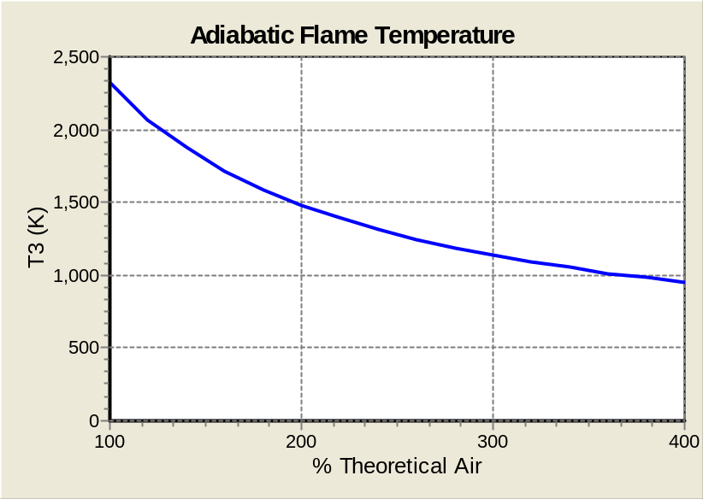
Adiabatic Flame Temperature
Applying an energy rate balance at steady state, using Eq. 13.9 to express the enthalpy of each substance in terms of its enthalpy of formation, and varying x from 1 to 4 yields the plot at right.
Maximum
T_{P} (K)
Once adequate oxygen has been provided to permit complete combustion, bringing in more air dilutes the combustion products, lowering their temperature.

Slide 42
Absolute Entropy
For reacting systems, a common datum must be used to assign entropy values to participating substances. This is accomplished using the third law of thermodynamics.
Based on empirical evidence, the third law states that the entropy of a pure crystalline substance is zero at the absolute zero of temperature, 0 K.
Values of entropy determined relative to this datum are called absolute entropy values.
Observe that the steam tables and Tables A-7 through A-18 DO NOT provide absolute entropy values.

Slide 43
Absolute Entropy
Tables A-25 and A-25E give the value of the absolute entropy for selected substances at the standard state in units of kJ/kmol∙K and Btu/lbmol∙ºR, respectively.
TABLE A-25

Slide 44
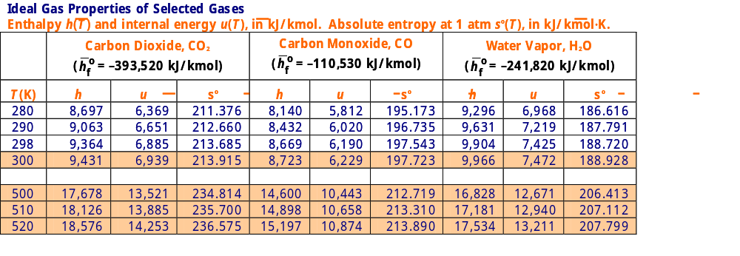
Absolute Entropy
Tables A-23 and A-23E give the value of the absolute entropy for selected substances versus temperature at a pressure of 1 atm in units of kJ/kmol∙K and Btu/lbmol∙ºR, respectively. In these tables
  The absolute entropy at 1 atm and temperature T is designated sº(T).
  The ideal gas model applies to the gases.
TABLE A-23

Slide 45
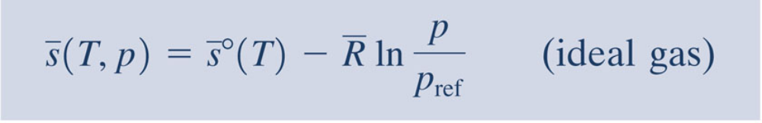
Absolute Entropy
For the ideal gases in Tables A-23, the absolute entropy at a state where temperature is T and pressure is p is given by
(Eq. 13.22)
The first term on the right is the absolute entropy at temperature T and pressure p_{ref} = 1 atm.

Slide 46
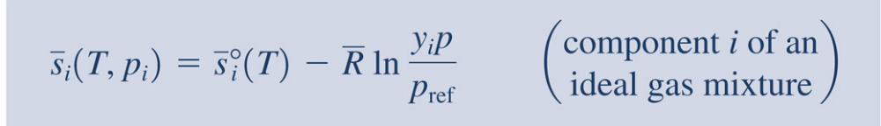
Absolute Entropy
For the i^{th} component of an ideal gas mixture, Eq. 13.22 takes the form
(Eq. 13.23)
In this expression, p_{i} is the partial pressure of component i, y_{i} is the mole fraction of component i, and p is the mixture pressure.

Slide 47
Absolute Entropy
Example: Applying Eq. 13.23, evaluate the absolute entropy for dry air at T = 350 K,
p = 2 atm, in kJ/kmol(air)∙K. The molar analysis is
y_{O2} = 0.21 kmol (O₂)/kmol(air)
y_{N2} = 0.79 kmol(N₂)/kmol(air)
and the ideal gas model applies.

Slide 48
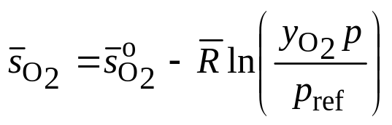

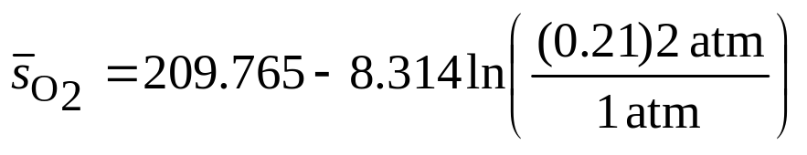
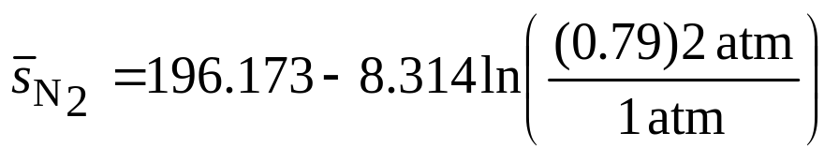
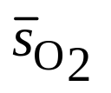
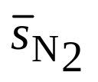
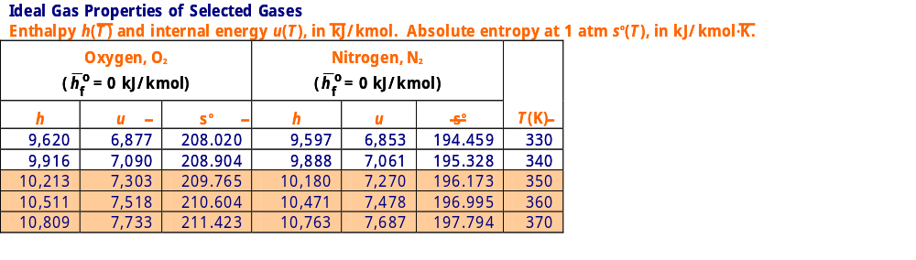
Absolute Entropy
With data from Table A-23, Eq. 13.23 gives
= 216.977 kJ/kmol(O₂)∙K
= 192.370 kJ/kmol(N₂)∙K
TABLE A-23

Slide 49
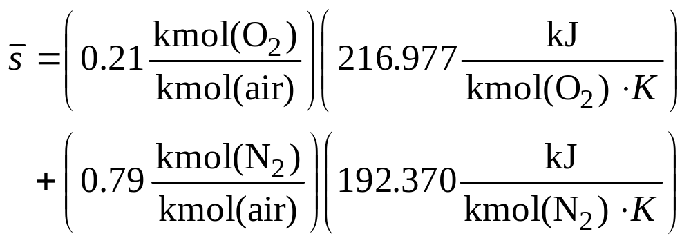

Absolute Entropy
Finally, per kmol of air
= 197.537 kJ/kmol(air)∙K

Slide 50
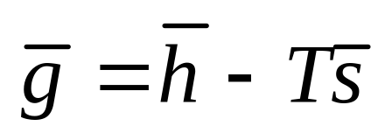
Evaluating Gibbs Function for Reacting Systems
The specific Gibbs function g is given by
(Eq. 13.27)
Gibbs function is a property because it is defined in terms of other properties.
Gibbs function has no physical significance – in general, but contributes to the development of chemical exergy in the next part of Chapter 13, and has other important applications.

Slide 51
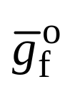
Evaluating Gibbs Function for Reacting Systems
As for enthalpy, a Gibbs function datum for the study of reacting systems is established by assigning a value of zero to the Gibbs function of C, H₂, N₂, O₂ at the standard reference state: 298.15 K, 1 atm.
The Gibbs function of a compound at the standard state equals its Gibbs function of formation, denoted .
The Gibbs function of formation is the change in the Gibbs function for the reaction in which the compound is formed from its elements, the compound and elements all being at the standard state.

Slide 52
Evaluating Gibbs Function for Reacting Systems
Tables A-25 and A-25E give values of the Gibbs function of formation in kJ/kmol and Btu/lbmol, respectively.
As indicated by the table heading these data apply only to the standard state, 298 K, 1 atm.
TABLE A-25

Slide 53
Evaluating Gibbs Function for Reacting Systems
The specific Gibbs function of a compound at a state where temperature is T and pressure is p is determined from
(Eq. 13.28a)
where
(Eq. 13.28b)

