Slide 1

AI-Powered Student Attendance Management System
A dual-mode authentication platform combining facial recognition and QR code verification to deliver accurate, real-time, and fraud-resistant attendance tracking for modern academic institutions.
ACADEMIC PROJECT
COMPUTER SCIENCE
YAKA ANANTHA
323129512059

Slide 2

The Problem with Traditional Attendance
Manual attendance systems are error-prone, time-consuming, and increasingly inadequate as class sizes grow.
⏱ Time Loss
Roll calls consume 5–10 minutes per session, reducing instructional time.
📋 Proxy Attendance
Students easily mark absent peers as present with no verification mechanism.
❌ Human Errors
Manual registers introduce data entry mistakes and record inconsistencies.
📊 No Real-Time Data
Fraudulent records go undetected until end-of-term reviews.

Slide 3
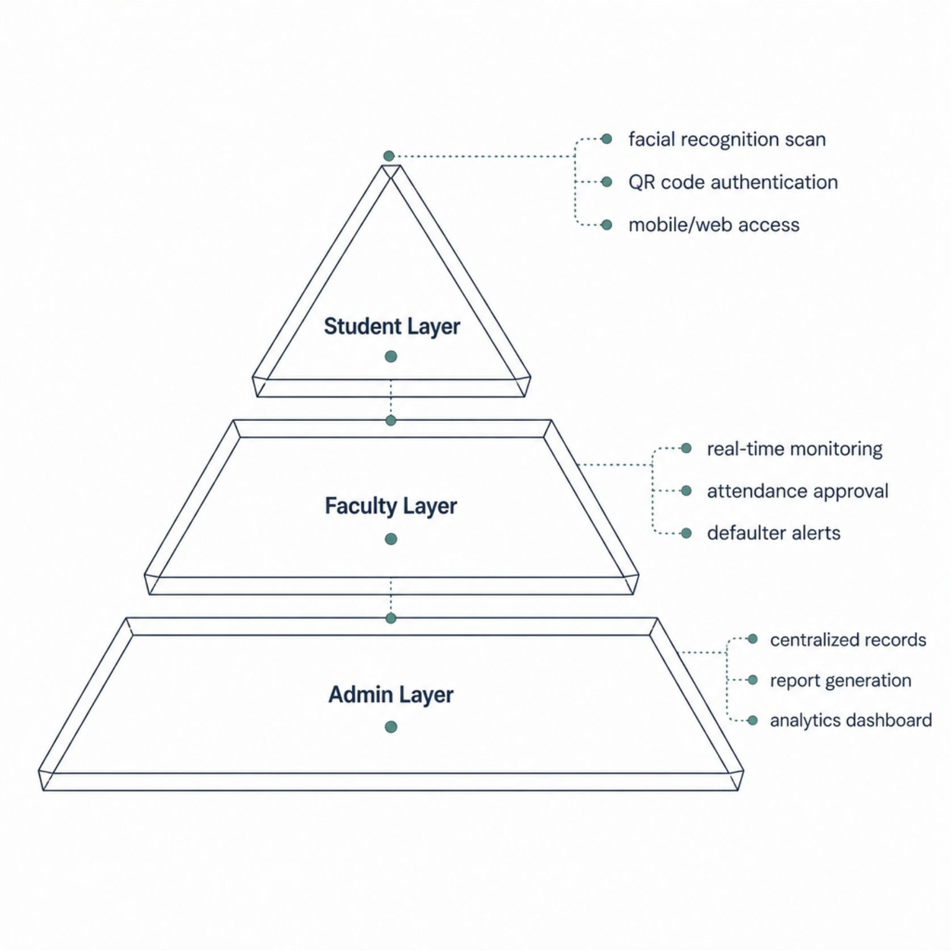
Our Solution: An Intelligent Attendance Platform
A unified system enabling students to authenticate via facial recognition or QR code, while faculty and administrators access live dashboards and automated reports.
Dual-Mode Authentication
Students choose facial recognition or QR code based on device availability and classroom setup.
Live Faculty Dashboard
Instructors monitor attendance status in real time and receive automated defaulter alerts.
Centralized Records
All data syncs to a secure cloud database with exportable reports and trend analytics.

Slide 4
Technology Stack
The system integrates proven open-source and enterprise-grade technologies across the full stack.
Computer Vision
QR Authentication
OpenCV and dlib for facial detection, landmark extraction, and 128-dimensional face encoding.
Time-sensitive, session-bound QR codes generated per class to prevent replay attacks.
Backend & Database
Frontend & Sync
RESTful API (Node.js/Python) with PostgreSQL for records and Redis for session caching.
Responsive React web app with WebSocket-based real-time data synchronization.

Slide 5

System Architecture & Workflow
Authenticate
Validate
Record
Sync & Alert
From authentication to record storage, the entire pipeline completes in under 3 seconds, ensuring zero disruption to classroom flow while maintaining an auditable, tamper-proof attendance log.

Slide 6
Features by User Role
Students
Faculty
Administrators
Self-service attendance via face scan or QR code
Personal attendance history and trend view
Low-attendance warnings and notifications
Cross-device access (web and mobile)
Real-time class attendance dashboard
Manual override and correction tools
Automated defaulter identification
Session-wise and semester-wise reports
Institution-wide attendance analytics
Exportable reports (PDF, CSV, Excel)
Course and student enrollment management
System configuration and audit logs

Slide 7

Traditional vs. AI-Powered Attendance
The table below highlights key differences between manual attendance methods and the proposed AI-powered system across critical operational dimensions.
Feature
Traditional
AI System
Verification Method
Manual roll call
Face + QR code
The AI-powered system eliminates proxy attendance, reduces administrative time by up to 80%, and provides auditable, real-time records accessible from anywhere.
Proxy Prevention
None
Biometric + session token
Record Accuracy
Error-prone
Automated, timestamped
Real-Time Access
Not available
Live dashboard
Report Generation
Manual effort
One-click export
Scalability
Limited
Cloud-ready, unlimited

Slide 8

Security, Scalability & Reliability
🔒 Fraud Prevention
Session-bound QR codes expire after each class. Facial recognition uses 128-dimensional embeddings that are computationally infeasible to spoof.
☁️ Platform Independence
Browser-based frontend runs on any device — desktop, tablet, or smartphone — with no proprietary hardware required.
📈 Scalability
Modular microservices architecture supports horizontal scaling from a single classroom to institution-wide deployment.
✅ Data Integrity
Immutable audit logs, role-based access control, and encrypted data transmission ensure compliance with academic data policies.

Slide 9

Benefits of the Proposed System
~80%
Admin Time Saved
Automated capture eliminates manual roll calls and data entry.
~3s
Authentication Speed
Face scan or QR verification completes in seconds per student.
24/7
Dashboard Access
Faculty and admins access live records anytime, anywhere.
100%
Timestamped Records
Every attendance entry is automatically time-stamped and auditable.

Slide 10
Future Enhancements & Roadmap
The platform is designed for continuous evolution, with the following capabilities planned for upcoming releases.
Phase 1 — Anti-Spoofing
1
Liveness detection using blink and depth analysis to prevent photo-based spoofing.
2
Phase 2 — Mobile & Cloud
Native iOS/Android apps with cloud deployment for multi-campus scalability.
Phase 3 — AI Analytics
3
Predictive models to identify at-risk students based on attendance patterns.
4
Phase 4 — Ecosystem Integration
Geofencing, multi-factor authentication, and LMS integration (Moodle, Canvas).

