Slide 1
Building Python Programs
Chapter 1: Introduction to Python

Slide 2
Computer Science
CS is about PROCESS – describing how to accomplish tasks
"efficiently implementing automated abstractions" (Philip Guo)
Computers are a tool
Currently the best implementation platform
What kinds of problems can they solve?
How can they be made faster, cheaper, more efficient…?
Science?
More like engineering, art, magic…
Hypothesis creation, testing, refinement important
CS is still a young field finding itself

Slide 3
Why should you take Computer Science?
… like solving tricky problems
… like building things
… (will) work with large data sets
… are curious about how Facebook, Google, etc work
… are shopping around for a major

Slide 4

Programming
program: A set of instructions to be carried out by a computer.
program execution: The act of carrying out the instructions contained in a program.
programming language: A systematic set of rules used to describe computations in a format that is editable by humans.

Slide 5
Some modern languages
procedural languages: programs are a series of commands
Pascal (1970): designed for education
C (1972): low-level operating systems and device drivers
functional programming: functions map inputs to outputs
Lisp (1958) / Scheme (1975), ML (1973), Haskell (1990)
object-oriented languages: programs use interacting "objects"
Smalltalk (1980): first major object-oriented language
C++ (1985): "object-oriented" improvements to C
successful in industry; used to build major OSes such as Windows
Python (1991):
The language taught in this course

Slide 6
Why Python?
Relatively simple
Pre-written software
Widely used

Slide 7
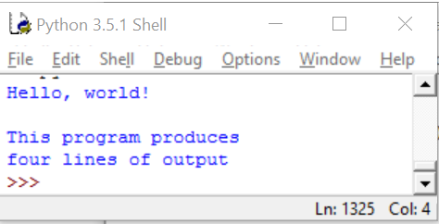
A Python program
print("Hello, world!")
print()
print("This program produces")
print("four lines of output")
Its output:
Hello, world!
This program produces
four lines of output
console: Text box into which the program's output is printed.

Slide 8
print
A statement that prints a line of output on the console.
Two ways to use print :
print("text")
Prints the given message as output.
print()
Prints a blank line of output.
Notes:
8

Slide 9
Strings and escape sequences

Slide 10
Strings
string: A sequence of characters to be printed.
Starts and ends with a " quote " character or a ' quote ' character.
The quotes do not appear in the output.
Examples: "hello" "This is a string. It's very long!" 'Here is "another" with quotes in' """I can span multiple lines because I'm surrounded by 3 quotes"""
Restrictions:
Strings surrounded by " " or ' ' may not span multiple lines "This is not a legal String."
Strings surrounded by " " may not contain a " character. "This is not a "legal" String either."
Strings surrounded by ' ' may not contain a ' character. 'This is not a 'legal' String either.'
Notes:
10

Slide 11
Escape sequences
escape sequence: A special sequence of characters used to represent certain special characters in a string.
\t tab character
\n new line character
\" quotation mark character
\' quotation mark character
\\ backslash character
Example: print("\\hello\nhow\tare \"you\"?\\\\")
Output: \hello how are "you"?\\

Slide 12
Questions
What is the output of the following print statements?
print("\ta\tb\tc")
print("\\\\")
print("'")
print("\"\"\"")
print("C:\nin\the downward spiral")
Write a print statement to produce this output:
/ \ // \\ /// \\\

Slide 13
Answers
Output of each print statement:
a b c
\\
'
"""
C:
in he downward spiral
print statement to produce the line of output:
print("/ \\ // \\\\ /// \\\\\\")

Slide 14
Questions
What print statements will generate this output?
This quote is from
Irish poet Oscar Wilde:
"Music makes one feel so romantic
- at least it always gets on one's nerves –
which is the same thing nowadays."
What print statements will generate this output?
A "quoted" String is
'much' better if you learn
the rules of "escape sequences."
Also, "" represents an empty String.
Don't forget: use \" instead of " !
'' is not the same as "

Slide 15
Answers
print statements to generate the output:
print("This quote is from")
print("Irish poet Oscar Wilde:”)
print()
print("\"Music makes one feel so romantic")
print("- at least it always gets on one's nerves -")
print("which is the same thing nowadays.\"")
print statements to generate the output:
print("A \"quoted\" String is")
print("'much' better if you learn")
print("the rules of \"escape sequences.\"")
print()
print("Also, \"\" represents an empty String.")
print("Don't forget: use \\\" instead of \" !")
print("'' is not the same as \"")

Slide 16
Creating a Python Program

Slide 17
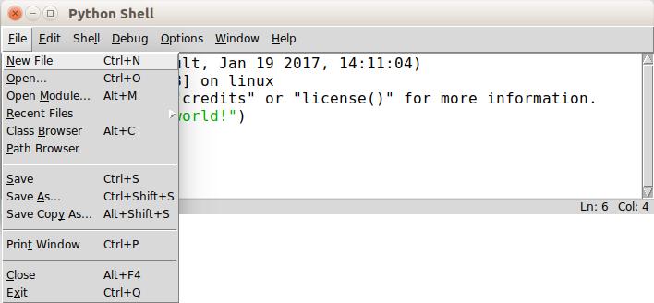
Creating a Python Program File

Slide 18
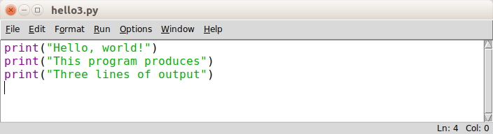
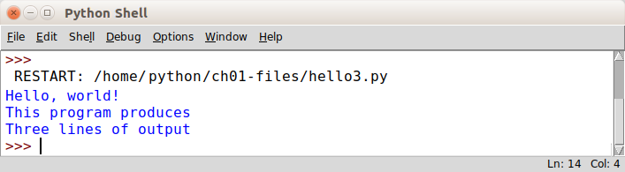
Creating a Python Program File
When Run -> Run Module is selected:

Slide 19
Comments
comment: A note written in source code by the programmer to describe or clarify the code.
Comments are not executed when your program runs.
Syntax:
# comment text
Examples:
# This is a one-line comment.
# This is a very long
# multi-line comment.

Slide 20
Comments example
# Suzy Student,
# CSc 110, Fall 2019
# Displays lyrics
# first line
print("When I first got into magic")
print("it was an underground phenomenon")
print()
# second line
print("Now everybody's like")
print("pick a card, any card")

Slide 21
functions

Slide 22
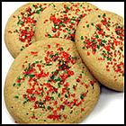
Algorithms
algorithm: A list of steps for solving a problem.
Example algorithm: "Bake sugar cookies"
Mix the dry ingredients.
Cream the butter and sugar.
Beat in the eggs.
Stir in the dry ingredients.
Set the oven temperature.
Set the timer for 10 minutes.
Place the cookies into the oven.
Allow the cookies to bake.
Spread frosting and sprinkles onto the cookies.
...

Slide 23
Problems with algorithms
lack of structure: Many steps; tough to follow.
redundancy: Consider making a double batch...
Mix the dry ingredients.
Cream the butter and sugar.
Beat in the eggs.
Stir in the dry ingredients.
Set the oven temperature.
Set the timer for 10 minutes.
Place the first batch of cookies into the oven.
Allow the cookies to bake.
Set the timer for 10 minutes.
Place the second batch of cookies into the oven.
Allow the cookies to bake.
Mix ingredients for frosting.
...

Slide 24
Structured algorithms
structured algorithm: Split into coherent tasks.
1 Make the batter.
Mix the dry ingredients.
Cream the butter and sugar.
Beat in the eggs.
Stir in the dry ingredients.
2 Bake the cookies.
Set the oven temperature.
Set the timer for 10 minutes.
Place the cookies into the oven.
Allow the cookies to bake.
3 Decorate the cookies.
Mix the ingredients for the frosting.
Spread frosting and sprinkles onto the cookies.
...

Slide 25
Removing redundancy
A well-structured algorithm can describe repeated tasks with less redundancy.
1 Make the cookie batter.
Mix the dry ingredients.
...
2a Bake the cookies (first batch).
Set the oven temperature.
Set the timer for 10 minutes.
...
2b Bake the cookies (second batch).
Repeat Step 2a
3 Decorate the cookies.
...

Slide 26
functions
function: A named group of statements.
denotes the structure of a program
eliminates redundancy by code reuse
procedural decomposition: dividing a problem into functions
Writing a function is like adding a new command to Python.
Function A
statement
statement
statement
Function B
statement
statement
Function C
statement
statement
statement

Slide 27
Declaring a function
Gives your function a name so it can be executed
Syntax: def name(): statement statement ... statement
Example: def print_warning(): print("This product causes cancer") print("in lab rats and humans.")

Slide 28
Calling a function
Executes the function’s code
Syntax:
name()
You can call the same function many times if you like.
Example:
print_warning() #separate multiple words with underscores
Output:
This product causes cancer
in lab rats and humans.

Slide 29
Using functions
1. Design (think about) the algorithm.
Look at the structure, and which commands are repeated.
Decide what are the important overall tasks.
2. Declare (write down) the functions.
Arrange statements into groups and give each group a name.
3. Call (run) the function.

Slide 30
Program with functions
# This function prints the lyrics to my favorite song.
def rap():
print("Now this is the story all about how")
print("My life got flipped turned upside-down")
rap() # Calling (running) the rap function
print()
rap() # Calling the rap function again
Output:
Now this is the story all about how
My life got flipped turned upside-down
Now this is the story all about how
My life got flipped turned upside-down

Slide 31
Functions calling functions
def message1():
print("This is message1.")
def message2():
print("This is message2.")
message1()
print("Done with message2.")
message1()
message2()
print("Done with everything.")
Output:
This is message1.
This is message2.
This is message1.
Done with message2.
Done with main.

Slide 32
Control flow
When a function is called, the program's execution...
"jumps" into that function, executing its statements, then
"jumps" back to the point where the function was called.
message1()
message2()
print("Done with main.")
...
def message1():
print("This is message1.")
def message2():
print("This is message2.")
message1()
print("Done with message2.")
def message1():
print("This is message1.")

Slide 33
Structure of a program
No code should be placed outside a function. Instead use a main function.
The one exception is a call to your main function
def main():
message1()
message2()
print("Done with everything.")
def message1():
print("This is message1.")
def message2():
print("This is message2.")
message1()
print("Done with message2.")
main()

Slide 34
When to use functions (besides main)
Place statements into a function if:
The statements are related structurally, and/or
The statements are repeated.
You should not create functions for:
An individual print statement.
Only blank lines.
Unrelated or weakly related statements. (Consider splitting them into two smaller functions.)

Slide 35
Drawing complex figures with functions

Slide 36
Functions question
Write a program to print these figures using functions.
______
/ \
/ \
\ /
\______/
\ /
\______/
+--------+
______
/ \
/ \
| STOP |
\ /
\______/
______
/ \
/ \
+--------+

Slide 37
Development strategy
______
/ \
/ \
\ /
\______/
\ /
\______/
+--------+
______
/ \
/ \
| STOP |
\ /
\______/
______
/ \
/ \
+--------+
First version (unstructured):
Create an empty program.
Copy the expected output into it, surrounding each line with print syntax.
Run it to verify the output.

Slide 38
Program version 1
def main():
print(" ______")
print(" / \\")
print("/ \\")
print("\\ /")
print(" \\______/")
print()
print("\\ /")
print(" \\______/")
print("+--------+")
print()
print(" ______")
print(" / \\")
print("/ \\")
print("| STOP |")
print("\\ /")
print(" \\______/")
print()
print(" ______")
print(" / \\")
print("/ \\")
print("+--------+")
main()

Slide 39
Development strategy 2
______
/ \
/ \
\ /
\______/
\ /
\______/
+--------+
______
/ \
/ \
| STOP |
\ /
\______/
______
/ \
/ \
+--------+
Second version (structured, with redundancy):
Identify the structure of the output.
Divide the code into functions based on this structure.

Slide 40
Output structure
______
/ \
/ \
\ /
\______/
\ /
\______/
+--------+
______
/ \
/ \
| STOP |
\ /
\______/
______
/ \
/ \
+--------+
The structure of the output:
initial "egg" figure
second "teacup" figure
third "stop sign" figure
fourth "hat" figure
This structure can be represented by functions:
egg
tea_cup
stop_sign
hat

Slide 41
Program version 2
def main():
egg()
tea_cup()
stop_sign()
hat()
def egg():
print(" ______")
print(" / \\")
print("/ \\")
print("\\ /")
print(" \\______/")
print()
def tea_cup():
print("\\ /")
print(" \\______/")
print("+--------+")
print()
def stop_sign():
print(" ______")
print(" / \\")
print("/ \\")
print("| STOP |")
print("\\ /")
print(" \\______/")
print()
def hat():
print(" ______")
print(" / \\")
print("/ \\")
print("+--------+")

Slide 42
Development strategy 3
______
/ \
/ \
\ /
\______/
\ /
\______/
+--------+
______
/ \
/ \
| STOP |
\ /
\______/
______
/ \
/ \
+--------+
Third version (structured, without redundancy):
Identify redundancy in the output, and create functions to eliminate as much as possible.
Add comments to the program.

Slide 43
Output redundancy
______
/ \
/ \
\ /
\______/
\ /
\______/
+--------+
______
/ \
/
| STOP |
\ /
\______/
______
/ \
/ \
+--------+
The redundancy in the output:
egg top: reused on stop sign, hat
egg bottom: reused on teacup, stop sign
divider line: used on teacup, hat
This redundancy can be fixed by functions:
egg_top
egg_bottom
line

Slide 44
Program version 3
# Draws a teacup figure.
def tea_cup():
egg_bottom()
line()
print()
# Draws a stop sign figure.
def stop_sign():
eggTop()
print("| STOP |")
egg_bottom()
print()
# Draws a figure that looks sort of like a hat.
def hat():
egg_top()
line()
# Draws a line of dashes.
def line():
print("+--------+")
# Suzy Student, CSc 110, Spring 2094
# Prints several figures, with methods for structure and redundancy.
def main():
egg()
tea_cup()
stop_sign()
hat()
# Draws the top half of an an egg figure.
def egg_top():
print(" ______")
print(" / \\")
print("/ \\")
# Draws the bottom half of an egg figure.
def egg_bottom():
print("\\ /")
print(" \\______/")
# Draws a complete egg figure.
def egg():
egg_top()
egg_bottom()
print()

Slide 45
Keywords
keyword: An identifier that you cannot use because it already has a reserved meaning in Python.
and del from not while
as elif global or with
assert else if pass yield
break except import print
class exec in raise
continue finally is return
def for lambda try

