Slide 1
ILT Evaluator Cockpit Architecture
Real-Time 80% Stroke Mirroring, Clinical Telemetry, and Dynamic Controls
Invented Letter Task (ILT) Research Platform | Wacom DTHA116 Deployment | October 2026

Slide 2
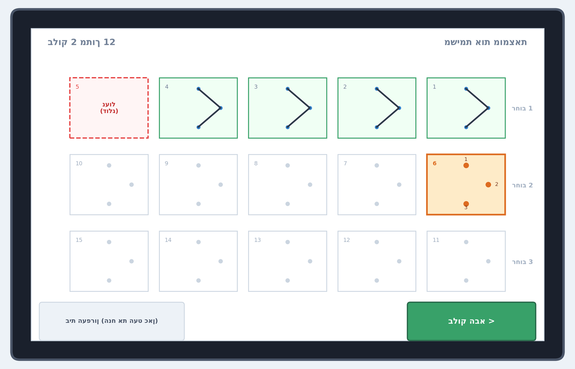
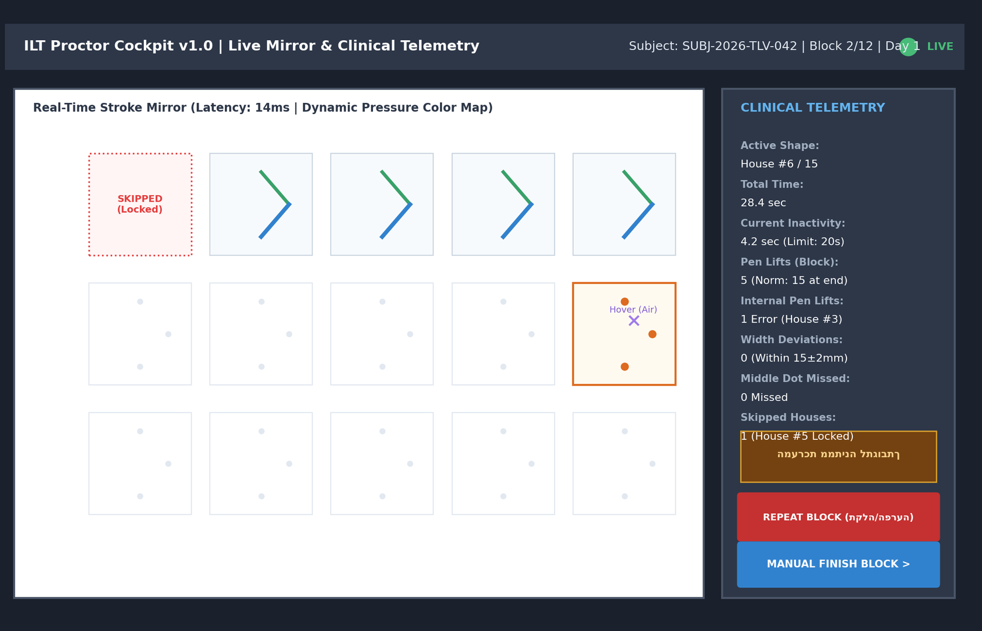
CORE SYSTEM WIREFRAMES
Primary 1:1 Proctor Cockpit and Student Canvas
Student Kiosk Canvas (3x5 Grid): Forward-only locking prevents backtracking; pen rest and green Next Block.
Evaluator Cockpit (80% Mirror / 20% Telemetry): Real-time pressure colors, in-air hover, Repeat Block, and inactivity warning.
Source: ILT Functional Requirements Specification v1.0 | Clinical Pilot Protocol

Slide 3
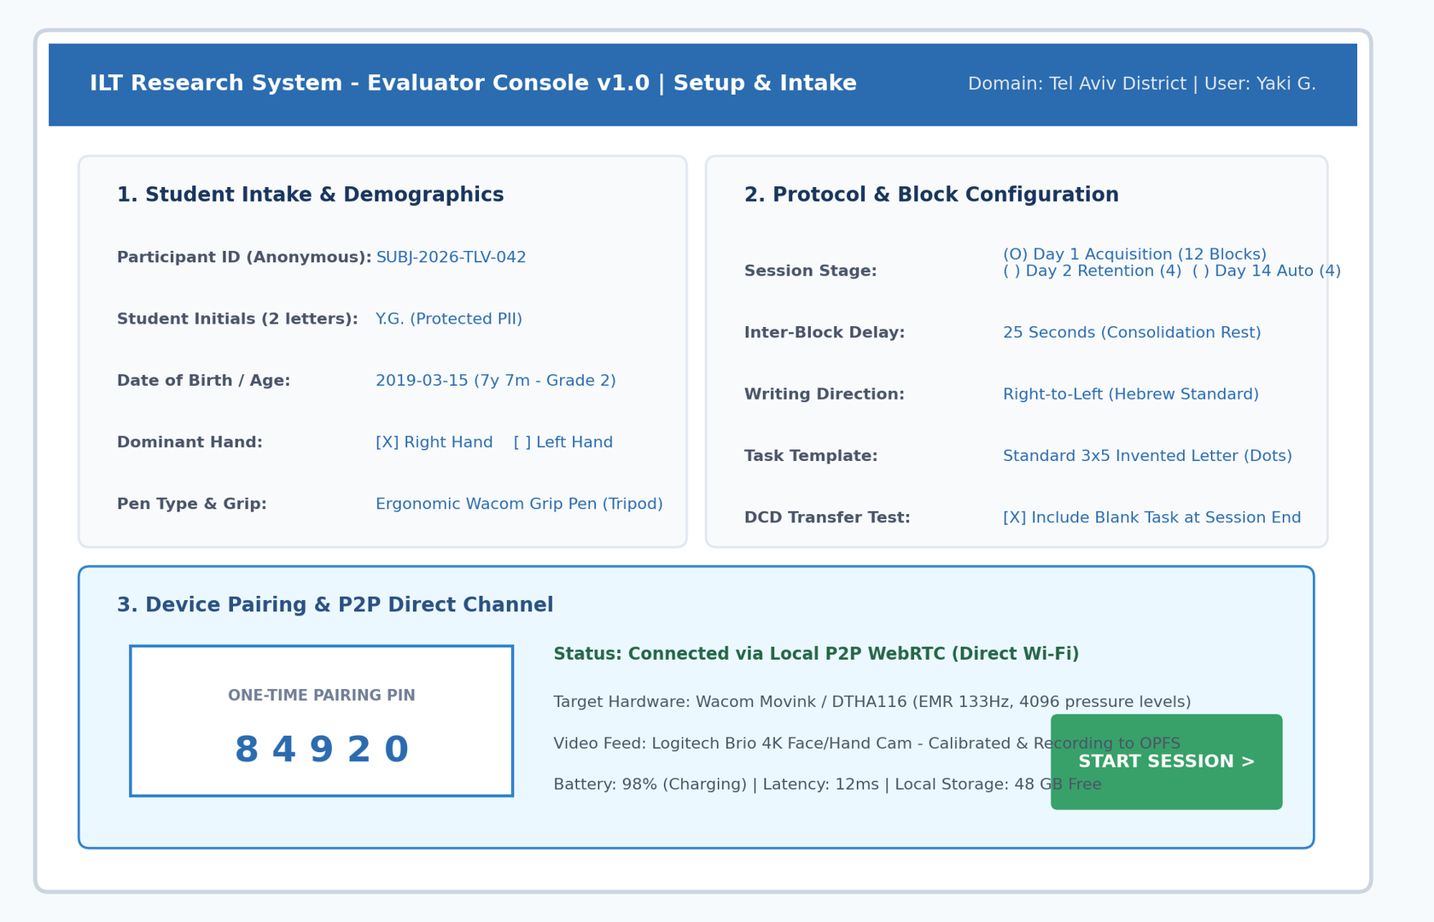
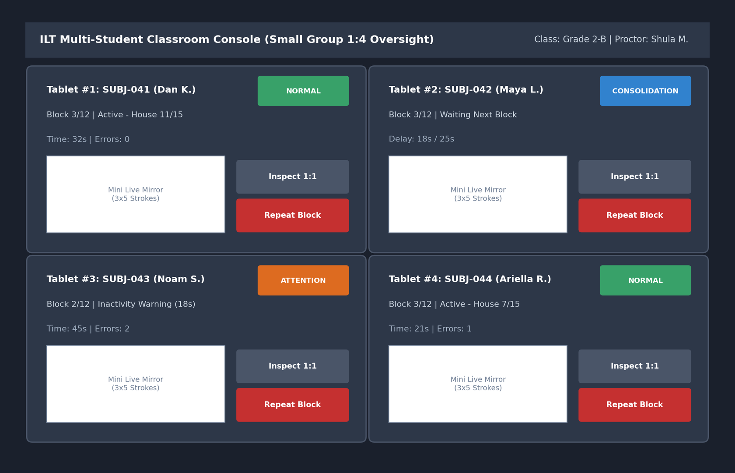
SCALABLE FIELD WORKFLOW
Setup Intake and Classroom Multi-Student Console
Setup & Pairing Console: Anonymous participant ID, dominant hand toggle, 5-digit PIN token, and local P2P.
1:4 Multi-Student Console: Quad-view for small groups, live status badges, and individual drill-down inspection.
Source: ILT Functional Requirements Specification v1.0 | Clinical Pilot Protocol

Slide 4
Precision Technology for Early Literacy Screening
Open-Source Educational Research Initiative

