Slide 1
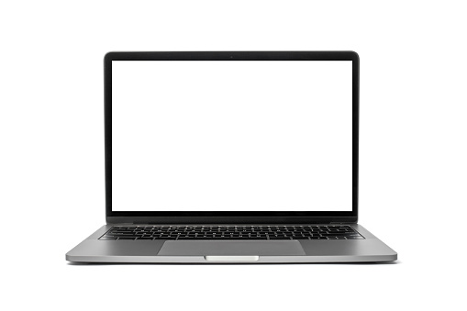

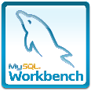


RDS
3306
PART-1
Part-1 install mariadb-server
sudo yum update -y
sudo yum install mariadb-server -y
Part-1 Launch EC2 Instance
-AMI: Amazon Linux 2
-Instance Type: t2.micro
-Security Group
- SSH -----> 22 -----> Anywhere
- MYSQL/Aurora -----> 3306 -----> Anywhere
ssh

Slide 2
Part-2 install mariadb-server
mysql -u root
sudo mysql_secure_installation
Part-3 Manipulating MariaDB Database
-Create a table
-Insert some data
Part 4 - Creating a Client Instance and Connecting to MariaDB Server Instance Remotely
Launch EC2 Instance (Ubuntu 22.04) and name it as MariaDB-Client
Install the mariadb-client.
Connect the clarusdb on MariaDB Server on the other EC2 instance
CONNECT

