Slide 1
Data
Imputation

Slide 2
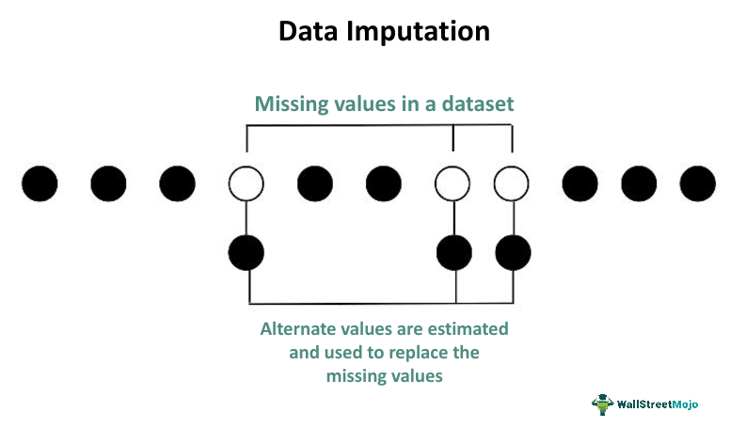
01
Data Imputation
Process of handling missing data
Inferring unknown data
Missing data can cause:
distortion of dataset
bias
reduce efficiency
complicate analysis
mistakes may occur because there is no automatic handling of missing data in Python libraries

Slide 3
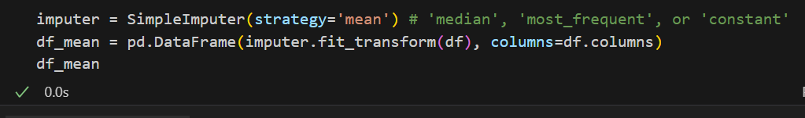
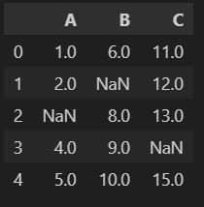
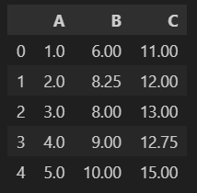
02
Unsupervised Imputation Methods
Mean / Mode / Median imputation
Replace missing numerical values with the mean, median, or mode of the remaining data from that column

Slide 4

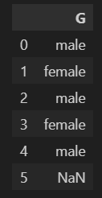
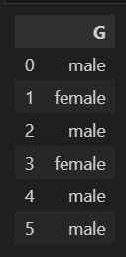
03
Unsupervised Imputation Methods
Mean / Mode / Median imputation

Slide 5
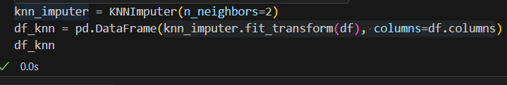
04
Unsupervised Imputation Methods
K-Nearest Neighbor (KNN) imputation
Finds the k-nearest neighbors to a data point with a missing value
Imputing missing value using the mean or median of the neighboring data points
Preserves the relationships between features

Slide 6
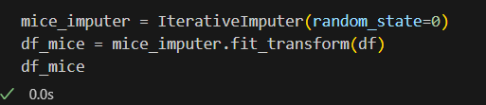
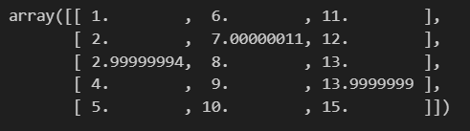
05
Supervised Imputation Methods
MICE Imputation
Multiple Imputation by Chained Equation
Iteratively estimates values based on relationships between variables
Creates a series of predictive models that take cues from other variables

Slide 7
06
Other Imputation Techniques
Complete Case Analysis(CCA)
directly removes the rows that have missing data
assumption: data is Missing At Random (MAR)
Next or Previous Value
for time-series data or ordered data
nearby values are likely more comparable than far-off ones
Missing Value Prediction
regression or classification model
Maximum or Minimum Value
Fixed Value
Random Sample Imputation
Adding a "Missing" Indicator

Slide 8
Outlier Detection

Slide 9
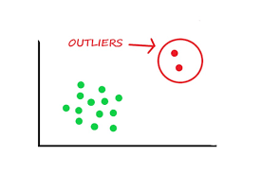
01
Outliers
irregularities / anomalies
data point that significantly deviates from other observations in a dataset
Causes:
measurement errors
data entry error
experimental error
natural variation
Outlier detection is a process of identifying such outliers

Slide 10
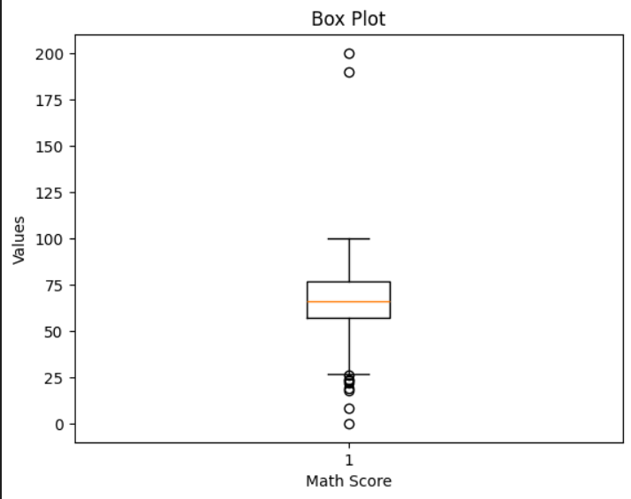
02
Boxplots
One of the simplest methods for detecting outliers is using box plot
Box plot:
graphical distribution of data distribution
marks the minimum, maximum, median, first, and third quartiles of the dataset
Any data points that show above or below the whiskers, can be considered outliers

Slide 11
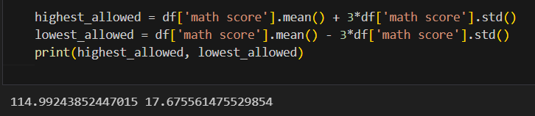
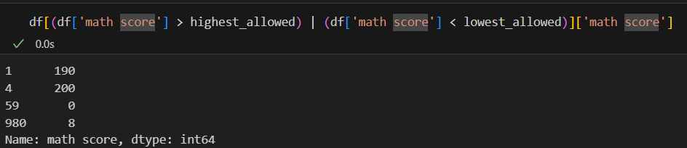
03
Standard Deviation Method
(assuming data follows normal distribution)
data points outside of three standard deviations from the mean are considered outliers

Slide 12
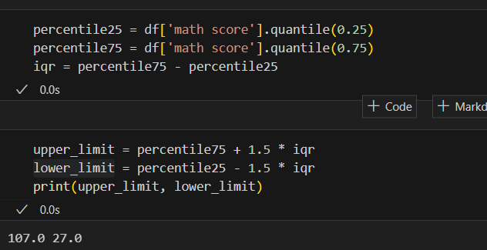
04
IQR (InterQuartile Range) Method
focuses on the spread of the middle 50% of data
IQR = difference between the 75th and 25th percentiles of the data
outliers = points that fall below 1.5 times the IQR below the 25th percentile, or above 1.5 times the IQR above the 75th percentile

Slide 13
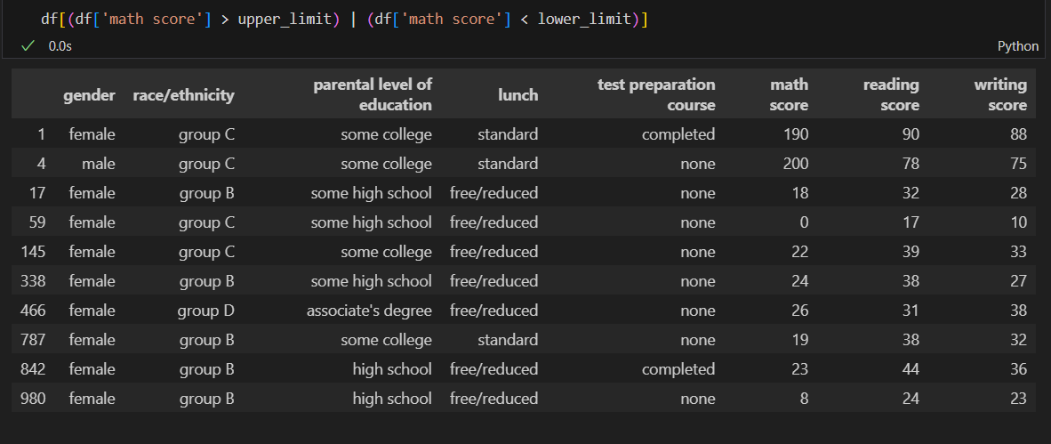
05
IQR (InterQuartile Range) Method

Slide 14
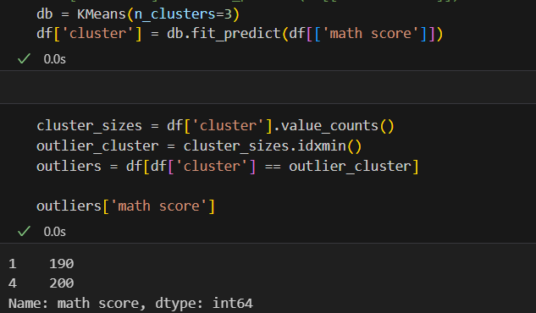
06
Clustering Method
Clustering is the process of grouping data points together based on their similarity to each other
Points that do not belong to any cluster are often considered outliers

Slide 15
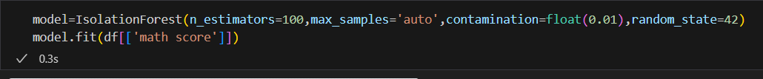
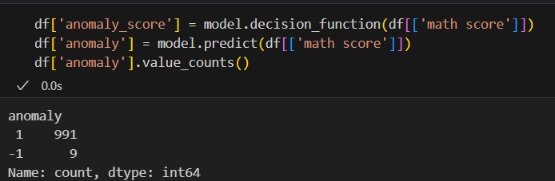
07
Isolation Forest Method
Based on principle: outliers are fewer and different
First, it randomly select an feature and splits between max and min values
It continues splitting recursively until all points are isolated
We can detect outliers as the points that require lesser splits

Slide 16
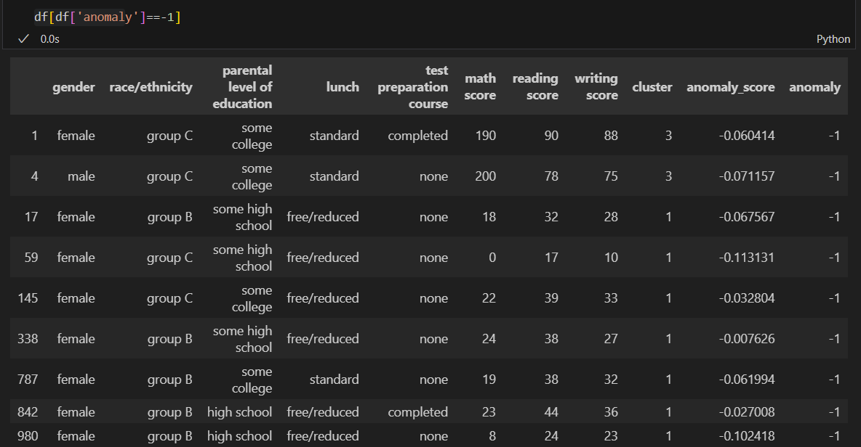
08
Isolation Forest Method

Slide 17
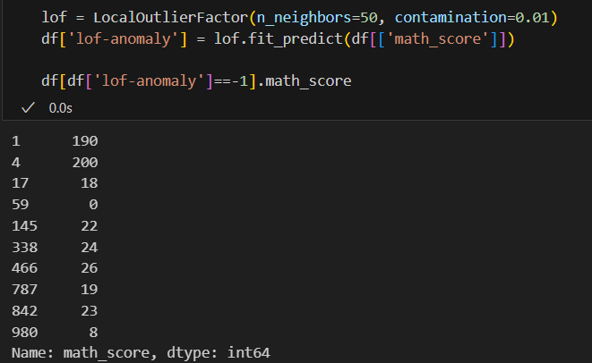
09
Local Outlier Factor (LOF) Method
Density-based method
It measures the local density of a data point compared to its neighbors
Outliers = data points with significantly lower density than their neighbors

Slide 18
10
Applications of Outlier Detection
Fraud Detection: Credit card companies use outlier detection algorithms to flag unusual spending patterns that may indicate stolen card usage
Market Analysis: Identifying market manipulation or insider trading
Healthcare Monitoring: Monitor patients' vital signs and identify any abnormal readings that could indicate a potential health issue
Quality Control: Ensuring product quality by identifying defects in the production process
Cybersecurity: Monitoring user activity to detect unusual login attempts or access to sensitive data can help in identifying compromised accounts

Slide 19
Thank You!

