Slide 1
Methods of Fine Tuning Large Language Models

Slide 2

LLMs
large deep learning models that are pre-trained on vast amounts of data
includes set of neural networks that consist of an encoder and decoder with self attention capabilities
encoder and decoder extract meanings from text and understand relationships between words and phrases
transformers process entire sequences in parallel

Slide 3
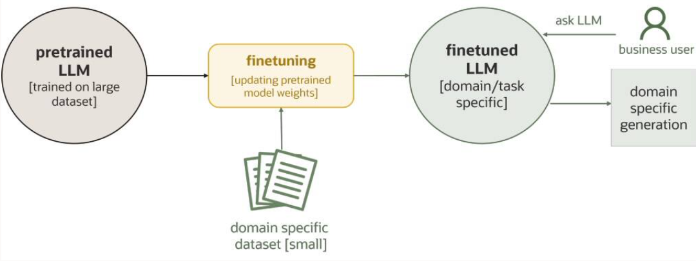
Finetuning LLMs
enhance performance of pretrained LLM for specific tasks
achieve improved inference quality with limited resources
crucial for domain specific applications

Slide 4
Types of LLM Finetuning
Unsupervised finetuning
does not require labeled data
LLM is exposed to large corpus of inlabeled test from target domain
LLM analyzes properties and relationships between words and refines understanding of language used in that field
commonly used for language modeling tasks
can be less precise when comes to specific tasks such as classification or summarization

Slide 5
Types of LLM Finetuning
Supervised finetuning
provide labeled data
LLM identifies patterns in text relating to the labels
expensive and time consuming to collect data and annotate
Instruction finetuning
provide instructions in natural language
LLM Llearns to interpret the instructions
perform tasks without needing vast amount of labeled data
empowers control. adaptability, reduces data dependability
designing prompt/instructions can be challenging

Slide 6
Techniques of LLM Finetuning
Full finetuning
retraining entire LLM architecture on labeled dataset
when high accuracy is critical
cost and resource intensive
Adapter-based finetuning
adapter modules act as specialized add-ons
small trainable modules integrated into specific layers
minimizes risk of LLM forgetting pretrained knowledge (catastrophic forgetting)
might not generalize effectively

Slide 7
Techniques of LLM Finetuning
Parameter-efficient finetuning
strategic selection of model components for training
rest of the parameters are frozen
reduces number of trainable parameters
low computational codt, faster training
stores a small footprint of parameters for each fine tuned task
mitigates storage issues
enables simultaneous loading of multiple finetuned models in memory with base LLM

Slide 8
Techniques of LLM Finetuning
Parameter-efficient finetuning
strategic selection of model components for training
rest of the parameters are frozen
reduces number of trainable parameters
low computational codt, faster training
stores a small footprint of parameters for each fine tuned task
mitigates storage issues
enables simultaneous loading of multiple finetuned models in memory with base LLM
Notes:
These traditional fine-tuning techniques described don’t always guarantee human-preferred outputs. Some advanced techniques proposed can bridge the gap, such as reinforcement learning from human feedback (RLHF) and direct performance optimization (DPO).

Slide 9

THANK YOU

