Slide 1
AA
AF
11
22
33
44
66
77
88
99
10
20
55
BA
Frame Aligner Verification
Specification-driven verification of a byte-stream frame aligner
8 DUT defects, 3 critical / high
Corrected RTL: 0 spec violations
100 % functional coverage
Yakir Aqua · Verification plan, results and bug report · revised edition
Notes:
Revised edition of the verification plan. The environment was rebuilt around an independent specification model; the delivered RTL is unchanged and was re-verified.

Slide 2
0x01
Results at a glance
8
0
100 %
910 k
DUT defects
unexplained mismatches
functional coverage
fuzzed cycles cross-checked
3 critical / high; DUT-02 and DUT-03 had been filed as "spec gaps"
every one of 255 spec violations on the delivered RTL is attributed to a known defect
14 spec-feature coverpoints, every cover property hit
corrected RTL = 3 independent spec models, 0 differences
Delivered RTL: TEST FAILED, 255 spec violations and 214 of 3,555 test-plan checkpoints failed, 0 unexplained. Corrected RTL: TEST PASSED, 0 violations, all checkpoints, 0 assertion failures.
Frame Aligner Verification
2

Slide 3
0x02
The design under test
One byte per clock; a frame is a 16-bit header (LSB first) and 10 payload bytes, back to back
clk, reset (async)
Frame format and fr_byte_position
frame_aligner
AA
AF
P0
P1
P2
P3
P4
P5
P6
P7
P8
P9
FR_IDLE
FR_HLSB
0
1
2
3
4
5
6
7
8
9
10
11
PHY RX
FR_HMSB
FR_DATA
HEAD_1 = 0xAFAA (AA then AF)
HEAD_2 = 0xBA55 (55 then BA)
legal_frame_counter[1:0]
Align
after 3 consecutive frames with a correct header: frame_detect = 1
rx_data[7:0]
na_byte_counter[5:0]
header_lsb_samp[7:0]
Lose
after 4 frames without a header (48 header-less bytes): frame_detect = 0
Track
fr_byte_position = index 0..11 of the last byte (registered output)
frame_detect fr_byte_position[3:0]
Frame Aligner Verification
3

Slide 4
0x03
From the specification to seven checkable rules
The text, the design slides and the RTL disagree in places; the verification fixes one interpretation
Header = LSB immediately followed by its MSB: AA AF or 55 BA
While hunting, every byte is examined; a wrong MSB that is itself an LSB starts a new candidate. No header in the stream is missed
R1
R2
text p.3, p.5
text p.3
After a header the next 10 bytes are payload and are not examined
frame_detect rises one byte after the 3rd consecutive header (payload byte 0)
R3
R4
design slides (FSM)
text p.6, waveform 1
frame_detect falls on the 48th consecutive byte that is not part of a validated header
fr_byte_position = index of the byte just consumed (0..11); 0 while hunting
R5
R6
text p.6, register table
port table, waveform 1
Asynchronous reset: outputs 0, hunting restarts
Implemented three times, independently: SV reference model, a causal Python model and an offline frame parser. They agree on every cycle.
R7
port table
Frame Aligner Verification
4

Slide 5
0x04
Why the environment was rebuilt
The original bench could not fail: its model was a copy of the RTL, and mismatches were fixed in the scoreboard
 | Original environment | New environment
Reference | copy of the RTL (and even that one byte early) | spec rules R1-R7, cross-checked by two Python models
Mismatch policy | "correct the scoreboard" | attribute to a known defect, or flag as UNEXPLAINED
Expected outcomes | not checked | 3,555 checkpoints at exact byte positions
Stimulus | X bytes; 117 of 917 items never driven; preconditions shuffled away | 2-state; everything driven; every scenario starts from reset
Timing | program-block dependent; reset released on a clock edge | clocking blocks; reset on the falling edge
Assertions | 3 of 3 vacuous or false; failures not counted | 25 rule-based assertions, counted; non-vacuity proven
Coverage | reachable illegal bins, unreachable bins, no spec features | 14 spec-feature coverpoints, closed at 100 %
Frame Aligner Verification
5

Slide 6
0x05
Verification architecture
Class-based SystemVerilog, race-free clocking blocks, assertions bound into the DUT
generator
+ 27 scenarios
driver
drv_cb
(+1 ns)
DUT
frame_aligner
mon_cb
(#1step)
monitor_in /
monitor_out
+ fa_spec_sva (14)
+ fa_whitebox_sva (11)
scoreboard
checkpoints
spec model
DUT model
checkpoints
coverage
R1-R7, knobs off
known defects on
test-plan outcomes
14 coverpoints
Monitors are numbered sample by sample; the scoreboard proves lock-step and compares outputs(k) with the model after byte k-1.
Frame Aligner Verification
6

Slide 7
0x06
Every mismatch is triaged, not "fixed"
Two instances of the same specification model: one pure, one with the delivered design's defects switched on
MATCH
KNOWN DEFECT
attributed to
DUT-0x
yes
yes
DUT outputs
at cycle k
equal to the
spec model?
equal to the
DUT model?
no
UNEXPLAINED
new problem
no
Known defect: the knob that fired in the DUT model names the defect; the spec model is then re-synchronised to the DUT's path, so each occurrence is reported once, with no cascade.
+MODEL=dut: the same bench becomes a regression bench for the delivered RTL and fails only on NEW behaviour.
Result on the delivered RTL: 255 spec violations, 0 unexplained.
Frame Aligner Verification
7

Slide 8
0x07
Three independent oracles, three independent models
1
Reference model
2
Checkpoints
3
Assertions
every byte, every cycle
3,555 expected outcomes
14 black-box + 11 white-box
cycle-accurate compare of frame_detect and fr_byte_position against R1-R7
the test plan's "expected outcome" column, checked at the exact byte (e.g. "aligned after 47 header-less bytes, lost on the 48th")
spec rules on the ports; FSM and counter checks inside the DUT catch latent defects the ports never show
Differential fuzzing (scripts/fuzz_rtl.py): 6 000 streams, 910 k cycles
corrected RTL = SV spec model = Python causal model = independent frame parser: 0 differences
delivered RTL = bug-emulating model: 0 differences (every deviation is DUT-01, 02 or 03)
delivered RTL vs. specification: 13 % of all cycles wrong on stress traffic
Frame Aligner Verification
8

Slide 9
0x08
Test plan (1/2)
Every scenario starts from reset and checks its expected outcome at exact bytes (checkpoints)
ID | +TEST= | Stimulus | Expected (spec) | Exposes
TP01 | spec_suggested | 5xHEAD_1, 4 illegal, 5xHEAD_2 (spec p.23) | aligned on frame 3; lost on the 48th byte
TP02 | mixed_headers | HEAD_1 / HEAD_2 in any mix | aligned after 3 frames
TP03 | swapped_header | AF AA / BA 55; 4 of them while aligned | never aligns; loss on the 48th byte | DUT-03
TP04 | inverted_header | bit-inverted and bit-reversed headers | never aligns | DUT-03
TP05 | lsb_ok_msb_bad | AA 01, 55 01, AA 00, 55 00, AA BA, 55 AF | position 0 after the rejected MSB | DUT-03
TP06 | lsb_bad_msb_ok | 0A AF, 05 BA | position 0, never aligns
TP07 | msb_in_payload | AF / BA bytes inside payloads | frame boundaries unchanged
TP08 | header_in_payload | headers at every payload offset | ignored (R3)
TP09 | restart_header | AA|AA AF, 55|55 BA, AA|55 BA, 55|AA AF, ... | header found; aligned after 3 frames | DUT-01
TP10 | loss_boundary | aligned, 44..48 header-less bytes, header | kept for <= 46, lost for >= 47 | DUT-02
TP11 | corrupted_frames | aligned, 1..4 corrupted frames | kept for <= 3, lost on byte 48 for 4 | DUT-03
TP12 | header_in_illegal | legacy illegal frames with inner headers | frame at the inner header
TP13 | frames_in_illegal | 3 frames inside a 49-byte illegal frame | aligned exactly on byte 29
TP14 | header_soup | 49-byte frames of random header bytes | model-checked | DUT-01/03
Frame Aligner Verification
9

Slide 10
0x08
Test plan (2/2)
Every scenario starts from reset and checks its expected outcome at exact bytes (checkpoints)
ID | +TEST= | Stimulus | Expected (spec) | Exposes
TP15 | lsb_at_payload_end | payload ends in AA / 55 / AA AF (aligned) | next header found
TP16 | long_valid_run | 10 consecutive frames | aligned; counter saturates | DUT-04
TP17 | long_garbage | 80 header-less bytes, re-align | lost on 48; counter saturates | DUT-05
TP18 | reset_every_phase | async reset in each phase, aligned or not | outputs 0; no header across reset
TP19 | false_lock_in_sync | corrupted header + header pattern in payload | locks on the false frame | DUT-07 demo
TP20 | consecutive_rule | V, 1 byte, V, V, V | aligned only after frame 4
TP21 | header_across_items | ... AA | AF ... across two items | recognised
TP22 | illegal_lengths | illegal frames of 2..49 bytes (aligned) | lost on exactly the 48th byte
TP23 | boundary | sweep 0..60 header-less bytes, +/- stray LSB | kept iff gap + prefix <= 46 | DUT-01/02
TP24 | loss_cause | 48th byte = rejected MSB / restart LSB | lost on that byte | DUT-01
TP25 | midstream_entry | start mid-stream; payloads end in 55 / AA | aligned after 3 frames | DUT-01
TP26 | error_then_lsb_payloads | 1 header error, then payloads ending in 55 | alignment kept | DUT-01
TP27 | slip_in_sync | 13-byte frames before / after alignment | hunting keeps alignment | DUT-07 demo
RND | random | 61 % valid, 18 % illegal, 8 % restart, 12 % gap, 2 % reset | model + assertions | all
Frame Aligner Verification
10

Slide 11
0x09
Spec-feature coverage and assertion results
Coverage is sampled from the reference model, so it measures behaviour, not raw signal values
CP02 / CP03
every transition (hunt, LSB, reject, restart, frame) x aligned
CP06
every byte that can follow a header LSB
CP07
gap before a header while aligned: 0 .. 44, 45, 46 (last chance)
CP08
every kind of 48th byte: plain, LSB, rejected MSB, restart LSB
CP09
fr_byte_position 0..11 x frame_detect
CP11
asynchronous reset in every phase, aligned or not
CP12
header patterns inside payloads
100 % of 14 coverpoints (102 bins) in the regression; every cover property hit
Frame Aligner Verification
11

Slide 12
DUT defects
The student's scoreboard mirrored the RTL, so these were either unseen or filed as "gaps in the spec".
DUT-01
Header LSB lost: legal streams never align
DUT-04
Frame counter wraps 3 -> 0
Critical
Low (latent)
DUT-02
Alignment dropped on a valid header
DUT-05
Byte counter wraps 63 -> 0
High
Low (latent)
DUT-07
No fly-wheel: slips never lose alignment
DUT-08
X-optimistic header decode
High (arch.)
Low
DUT-03
Position 1 reported for a rejected header
DUT-06
Coding issues (default, width, comments)
Medium
Info
Frame Aligner Verification
12

Slide 13
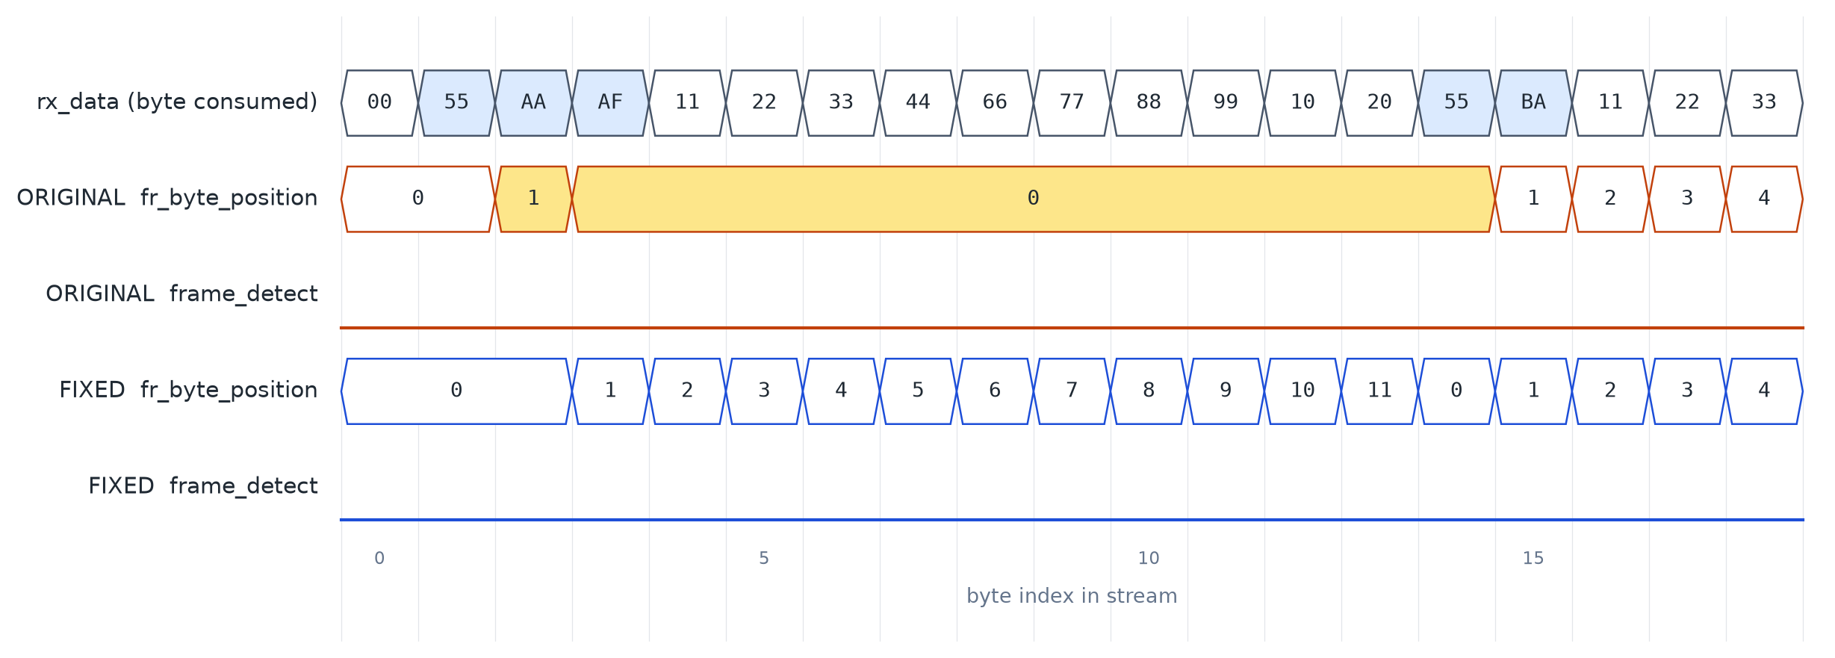
DUT-01
Header LSB thrown away after a rejected MSB
Critical · extends the student's "LSB twice then MSB": it happens for all four LSB combinations
Root cause
end else if (header_lsb_valid) begin // FIX DUT-01
legal_frame_counter_rst = 1'b1; fr_byte_position_rst = 1'b1;
na_byte_count_inc = 1'b1; next_state = FR_HLSB;
end
In FR_HLSB a wrong MSB always returns to FR_IDLE. If that byte is itself a header LSB (AA / 55) it is never examined, so its header is missed.
Frame Aligner Verification
13

Slide 14
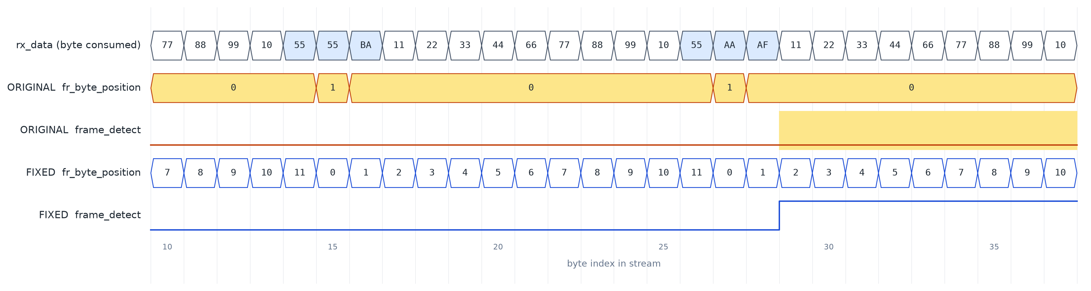
DUT-01
Legal traffic is never aligned
Payload byte 9 = 0x55 (or 0xAA) looks like a header LSB; the real LSB rejects it and is thrown away, for every frame
never
permanent
1 in 128
aligned: start-up in the middle of a legal stream whose payloads end in 0x55 (TP25: 20 of 20 checkpoints fail)
loss after one bit error in a header, if the following payloads end in 0x55 (TP26)
chance per bad frame of losing alignment after only 3 bad frames (random payload)
Frame Aligner Verification
14

Slide 15
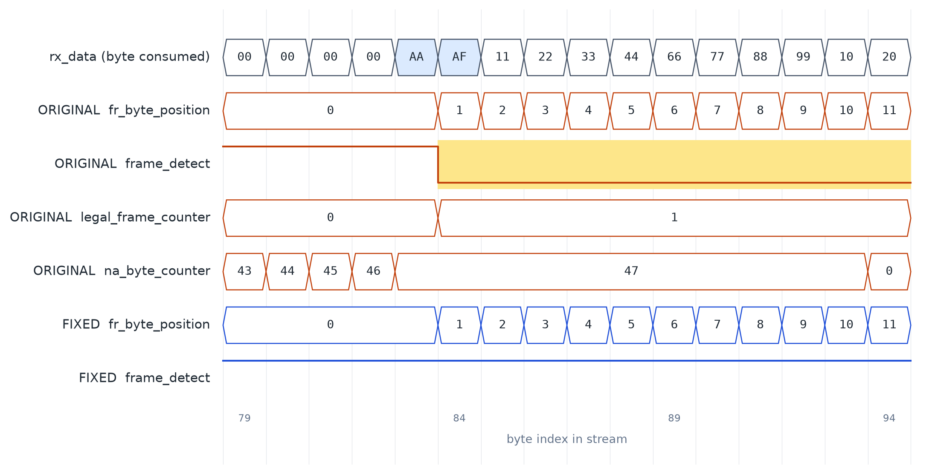
DUT-02
Alignment dropped on a valid header
High · the student saw "last chance is a header at byte 45" and filed it as a spec gap
Root cause
the header LSB is counted as a non-aligned byte (46 -> 47)
the clear (na_byte_counter == 47) is not qualified: the valid MSB clears frame_detect
the whole valid frame is received with frame_detect = 0; outage lasts 3 frames
gap | spec | delivered RTL
<= 45 | kept | kept
46 | kept | LOST
>= 47 | lost | lost
Fix: clear only when the consumed byte is itself counted: na_byte_count_inc && na_byte_counter == 47
Frame Aligner Verification
15

Slide 16
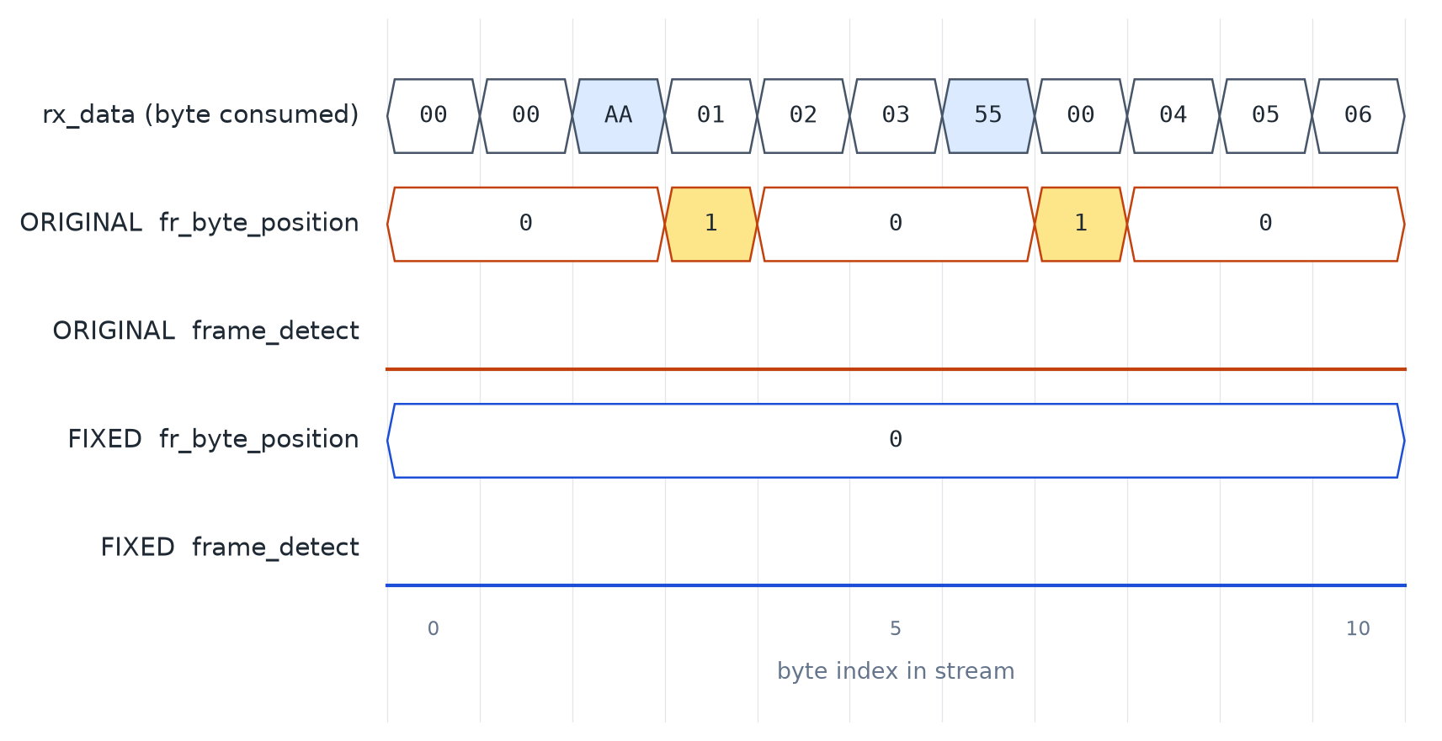
DUT-03
Position reported for a rejected header
Medium · the student noted the one-cycle "1" and filed it as a spec gap
What happens
after AA 01 the output says "header MSB" (position 1) although no frame exists
every other hunting byte reports 0, so a consumer sees a phantom header
the FSM slide omits the position reset on the HLSB -> IDLE arc too
Fix: fr_byte_position_rst = 1 on the reject arc. Caught by SPEC_POS1_AFTER_HEADER, SPEC_POS_INCREMENT and WB_DUT03_POS_RESET_ON_REJECT.
Frame Aligner Verification
16

Slide 17
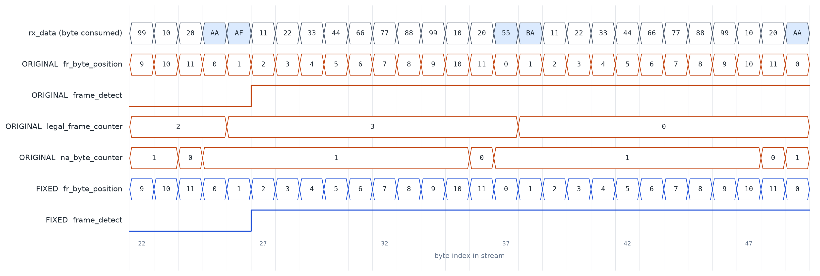
DUT-04
Latent and hygiene defects
Invisible on the ports today; caught at the root cause by white-box assertions and lint
legal_frame_counter wraps 3 -> 0 on the 4th frame (above). Caught by WB_DUT04_LEGAL_NO_WRAP. Fix: saturate.
na_byte_counter wraps 63 -> 0 on long header-less streams. Caught by WB_DUT05_NA_NO_WRAP. Fix: saturate.
DUT-04
DUT-05
no next_state default; 4-bit vs 8'd10 compare; wrong comments. The corrected RTL is verilator -Wall clean.
X on rx_data is silently decoded as "not a header" in RTL, but not in gates. TB_IN_KNOWN forbids X stimulus.
DUT-06
DUT-08
Frame Aligner Verification
17

Slide 18
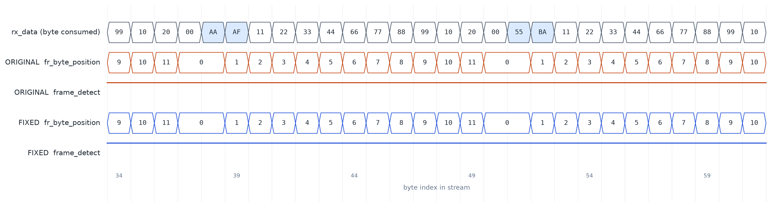
DUT-07
No fly-wheel: slips never lose alignment
High (architecture) · spec text: out of alignment after four frames without the EXPECTED header
13-byte frames: every header one byte late, and frame_detect stays 1 forever. The same stream never aligns from reset (hysteresis).
Tracking stops: after one bad header, fr_byte_position is 0 for a whole frame while frame_detect = 1; a header pattern in a payload re-bases the frame (false lock).
Proposed fix: while aligned, count 0..11 freely, check headers only at the expected position, and declare out-of-frame after 4 bad frames. Hunt byte by byte only while not aligned.
Frame Aligner Verification
18

Slide 19
0x0A
Issues in the specification itself
To be clarified with the designer; each affects what "correct" means
SPEC-01
SPEC-02
Output data interface (header + payload forwarding) is specified but not implemented
Text: loss after 4 frames without the expected header. Design slides: 48 hunting bytes. Leads to DUT-07
SPEC-03
SPEC-04
Waveform 2 is one clock late against the FSM slide and the RTL; waveform 1 starts in an unreachable state
fr_byte_position is undefined outside a frame and has no valid qualifier (0 = LSB and 0 = not aligned)
SPEC-05
SPEC-06
Name mismatches: fr_is_aligned / frame_detect, na_frame_counter / na_byte_counter, Valid_h2 missing
The 48th header-less byte is a header LSB: counted (register table) or not (look-ahead)? The RTL violates both
Frame Aligner Verification
19

Slide 20
0x0B
Defects in the original testbench
Why the original run looked clean although the design is not
12.8 %
1 byte
102
of the queued stimulus never driven (117 of 917 items): end of test compared transactions with repeat_count
early: the "copied" model sets and clears frame_detect one byte before the RTL, so no clean run was possible
false assertion failures per run from one legacy property; the other two are vacuous or always fail
TB-01
model copied from the RTL; mismatches fixed in the scoreboard
TB-04
5 directed tests drive X (new[N] on a 4-state array, 8'hxA)
TB-05
tests shuffled: preconditions not met, tests spill into the next one
TB-07
coverage: reachable illegal bins, unreachable bins, no spec features
TB-08
sampling depends on program-block scheduling; reset on a clock edge
TB-09
2-state scoreboard turns X/Z into 0
TB-10
build order wrong; bind by instance name not elaborated
TB-11
out-of-bounds writes, misleading "illegal" frames, no seed control
Frame Aligner Verification
20

Slide 21
0x0C
Regression results
make -C sim regress: every run is checked against its EXPECTED outcome
RTL | test | model | cycles | checkpoints | verdict | expected
corrected | directed | spec | 4,300 | 995 / 995 | PASS | PASS
corrected | boundary sweep | spec | 9,701 | 2,560 / 2,560 | PASS | PASS
corrected | random | spec | 6,485 | - | PASS | PASS
corrected | regression | spec | 20,985 | 3,555 / 3,555 | PASS | PASS, cov 100.0 %
delivered | regression | DUT | 20,985 | tolerated | PASS | PASS (no new behaviour)
delivered | regression | spec | 20,985 | 3,341 / 3,555 | FAIL | FAIL, 0 unexplained
RTL untouched: hash of the annotated DUT = hash of the delivered dut.sv
The corrected RTL is verilator -Wall clean
Differential fuzzing: 0 differences between the corrected RTL and the three specification models
Frame Aligner Verification
21

Slide 22
Conclusions
The design is not bug-free. Its header search can miss every header of a legal stream (DUT-01) and drops alignment on a valid header (DUT-02).
A scoreboard that copies the RTL cannot find design bugs. The spec model with defect triage found all of them, with 0 unexplained mismatches.
Expected outcomes must be executable. 3,555 checkpoints turn the test plan into checks.
Evidence, not assumption. Three independent models agree; the corrected RTL passes everything.
Next steps
Designer to accept DUT-01..06 fixes (rtl/frame_aligner_fixed.sv)
Decide on the fly-wheel (DUT-07) and resolve SPEC-02/-06
Add the output data interface (SPEC-01)
Run the bench on a commercial simulator to merge native covergroups
Formal proof of R1-R7 on the corrected RTL
Frame Aligner Verification
22

Slide 23
0x0D
Appendix: how to run
Verilator >= 5.030 with z3; Python 3; Icarus Verilog for scripts/
cd sim
make sim DUT=fixed # corrected RTL -> TEST PASSED
make sim DUT=orig # delivered RTL -> TEST FAILED, defects listed
make sim DUT=orig MODEL=dut # regression mode -> only new behaviour fails
make sim DUT=orig TEST=restart_header VERBOSITY=2
make sim DUT=orig TEST=loss_boundary WAVES=1 # waves.vcd
make regress # full matrix, expected outcomes
python3 ../scripts/fuzz_rtl.py # differential fuzzing (Icarus)
python3 ../scripts/plot_waves.py # regenerate the figures
Documents: docs/BUG_REPORT.md (every defect, reproduction, fix) · docs/VERIFICATION_PLAN.md (rules, test plan, coverage, assertions, results)
Frame Aligner Verification
23

