Slide 1

Data Bases Project Ran Sasson Yakir Travish
COVID-19 Vaccination Delivery to the Population of a Small Town

Slide 2
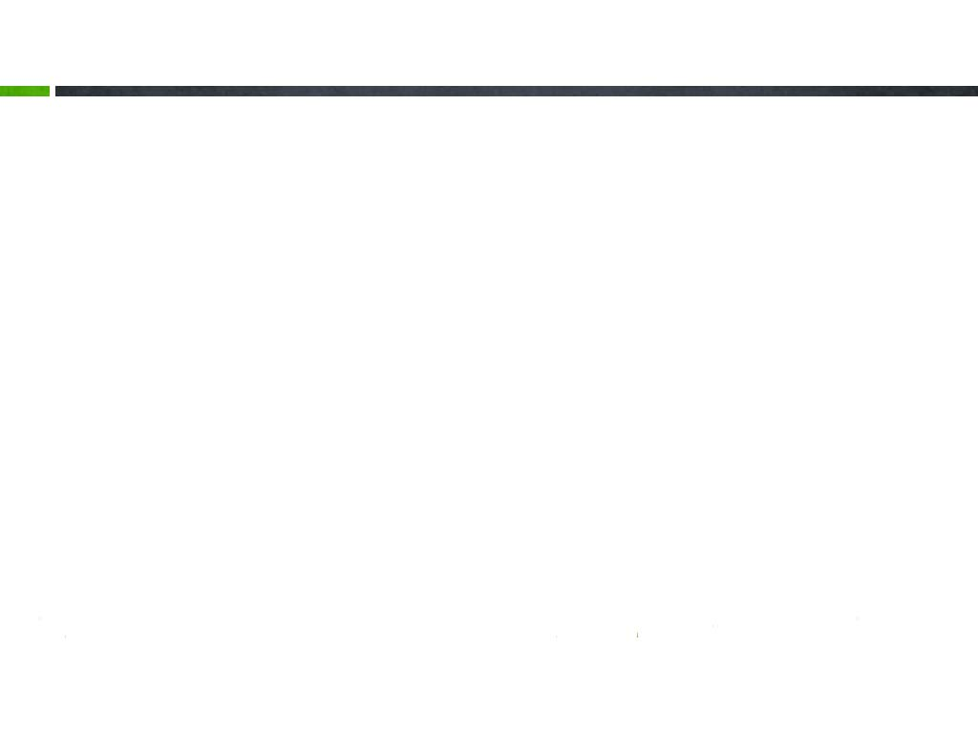
Introduction
Managing vaccination delivery DB
The system is used to manage the data required for the operation of vaccinating the population of a small town.
The goal is to get to an “Herd Immunity” - When most of a population is immune to COVID-19, this provides indirect protection to those who are not immune to the disease. In order to reach this goal:
Monitoring – Keep track on vaccination process
Time – Process as short as possible
Efficiency - Using minimum number of doses.

Slide 3
Data
Population:
Name
ID
HMO details
Neighborhood
Birthdate
vaccinated(first/second dose)
COVID-19 positive?
Vaccine:
Batch number
Manufacturer
Expiry date
Manufacturing date
Inventory:
Amount of vaccines
HMO:
Name
Has its own inventory

Slide 4
Users
Ministry of Health
National inventory management
Supply vaccines to HMOs
HMO
Carrying out vaccinations to the public
Monitoring and reporting

Slide 5
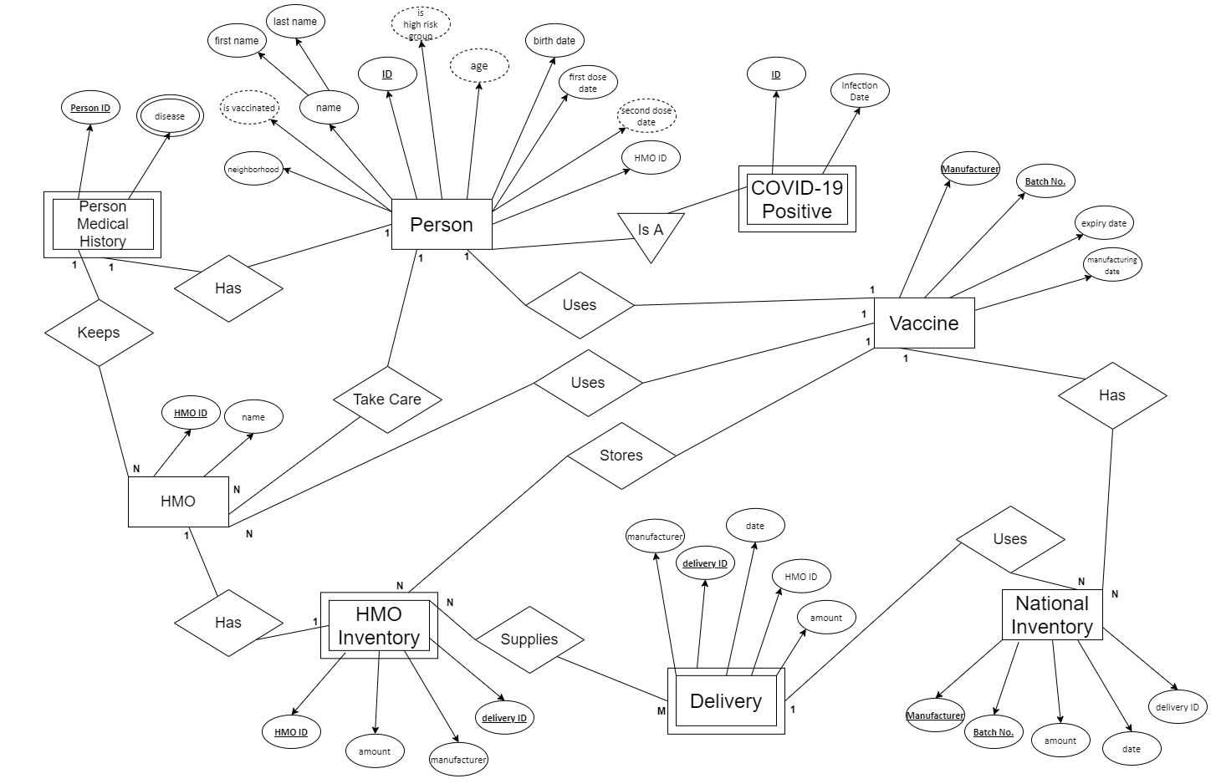
ERD

Slide 6
Tables
Person Table
ID | First name | Last name | Neighborhood | Birth date | First dose | HMO ID
Person Medical History Table
Person ID | Disease ID | HMO ID
HMO Inventory Table
HMO ID | Delivery ID | Manufacturer | Amount
Delivery Table
Delivery ID | Amount | Manufacturer | Batch number | Date | HMO ID

Slide 7
Tables(2)
National Inventory Table
Manufacturer | Batch number | Amount | Date | Delivery ID
COVID-19 Positive Table
Person ID | Infection date
Vaccine Table
Manufacturer | Batch number | Expiration date | Manufacturing date | HMO ID
HMO Inventory_Delivery Table
HMO ID | Delivery ID
HMO Table
HMO ID | HMO name
Disease Table
Disease ID | Disease name

Slide 8
Question and Updates
Select:
Select the ID and name of each non COVID-19 positive who is in high-risk group (join COVID-19 Positive table with person table by person ID) - HMO
Select the manufacturer and total amount of vaccines in HMO inventory (sum the amount for each manufacturer) - HMO
Select the batch no. and expiry date of the closest vaccine expiry date - HMO/ Ministry of Health
Select the ID and name of each person who got first dose - HMO
Select the ID and name of each person who is vaccinated (got second dose) - HMO
Select the ID and name of each person who isn’t vaccinated (didn’t get first dose) - HMO
Select the manufacturer and total amount of vaccines in national inventory (sum the amount for each manufacturer) - Ministry of Health
Select the ID and name of all currently sick people (join COVID-19 Positive table with person table by person ID) - Ministry of Health
Get the HMO ID and percent of vaccinated people in HMO (count (select all vaccinated people in HMO)/count (select all people in HMO)*100 AS percent) - HMO
Get the percent of vaccinated people in the town (count (select all vaccinated people)/count (select all people)*100 AS percent) - Ministry of Health
Get the neighborhood and percent of vaccinated people group by neighborhood - Ministry of Health
Get the neighborhood and percent of COVID-19 positive people group by neighborhood (join COVID-19 Positive table with person table by person ID) - Ministry of Health

Slide 9
Question and Updates(2)
Delete:
Remove all vaccines that expired (expiry date<current date) - HMO/ Ministry of Health
Insert:
Add new delivery from national inventory to HMO inventory - Ministry of Health
Add new person to town and update his age and high-risk group using Trigger - HMO
Update:
Each time a person is vaccinated, remove 1 vaccine from the specific HMO amount in inventory and after a person receives first dose update his second dose date to be 21 days after his first dose date (used by a Trigger) - HMO

Slide 10


Questions?

