Slide 1
Predicting Relative Article Popularity
Using Multimodal Transfer Learning
Deep Learning Final Project — Technion DS 26-529625
Yakir Cohen
mako.co.il & n12.co.il — Keshet Digital

Slide 2
Agenda
• 1. The problem & why it's hard
• 2. Data & evaluation metrics
• 3. Four baselines — isolating each input modality
• 4. Model 1: SigLIP2 staged fine-tuning + cross-attention fusion
• 5. Model 2: Hybrid AlephBERT + ResNet50
• 6. Final ablation table & held-out test results
• 7. Live demo — scoring new headline/image pairs
• 8. Conclusions & limitations
Predicting Relative Article Popularity — Multimodal Transfer Learning
1

Slide 3
The Problem
Given only what an editor has before publishing — headline, thumbnail image, and site —
predict whether the article will be a top performer.
• Input: headline + thumbnail image + site (mako / n12)
• Output: probability the article lands in the top 10% of page views
• Success is relative: top 10% within the same site, same calendar month — not a fixed traffic threshold
• Why relative? mako vs n12 traffic differs hugely; traffic swings by season/news cycle
• Use case: editorial decision-support — flag a promising headline/thumbnail before it goes live
Predicting Relative Article Popularity — Multimodal Transfer Learning
2

Slide 4
Does the thumbnail image add predictive value
beyond the headline alone?
Not obvious a priori — headlines are information-dense; thumbnails are often generic stock images.
This is the question the whole project is organized around.
Predicting Relative Article Popularity — Multimodal Transfer Learning
3

Slide 5
Data
Split | Period | Rows | Positive rate
Train | 2024-01 – 2026-04 | 87,334 | ~10.0%
Validation | 2026-05 | 3,722 | ~10.0%
Test (held-out) | 2026-06 | 3,745 | ~10.0%
• Time-based split: prevents leakage from near-duplicate/related articles across train/val
• Source: Keshet's internal Snowflake page-view warehouse (mako.co.il, n12.co.il)
• Images: 71,536 / 71,546 thumbnail URLs downloaded successfully (99.99%)
• No tags: 49.5% of articles have none — excluded from the core model entirely
Predicting Relative Article Popularity — Multimodal Transfer Learning
4

Slide 6
Data Quality Finding: Image Resolution
The stored thumbnail URL resolves to a tiny 82x62px image by default — not the original.
Tier | Resolution | Share of dataset
Full resolution (URL suffix stripped) | original, up to 1000s px | 60.8%
Fallback variant | 232 x 175 px | 35.1%
Thumbnail only (both above missing) | 82 x 62 px | 4.1%
This resolution variance was later used as a controlled variable in one experiment (Model 1: full-res-only filtering). A good example of a real-world data issue only discovered mid-project, not during planning.
Predicting Relative Article Popularity — Multimodal Transfer Learning
5

Slide 7
Evaluation Metrics — Why Not Just Accuracy?
~10% positive rate: a model that always predicts “no” scores 90% accuracy and is useless.
• ROC-AUC: P(random positive scored higher than random negative). Random = 0.5
• PR-AUC (primary metric): area under precision/recall curve. Random ≈ base rate (≈0.10 here)
• F1: single-threshold balance of precision & recall
• Precision@K: of the top-K most confident predictions, how many are true positives — closest to the actual editorial ranking use case
Predicting Relative Article Popularity — Multimodal Transfer Learning
6

Slide 8
Four Baselines — Isolating Each Modality
Model | Inputs | ROC-AUC | PR-AUC | F1
tfidf_logreg | title | 0.660 | 0.208 | 0.245
text_only_bert | title (+tags) | 0.704 | 0.212 | 0.248
image_only | image | 0.619 | 0.148 | 0.229
title_image_frozen | title+image (naive concat) | 0.619 | 0.147 | 0.214
Key finding: naively concatenating frozen embeddings is NO BETTER than image alone, and WORSE than text alone. Two signals not trained together don't combine — the weak signal dilutes the strong one. This is the strongest justification for jointly-trained architectures.
Predicting Relative Article Popularity — Multimodal Transfer Learning
7

Slide 9
Model 1: SigLIP2 — Vision-Language Backbone
• Pretrained on hundreds of millions of (image, caption) pairs — contrastive learning
• Text and images already share one embedding space before we touch it
• Zero-shot Hebrew diagnostic (950 pairs, no fine-tuning): ~28x random baseline retrieval accuracy
Staged fine-tuning — how much to let the pretrained model move:
• Stage A — frozen: only a small head trains (395K params, 0.11%)
• Stage B — unfreeze top 4 layers: 57.1M params (15.2%) — overfits fast
• Stage C — LoRA (r=8): ~986K params (0.28%) — parameter-efficient middle ground
Predicting Relative Article Popularity — Multimodal Transfer Learning
8

Slide 10
SigLIP2 Staged Fine-Tuning — Results
Stage | Trainable params | ROC-AUC | PR-AUC | Outcome
A — frozen | 395.8K (0.11%) | 0.651 | 0.167 | Below text baseline
B — unfreeze 4 | 57.1M (15.2%) | — | — | Overfits by epoch 1
C — LoRA r=8 | 986K (0.28%) | 0.659 | 0.184 | Best of the 3, stable
None beat text_only_bert (0.704 / 0.212). Stage B's fast collapse vs. Stage C's stability is the classic overfitting pattern: 57M trainable params on ~87K training rows memorizes the training set; LoRA's ~1M params generalize far better for comparable adaptation capacity.
This motivated the next question: is it backbone capacity, or how text and image are fused, that's the bottleneck?
Predicting Relative Article Popularity — Multimodal Transfer Learning
9

Slide 11
Adding Cross-Attention Fusion
Attention(Q, K, V) = softmax( QKᵀ / √d_k ) · V
• Instead of comparing two pre-summarized vectors (concatenation)...
• ...let pooled text “query” the image's 196 raw patch tokens directly
• ...and symmetrically let pooled image query the raw text tokens
• Implemented via nn.MultiheadAttention, bidirectionally
Predicting Relative Article Popularity — Multimodal Transfer Learning
10

Slide 12
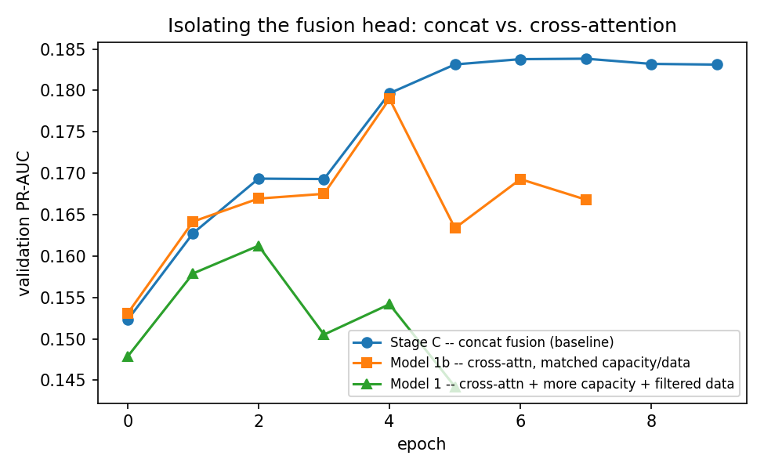
The Right Way to Test It: One Variable at a Time
• First attempt (Model 1): changed fusion AND capacity AND filtered the data, all at once — regressed, but couldn't tell why
• Controlled follow-up (Model 1b): identical capacity & data to Stage C — the ONLY difference is fusion type
Predicting Relative Article Popularity — Multimodal Transfer Learning
11

Slide 13
Clean Result: Fusion Wasn't the Problem
Run | Fusion | Capacity | Data | ROC-AUC | PR-AUC
Stage C | Concat | LoRA only | full | 0.659 | 0.184
Model 1b | Cross-Attn | LoRA only (matched) | full | 0.643 | 0.179
Model 1 | Cross-Attn | unfreeze+LoRA | filtered | 0.625 | 0.161
Model 1b (matched capacity/data) is close to but consistently below Stage C — a clean, isolated result. The cross-attention mechanism itself was NOT the problem in Model 1 — the added trainable capacity and reduced dataset were.
Predicting Relative Article Popularity — Multimodal Transfer Learning
12

Slide 14
Model 2: Hybrid — AlephBERT + ResNet50
• Different bet: two backbones never jointly pretrained (unlike SigLIP2)
• Text: AlephBERT — Hebrew-specific, not multilingual-but-English-heavy
• Image: ResNet50, ImageNet-pretrained, global-average-pooled features
• Fusion: concatenation + small MLP — cross-attention deliberately skipped (Slide 13's result)
Hypothesis: maybe the bottleneck wasn't fusion sophistication — maybe it was using a multilingual text encoder for a Hebrew-only task.
Predicting Relative Article Popularity — Multimodal Transfer Learning
13

Slide 15
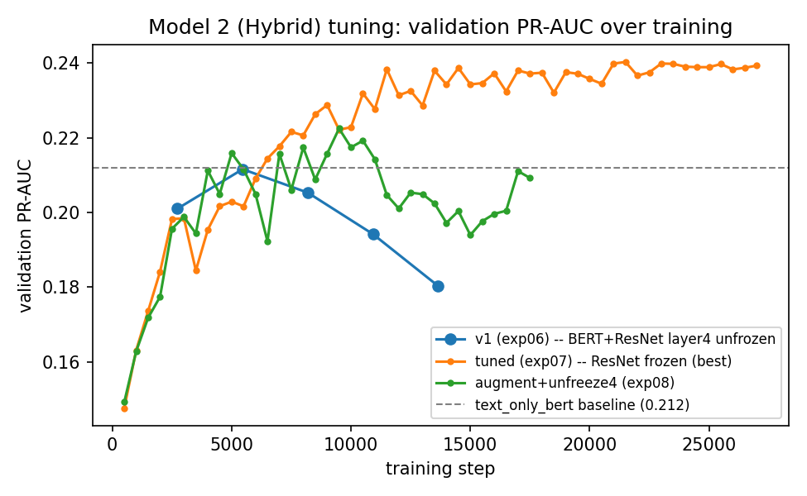
The Tuning Journey
v1 overfits early; exp07 (tuned) climbs steadily past the text baseline; exp08 improves on v1 but plateaus below exp07.
Predicting Relative Article Popularity — Multimodal Transfer Learning
14

Slide 16
What Changed at Each Step
• v1 (exp06): peaks epoch 1 (0.660/0.212), overfits steadily after
• First tuning attempt: early-stopping patience left uncalibrated after switching to finer eval frequency — stopped right as ROC-AUC hit a new high. A real bug, caught and fixed.
• exp07 (best): ResNet fully frozen + higher weight decay + fixed patience — completes all 10 epochs, no collapse. ROC-AUC 0.693, PR-AUC 0.240 — beats text_only_bert!
• exp08: tried recovering ResNet capacity with augmentation — improved on v1 (0.674/0.222) but didn't beat exp07. exp07 stays final.
Predicting Relative Article Popularity — Multimodal Transfer Learning
15

Slide 17
Final Ablation Table
Inputs | ROC-AUC | PR-AUC
Title only | 0.660 | 0.208
Title (+tags)* | 0.704 | 0.212
Image only | 0.619 | 0.148
Title + image (naive) | 0.619 | 0.147
Full model (title+image+site) | 0.693 | 0.240
*No model ever used tags — kept for the table's canonical shape. Cleanest read: full model (0.240) vs. text_only_bert (0.212) on PR-AUC — the image appears to help.
Predicting Relative Article Popularity — Multimodal Transfer Learning
16

Slide 18
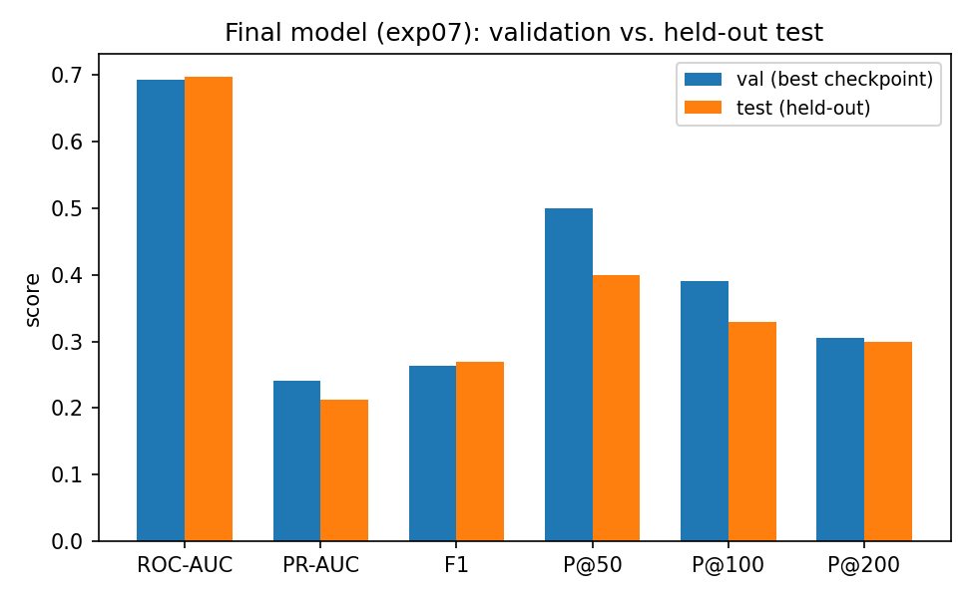
The Honest Part: Held-Out Test Set
Val PR-AUC 0.240 → Test PR-AUC 0.212 — the advantage over the text baseline nearly vanishes. ROC-AUC actually improves slightly (0.693→0.697).
Predicting Relative Article Popularity — Multimodal Transfer Learning
17

Slide 19
Why the val → test gap?
• Not classic overfitting: ROC-AUC held up — the model's general ranking ability is fine
• Selection bias instead: exp06→exp07→exp08 — every tuning decision was made watching the SAME ~3,700-row validation set
• The mechanism: repeatedly picking the “best” config against one small validation set systematically favors configs that got a bit lucky on it, not just genuinely better ones
• Lesson: a test set touched exactly once, at the very end, is what actually corrects for this
Predicting Relative Article Popularity — Multimodal Transfer Learning
18

Slide 20
Live Demo: Scoring New Examples
• src/inference/predict.py — score one new (headline, image, site) triple
• src/inference/compare_ab.py — score two candidates, see which the model prefers
python -m src.inference.compare_ab --site mako \
--headline-a "..." --image-a a.jpg \
--headline-b "..." --image-b b.jpg
Validation idea: run this on real internal A/B test variants with known winners — does the model's preferred variant match what actually won in production?
Predicting Relative Article Popularity — Multimodal Transfer Learning
19

Slide 21
Conclusions
• Does the image help? Modestly, not conclusively — real signal on validation, largely erased on test
• Naive fusion actively hurts: concatenating frozen embeddings is worse than text alone
• Fusion mechanism wasn't the bottleneck: isolated test showed cross-attention ≈ concat at matched capacity
• Language-appropriate text encoder mattered most: AlephBERT (Hebrew-specific) beat SigLIP2 (multilingual) as the deciding factor
• Methodology lesson: repeated validation-based tuning inflates apparent gains — a real held-out test set is what keeps you honest
Predicting Relative Article Popularity — Multimodal Transfer Learning
20

Slide 22
Limitations & Future Work
• Single val/test month — can't separate month-to-month noise from real signal
• Tags excluded entirely — their marginal value was never measured
• Thumbnail quality varies; only controlled for in one experiment
• One random seed per config — no variance estimate
• Future: multiple test months, tags as a 5th ablation arm, cross-attention at matched capacity across a wider sweep, multi-seed runs
Predicting Relative Article Popularity — Multimodal Transfer Learning
21

Slide 23
Thank you
Questions?

