Slide 1
UNIVERSITY MANAGEMENT SYSTEM
Presented by
Y Swathi Priya
SK kulsoom Banu
S Akhila
S Meghana

Slide 2
TECHNOLOGIES USED
java
MySQL
MySQL Connector/J 9.2.0
Intellij IDEA

Slide 3
ADMIN ROLE
Admin is the only user role
Add/Update/Delete student and faculty details
View student details
Enter and update marks
View examination details
Search for a student by roll number

Slide 4
MODULE OVERVIEW
Class Name | Function
AddStudent | Add new student data
AddFaculty | Add new faculty info
updateStudent | Edit student data
UpdateTeacher | Edit faculty data
StudentDetails | View list of students
TeacherDetails | View faculty list
EnterMarks | Input student marks
ExaminationDetails | Show exam schedules/details
Conn | DB connection handler
Login / Splash | Admin access

Slide 5

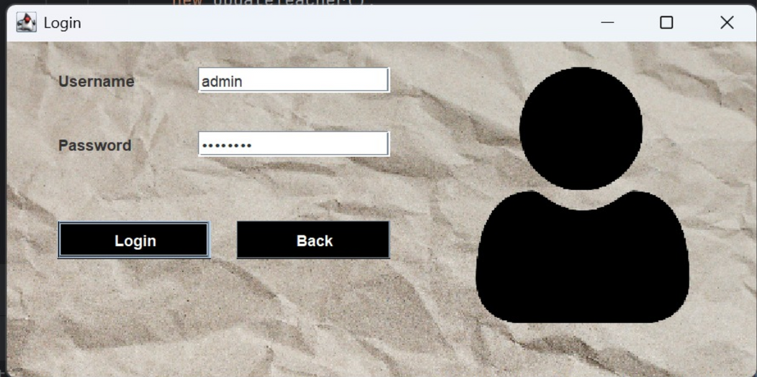
KEY FUNCTIONALITIES

Slide 6
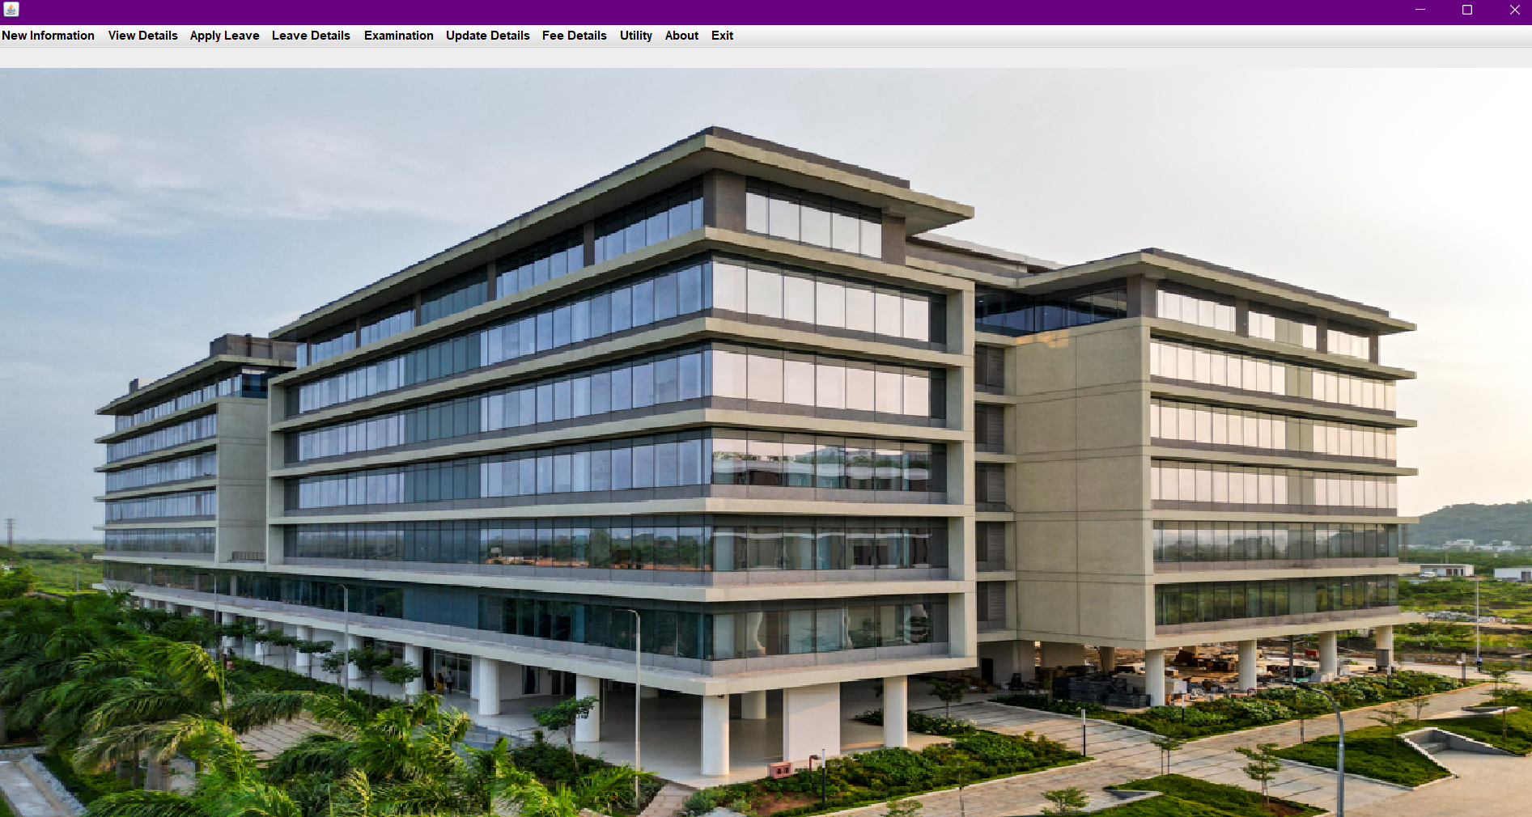

Slide 7

THANK YOU

