Slide 1
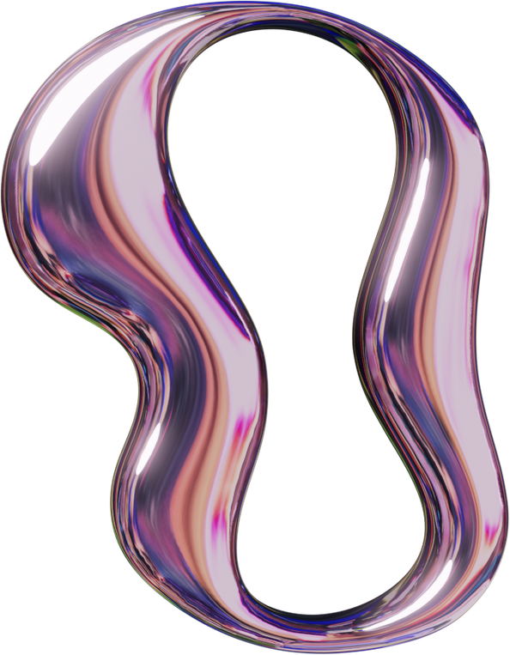


GNR 607
PRINCIPAL COMPONENT ANALYSIS FOR MULTISPECTRAL IMAGE PROCESSING
SATELLITE IMAGE PROCESSING
2025

Slide 2



GNR- 607
PCA
Presented by
Yaksh Bhesaniya - 25M0313
Aditya Awasthi - 25M0307
Bahul Mishra - 25M0317
Presented To
Professor - BK Mohan Sir

Slide 3
Content
Project Definition
Project Objectives
The Solution: What is PCA?
Core Formulas
Our Project:
Methodology & Implementation (Flowchart)
Our Application Interface
Results & Analysis
The Principal Components
Variance & Error (MSE)
Image Reconstruction
Conclusion, Limitations & Future Work

Slide 4

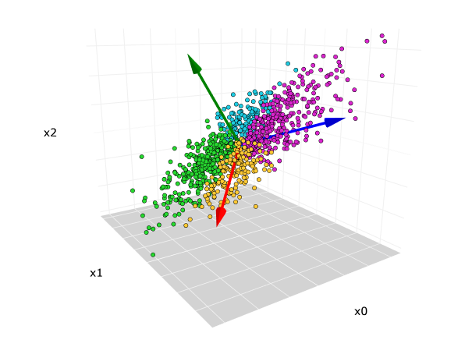
Project
Definition
Compute all the principal component images and display them along with the input multiband image. (Built-in function permitted for computing eigenvectors and eigenvalues. Students must write the code to compute the covariance matrix and generation of principal components). Generate inverse PCT images with user-specified number of the top few principal components and show the meansquared error between original multispectral images and reconstructed images.

Slide 5


Project
Objectives
COMPUTE & DISPLAY PCA
To write code that computes all principal component images from an input multiband image and displays them.
IMPLEMENT INVERSE PCT
To generate inverse PCT images using a user-specified number ('k') of the top principal components.
EVALUATE PERFORMANCE
To show the mean-squared error (MSE) between the original multispectral images and the reconstructed images.
BUILD AN INTERFACE
To create a UI that facilitates loading images, computing PCA, setting 'k' and visualizing all results.

Slide 6
What is
Principal Component Analysis (PCA)?
PCA is a statistical technique that transforms data from a set of correlated variables (Bands) into a new set of uncorrelated variables (PCs).
PC1: The first component contains the maximum possible variance.
PCn: The last component contains the least variance (often just noise).
It finds a new set of orthogonal axes for the data, ordered by variance.

Slide 7
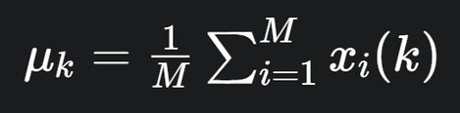
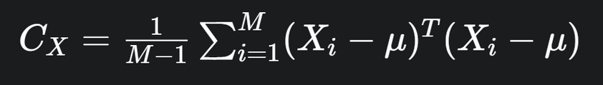

Core Theory
& Formulas
Compute Mean Vector :
Compute Covariance Matrix
Eigen-Decomposition:
Find the mean value for each band.
Measure how all bands vary with each other.
Find the axes (Eigenvectors) and magnitude (Eigenvalues) of the variance.

Slide 8
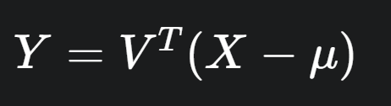
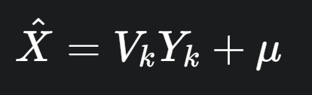
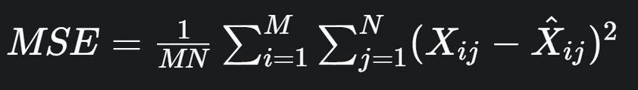
Core Theory
& Formulas
Project (Get PCs/Scores)
Reconstruction
(Inverse PCT)
Mean-Squared Error (MSE)
Transform the original data to the new axes.
Transform back to the original space using only the top 'k' components.
Calculate the average squared difference between the original and reconstructed images.

Slide 9
Our Project:
Methodology & Implementation
LOAD N-BAND
IMAGES
COMPUTE MEAN & CENTER DATA
COMPUTE
COVARIANCE
MATRIX
FIND EIGENVALUE
EIGENVECTOR
START
SHOW ORIGINAL VS
RECOSTRUCTED
BAND
SELECT TOP K PC’S
AND RECONSTRUCT
SHOW PC IMAGE
ON DISPLAY
END
DISPLAY MSE

Slide 10
Project Toolkit:
Libraries Used
This project was built using a combination of powerful Python libraries:
Tkinter (tk, ttk)
Used to build the entire graphical user interface (GUI), including buttons, sliders and canvases.
NumPy (np)
The core of the project. Used for:
All N-dimensional array storage (the image stack).
Calculating the Covariance Matrix ((Xc.T @ Xc)).
The built-in np.linalg.eigh for Eigen-decomposition.
All matrix-based projections and reconstructions.

Slide 11
Project Toolkit:
Libraries Used
This project was built using a combination of powerful Python libraries:
Pillow (PIL)
Used to convert NumPy arrays into ImageTk objects that can be displayed inside the Tkinter GUI.
ImageIO & Tifffile
Essential for reading the input data, handling both standard formats (like .png) and scientific formats (like multi-band .tif files).
Scikit-image (skimage)
Used for utility functions, specifically resize to ensure all input bands match in dimension.

Slide 12
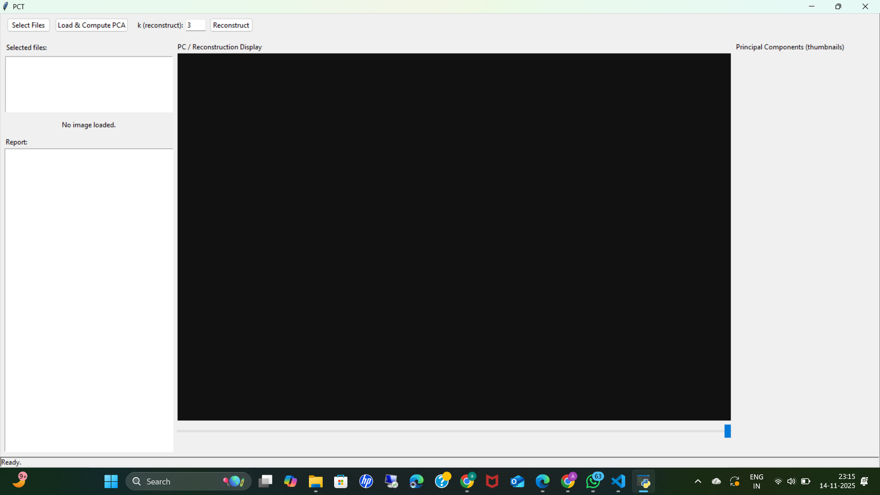
Our Application Interface
Inverse PCA
Control
Band Loader
(select files)
PCA Control
(load and compute PCA)
PC Display
Report

Slide 13
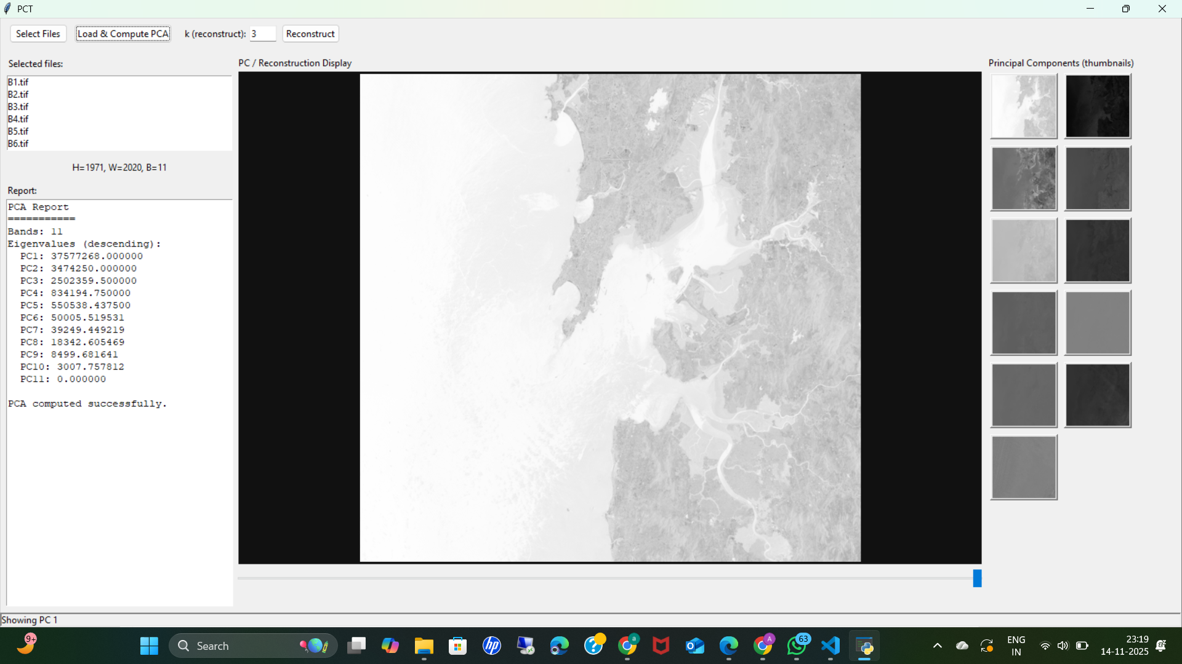
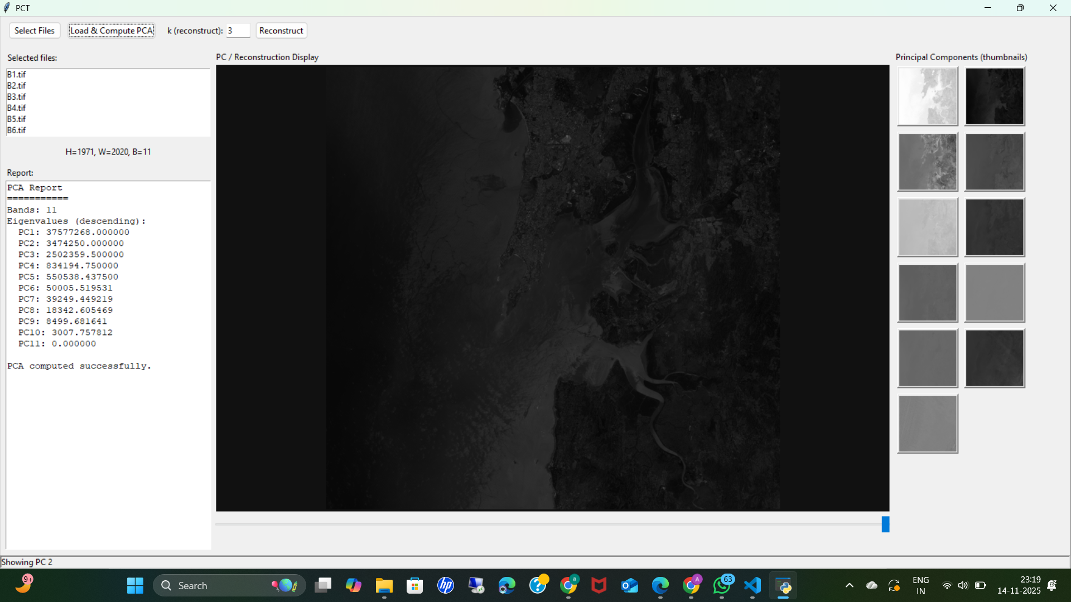
PC1
PC2

Slide 14
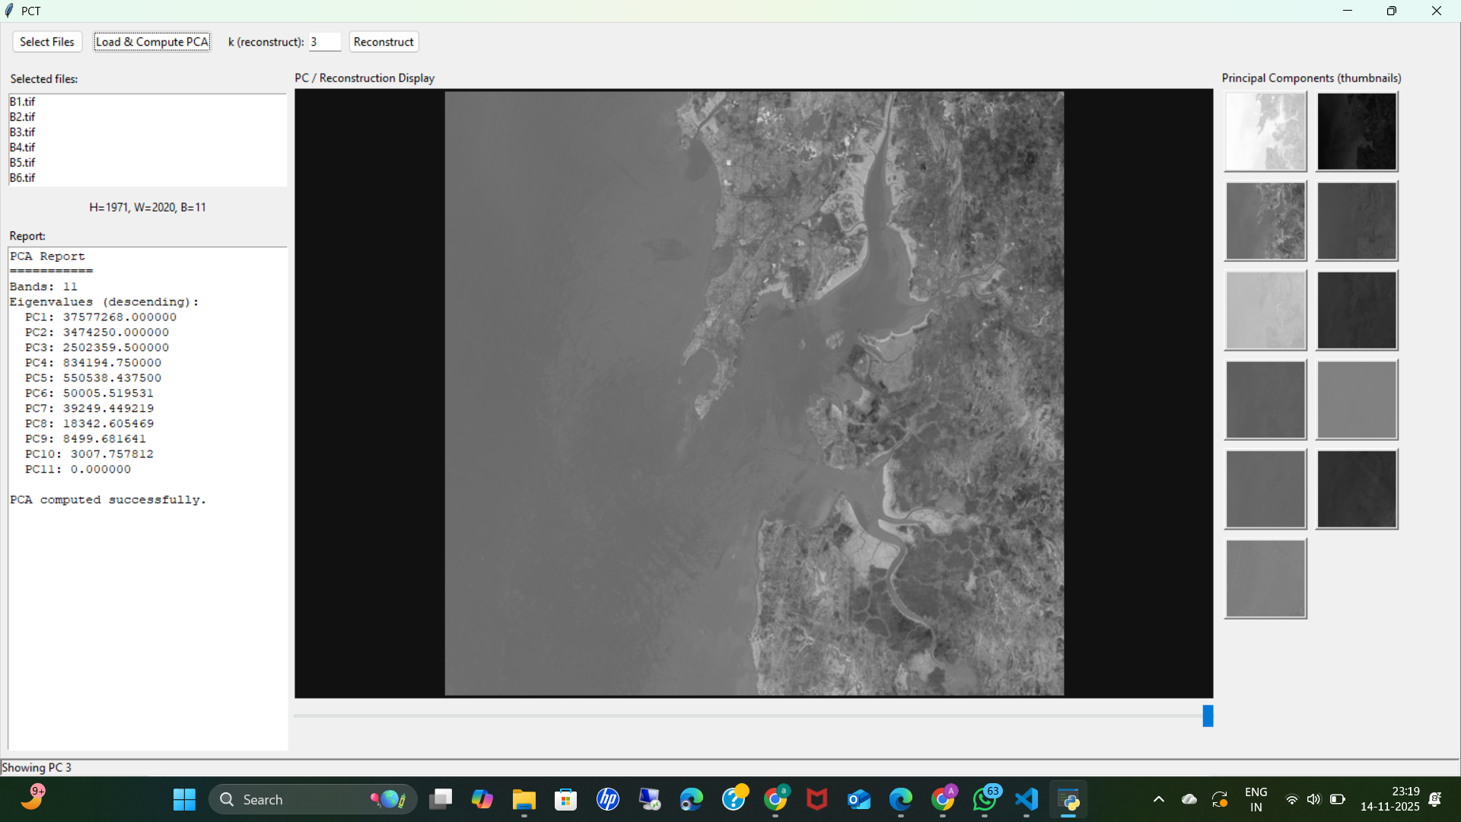
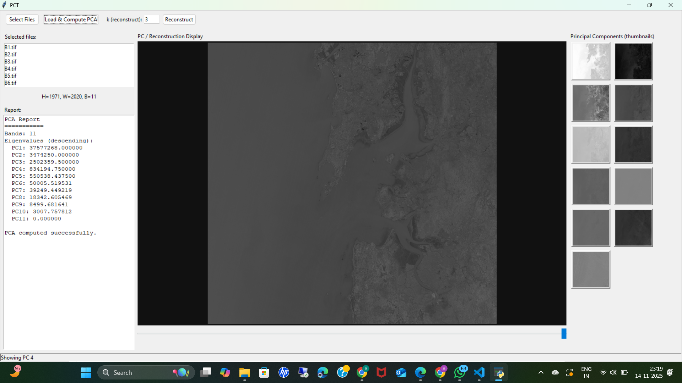
PC3
PC4

Slide 15
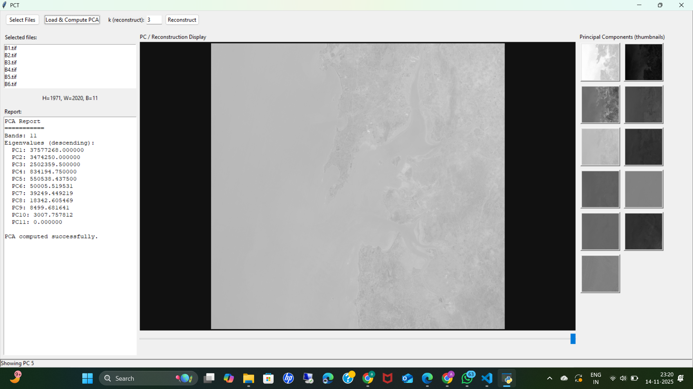
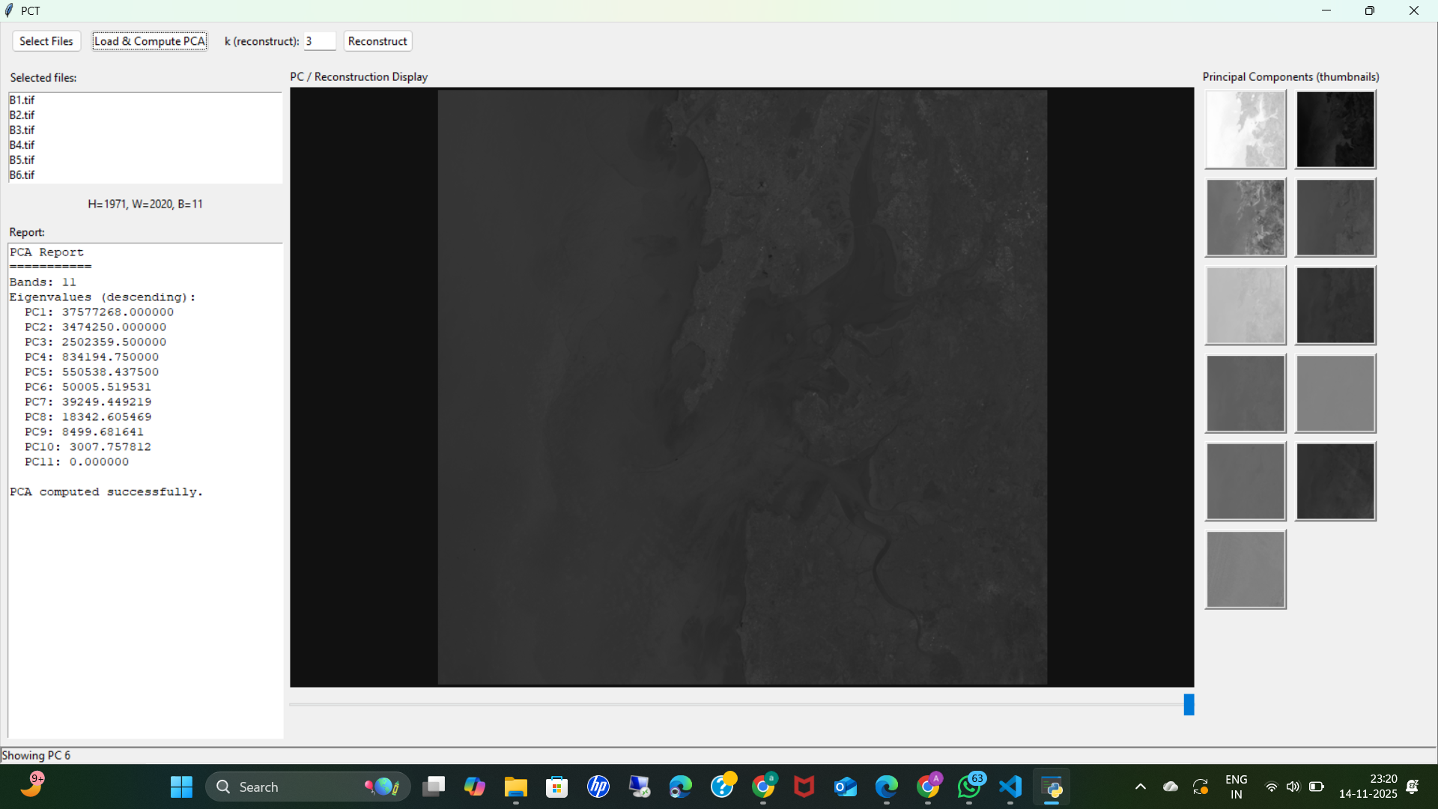
PC5
PC6

Slide 16
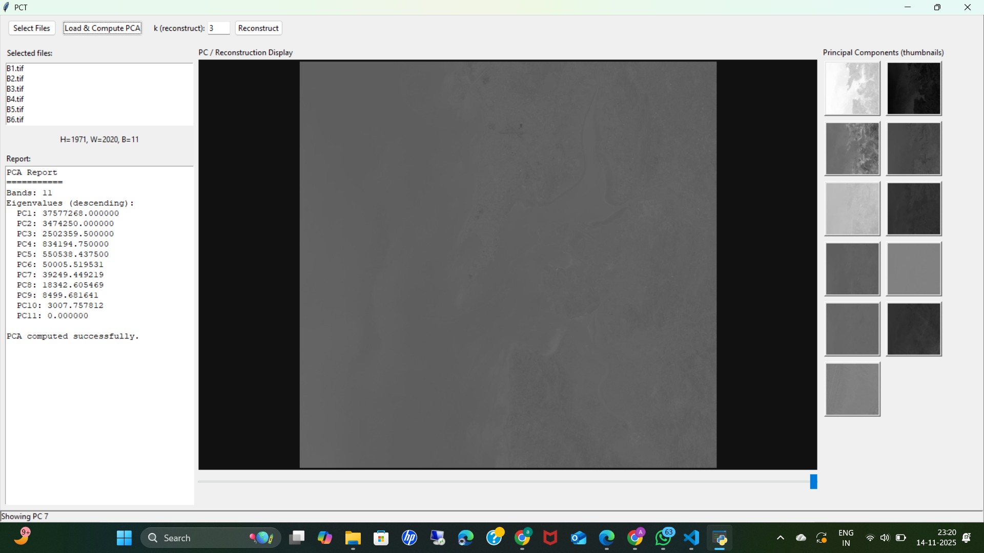
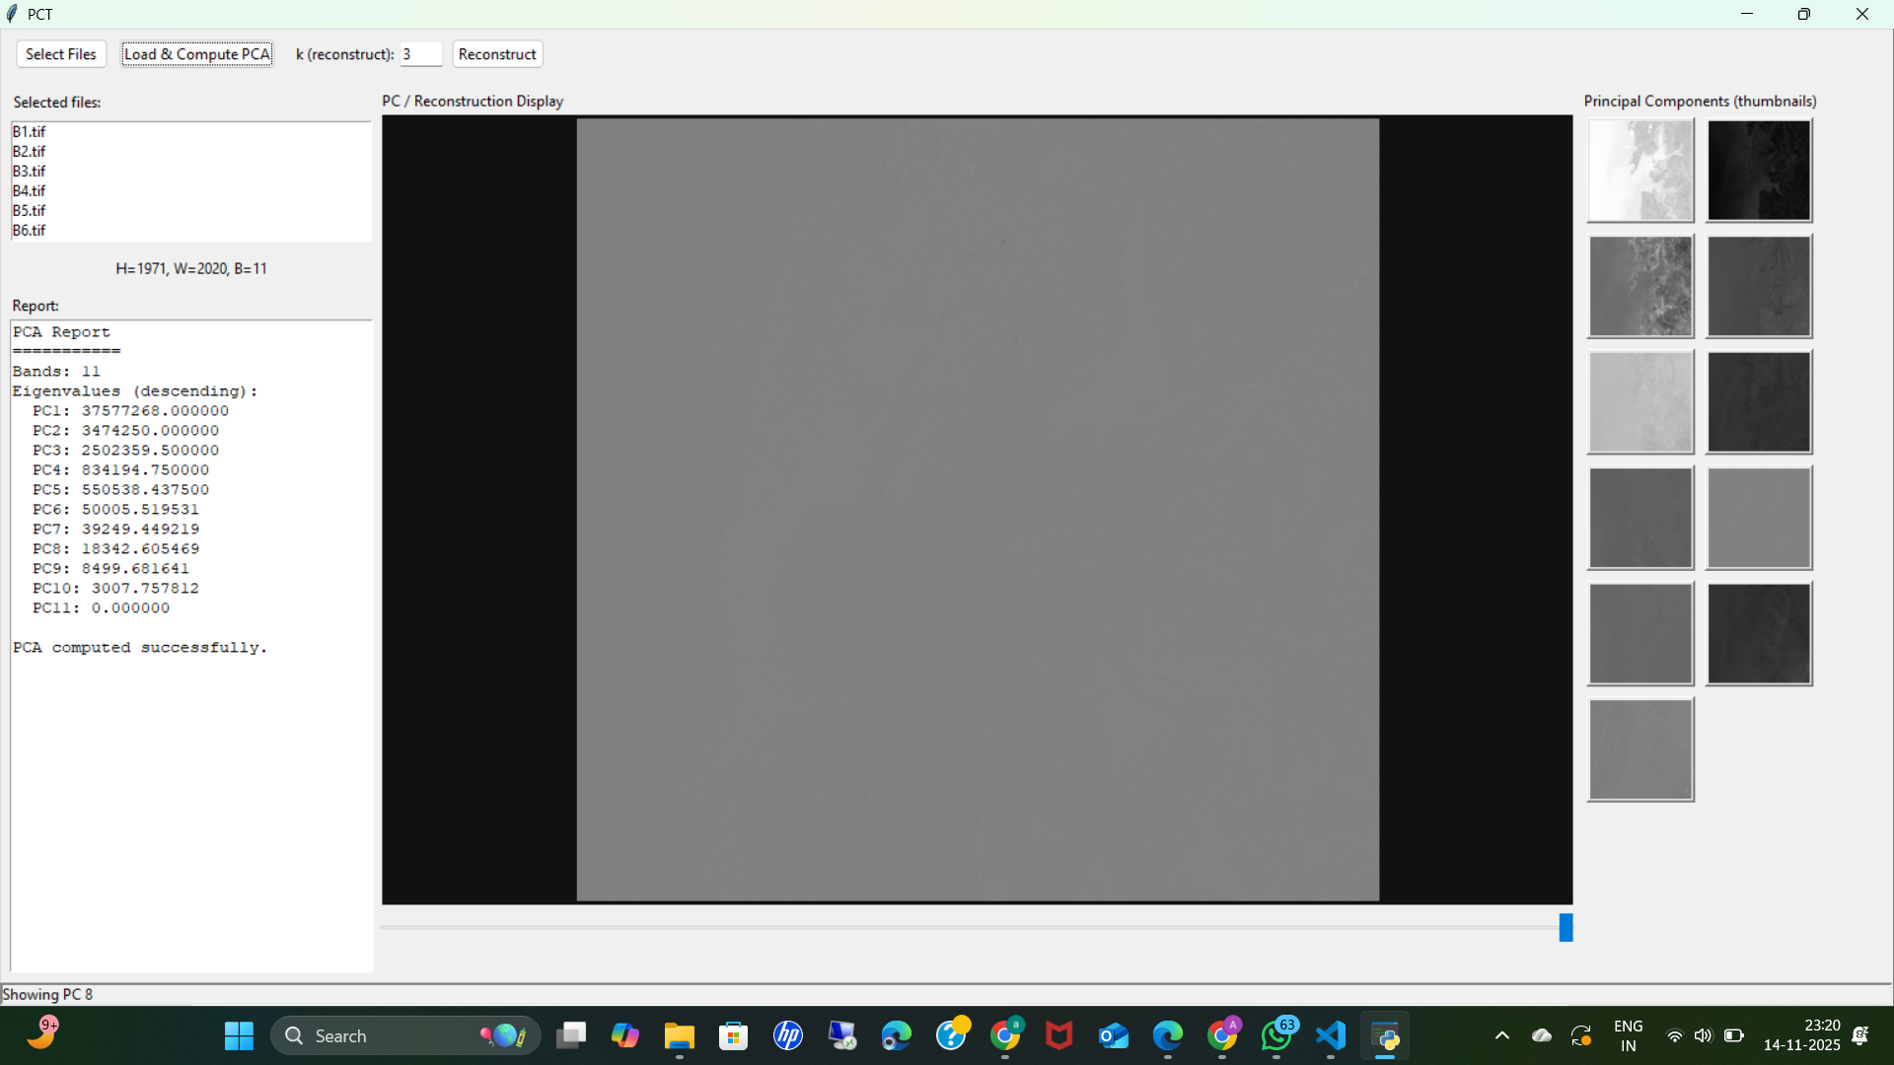
PC7
PC8

Slide 17

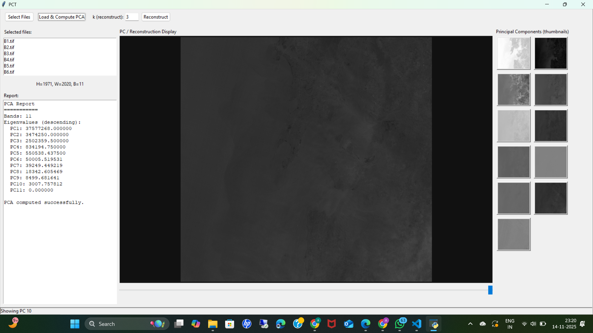
PC9
PC10

Slide 18
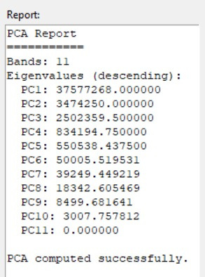
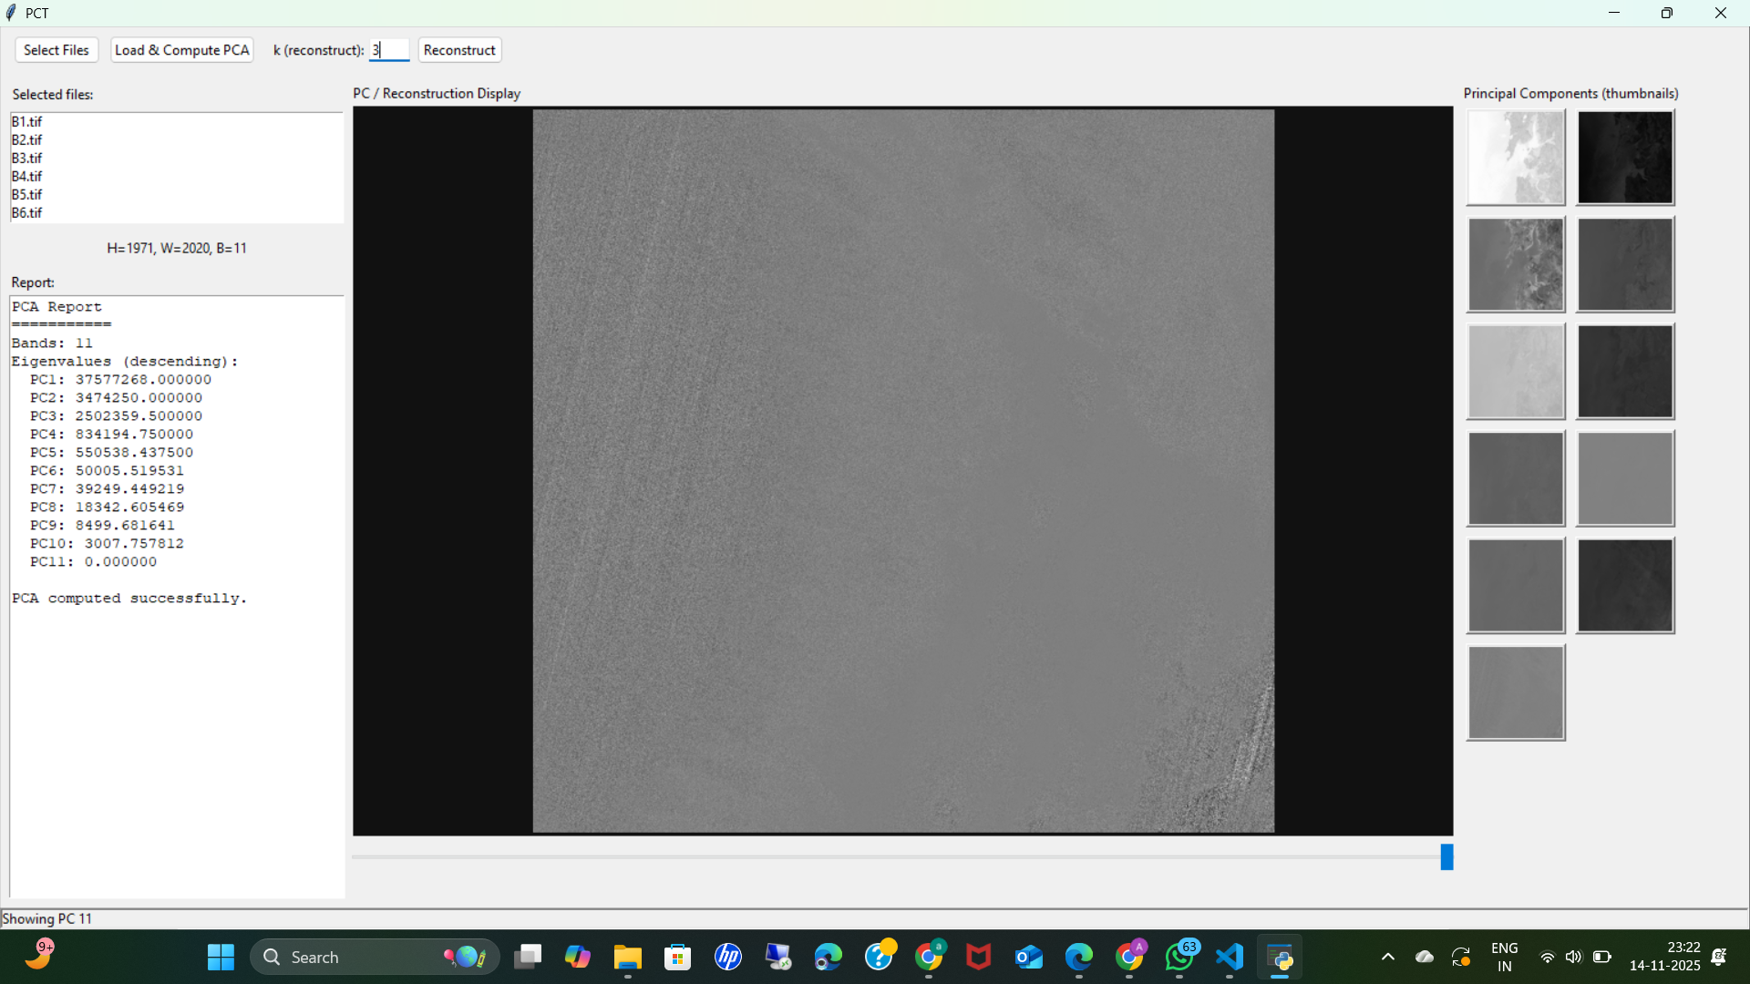
PC11
REPORT

Slide 19
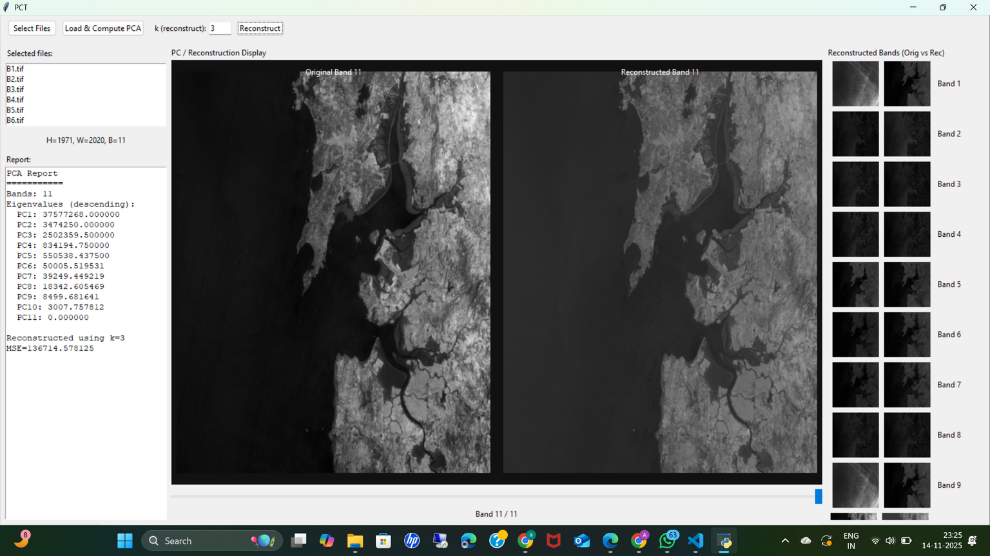
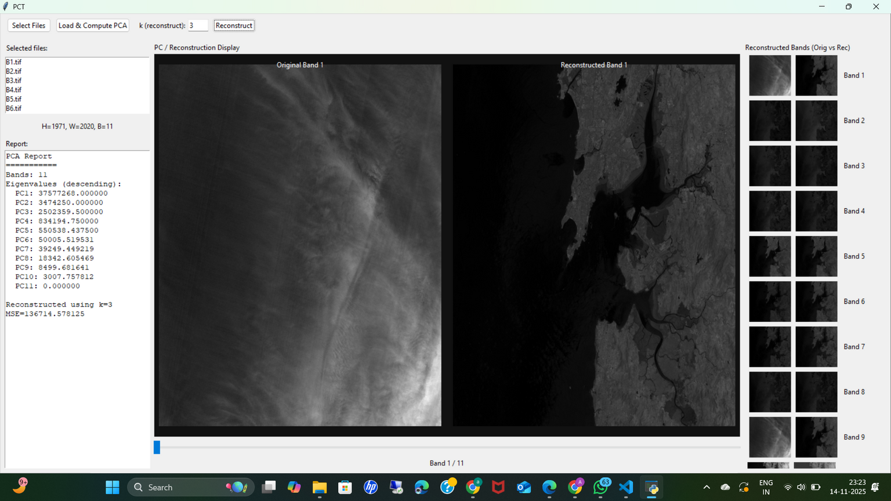
Original v/s Recostructed Image(k=3)

Slide 20
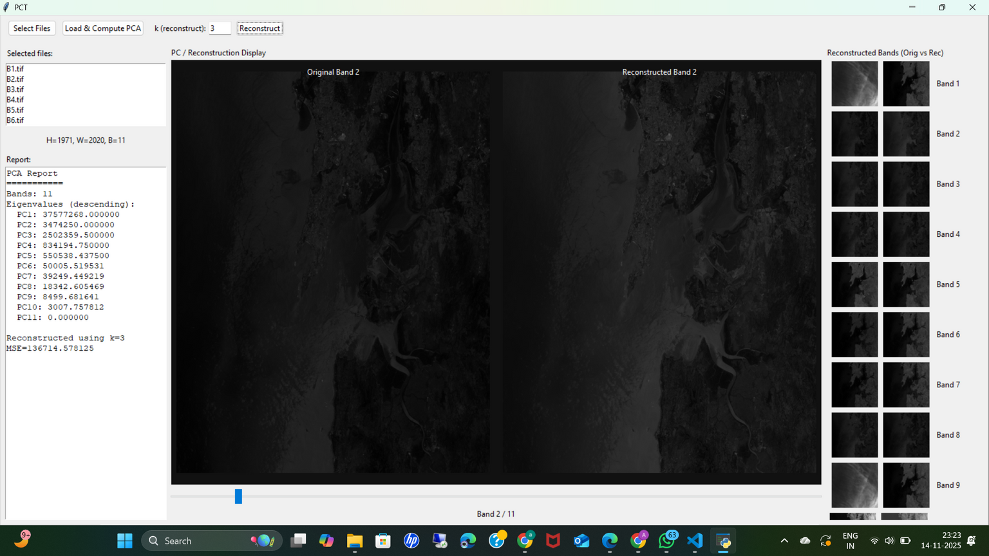
Original v/s Recostructed Image(k=3)

Slide 21
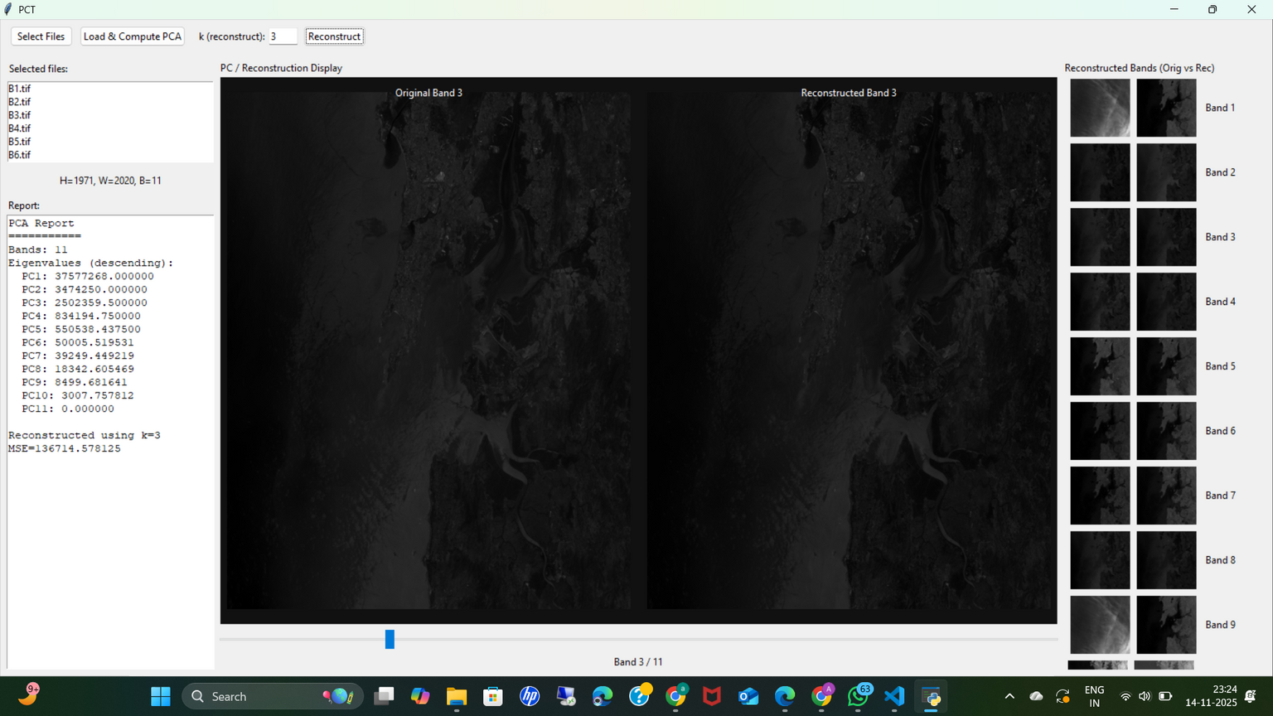
Original v/s Recostructed Image(k=3)

Slide 22
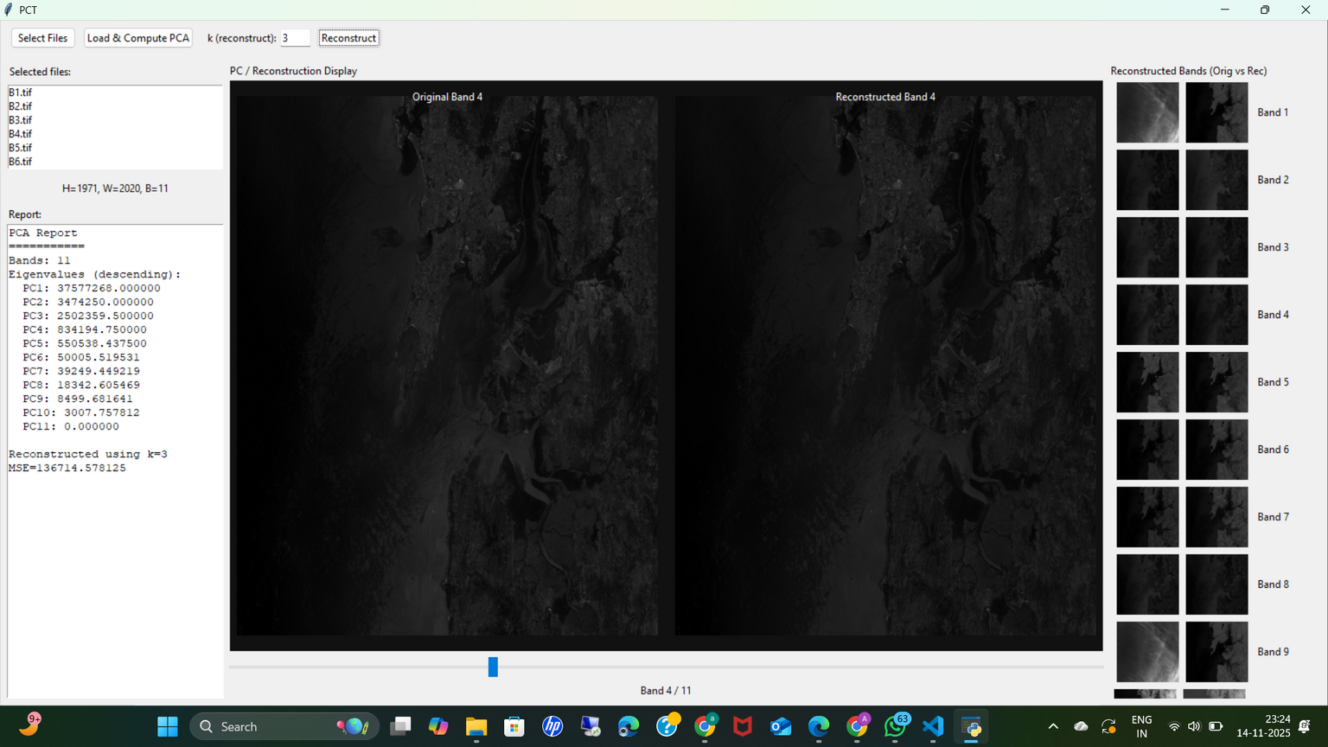
Original v/s Recostructed Image(k=3)

Slide 23
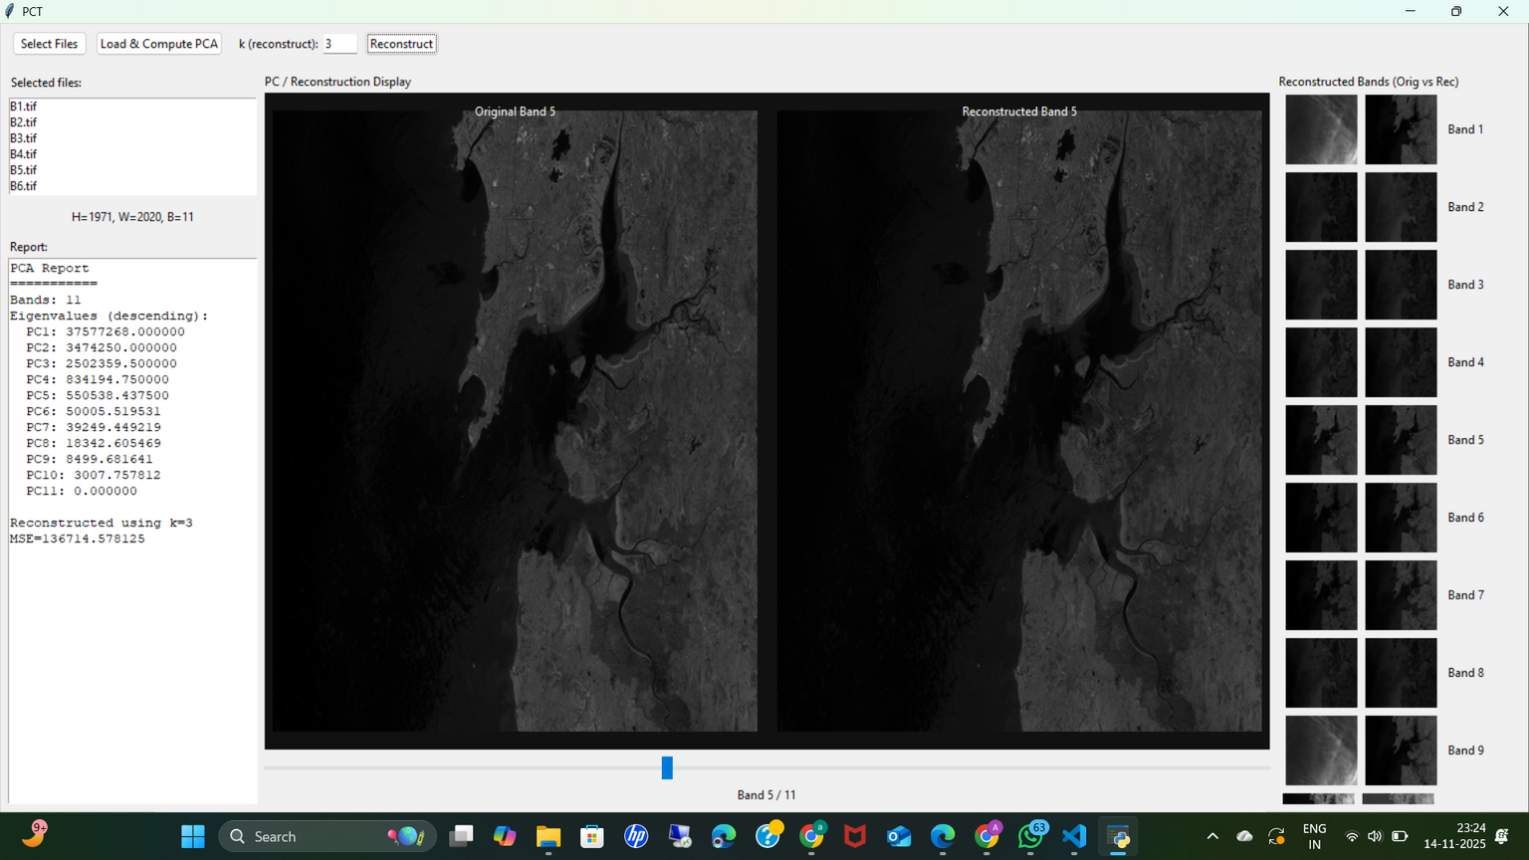
Original v/s Recostructed Image(k=3)

Slide 24
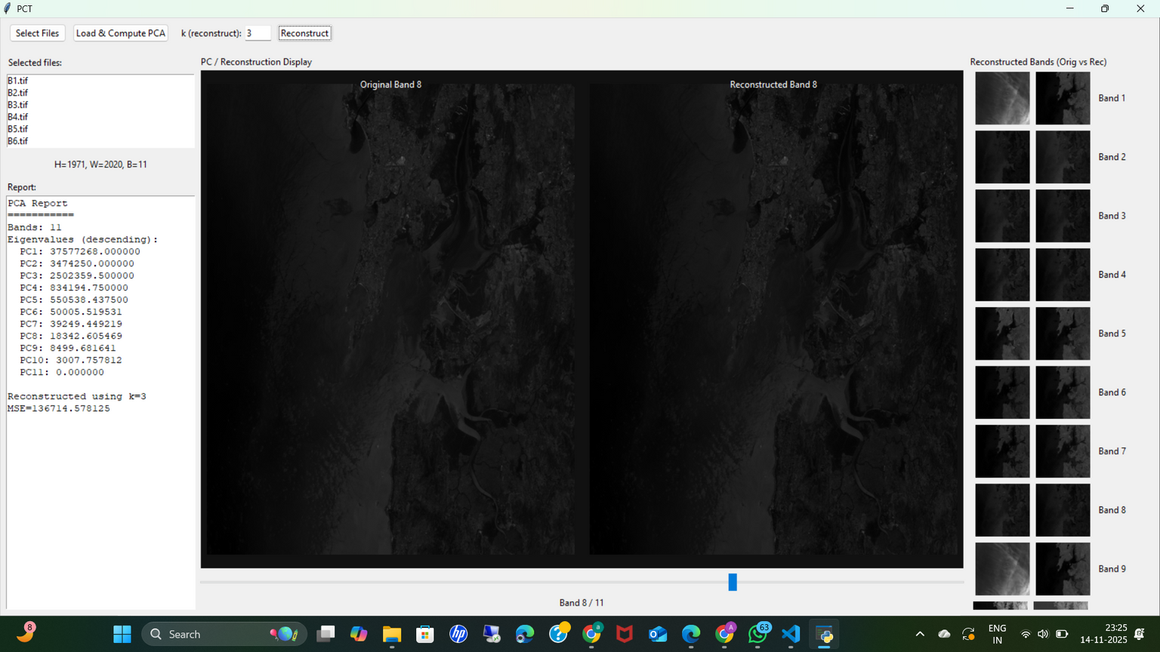
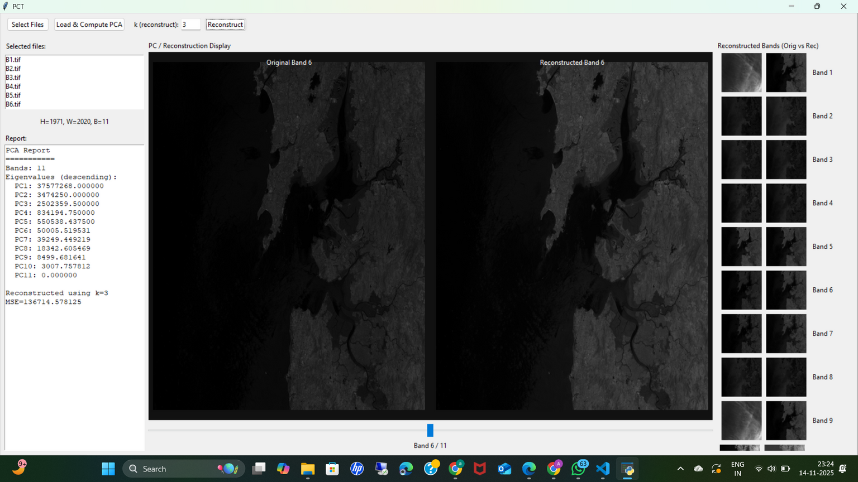
Original v/s Recostructed Image(k=3)

Slide 25
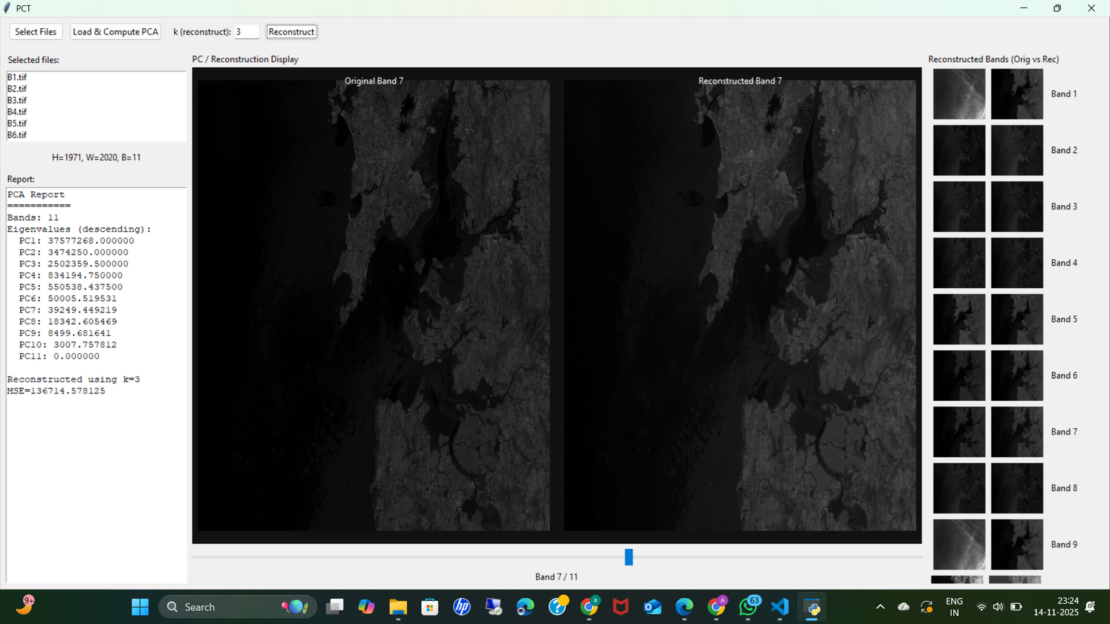
Original v/s Recostructed Image(k=3)

Slide 26
Original v/s Recostructed Image(k=3)

Slide 27
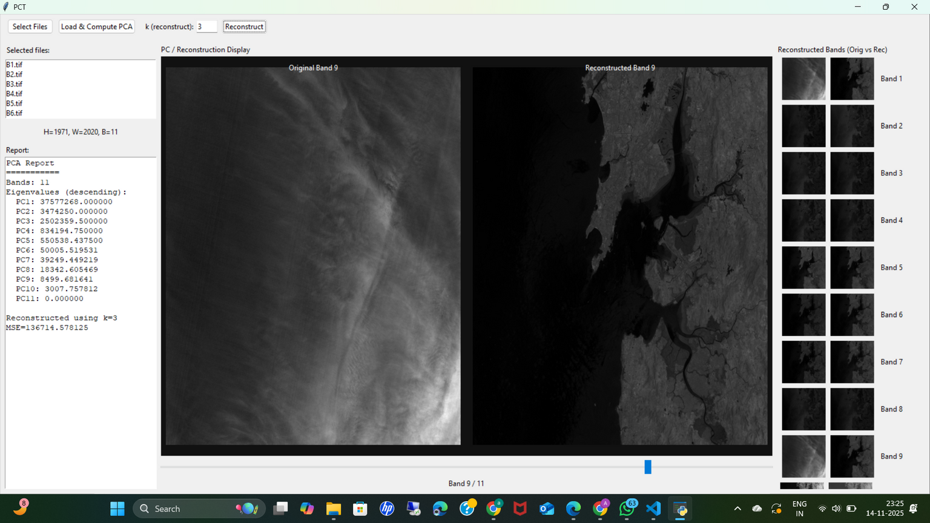
Original v/s Recostructed Image(k=3)

Slide 28
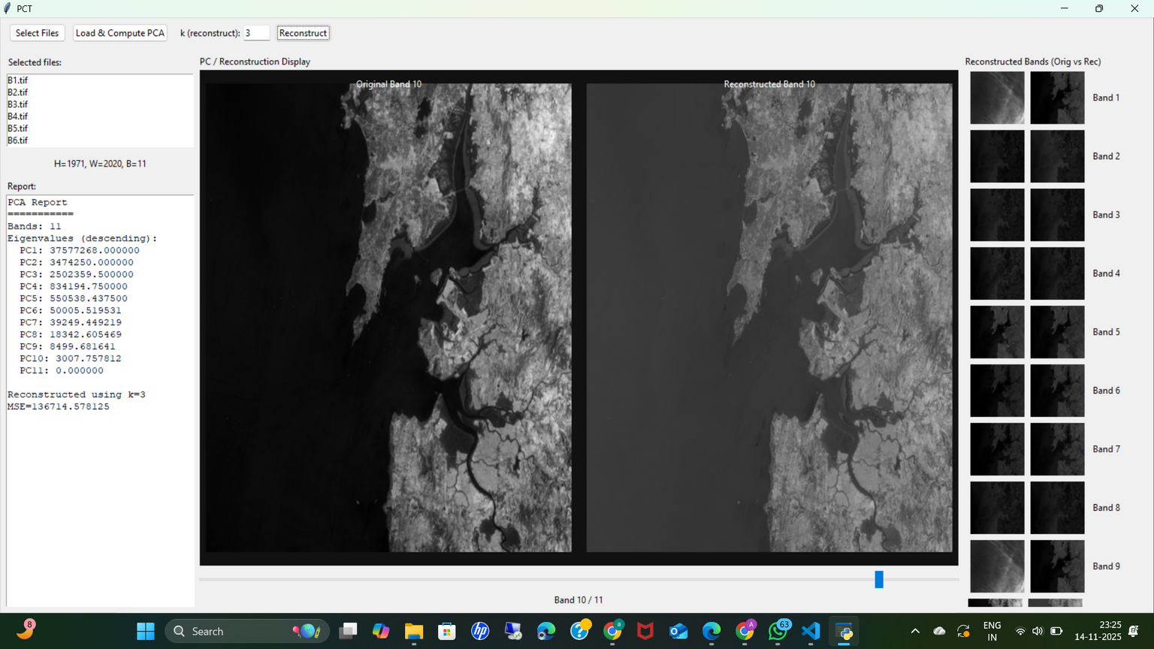
Original v/s Recostructed Image(k=3)

Slide 29
Original v/s Recostructed Image(k=3)

Slide 30
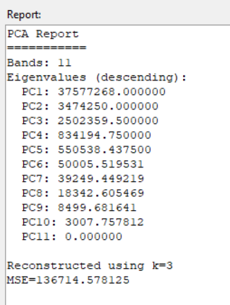
Results:
Variance & Error
Original Bands vs. Reconstructed Bands (from Top 3 PCs)
Result: Visually almost identical to the original.
Overall MSE (for k=3): 136,714.578125

Slide 31
Conclusion
& Observations
Project Goal: We built a tool to compute PCA, implement Inverse PCT and evaluate MSE, meeting all project requirements.
Key Observations:
PCA successfully decorrelates data and concentrates information into the first few components.
PC1 captures the most variance (brightness).
The last PCs (e.g., 9, 10, 11) contain almost exclusively noise.

Slide 32
THANK YOU!
ANY
QUESTIONS?

