Slide 1

GNR- 605
Truck Booking & Tracking Web Application
GIS enabled truck booking and real time freight Tracking System
Name of Subject:
Principal of Geographic Information System
Presented To:
Presented By:
Prof. Surya Durbha
Aditya Awasthi-25m0307
Yaksh Besaniya-25m0313
Bahul Mishra- 25m0317

Slide 2
2025
Project Definition.
Develop an APP for trucks and other heavy vehicles that is similar to UBER. The user should be able to hire a heavy vehicle nearby and track the goods to the destination. Various optimizations have to be done so that the profit is maximized for the vehicle owner as well as minimum cost to the user.
Project Objective:
Build a GIS-based system where:
Users can book heavy vehicles near their location
Owners/drivers can accept rides
Users can track movement of the truck live
System simulates vehicle movement & updates booking status
Optimize so that user cost is minimized & truck owner profit maximized

Slide 3
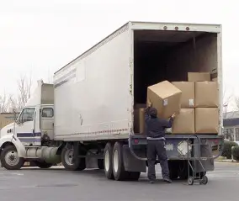
2025
Contents
Introduction & Problem Statement
Tech Stack
Methodology & Implementation
System Architecture
Workflow / Algorithm
UI Screens & Trip Simulation
Results
Conclusion

Slide 4
2025
Tech Stack
Frontend
Database
HTML, CSS, Bootstrap, JavaScript
Leaflet
‘data.json’ file storing
Vehicles, Locations, Bookings
Backend
Tools
Flask (Python)
REST APIs for booking, driver actions, simulation
GitHub (Code Repo)
VS Code
Browser & Localhost (Testing Environment)
Simulation Engine
Python-based simulator script
Coordinate update every 0.8 seconds

Slide 5
2025
Methodology & Implementation
User Booking
Driver Interaction
Simulation Engine
Tracking on Map
User selects pickup + drop on map
System fetches nearest available truck
New booking is created: PENDING
Driver panel lists active bookings
Driver accepts a booking
Booking status → ACCEPTED
Background thread starts
Truck moves to pickup location (phase-1)
Status changes: ARRIVED_DRIVER → LOADED
Truck then moves to drop location (phase-2)
Status → COMPLETED
Frontend periodically fetches updated coordinates
User sees live truck movement

Slide 6
User Panel
(Web UI)
2025
System
Architecture
Flask Backend
(Rest API)
Simulator Engine
(Background Thread)
data.json
Database
Driver Panel
(Web UI)
Map View (Tracking UI)

Slide 7
2025
Workflow
Open Web Application
Select Pick up and Drop Location
Calculate
Fare
Make booking request
Driver arrived and mark loaded
Truck move to pickup location
Driver accepts booking
Driver receives booking notification
Truck moves to drop location
User can track truck live on map
Truck reach its destination
Trip completed and available for new booking

Slide 8
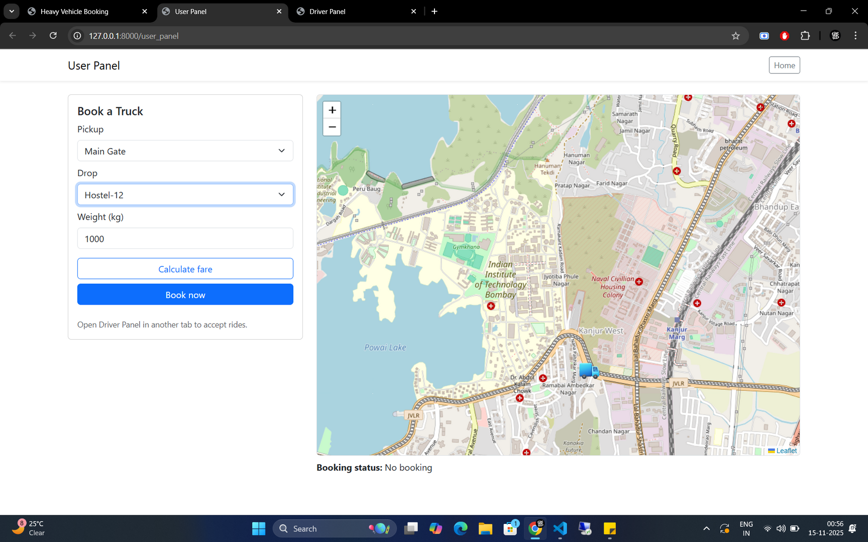
2025
User Panel
[Selecting Pickup and drop ]

Slide 9
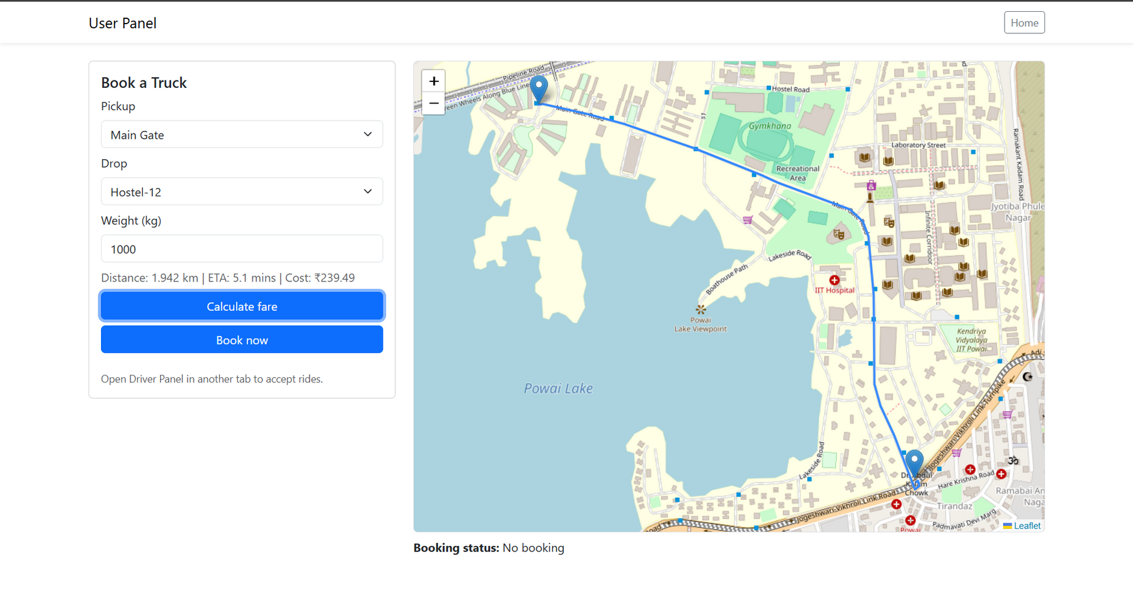
2025
User Panel
[Calculate fair ]

Slide 10
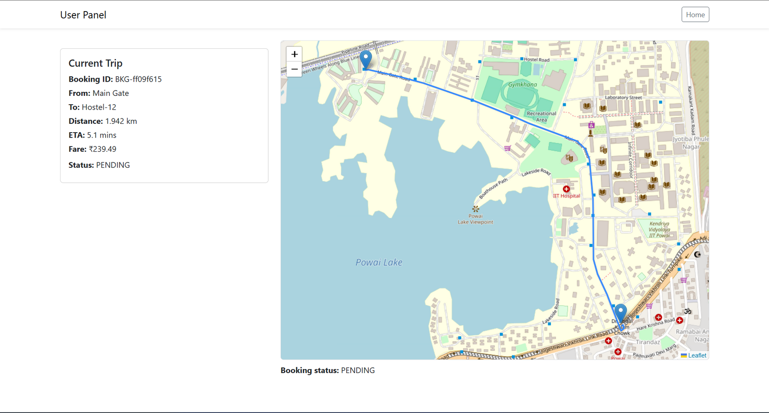
2025
User Panel
[Current trip created ]

Slide 11
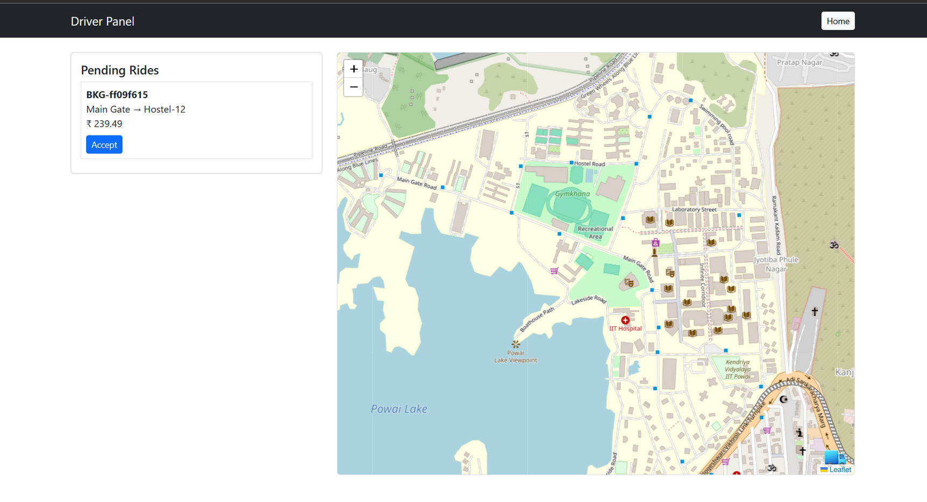
2025
Driver Panel
[Accept trip ]

Slide 12
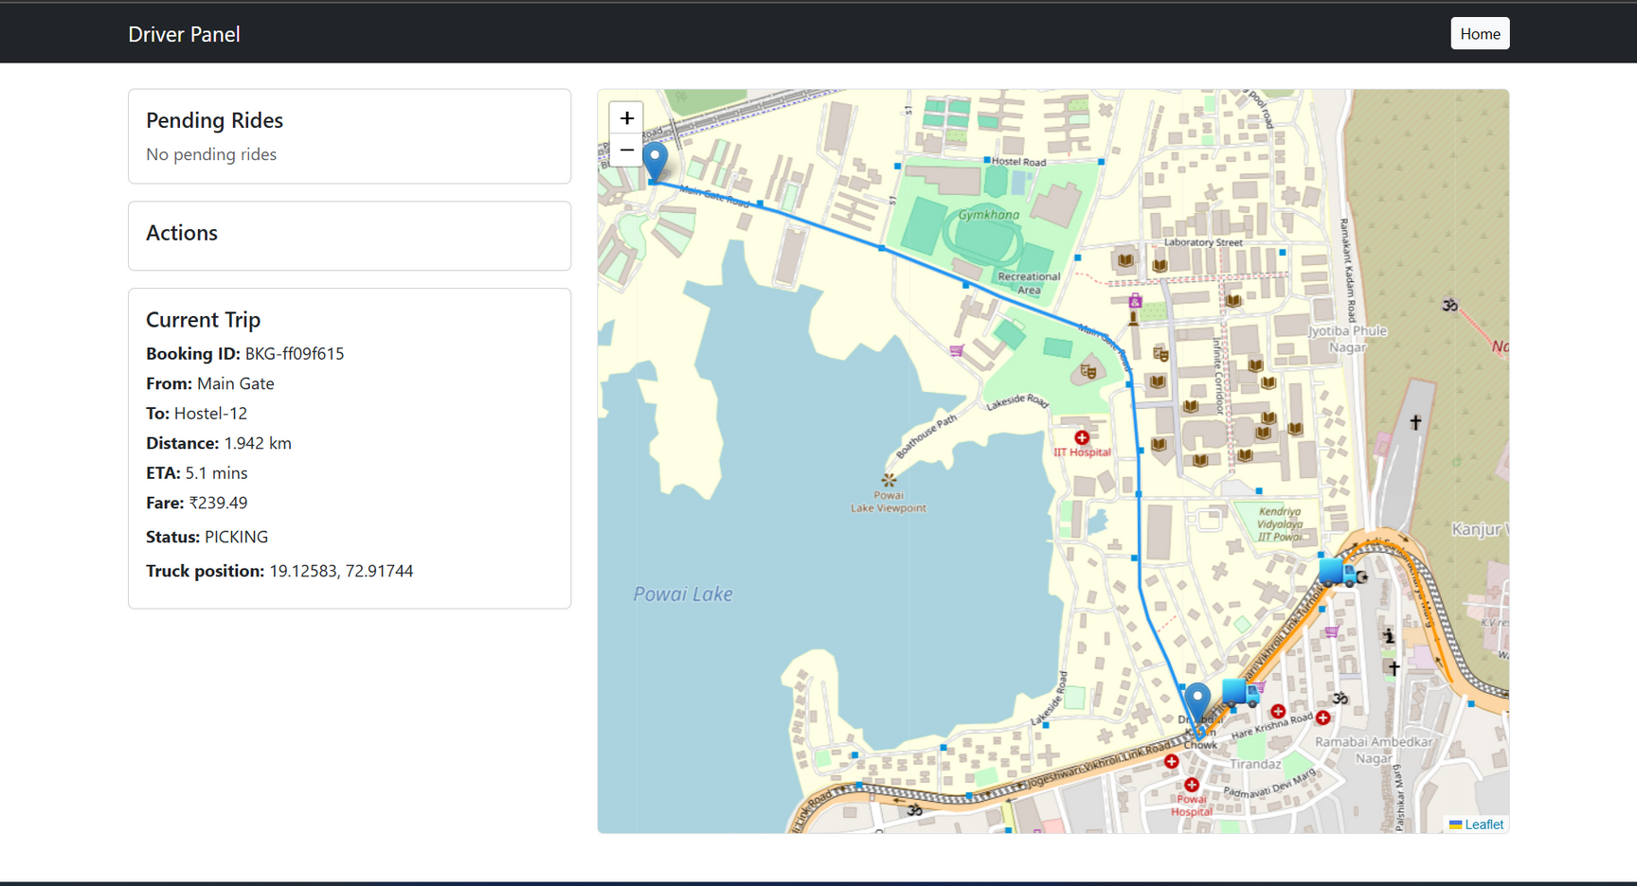
2025
Driver Panel
[Reaching pickup point ]

Slide 13
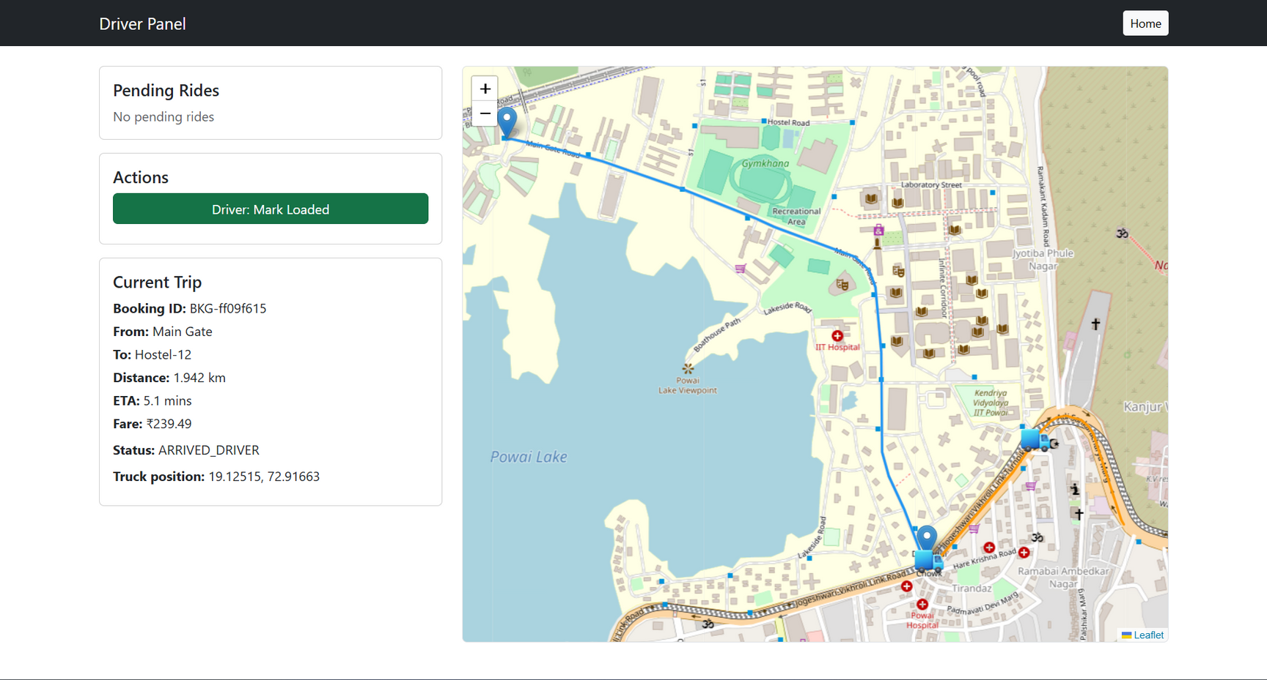
2025
Driver Panel
[Driver reached pickup point waiting for loading ]

Slide 14
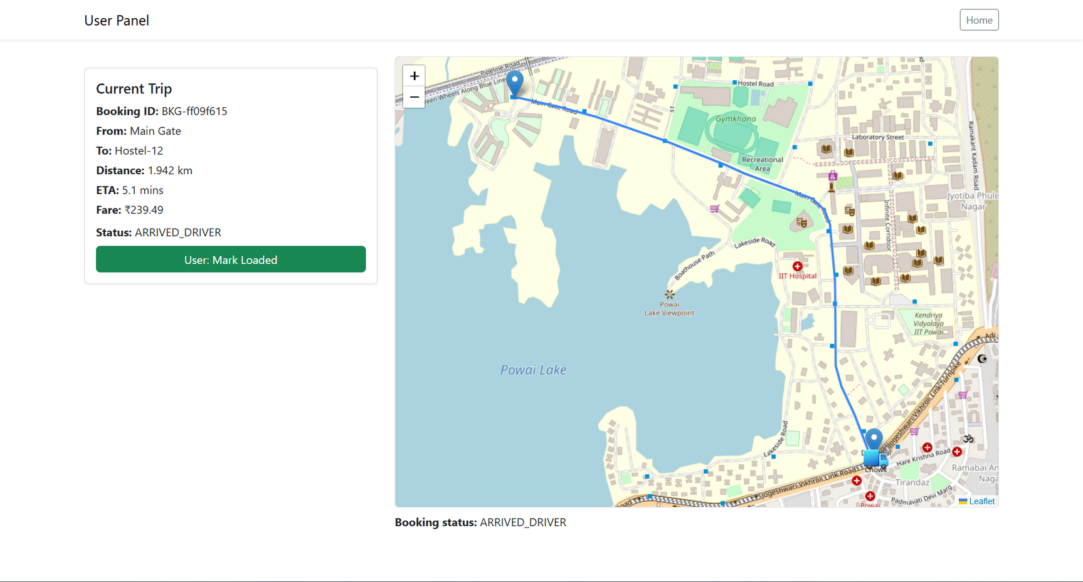
2025
User Panel
[ After loading user marks loaded ]

Slide 15
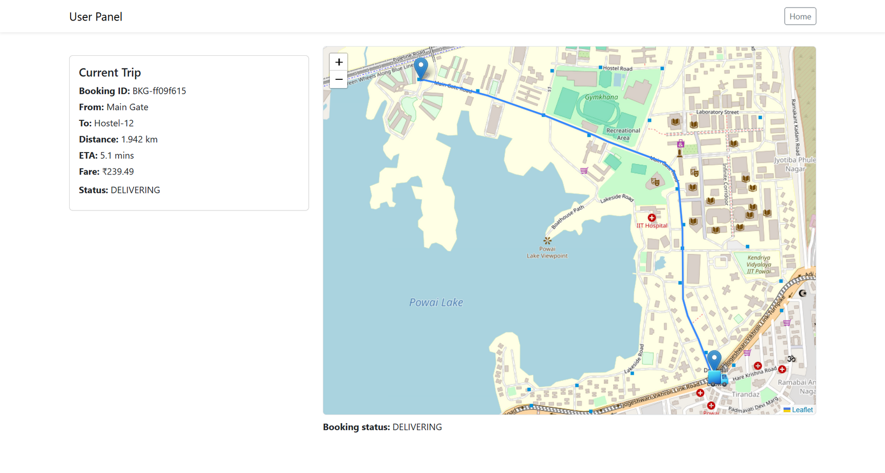
2025
User Panel
[ Trip started and user can track live status ]

Slide 16
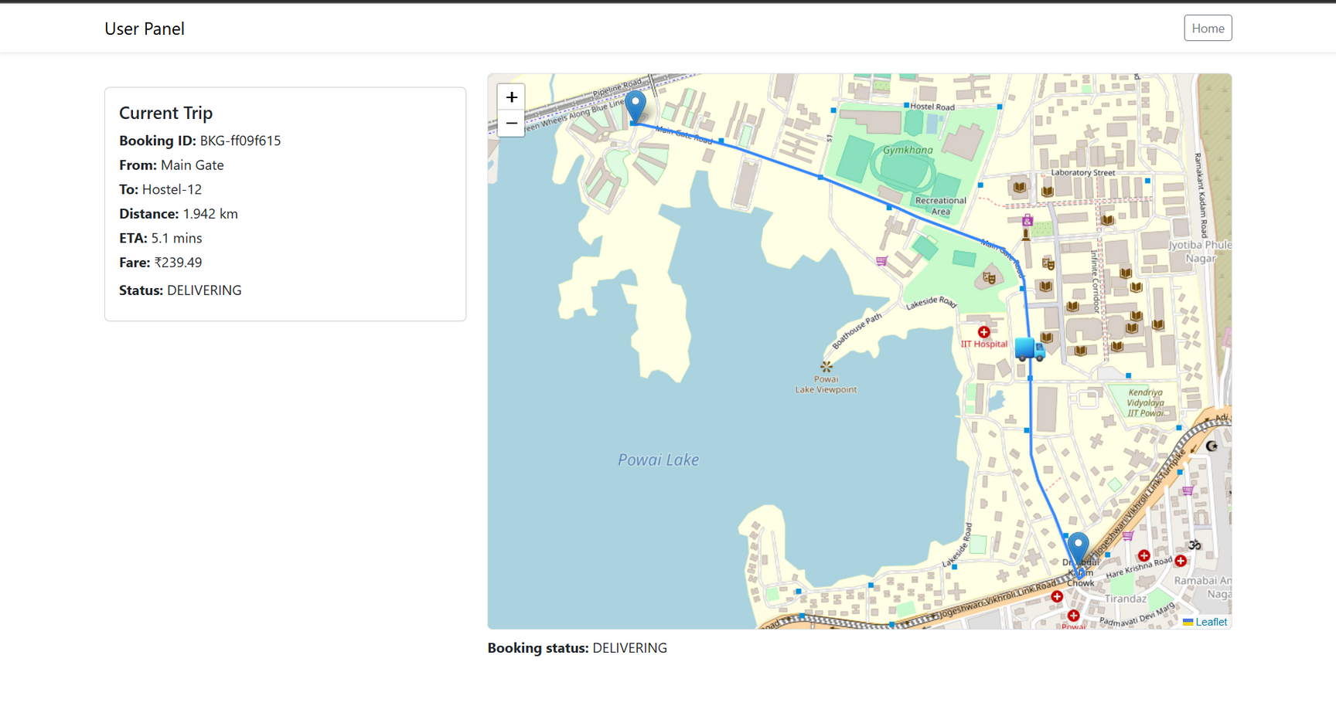
2025
User Panel
[ Trip progress on user panel ]

Slide 17
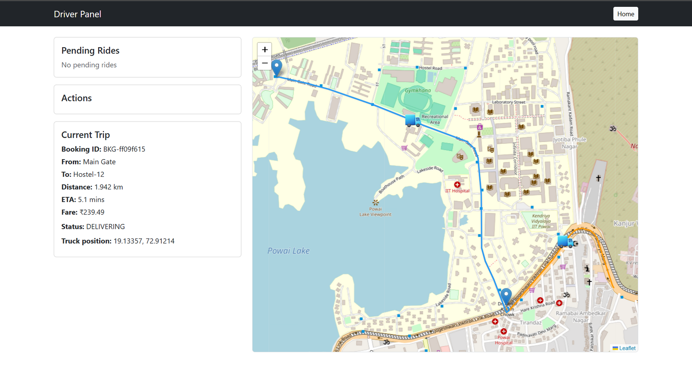
2025
Driver Panel
[ Trip progress on driver panel ]

Slide 18
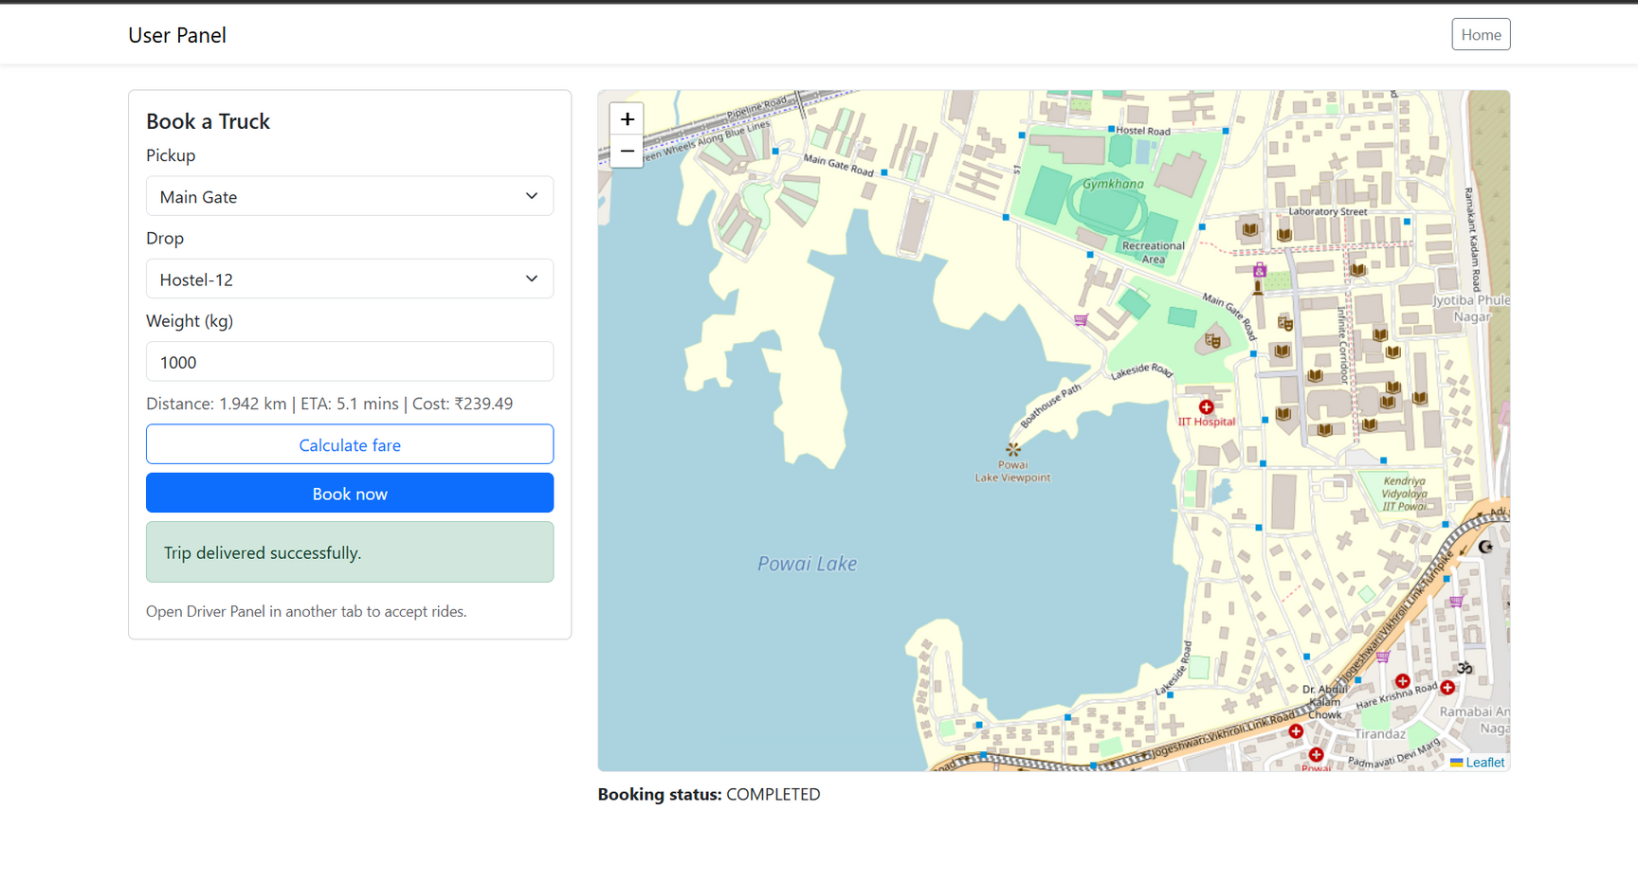
2025
User Panel
[ Trip completed successfully ]

Slide 19
2025
Task Accomplished
Successful booking and allocation of trucks
Real-time movement simulation
Live tracking on map
Continuous status updates
Smooth driver–user interaction
Trip progress updated every 0.8 seconds
Minimal backend processing delay
Lightweight JSON-based storage
Visualization on interactive map

Slide 20
2025
Conclusion
Built a working prototype of Uber-like truck hiring system
Demonstrated GIS-based vehicle tracking & routing simulation
Achieved end-to-end flow from booking → tracking → trip completion
System can be extended to real-world:
✔ Real routing APIs
✔ Database integration
✔ Pricing optimization
Provides foundation for smart logistics & transport automation

Slide 21
Thank
You

