Slide 1



OSCP
PREPARATION
EXAM OVERVIEW

Slide 2


Meeting Overview
Course Prerequisites
Overview of the Course
Lab Environment, Challenge Labs & Proving Ground
Exam Preparation & Additional Resources
Exam & Exam Experience
Tips when you are taking the Exam
OSCP+

Slide 3


OSCP Overview & Prerequisites
Designed for information security professionals who want to take a serious and meaningful step into the world of professional penetration testing.
COMPETENCIES
Creative problem solving and lateral thinking skills
Using information gathering techniques to identify and enumerate targets running various operating systems and services
Writing basic scripts and tools to aid in the penetration testing process
Analyzing, correcting, modifying, cross-compiling, and porting public exploit code
Conducting remote, local privilege escalation, and client-side attacks
Identifying and exploiting XSS, SQL injection, and file inclusion vulnerabilities in web applications
Leveraging tunneling techniques to pivot between networks
PREREQUISITES
Note Taking Tools (Cherrytree, Obsidian, Microsoft OneNote & Keepnote)
Operating Systems Knowledge(Linux and Windows)
Reasonable Windows and Linux administration experience
Familiarity of Bash scripting with basic Python or Perl a plus
GET READY FOR OSCP
OSCP - Challenge Labs(A, B & C)
TjNull & LainKusanagi list
HTB and Proving Grounds
PEN-200
The official OSCP certification course.
MATERIALS • 17+ hours of video
850-page PDF course guide
Virtual lab environment 70 machines
Active student forums - Very Helpful
24H EXAM
Proctored, hands-on penetration test exam that requires students to submit a comprehensive report that should contain in-depth notes and screenshots detailing the findings.
Earn OSCP

Slide 4

OSCP
Overview - CONT
Course Modules
Bonus Points & Passing Scenario
Passing Scenarios
Currently 26 Modules
Module Lab Exercises
Modules Enumerating AWS Cloud Infrastructure
To receive ten (10) bonus points, you must complete at least
80% of the module lab exercises) per each learning module (excluding the new "Enumerating AWS Cloud Infrastructure" module) in the PEN-200 course
submit 30 correct proof.txt hashes from the PEN-200 challenge lab machines on the OffSec Learning Platform.
40 pt AD + 3 local.txt flags
40 pt AD + 2 local.txt flags + 1 proof.txt flag
40 pt AD + 2 local.txt flags + bonus points
40 pt AD + 1 proof.txt + 1 local.txt + bonus points
3 fully completed non-AD machines + bonus points

Slide 5
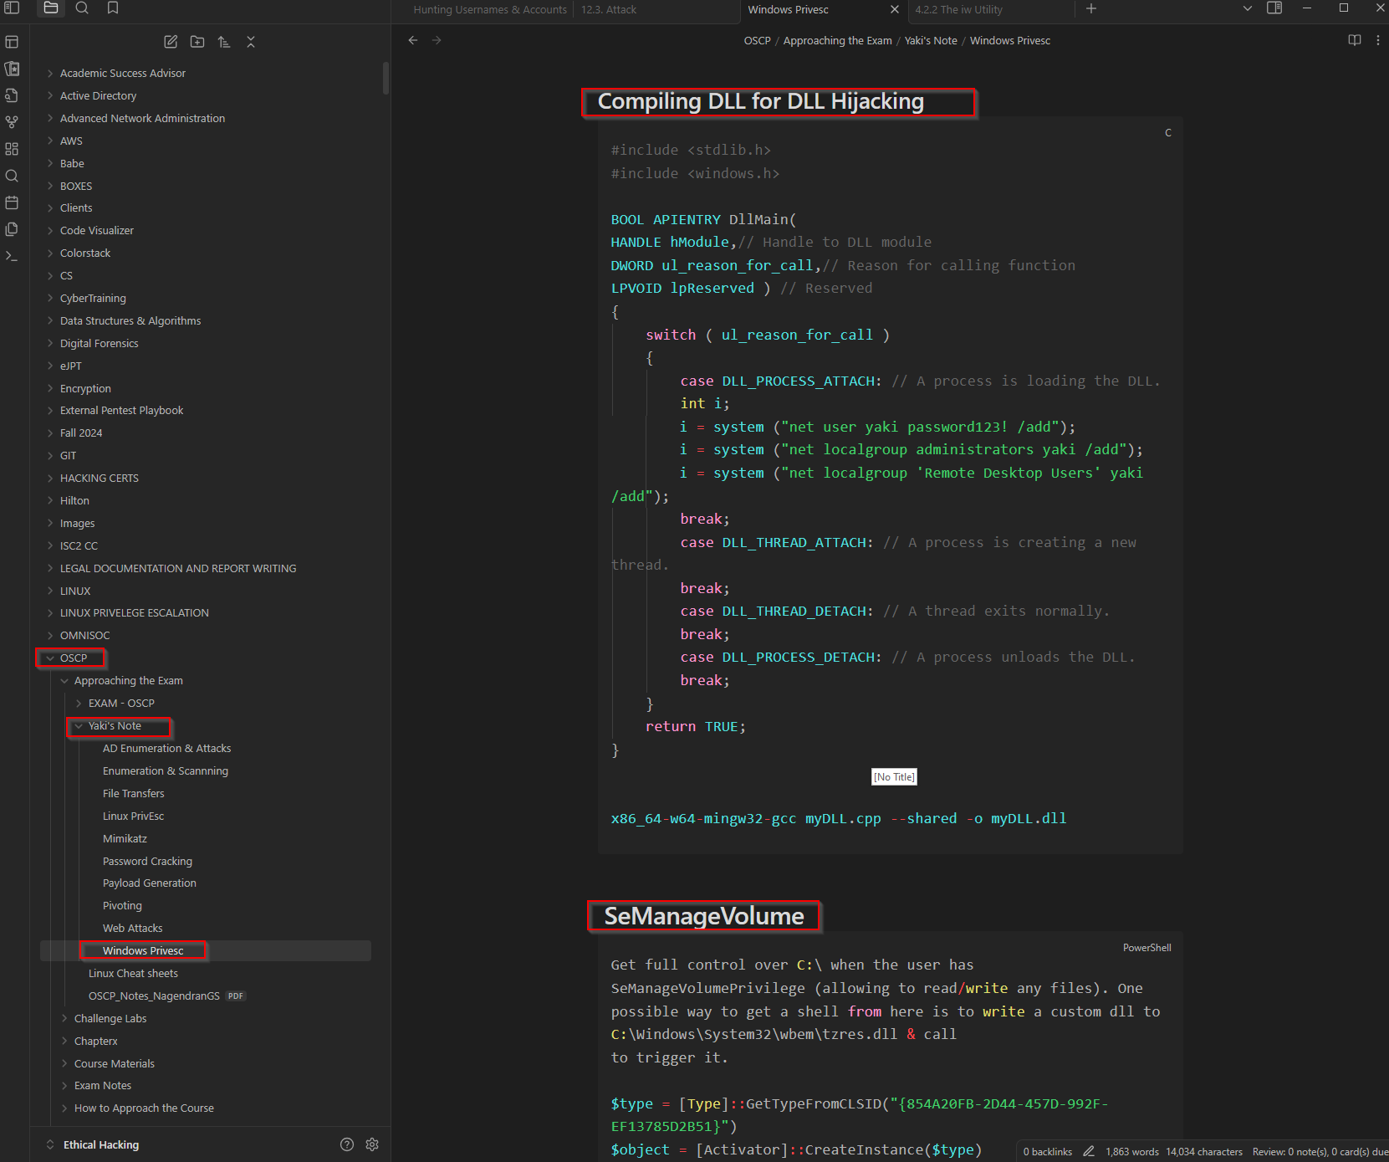
OSCP
Prerequisites - CONT
Note Taking
EXTREMELY Important to take good notes.
Helps save time during your prep and during the exam.
Reduces Cognitive Load
Note Taking Applications
Obsidian – Personal Recommendation
Markdown, OSCP Report, exporting
CherryTree
Microsoft OneNote
Notion
Note Methodologies
Searching through Notes – Advanced Search
PrivateGPT/LLM Fine Tuning

Slide 6
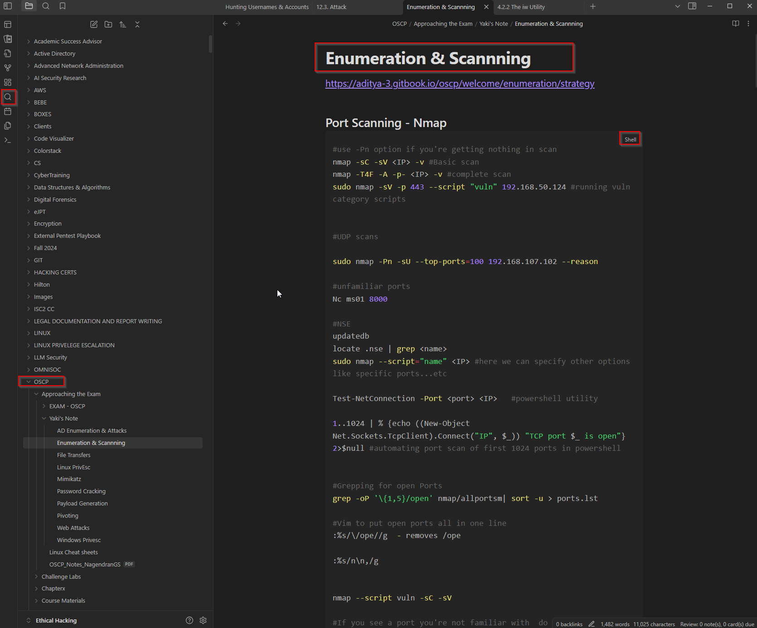
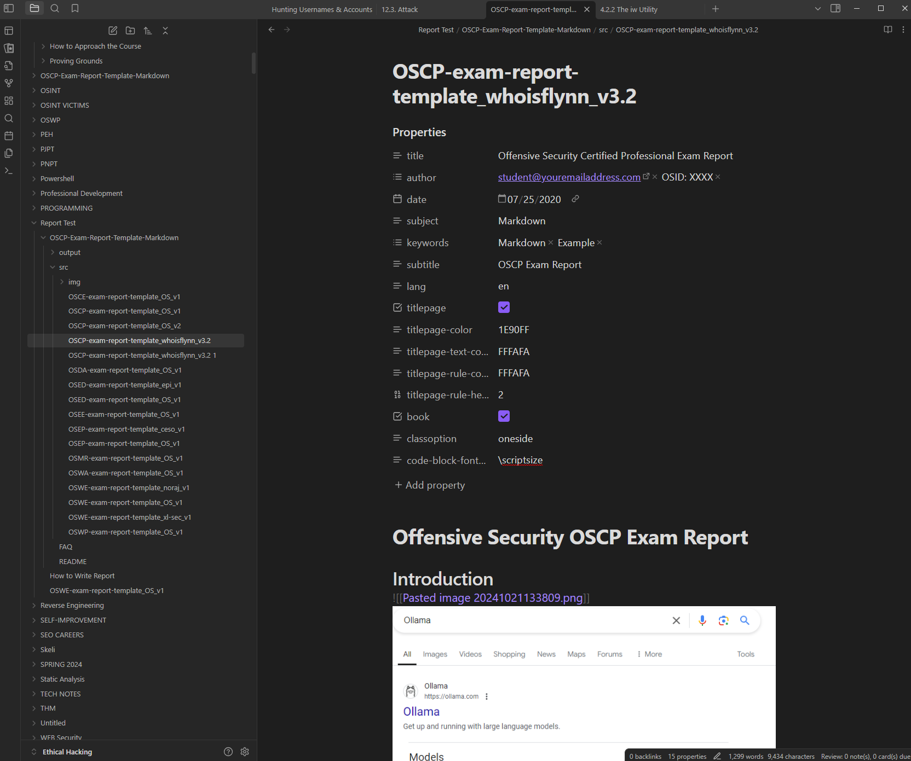
OSCP
Prerequisites - CONT

Slide 7
OSCP
LAB ENVIRONMENT & EXAM PREP
Proving grounds, HTB/LainKusanagi/TJNULL
Module Labs
Challenge Labs
Present in Every Major Module in the course
A lot of them
Slow and painful to complete – Bonus Points
Previously 6, Currently 8
Secura & Zeus (New Addition)
Recommended path for challenge labs
Please ask for hints only if you have tried and are stuck. Update your notes so the same mistake doesn’t happen twice. Ex: SC/Restart-Service
Medtech – Minimal Assistance
Relia - Minimal Assistance
Secura - Minimal Assistance
OSCP - A – Treat like actual Exam
OSCP - B - Treat like actual Exam
OSCP – C - Treat like actual Exam
Skylark – Spare time?
Zeus - Spare Time?
The OSCP (A - C) are mandatory, do only these three if you don’t have a lot of time.
TJ Null – Previous gold standard prep list
Lainkusanagi – Current Gold Standard
Lainkusanagi’s list contains machines from
Proving Ground’s practice (PG - Practice)
Hack the box (HTB)
Proving Grounds Play (PG - Play)
Tryhackme
Vulnlab
Do the labs after Medtech, Relia, Secura and the three OSCP like machines
Lainkusanagi’s list: https://docs.google.com/spreadsheets/d/18weuz_Eeynr6sXFQ87Cd5F0slOj9Z6rt/htmlview
TjNull’s list: https://docs.google.com/spreadsheets/u/1/d/1dwSMIAPIam0PuRBkCiDI88pU3yzrqqHkDtBngUHNCw8/htmlview

Slide 8
OSCP
Additional Resources for Exam
Improving Confidence
Exam Resources
Mind Maps – Build your own or Look them Up
https://orange-cyberdefense.github.io/ocd-mindmaps/img/pentest_ad_dark_2023_02.svg
GTFObins, WADCOMs, Hacktrciks
LinPEAS/WinPEAS – Script for Parsing through information
Familiarity with AD Enumeration (LDAP, Kerberos Pre-Authentication/Kerberute, RPC) – Supplement WADComs
Have your most commonly used payloads or commands staged in a script or in a central folder so you don’t have to look for them during exam.
Read people’s Blog on passing/preparing for the exam
Reddit OSCP page and Discord channel is extremely valuable for preparation
Use People’s note - https://aditya-3.gitbook.io/oscp/
HTB Active Directory Penetration Tester – Path -
Ippsec Videos (Youtube) – Goes over some OSCP and HTB Boxes. Watch his vidoes passively and update notes.
S1ren Videos (Youtube) – PG Practice Walkthroughs, different methodologies. Update Notes Accordingly
Darren Active Directory Walkthrough ( Youtube) - if you feel like you are not as strong in Active Directory
TCM – Windows and Linux Privilege Escalation

Slide 9
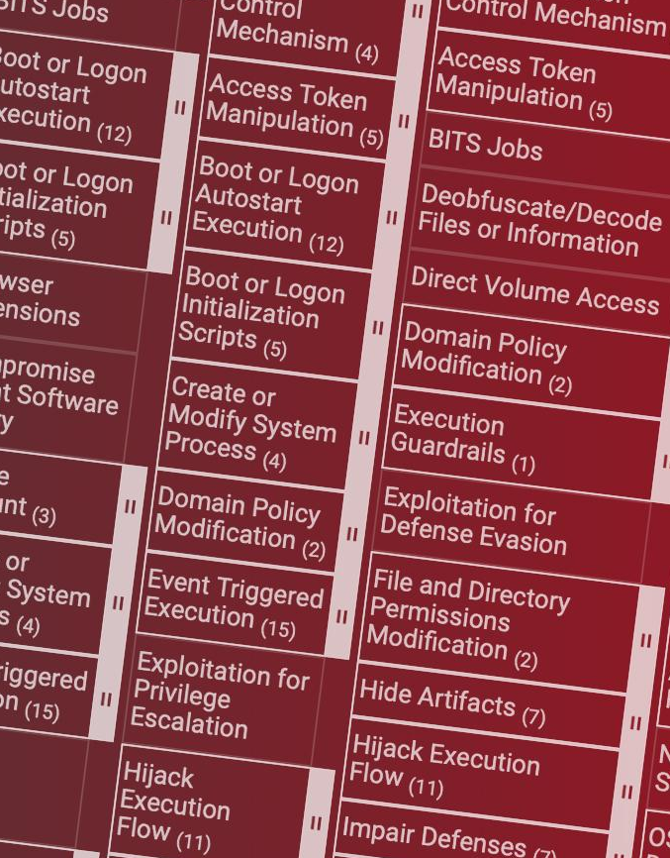
®
EXAM
EXAM DISCUSSION

Slide 10
OSCP
EXAM DAY
Exam Structure
Exam
Exam Restrictions
Identity Verification with Proctor
Host Machine Verification (Performance & Remote Monitoring tools)
Exam is actually 23 hours and 45 minutes
Additional 24 hours for Report
6 Total Target Systems
Minimum of 70 points or higher to pass
Exam is broken down into 2 sections
Active Directory Set
3 Standalone machines( Windows/Linux)
In order to pass the Active Directory set you have to own the Domain Controller or you get 0 Points regardless of all the machines you pwned in the environment. In order for you to move laterally to a different host, you must privesc on current host. This is how the environment is set up
Standalone Machine Points
Foothold – 10 points
PrivEsc – 10 points
No Spoofing (ARP, IP, DNS, NBNS, etc)
No Use of Commercial tools (Burpsuite Pro, Metasploit Pro)
No use of Automatic Exploitation tools (SQlMap, Sqlninja, etc)
No use of mass Vulnerability Scanners (Nessus, Nexpose, OpenVAS, SAINT, etc)
No Use of Chatbots (ChatGPT, Claude, etc)
Look at Offsec’s website for more information on this: https://help.offsec.com/hc/en-us/articles/360040165632-OSCP-Exam-Guide

Slide 11
EXAM TIPS
Don’t study 2 days before the exam. Relax your mind
Have at least 8 hours of sleep the day before your exam
Verify timezone when scheduling the exam
Read the guidelines carefully before you take the exam
Have your cheat sheets and notes ready
Have an area or space that will prevent distractions during the exam
Use an existing exam report template – whoisFlynn is a good one
Make sure you are taking breaks regularly or when you get stuck
Monitor your time and set a deadline for each box.
Hydrate, keep your composure and be cool.
Make sure you are capturing all your commands and taking screenshots during the exam. This will save you a lot of time when writing the report.
Report section is extremely important!
My Exam Experience

Slide 12
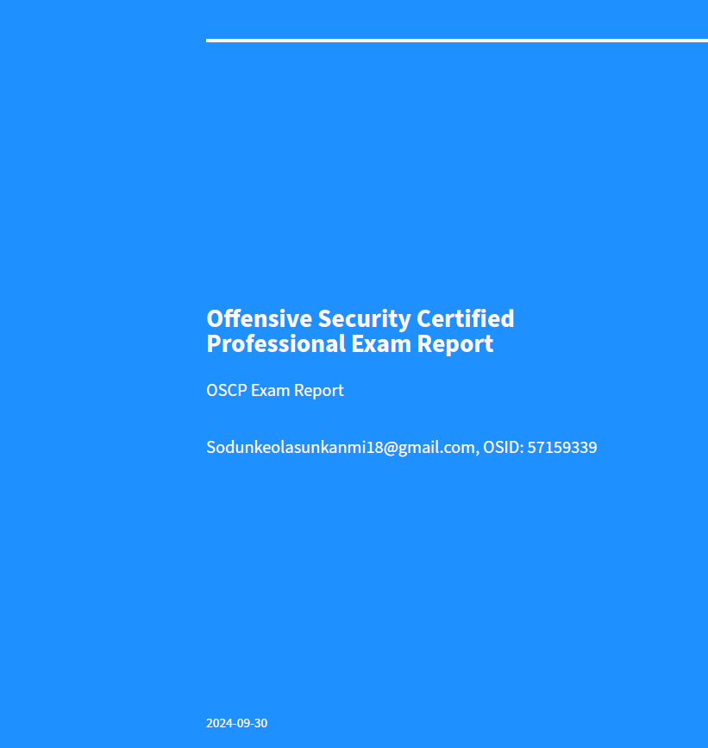
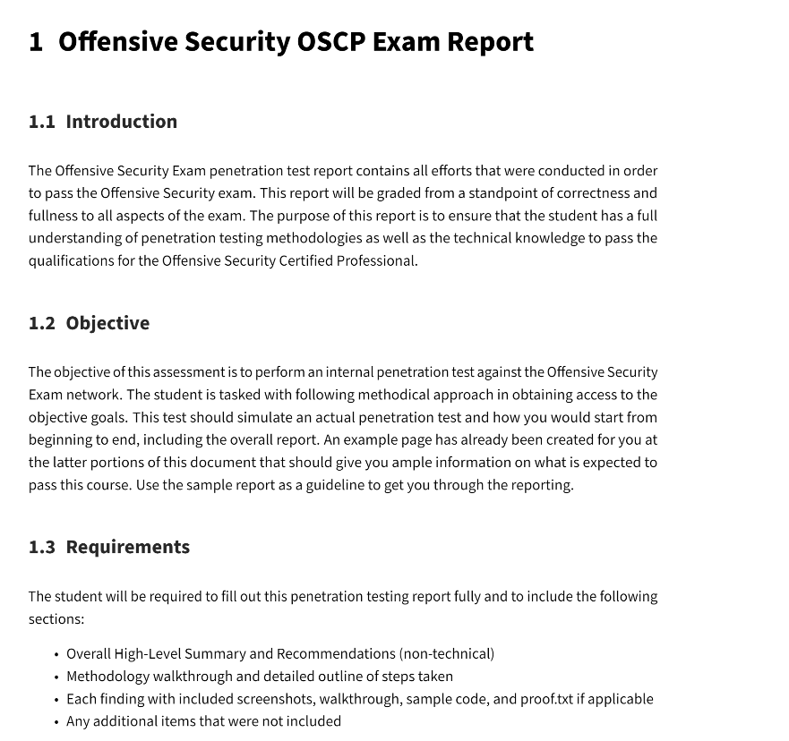
EXAM Report Template
WhoisFlynn -https://github.com/noraj/OSCP-Exam-Report-Template-Markdown/blob/master/output/examples/OSCP-exam-report-template_whoisflynn_v3.2.pdf

Slide 13
EXAM Results
Exam results will be out in 10 Business days – Earlier sometimes

Slide 14
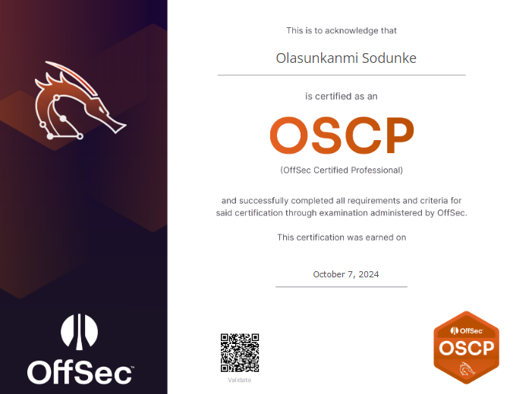
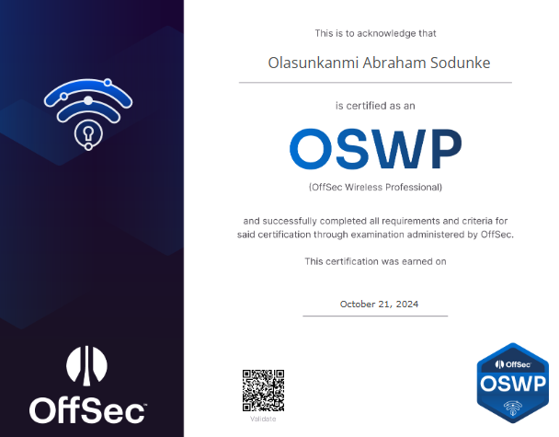
Passing EXAM
https://www.credential.net/e79c16e9-ac53-4ac3-a6c6-124d4e80cf5d#gs.gztdug
https://www.credential.net/64c7d90f-a039-4a42-bdce-16d83cc35f25#gs.gztjtg

Slide 15

OSCP+
Exam Changes – November 1st 2024
No more bonus points – Have until October 31st exam.
Updating the Active Directory(AD) Portion of the exam.
Learners will be provided with a username and password, simulating a breach scenario
10 points for machine #1
10 points for machine #2
20 points for machine #3;
OSCP is for life, OSCP+ expires after three(3) years
https://help.offsec.com/hc/en-us/articles/29865898402836-OSCP-Exam-Changes - More Information

