Slide 1
Md. Yakub Ali
Id: 1263399

Slide 2

Hospital Management

Slide 3
About Hospital Management Software
An admin can login with security. And anyone can register.
I can add all types of patients in the hospital.
I will be able to view and update the list of all patients.
I can add doctors of all departments.
I can see and update all doctors list.
I will be able to make a list of each ward and show the list of doctors and patients in charge of the ward.
The list of total departments can be created , show and updated.
The total medicine price can be added , show and update.
The patients total bill list can be created , show, Updated , invoice generated and printed in pdf format.

Slide 4


The programming Languages used in this software:
Fronted: Angular
Backend: Pro Spring boot

Slide 5

Login Page

Slide 6

Home page:

Slide 7
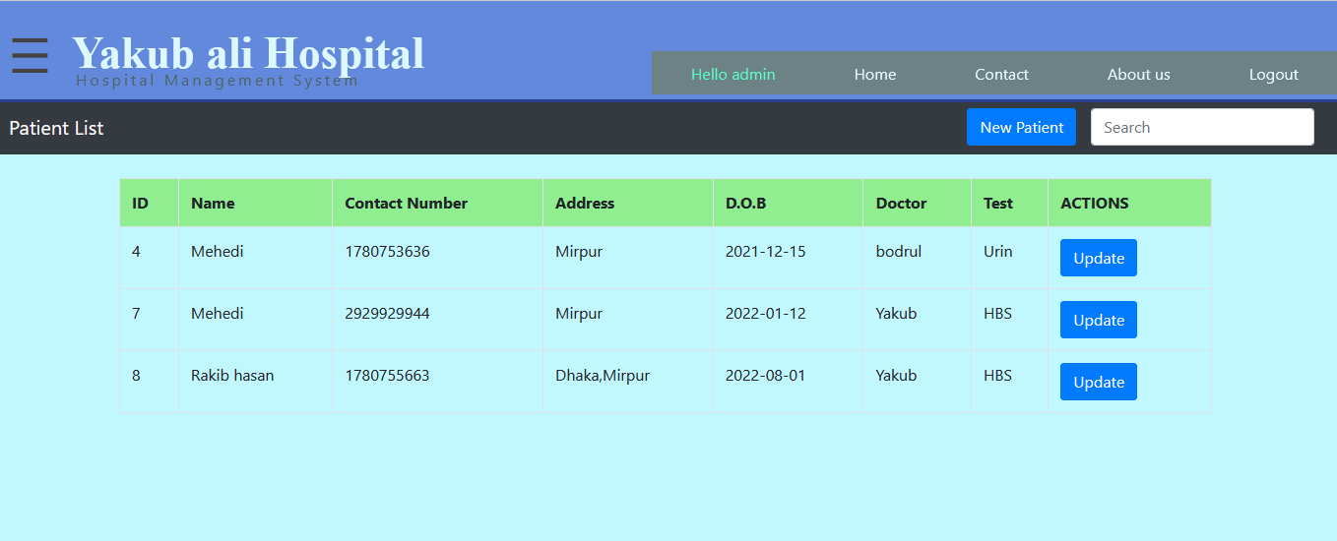
Patient list

Slide 8
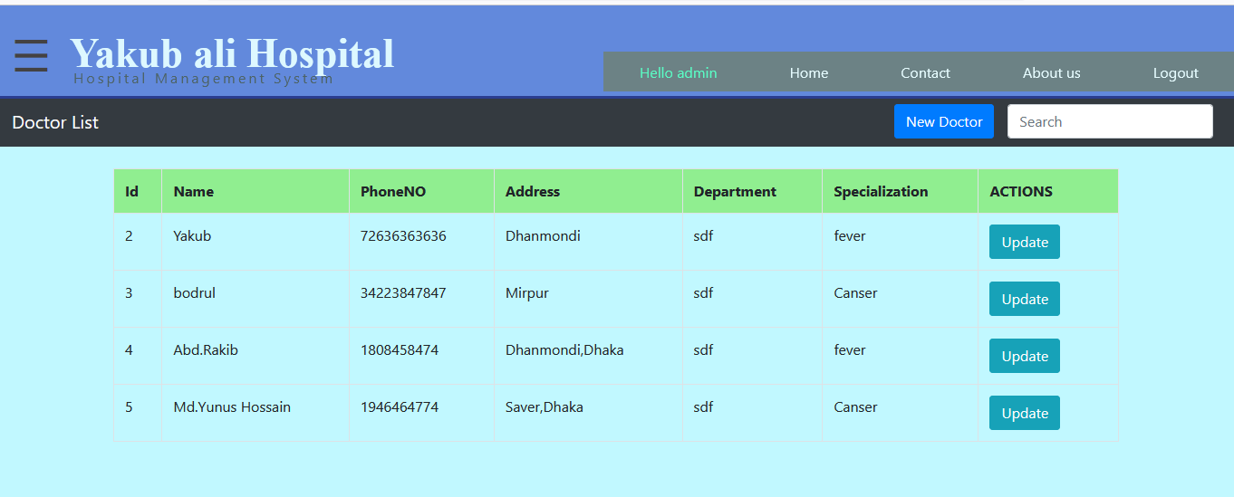
Doctors list:

Slide 9
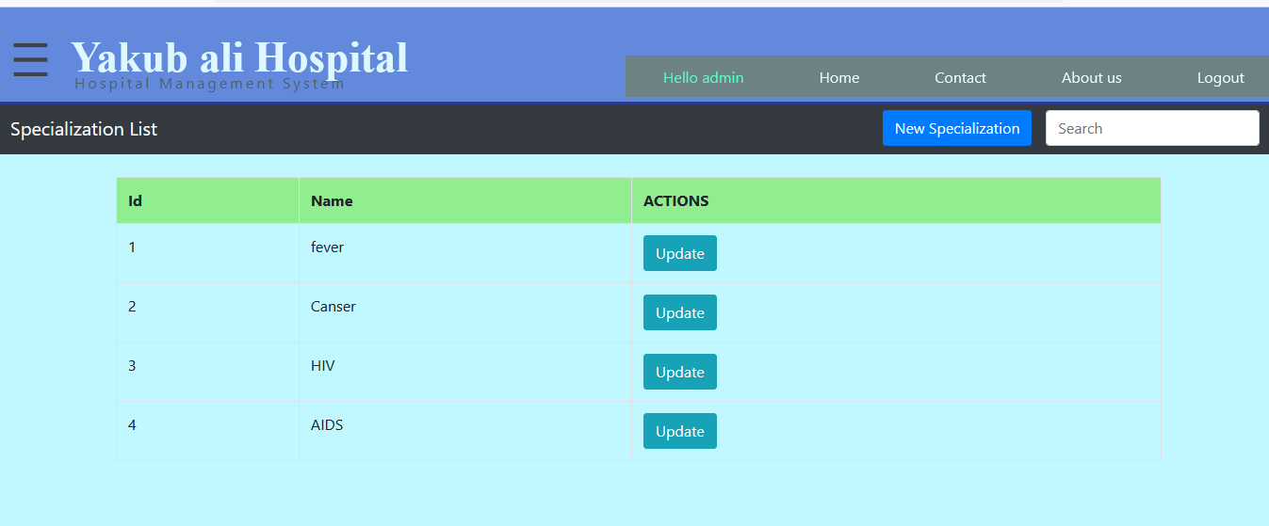
Specialization List:

Slide 10
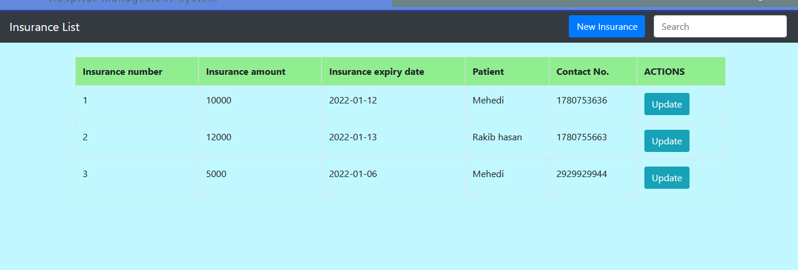
Insurance List:

Slide 11
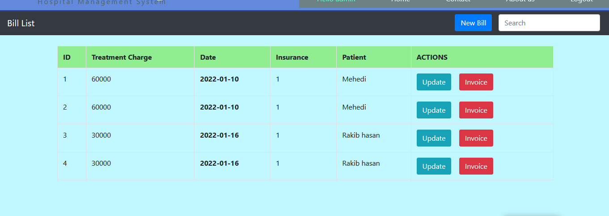
Hospital Treatment Charge list:

Slide 12
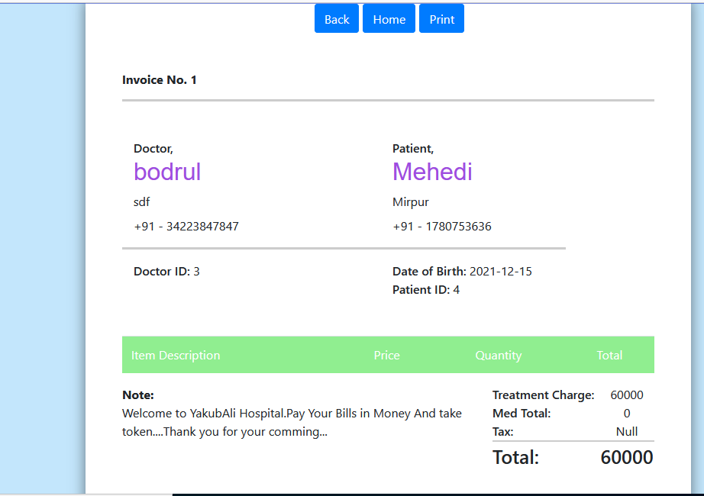
Invoice print : For Document total treatment charge:

Slide 13
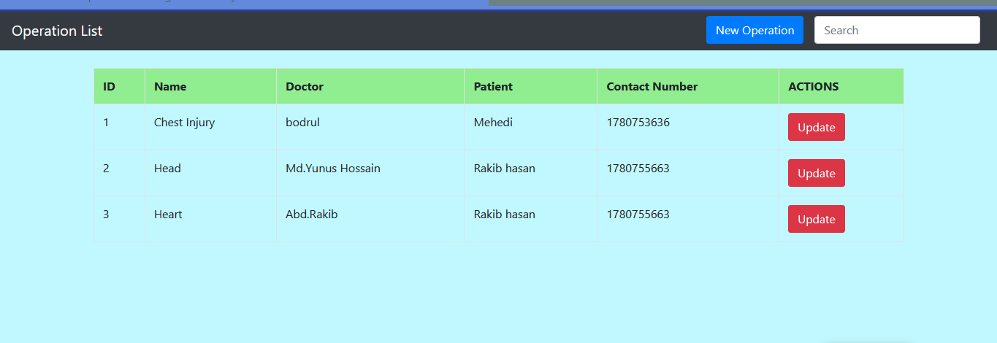
Operation List:

Slide 14
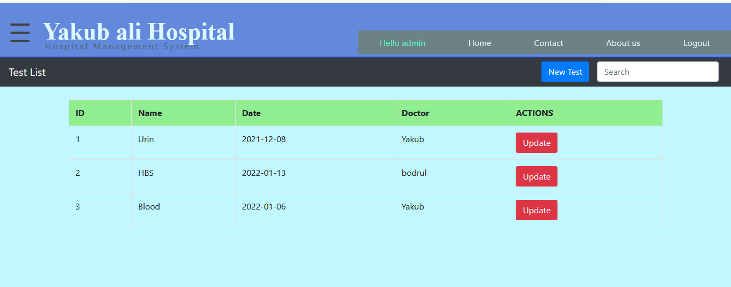
Medical Test List:

Slide 15
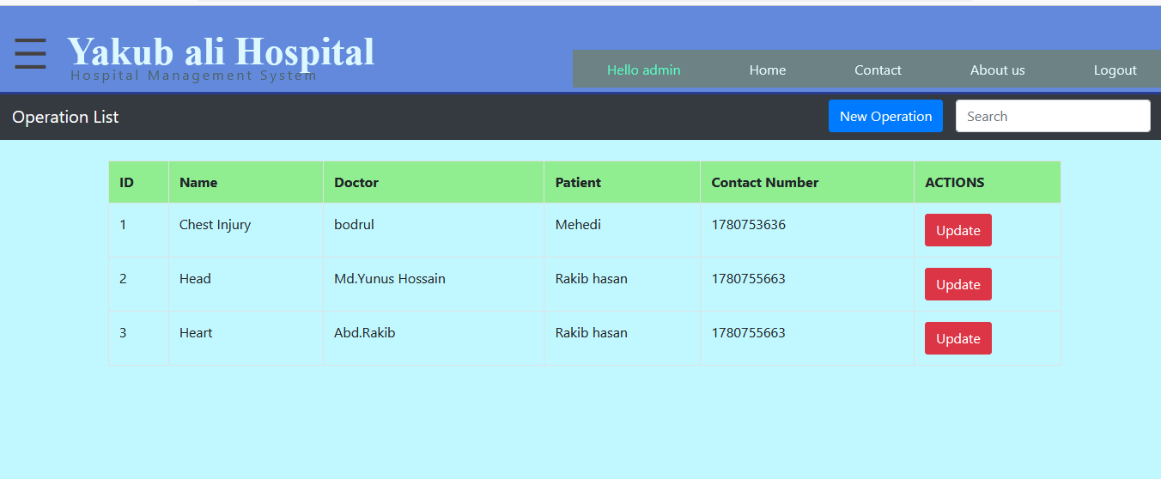
Operation List:

Slide 16
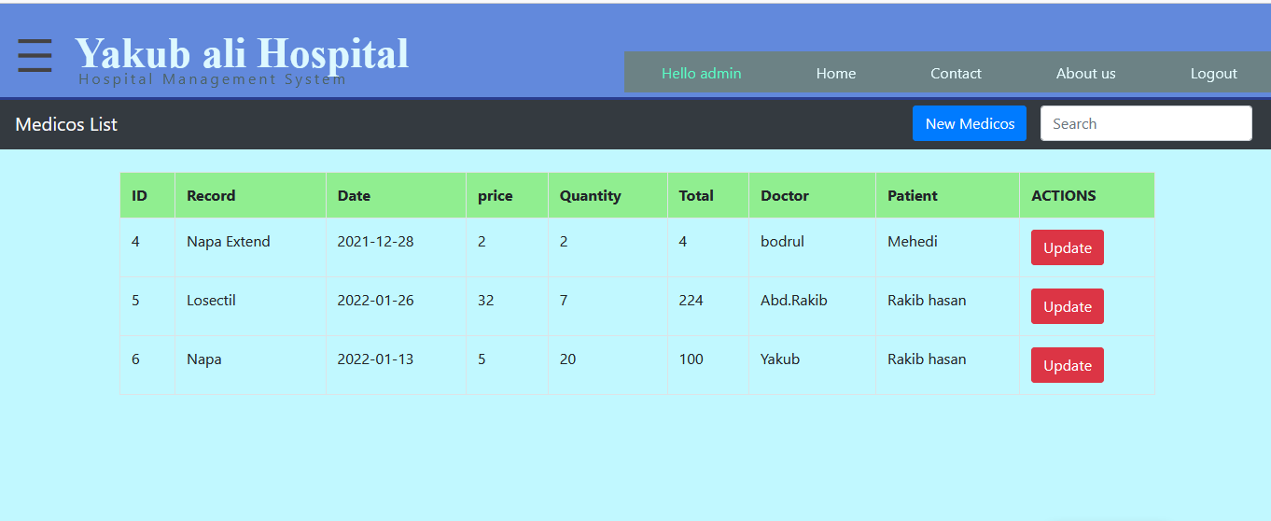
Medicin List :

Slide 17
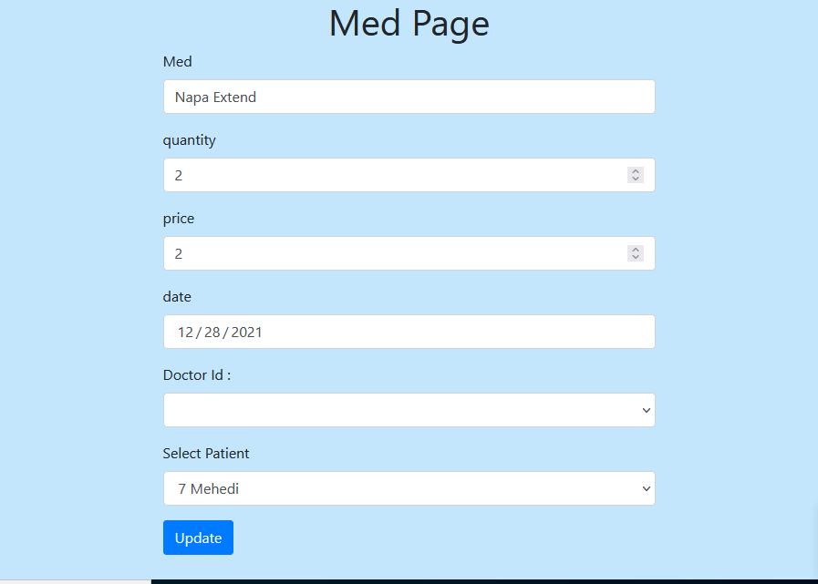
Medicin Add List:

Slide 18
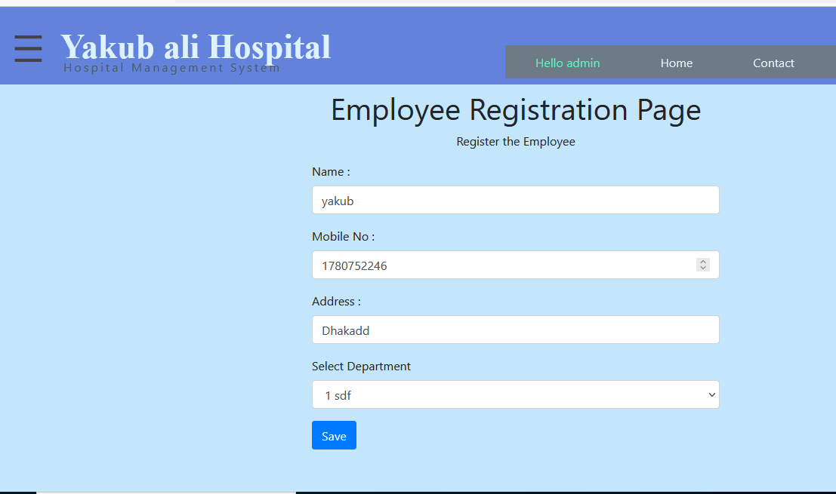
Employee Registration Page:

Slide 19
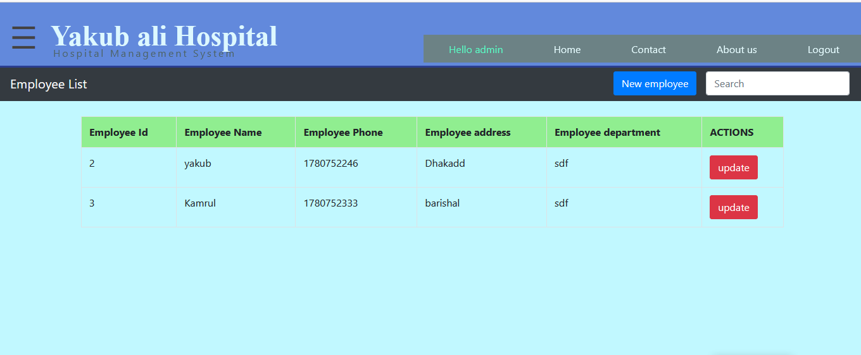
Show Employee List:

