Slide 1
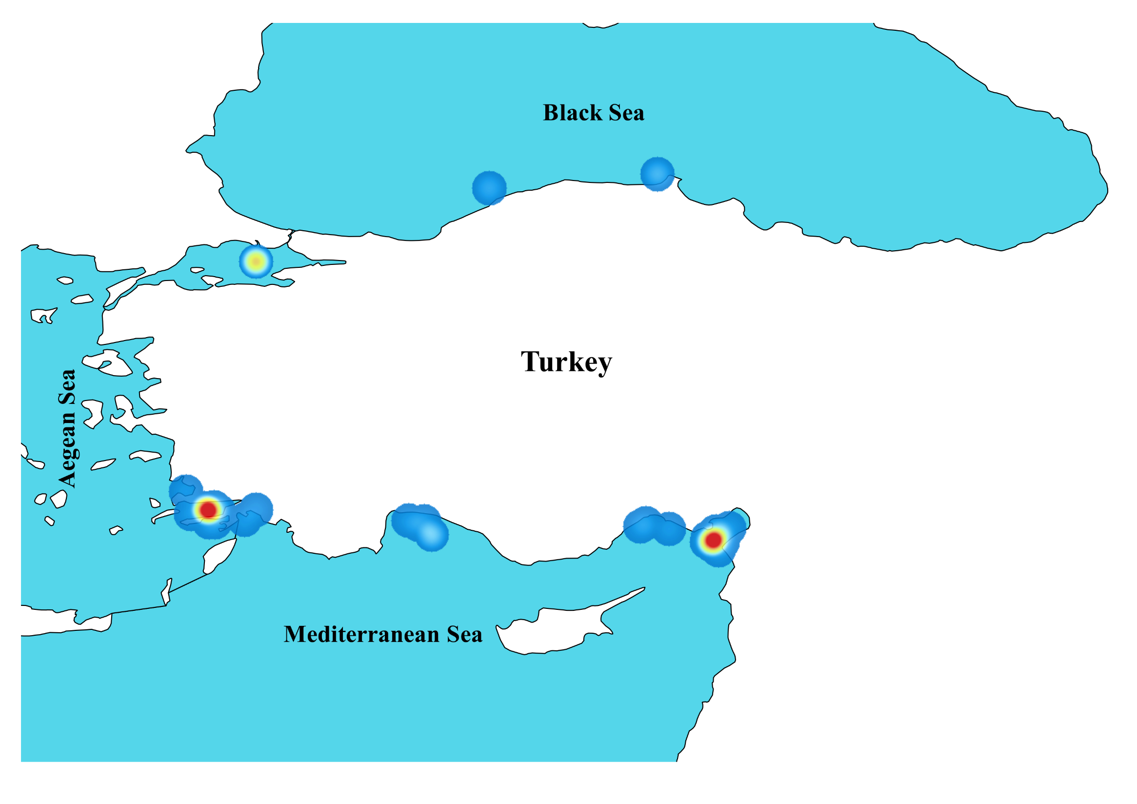
Color Scale
0
45

Slide 2
Color Scale
0
5
10
15
25
35
45

Slide 3
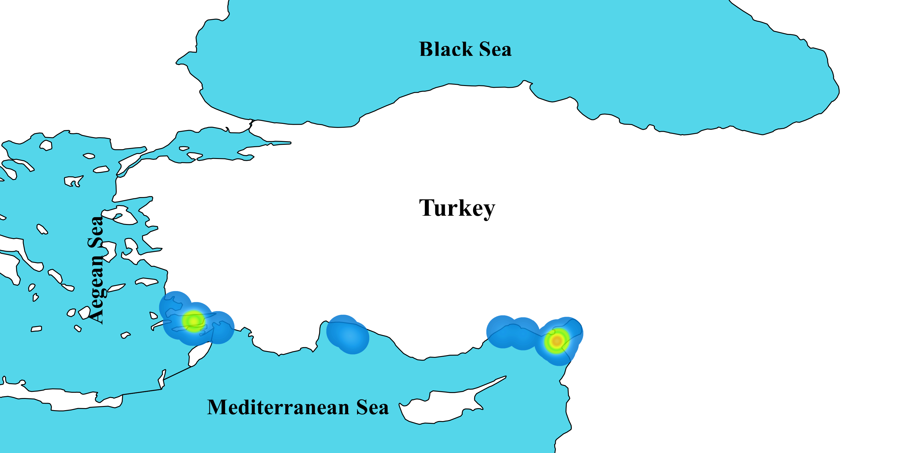
1990
Sea of
Marmara
Colour Scale
1
5
8
10
12
15
18
20

Slide 4
Color Scale
0
45

