Slide 1
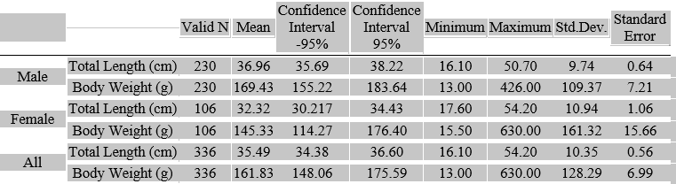
Length-weight relationship of the blackmouth catshark (Galeus melastomus Rafinesque, 1810) on the Turkish coasts of the Mediterranean Sea
This study investigates the relationship between the total length and body weight of the blackmouth catshark (Galeus melastomus) sampled along the Mediterranean coast of Türkiye within the boundaries of the Geographical Sub-Area24 (GFCM GSA24) during August and September 2023.

Slide 2
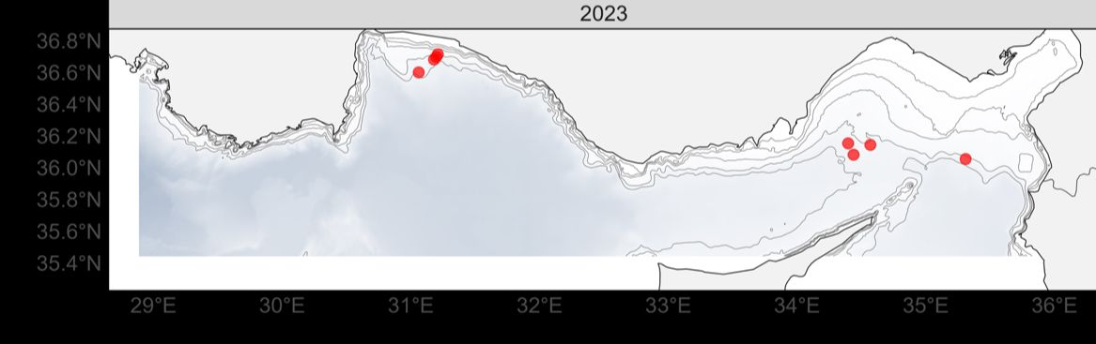
Length-weight relationship of the blackmouth catshark (Galeus melastomus Rafinesque, 1810) on the Turkish coasts of the Mediterranean Sea
The blackmouth catshark samples were collected during a bottom trawl survey along the Mediterranean coast of Türkiye within the boundaries of the Geographical Sub-Area24 (GFCM GSA24). Altogether, 54 bottom trawl operations were performed at depths ranging from 50 to 800 m by R/V Akdeniz Araştırma 1 in August and September 2023. The blackmouth catshark specimens were captured only in 8 trawls towed at depths ranging from 420 to 780 meters. The trawl haulings were conducted following the standard survey sampling protocol outlined in the MEDITS Handbook.

Slide 3
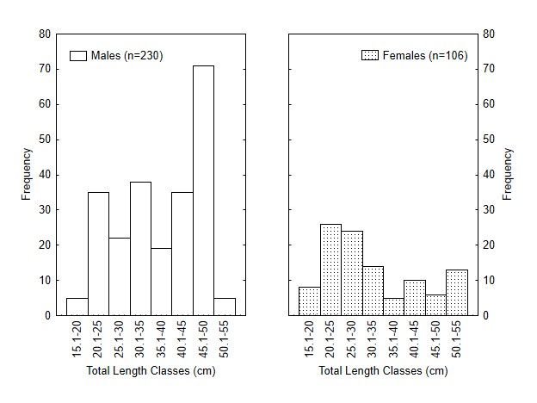
Length-weight relationship of the blackmouth catshark (Galeus melastomus Rafinesque, 1810) on the Turkish coasts of the Mediterranean Sea
A total of 336 blackmouth catshark specimens, 106 females and 230 males, were examined. Their body weight ranged from 13 to 630 g, while their total length varied from 16.1 to 54.2 cm. A significantly higher number of males were captured than females, especially among individuals measuring between 30 and 50 cm. However, females were more dominant in individuals larger than 50 cm.

Slide 4
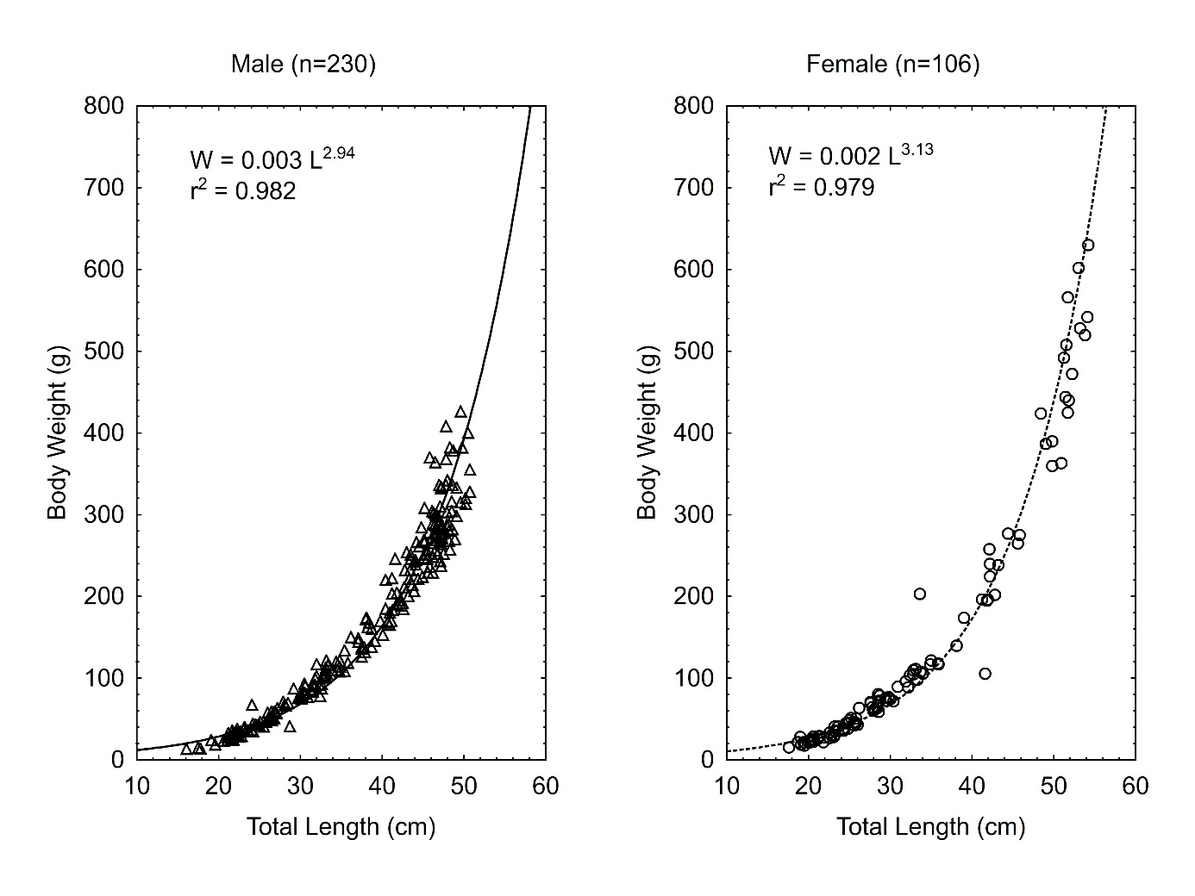
Length-weight relationship of the blackmouth catshark (Galeus melastomus Rafinesque, 1810) on the Turkish coasts of the Mediterranean Sea
The total length-weight relationships for females, males, and combined are reported . This relationship is also represented graphically for males and females. b values together with their confidence intervals (± 95%) were calculated as 3.13 ± 0.087 for females, 2.94 ± 0.051 for males and 3 ± 0.045 for all individuals. Since the lower and upper confidence interval values of the b for both males and females differ from the theoretical value of 3, they exhibit allometric growth (negative allometry for males, positive allometry for females). However, upon examining all fish, it is observed that they show isometric growth because the 95% confidence interval values of b include 3.

Slide 5
Length-weight relationship of the blackmouth catshark (Galeus melastomus Rafinesque, 1810) on the Turkish coasts of the Mediterranean Sea
Authors | Areas | Depth (m) | Gender | Total Length (mm) | Body Weight (g) | N | a | b | r2 | Growth Type
Rinelli et al. (2005) | Tyrrhenian Sea | 300 - 700 | F | 140-500 | - | 509 | 0.084 | 2.96 | 0.98 | I
 |  |  | M | 135-500 | - | 537 | 0.078 | 3.01 | 0.98 | I
Ismen et al. (2007) | Saroz Bay | 28-370 |  | 120 - 317 | 5 - 86 | 93 | 0.00238 | 3.02 | 0.98 | I
Özütemiz et al. (2007) | Aegean Sea | - | F | 90 - 190 | - | 130 | 0.004 | 2.85 | 0.88 | A+
 |  |  | M |  |  |  | 0.002 | 3.05 | 0.93 | A+
 |  |  | C |  |  |  | 0.0025 | 3.04 | 0.88 | A+
Ragonese et al. (2009) | Central Mediterranean (Sicily) | 200-800 | F | 70 - 590 | - | - | 0.000027 | 3.02 | - | I
 |  |  | M |  |  |  | 0.000041 | 2.95 | - | I
Güven et al. (2012) | Eastern Mediterranean (Antalya Bay) | 200-800 | F | 115-575 | 4.6-693 | 267 | 0.0024 | 3.03 | 0.986 | I
 |  |  | M | 117-501 | 4.7-361.3 | 277 | 0.0028 | 2.97 | 0.976 | I
 |  |  | C | 115-575 | 4.6-693 | 544 | 0.0026 | 3 | 0.982 | I
Bottari et al. (2016) | Central Mediterranean (Sicily) | 200-700 | F | 70 - 540 | - | 1572 | - | 3 | - | I
 |  |  | M | 80 - 550
Metochis et al. (2016) | North-Western Aegean | 200-450 | F | - | - | 452 | - | 3.34 | - | A+
 |  |  | M |  |  |  |  | 3.31 |  | A+
Gönülal, (2017) | North Aegean Sea | 500-900 | F | 362 - 523 | 125 - 525 | 26 | 0.0003 | 3.65 | 0.95 | A+
 |  |  | M | 261 - 478 | 135 - 435 | 13 | 0.1746 | 2.08 | 0.85 | A-
Darna et al. (2018) | South Mediterranean (Algeria) | 200-400 | F | 290 - 560 | - | 191 | 0.0085 | 2.80 | 0.93 | A-
 |  |  | M | 250 - 550 |  | 360 | 0.0035 | 2.90 | 0.93 | A-
Cabbar and Yıgın, (2021) | North Aegean Sea | 120-400 | F | 100 - 480 | 23 – 322 | 438 | 0.001706 | 3.14 | 0.97 | A+
 |  |  | M | 119 - 420 | 43.5 - 190 | 357 | 0.001688 | 3.14 | 0.97 | A+
D’Iglio et al. (2021) | South Tyrrhenian Sea | - | F | 145 - 520 | 9.5 - 538 | 127 | 0.001 | 3.20 | 0.96 | A+
 |  |  | M |  |  |  | 0.003 | 2.95 | 0.99 | A-
 |  |  | C |  |  |  | 0.002 | 3.04 | 0.98 | I
Karampetsis et al. (2022) | North Aegean Sea | 108-607 | F | 95-560 | - | 3053 | 0.001 | 3.34 | 0.92 | -
 |  |  | M |  |  |  | 0.001 | 3.23 | 0.92 | -
Mutlu et al. (2022) | Eastern Mediterranean | - | F | 130-510 | - | 132 | 0.0018 | 3.13 | - | A+
 |  |  | M |  |  |  | 0.0023 | 3.04 | - | A+
 |  |  | C |  |  |  | 0.0022 | 3.06 | - | A+
Present Study (2023) | Eastern Mediterranean | 420 - 780 | F | 176-542 | 15.5-630 | 106 | 0.000001 | 3.13 | 0.97 | A+
 |  |  | M | 161-507 | 13 - 426 | 230 | 0.000004 | 2.94 | 0.98 | A-
 |  |  | C | 161–542 | 13 - 630 | 336 | 0.000003 | 3 | 0.98 | I
Some of the previous studies providing length-weight relationships for black-bellied catfish from various localities in the Mediterranean are reported in the table. The table shows that some studies give comparable results, while others Show differences.
The existing differences can be ascribed to discrepancies in sample size, duration of sampling, and sampling location, as diverse environmental conditions may influence growth
The study yielded high coefficient of determination values (r2=0.97 for females and r2=0.98 for males), indicating a strong predictive accuracy of the linear regression model for the species under analysis. This suggests that extrapolation of future catches within a comparable size range and geographical location of the specimen is feasible.

Slide 6
Length-weight relationship of the blackmouth catshark (Galeus melastomus Rafinesque, 1810) on the Turkish coasts of the Mediterranean Sea
Length-weight relationships serve multiple purposes, including converting lengths into biomass, assessing fish condition, comparing fish growth across different areas, and enhancing species-specific studies on reproduction and feeding.
Elasmobranchs play a crucial role in marine ecosystems but are severely affected by human-induced activities in the Mediterranean For this reason, a wide range of biological and ecological data, including length-weight relationships, are essential for effectively managing them.
Gathering long-term fishery data to evaluate cartilaginous populations and ensure their sustainability is imperative. Ongoing monitoring is essential to safeguarding these highly threatened organisms.

