Slide 1
Artificial Intelligence on Automotive Industry

Slide 2
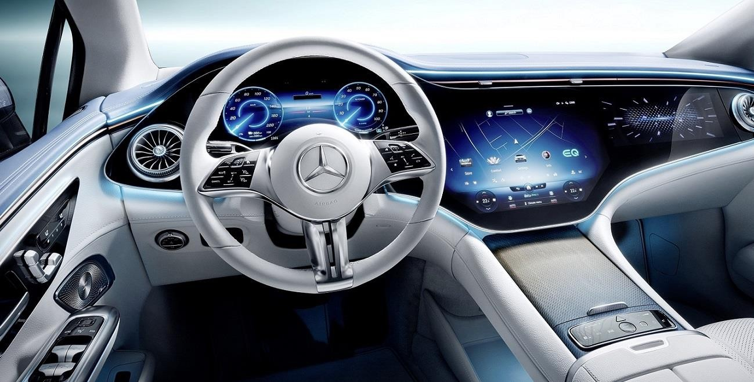
Figure 1.mercedes artificial intelligence assistant

Slide 3
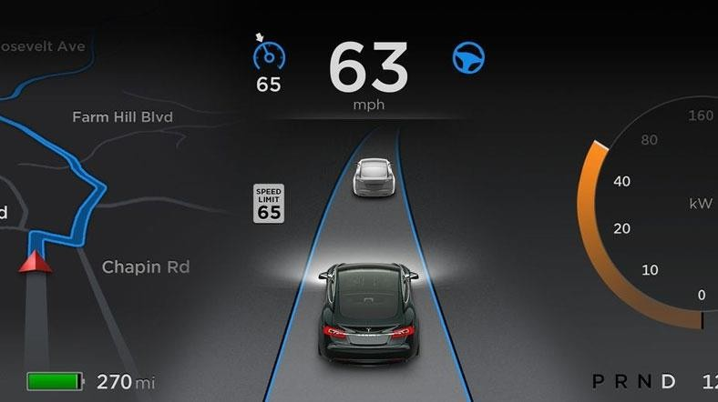
Figure 2.Tesla artificial intelligence assistant

Slide 4
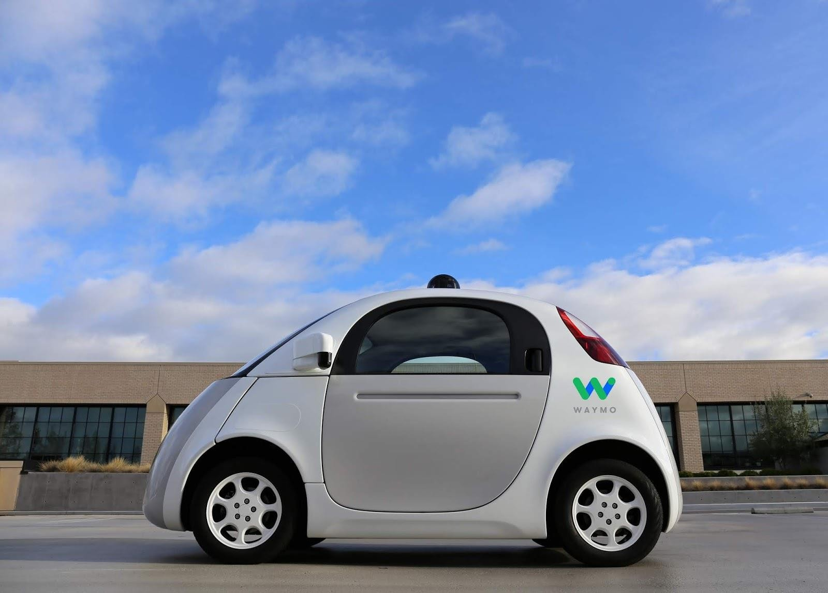
Figure 3.Waymo fully driverless car

Slide 5
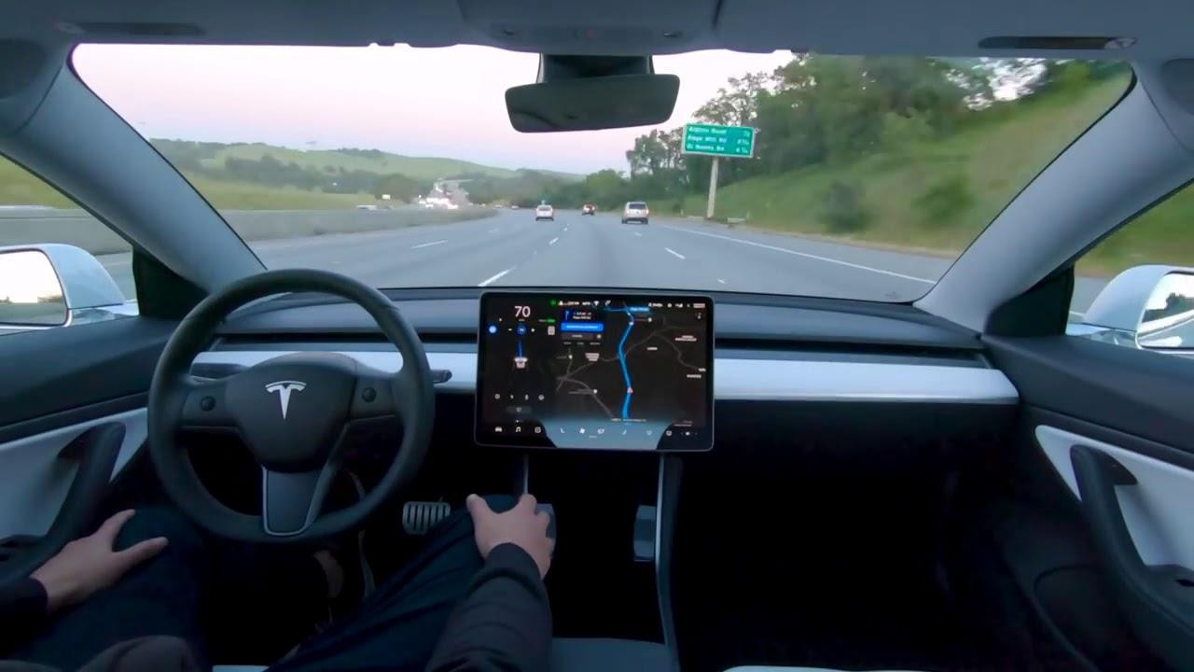
Figure 4.Tesla autonomous driving

Slide 6
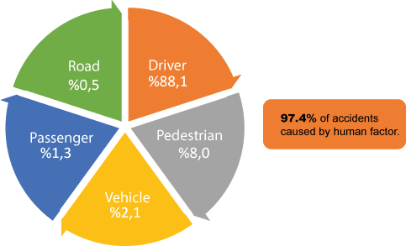
Figure 5. MDPI publisher of open-access scientific journals data

Slide 7
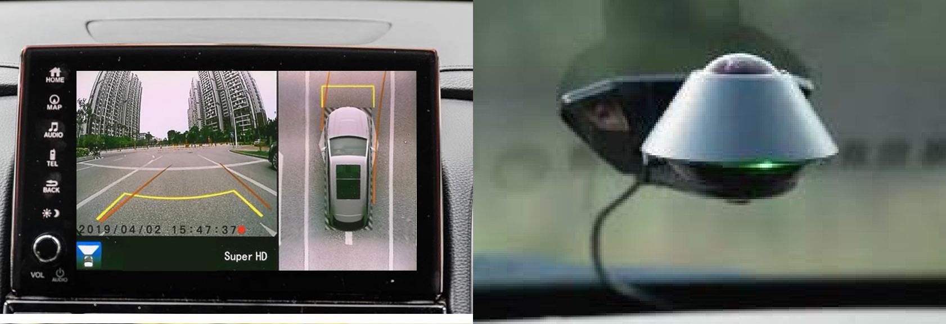
Figure 6. Providing 360 degree views

Slide 8
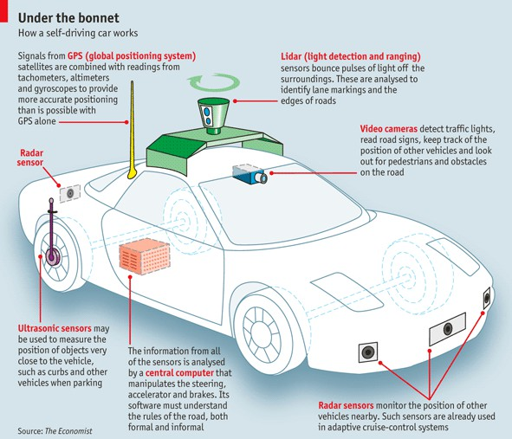
Figure 7. Otonom Araçlar - Mühendis Beyinler

Slide 9
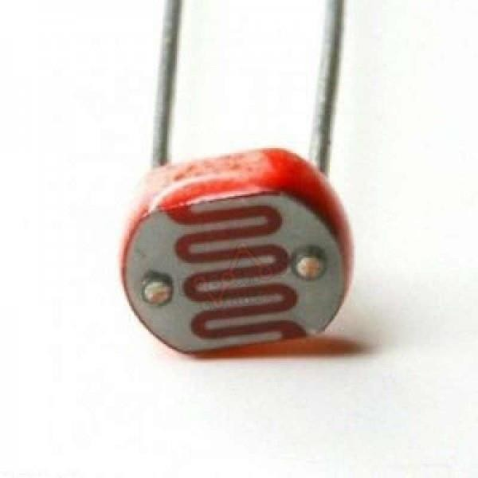
Figure 8. LDR sensor

Slide 10
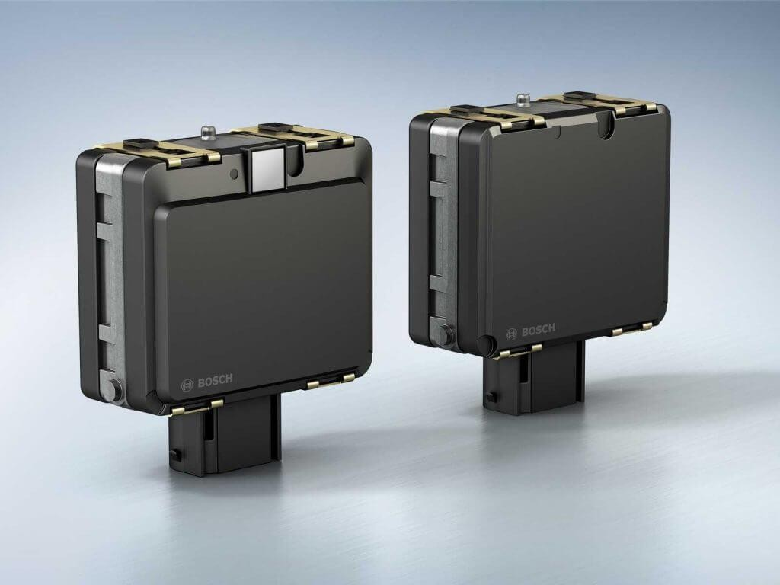
Figure G. Bosch radar sensor

Slide 11
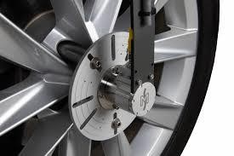
Figure 10. Encoder sensor

Slide 12
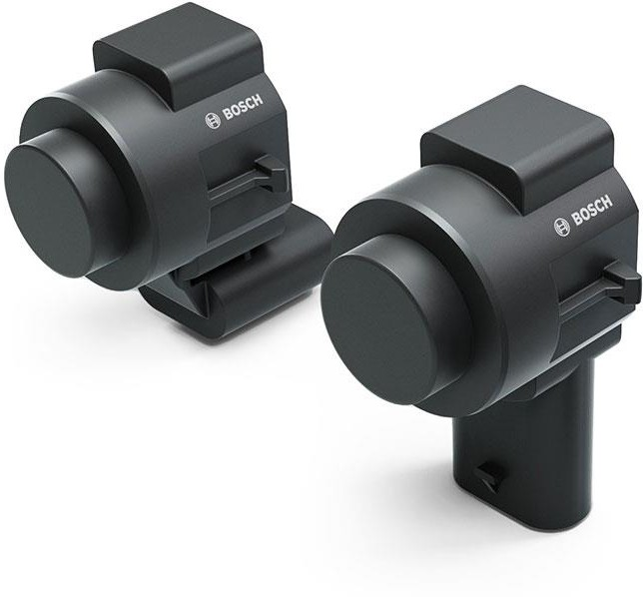
Figure 11. Bosch ultrasonic sensor

Slide 13
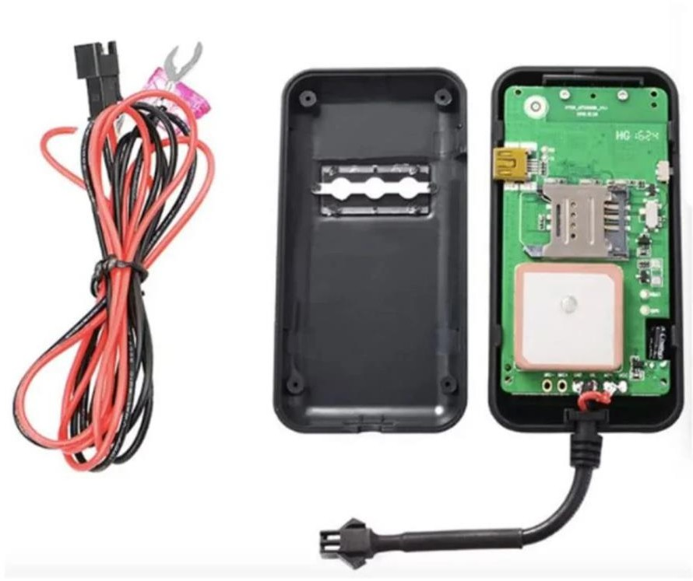
Figure 12. GPS.802.I

Slide 14
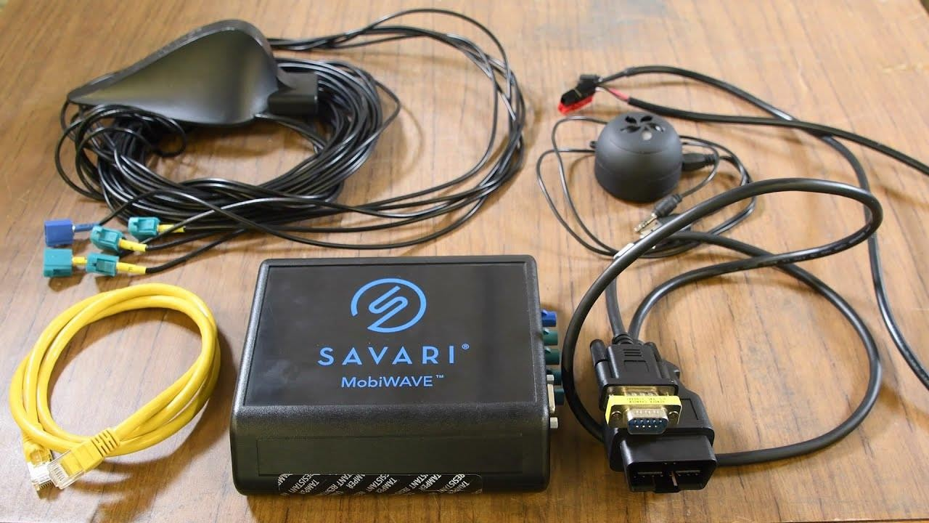
Figure 13.Logic boarda unit

Slide 15
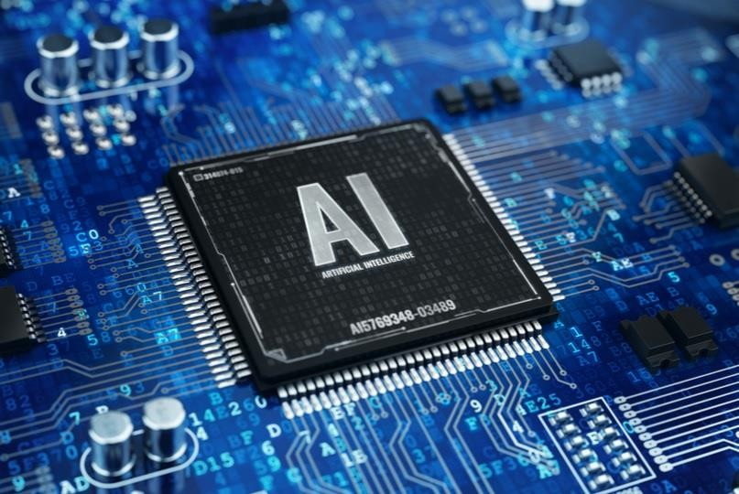
Figure 14. AI Hardware Technologies

Slide 16
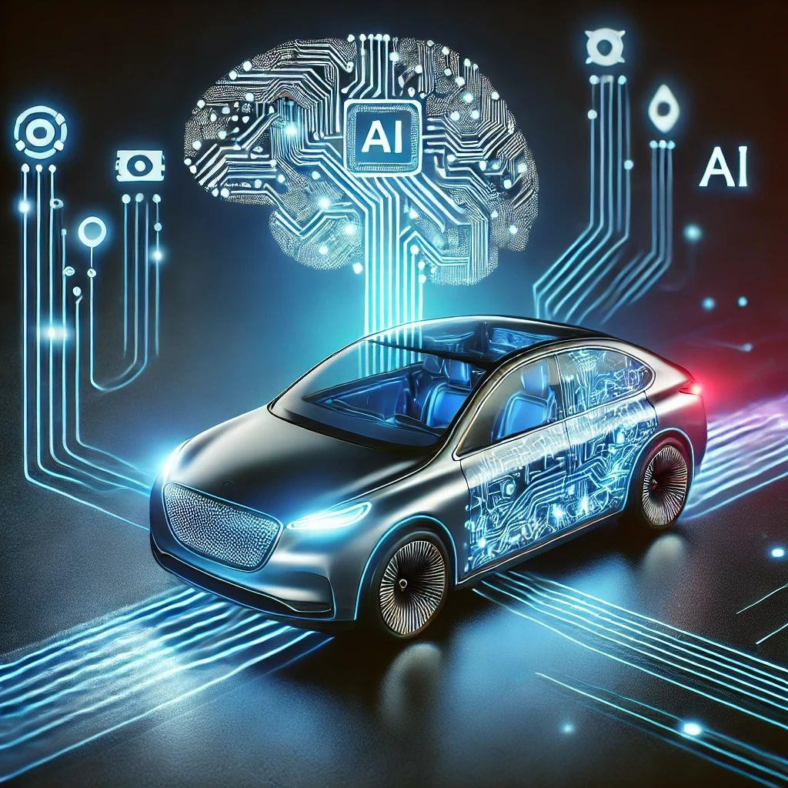
Fİgure 15. Autonomous vehicle symbolic visual

Slide 17
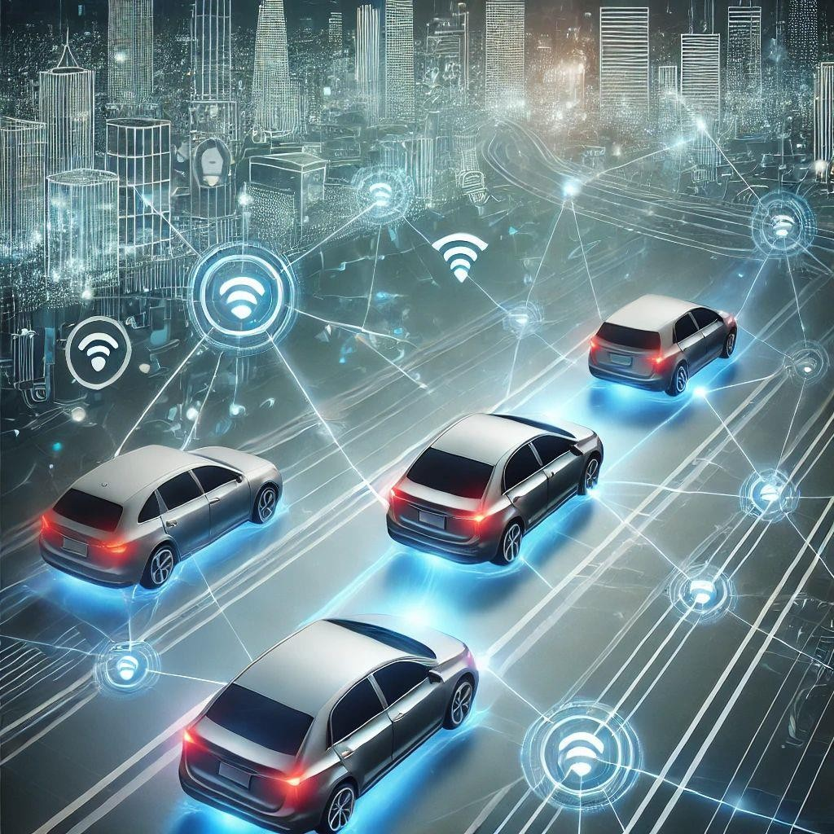
Figure 16.In the future, vehicles are expected to communicate in traffic

