Slide 1
Database Query and Reasoning
PIP2001 Capstone Project
Review-0
Batch Number: 48
Under the Supervision of,
Mrs. Kayal Vizhi V
Assistant Professor
School of Computer Science and Engineering
Presidency University
Roll Number 20211CSE0104 20211CSE0109 20211CSE0106 20211CSE0069 | Student Name Y GOWTHAM NAIDU K SASIVARAN REDDY PATAN FAIROZ KHAN KODITALA ABHINAY
Name of the Program: CSE
Name of the HoD: Dr. Blessed Prince P/Dr. Robin Rohit/Dr.Asif Mohammed H.B
Name of the Program Project Coordinator: Mr. Amarnath J.L & Dr. Jayanthi. K.
Name of the School Project Coordinators: Dr. Sampath A K / Dr. Abdul Khadar A / Mr. Md Ziaur Rahman

Slide 2
Content
Problem Statement
Github Link
Analysis of Problem Statement
Introduction
Proposed Methodology
Timeline
References
Conclusion

Slide 3
Problem Statement Number:
Organization: COLING 2025 Workshop
Category (Hardware / Software / Both) : Software
Problem Description:This task involves querying and reasoning from a database for financial QA, requiring models to generate code for querying and
reasoning based on questions.
Difficulty Level: Complicated / Hard

Slide 4
Github Link
Github Link
https://github.com/YalamandalaGowtham/Database-Query-and-Reasoning.git

Slide 5
Analysis of Problem Statement
In today’s data-driven world, the ability to extract meaningful insights from databases is essential across various domains such as healthcare, finance, education, and business.
However, accessing and analyzing data stored in databases typically requires technical expertise in Structured Query Language (SQL), making it challenging for non-technical users to leverage the full potential of their data.
While databases are ubiquitous, the complexity of crafting SQL queries remains a significant barrier for individuals lacking programming or database management skills.
This gap often results in delayed decision-making, inefficient workflows, and underutilization of valuable data resources.

Slide 6
Analysis of Problem Statement
Techology components Used:
Python
NLP(transformers library, google gemini model)
Database management(sqlite3,pandas library)
Framework for frontend and backend(Streamlit)
Cloud based AI integration(google generative Ai Api)
Environment Configuration(dotenv library)

Slide 7
Introduction
This project, Database Query and Reasoning for Financial QA, bridges the gap between technical financial data systems and user-friendly interfaces.
It allows users to ask financial questions in natural language, which the system processes to generate SQL queries, retrieve relevant data, and apply reasoning techniques to provide insights.
The project's scope includes developing an intelligent, automated system that supports querying, reasoning, and decision-making by leveraging modern technologies such as Natural Language Processing (NLP), google gemini, and database systems.

Slide 8
Proposed Methodology
Data Ingestion and preprocessing
Natural Language query input
Query Generation using Gemini AI
Query Execution
Reasoning and explanation
User Interface and interactions

Slide 9
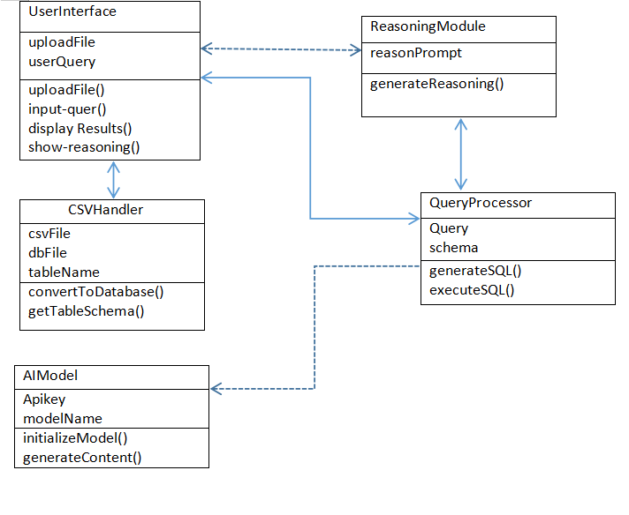
Proposed Methodology
Class Diagram:

Slide 10
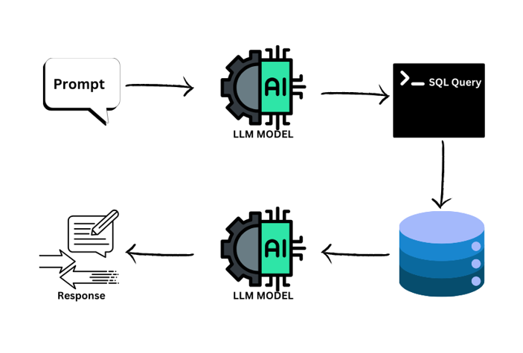
Proposed Methodology
Algorithm:

Slide 11
Timeline of the Project (Gantt Chart)
Phase 0
Discussion and finalizing about the project details
Phase 1
Explanation about Data collection , data preprocessing,
And develop the model
Phase 2
Collecting the data and Model Training and Testing the developed model.
Phase 3
Final Presentation and view developed model.
Reserch on previous works and prepare an blue print to develop a model

Slide 12
References (IEEE Paper format)
Nararatwong, R., Chen, C.-C., Kertkeidkachorn, N., Takamura, H., & Ichise, R. (2024). "DBQR-QA: A Question Answering Dataset on a Hybrid of Database Querying and Reasoning." Artificial Intelligence Research Center, AIST, Japan Advanced Institute of Science and Technology, Tokyo Institute of Technology.
Chu, S. (2019). "Automated Reasoning of Database Queries." Paul G. Allen School of Computer Science, University of Washington.
Kumar, T., Kommanaboina, K. Y., & Kumar, B. (2024). "Next-Generation Text-to-SQL: A Survey of Advanced Reasoning Enhancements Techniques." Independent Researchers.

Slide 13
References
Androutsopoulos, I., Ritchie, G. D., & Thanisch, P. (1995). "Natural Language Interfaces to Databases – An Introduction." Journal of Natural Language Engineering.
Dong, L., & Lapata, M. (2018). "Coarse-to-Fine Decoding for Neural Semantic Parsing." Proceedings of the Association for Computational Linguistics (ACL).
Finegan-Dollak, C., et al. (2018). "Improving Text-to-SQL Evaluation Methodology." Proceedings of the Annual Meeting of the Association for Computational Linguistics (ACL).
Ribeiro, M. T., Singh, S., & Guestrin, C. (2016). "Why Should I Trust You? Explaining the Predictions of Any Classifier." Proceedings of the 22nd ACM SIGKDD International Conference on Knowledge Discovery and Data Mining.

Slide 14
Conclusion
The "Database Query and Reasoning" system represents a significant advancement in making database interactions more intuitive and accessible to users without technical expertise.
By leveraging cutting-edge AI technologies, the system effectively bridges the gap between natural language inputs and SQL query generation.
This innovation empowers users to explore and analyze data from diverse domains without requiring knowledge of complex database languages or structures.
Its ability to cater to non-technical users opens new opportunities in education, business, research, and beyond.

Slide 15
Conclusion
In conclusion, the "Database Query and Reasoning" project sets a strong foundation for a new generation of AI-driven database tools. By prioritizing accessibility, transparency, and usability, this system is well-positioned to make a meaningful impact across industries and pave the way for further innovation in user-centric data solutions.

Slide 16
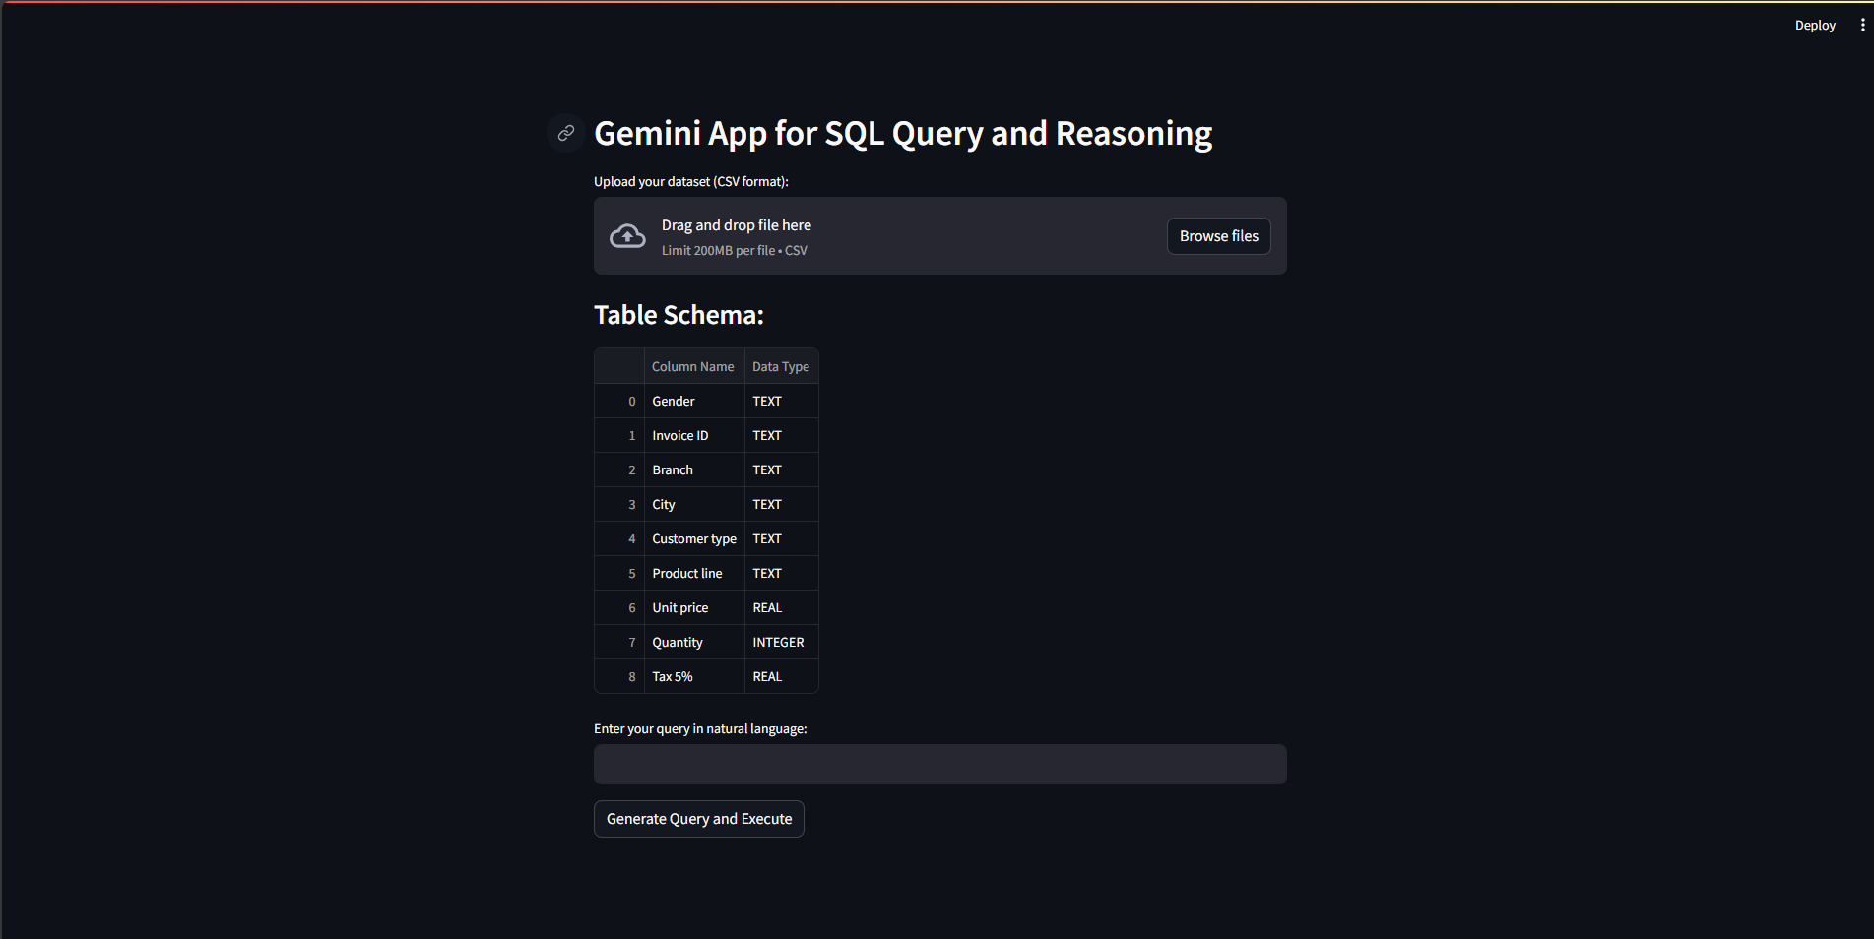
Conclusion
Outputs:

Slide 17
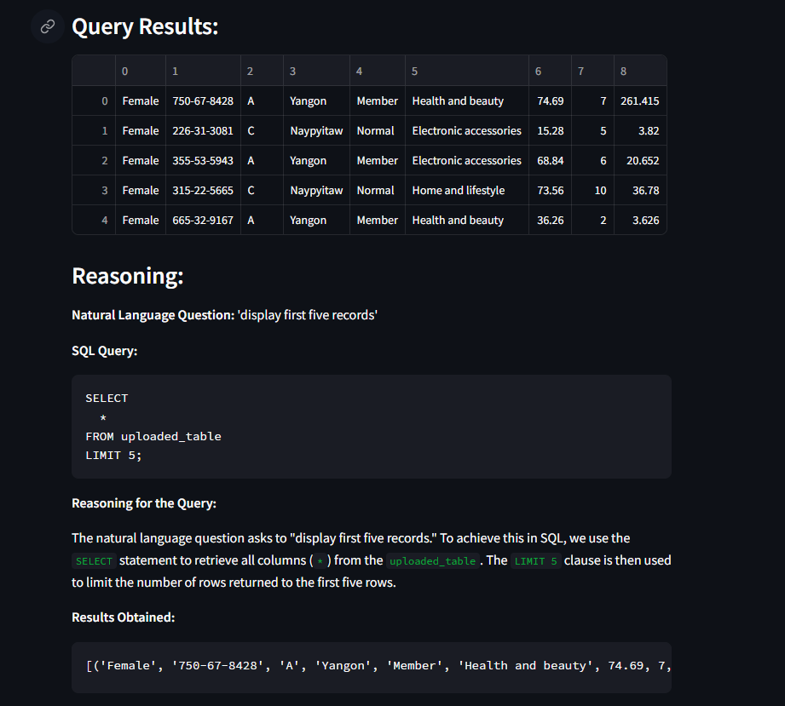
Conclusion
Outputs:

Slide 18


