Slide 1
Implementing Reinforcement Learning in Gaming
CSCI-6660-01-Introduction to Artificial Intelligence
Done by:
Ravi Varma Jampani
Ashish Sadineni
Sowmyakala Yalamudi

Slide 2
Introduction:
Training a Reinforcement agent – Mario agent to learn how to play a mario game by itself using Double deep Q-Networks.
Using OpenAI Gym environment for Super mario Bros to train an agent using the nes-py emulator.
Returns the Mean reward value , Mean loss value and Mean Q value for the set of episodes.
Resulting in a simulation of training a Mario Agent.

Slide 3
Reinforcement Learning:
Reinforcement learning is a machine learning training method based on rewarding desired behaviors and/or punishing undesired ones. In general, a reinforcement learning agent is able to perceive and interpret its environment, take actions and learn through trial and error.
Agent: One who takes actions in a stochastic environment based on the rewards.
Example:Pacman

Slide 4
Keywords:
Environment :The world that an agent interacts with and learns from.
Action a : How the Agent responds to the Environment. The set of all possible Actions is called action-space.
State s : The current characteristic of the Environment. The set of all possible States the Environment can be in is called state-space.
Reward r : Reward is the key feedback from Environment to Agent. It is what drives the Agent to learn and to change its future action. An aggregation of rewards over multiple time steps is called Return.
Optimal Action-Value function Q∗(s,a) : Gives the expected return if you start in state s, take an arbitrary action a, and then for each future time step take the action that maximizes returns. Q can be said to stand for the "quality" of the action in a state. We try to approximate this function.

Slide 5
Tools and Packages:
Setup Mario Environment:
Executed on: Anaconda-Jupyter Lab
Framework: Gym -Toolkit used for developing and comparing RL algorithm, It supports teaching agents from walking , playing games etc.
Environment: gym-super-mario-bros==7.3.0
Platform:Pytorch
Actions: (joypad space): from nes-py is an NES emulator and OpenAI Gym interface used to build a virtual joypad to play mario game
Wrappers :To preprocess environment data before sending it to the agent

Slide 6
Agent:
We create Mario class to represent our agent in the game.
To Act according to the optimal action policy based on the current state (of the environment).
Maintain a log of Experience = (current state, current action, reward, next state) and learn from it.
Learn a better action policy over training.
In each given state, an agent can choose to do the most optimal action when exploit or a random action when exploring.

Slide 7



Training model:
Mario uses DDQN algorithm (Deep Reinforcement Learning with Double Q-learning) - uses two convoluted networks that independently approximate the optimal action-value function
Predicted Optimal Q* for each state and
The aggregation of current rewards and estimated Q* is given by

Slide 8
Implement and compare model-free RL Algorithm
Policy gradient:
Policy gradient methods are a type of reinforcement learning techniques that rely upon optimizing parametrized policies with respect to the expected return (long-term cumulative reward) by gradient descent.
Here, we consider the case of a stochastic, parameterized policy, . We aim to maximize the expected return
To actually use this algorithm, we need an expression for the policy gradient which we can numerically compute. This involves two steps: 1) deriving the analytical gradient of policy performance, which turns out to have the form of an expected value, and then 2) forming a sample estimate of that expected value, which can be computed with data from a finite number of agent-environment interaction steps.

Slide 9
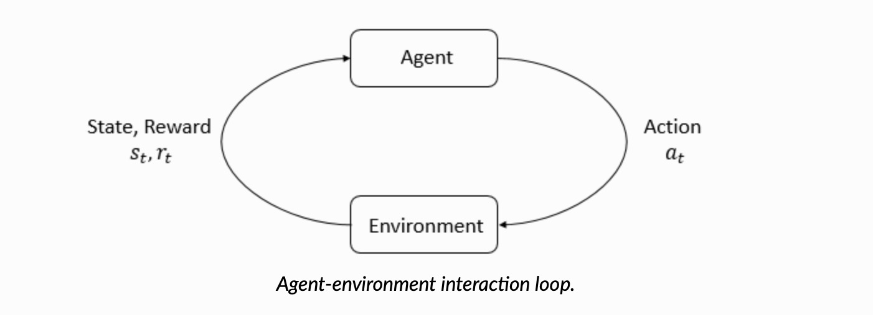
Training Model:

Slide 10
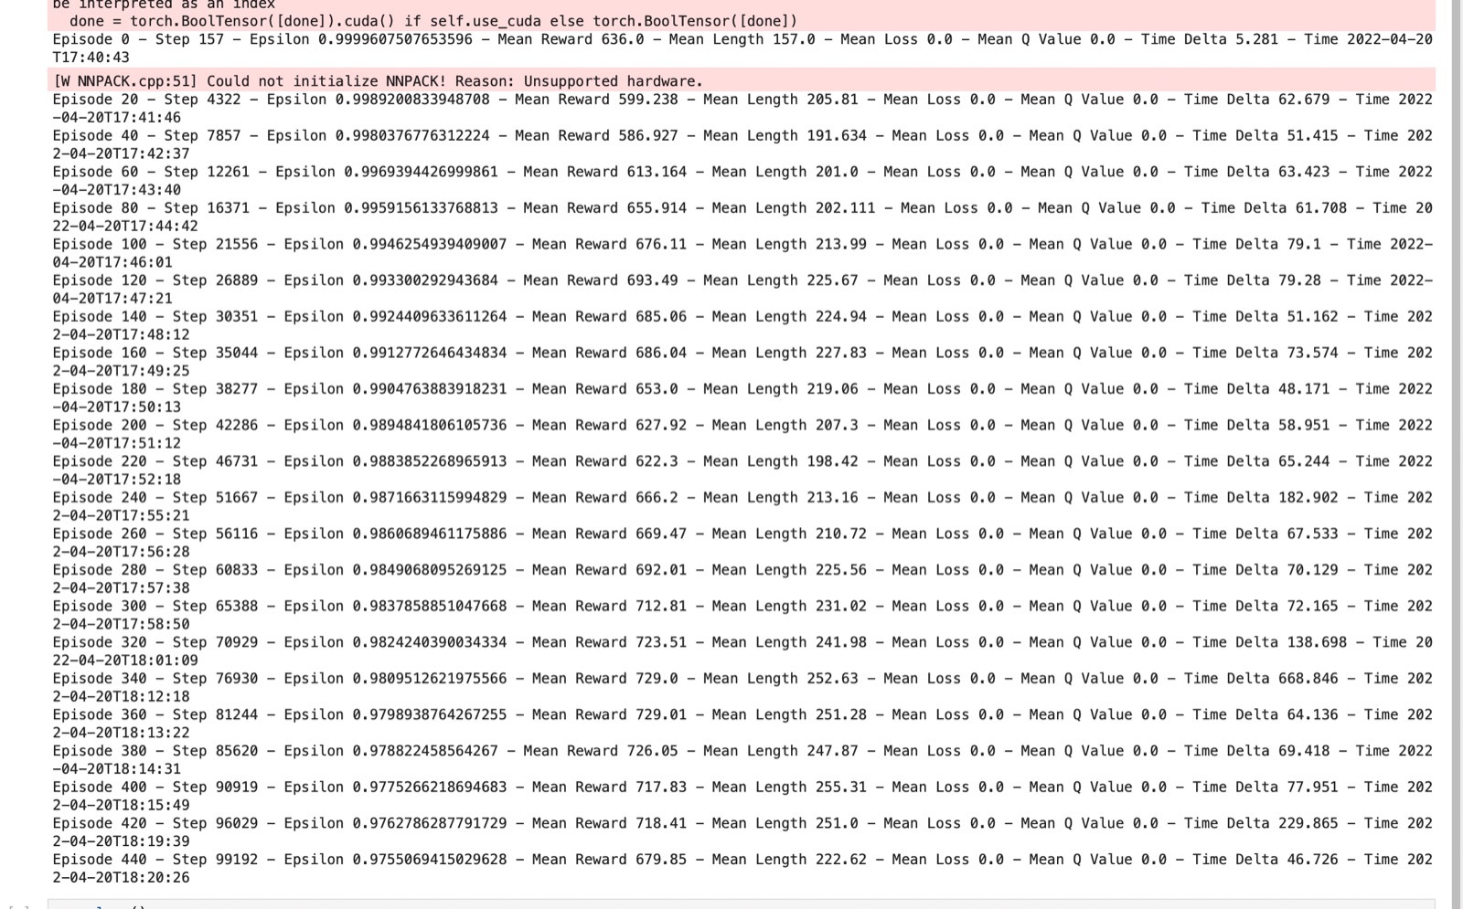
Output:

Slide 11
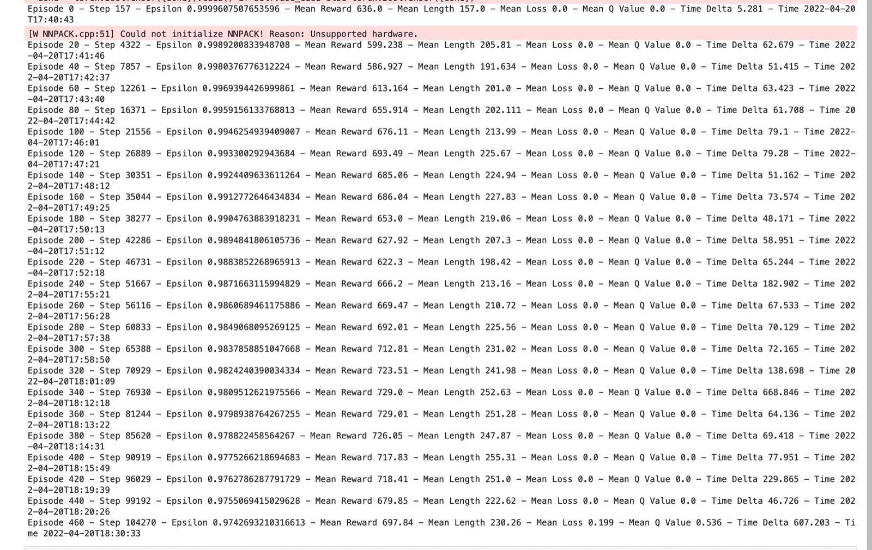
Output:

Slide 12
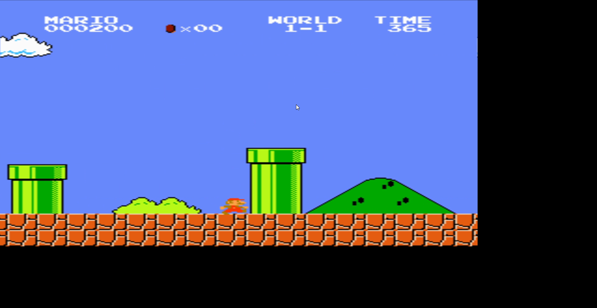
Output Video:

Slide 13
Inference:
We saw how Reinforcement learning method can be implemented practically in order to build a learning model in an environment and train an agent using it.
APPLICATIONS:
RL can be applied in some of the applications like:
Self driving cars
Industry automation
Trading and finance
NLP

Slide 14
References:
Paper on Deep Reinforcement Learning with Double Q-learning - https://arxiv.org/pdf/1509.06461.pdf
Toolkit resource- Gym (openai.com)
RL learning guide- Reinforcement Learning Tips and Tricks — Stable Baselines3 1.5.1a4 documentation (stable-baselines3.readthedocs.io)
Reinforcement Learning: An Introduction, Richard S. Sutton et al.
SuttonBartoIPRLBook2ndEd.pdf (stanford.edu)
Key concepts of RL
Part 1: Key Concepts in RL — Spinning Up documentation (openai.com)

