Slide 1

أٍ»
Yasser Albogami, MPH, Ph.D.

Slide 2
Outline
History of drug safety regulations
Pharmacovigilance Definition
Concept of ADR and ADE
Pharmacovigilance Scope and Activities
Pharmacovigilance in Saudi Arabia

Slide 3
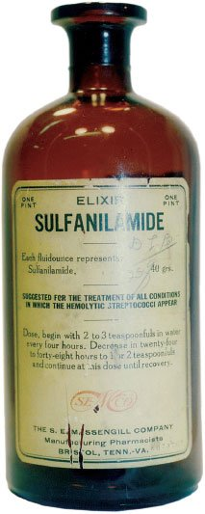

Elixir Sulfanilamide Tragedy (1937)
1937
Elixir sulfanilamide killed 107 persons, many of whom were children, dramatizing the need to establish drug safety before marketing and to enact the pending food and drug law.

Slide 4
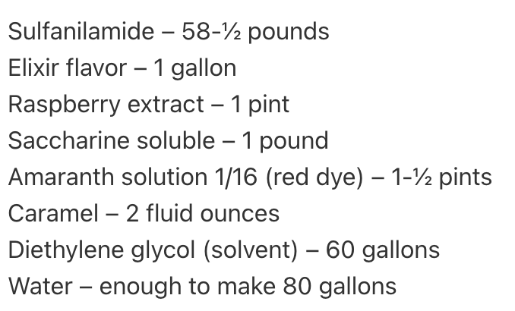
Elixir Sulfanilamide Tragedy (1937)
In 1935, sulfanilamide was discovered to treat infections caused by streptococcal.
Before august 1937, sulfanilamide was marketed as capsules and powders. However, liquid forms was demanded for young children.
A chemist worked for Massengill company invented a formula for the liquid form.

Slide 5
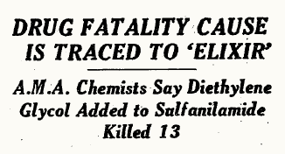
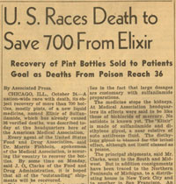
Elixir Sulfanilamide Tragedy (1937)
Two months after the liquid form was marketed, an urgent telegram was delivered to the American Medical Association (AMA):
“A group of Tulsa, Oklahoma doctors expressed their great concern over the recent death of six children. All had died from strep throat within the previous ten days exhibiting very similar symptoms: all had lower-than-normal temperatures, respiration had slowed, and then their bodies stopped producing urine before succumbing to whatever had killed them.” October 1937
The FDA did not have power. However, the commissioner ordered all staff (~250) to trace the causes.
*Diethylene glycol*

Slide 6
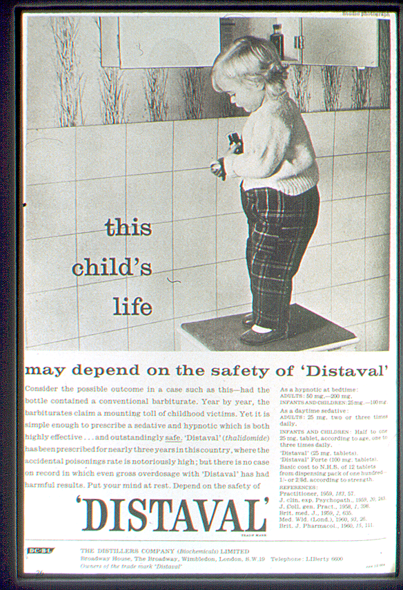
Thalidomide Scandal (1956-1964)
Quickly discovered to also be an effective anti‐emetic and used to treat morning sickness in pregnant women in European countries.
Marketed in ~ 46 countries with following statements:
“…drug of choice to help pregnant women”
“completely safe for pregnant women”
However:
No studies in pregnant women (or animals) had been conducted.
Practically nothing was known about the drug at the time of its marketing

Slide 7
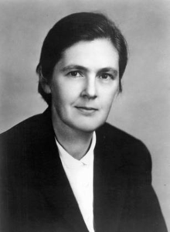
Thalidomide Scandal (1956-1964)
In the US, there was a hero: Dr. Frances Kelsey
Even though it had already been approved in Canada and more than 20 European and African countries, Dr. Kelsey withheld approval for the drug and requested further studies.
On Aug. 1, 1962, President John F. Kennedy issued a warning during his speech: “Every woman in this country, I think, must be aware that it’s most important that they check their medicine cabinet and that they do not take this drug.”

Slide 8

Thalidomide Scandal (1956-1964)
Lessons learned:
Recognition of epidemic of rare defects took almost 4 more years
Around 10,000 infants were born with deformities worldwide; only about 5,000 survived beyond childhood
The need for post-marketing surveillance programs

Slide 9

Thalidomide Scandal (1956-1964)
Lessons learned:
Recognition of epidemic of rare defects took almost 4 more years.
Around 10,000 infants were born with deformities worldwide; only about 5,000 survived beyond childhood
The need for post-marketing surveillance programs

Slide 10
Pre-approval information is not enough
Drug | Unexpected Drug Effect
Isotretinoin (1987) | Birth Defect
Troglitazone (1997) | Hepatotoxicity
Cerivastin (2001) | Rhabdomyolysis
Rofecoxib (2005) | Heart Attack
?? (2021) | ??

Slide 11
Pharmacovigilance (Post-Marketing Surveillance)

Slide 12
Pharmacovigilance (PV)
PV is defined as
“The science and activities relating to the detection, assessment, understanding and prevention of adverse effects or any other medicine-related issue”
World Health Organization, 2002

Slide 13
Adverse Drug Event Vs Adverse Drug Reaction
ADE:
An injury resulting from medical intervention related to a drug. This includes medication errors, adverse drug reactions, allergic reactions, and overdoses.
ADR:
A response to a drug which is noxious and unintended and which occurs at normal doses.
ADEs
ADRs
Guideline for Industry, US FDA

Slide 14
Adverse Drug Event Vs Adverse Drug Reaction
ADE:
An injury resulting from medical intervention related to a drug. This includes medication errors, adverse drug reactions, allergic reactions, and overdoses.
ADEs
Pharmacovigilance

Slide 15
Pharmacovigilance (PV)
PV is defined as
“The science and activities relating to the detection, assessment, understanding and prevention of adverse effects or any other medicine-related issue”
World Health Organization, 2002

Slide 16
ADEs Signal Detection

Slide 17
ADEs Signal Detection (1- Spontaneous Reports)
Spontaneous reports are
“direct communications from an individual (e.g., health care professional, consumer) to a company or regulatory authority describing a suspected adverse drug event”
Cons Pros
Under-reporting (voluntary) - Includes all medicines
Causality assessment is difficult - Detects signals of new and rare ADRs
Duplicate reporting - Easiest method to establish
Reporting bias (passive)

Slide 18



Examples of Spontaneous Reporting Systems
Saudi Vigilance System in Saudi Arabia
Yellow Card system in the UK
The U.S. FDA Adverse Event Reporting System (FAERS)

Slide 19
ADEs Signal Detection (2- Post-marketing studies)
Post-marketing studies can be:
1- Observational studies conducted by regulatory agency
2- Observational studies or RCTs conducted by manufacturers (voluntary or required by FDA)
Post-marketing studies are considered active surveillance.
COVID-19 Pfizer Vaccine and Myocarditis ---> A post-marketing study was required by the U.S. FDA

Slide 20
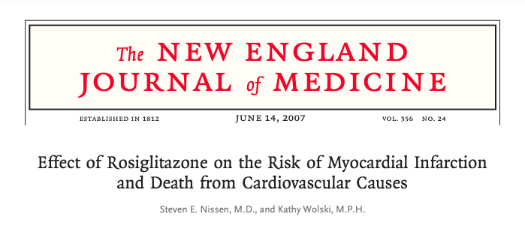
ADEs Signal Detection (3- Literature review)
Pharmacovigilance offices and departments in regulatory agencies and manufacturers review new published studies if they report possible adverse drug events.
An example of when a group of researchers in 2007 reported a cardiovascular safety issue with rosiglitazone. Multiple regulatory agencies imposed restrictions on prescribing because of the published studies.

Slide 21
Pharmacovigilance (PV)
PV is defined as
“The science and activities relating to the detection, assessment, understanding and prevention of adverse effects or any other medicine-related issue”
World Health Organization, 2002

Slide 22
Assessment and Understanding of ADEs signals
The assessment of safety signals establishes whether or not there is a causal relationship between the medicine and the reported adverse event.
Examples of causal relationship assessment:
Strength
Consistency
Temporality
Dose-response relationship
Plausibility

Slide 23
Strength
Measures of the association
− Relative risk
− Odds ratio
Stronger association is more likely to be causal, but a weak association can also be causal
Examples:
− RR for lung cancer and cigarette smoking from various studies are around 10
− RR for breast cancer and cigarette smoking from various studies are between 1–1.5
This suggests that the association between smoking and lung cancer is more likely to be causal than smoking and breast cancer

Slide 24
Consistency
Animal studies
In vitro studies
In vivo studies
Other studies such as ecological studies, cross-sectional studies
Other types of data such as sales data, time trend.
All should point to the same direction of a possible causal association.

Slide 25
Temporality
The necessity that the cause precede the effect in time. Exposure precedes disease development with adequate elapsed time.
Study designs with temporal relationship are Cohort, case-control, and RCTs

Slide 26
Dose-Response Relationship
If risk increases with increasing exposure, it supports the notion of a causal association
Example, more smoking means more carcinogen exposure and more tissue damage, hence more carcinogenesis

Slide 27
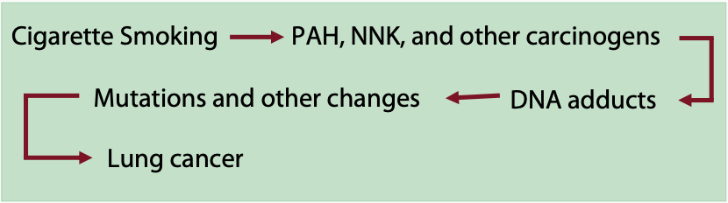
Plausibility
A possible biological explanation of the observed ADE signal.
Example, smoking and lung cancer was possibly explained by a biological mechanism of action of cigarette smoking on the lungs.

Slide 28
Pharmacovigilance (PV)
PV is defined as
“The science and activities relating to the detection, assessment, understanding and prevention of adverse effects or any other medicine-related issue”
World Health Organization, 2002

Slide 29
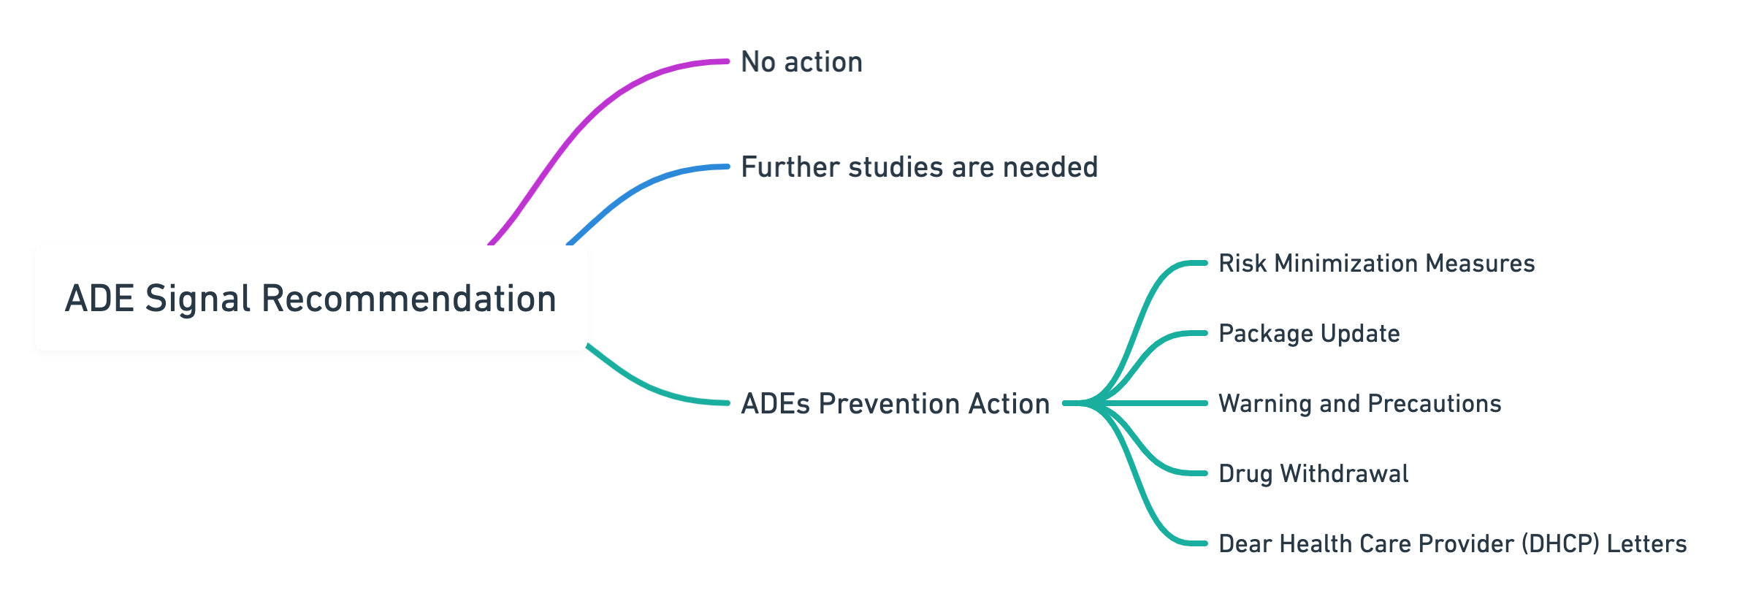
ADEs Prevention
After evaluation the signal and receive the recommendation for the staff and specialized committees, an action by the regulatory or manufacturers will be taken as follows:

Slide 30
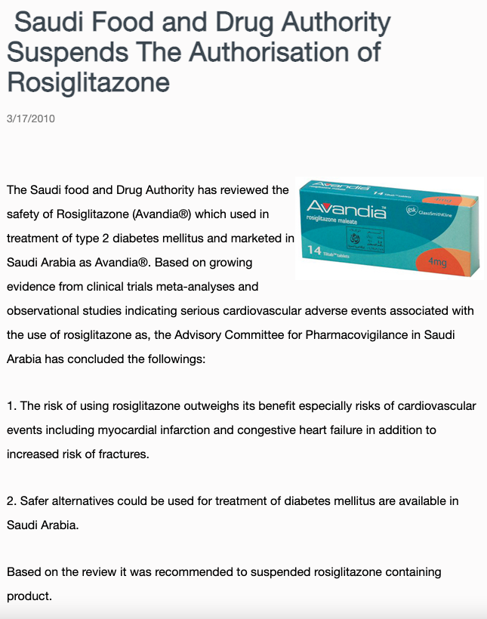
Drug Withdrawal Example in Saudi Arabia

Slide 31
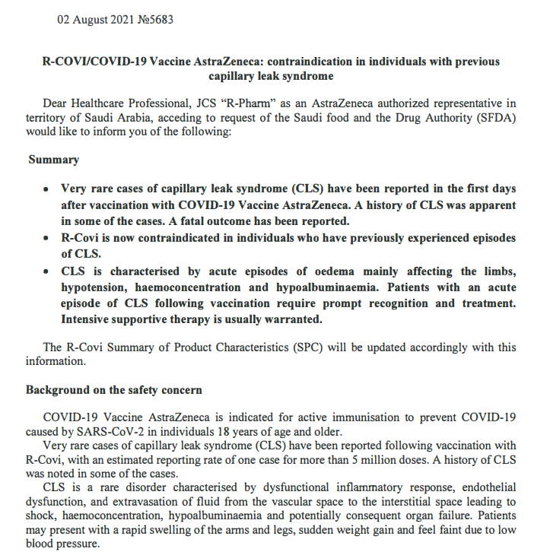
DHCP Letter Example in Saudi Arabia

Slide 32
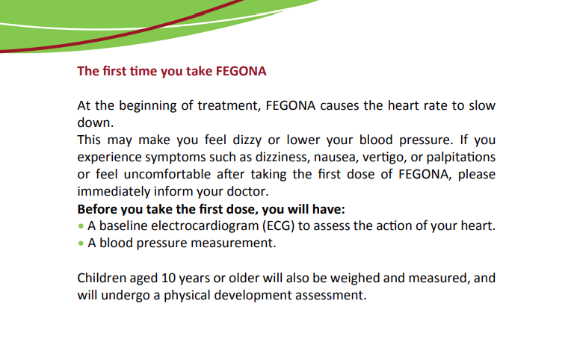
Risk Minimization Measures Example in Saudi Arabia

Slide 33
Pharmacovigilance in Saudi Arabia

Slide 34
Pre - SFDA
The earliest program for adverse drug event (ADE) reporting was established in 1975 as a hospital-based program at King Faisal Specialist Hospital and Research Center in Riyadh.
In 1998, the MOH in Saudi Arabia established a post-marketing program, which focused mainly on early detection of unexpected and serious adverse drug reactions (ADRs), detecting increases in frequency of known ADEs, identifying quality defect issues of registered products, and disseminating necessary safety information.

Slide 35

After SFDA established
SFDA has established a pharmacovigilance system that operates under the National Pharmacovigilance and Drug Safety Center (NPC) in 2009.
The NPC developed three methods for reporting ADEs :
(A) Online submission;
(B) Paper based reporting form and
(C) Traditional method such as : verbal, fax, telephone.

Slide 36
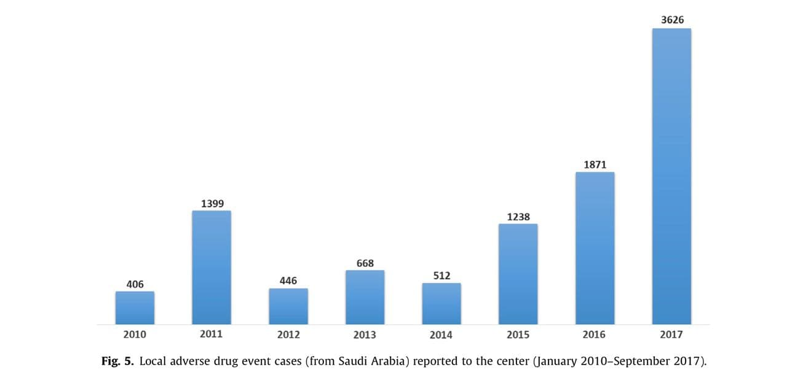
Local ADEs reporting

Slide 37
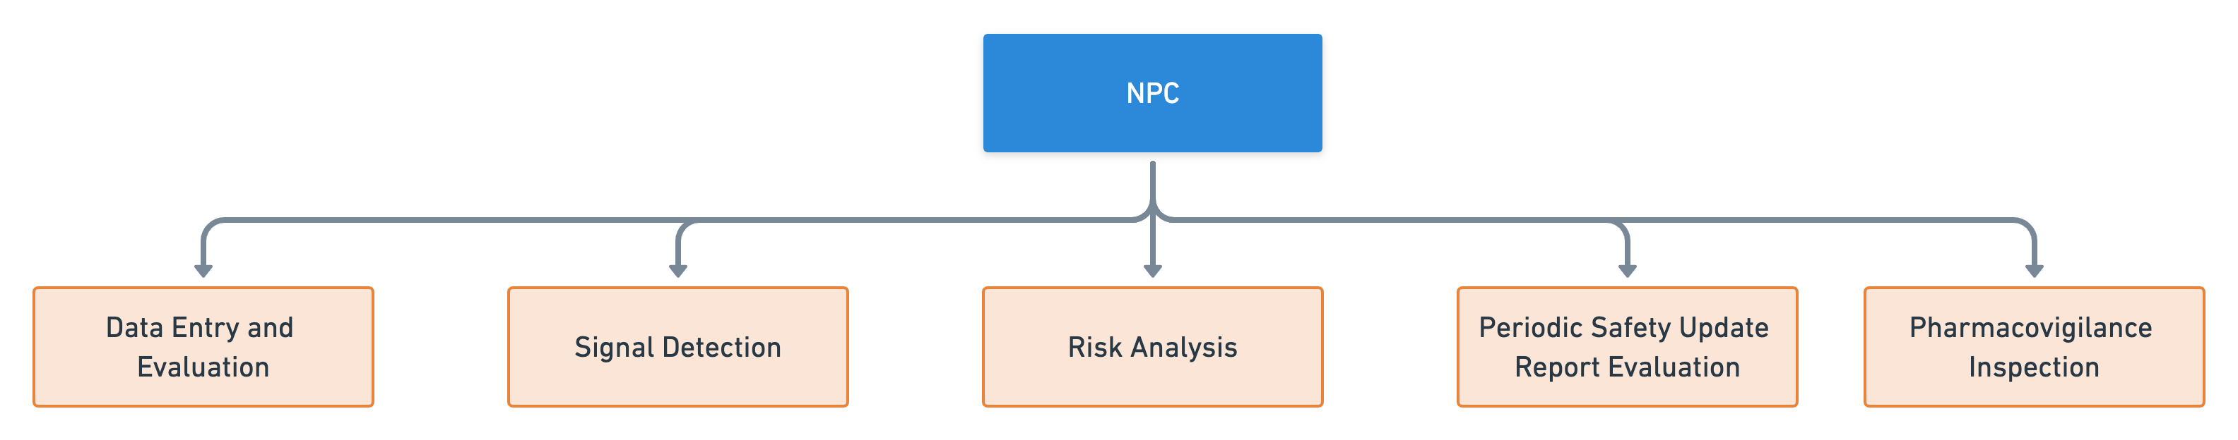
NPC
Today, the NPC efficiently conducts several pharmacovigilance activities

Slide 38
NPC
The signal detection team periodically reviews the local ADE databases to investigate issues raised by specific drugs or specific pharmacological group.
After a safety signal has been refined and detected, the section prepares a signal validation report with appropriate recommendations against the concerned medication, which advisory committee will subsequently discuss to take the appropriate regulatory action.

Slide 39
Thank you
yalbogami@ksu.edu.sa

