Slide 1

Benefit – Risk Assessment Introduction
Yasser Albogami, MPH, Ph.D.

Slide 2


Slide 3
Outline
History of drug safety regulations
Benefit – Risk Assessment Definition
Benefit – Risk Assessment lifecycle

Slide 4
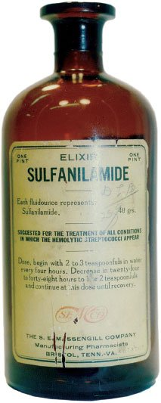

Elixir Sulfanilamide Tragedy (1937)
1937
Elixir sulfanilamide killed 107 persons, many of whom were children, dramatizing the need to establish drug safety before marketing and to enact the pending food and drug law.

Slide 5
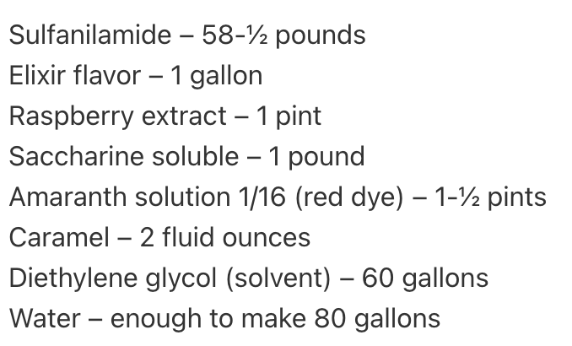
Elixir Sulfanilamide Tragedy (1937)
In 1935, sulfanilamide was discovered to treat infections caused by streptococcal.
Before august 1937, sulfanilamide was marketed as capsules and powders. However, liquid forms was demanded for young children.
A chemist worked for Massengill company invented a formula for the liquid form.

Slide 6
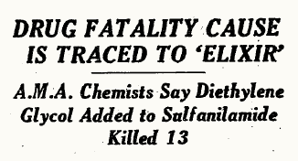
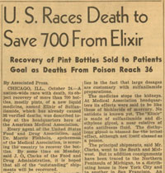
Elixir Sulfanilamide Tragedy (1937)
Two months after the liquid form was marketed, an urgent telegram was delivered to the American Medical Association (AMA):
“A group of Tulsa, Oklahoma doctors expressed their great concern over the recent death of six children. All had died from strep throat within the previous ten days exhibiting very similar symptoms: all had lower-than-normal temperatures, respiration had slowed, and then their bodies stopped producing urine before succumbing to whatever had killed them.” October 1937
The FDA did not have power. However, the commissioner ordered all staff (~250) to trace the causes.
*Diethylene glycol*

Slide 7
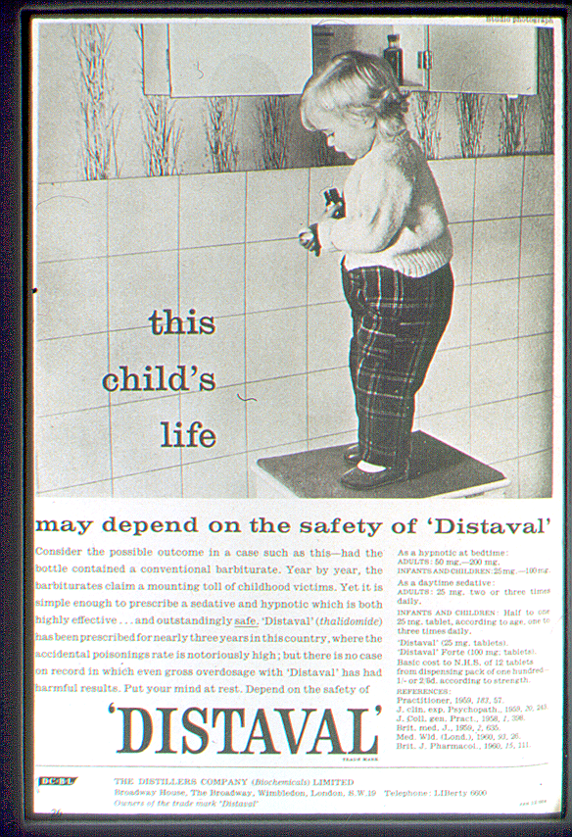
Thalidomide Scandal (1956-1964)
Quickly discovered to also be an effective anti‐emetic and used to treat morning sickness in pregnant women in European countries.
Marketed in ~ 46 countries with following statements:
“…drug of choice to help pregnant women”
“completely safe for pregnant women”
However:
No studies in pregnant women (or animals) had been conducted.
Practically nothing was known about the drug at the time of its marketing

Slide 8
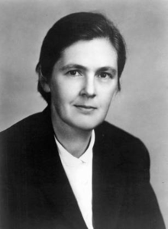
Thalidomide Scandal (1956-1964)
In the US, there was a hero: Dr. Frances Kelsey
Even though it had already been approved in Canada and more than 20 European and African countries, Dr. Kelsey withheld approval for the drug and requested further studies.
On Aug. 1, 1962, President John F. Kennedy issued a warning during his speech: “Every woman in this country, I think, must be aware that it’s most important that they check their medicine cabinet and that they do not take this drug.”

Slide 9

Thalidomide Scandal (1956-1964)
Lessons learned:
Recognition of epidemic of rare defects took almost 4 more years
Around 10,000 infants were born with deformities worldwide; only about 5,000 survived beyond childhood
The need for post-marketing surveillance programs

Slide 10
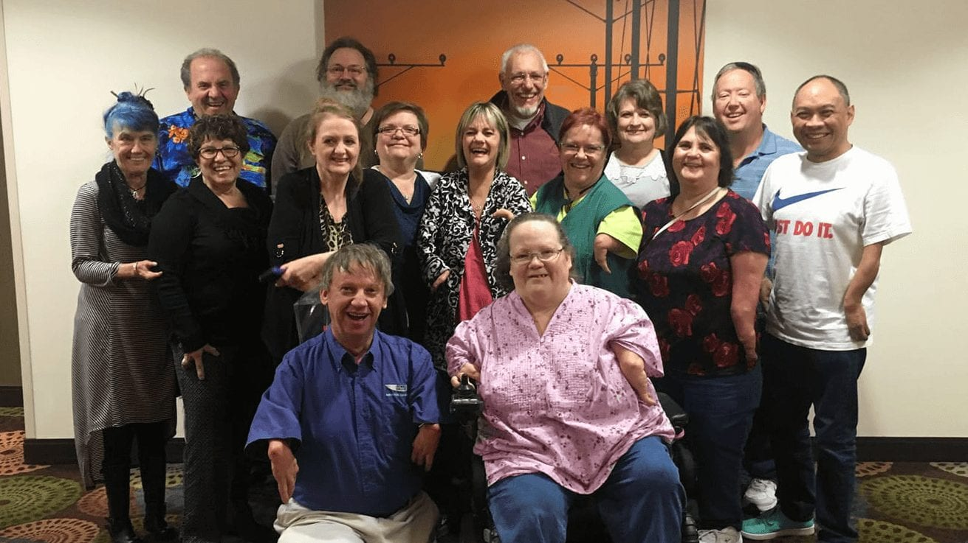
Thalidomide Scandal (1956-1964)
Lessons learned:
Recognition of epidemic of rare defects took almost 4 more years.
Around 10,000 infants were born with deformities worldwide; only about 5,000 survived beyond childhood
The need for post-marketing surveillance programs

Slide 11
Pre-approval information is not enough
Drug | Unexpected Drug Effect
Isotretinoin (1987) | Birth Defect
Troglitazone (1997) | Hepatotoxicity
Cerivastin (2001) | Rhabdomyolysis
Rofecoxib (2005) | Heart Attack
?? (2023) | ??

Slide 12
BRA definition
Drug benefit-risk assessment is a process used by regulatory authorities, healthcare professionals, and pharmaceutical companies to evaluate the benefits and risks associated with a particular drug or therapy. This involves analyzing the potential benefits of the drug in terms of its potential therapeutic effects, as well as the potential risks and adverse effects that may occur when using the drug.

Slide 13
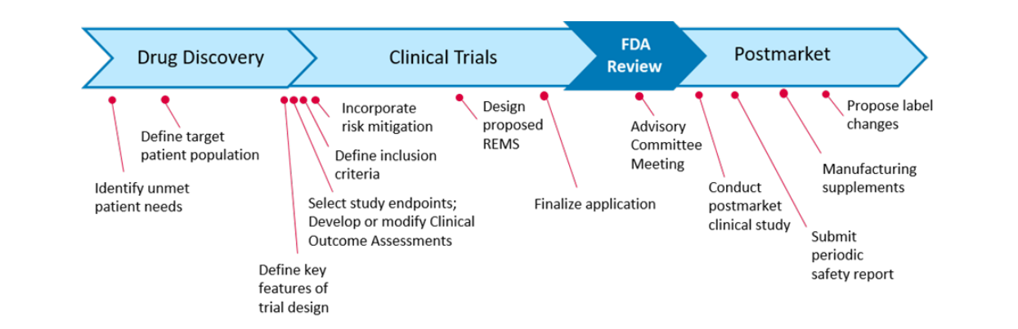
Development activities along drug lifecycle
Sample milestones along the drug lifecycle that may have a particular bearing on benefit-risk assessment of a marketing authorization.
2019 FDA Discussion Document: https://healthpolicy.duke.edu/sites/default/files/atoms/files/discussion_guide_b-r_assessment_may16.pdf

Slide 14
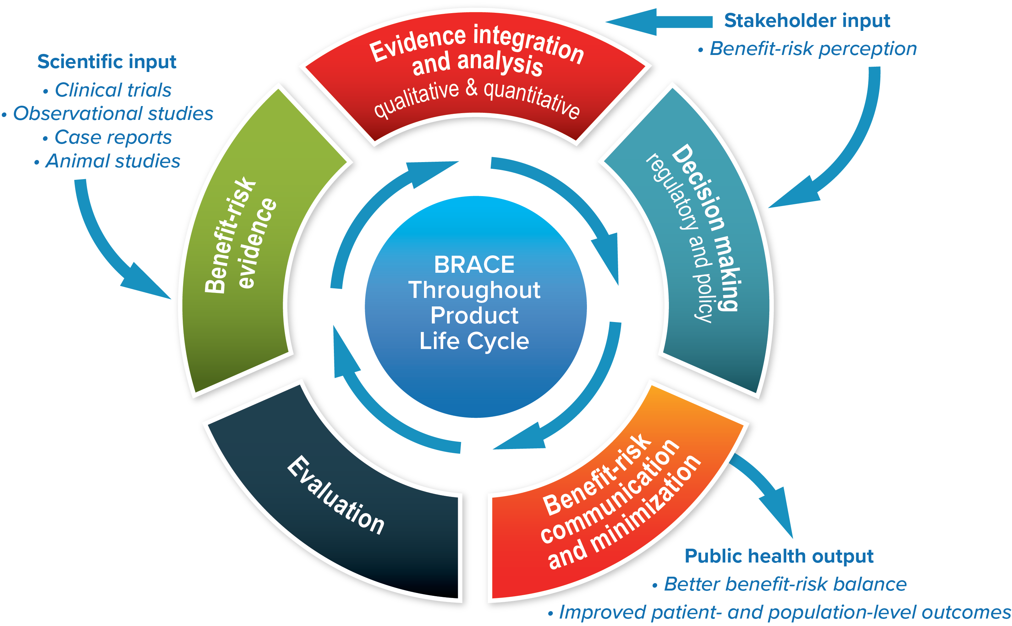
BRA lifecycle
Benefit-Risk Assessment, Communication, and Evaluation (BRACE) Throughout the Life Cycle of Medicinal Products and Devices
* Evaluation includes (1) effectiveness of risk communication and risk management; and (2) re-assessment of benefit-risk.
Radowski et al., on behalf of the ISPE BRACE Special Interest Group. Pharmacoepidemiol Drug Saf. 2015 Dec;24(12):1233-40.

Slide 15
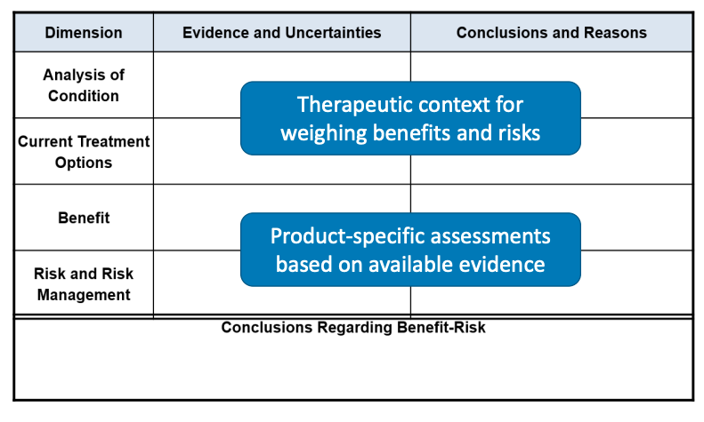
Development activities along drug lifecycle
FDA’s Benefit-Risk Framework: Structured approach for human drug review
Benefit-Risk Assessment of Human Drugs and Biologics at FDA by Dr. Leila Lackey, 2019

Slide 16
Thank you
yalbogami@ksu.edu.sa

