Slide 1
PREGNANCY EXPOSURE TO ISOTRETINOIN IN SAUDI ARABIA
A Multicenter Real-World Data Analysis from 2015-2022

Slide 2




INTRODUCTION
Context
Current state
The problem
Isotretinoin is a potent acne treatment but with severe teratogenic effects.
The Saudi Food and Drug Authority approved and updated risk minimization measures to prevent fetal exposure over the years.
The extent of pregnancy exposure to isotretinoin in Saudi Arabia is unknown.

Slide 3
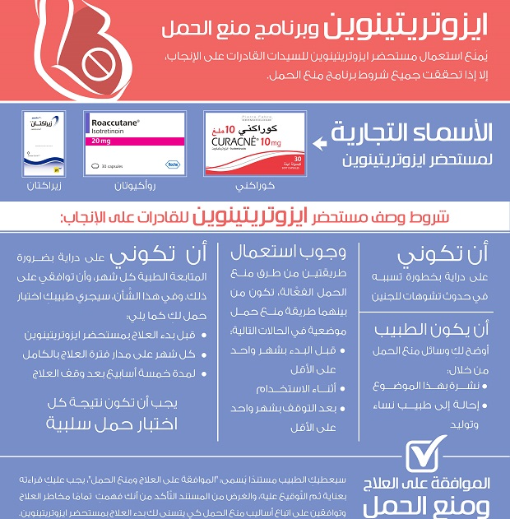
CURRENT STATE
LATEST SFDA CAMPAIGN
(2017)

Slide 4
OBJECTIVE 1
OBJECTIVE 2
to quantify pregnancy exposure to isotretinoin in Saudi Arabia using real-world data.
to quantify the adherence to risk minimization measures.
Study Objectives

Slide 5
Methods

Slide 6







Methods
Data Source (2015-2022)
King Saud University Medical City
Ministry of National Guard Health Affairs
King Abdullah bin Abdulaziz University Hospital
Kingdom's Hospital
Inclusion Criteria
Women of Childbearing Age (15-49)
Received at least one isotretinoin prescription
Exclusion Criteria
diagnosed with premature menopause, natural menopause
had undergone sterility, hysterectomy
bilateral oophorectomy, or total abdominal hysterectomy
Exposure and Outcome Definitions
Exposure: from 1st day of isotretinoin dispensing to 30 days post discontinuation, during which WCBAs must avoid pregnancy (risk period)
Outcome: Pregnancy exposure was defined as any positive pregnancy test or any diagnosis or procedure related to pregnancy
1- fetal exposure was quantified as the total number of pregnancies during the risk period divided by total total sample in the study
2- Total number of pregnancy test and contraceptive users were divided by study sample to quanitfy adherance to RMMs
Analysis

Slide 7
Results

Slide 8
STUDY CHARACTERISTICS
Age Distribution (%)
55.5
26.1
14.6
3.6
age 15-19
age 20-29
age 30-39
age >=40

Slide 9
STUDY CHARACTERISTICS
BMI Category Distribution (%)
38
39
4.5
6
Underweight
Normal
Overweight
Obese

Slide 10
STUDY CHARACTERISTICS
Most common disease (%)
5.5
2.2
5.1
1.4
1.4
1.1
2.5
Vit D deficiency
Dermatitis
PCOS
Hypothyroidism
Asthma
IBS
Obesity

Slide 11
STUDY CHARACTERISTICS
Most common medications (%)
5.9
5.4
4.5
4.2
2.8
2.8
2.7
clindamycin
paracetamol
adapalene
diclofenac
loratadine
ibuprofen
atorvastatin

Slide 12
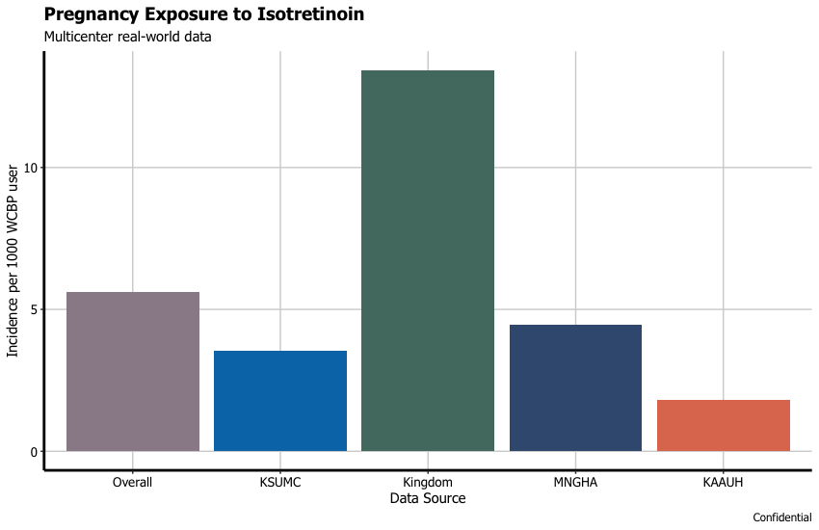
Objective 1: Extent of pregnancy exposure

Slide 13
Additional Analysis: Pregnancy Outcome
Institution | Live birth w/o complications n (%) | Live birth with complications n (%) | Abortion n (%) | Unknown n (%)
KSUMC | 1 (33) | 1 (33) | 1 (33) | 0
MNGHA | 2 (11.11) | 1 (5.56) | 4 (22.22) | 11 (61.11)
KAAUH | 0 | 0 | 0 | 1 (100)
Kingdom Hospital | 0 | 0 | 0 | 13 (100)
Overall | 3 (8.57) | 2 (5.71) | 5 (14.28) | 24 (68.57)

Slide 14
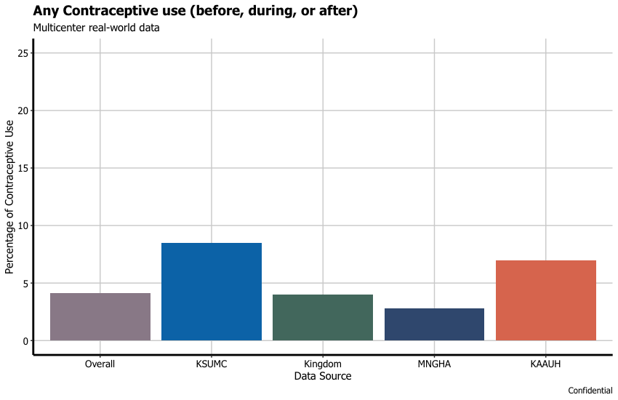
Objective 2: Adherence to RMP

Slide 15
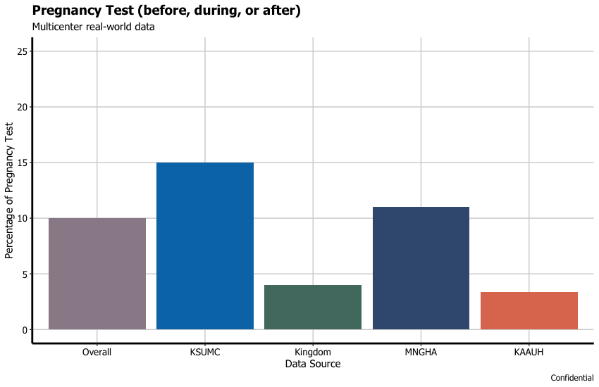
Objective 2: Adherence to RMP

Slide 16
Discussion

Slide 17
Discussion: Comparison with Literature
Saudi Survey Study: 7
Canada & Estonia: 3
United States: 2
France & NZ: 1

Slide 18
Discussion: Comparison with Literature
Caveat: to make a fair comparison, the denominator should only include women who have the potential to become pregnant, (married women).
Saudi Survey Study: 7
Canada & Estonia: 3
United States: 2
France & NZ: 1

Slide 19
Discussion: Contraceptive use
Our study indicates < 5% of WCBPs used contraceptives to avoid fetal exposure to isotretinoin; however, this is potentially biased since the denominator includes single users. The unbiased estimate must be higher than 5%.
A survey study conducted by SFDA showed 70% of married WCBPs used one contraceptive method and 16% used two methods during isotretinoin exposure.
Our study sample had 805 WCBPs who are known to be married. Assuming all contraceptive prescriptions were dispensed to the married WCBPs, the percentage is ~ 30%.
Overall, contraceptive use is significantly lower than what is recommended in the RMP.

Slide 20
Discussion: Pregnancy Test
Our study indicates < 10% of WCBPs performed pregnancy test before, during or after using isotretinoin; however, this is potentially biased since the denominator includes single users. The unbiased estimate should be higher than 10%.
A Saudi survey study showed 7 out of 8 married WCBPs performed pregnancy test before initiating isotretinoin. However, none of them did pregnancy test during or post treatment.
Our study sample had 805 WCBPs who are known to be married. Assuming pregnancy tests were done by the married WCBPs, the percentage is ~ 40%.
Overall, pregnancy test during exposure will not prevent fetal exposure to isotretnion; it only increases the possibility of detecting it!

Slide 21
1) IT’S NOT awareness issue
2) IT’S NOT cost issue
Most published studies show a high level of knowledge regarding teratogenicity and the risk minimization plans
Most government hospitals and insurance companies cover the cost of risk minimization measure.
Potential causes of RMP failure
3) It’s a behavior issue
4) It’s regulatory issue
Most published studies show a low level of behavior towards risk minimization plan
Risk minimization plans are not enforced, which has been shown in the literature several times

Slide 22
1) New Policy
2) Unified health records
The SFDA requires a policy from the government that empowers them to implement and enforce risk minimization plans effectively.
The implementation of a unified health records system allows healthcare providers to verify pregnancy test results and their history of contraceptive use.
Potential Solutions
3) Targeted RMP
4) Digital solutions
RMP should target married WCBPs only which reduces costs and improves compliance
It facilitates the implementation of hard-stops on prescribing and dispensing for WCBPs who are not compliant with the RMP

Slide 23
Strengths and Limitations
Strengths:
This is the first regional and local study that estimates pregnancy exposure to isotretinoin using real-world data.
The study includes academic, private, and governmental hospitals.
Manual review of pregnancy cases was conducted to confirm the cases.
Limitations:
The study may not be representative of all women of childbearing potential (WCBPs) who use isotretinoin in Saudi Arabia.
We were not able to identify the marital status of the majority of the study participants, which may have led to an underestimation of the reported results.
Contraceptive use and pregnancy testing might occur outside of the hospital and thus may not be reflected in the hospital information system (HIS).

Slide 24




STUDY PARTNERS

