Slide 1

Bias in PE
Yasser Albogami, MPH, Ph.D.
PHCL 623
Lecture, 2024

Slide 2
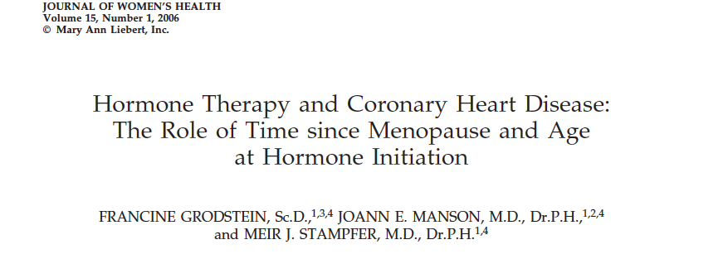
Selection Bias
In 2006, researchers analyzed a RWD and found that postmenopausal hormone therapy significantly reduced coronary heart disease about 30% compared to postmenopausal women who never used hormone therapy.
These results contradict previous findings from an RCT that showed initiating hormone therapy increases the risk of CHD by 20% among postmenopausal women!! (Manson et al. NEJM, 2003)

Slide 3
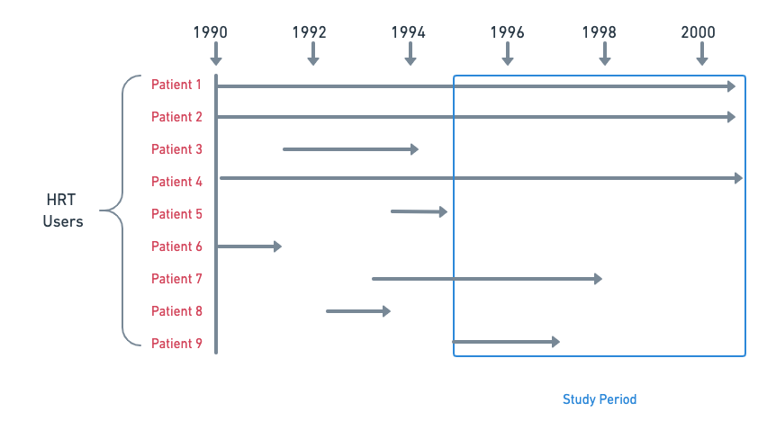
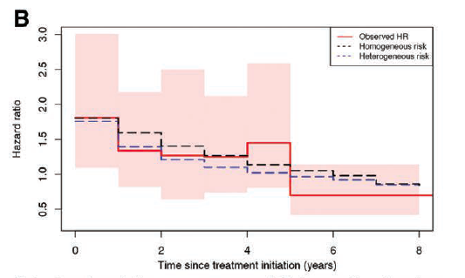
Selection Bias
Researchers assumed the CHD risk is constant during HRT exposure
Stensrud et al., Epidemiology, 2017

Slide 4
Selection Bias
In 2008, the same RWD were re-analyzed to explain the discrepancies between RCTs and RWE findings.
The researchers emulated an RCT by only including HRT initiators (new users). The only two differences between the RCT and the new RWD analysis are:
1- No randomization ad 2- No placebo assignment
 | RCT (Women Health Initiative) | RWE (Nurses’ Health Study)
Overall (HR (95%CI)) | 1.23 (0.99 – 1.53) | 1.05 (0.82 – 1.34)
Stratified by years of follow-up
0 – 2 years (HR (95%CI)) | 1.51 (1.06 – 2.14) | 1.43 (0.92 – 2.23)
> 2 years (HR (95%CI)) | 1.07 (0.81 – 1.41) | 0.91 (0.72 – 1.16)
Hernán et al. Epidemiology. 2008;19(6):766-779. doi:10.1097/EDE.0b013e3181875e61

Slide 5

Measurement Bias
In 2019, analyzing EHRs of patients hospitalized for asthma exacerbations, researchers compared receiving antibiotics on day 1 to not treated on day 1.
Those treated with antibiotics had a significantly longer hospital stay (median [IQR], 4 [3-5] vs 3 [2-4] days).

Slide 6
Measurement Bias
RETRACTED
In 2019, analyzing EHRs of patients hospitalized for asthma exacerbations, researchers compared receiving antibiotics on day 1 to not treated on day 1.
Those treated with antibiotics had a significantly longer hospital stay (median [IQR], 4 [3-5] vs 3 [2-4] days).

Slide 7
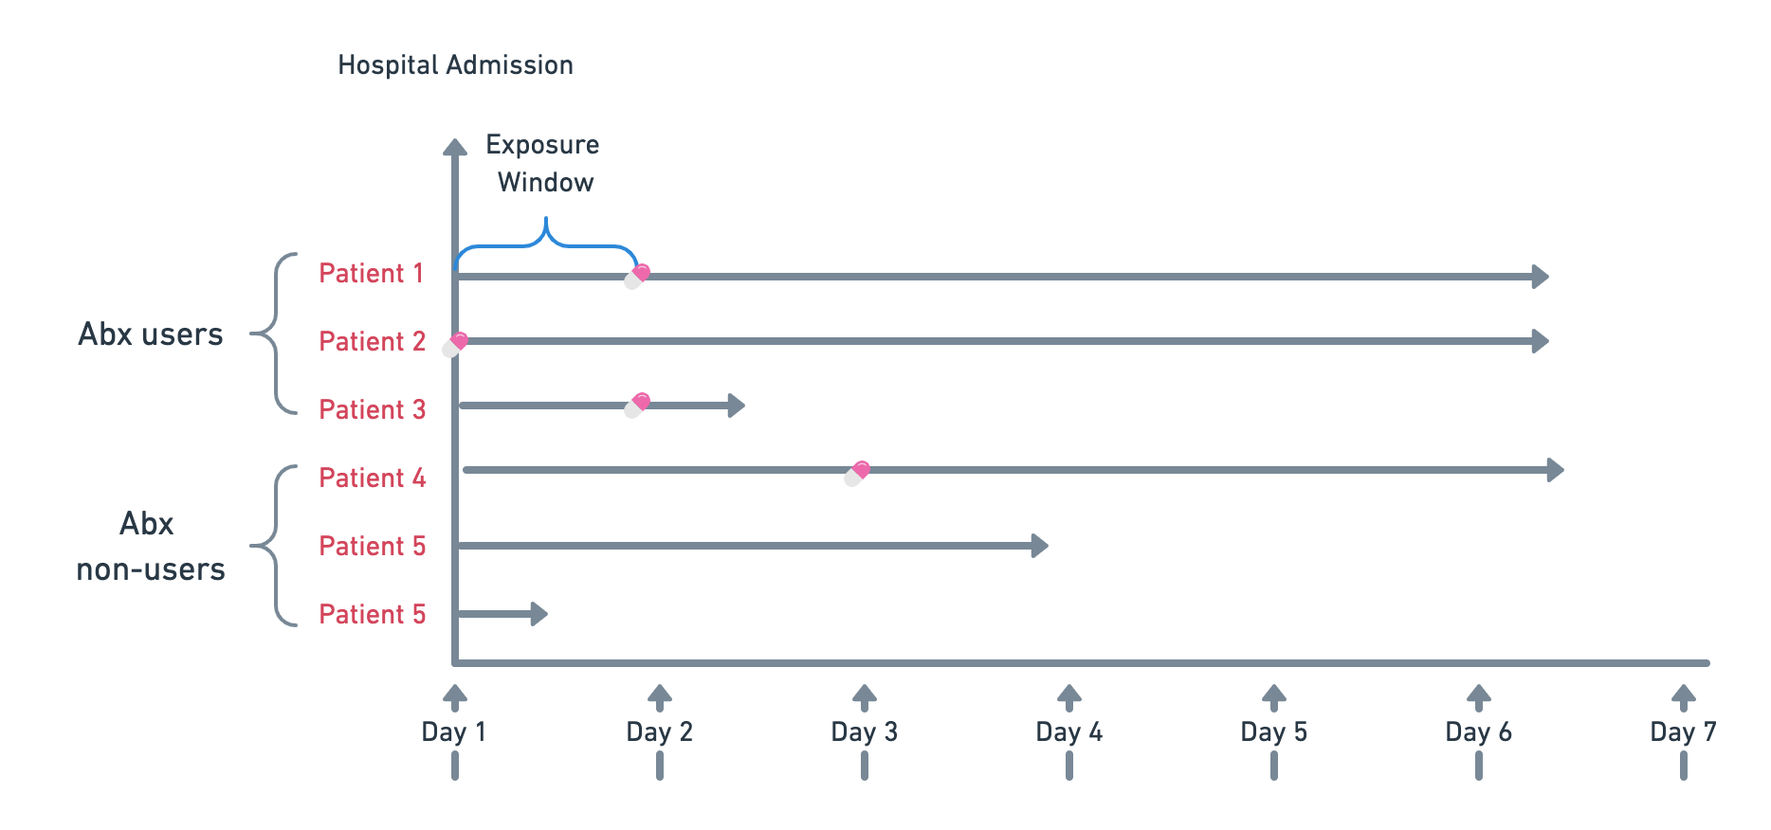
Measurement Bias
Users were defined as asthma patients who received Abx within the first two days of admission assuming the outcome occurs only after the first two days (immortal time bias).
Redefining the groups considering the outcome can happen on the first day solves the issue.

Slide 8
Measurement Bias
 | Before Retraction | After Retraction (addressing immortal time bias)
Length of stay ratio
Unadjusted analysis | 1.34 (1.32 – 1.36) | 1.10 (1.08 – 1.12)
Propensity score analysis | 1.29 (1.27 – 1.31) | 1.06 ( 1.04 – 1.09)
The comment from the corresponding author:
“I knew very well about immortal time bias but somehow it slipped through my and my collaborators mind”

Slide 9
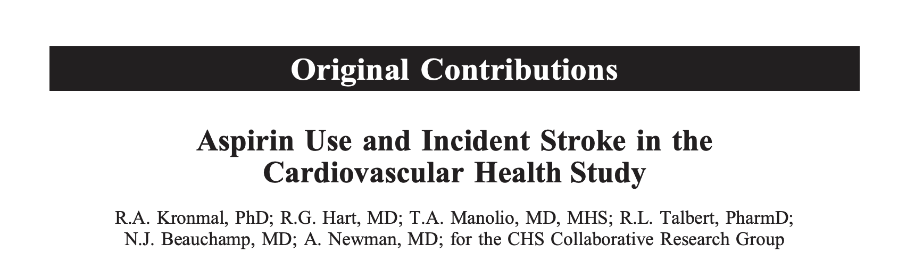
Confounding
A study found that using aspirin increases the risk of developing stroke. The authors concluded that using aspirin may harm older patients who are at a higher risk of stroke.
The researchers attempted to adjust for several potential confounders including diabetes, blood pressure, hypertension, age, gender, HF, MI, BMI, smoking and arthritis.

Slide 10
Confounding
The researchers assumed all potential confounders were adjusted for.
However, atherosclerosis, a third variable, distorted the association between aspirin use and stroke.
The way drugs are being prescribed introduces bias in observational studies which is referred to as confounding by indication.

Slide 11
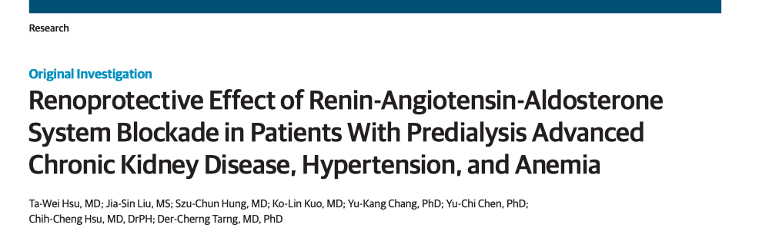

Slide 12
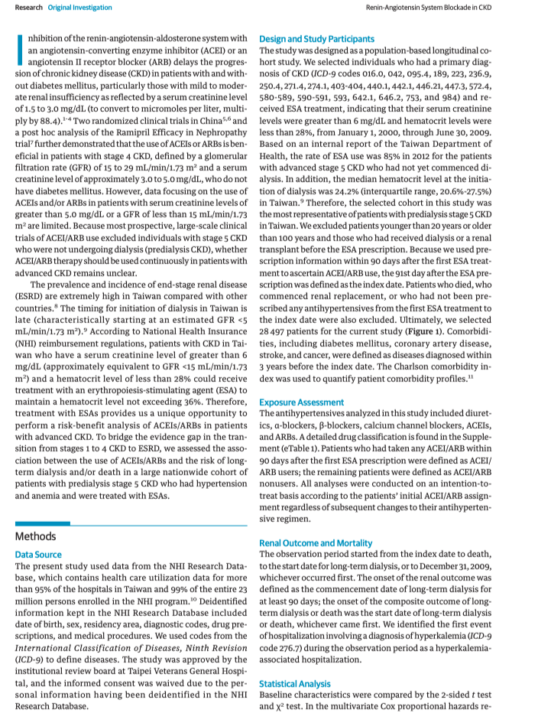

Slide 13
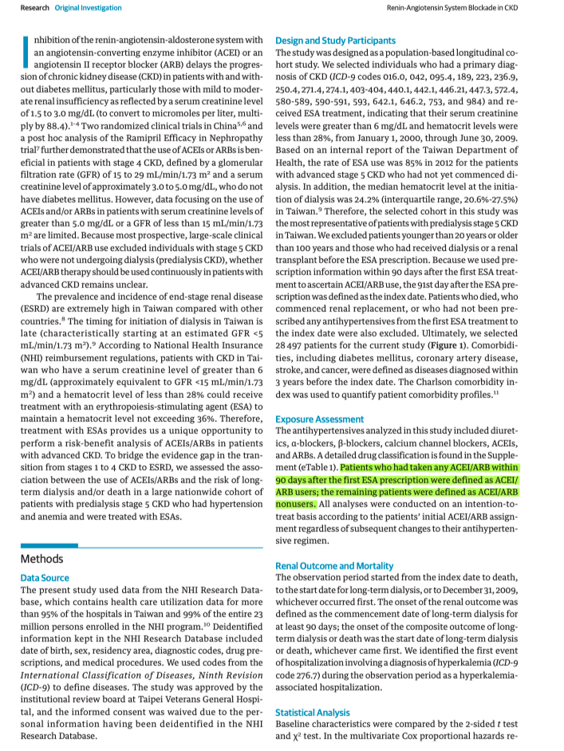

Slide 14
Thank you
For questions
yalbogami@ksu.edu.sa

