Slide 1

Audio Compression

Slide 2
What is audio compression
Audio compression refers to the process of reducing the dynamic range of an audio signal.
The dynamic range of an audio signal is the difference between its loudest and softest parts.

Slide 3
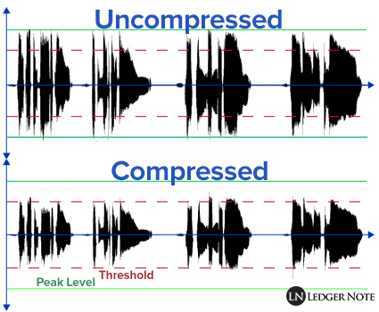
Compare compressed and uncompressed files
We have fewer details in the compressed file.
This reflects how compressed audio files are smaller but may lose some fine details compared to the larger, more detailed uncompressed files.

Slide 4
Audio Compression Formats
MP3 (MPEG Audio Layer III)
AAC (Advanced Audio Coding)
WAV (Waveform Audio File Format)
FLAC (Free Lossless Audio Codec)
WMA (Windows Media Audio)
ALAC (Apple Lossless Audio Codec)
OGG Vorbis

Slide 5
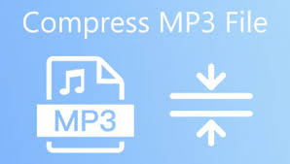
MP3
MP3 is a lossy compression format widely
used for music and audio.
The compression will be done by removing
some details in the sound that are harder
for our ears to notice.

Slide 6

AAC
A successor to MP3, AAC offers better
sound quality at similar bit rates.
It is commonly used in applications like
iTunes, iPods, and online streaming

Slide 7
Let's compare AAC and MP3
They are both audio compression formats, and we are going to look more in detail about some aspects like:
Compression Standard
Encoding Efficiency
Sound Quality
Applications
Compatibility

Slide 8
Compression Standard
MP3: MP3 is standardized by the Moving Picture Experts Group (MPEG). It became one of the most popular audio compression formats for music and other audio applications.
AAC: AAC is standardized by MPEG and later extended by the ISO (International Organization for Standardization). It is the successor to MP3 and is designed to provide better sound quality at similar bit rates.

Slide 9
Encoding Efficiency
MP3: MP3 uses perceptual coding to remove audio data that is less perceptible to the human ear. It achieves compression by discarding some audio information.
AAC: AAC is considered more efficient than MP3 in terms of compression and sound quality. It can provide similar or better audio quality at lower bit rates compared to MP3.

Slide 10
Sound Quality
MP3: MP3 is known for its good balance between file size and sound quality. However, at very low bit rates, artifacts such as compression noise and loss of high-frequency information may become more noticeable.
AAC: AAC generally provides better sound quality than MP3, especially at lower bit rates. It is often preferred for applications where high audio quality is crucial, such as streaming and mobile devices.

Slide 11
Applications
MP3: MP3 has been widely used for many years, though newer formats like AAC have gained popularity in recent years.
AAC: AAC has become the standard audio format for various applications, including Apple's iTunes, iPod, iPhone, and other Apple devices. It is also commonly used in online streaming services and digital broadcasting.

Slide 12
Compatibility
MP3: MP3 has been around for a long time, and its widespread use means it is supported by a vast array of devices and software across different platforms.
AAC: While AAC is widely supported, its adoption can vary across platforms. Apple devices, in particular, have strong support for AAC.

Slide 13
Conclusion
In summary, both MP3 and AAC are audio compression formats, but AAC is considered to have improved efficiency and sound quality compared to MP3.
The choice between them may depend on factors such as device compatibility, file size constraints, and the desired level of audio quality.

Slide 14

Email: shokoufeh.amirsoleymani@studenti.unipd.it

