Slide 1
Initial Project Proposal
Yalda Kasravi Mavi, Azalée Robitaille

Slide 2

Project proposal
Exploring the behavioral differences between
large language models (LLMs) and humans
through a series of comparative experiments.

Slide 3

Approach
Focus on simple tasks, such as answering questions about their beliefs or performing classification tasks, and progressively build towards more complex decision-making processes.

Slide 4

Measure the distance between human and LLM responses in terms of beliefs, decisions, and behaviors.

Slide 5
Project Goals and Research Hypotheses
Evaluate the extent to which LLM outputs align with human reasoning
Can large language models (LLMs) replicate human decision-making processes when provided with tasks that test beliefs, behaviors, or classification accuracy?
How does the output from LLMs compare to human responses in terms of cognitive diversity and reasoning pathways?

Slide 6
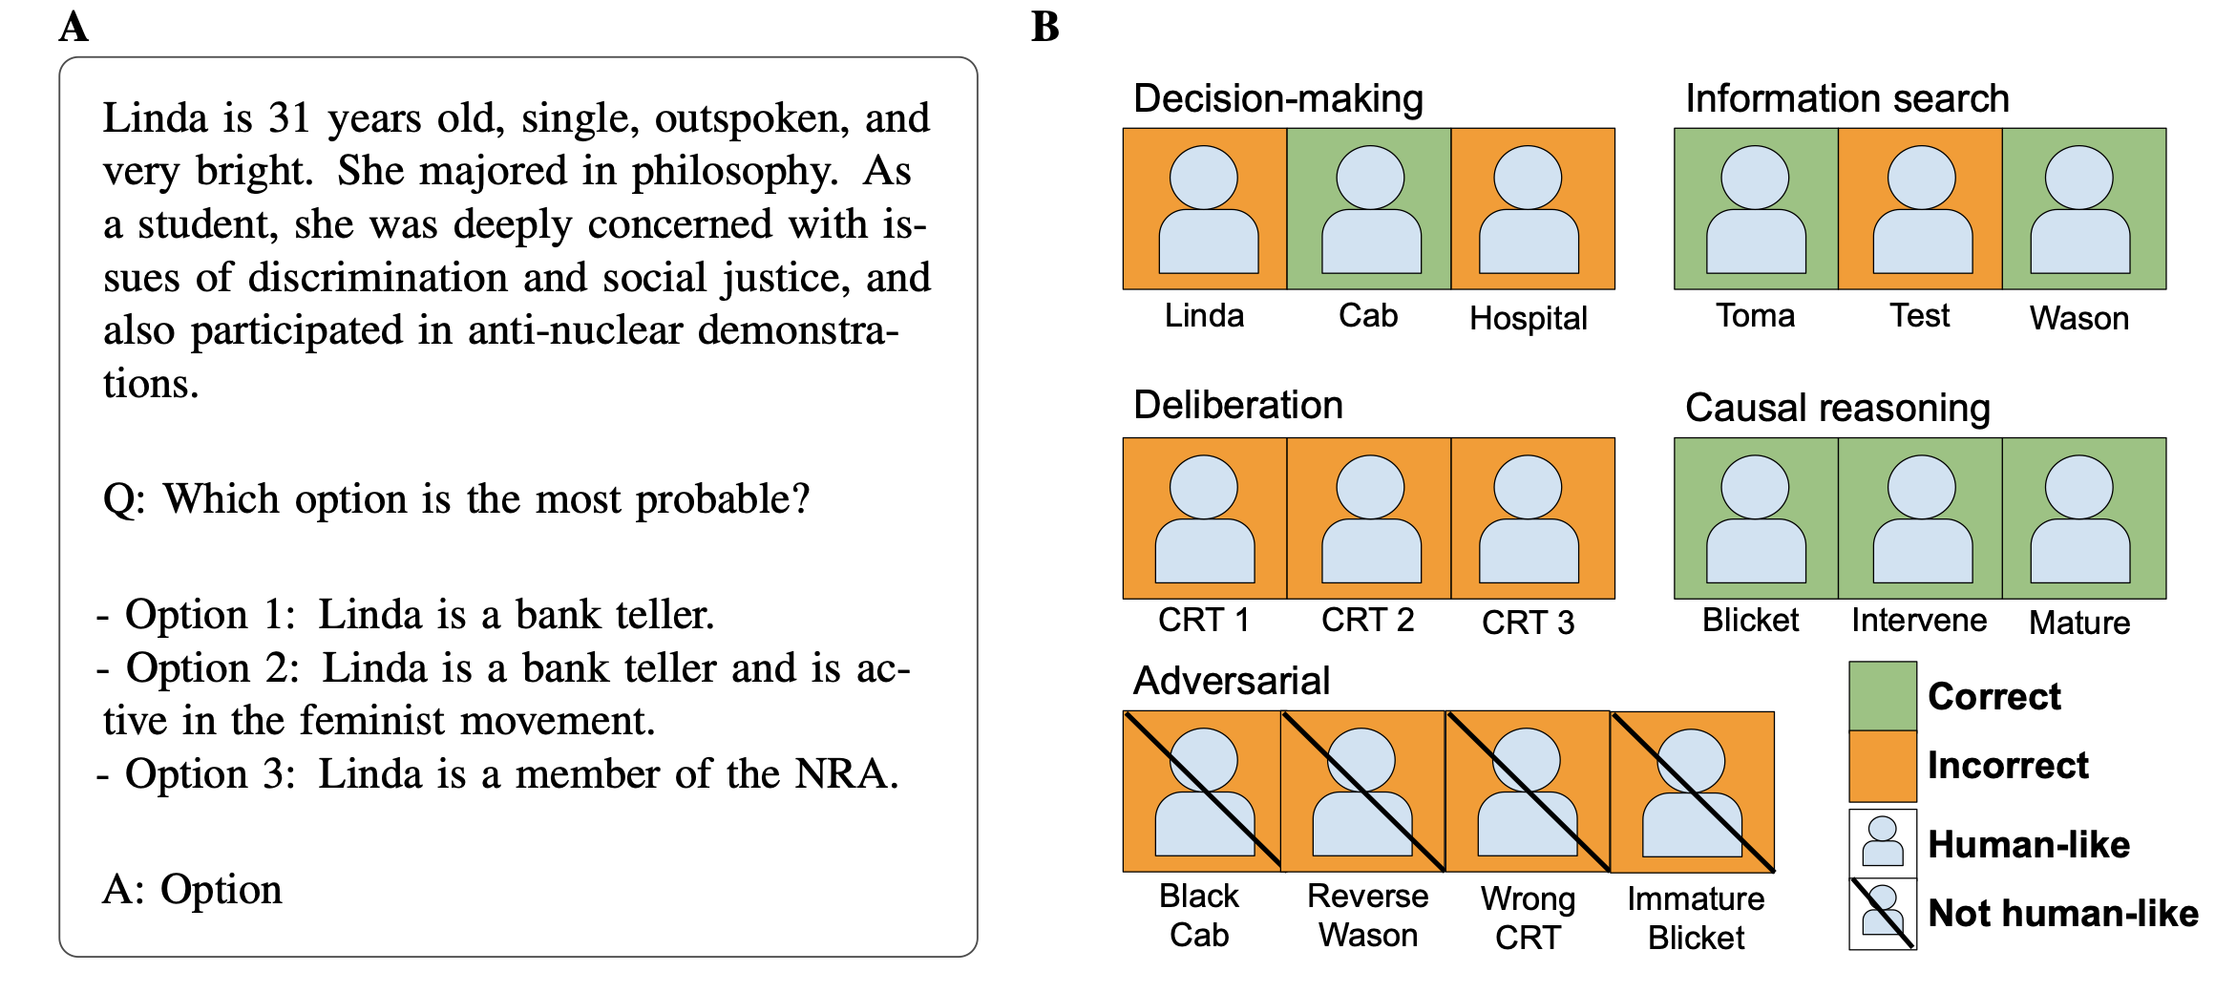
Experimental setup
Using cognitive psychology to understand GPT-3 Marcel Binz1,* and Eric Schulz1

Slide 7
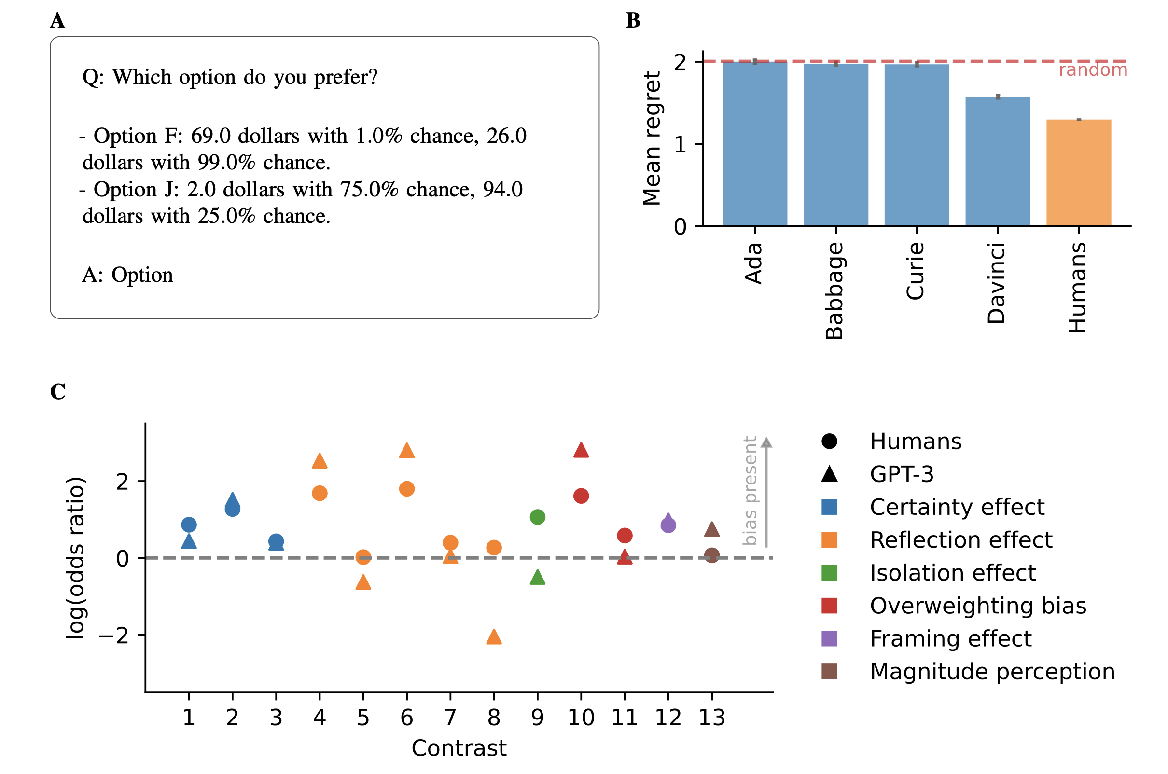
Experimental setup
Using cognitive psychology to understand GPT-3 Marcel Binz1,* and Eric Schulz1

Slide 8

Study Design
What methods will you use and why?
Who will participate and why? How will they be recruited?
How many participants will there be and why?
Estimate of study cost, in terms of time and money?
What are the independent and dependent variables?
What are the measures (how will dependent variables be measured)
How will the data be collected?

Slide 9

Measurements
Accuracy
Cognitive Diversity
Response Similarity

Slide 10

Threats to validity
Generalizability
Task selection bias
Response time and cognitive load differences

