Slide 1
Lecture 6: C Structure, Union, and Enumeration
Reference: Deitel, C How to Program, 8/e

Slide 2
I.1 Definition of Structure
Structures: are collections of a fixed number of related variables under one name.
They are commonly used to define records
Variables may be of many different data types, in contrast to arrays, which contain only elements of the same data type.
Structures are derived data types, they’re constructed using objects of other data types

Slide 3
I.2 Syntax of C-Structure Definition
Common Syntax:
struct <struct_Tag> { datatype1 variableName1; datatype2 variableName2;
….. };
Each structure definition must end with a semicolon.
Keyword struct introduces the structure definition.
The identifier <struct_Tag> is the structure tag, which names the structure definition and is used with struct keyword to declare variables of the structure type
Structure definitions do not reserve any space in memory; rather, each definition creates a new data type that’s used to define variables.

Slide 4

…Continued
Example:
struct card { char face [10] ; char suit [10] ; };
The definition of struct card contains members face and suit, each of type array of chars.
The definition
struct card MyCard, deck[52];
declares:
MyCard to be a variable of type struct card, and
deck to be an array with 52 elements of type struct card.

Slide 5
…Continued
Variables of a given structure type may also be declared by placing a comma-separated list of the variable names between the closing brace of the structure definition and the semicolon that ends the structure definition:
struct card { char face [10] ; char suit [10] ; } MyCard, deck[52];
In this instance, the structure tag name is optional.
However, if a structure definition does not contain a structure tag name, variables of the structure type may be declared only in the structure definition, not in a separate declaration.
struct { char face [10] ; char suit [10]; } aCard, deck[52];

Slide 6
Use of “typedef” to create a Struct Name
The keyword typedef provides a mechanism for creating synonyms (or aliases) for previously defined data types.
Creating a new name with typedef does not create a new type; typedef simply creates a new type name, which may be used as an alias for an existing type name.
Names for structure types are often defined with typedef to create shorter type names.
For example, the statement
typedef struct card card_t;
defines the new type name card_t as a synonym for type struct card.
Notes:
A meaningful name helps make the program self-documenting.
Often, typedef is used to create synonyms for the basic data types.
For example, a program requiring four-byte integers may use type int on one system and type long on another.
Programs designed for portability often use typedef to create an alias for four-byte integers, such as Integer.
The alias Integer can be changed once in the program to make the program work on both systems.

Slide 7
…Continued
C programmers often use typedef to define a structure type, so a structure tag is not required.
For example, the following definition:
typedef struct { char face[10]; char suit[10]; } card_t;
creates the structure type card_t without the need for a separate typedef statement and structure definition like in the previous slide
The declaration
card_t deck[52];
declares an array of 52 card_t structures (i.e., variables of type struct card_t).
Recommended definition

Slide 8
Summary : struct definition
struct card { char face [10] ; char suit [10] ; };
typedef struct { char face[10]; char suit[10]; } card_t;
card_t MyCard;
①
struct card MyCard;
struct card { char face [10] ; char suit [10] ; } MyCard;
struct { char face [10] ; char suit [10]; } MyCard;
②
③
typedef struct card card_t;
④
struct card_t MyCard;
⑤
Recommended definition

Slide 9
…Continued
Variables declared within the braces of the structure definition are the structure’s members.
Members of the same structure type must have unique names, but two different structure types may contain members of the same name without conflict
Structure members can be variables of the primitive data types (e.g., int, float, etc.), or collection such as arrays and other structures.
Example: struct employee { char firstName[20]; char lastName[20]; unsigned int age; char gender; // ‘M’ or ‘F’ double hourlySalary; };

Slide 10
…Continued
A structure cannot contain an instance of itself.
For example, a variable of type struct employee cannot be declared in the definition for struct employee.
struct employee { char firstName[20]; char lastName[20]; unsigned int age; char gender; double hourlySalary; struct employee person; // ERROR };
However, a pointer to the same struct (employee in the above), may be included (more later )

Slide 11
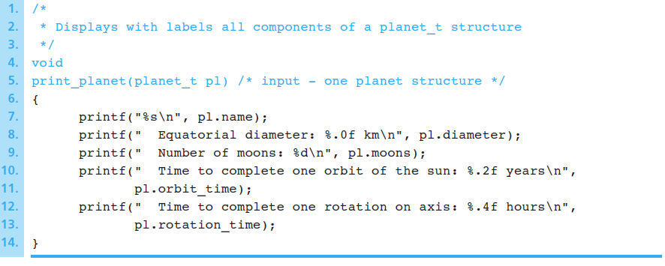
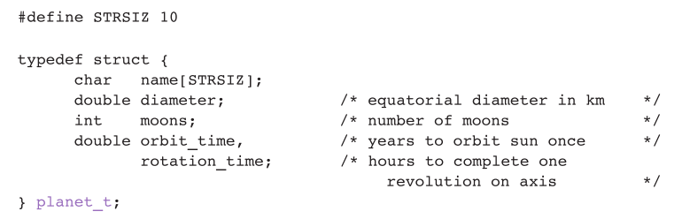
Example

Slide 12
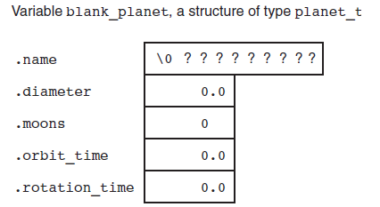
…Continued
planet_t blank_planet
Name: Jupiter
Diameter: 142,800 km
Moons: 16
Orbit time: 11.9 years
Rotation time: 9.925 hours

Slide 13
I.3 Initialization of Structures
Structures can be initialized using initializer lists as with arrays.
To initialize a structure, follow the variable name in the definition with an equals sign and a brace-enclosed, comma-separated list of initializers.
For example, the declaration
card_t MyCard = {“Three”, “Hearts”};
creates variable MyCard to be of type struct card, and initializes member face to “Three”’ and member suit to “Hearts”
If there are fewer initializers in the list than members in the structure, the remaining members are automatically initialized to 0 (or NULL if the member is a pointer).

Slide 14
…Continued
Structure variables may also be initialized in assignment statements by:
assigning a structure variable of the same type, or
assigning values to the individual members of the structure:
Two operators are used to access members of a structure: the structure member operator (.)—also called the dot operator—and the structure pointer operator (->)—also called the arrow operator.
The structure member operator (.) accesses a structure member via its structure variable name.
For example, to print member suit of structure variable MyCard, use the statement
card_t MyCard;
printf("%s", MyCard.suit); // displays Hearts
Notes:
Structure variables defined outside a function definition (i.e., externally) are initialized to 0 or NULL if they’re not explicitly initialized in the external definition.

Slide 15
Examples
Example1:
typedef struct
{ int resistance; int tolerance;
} resistor_t;
member access through the struct variable name and dot operator
/* a new structured data type */
resistor_t r1, r2;
/* variables of type resistor */
r1.resistance = 470;
r1.tolerance = 5;
/* 470 ohms */
/* 5% */
r2.resistance = r1.resistance;
Example2:
typedef struct
{ int resistance; int tolerance;
} resistor_t;
Initializer or struct to struct assignment
Resistor_t r1={4.7, 5}, r2;
/* assign one structure variable to another */
r2.resistance = r1.resistance;
r2.tolerance = r1.tolerance;
r2 = r1;

Slide 16
I.4 Structures and Functions
Structures may be passed to functions by:
individual structure members, or
an entire structure, or
a pointer to a structure (more later)
When structures or individual structure members are passed to a function, they’re passed by value.
Therefore, the members of a caller’s structure cannot be modified by the called function.
To pass a structure by reference, pass the address of the structure variable (more later)

Slide 17
…Continued
Arrays of structures, like all other arrays, are automatically passed by reference.
To pass an array by value, create a structure with the array as a member
Structures are passed by value, so the array is passed by value.

Slide 18
Struct as a Function return data type
A struct variable can be passed as a parameter to a function
A function can return a value of the type struct
/* type definition */
typedef struct
{
int int int
} date_t;
day; month; year;
data type of a function argument
/* function prototypes */
void setDate( date_t theDate );
date_t getDate ( int projNumber );
/* OK */
/* OK */
return data type of a function
Notes:
A local variable of the structure type can be allocated, fill with the desired data, and returned as the function result.
The function does not return the address of the structure as it would with an array result.
Rather, it returns the values of all components.

Slide 19
I.4. Operations on Structures
The only valid operations that may be performed on structure variables are:
assigning structure variables to structure variables of the same type,
taking the address (&) of a structure variable,
accessing the members of a structure variable, and
using the sizeof operator to determine the size of a structure variable.
Structure variables should not be compared using relational operators, such as == and > because structure members are not necessarily stored in consecutive bytes of memory.
Sometimes there are “holes” in a structure, because computers may store specific data types only on certain memory boundaries such as half-word, word or double-word boundaries.

Slide 20
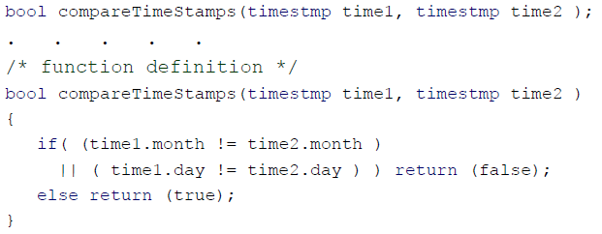
Comparison of Structures
struct variables can be compared member‐wise only
resistor_t r1
. . . . . .
={4.7, 10}, r2
. .
={4.7, 10};
if(r1 == r2); �
compiler
error!!
To compare the values of r1 and r2, you must compare them member‐wise, as follows:
if( r1.value==r2.value
{
. . . .
}
&& r1.tolerance==r2.tolerance )
Example:
typedef struct
{
int month;
int day;
}timestmp;
Notes:
Even if the member values of two structures are in fact equal, the structures are not necessarily equal, because the undefined holes are not likely to contain identical values.

Slide 21
Arrays of Structures
You can declare an array of structures
typedef struct
{
float x; float y;
}coordinate_t;
coordinate_t polygon[5];
polygon is described by 5 coordinates
Each element of this array is a structure of type coordinate
You can access any structure member specifying the array index and using the member access operator – the dot
polygon[1].y = 12.3;
array name
Index of the array element
Member access operator
struct member name

Slide 22
Array of Structures vs. Structure of Arrays
Caution: Do not confuse arrays made of structures with structures made of arrays
typedef struct { int day;
float mark[50];
} exam_t;
exam_t examReport;
/* an array (with 50 elements) is a structure member */
/* a struct variable */
examReport.mark[3] = 76.43;
typedef struct{ int day;
double mark;
} exam_t;
exam_t examReport[50];
/* an array (with 50 elements) made of structures */
examReport[3].mark = 76.43;

Slide 23

I.5. Nested Structures
Consider the following record of an employee as an example:
typedef struct
{
char first[20]; char middle[20]; char last[20]; char street[40]; char city[20]; int zip;
char day; char month; char year; int phone;
int cellphone; int fax;
int deptID; float salary;
} employee;
It may be more convenient, if all structure members were divided into subcategories as it is usually done with files and folders
programs
 |  | struct.cpp array.cpp help.txt struct.doc stream.doc array.exe struct.exe
bin docs
programs
source

Slide 24
…Continued
typedef
{
char char char char
struct
/* members describing
typedef struct
{
a name */
first[20]; middle[20]; last[20];
street[40];
char char char
} name_t;
first[20]; middle[20]; last[20];
char city[20]; int
address*/
/*members describing an
typedef struct
{
zip;
char day; char month; char year; int phone; int
int int float
char street[40]; char city[20]; int zip;
} address_t;
cellphone; fax; deptID;
salary;
/*members describing
contact
info */
typedef struct
{
int int int
phone; cellphone; fax;
} employee_t;
} contact_t;

Slide 25
…Continued
typedef struct
{
name_t address_t date_t
contact_t int
float
}employee_t;
/* a top-level structure */
theName; homeAddr; hireDate; contactInfo; deptID; salary;
Well structured representation
Some sub‐structures can be reused to build other high level structures
/* variable declarations */ employee_t newEmployee; employee_t uowEmployees[2000];

Slide 26
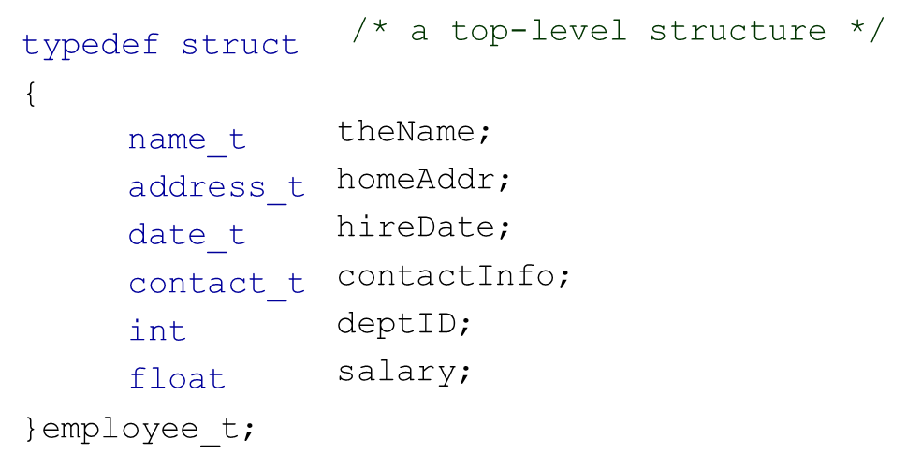
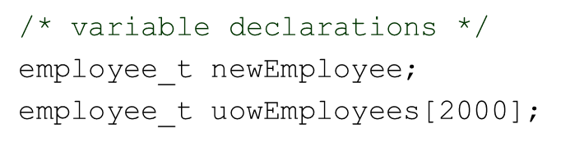
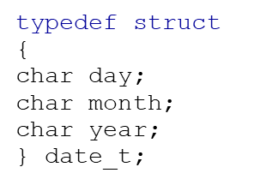
Accessing Nested Structures
You need to specify all levels of hierarchy starting from the top level
newEmployee.depID = 371;
newEmployee.hireDate.month = 2;
newEmployee.hireDate.year = 2004;
printf(“Last name: %s", newEmployee.theName.last);
uowEmployees[3].hireDate.year = 2009;
uowEmployees[3].hireDate.month = 3;
newEmployee.homeAddr.zip = 2522;
newEmployee.address_t.zip = 2522;
/* OK */
/*Error */
address is not a member, this is a data type and it must not be used here

Slide 27
II. Union
A union is a collection of a fixed number of related variables under one name that share the same storage space in the memory
A union is a derived data type—like a structure—with members that share the same storage space in the memory
For different situations in a program, some variables may not be relevant, but other variables are—so a union shares the space instead of wasting storage on variables that are not being used.
The members of a union can be of any data type.

Slide 28
…Continued
The number of bytes used to store a union must be at least enough to hold the largest member.
In most cases, unions contain two or more data types.
Only one member, and thus one data type, can be referenced at a time.
It’s your responsibility to ensure that the data in a union is referenced with the proper data type.

Slide 29
Union Declarations
A union definition has the same format as a structure definition.
Variable of type union can be declared as with struct
A union definition
union number { int x; double y; };
indicates that number is a union type with members int x and double y.
Better to use typedef:
typedef union {
int x; double y; } number_t;
Notes:
The union definition is normally placed in a header and included in all source files that use the union type.

Slide 30
Union vs. Struct
stuct Memory Allocation
union Memory Allocation
typedef struct
{
char int
typedef union
{
char int
type1; type2; type3;
type1; type2; type3;
double
double
} newType_t; newType_t strt;
} newType_t; newType_t uni;
char | int | double
char | int | double
A block of memory allocated for a struct can store ALL members of the struct
A block of memory allocated for a union can store only one member at a time

Slide 31
Operations on Unions
The operations that can be performed on a union are:
assigning a union to another union of the same type,
taking the address (&) of a union variable,
accessing union members using the structure/union member operator (.) and the structure/union pointer operator(->)
Unions should not be compared for the same reasons that structures cannot be compared.

Slide 32
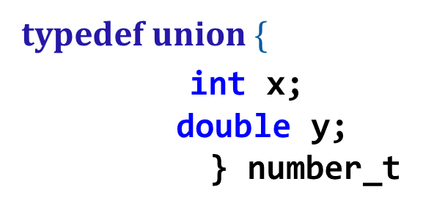
Initializing Unions in Declarations
In a declaration, a union may be initialized with a value of the same type as the first union member.
For example, with the union number,
the statement: number_t value = {10};
is a valid initialization of union variable value because the union is initialized with an int
The statement: number_t value = {1.43};
would truncate the floating-point part of the initializer value and ideally would produce a warning from the compiler

Slide 33
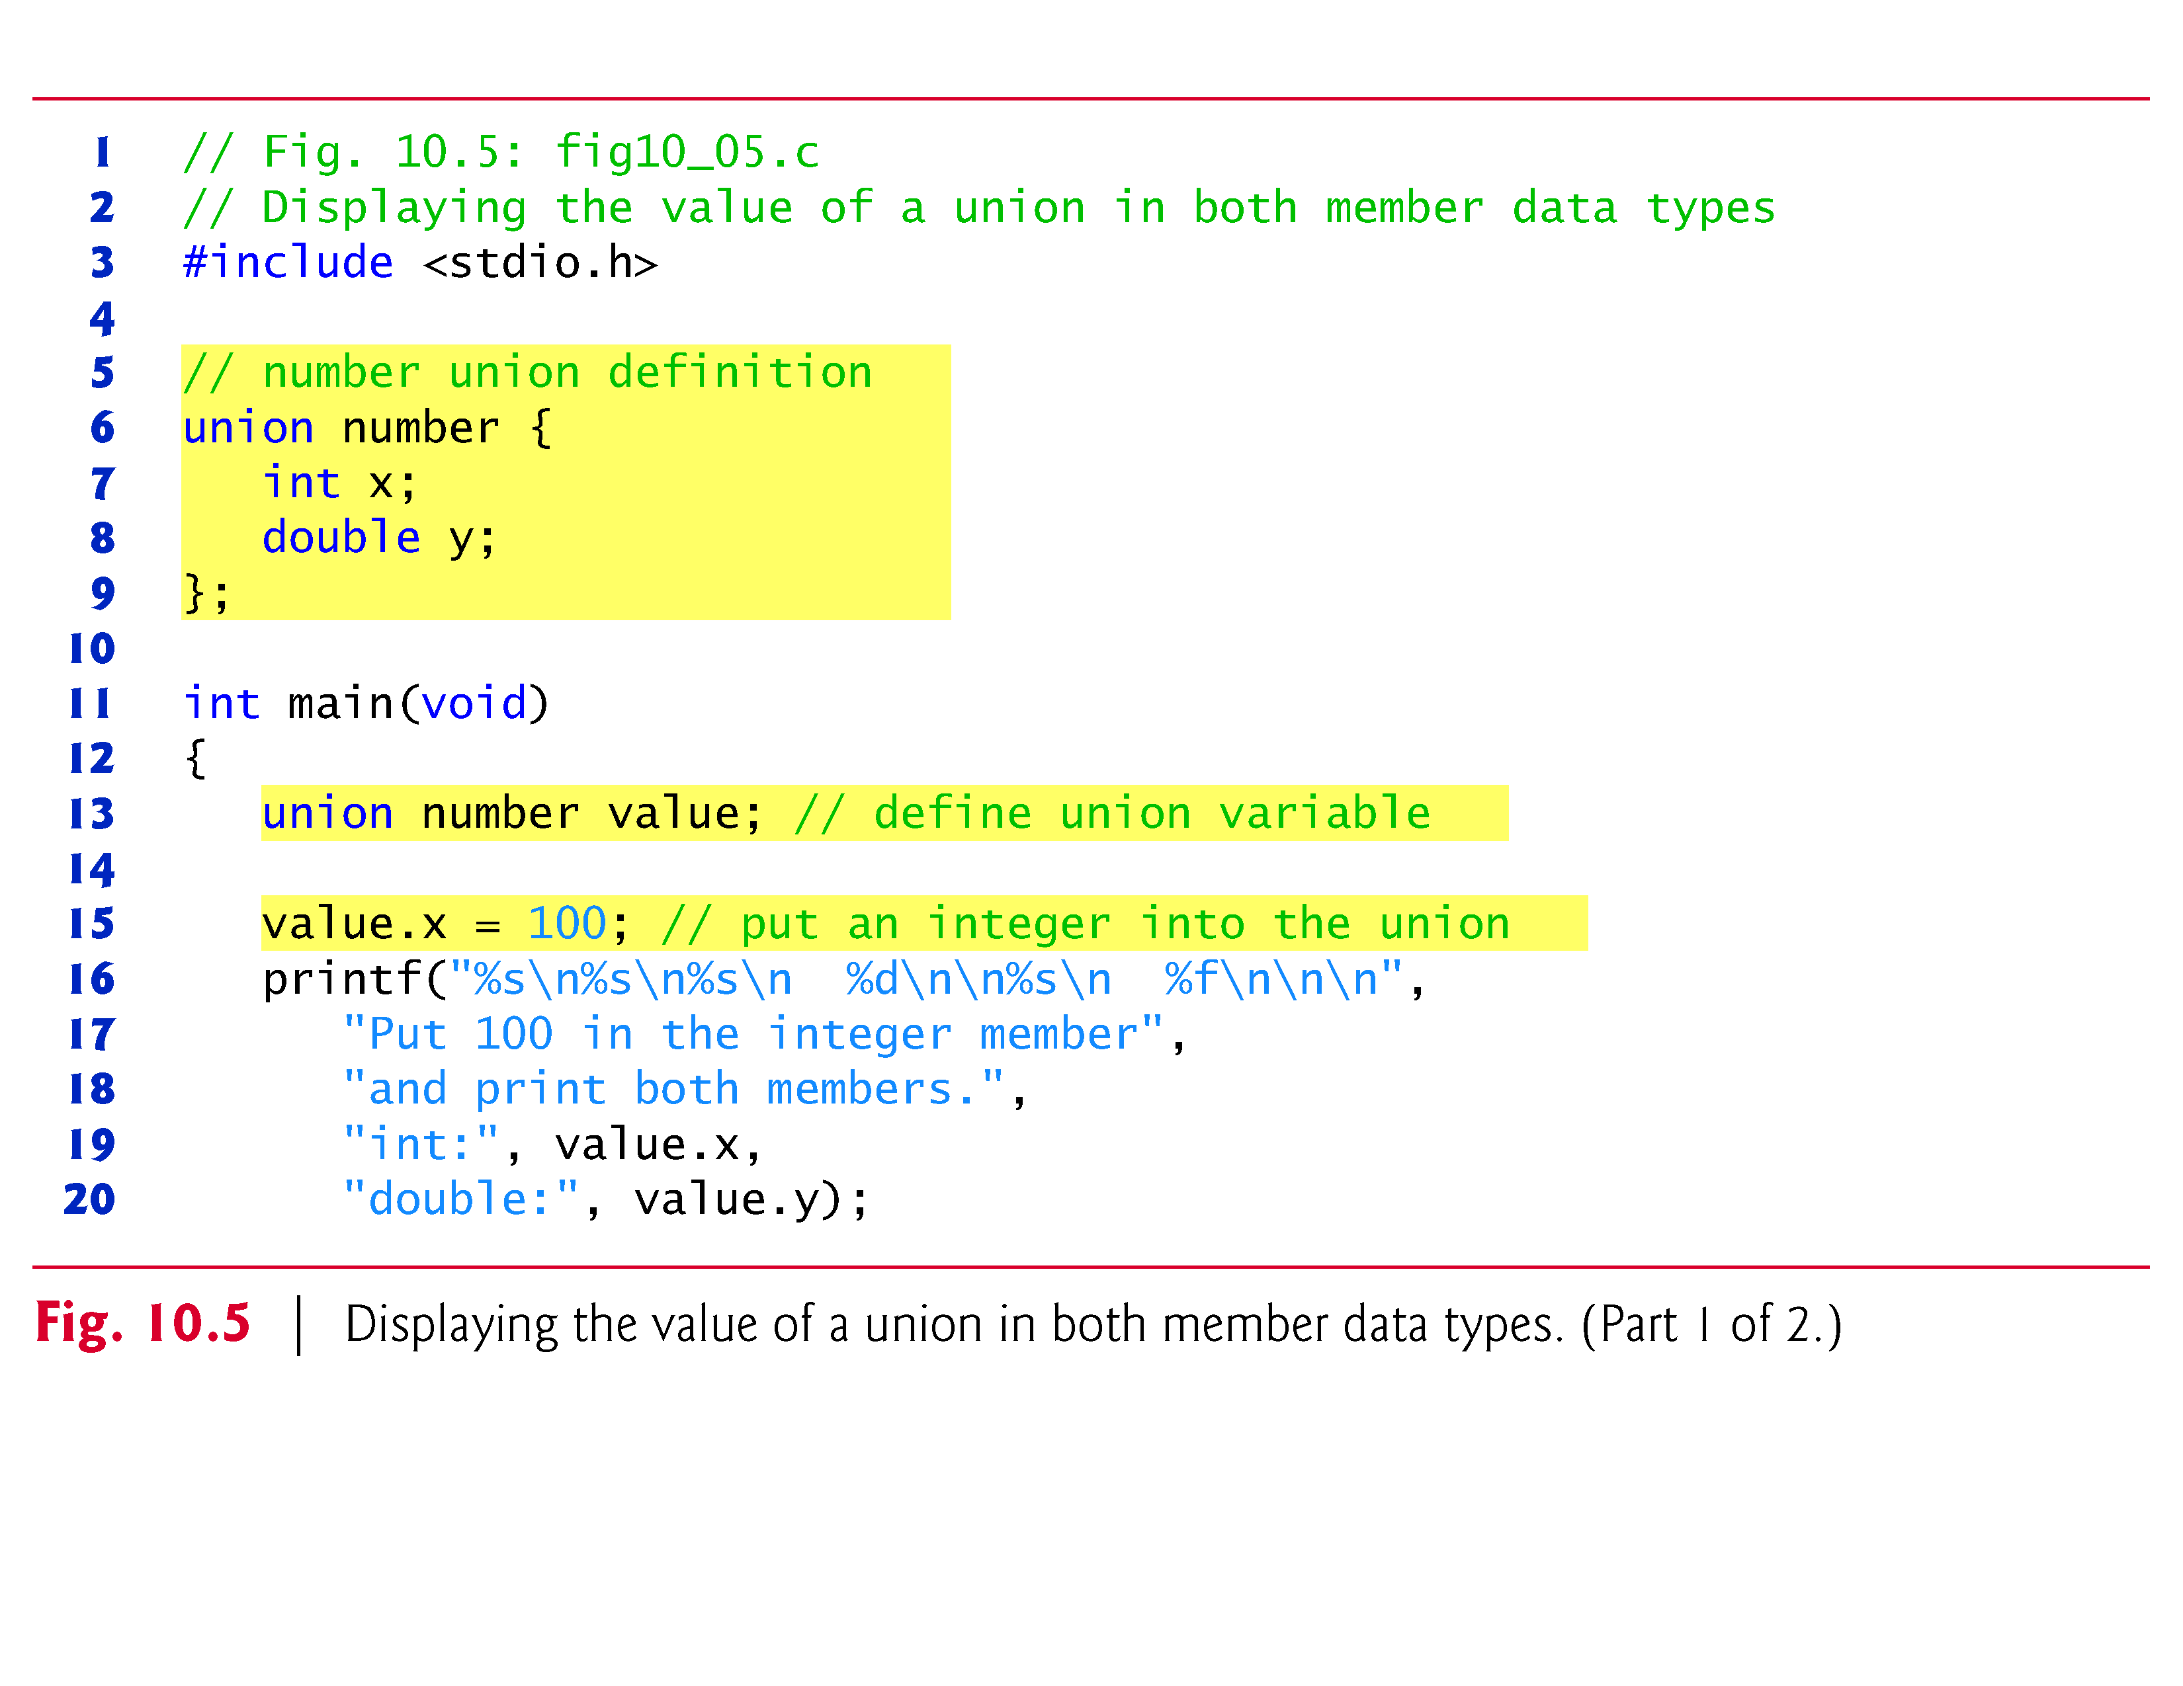
Example 1

Slide 34
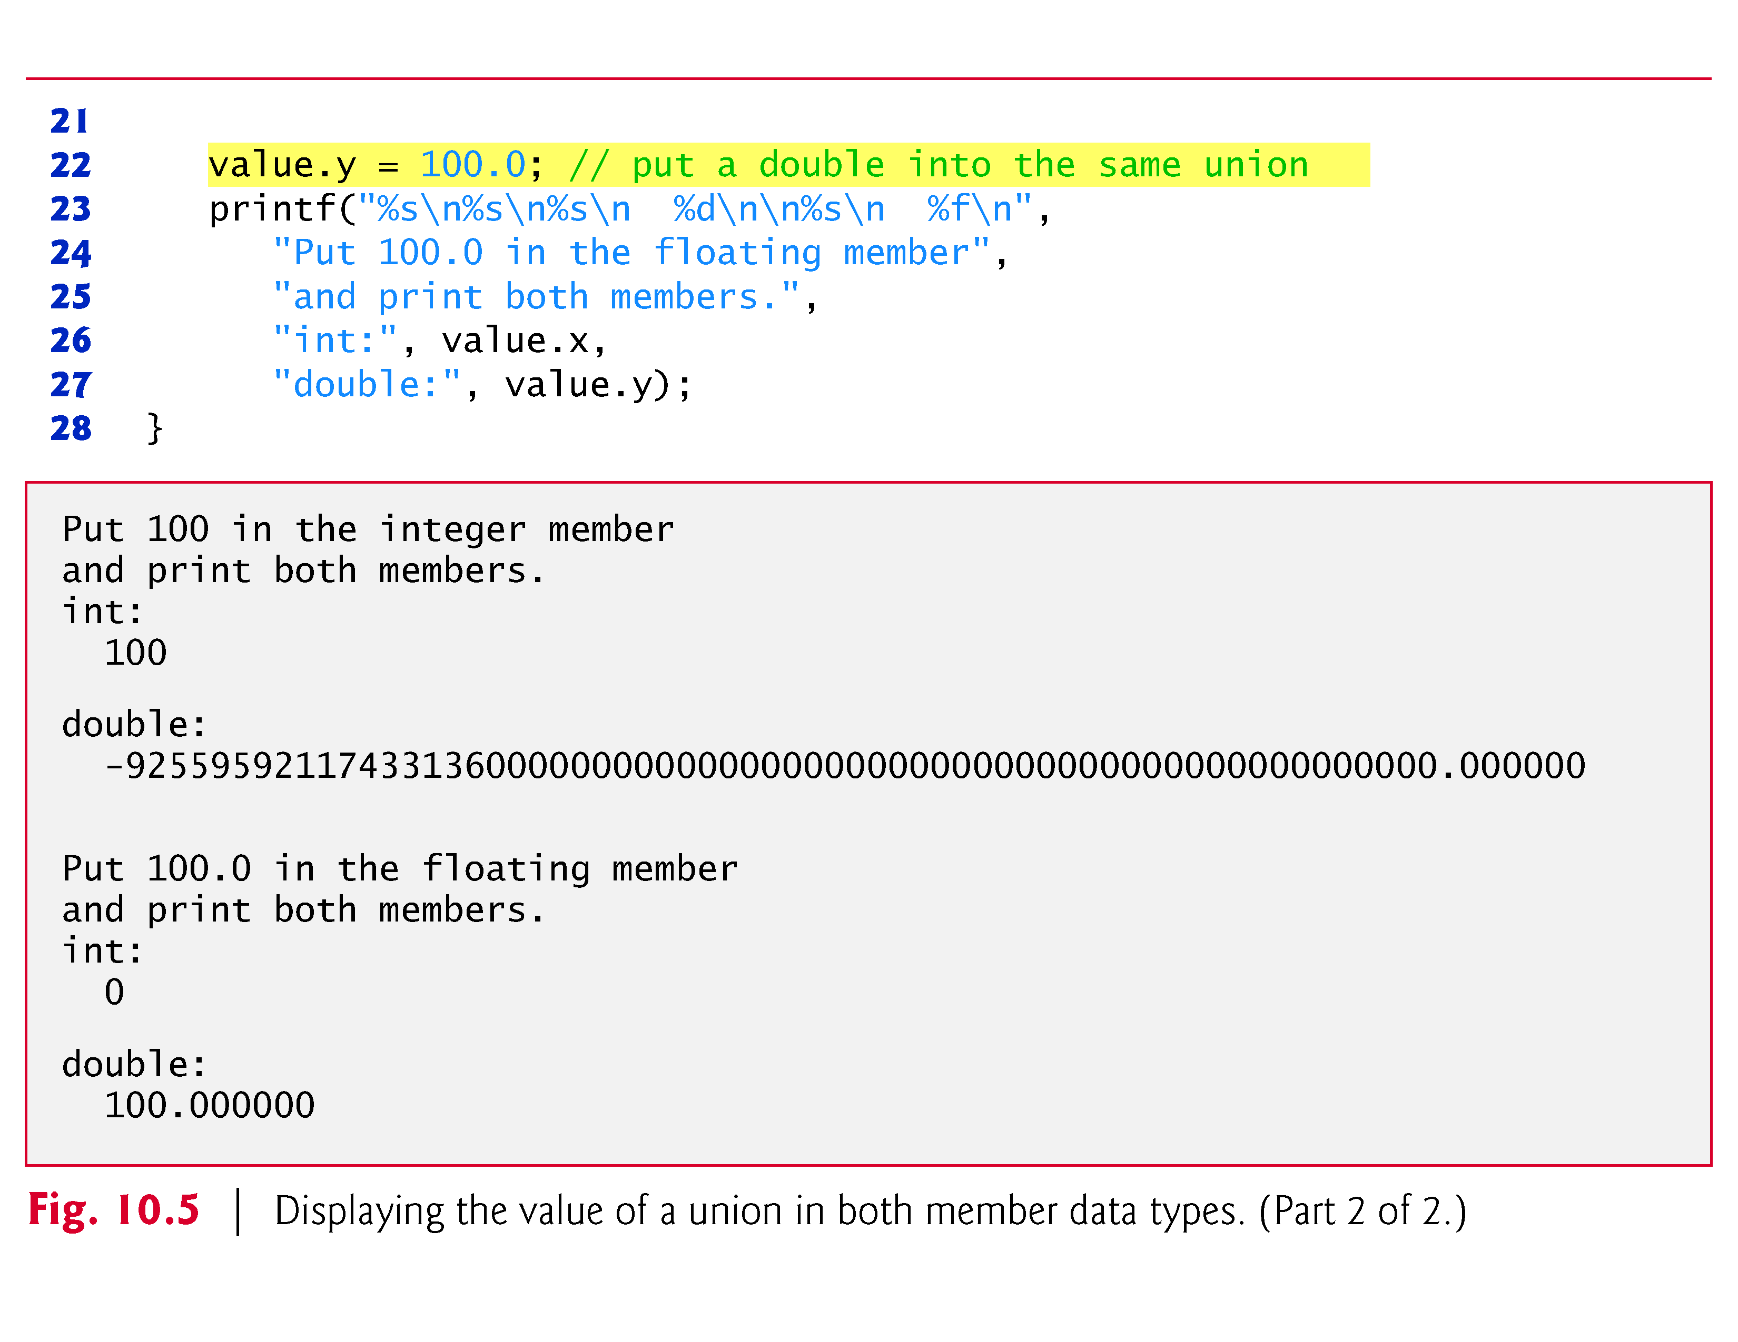
…Continued

Slide 35


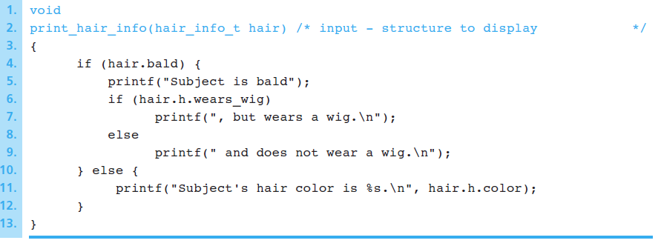
Example 2
Function displaying a Struct with a Union type component
Notes:
For bald subjects, the wears_wig interpretation of component h is valid. For nonbald subjects, the color interpretation is valid and represents the color of the subject’s hair. Figure 10.14 shows a function to display hair_info_t data.
In Fig. 10.15 , we see the two possible interpretations of the h component of parameter hair , one that is conceptually valid when hair.bald is true, and one that applies when hair.bald is false. Referencing the appropriate union component is
always the programmer’s responsibility; C can do no checking of the validity of such a component reference.

Slide 36
III. Enumeration Type: Motivation
Assume that you need to implement an inventory management program for your store of electronic components.
There are three major types of capacitors: electrolytic, film and ceramic.
What data type would you choose for variables that describe the capacitor type property?
1. char – only one character: ‘e’ for electrolytic, ‘f’ for film, ‘c’ for ceramic
int –a whole number: 1 for electrolytic, 2 for film, 3 for ceramic
float …
Although it is possible to use one of the basic data types for this application
the program may look confusing and hard for debugging and maintenance
wrong values (‘v’, 5, . . .) may be assigned by mistake without any warnings or error messages

Slide 37
Syntax of Enumeration Type
C provides a method of defining a data type with a limited number of
values that have specific names; it is called enumeration
An enumeration is a data type that consists of a set of named values that
represent integral constants, known as enumeration constant
General syntax:
enum <enum_tag> {value1, value2,..., valueN};
Variable of type enumeration can be declared as with Struct and Union.
In the following, we use the typedef to create an alias to an enumeration data type
General syntax:
typedef enum {value1, value2,..., valueN} TypeName;
Example:
typedef enum
{ELECTROLYTIC, FILM, CERAMIC
} capType_t;
enumerators
data type

Slide 38
Enumeration Type
Once a data type is defined, you can declare its variables and process its values from the enumeration list (enumerators)
Example:
/* new data type definition */
typedef enum { RED, GREEN, BLUE, WHITE,
BLACK
} color_t;
int main(void)
{
/* variable declaration */
color_t primaryColor, secondColor;
. . . . . . . .
/* assigning a value */ secondColor = BLUE;
primaryColor = YELLOW;
Error !

Slide 39
Enumerators
Enumerators must have valid identifiers
Example of valid enumerators:
Example of illegal enumerators:
If an identifier has been used in one enumeration type, it cannot be used by any other enumeration type or a variable within the scope
typedef enum {John, Bill, Peter, William} mname_t;
typedef enum {Susan, Ann, Lisa, Joan} fname_t;
Illegal
int Ann;
typedef enum | { first, second, third, fourth | }places_t;
typedef enum | {A, B, C, D, F} grades_t;
typedef enum | {1st, 2nd, 3rd, | 4th} places_t;
typedef enum | {'A', 'B', 'C', | 'D', 'F'} grades_t;

Slide 40
Enumerators Representation
C compiler assigns an integer value to each enumerator
Example:
typedef enum
{ LOW, HIGH, ZSTATE, UNDEF } signal_t;
By default it starts with 0
LOW = 0, HIGH = 1, ..., UNDEF = 3
Although it is not common, you can specify your own starting value
Example:
typedef enum {Sun =1,Mon,Tue,Wed,Thr,Fri,Sat} weekday_t;
Sun = 1, Mon = 2, ..., Sat = 7

Slide 41
Arithmetic Operations
Arithmetic operations are allowed on the enum type variable
Example:
typedef enum { RED, GREEN, BLUE, WHITE,
colour newColor = RED, primaryColor;
BLACK
} colour;
primaryColor = primaryColor = | newColor newColor | - + | 1; RED;
primaryColor++;
primaryColor -= 2;

Slide 42
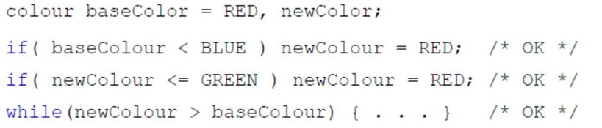
Relational Operations
You can use the relational operators with of the same the enum types
Example:
typedef
enum{ RED, GREEN, BLUE,
WHITE, BLACK
} colour;
enum type values are compared based upon integer values assigned to the enumerators (their positions in the list)

Slide 43
…Continued
You can compare variables of different enum types
typedef enum {RED,GREEN, YELLOW} apple_t;
typedef enum{AUSTRALIAN,AFRICAN, AMERICAN} orange_t;
int main(void){
apple_t anApple = RED;
orange_t anOrange = AUSTRALIAN;
if( anApple == anOrange )
anApple = GREEN;
printf("%d", anApple);
return 0;
}
The printed value is 1 which corresponds to GREEN

Slide 44
Enumeration and Switch
You can use the enumeration type with the switch multiple
selection statement
typedef enum { RED, GREEN, BLUE, BLACK } palette_t;
palette_t newColor;
int colorIntensity;
. . . . enum type selector
switch( newColor )
{
case
RED :
GREEN :
colorIntensity= 25; break;
colorIntensity= 40; break;
: colorIntensity= 73; break;
: colorIntensity= 0;
case
case BLUE
default
}

Slide 45
Read and Write
Input/output operations with enum type variables are possible, but the variables are treated as integers.
printf() and scanf() support only fundamental data types
typedef enum { RED, GREEN, BLUE, WHITE } colour_t;
colour_t newColor = GREEN;
printf("%d", newColor ); /*The output will be: 1 */
scanf("%d", &newColor);
/* You can input only a corresponding integer value */

Slide 46
Quiz
Would you use the enumerated type for variables that describe:
voltage ranging from 0 to 5.5 volts
A number of electronic components used in a module
resolution of digital video that can be only one of the following modes: QQCIF, QCIF or CIF
transistor package type: TO1, TO3, TO202, TOP3, SOT25 or SOT30
No
Yes
Yes
Yes

Slide 47
Appendix: Anonymous Structures and Unions
C11 supports anonymous structs and unions that can be nested in named structs and unions
Members in a nested anonymous struct and union are considered to be members of the enclosing type and can be accessed directly through an object of the enclosing type
Example
struct MyStruct { int member1; int member2; struct { int nestedMember1; int nestedMember2; }; };
For a variable myStruct of type struct MyStruct, you can access the members as:
myStruct.member1 myStruct.member2 myStruct.nestedMember1 myStruct.nestedMember2

Slide 48
Appendix
Because of boundary alignment requirements, the size of a struct variable is not necessarily the sum of its members’ sizes. Always use sizeof to determine the number of bytes in a struct variable.
struct variables cannot be compared for equality or inequality, because they might contain bytes of undefined data. Therefore, you must compare their individual members.

