Slide 1
CSCI291
Programming for Engineers
Lecture 1: Overview of the C language
Content:
I. Introduction: Software Development Cycle
II. Basic C Program structure
II.1. Comments
II.2. Pre‐ processor Directives
II.3. C Functions
II.4. Variables
II.5. Statements
II.6. Formatted Input/Output
II.7. The return Statement
II.8. Operators
II.9. Expressions
Appendix
Please check the note sections
for further details
Acknowledgment: these slides are amendment to Dr Obada Al Khatib 2019 notes.

Slide 2
Introduction: Software Development Cycle
Before starting to write your code, you need to follow these steps:
Analyse carefully the problem definition to specify unambiguously the requirements of the system
Design an algorithm solution to implement the requirements of the system
Document your design solution using pseudo code/ flowchart
Translate your design description into code
Example: Write a program that converts distance measured in miles into kilometres
Design solution
Input: miles
Output: kilometres
Algorithm: kilometres = 1.609*miles
Input miles
Convert the value
Output kilometres
Code in Matlab
% MATLAB - Convert distance
miles = input(‘Enter the distance in miles > ’); kilometres = 1.609 *miles;
fprintf(‘That equals to %.3f km\n’, kilometers);

Slide 3
II. Basic C Program structure
The below program gives the basic structure of a program in C
C Code of slide 1 problem
Comments
/* C program – convert distance */
Pre‐processor directives
#include <stdio.h>
#define KMS_PER_MILE 1.609 /*conversion constant*/
int main(void)
{
float miles, klms;
/* Get the distance in miles */ printf("Enter the distance in miles scanf("%f", &miles);
> ");
main function
/* Convert the distance to kilometers */ klms = KMS_PER_MILE * miles;
/* Display the distance in kilometers */ printf("That equals %.3f km\n", klms);
return (0);
}
Notes:
The value 0 is optional; indicates that your program executed without an error

Slide 4
II.1: Comments
Comments help to understand/explain the code
In C, they begin with /* and end with */ and can span multi lines
/*‐‐‐‐‐‐‐‐‐‐‐‐‐‐‐‐‐‐‐‐‐‐‐‐‐‐‐‐‐‐‐‐‐‐‐‐‐‐‐‐‐‐‐‐‐‐‐‐
A function that calculates the area of a rectangle
It takes two parameters of type float
and returns a value of type float
‐‐‐‐‐‐‐‐‐‐‐‐‐‐‐‐‐‐‐‐‐‐‐‐‐‐‐‐‐‐‐‐‐‐‐‐‐‐‐‐‐‐‐‐‐‐‐‐‐‐*/
float calculateArea (float width, float height)
{
Introductory comments.
The underlined text is extra!
Descriptive comments
float rectArea;
rectArea = width * height; return rectArea;
/* the area of a square */
/* calculate the area */
}
Nested comments are not supported
start
/* calculate the area of a square
/* input - width and length */
and return a float type value */
end
To comment a single line, you can prefix it with //
Notes:
C++ introduced a double slash comment prefix // to comment single lines. Example
// My First C program: Hello World
This form of commenting may be used with most modern C compilers if they also support C++ language.

Slide 5

II.2. Pre‐ processor Directives
A pre-processor is a program that processes our source program before it is passed to the compiler
The pre-processor works on the source code and creates an expanded source code!
The pre-processor offers several features called pre-processor directives
Each of these pre-processor directives begin with a #symbol
No ; at the end of line
The directives can be placed anywhere in a program but most often placed at the beginning of the program, before the function definition
#include <stdio.h>
#include <math.h>
#define PI 3.1415926
#define MAX_LENGTH 200
int main(void)
{
}

Slide 6
#include directive
Syntax:
#include <a header file name>
Example:
#include
#include
<stdio.h>
<math.h>
stdio.h
contains definitions of standard input/output
functions scanf(…) and printf(…)
math.h
contains definitions of math functions such as
sin(), cos(), log(), exp(), etc.
Include files (header files)
#include <filename>
Causes the preprocessor to look for filename in system defined places and replace the #include line with a copy of contents of filename.
#include “filename”
Same as above, but the preprocessor looks in the current directory before looking in the system defined directory locations.
Notes:
The standard header files are text files that you can read using a text editor. They provide information needed by the library functions
Header Files Must be Included for Functions in the Standard Library. The system knows where to find the code for functions in the standard library.
However, it is the responsibility of the programmer to include the header files that provide the prototypes for library functions.
The standard library contains object code (already compiled library functions).

Slide 7
#define directive
Syntax:
You can use the symbolic constants instead of actual values (makes C code more readable and simplifies further modification)
#define NAME value
Example:
#define PI 3.1415926
#define MAX_LENGTH 2000

Slide 8
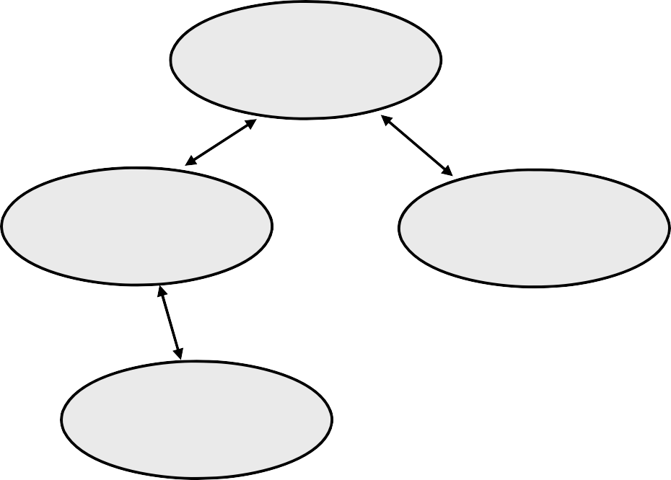
II.3 C Functions
C language is based on the concept of Structured Programming.
The building blocks of C programs are functions
Types of functions
− main function
Function
main
standard functions
user-defined functions
Function A
Function B
Function C
Any C program is a collection of interacting functions

Slide 9
Function main
Every program has one main(…) function
This is the first function to be executed when you run a program.
There is only one main function in a program
int main( void )
{
/* function body */
. . . .
Function body is enclosed in braces
}

Slide 10
II.4 Variables
To process data you need to store them somewhere in memory
In order to reserve memory space, you need to declare/ define variables.
When a variable is declared, a memory location is reserved for this variable.
Variable is a named location in memory.
In MATLAB, memory is reserved when you use a variable
In C, memory is reserved when you define/declare a variable
#include <stdio.h>
int main(void)
{
int age; float height;
height = 1.81;
age = 23;
weight = 65;
}
You cannot use a variable if
It has not been declared

Slide 11
Fundamental data types
integral | char | a character a small integer number | char unit=‘m’; char errCode = 4;
 | int | An integer number | int year = 2016;
floating point | float | a single‐precision real number | float area = 12.54; float mass =1.7e+05;
 | double | a double‐precision real number | double weight=2.395;
boolean | bool | true or false | bool flagOn=true;
 | void | typeless and valueless | mainly used for function parameters & return
Sizes and ranges of the fundamental data types are platform dependent even when you use ANSI / ISO C.
Actual memory size of a type can be obtained using the operator sizeof( type )
Ranges are specified as constants in <limits.h> and <float.h>
An integer number is is a whole number can be positive, negative, or zero
Notes:
Please keep in mind that storage size and range for int and float datatype will vary depend on the CPU processor (8,16, 32 and 64 bit)

Slide 12
Example: sizeof(type)
/* Display size and range of C data types */
#include <stdio.h>
#include <limits.h>
#include <float.h>
#include <stdbool.h>
int main(void)
{
printf("char size = %d, Min=%d, Max=%d\n", sizeof(char), CHAR_MIN, CHAR_MAX); printf("int size = %d, Min=%d, Max=%d\n", sizeof(int),INT_MIN, INT_MAX); printf("float size = %d, Min=%e, Max=%e\n", sizeof(float), FLT_MIN, FLT_MAX); printf("double size = %d, Min=%e, Max=%e\n", sizeof(double), DBL_MIN, DBL_MAX);
printf("bool size = %d \n", sizeof(bool) );
return (0);
}

Slide 13
Size and Range (32/64 Windows)
Type | Size (bytes) | Min | Max
char | 1 | CHAR_MIN ‐128 | CHAR_MAX 127
int | 4 | INT_MIN ‐2147483648 | INT_MAX 2147483647
float | 4 | FLT_MIN 1.18e‐38 | FLT_MAX 3.40e+38
double | 8 | DBL_MIN 2.23e‐308 | DBL_MAX 1.80e+308
bool | 1 | ‐ | ‐
A memory block of this size is allocated when you declare a variable

Slide 14
char Data type
Simple data type char can represent:
A whole number in the range: [‐128…127]
char date = 24; char hours = -97;
A text character:
'A',
char char
'c', '#',
'+', 'S'
grade = 'A'; pattern = '#';
Each text character is ASCII coded
'A' = 65, 'd' = 100, '#' = 35, '2' = 50,
( see Appendix A , J. R. Hanly, "C Program Design for Engineers" )
'7' = 55

Slide 15
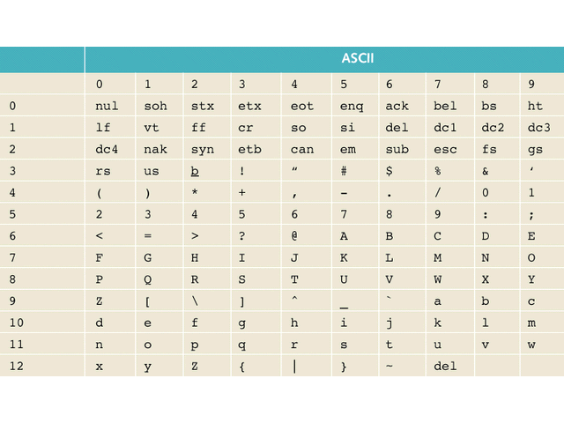
ASCII Codes
Example: ASCII code for ‘A’ is 65
ASCII code for ‘1’ is 49
Special ASCII codes
‘\b’ – backspace (bs) | ‘\t’ – horizontal tab(ht) | ‘\n’ – new line (lf)
‘\r’ – return (cr) | ‘\v’ – vertical tab (vt) | ‘\0’ – null (nul)

Slide 16
II.5 Statements
Any C program is made of functions. What are functions made of?
C functions are composed of statements.
A statement expresses an action/command to be carried out:
non‐ executable statements : actions which are NOT translated into microprocessor instructions
2. executable statements :
actions which are translated into microprocessor instructions
The semicolon (;) is a statement terminator
Example:
int age; this is a non‐ executable statement that causes a memory allocation action for the variable age
#define MAX_VOLTAGE 12
this is not a statement. This is a definition of a symbolic constant MAX_VOLTAGE that will not be placed
in memory

Slide 17
Non‐executable statements:
Definition of variables
Syntax:
datatype variable_identifier ;
Example:
int numOfDays, iterationCounter=0;
float inputVoltage=0.35, output1, output2; char grade=‘D’;
C language requires that all variables be given a data type and an identifier (name)
Data Types determine:
how much memory is allocated to store a variable
what are legal values that can be assigned to variables
what kind of operations are allowed with this variable
A valid identifier must
consist of only letters, digits, or underscores
not begin with a digit
not be a C‐reserved word
#ofItems low-rate 4thElement switch
Variables can be initialized at the time of declaration
float speed=0.5;

Slide 18
Executable statements
There are several types of executable statements in C
Expression statement :
new value
klms = KMS_PER_MILE * miles;
expression
Null statement : ;
Function call :
printf("D equals %.3f km\n", klms);
Execution control :
selection ( if…else, switch ) repetition ( for, while, do…while )
return from a function ( return 0; )
. . . .
Notes:
An expression is a combination of: Operands, Operators, and optionally Parentheses: ( ) which returns a value

Slide 19
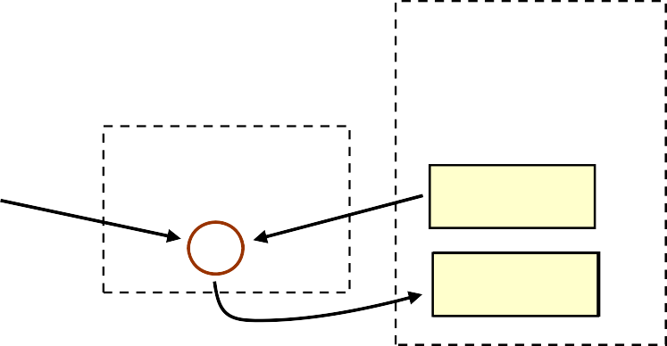
Expression statements
Syntax:
variable = expression;
Examples:
klms = KMS_PER_MILE * miles; area = calculateArea(radius);
x = -x; y += 5;
#define KMS_PER_MILE 1.609
float miles=10.0, klms; klms = KMS_PER_MILE * miles;
Computer memory
Memory space is reserved for every variable
A constant doesn’t require any data memory space
CPU
1.609
10.00
miles klms
*
16.09

Slide 20
Quiz 1
Find a bug in this C code and explain how this code can be interpreted using C syntax
int a, b, c;
a | = | 10;
b | = | 5 + a
c | = | b * 2;
b = 5 + a
Semicolon is missing
b = 5 + ac = b*2;

Slide 21
Quiz 2
What is the difference between these two definitions?
char a = '1'; char b = 1;
What is the output?
char value = 82;
1 here is a character
1 here is an ASCII code
82
R
printf("%d printf("%c
\n", value);
\n", value);
What is wrong with this definition?
char numOfDays = 230;
Out of char range (-128,127) - Warning
Notes:
The number , the ASCII code
82 R

Slide 22

II.6 Formatted Input/Output
Input/output is carried out using functions defined in stdio.h header file
scanf(…) – input from the keyboard printf(…) – output to the screen
To use these functions in your program you need to include stdio.h header file
#include <stdio.h>
These functions provide interface with input/output devices through buffers:
Input stream ( e.g. 123.56 )
………… |  |  |  |  | 6 | 5 | . | 3 | 2 | 1
Your program
Output stream (1.2\nxyz)
1.2
xyz
\n
1 . 2
x y z
…………

Slide 23
II.6.a printf() Function
This C function looks a lot like fprinf() in MATLAB Syntax:
printf(“format
Examples:
printf(“Hello printf("Enter
string” [,
list_of_values])
World !\n”);
the distance in miles> ");
printf("That equals %f kilometers \n", kms);
Format specification
General Syntax: %[flags][width][.prec][hlL]type
Fields in bracket are optional. If they are used, they must appear in the order shown

Slide 24
Format Specification: type
type | Interpretation
d or i | Integer
f or F | floating point number, to six decimal places by default
e or E | floating‐point number in exponential format (e or E places before the exponent)
c | single character
s | null‐terminated character string

Slide 25
printf() Function
%[flags][width][.prec][hlL]type
flag | Meaning
- | left‐justified within the given field width
+ | precede with + or ‐
0 | Left-pads the number with zero if there is a space
space | Print a space before a positive value. It is not printed with the + flag
width & prec | Meaning
width | minimum size of field to print the value
.prec | minimum number of digits to display for d or i. number of decimal places for e or f formats. maximum number of characters for s.
Notes:
https://www.tutorialspoint.com/c_standard_library/c_function_printf.htm

Slide 26
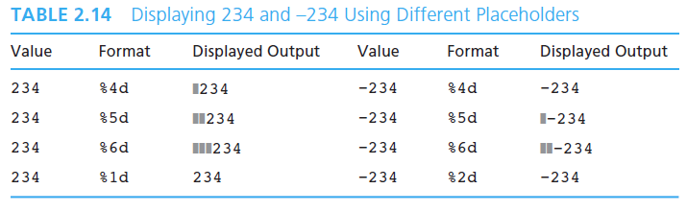
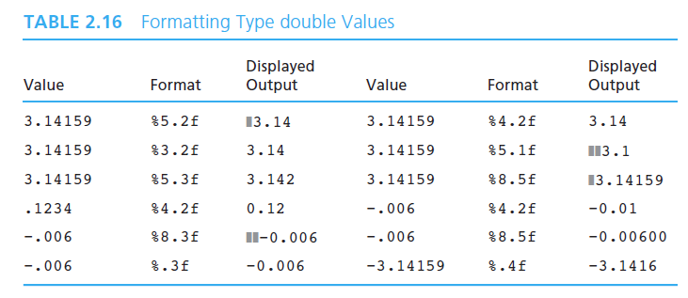
Examples
%[flags][width][.prec][hlL]type

Slide 27
II.6.b scanf() function
This C function looks a lot like fscanf() in MATLAB Syntax:
scanf("format
Example:
string",
list_of_variables );
int width, height; scanf("%d%d", &width, &height);
scanf(…) gets values from the input stream and stores them into variables
data in the input stream must match the order of the variables in the list
Each variable, if not a pointer (more later), must be preceded by &
keyboard input: after scanf(…)
keyboard input: after scanf(…)
200 300 Enter
width = 200, height = 300
150 24 Enter
width = 150, height = 24

Slide 28
Format Specifier
Format string: %[modifier]type
type | Action
d | read an integer expressed in decimal notation; int
e,f | read a float in floating‐point or exponential notation (e.g. 3.45e‐3); float
c | read single character even a whitespace character; char
s | read a sequence of characters, the sequence begins with first non‐whitespace character and is terminated by the first whitespace character;

Slide 29
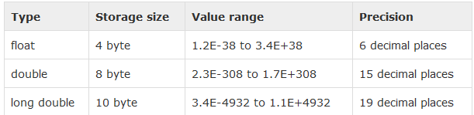
…Continued
Format string : %[modifier]type
modifer | Meaning
* | field to be skipped and not assigned (read and ignore)
size | maximum size of input field
double weight; scanf("%d", &weight);
float weight; scanf("%f", &weight);
Wrong
Right
54

Slide 30

Whitepace Characters
Except with %c format, scanf(…) bypasses any leading whitespace characters. whitespace characters are: blank_space,
tab (‘\t’),
return (‘\r’),
new_line (‘\n’)
input stream buffer
 |  | 3 | 0 | 0 |  | \r | 2 | 0 | 0 |  | \t | 3 | 0 | \r
scanf(“%d%d%d”,
w=300, h=200, d=30
&w, &h, &d);

Slide 31
Quiz 3
scanf(…) |  | Input | Results
(“%d%f”, &x, &y) |  | 250 350.0 | x= | y=
(“%d%c”, &x, &y) |  | 29 w | x= | y=
(“%d %c”, &x, &y) |  | 29 w | x= | y=
(“%d %*f %d”, &x, | &y) | 144 736.54 288 | x= | y=
Caution: Any white space in front of %c tells scanf to skip whitespaces stored in the buffer
Results
x = 250 | y= 350.000000
x = 29 | y= white space
x = 29 | y= w
x = 144 | y= 288

Slide 32
II.7. The return Statement
A return statement ends the execution of a function, and returns control to the calling function.
Execution resumes in the calling function at the point immediately following the call.
A return statement can return a value to the calling function

Slide 33
II.8. Operators: Assignment operator
lvalue =
rvalue;
Assigns rvalue to lvalue
lvalue: a variable, i.e. a reference to a memory location.
rvalue does not need to have a location in memory and can be a constant, a variable, or a value produced by an expression
Unlike lvalue, rvalue can’t appear at the left of the operator (=)
Example: int number = 25; |  | // OK
number = number + | 10; | // OK
A copy of the lvalue number is created as an rvalue, rvalue+rvalue produces an rvalue that is assigned then to an lvalue number
25 = number; (number+1) = 25;
// ERROR
// ERROR
“number+1” is an expression and not a variable

Slide 34
II.8. Operators: Arithmetic operators
There are two types of operators in C
binary – needs two operands :
unary – only needs one operand:
+, -, *, /, %
+, -, ++, --
operators |  | meaning | examples
unary | + | no change | +x, +200
 | ‐ | inverse | -x, -200
 | ++ | Increment [prefix, postfix] | ++count, count++
 | ‐‐ | Decrement [prefix, postfix] | --count, count--
binary | + | addition | 5.0 + 2.0 is 7.0, | 5 + 2 is 7
 | ‐ | subtraction | 5.0 – 2.0 is 3.0 | 5 – 2 is 3
 | * | multiplication | 5.0 * 2.0 is 10.0, | 5 * 2 is 10
 | / | division | 5.0/2.0 is 2.5 | 5/2 is 2
 | % | remainder | not applicable | 5%2 is 1

Slide 35
II.8. Operators: Integer division and remainder
If both operands are integers, then
/ calculates the integer part of the division
% calculates the integer remainder of the division
( m%n is always less than n)
3
7
2
7.0/2.0 = 3.5
7 – (7/2)*2 = 1
1
3
7/2 | = | 3 | 7%2 = | 1
23/5 | = | 4 | 23%5= -21 | 3 - (-21/4)*4 = -1
-21/4 | = | -5 | -21%4= | -1
21.0%4.0 = ?
% is not defined for float and double

Slide 36
II.8 Operators: increment and decrement
Increment operator ++ (increase by 1)
Pre‐increment: ++count
increment happens before the value to be used
Post‐increment : count++
increment happens after the value is used
Decrement operator – (decrease by 1)
Pre‐decrement: - -count
decrement happens before the value to be used
Post‐decremente: count-‐
decrement happens after the value is used
If used properly, the increment and the decrement operators can increase efficiency of expressions
Example:
x=1;
printf(“%d and %d”,++x,x++);
printf(“and %d”,x);
output: 2 and 2 and 3
int j = i++; // the value of i is first assigned to j, then i is incremented.
int j = ++i; // the value of i is first incremented, then the new value i is assigned to j

Slide 37
…Continued
expressions
counter++;
++counter;
sum = sum + counter++; sum = ++counter + sum;
example
(assume sum is 10, counter is 5 )
counter = 6 counter = 6
counter = 6 counter = 6
sum = 15
sum = 16
Equivalent to:
counter = counter +1; sum = sum + counter;
Equivalent to:
sum = sum + counter; counter = counter +1;

Slide 38
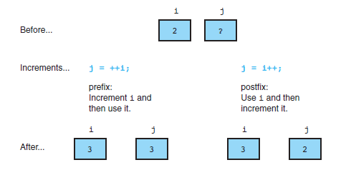
Comparison of pre‐ increment and post‐ increment

Slide 39
Compound Assignment Operator
assignment |  |  | compound assignment
sum = sum | + number; |  | sum += number;
product = | product * | number; | product *= number;
36
Syntax:
variable op= expression;
Meaning:
variable = variable op expression
Examples:
count += 2;
sum += 2+3;
stock -= quantity; power *= 2.71;
div /= 10.0+20.0;
rem %= d;
/* count
/* sum =
/* stock
/* power
/* div =
/* rem =
= count + 2; */ sum + (2+3) */
= stock – quantity */
= power * 2.71 */ div/(10.0+20.0) */ rem % d */

Slide 40
Relational Operators
Purpose:
Compare two operands
Syntax:
Operand1 RelationalOperator Operand2
Operands: constants variables
arithmetic expressions function calls
Operators
== equal
!= not equal
> greater than
>= greater than or equal to
< less than
<= less than or equal to
Examples:
y >= 20
offset == (640 + x) z < log(y)

Slide 41
II. 9. Expressions
An “expression” is a combination of values, variables, operators, functions which returns a value
Statement
Operands
Statement terminator
klms
= KMS_PER_MILE
* miles ;
Operators
Expression

Slide 42
Mixed type expressions
What is the type of the result of an expression that includes different data types? 2*12.25 is 24.5 or 24 or 25 ?
Basic arithmetic operations are supported by hardware modules in the CPU
CPU
Integer Adder
int op1 int op2 float op1 float op2
Operands op1 and op2 must have the same data type in order to be processed by CPU
Floating point Adder
Integer Multiplier
int op1 int op2
Floating point Multiplier
float op1 float op2

Slide 43
Data type conversion
Operands of different types must be converted to a common data type before they can be sent to the CPU execution
Upward : conversion to a data type with a higher precision
Downward: conversion to a data type with a lower precision
C does upward conversion automatically
wage = 2 * 14.8; /* 2 is auto converted to 2.0 */
You can explicitly convert a value to any data type upward or downward depending on your needs through casting
Syntax:
(cast_type)expression;
Examples:
(int)12.8; (float)length;
/* 12.8 is converted to int 12 */
/* length is converted to float */

Slide 44
Quiz 4
What values are assigned to
int a = 5, b = 6;
result ?
float fa=5.0, fb=6.0, result;
result result result result result
= (a + b)/2;
= (a + b)/2.0;
=
=
=
/* result =
/* result =
/* result =
/* result =
/* result =
*/
*/
*/
*/
*/
5
5.5
5.5
5.5
5.0
(fa + b)/2; (float)(a + b)/2;
(float)((a + b)/2);

Slide 45
Evaluation of complex expressions
Calculate the value of the following C expression
-2 * -3/4%5 + -6 + 4
Rules used in C for evaluation of expressions
Precedence rules: describe how an underparenthesized expression should be parenthesized when the expression mixes different kinds of operators
Associativity:when two operators in an expression have the same precedence, their associativity is used to determine how the expression is evaluated.

Slide 46
Arithmetic operators precedence
Operators | Associativity
function calls , (…),postfix ++, -- | left to right
(prefix) ++ --, unary(+ -), (type cast),sizeof( ) | right to left
binary: *, /, % | left to right
binary: +, - | left to right
= , += , -= , *= , /= , %= | right to left
Expressions inside parentheses are evaluated first.
Example: In the expression “- a * b – c” the first minus is unary and the second is binary.
We can use parentheses to write an equivalent expression that is less likely to be misinterpreted:
((- a) * b) - c
Notes:
In the expression 8 / 2 * 4, both / and * have the same precedence.
Since they both have left to right associativity, the expression has the value 16 rather than 1.

Slide 47
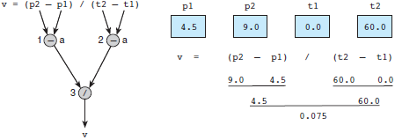
Evaluation Tree and Evaluation for v = (p2 - p1) / (t2 - t1);

Slide 48
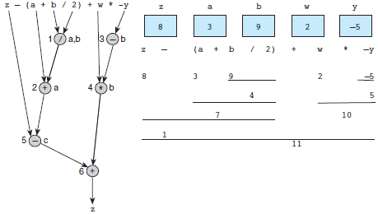
Evaluation Tree and Evaluation for z - (a + b / 2) + w * -y

Slide 49
Practice with Operators and Expressions
Declarations and Initializations
int a = 1, b = 2, c = 3, d = 4;
Expression Equivalent expression Value
a * b / c (a * b) / c 0
a * b % c + 1 ((a * b) % c) + 1 3
++a * b - c -- ((++a) * b) - (c--) 1
7 - -b * ++d 7 - ((-b) * (++d)) 17

Slide 50
Quiz 5
Which expressions are not implemented correctly?
ab
a * b / ( a + b )
a + b
_{a +} b
_{c}2
a + b / c * c
X
ª + c
b
a/b + c/( a – b/c )
X
a − b
_
c
c = p(1 + r) ^{y}
c = p * pow( (1+r), y )

Slide 51
Appendix: Programming Style
C language is case sensitive
All Identifiers in your program should be meaningful, having descriptive names:
a1, b, x3, y – confusing
colourPalet, lightIntensity, reflectionAngle – OK
Use CAPITAL for constants
LIMIT, THRESHOLD, GBP
Avoid names that differ only in case, like foo and Foo. Similarly, avoid foobar and foo_bar. The potential for confusion is considerable.
Indentation
Use spaces wisely
Comments
Concise and clear Consistent style

Slide 52
Indentation
Chaotic indentation makes a program code messy
#include <stdio.h> int main( void )
{
float x, y, tmp;
printf("Input two numbers >");
scanf("%f%f", printf(“Before y);
&x, &y);
swap: x=%.2f, y=%.2f\n”, x,
tmp=x; y=tmp;
x=y; y=%.2f\n”, x, y);
printf(“After
swap: x=%.2f,
return 0;
}

Slide 53
Indentation
It is easier to follow a program code when it is well organised
#include <stdio.h>
int main( void )
{
float x, y, tmp;
printf("Input two numbers >");
scanf("%f%f", &x, &y); /* input x and y */ printf(“Before swap: x=%.2f, y=%.2f\n”, x, y);
/* swap x and tmp=x;
x=y; y=tmp;
/* Output the printf(“After return 0;
y using a temporary buffer */
result */
swap: x=%.2f, y=%.2f\n”, x, y);
}

