Slide 1
Lecture 2
Design Solutions Description
Objective: This lecture explains the use of pseudo-code and Flowchart in describing algorithms solution. It demonstrates how a good a design description leads to a successful and fast implementation
See the Notes pages (section) of this presentation

Slide 2
I. Software Development Process
With non-trivial problems, we can NOT just type in the code and always expect to solve the problem in hand. Instead, we need to:
  Define clearly the problem
  Analyse the problem and specify clearly its requirements along with any constraint
  Design an algorithm solution: a sequence of steps that describe a solution to a problem
  Code (implement) the algorithm
  Test the code; Go to 4 or ….3 if needed
Analysis
Design
Implement
Test
debugging and testing
Notes:
CSE1301, Sem 1 - 2006
L15: Flowcharts, testing and debuggingLecture 12: Flowcharts, testing and debugging
Debugging: the process of finding and correcting errors (a.k.a “bugs”)
Testing: executing the program on a test data set
Always comment your code

Slide 3
II. Design Documentation
Design solutions (algorithms) can be described using either Pseudo-code or Flowchart
Pseudo-code: is very similar to everyday English. It is an artificial and informal language that helps programmers develop and describe algorithms
Flowchart: is a diagram, a graphical representation of the sequence of operations in an algorithm
  Each operation is represented by a symbol
  Symbols are connected with arrows to specify the sequence of operations

Slide 4
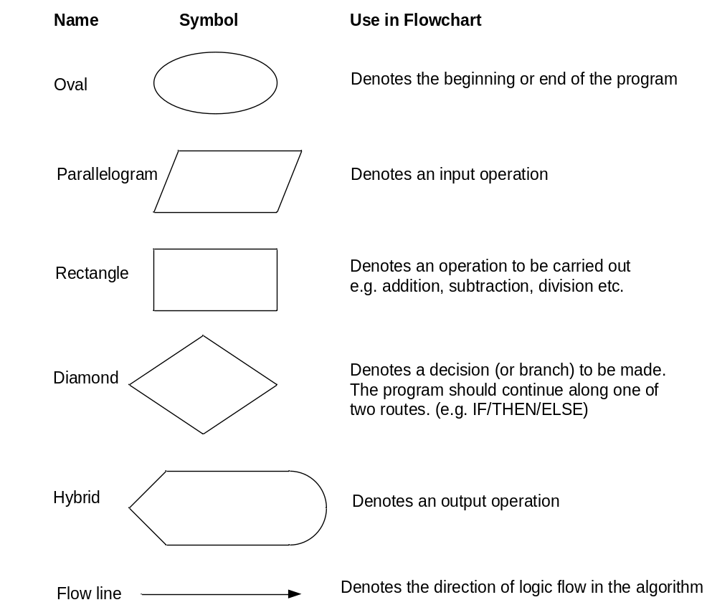
III. Flowchart Main Symbols
Notes:
A flowchart is a type of diagram, that represents an algorithm showing the steps as boxes of various kinds, and their order by connecting these with arrows. This diagrammatic representation can give a step-by-step solution to a given problem. Data is represented in these boxes, and arrows connecting them represent flow / direction of flow of data. Flowcharts are used in analysing, designing, documenting or managing a process or program in various fields [wikipedia].

Slide 5
Example
Example 1: write an algorithm to determine a student’s final mark and indicate whether it is passing or failing. The final mark is calculated as the average of three marks
Solution:
  Data Model
    M1, M2, M3: the three marks of the student
    FinalMark: student’s final mark
  Detailed Algorithm in pseudo-code:
Input M1, M2, M3
FinalMark = (M1+M2+M3)/3
if (FinalMark < 40) then
Print “FAIL”
Else
Print “PASS”
endif
Notes:
You would need to specify the types (e.g. integer, real) of your variables in the data model

Slide 6
…Continued
Detailed Algorithm in Flowchart
START
Input
M1, M2, M3
FinalMark =(M1+M2+M3)/3
NO
FinalMark<40?
YES
PRINT
“PASS”
PRINT
“FAIL”
STOP

Slide 7
Flowchart Symbol: Connector
Sometimes a flowchart will not fit on one page
A labelled connector (represented by a small circle and a label) allows you to connect two flowchart segments
L
The “A” connector in the diagrams below indicates that the second flowchart segment begins where the first segment ends
START
A
END
A

Slide 8
Flowchart Symbol for Modules / functions
A program module (such as a function in C) is represented by a special symbol
The position of the module symbol indicates the point the module is executed
A separate flowchart can be constructed for the module
START
Read Input
Call a function
Display
results
END
Notes:
1- A function in C language is a block of code that performs a specific task.
2- It has a name and it is reusable i.e. it can be executed from as many
different parts in a C program as required.
3- It also, optionally, returns a value to the calling program. ( might not ).

Slide 9
IV. Four Flowchart Structures
Sequence
Decision
Repetition
Case

Slide 10
1. Sequence Structure
a series of actions are performed in sequence

Slide 11
2. Decision Structure
The diamond indicates a yes/no question. If the answer to the question is yes, the flow follows the YES path. If the answer is no, the flow follows the NO path
NO
YES
Notes:
Arrow labeled with result of condition test

Slide 12
Decision Structure to C code: examples
Flowchart
C Code
NO
YES
x <y?
if (x < y)
a = x * y;
else
a = x + y;
a = x + y.
A = x *y
Flowchart
NO
YES
C Code
x <y?
if (x < y)
a = x * 2;
a = x * 2.

Slide 13
3. Repetition Structure
A repetition structure represents part of the program that repeats. This type of structure is commonly known as a loop
A loop tests a condition, and if the condition exists, it performs an action. Then it tests the condition again. If the condition still exists, the action is repeated. This continues until the condition no longer exists
YES
NO
Example
Flowchart
C Code
YES
while (x < y)
x = x+ 1;
x < y?
x = x+1
NO

Slide 14
4. Case Structure
One of several possible actions is taken, depending on the contents of a variable
The example case structure in the next slide indicates actions to perform depending on the value in years_employed

Slide 15
Case structure: example
If years_employed = 2, bonus is set to 200
If years_employed = 3, bonus is set to 400
If years_employed = 1, bonus is set to 100
If years_employed is any other value, bonus is set to 800
CASE
years_employed
1
2
3
Other
bonus = 100
bonus = 200
bonus = 400
bonus = 800
switch(years_employed )
{
case 1: bonus=100; break;
case 2 : bonus=200; break;
case 3 : bonus=400; break;
default: 800};

Slide 16
Combining structures
Structures are commonly combined to create more complex algorithms
The flowchart segment below combines a decision structure with a sequence structure
YES
Call a function
x < y?
x=x+1
NO

Slide 17
Conclusion
A very good design flowchart can be translated on the fly into a programming language. This can be done by identifying the type of structure in the flowchart and associate to it the corresponding code (e.g. C) as shown in the previous slides

