Slide 1
Lecture 4 Repetition Statements
I. Repetition Statements
II. The while loop
III. The for loop
IV. break and continue

Slide 2

I. Repetition Statements
Repetition statements are intended to implement loops that repeat an action as long as some condition remains true
C language has three C repetition constucts:
pre‐test loop for
pre‐test loop while
3. post‐test loop do…while
Apart from some difference in syntax, major properties of C for and while loops are similar to those supported by MATLAB
MATLAB
sum = 0; for i = 1:10
sum = sum + i; end
Having different syntax, all loops contain three common components:
initialize loop
test loop condition
update

Slide 3
Pre‐test and Post‐test loops
Pre‐test loop
Post‐test loop
The loop condition is tested before the statements are executed
Initialization
Initialization
Test loop condition
true
Statements
false
Updating
Statements
Updating
Test loop condition
true
The loop condition is tested after the statements are executed
false

Slide 4
II. The while loop
Syntax:
while( expression)
{
statements; /* loop body */
}
loop repetition condition
It is a pre‐test loop; if the expression is true, then the statements are executed;
the expression is re-evaluated after each iteration. The loop is exited once
the expression becomes false.
Example: Display all characters from a to z
char symbol;
symbol = ‘a’;
while( symbol <= ‘z’ )
{
printf(“%c ”, symbol); symbol++;
}
/*initialization */
/* test loop condition */
/* update */
Notes:
Iteration is one execution of a section program code
Iterating means repeating that code again and again until a condition is met
Infinite loops never end - created when a loop does not encounter a terminating condition or when a loop is set to restart itself
Sometimes the OS will detect a forever loop and attempt to terminate it, but this only works for some programs. You may get an error after a certain amount of time has passed if that's part of the catch condition
If you are experiencing an infinity loop, press Ctrl + C, which produces a break in the program. If that doesn’t work - end task (Ctrl + Alt + Delete) and end the process! (works for other problems too)

Slide 5
Example
What is the limit of the sequence?
1 + 1/2 + 1/4 + 1/8 + ... =>
1, 1.5, 1.75, 1.875, …
#define DIF
0.0001
/* accuracy */
. .
float float
.
oldResult = 0.0 , x= 2.0;
newResult =
1.0;
old = 0.0 new=1.0
x=2.0
new – old > 0.0001 old = 1.0 new=1.5
true
x=4.0
while( newResult – oldResult
{
> DIF )
new – old > 0.0001 old = 1.5 new=1.75
true
x=8.0
oldResult
newResult x *= 2.0;
= newResult;
+= 1/x;
new – old > 0.0001 old = 1.75
true
new=1.875
x=16.0
}
. . . .
new –
STOP
old >
0.0001
false
printf(“The limit is %.3f”, newResult);
output new
Definition: accumulator (computing a sum or product in a loop) is a variable used to store a value being computed in increments during the execution of a loop

Slide 6
III. The for loop
The for loop is a version of a pre‐test loop that has a more convenient syntax to implement a determined number of repetitions.
Syntax:
for ( initialization; repetition condition ; update )
{
statements; /* loop body */
}
Explanation:
1. initialization expression is executed only once.
2. The loop repetition condition is then tested; if it is true, the statements in the loop body are executed. Otherwise, the loop is exited.
3. The update expression is then executed, go back to step 2.
Notes:
If the condition is false, the body of the loop does not execute and the flow of control jumps to the next statement just after the 'for' loop.

Slide 7
…Continued
Initialization:
Allows to declare and initialise any loop control variables (iterator).
The iterator is used to index what iteration the loop is currently on
This statement can be left blank but the semicolon must be present
Update:
Allows to update the iterator.
The statement can be left blank but the semicolon must be present
Example:
/* calculate a factorial N!= 1*2*3*...*N */
#define N 5
int factorial = 1;
for( int counter=1; counter<=N; counter++ ) factorial *= counter;

Slide 8
“for“- “While” loops Translation
/*
* sum of numbers from
*/
/*
* sum of numbers from 1 to n
*/
#include <stdio.h>
int main(void)
{
int n, sum, counter;
1 to n
#include <stdio.h>
int main(void)
{
int n, sum,
counter;
printf(“Enter n: scanf(“%d”, &n);
sum = 0;
\n”);
printf(“Enter n: ”);
scanf(“%d”, &n);
sum = 0;
for ( counter=1; counter<=n; counter++ )
{
counter while (
{
= 1;
counter<=n )
sum += counter;
. . .
}
printf(“Sum of 1 to %d is %d!\n”, n, sum);
return (0);
sum += counter;
. . .
counter++;
}
printf(“Sum is return(0);
%d!\n”,
sum);
}
}

Slide 9
Variations of the for loop
Several initialization expression separated by comma
for( factorial=1, counter=1; counter <= n; ++counter) factorial *= counter;
No initialization expressions
for( ; n > 0; n-- )
printf(“*”);
A simple implementation of a delay (the actual delay time is platform dependent)
for( counter=0; counter < 1000; counter++ ) ;
An infinite loop (until it is terminated inside the loop body)
for( ; ; )
{
. . .
}

Slide 10
III. do-while Statement
Syntax:
do{
statement_list;
}
while (expression);
It is a post‐test loop; the body of the loop is executed once, before checking the test expression. Hence, the do...while loop is always executed at least once.
It is suitable for conditions where we know that a loop must execute at least one time.
Example:
/* Find first even number input */
do
status = scanf(“%d”, &num);
while (status > 0 && (num % 2) != 0);
Explanation:
Get a data value
If data value isn’t in the acceptable range, go back to step 1.

Slide 11
IV. break and continue
break;
when a break statement is encountered within a loop body, the execution of the loop body is exited
It useful if we want to exit a loop under special circumstances.
continue;
when a continue statement is encountered within a loop body , all remaining statements in the loop body following the continue statement are skipped for the current loop iteration, moving then to the next iteration of the loop to take place.
For the For loop, it causes the update and conditional test portions of the loop to execute.
For the While loops, it causes the conditional tests to be checked again.
Notes:
it forces the next iteration of the loop to take place, skipping any code in between

Slide 12
Example
Int main(){
int i, number, sum = 0; for(i=1; i <= 10; ++i)
{
printf("\nEnter a number %d: ",i); scanf("%d",&number);
// loop terminates for a negative input
if(number < 0)
{
break;
}
sum += number; // sum = sum + number;
}
printf("\nSum = %d",sum); return 0;
}
Int main(){
int i, number, sum = 0; for(i=1; i <= 10; ++i)
{
printf("\n Enter a n%d: ",i); scanf("%d",&number);
// loop to the next iteration if input is negative
if(number < 0)
{
continue;
}
sum += number; // sum = sum + number;
}
printf("\nSum = %d",sum); return 0;
}

Slide 13
V. Nested loops
A loop body may include other internal loops.
Nested loops consist of an outer loop with one or more inner loops.
Each time the outer loop is repeated, the inner loops are reentered, their loop control expressions are reevaluated, and all required iterations are performed.

Slide 14
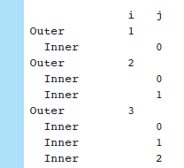
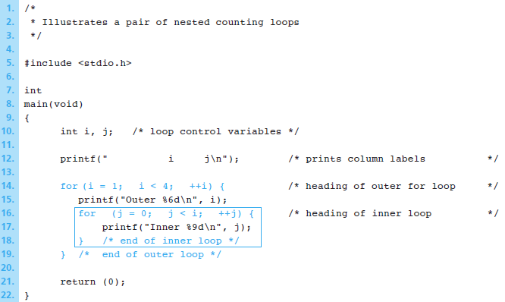
Example: Nested Counting Loop

Slide 15
Example 2: Company Payroll
Write a program that displays each employee’s pay and computes and displays the company’s total payroll. Prior to loop execution, the statements
Sample Run
initialize both total_pay and count_emp to 0 , where count_emp is the counter variable. Here total_pay is an accumulator variable, and it accumulates the total payroll value.

Slide 16
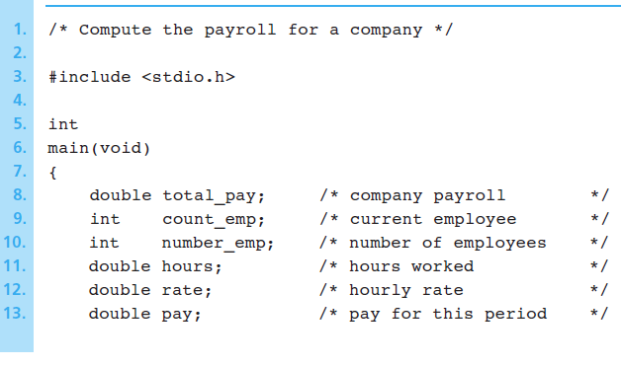
…Continued

Slide 17
…Continued

Slide 18
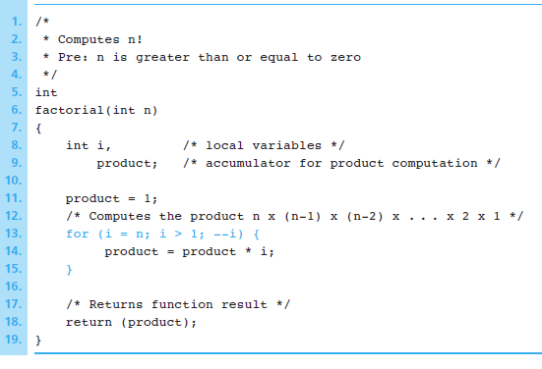
Example 3: Computing Factorial
Loop body executes for decreasing value of i from n through 2.
Each value of i is incorporated in the accumulating product.
Loop exit occurs when i is 1.

Slide 19
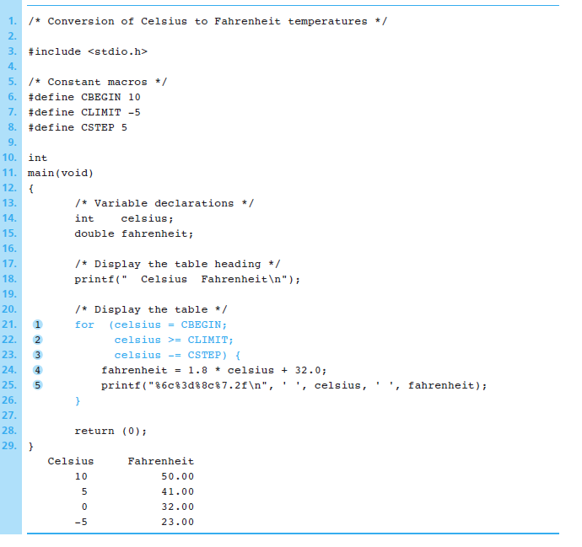
Example 4: Conversion of Celsius to Fahrenheit
Example shows conversions from 10 (CBEGIN) degree Celsius to -5 (CLIMIT) degrees Celsius
Loop update step subtracts 5 (CSTEP) from Celsius
accomplished by decreasing the value of the counter after each repetition
Loop exit occurs when Celsius becomes less than CLIMIT.
Sample Run

Slide 21
Example 5: Sum of Exam Scores
A program that calculates the sum of a collection of exam scores If the class is large, the instructor may not know the exact number of students who took the exam being graded. The program should work regardless of class size.
Enter first score (or -99 to quit)> 55
Enter next score (-99 to quit)> 33
Enter next score (-99 to quit)> 77
Enter next score (-99 to quit)> -99
Sum of exam scores is 165

Slide 22
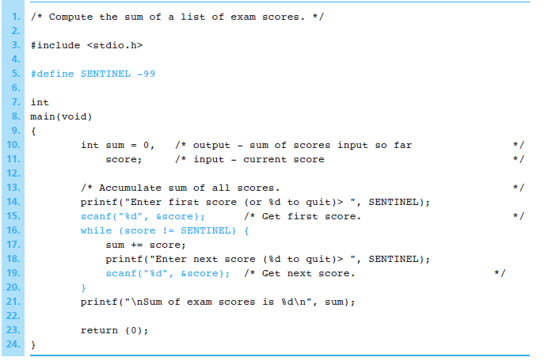

Slide 23
Appendix: Using Debugger Programs
A debugger program can help you find defects in a C program
It lets you execute your program one statement at a time (single-step execution).
Use this to trace your program’s execution and observe the effect of each C statement on variables you select.
Separate your program into segments by setting breakpoints.

Slide 24
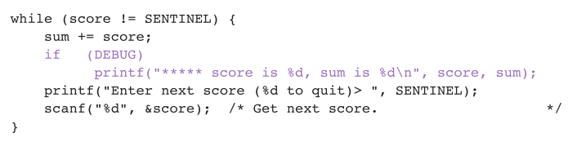
Debugging without a Debugger
Insert extra diagnostic calls to printf that display intermediate results at critical points in your program.
# define DEBUG 1

