Slide 1
Selection Structures: Supplement
CSCI291 Programming for Engineers

Slide 2
What is true and what is false in C
C uses integer values to represent boolean true and false
false (zero)
true (nonzero)
true (nonzero)
0
#include <stdbool.h>
………
int flag, p=100, q=50; bool isBigger = false;
flag = (p <= q); isBigger = (p >= q);
flag = 0;
isBigger = 1;
false true
You need to include <stdbool.h> to use bool
data type in your program

Slide 3
Relational Operators
Purpose:
Compare two operands
Syntax:
Operand1 Relational Operator Operand2
Operands: constants variables
arithmetic expressions function calls
Operators
== equal
!= not equal
> greater than
>= greater than or equal to
< less than
<= less than or equal to
Examples:
y >= 20
offset == (640 + x) z < log(y)

Slide 4
Logical operators
Syntax:
Operand1 LogicOperator Operand2
or ! Operand
Examples:
(current >= 2.0e-3) && (current <= 5.0e-3) ans = (p > 95) || (q < 95);
ans = !(p > 95);
Operands: bool constants bool variables
relational expressions function calls
Operators:
&& logical AND
|| logical OR
! logical NOT
Expression result:
true false
Apart from difference in syntax, all properties of C logical operators are similar to those used for digital hardware design ( covered by ECTE233 ) and in MATLAB ( covered by ENGG100 )
Notes:
If a condition is true, then Logical NOT operator will make it false.

Slide 5
Logical operators
Evaluation of logical expressions
x | y | x && y | x || y | !x
false | false | false | false | true
false | true | false | true | true
true | false | false | true | false
true | true | true | true | false
Truth table
As follows from the table:
If at least one operand is false, then && is also false
If at leas one operand is true, then || is also true
int x=2, y=4, z=9, bool isMaxVal;
true
flag;
isMaxVal = (z >
false
flag = (x == y)
true
x) && (z > y);
true
&& ( x < y );
/* true */
/* false */

Slide 6
Operator Precedence
Operator | Precedence
function calls | highest (evaluated first)
! + - & (unary operator)
* / %
+ -
< <= >= >
== !=
&&
||
= | lowest (evaluated last)

Slide 7
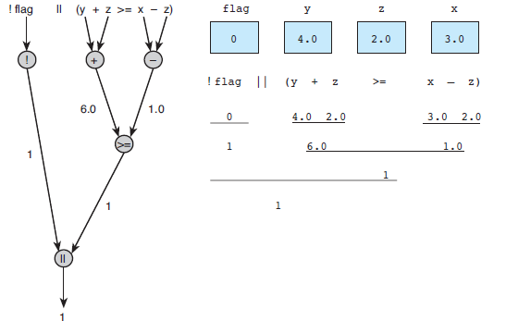
Evaluation Tree and Step-by-Step Evaluation for !flag || (y + z >= x - z)

Slide 8
Comparing Characters
Expression | Value
‘9’ >= ‘0’ | 1 (true)
‘a’ < ‘e’ | 1 (true)
‘B’ <= ‘A’ | 0 (false)
‘Z’ == ‘z’ | 0 (false)
‘a’ <= ch && ch <= ‘z’ | 1 (true) if ch is a lowercase letter

Slide 9
Short circuit evaluation
Short‐ Circuit evaluation
C stops further evaluation of an expression when the result becomes obvious ( MATLAB uses short‐circuit evaluation too )
An expression of the form A||B is always true if A is true
An expression of the form A&&B is always false if A is false
In these cases B is not evaluated
int x=1, y=2, z=3;
(x < y) || (x+y > z)
(x > y) && (x+y > z)
true
||
false
not evaluated
&&
not evaluated
true
false

Slide 10
Short circuit evaluation
Short circuit evaluation reduces computational complexity of complex logical expressions
Does it have any side effects?
int x=1, y=2, z=3; bool flag;
flag | = x<0 || | ++y > 7;
flag | = x>0 || | ++y > 7;
/* flag= false y= 3 */
/* flag= true y= 2 */
Not run in sequence
When you use complex logical expression in your program, make sure that short circuit evaluation does not introduce intermittent mistakes in calculations

Slide 11
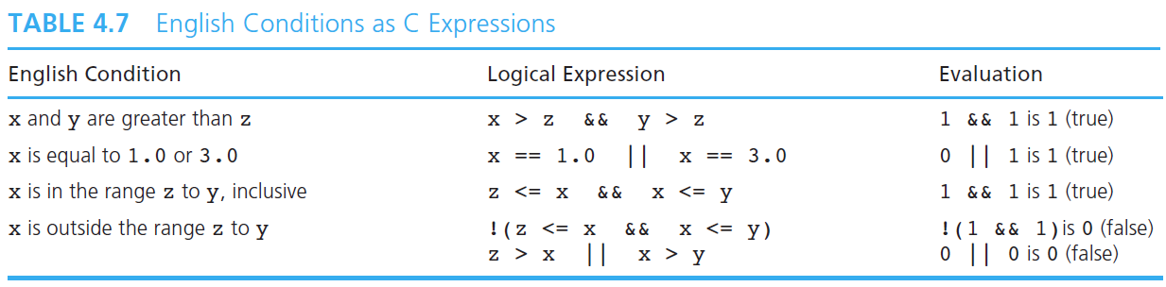
Writing English Conditions in C
Table below shows some English conditions and the corresponding C expressions. Each expression is evaluated assuming x is 3.0, y is 4.0, and z is 2.0.

Slide 12
Quiz
What are the values of the variables after execution of this code?
int a=0, b=0; int a=0, b=0;
if (a > b || a==0 && b>0) if
{
a++;
b += 2;
}
else
{
a--;
b -= 2;
}
(a == 0)
if (b > 0)
{
a++;
b += 2;
}
else if (a > b)
{
a++;
b += 2;
}
else
{
a--;
b -= 2;
}
a = ‐1
b = ‐2
a = ‐1
b = ‐2
Notes:
(a > b) || ((a==0) && (b>0))

Slide 13
Typical bugs
Unnecessary semicolon after the if(condition)
if(number > THRESHOLD);
Null statement, do nothing
number = 0; <- will be executed unconditionally
Missing braces {…} to enclose compound statements
if(number >
number
else
number
THRESHOLD)
= 0;
= getNewNumber;
counter++; <‐ will be executed unconditionally
Dangling else
if(a > 0)
if(b < 10)
c = 5;
else
c = 0;
<- else is always associated with the previous if

