Slide 1
Lecture 3 Selection (Conditional) Statements
I. Motivation
II.1 The if Selection Statement
II.2 The if…else Selection Statement
II.3 Nested if...else Statements
II.4 Conditional Operator (?:)
II.5 switch Multiple-Selection Statement
Appendix
Ack: slides based on deitel C How to Program, 8/e notes
See the Note sections
Notes:
A selection statement selects among a set of statements depending on the value of a controlling expression.

Slide 2

I. Motivation
Looking back at Q11 of tutorial 2.
Assume every time variable is given in the format HrMn
Departure
time : DT ?
Arrival
time:AT
Journey time: JT
To set the values of the Hr and Mn fields of the DT:
If JT(Mn)=0, DT(Hr)=AT(Hr)-JT(Hr)
If JT(Mn) ≠ 0,
If JT(Mn)≤ AT(Mn), then DT(Hr)=AT(Hr)-JT(Hr)
DT(Mn)=AT(Mn)-JT(Mn)
Else DT(Hr)=AT(Hr)-JT(Hr)-1
DT(Mn)=60+AT(Mn)-JT(Mn)
Different actions on different conditions
JT(Mn)
AT(Mn)
AT(Mn)
JT(Mn)
Notes:
Rule 1 is superseded by rule 2
To deduce the above rules, consider AT:15:10
And the following journey times
1 hour
1 hour 5 minutes
1 hour 20 minutes

Slide 3
II. Selection Statements in C
Selection (conditional) statements are used to choose among alternative courses of action
C provides three main types of selection structures in the form of statements:
The if selection statement: either selects (performs) an action if a condition is true or skips the action if the condition is false.
The if…else selection statement: performs an action if a condition is true and performs a different action if the condition is false.
The switch selection statement: performs one of many different actions depending on the value of an expression.

Slide 4
…Continued
The if statement is called a single-selection statement because it selects or ignores a single action.
The if…else statement is called a double-selection statement because it selects between two different actions.
The switch statement is called a multiple-selection statement because it selects among many different actions.

Slide 5
II.1 The if Selection Statement
An example: suppose the passing grade on an exam is 60.
The pseudo-code statement
If student’s grade is greater than or equal to 60 Print “Passed”
determines whether the condition “student’s grade is greater than or equal to 60” is true or false.
If the condition is true, then “Passed” is printed, and the next pseudocode statement in order is “performed”
If the condition is false, the printing is ignored, and the next pseudocode statement in order is performed.

Slide 6
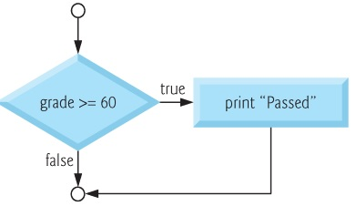
…Continued
The previous pseudo code can be represented using the flowchart below
The diamond symbol, also called the decision symbol, which indicates that a decision is to be made.
The decision symbol contains an expression, such as a condition, that can be either true or false.
The decision symbol has two flowlines emerging from it. One indicates the direction to take when the expression in the symbol is true and the other the direction to take when the expression is false.
Notes:
Decisions can be based on conditions containing relational or equality operators.
In fact, a decision can be based on any expression—if the expression evaluates to zero, it’s treated as false, and if it evaluates to nonzero, it’s treated as true.

Slide 7
…Continued
int grade;
…..
if ( grade >= 60 ) { printf( "Passed\n" ); } // end if
C code
In general, a single selection statement corresponds in C to
if(expression){
--statements of your action
}
If the action consists of one statement, the enclosing curly braces {} can be removed

Slide 8
II.2 The if…else Selection Statement
The if…else selection statement allows you to specify that different actions are to be performed when the condition is true and when it’s false.
For example, the pseudocode statement
If student’s grade is greater than or equal to 60 Print “Passed” else Print “Failed”
prints Passed if the student’s grade is greater than or equal to 60 and Failed if the student’s grade is less than 60.
In either case, after printing occurs, the next pseudo-code statement in sequence is “performed.”

Slide 9
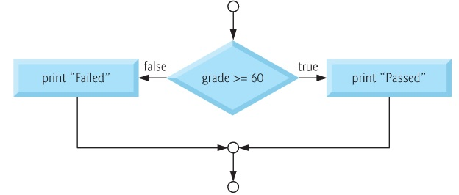
…Continued
int grade;
if ( grade >= 60 ) { printf( "Passed\n" ); } // end if else { printf( "Failed\n" ); } // end else
C code
In general, a double selection statement corresponds in C to
if(expression){
--statements of your action 1
}
else {
--statements of your action 2
}

Slide 10
II.3 Nested if...else Statements
Nested if…else statements test for multiple cases by placing if…else statements inside if…else statements.
For example, the following pseudocode statement will print A for exam grades greater than or equal to 90, B for grades greater than or equal to 80 (but less than 90), C for grades greater than or equal to 70 (but less than 80), D for grades greater than or equal to 60 (but less than 70) and F for all other grades.

Slide 11
…Continued
Pseudo code:
If student’s grade is greater than or equal to 90 Print “A” else If student’s grade is greater than or equal to 80 Print “B” else If student’s grade is greater than or equal to 70 Print “C” else If student’s grade is greater than or equal to 60 Print “D” else Print “F”

Slide 12
…Continued
This pseudocode may be written in C as
If the variable grade is greater than or equal to 90, all four conditions will be true, but only the puts statement after the first test will be executed.
After that puts is executed, the else part of the “outer” if…else statement is skipped.
The order of IF statements is IMPORTANT
int grade;
if ( grade >= 90 ) puts( "A" ); else if ( grade >= 80 ) puts("B"); else if ( grade >= 70 ) puts("C"); else if ( grade >= 60 ) puts( "D" ); else puts( "F" );
Notes:
The C library function int puts(const char *str) writes a string to stdout up to. A newline character is appended to the output

Slide 13
…Continued
You may prefer to write the preceding if statement as
if ( grade >= 90 ) puts( "A" ); else if ( grade >= 80 ) puts( "B" ); else if ( grade >= 70 ) puts( "C" ); else if ( grade >= 60 ) puts( "D" ); else puts( "F" );

Slide 14
Compound statement in if block
To include several statements in the body of an if or else, you must enclose the set of statements in braces ({ and }), otherwise the statements after the first one WILL ALWAYS executed regardless on the value of the expression.
if you have only one statement in the if’s body, you do not need the enclose it in braces.
A set of statements contained within a pair of braces is called a compound statement or a block.

Slide 15
…Continued
The following example includes a compound statement in the else part of an if…else statement.
if ( grade >= 60 ) { puts( "Passed. " ); } // end if else { puts( "Failed. " ); puts( "You must take this course again. " ); } // end else

Slide 16
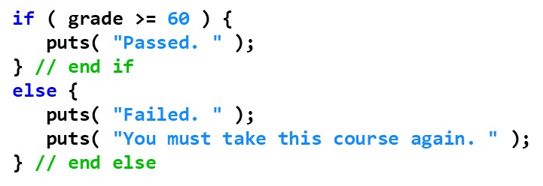
…Continued
if grade is less than 60, the program executes both puts statements in the body of the else and prints
Failed. You must take this course again.
The braces surrounding the two statements in the else are important. Without them, the statement
puts( "You must take this course again." );
would be outside the body of the else part of the if and would execute regardless of whether the grade was less than 60.

Slide 17
…Continued
Just as a compound statement can be placed anywhere a single statement can be placed, it’s also possible to have no statement at all, i.e., the empty statement.
The empty statement is represented by placing a semicolon (;) where a statement would normally be.

Slide 18
II.4 Conditional Operator (? :)
C provides the conditional operator (? :) which is closely related to the if…else statement.
The conditional operator is C’s only ternary operator; it takes three operands: cond ? Expr1:expr2
These three operands with the conditional operator (? :) form a conditional expression.
The first operand is the expression condition.
The second operand is the outcome for the entire conditional expression if the condition is true
the third operand is the outcome for the entire conditional expression if the condition is false.

Slide 19
…Continued
For example, the puts statement
puts( grade >= 60 ? "Passed" : "Failed" );
contains as its argument a conditional expression that evaluates to the string "Passed" if the condition grade >= 60 is true and to the string "Failed" if the condition is false.
The puts statement performs in essentially the same way as the preceding if…else statement.

Slide 20
…Continued
The second and third operands in a conditional expression can also be actions to be executed.
For example, the conditional expression
grade >= 60 ? puts( "Passed" ) : puts( "Failed" );
is read, “If grade is greater than or equal to 60 then puts("Passed"), otherwise puts( "Failed" ).”
This, too, is comparable to the preceding if…else statement.

Slide 21
II.5 switch Multiple-Selection Statement
Occasionally, an algorithm contains a series of decisions in which a variable or expression is tested separately for each of the constant integral values it may have, and different actions are to be taken.
This is called multiple selection.
C provides the switch multiple-selection statement to handle such decision making.
The switch statement consists of a series of case labels, an optional default case, and statements to execute for each case.
Notes:
constant integral expression—i.e., any combination of character constants and integer constants that evaluates to a constant integer value.

Slide 22
…Continued
The switch statement evaluates an expression, then attempts to match its value to one of several possible case labels/values
Keyword switch is followed by the expression in parentheses.
This is called the controlling expression.
The value of this expression is compared with each of the case labels.
If a match occurs, the statements for that case are executed.
switch ( expression ){
case value1 :
statement-list1
case value2 :
statement-list2
case value3 :
statement-list3
case ...
}

Slide 23
…Continued
Each case contains a constant integral value and a list of statements
The flow of control transfers to the list of statements associated with the case value that matches the expression value
switch ( expression ){
case value1 :
statement-list1
case value2 :
statement-list2
case value3 :
statement-list3
case ...
}
Note use of colon!
If expression
matches value3,
control jumps
to here
Notes:
Switch and case are reserved words

Slide 24
Break in Switch Statement
The break statement can be used as the last statement in each case's statement list
A break statement causes control to transfer to the end of the switch statement
If a break statement is NOT used, the flow of control will continue into the next case
switch ( expression ){
case value1 :
statement-list1
break;
case value2 :
statement-list2
break;
case value3 :
statement-list3
break;
case ...
}

Slide 25
Example: Break in a Switch-Case
switch (option){
case 'A':
aCount++;
break;
case 'B':
bCount++;
break;
case 'C':
cCount++;
break;
}
switch (option){
case 'A':
aCount++;
case 'B':
bCount++;
case 'C':
cCount++;
}
Fall through.

Slide 26
default case
A switch statement can have an optional default case
The default case has NO associated value and simply uses the reserved word default
If the default case is present, control will transfer to it if NO other case value matches the expression value
If there is no default case, and no other value matches, control falls through to the statement after the switch

Slide 27
…Continued
switch ( expression ){
case value1 :
statement-list1
break;
case value2 :
statement-list2
break;
case value3 :
statement-list3
break;
default: ...
statement-default
}
Each case can have one or more actions.
The switch statement is different from all other control statements in that braces are not required around the action(s) in a case of a switch.
A switch case action can use any of the C language construct including a switch case itself!

Slide 28
Constraints and Recommendations
The expression of a switch statement must result in an integral type, meaning an integer (byte, short, int) or a char (or a Boolean value although it will generate a warning)
It cannot be a floating point value (float or double)
The implicit boolean condition in a switch statement is equality
If needed, put the relational check in the switch expression
The values should be a constant integral value

Slide 29
…Continued
No two case labels may have the same value.
Two case labels may be associated with the same statements.
The default label is not required but sometimes preferable
values not explicitly tested in a switch would normally be ignored. The default case helps prevent this by focussing you on the need to process exceptional conditions.
There can be only one default label, and it is usually last.
Although the case clauses and the default case clause in a switch statement can occur in any order, it's common to place the default clause last
In a switch statement, when the default clause is last, the break statement is not required. You may prefer to include this break for clarity and symmetry with other cases.
Listing several case labels together simply means that the same set of actions is to occur for either of these cases.

Slide 30
Appendix: Example 1
Write a program that asks a user to enter his resting pulse rate. If his resting heart rate (per minute) is above 56, then display a message “Keep up your exercise program”. Otherwise, the program should display “Your heart is in excellent condition”.
A sample run of the program is shown below:
Sample Run 1
Take your resting pulse for 10 seconds.
Enter your pulse rate and press return> 12
Your resting heart rate is 72.
Keep up your exercise program!
Sample Run 2
Take your resting pulse for 10 seconds.
Enter your pulse rate and press return> 9
Your resting heart rate is 54.
Your heart is in excellent health!

Slide 31
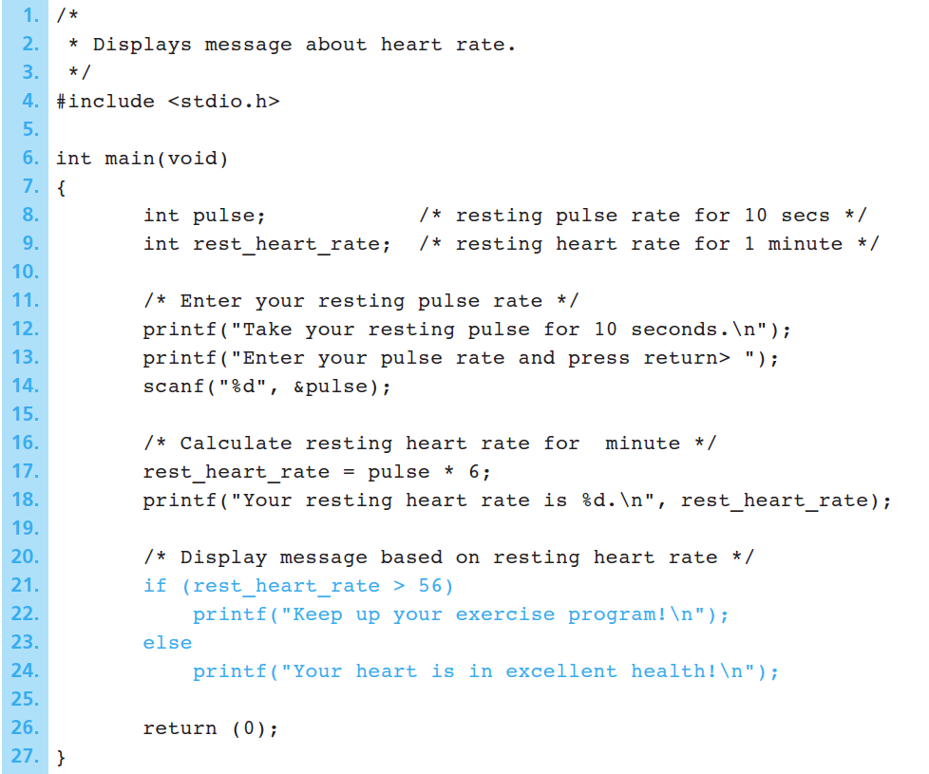
Solution

Slide 32
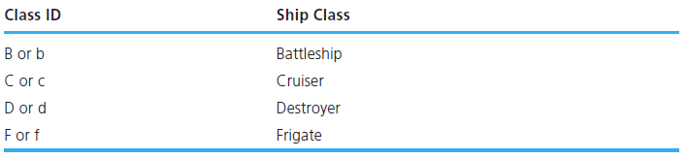
Example 2
Write a program that reads a ship’s serial number and displays the class of the ship. Each ship serial number begins with a letter indicating the class of the ship. The program first reads the first letter of a ship’s serial number into the char variable class and then displays that character. The switch statement displays a message indicating the class of the ship. It implements the following decision table.
Sample Run 1
Enter ship serial number> f3456
Ship class is f: Frigate
Sample Run 2
Enter ship serial number> P210
Ship class is P: Unknown

Slide 33
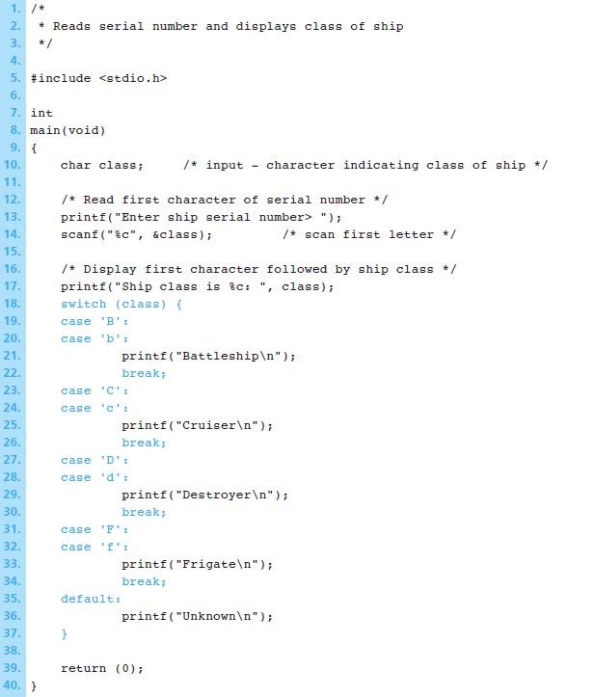
Solution
Listing several case labels together simply means that the same set of actions is to occur for either of these cases.

