Slide 1
Lecture 2:
Functions and Variable Scopes
Content:
I. Motivation
II. Modular Design and Coding
III. Functions in C
IV. Scope of Variable
V. Passing Arguments into Functions
Please check the note sections

Slide 2
I. Motivation
Coding a complex algorithm may result in a long main function inflated to an unmanageable complexity. How to get around this problem?
How several software engineers can work simultaneously on the same project when all C code is in the main ?
If the same set of statements has to be used in a program several times, how to avoid code duplication?

Slide 3
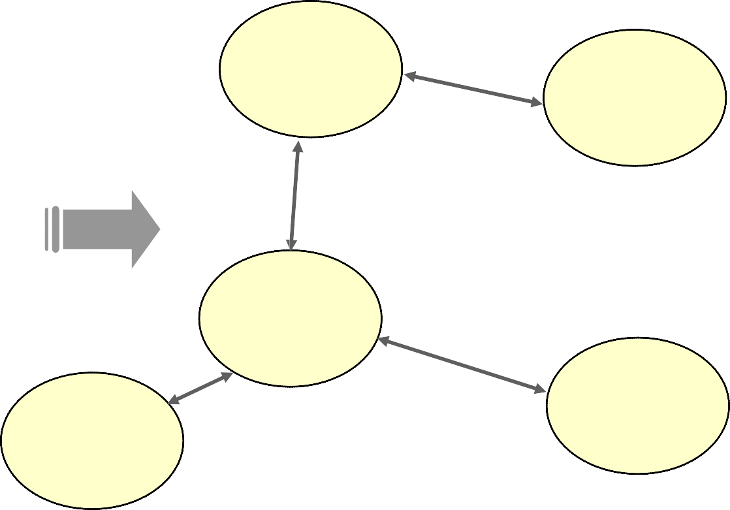
Solution: Modular Design
Major task of software design is how to split system's data and its processing into a set of interacting functions
A software Application
main
function4
function1
function3
function2

Slide 4
II. Modular Design and Coding
C is a structured modular programming language
  Allows to solve large problems by dividing into smaller ones: modules, called functions
  A function is a block of code that performs a specific task
    It has a name and it is reusable i.e. it can be executed from as many different parts in a C program as required.
    e.g. Program to process students’ grades - can use several functions (calculate grade, display record, get record, input marks etc)
Functions can call other functions; even themselves (recursion)

Slide 5
Advantages of Use of Function
Functions are useful to
  decompose a complex program into manageable parts
  reduce duplication of code (it can be executed from as many different parts in a program as required), enable code re-use, and ease future amendments and maintenance of the code
Functions allow code reusability:
  Functions can be created for problems that generally need frequently used solutions
  A common example we’ve seen so far is using system functions: printf() and scanf(). We have constantly been calling the function for reuse.

Slide 6
Modular Design: Top Down Design
Top Down Design breaks the specification down into simpler and simpler pieces, until a level has been reached that corresponds to the primitives of the programming language to be used.
  Break down program into small and manageable components, starting from the top. In C, this is your main() function. From main() your other smaller components will be used

Slide 7
Example
Task: program a virtual ATM
  What functions do we need?
    ATM needs to display balance, withdraw money, deposit/transfer money, etc.
    Then consider breaking those individual components further to make the implementation more manageable.
Take the withdraw function, break it down further:
  Get current balance
  Compare balance to amount requested
  If OK
    Update balance
    Distribute money
    Print a message
  If not OK
    Decline and print message

Slide 8
…Continued
Do we need to go further? Take “Distribute Money” part/function
  Verify the ATM has enough money to dispense
  Initiate (virtual) mechanical process
  Update bank record
  Update ATM current money
  Contact bank if money is low
  ….
If used properly, Top Down Programming is a useful tool for making problems easier to understand and implement
  Look at main functionality → break it down into smaller problems

Slide 9
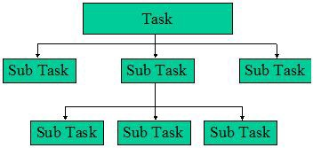
Structure Chart
Structure charts are drawn top‐down
Each rectangle in the chart represents a function, its name to be used as the function name in your program
Function chart describes only relationship between functions
Function chart does not tell when and how many times each function is called

Slide 10
Top Down Design
Advantages:
  Typically smoother and shorter process planned properly and the programmer has a good understanding of the task
  Decisions can be made and implemented much quicker - useful when time is a factor!
  Develop and test most important function first (main())
  Easy to see progress
  Testing and debugging is easier

Slide 11
Modular Design: Bottom Up Approach
An alternative approach: starts with low level system design → work way up!
  Example: A calculator:
    Look at the problem objectively - e.g. what are the mathematical functions I would need to design a calculator?
    Design the modules/functions like addition/subtraction, then decide how it will be called and then design main function around it
    main() function will hold code together as a sequence

Slide 12
III. Function Definition in C
type function_name (type1 par1, type2 par2,.. )
{
  statements;
}
int product(int x, int y)
{
int result;
result = x * y;
return result;
}
Function “header”
  type: return data type
    void if no value is returned
  function_name: the name of the function
    choose a descriptive name
  Parameters: par1, par2,..of data types type1, type2, etc…
    void or () if no other data is passed into the function
  Statements
    variable declaration
    operations
    return value (if any)
      Parentheses around the expression to return is optional

Slide 13
…Continued
In C,
  Functions can return up to one value to the calling program through a return statement.
  Functions of type void do not return a value
    end the function with return;
  Functions can however have multiple return statements, written anywhere in the function body.
    The first return executed exits the function code execution
Note: A C function can also return a struct value, more in the coming weeks.

Slide 14
Function Prototype and Execution
A function prototype is written before main(). It tells the compiler that the function definition will come later and gives the function a file scope
With a Function call, program execution(control flow) passes to the function code
  Function return statement terminates the execution of the current function
    program control flow passes back to the point immediately after the function call
#include <stdio.h>
/* function prototype */
int product(int x, int y);
int main(){
int var1 = 3, var2 = 5;
int ans;
ans = product(var1, var2);
printf("var1 = %d\n"
"var2 = %d\n",var1,var2);
printf("var1*var2 = %d\n", ans);
return 0;
}
/* function definition */
int product(int x, int y)
{
int result;
result = x * y;
return result;
}
Function
definition
Notes:
If return type of main() defined as: int main(), this means we can return an int value to main's calling function, which is the operating system. The operating system can use the value returned to know if main() executed properly.
x and y are optional in the prototype of the function

Slide 15
Function Prototype vs. Function Definition
Function Prototype:
outside and before main()
only needs to define variable data type for input and output, the variable names are OPTIONAL
has a semicolon at its end
Function definition:
header of the function uses the same name as prototype and contains actual variables to be used in the function implementation
must have { }
no semicolon after the header
Can use return value

Slide 16
IV. Scope of Variable
Does it make a difference where in a program a variable is declared?
  YES! --> concept of SCOPE
Scope refers to the region in the program where the variable can be referenced.
Five types of scope:
  Program (global scope)
  File
  Function prototype
  Function
  Block (“between the { } scope”)

Slide 17
Program Scope
#include <stdio.h>
int a = 10;
int product(int x, int y);
int main()
{
int var1 = 3, var2 = 5;
int ans;
ans = product(var1, var2);
printf("var1 = %d\n"
"var2 = %d\n",var1,var2);
printf("var1*var2 = %d\n", ans);
}
/* function definition */
int product(int x, int y)
{
int result;
result = x * y + a;
return result;
}
Program (global) scope
  if declared outside of all functions
  Visible to all functions from point of declaration
  Visible to functions in other source files (SHARED)
  It is kept throughout the life of your program
  Can be easily modified by any function and can lead to errors

Slide 18
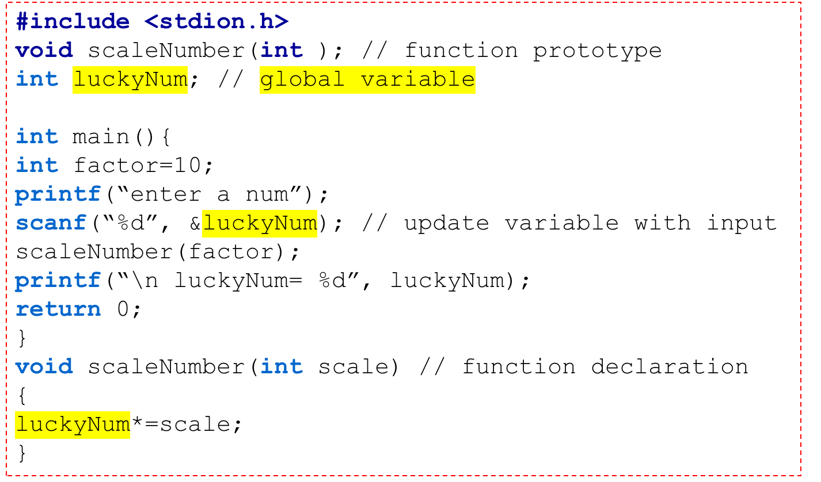
Example

Slide 19
File Scope
File scope
  Keyword static
    Makes a variable “visible” only within this source file
  Use file scope to avoid naming conflict if multiple source files are used
#include <stdio.h>
static int a = 10;
int product(int x, int y);
int main()
{
int var1 = 3.0, var2 = 5.0;
int ans;
ans = product(var1, var2);
printf("var1 = %d\n"
"var2 = %d\n",var1,var2);
printf("var1*var2 = %d\n", ans);
}
/* function definition */
int product(int x, int y)
{
int result;
result = x * y;
return result;
}

Slide 20
Function Prototype Scope
Function prototype scope
  Identifiers x and y are not visible outside the prototype
  Thus, names in the prototype do not have to match names in the function definition
    MUST match types, however!
#include <stdio.h>
int product(int x, int y);
int main()
{
int a = 10;
int var1 = 3.0, var2 = 5.0;
int ans;
ans = product(var1, var2);
printf("var1 = %d\n"
"var2 = %d\n",var1,var2);
printf("var1*var2 = %d\n", ans);
}
/* function definition */
int product(int A, int B)
{
int result;
result = A * B;
return result;
}
Notes:
int product(int x, int x); will produce an error
int product(int, int); will also work

Slide 21
Function & Block Scopes
Function scope
  Active from the beginning to the end of a function execution ONLY
  Example: each time the function product is run, C allocates memory space for the integer variable result with its variable declaration.
  Data stored in the variable is lost when the product function is terminated
#include <stdio.h>
int product(int x, int y);
int main()
{
int a = 10;
int var1 = 3.0, var2 = 5.0;
int ans;
ans = product(var1, var2);
printf("var1 = %d\n"
"var2 = %d\n",var1,var2);
printf("var1*var2 = %d\n", ans);
}
/* function definition */
int product(int x, int y)
{
int result;
int a= -33;
result = x * y+a;
return result;
}
Notes:
Most of the commonly used programming languages offer a way to create a local variable in a function or subroutine: a variable that goes out of scope when the function returns. In most cases the lifetime of the variable is the duration of the function call – it is an automatic variable, created when the function starts (or the variable is declared), destroyed when the function returns – while the scope of the variable is within the function, though the meaning of "within" depends on whether scoping is lexical or dynamic. However, some languages, such as C, also provide for static local variables, where the lifetime of the variable is the entire lifetime of the program, but the variable is only in scope when inside the function. In the case of static local variables, the variable is created when the program initializes, and destroyed only when the program terminates, as with a static global variable, but is only in scope within a function, like an automatic local variable.
[wikipedia]

Slide 22
Example
Because the variable num1 is inside the main() code, the same variable name can be used in other functions without any conflict. The two variables when allocated in the memory occupy different memory locations
#include<stdio.h>
int getNextNum(); // function prototype
int main(){
int num1;
printf("\n Enter num1 to the main");
scanf ("%d", &num1);
printf("num1 entered %d and num1 returned %d", num1, getNextNum());
}
int getNextNum() { // function definition
int num1;
printf("\n Enter num1 to the called function");
scanf ("%d", &num1);
return num1;
}
Notes:
The variable of a function is allocated into the function private memory segment called a stack. A new stack frame is created each time a function call and removed when the function execution ends.

Slide 23
Block Scope
Block (local) scope
  A block is a series of statements enclosed in braces { }
  The variable scope is active from the point of declaration to the end of the block ( } )
  Nested blocks can both declare the same variable name and not interfere

Slide 24
Example
What kind of scope do the variables have?
  i
  j
  m
  k
#include <stdio.h>
int i;
static float m;
int k=10;
int main()
{
int j;
for(j=0; j<5; ++j)
{
printf(“\n j= %d", j);
}
{
int k=7;
printf(“\n k= %d", k);
}
}
Notes:
variable i has a Global scope - Visible throughout the program
variable j has a function (Block can still be accepted) scope - only visible in main()
variable m has File scope - Visible throughout this source file only
variable k has Global scope, but a second variable k has Block scope within the block it is defined. Think of the variable k in the block temporarily hiding the variable k with Program scope (the k defined outside of main() retains its value of 10).

Slide 25
V. Passing Arguments into Functions
In Programming, caller arguments are passed to the called functions by value or reference
  Pass by value: the values of the arguments are passed to the function
    Function arguments can be expressions which get evaluated. Their resulting values are then passed to the called function
  Pass by reference: the addresses of the arguments, i.e., references to the caller’s variables are passed to the function’s parameters so it can change their memory content.
Pass by Value: the function does NOT change the values of the passed-in arguments
Pass by Reference: the function can change the values of the
passed-in arguments

Slide 26
C language
C language always uses “Pass by value”. However, we can simulate/implement “Pass by reference” through the use of Pointers.
  A Pointer is a variable that stores a memory address
  To get multiple values returned, we often use pointers in the arguments of the function and its return value
  More in the next lectures…

Slide 27
Example 1: C Pass By Value
#include <stdio.h>
int product(int x, int y);
int main()
{
int a = 10;
int var1 = 3, var2 = 5;
int ans;
ans = product(var1, var2);
printf("var1 = %d\n"
"var2 = %d\n",var1,var2);
printf("var1*var2 = %d\n", ans);
}
/* function definition */
int product(int A, int B)
{
int result;
result = A * B;
return result;
}
Example: in the function call:
  The values of the caller’s arguments are passed to the corresponding parameters of the called function
  The values of var1 and var2 are passed/copied to the function parameters: A and B
    var1 and var2 are NOT changed

Slide 28
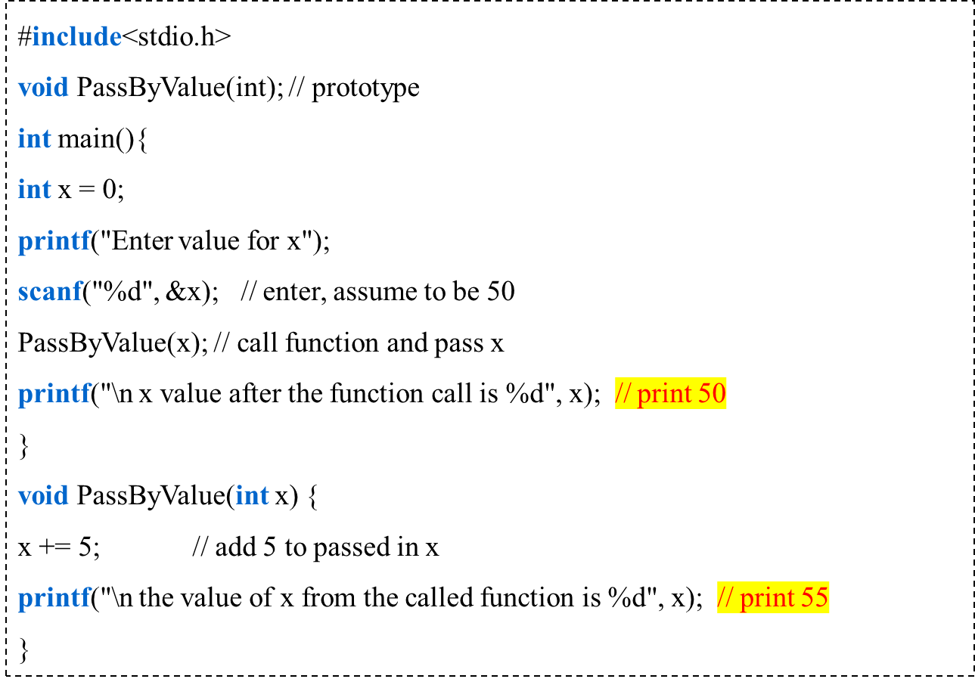
Example 2: C Pass By Value
Notes:
C reserves extra memory space to reserve copy of variables. In this scenario the copy of x is sent to the function as argument - not great use of memory (especially in embedded systems and when we start using lots of variables!)
When C passes arguments by value, you cannot modify the original contents of the incoming parameters. Only the copied variable is modified.
Use when you do not want the called function to modify the variables original contents!

