Slide 1
Lecture 5A: Arrays
Content
I. Definition of Array
II. 1‐D Arrays
III Arrays and Functions
IV. 2‐D Arrays
V. Multidimensional Arrays
Appendix

Slide 2
I. Definition of Array
Array is a collection of a fixed number of elements of the same data type
Common identifier (name)
Stored sequentially in the memory (contiguous allocation)
It is a powerful data structure for grouping alike variables for easy access
Although C and MATLAB arrays are based on the same computer science concept, the syntax is very different
All variables in MATLAB are arrays
Vect = [ 4 7 2 6 5 ]; % create a 1‐D array with 5 elements
numel(Vect) % obtain the number of elements in the array vect
X = Vect(2); % get the 2nd element and assign it to a scalar
Arrays in C programs must be declared before they can be used
int vect[5] = { 4, 7, 2, 6, 5 }; /*declare a 1‐D array with 5 elements*/
int x = vect[0]; /* get the 1st element (its index is 0) and assign it to a variable */
The first array element has index 0
Notes:
Arrays in C are static. Once it’s been created its’s set. If you want a dynamic structure, look at a Linked List or an ArrayList
Can use realloc() to resize the memory pointer to by a pointer (advanced!)
realloc(ptrToArray, newSize);
Suggestion for now - making arrays big enough for contents needed. This is OK for simple programs!

Slide 3
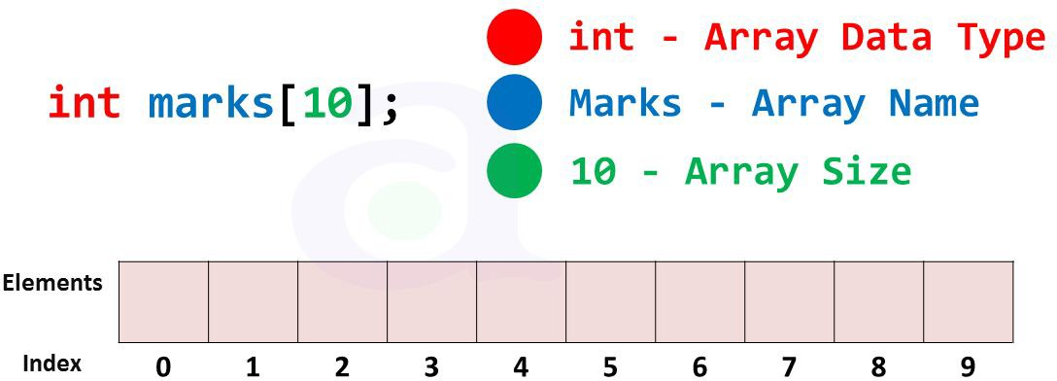


II. 1‐ D Array: Declaration
Syntax:
/* declaration of an array without initialization */
type arrayName[ numberOfElements ];
OPTIONAL
/* declaration of an array with initialization */
type arrayName[ numberOfElements
] = {list
of values};
type - any basic data type int, double, float char, short …
arrayName
a valid C identifier
numberOfElements: A numeric or a symbolic constant
Examples:
#define SIZE 32
. . . .
float amplitude[SIZE]; char letters[3] = {‘A’, int numbers[] = {6, 35,
/* declared without initialization */
’E’, ‘I’}; /* declared and initialized */
128};
/* declared and initialized, array size is determined automatically [3] */
int number [];

Slide 4
…Continued
Arrays must be declared with a fixed number of elements according to C89 version but not the latest
/*-----Declaration----*/ int itemsInStock[5];
/* size is
/* OK, but
a numeric constant */ not convenient */
or
#define SIZE 5
/* easy
to change when needed */
. . .
int itemsInStock[SIZE];
/* size
is a symbolic constant*/
int size = 5;
int itemsInStock[size];
/* size is not a constant */
/* not supported by C89 */
13

Slide 5
1-D Array Access
Individual variables in an array are called elements
Elements in an array are accessed via indexing
To access an individual element you need to specify its index
double x[8]; /* array declaration. 8 is the size */
. . |  |  | . .
x[0] | = |  | 12.0; | /* | access | an | element. | 0 is an index | */
x[2] | = |  | 6.0; | /* | access | an | element. | 2 is an index | */
. . |  | .
x[7] =
3.5;
/* access
x[1] x[2]
an element.
7 is an index */
x : x[0]
x[3] x[4]
x[5] x[6] x[7]
12.0 |  | 6.0 |  |  |  |  | 3.5
index:
0 1
first element has index 0
2
3
4
5
6
7
last element has index 7
Notes:
Inserting elements
int marks[5] = {3, 4, 60, 12, 20};
marks[3] = 9; //overwrites 4th element (12) to 9
scanf(“%d”, &marks[2]); // takes input from user and overwrite third element

Slide 6
…Continued
index can be a constant, a variable, or an expression
Syntax: of integral data type
arrayName[ index ]
Examples:
sum += x[7]; temp = x[i];
x[i+1] = y[2*j - 1]; sum += x[3.5];
/* index
/* index
/* index
/* Error
is a numeric constant */ is an integer variable */
is produced by an expression */
! Index must be an integer */
Cautions
– index must be an integral number ( int, short etc. )
–
–
–
index must range from 0 to the numberOfelements – 1 for correct access to your array elements
C does not check the value of the index
any invalid index may cause unexpected outcomes

Slide 7
…Continued
There is NO Index range checking in C
int dataBuffer[5]; /* array to store 5 integer numbers */
int dataBuffer[-1] = 17;
dataBuffer[2] = 24;
dataBuffer[6] = 35;
Memory
. . . . . . .
dataBuffer[0]
17
dataBuffer[1]
itemsInStock[2]
dataBuffer
C does not check whether the index is within the valid range or not
No error or warning messages
Can corrupt other variables
Unexpected behaviour at run time or program crash: segmentation fault
24
dataBuffer[3]
dataBuffer[4]
. . . . . . .
35
Notes:
A segmentation fault occurs when a program attempts to access a memory location that it is not allowed to access, or attempts to access a memory location in a way that is not allowed (for example, attempting to write to a read-only location, or to overwrite part of the operating system).

Slide 8
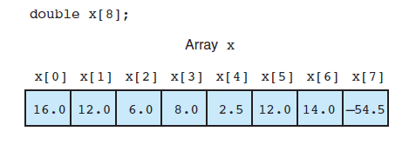
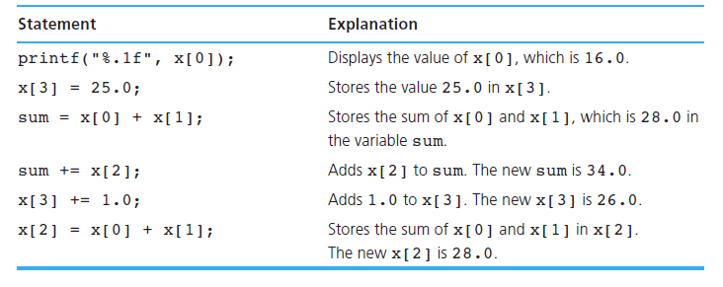
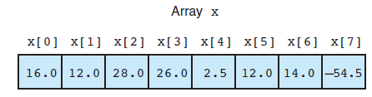
1-D Array Manipulation

Slide 9
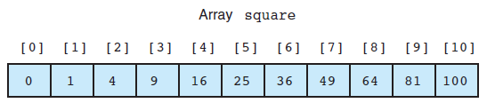
Using Loops for Sequential Access
To access the array elements sequentially, we can use loops
Example: the following array square will be used to store the squares of the integers: 0 through 10 (e.g., square[0] is 0 , square[10] is 100)
#define SIZE 11
…..
int main() {
int square[SIZE], i;
for (i = 0; i < SIZE; ++i)
square[i] = i * i;
}

Slide 10
Unsupported Operations
Caution: you can’t use the array name to
– a constant to all the array elements
float salePrice[SIZE]; salePrice = 15.0;
X
– one array content to another, even if they match completely in type and size
int inData[4]={2, 4, 8, 3}, outData[4];
X
− compare two array contents through the array names
if( outData == inData )
outData = inData;
X
- For any of the above operations, use Loops to go through the elements of the array

Slide 11
III. Arrays and Functions
Function parameters:
Individual array elements: elements are passed the same way as simple data types (their values are copied); use arrayName[Index of element]
Complete Array: user array name only. The array is passed by reference (their values are not copied, but the address of the array is). The called function can access the array directly
Besides the array you have to pass the array size to the called function, to access the valid range of the array
Return value:
– C does not allow functions to return a value of the type array
double[] createArray( int size); /* Error */
If you need to return an array, add it in the function parameters
void createArray( int size, int data[]);

Slide 12
…Continued
Example:
1. Function prototype
Empty [ ] indicate that
this function parameter
float findSmallest( float marks[],
2. Function call: pass the whole array
float examMarks[50];
int size);
is an array
the array name without brackets
baseNumber = findSmallest( examMarks,
3. Function definition
50);
float findSmallest( float
{
float min = marks[0]; int i;
for( i=1; i < size; i++
marks[], int
size )
Marks points to examMarks, see slide 17
)
min = marks[i];
if( return
min > marks[i] ) min;
}

Slide 13
…Continued
Since the function has full access to the actual array data, it may mistakenly change it
dataIn[0] dataIn[1] dataIn[2] dataIn[3]
dataOut[0]
dataOut[1]
dataOut[2]
dataOut[3]
void addVector( int dataIn[],
{
for(int i=0; i < size; i++) dataOut[i] = dataIn[i] +
int dataOut[], int size )
{
dataIn[i]%2;
if (dataOut[i] == 0) dataIn[i]++;
}
return ;
A bug: the source data array will be corrupted
Meant to be: dataOut[i]++
}

Slide 14
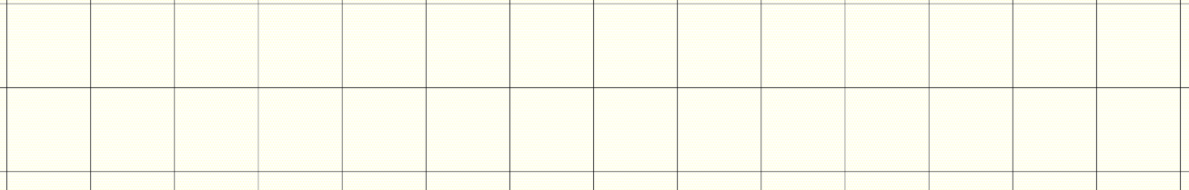
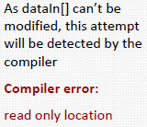
…Continued
To prevent accidental modification of arrays, pass them as const
int itemsIn[250]; int itemsOut[250]; itemsIn[5] = 128;
addVector( itemsIn, itemsOut, 250 );
void addVector( const int dataIn[], int dataOut[], int sz )
{
Can't be modified
for(int i=0; i < sz; i++) dataOut[i] = dataIn[i]
Can be modified
{
+ dataIn[i]%2;
if (dataOut[i] == 0) dataIn[i]++;
}
return ;
}
11/03/2016

Slide 15
…Continued
#include <stdio.h>
If the array is not to be
modified, declare it as
const
int sum( const int
int main(void)
{
int array[5] = int total;
data[], int size );
{1,2,3,4,5};
specify only the array name, no brackets
/* call the sum() function */
total = sum( array, 5 ); printf(“Total is %d\n”, total); return (0);
}
If the array is not to be modified, declare it as const
/* function definition */
int sum( const int
{
. . .
return theSum;
data[], int size )
}

Slide 16
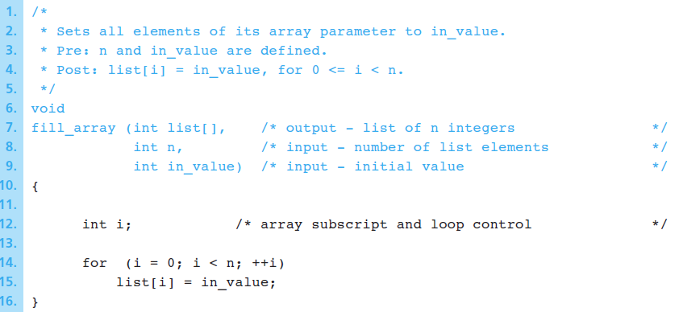
Example 1: Pass by Reference
A function that stores the same value ( in_value ) in all elements of the array corresponding to its formal array parameter list .
Notes:
21.3
21.3

Slide 17
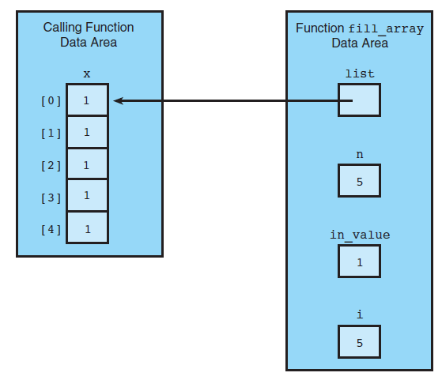
…Continued
The function’s local
variable
If x is an array with five type int elements, the function call
fill_array(x, 5, 1); stores the value of 1 in the five elements of array x .
The array x is passed by reference, whereas in_value and i are passed by value

Slide 18
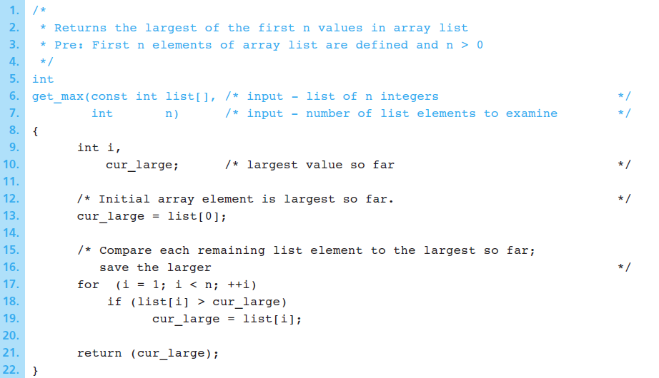
Example 2: max of an array
Write a function get_max to find the largest value in an array. It uses the variable list as an array input parameter.
Function call example:x_large = get_max(x, 5);

Slide 19
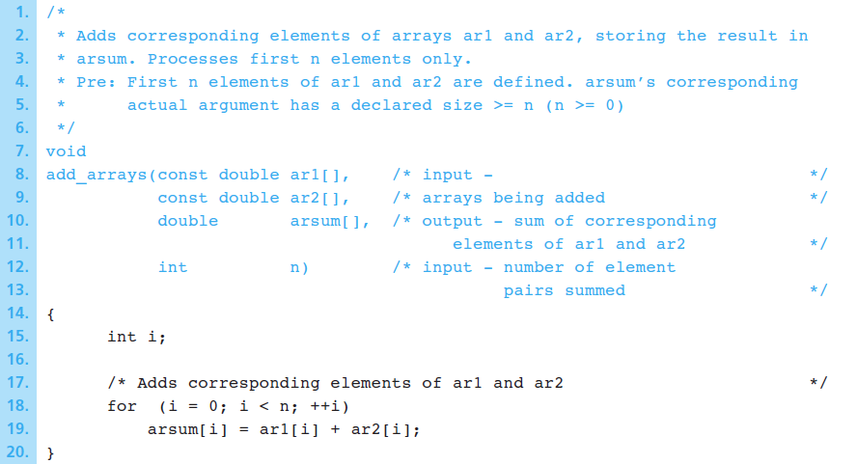
Example 3: return the sum of 2 arrays
Write a function add_arrays to add two arrays.
Notes:
Example of Returning an array result

Slide 20
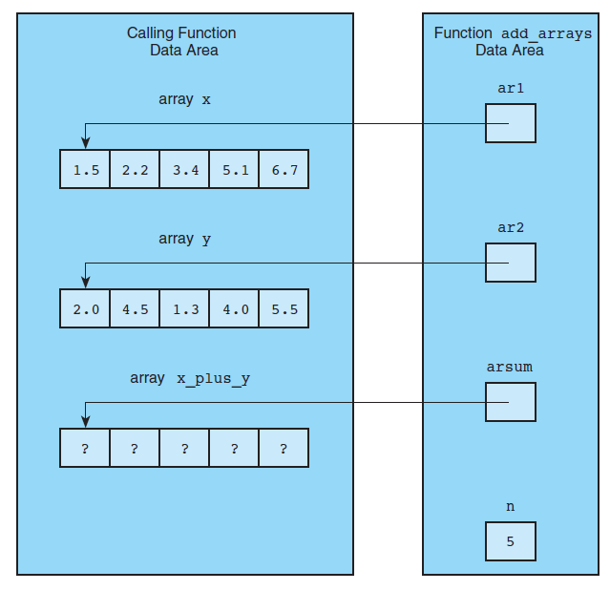
…Continued
Example function call:
add_arrays(x, y, x_plus_y, 5);
Formal parameters ar1 , ar2 , and arsum of the function point to the actual parameter arrays in the calling functions x, y, and x_plus_y (pass by reference) unlike n which is passed by value.
Notes:
Example of Returning an array result

Slide 21
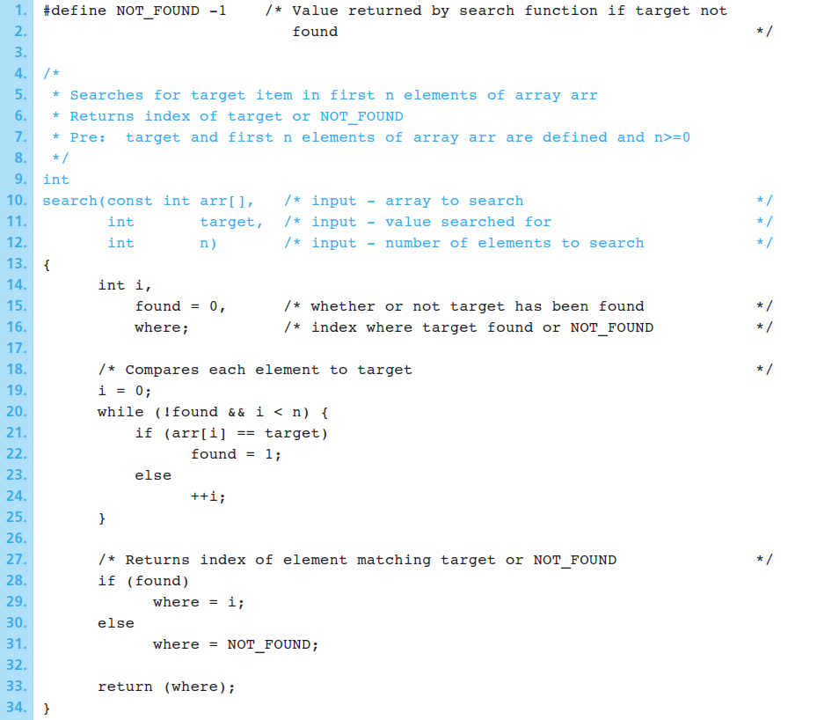
Example 4: search an array
The function search finds a target value in an array
If array ids is declared in the calling function, the assignment statement:
index = search(ids, 4902, ID_SIZE);
calls function search to search the first ID_SIZE elements of array ids for the target ID 4902 . The index of the first occurrence of 4902 is saved in index. If 4902 is not found, then index is set to −1 .

Slide 22
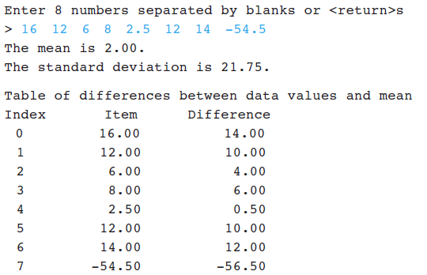
Example 5: statistical computation using arrays
Write a program that computes the mean and standard deviation of an array of data and displays the difference between each value and the mean.
Notes:
Arrays are a grouping of memory segments
Variables in the array share the same name and data type
Individual variables in an array are called elements
Elements in an array are accessed with an index number
Array elements start from 0 (first element)
Use loop structures (usually for loop) to iterate through each element of an array
2D arrays are two 1D arrays with pointers to each other
2D arrays can be visualised as a table (e.g. rows and columns)
Nested loops are necessary to search through a 2D array

Slide 23
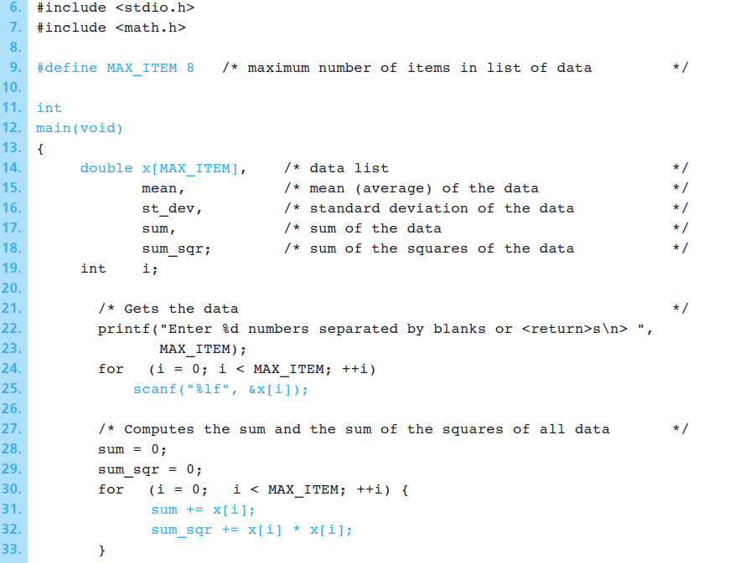
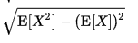
…Continued
Standard deviation

Slide 24
IV. 2‐ D Arrays
Created by defining two separate element numbers: number of rows and number of columns
Declaration
type name[numOfRows][numOfColumns];
Example: an array of integers with 5 rows and 4 columns
int codeTable[5][4];
Accessing elements: to access an element of a 2‐D array you need to specify both the row and the column indexes
Examples:
int x = 2, y = 1, codeTable[1][2] = codeTable[x][y] = codeTable[3] = 0;
z = 0;
128;
z + codeTable[1][2];
/* Error. This is a 2‐D array */
Notes:
.

Slide 25
2D Array Initialisation
You can use either,
Grouping of braces to initialise each row of elements
int myArray[3][3] = { {0, 1, 2}, {1, 2, 3}, {2, 3, 4} };
myArray[0][1] returns 1
myArray[1][2] returns 3
0 | 1 | 2
1 | 2 | 3
2 | 3 | 4
2. Use nested loop to access each element via its pair of indices:
for (int x = 0; x <=2; x++) { // row index
for (int y = 0; y <=2, y++) // column index
myArray[x][y] = ( x + y); // adds values to element
If you’re initalising the array elements to 0, int myArray[3][3] = {{0}}; works too!

Slide 26
2D Array Access
Use nested loops to iterate through each dimension of the array
int a[5][2] = { {0,0}, {1,2}, {2,4}, {3,6},{4,8}};
int i, j;
for ( i = 0; i < 5; i++ ) // row
for ( j = 0; j < 2; j++ ) // column
printf("a[%d][%d] = %d\n", i,j, a[i][j] );

Slide 27
2D Arrays and Functions
The number of columns
Function prototype
double findSmallest( double matrix[][3],
Function call
double data2D[25][3];
. . .
minNumber = findSmallest( data2D, 25);
must be a constant
int rows);
This function can process 2D arrays only with 3 columns
Function definition
double findSmallest( double matrix[][3],
{
double min = matrix[0][0]; for(i=0; i < rows; i++) for(j=0; j < 3; j++)
int rows )
if(min > matrix[i][j]) min = matrix[i][j]; return min;
}

Slide 28
V. Multidimensional Arrays
Multidimensional arrays are supported where every dimension should be associated with a [SIZE] in your array declaration
A simple example of a 3D array: considering storing a video.
Each frame of the video is a 2D image with intensity values: image (i,j).
To have multiple frames, we can use Mat[Height][Witdth][Depth] to store “Depth” frames, where each frame is a 2 D array of dimension Height*Width.
4D arrays is an array of 3D arrays… and so forth

Slide 29
Appendix: sizeof() function
Some of inbuilt functions are used to calculate length of array such as sizeof() function
Example:
int arr[] = {1, 2, 3, 4, 7, 98, 0, 12, 35, 99, 14};
printf("Num of elements: %d, sizeof(arr)/sizeof(arr[0]);
Prints: Number of elements: 11
sizeof(arr) by itself returns size of array in bytes, in this case 44 (int = 4 bytes).
sizeof(arr[0]) returns memory size of element. So 44/4 = 11
Example
int myArray[5] = {1, 3, 5, 7, 9}, search, c, size; size = sizeof(myArray)/sizeof(myArray[0]); printf("Enter value to find \n");
scanf("%d", &search);
for (c = 0; c<size; c++)
{
if (myArray[c] == search)
printf("Its in positions %d", c + 1);
}

